Slide 1
Meeting Management Project - Documentation
Created by Mahin

Slide 2
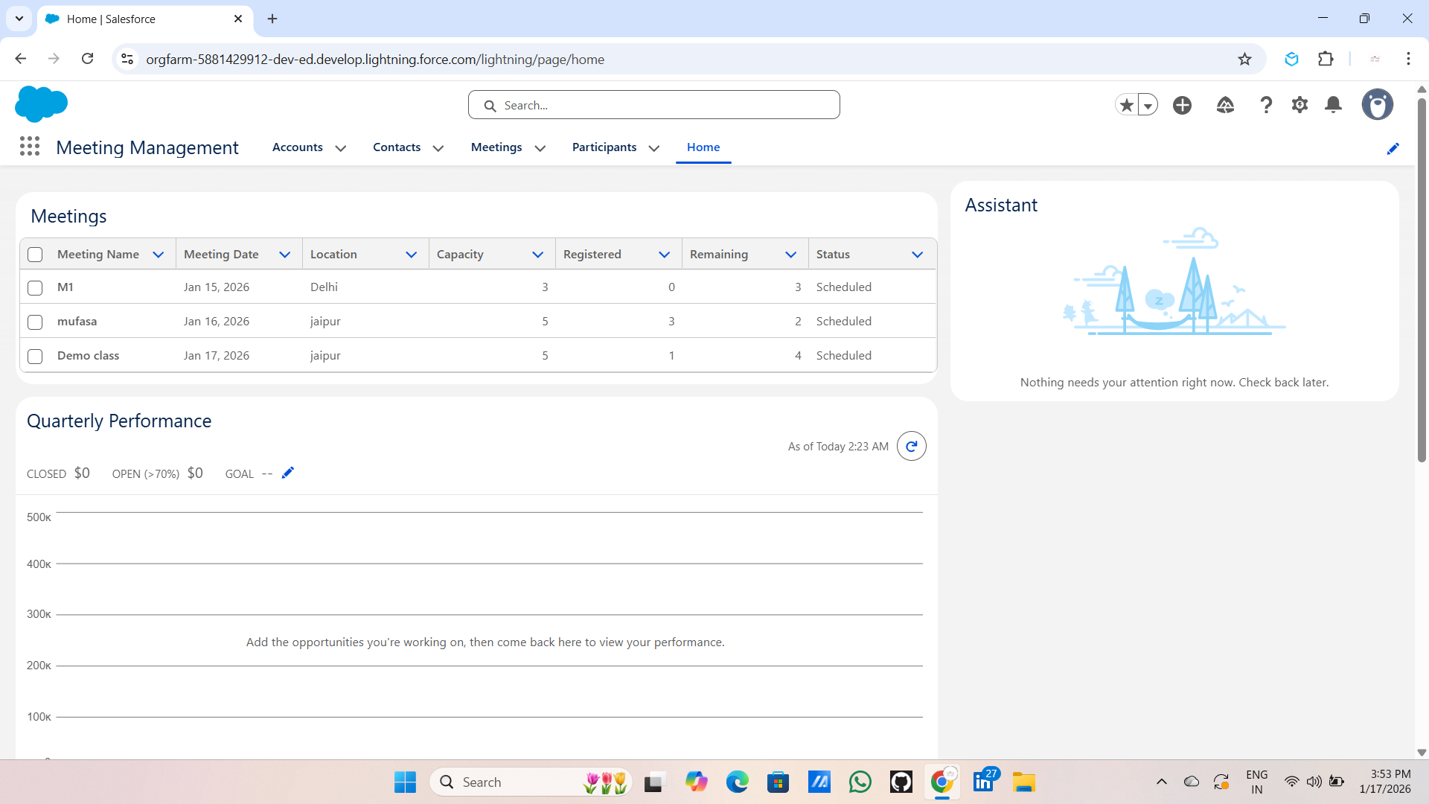
Meeting Dashboard (LWC)
Description: This is the home page of the application featuring a custom Lightning Web Component (LWC). It displays a real-time list of all meetings, including their date, location, capacity, and current registration status.

Slide 3
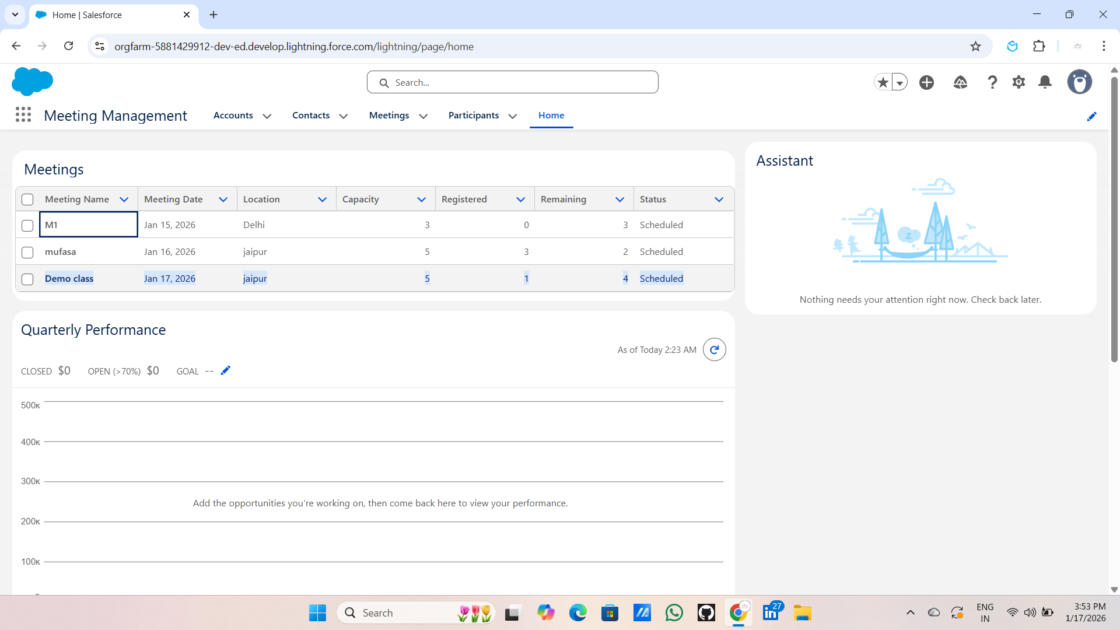
Meeting Details View
Description: Detailed view of a specific Meeting record showing the related list of Participants and the core fields like 'Remaining Capacity'.

Slide 4
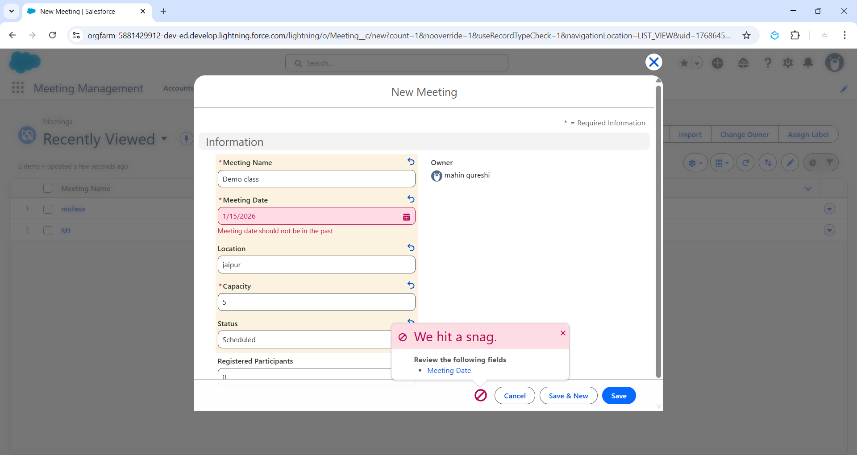
Custom Validation: Date Check
Description: I have implemented a Validation Rule to ensure data quality. If a user attempts to schedule a meeting in the past, the system triggers a custom error message: "Meeting date should not be in the past."

Slide 5
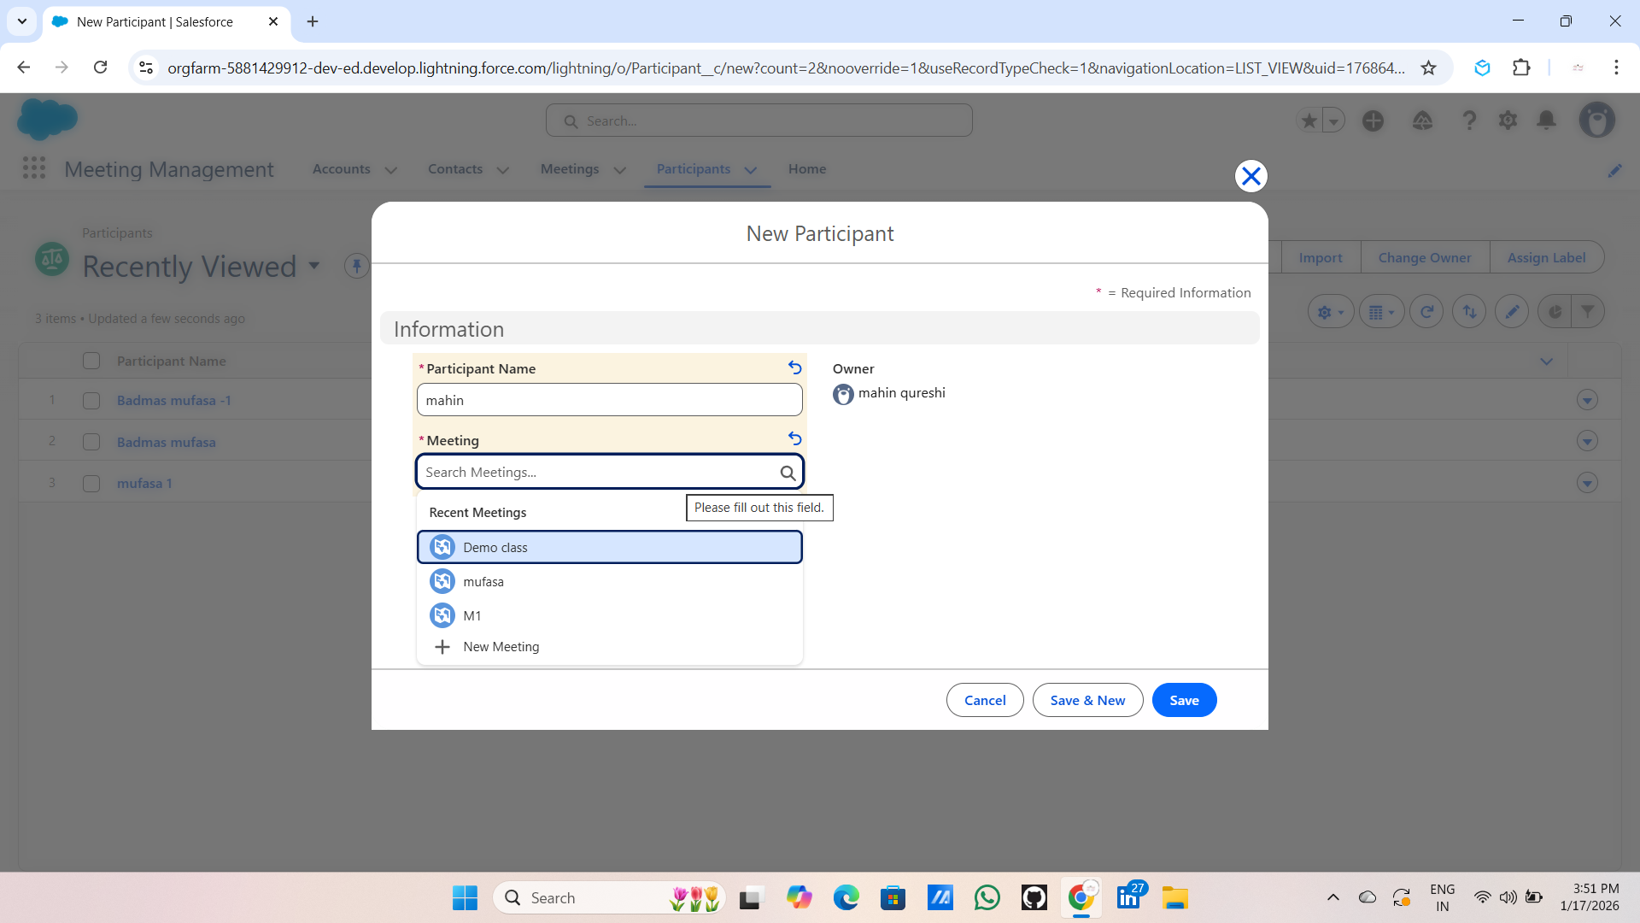
Participant Registration Process
Description: This screen shows the creation of a new Participant record. Each participant is linked to a specific meeting through a lookup relationship.

Slide 6
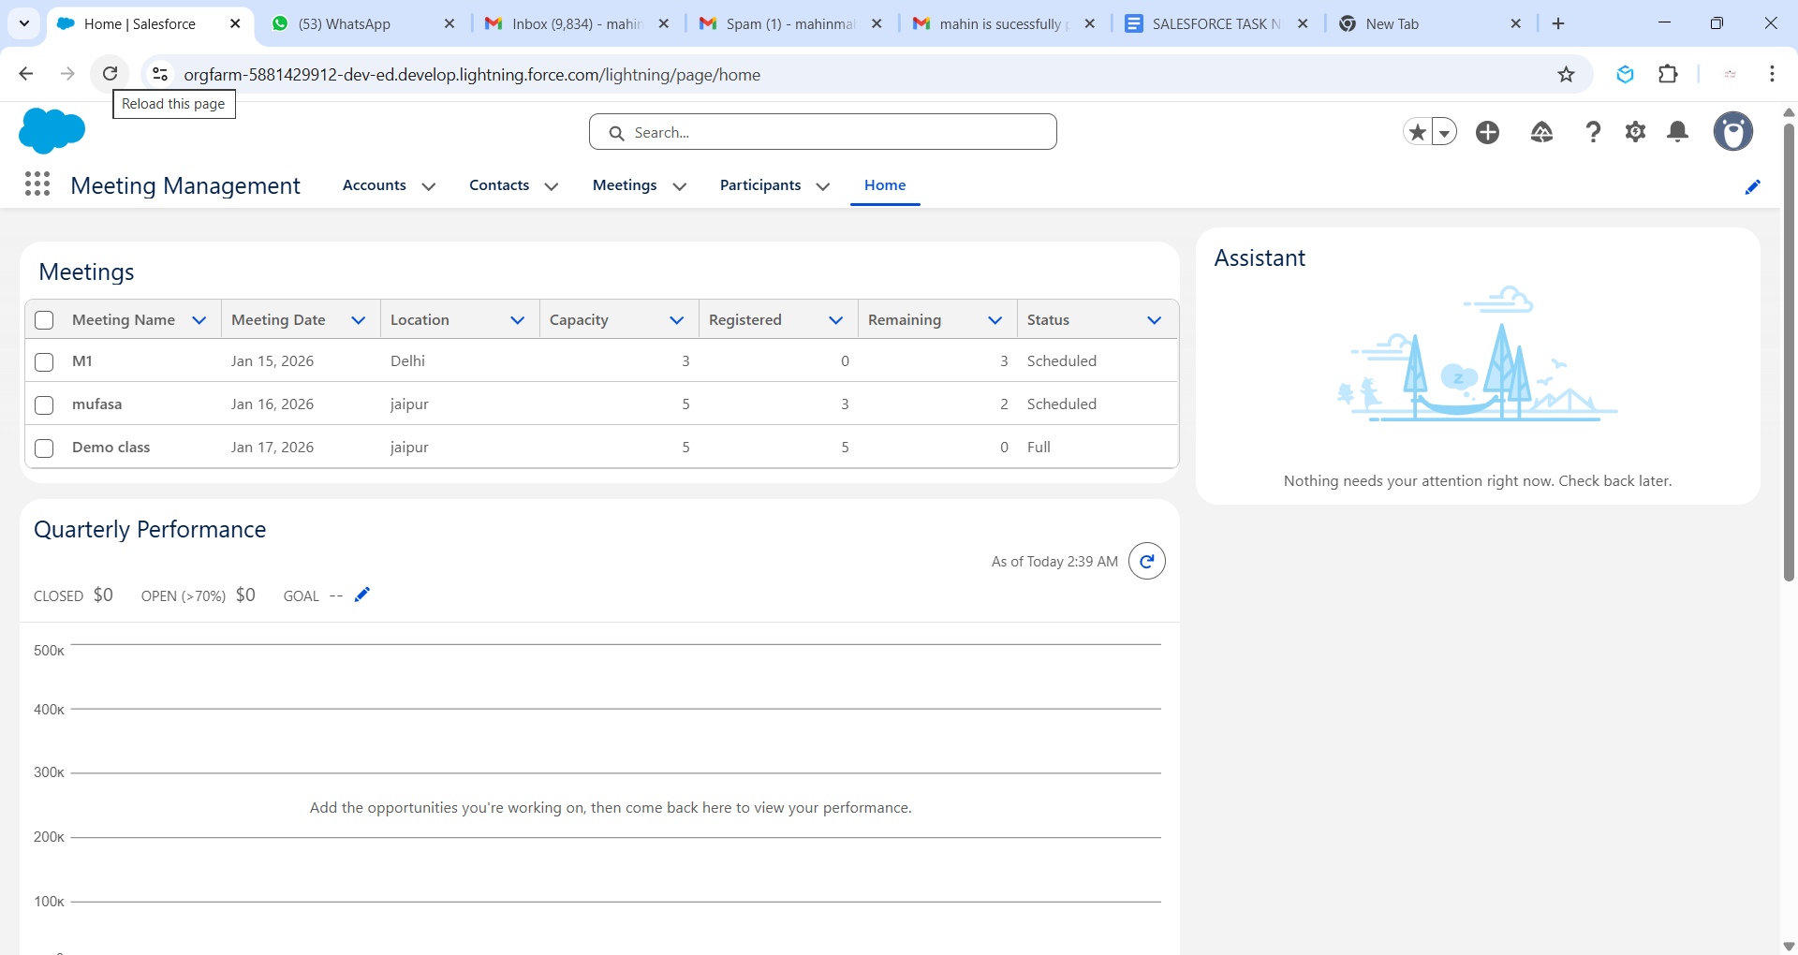
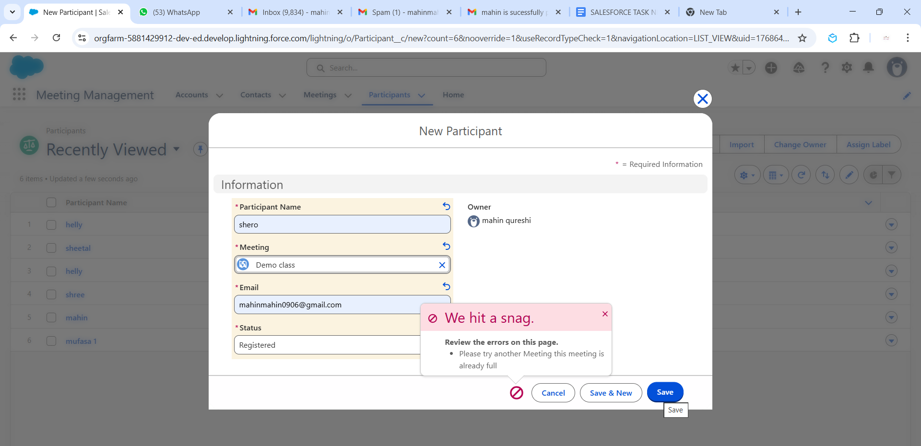
Apex Trigger: Capacity Hard-Stop
Description: This is the core logic. When the Apex Trigger detects that a meeting has reached its maximum capacity, it prevents further registrations and displays a custom error: "Please try another Meeting, this meeting is already full."

Slide 7
Automatic Status Update
Description: Once the capacity is full, the Apex Trigger automatically updates the 'Status' field of the Meeting record to "Full".

Slide 8
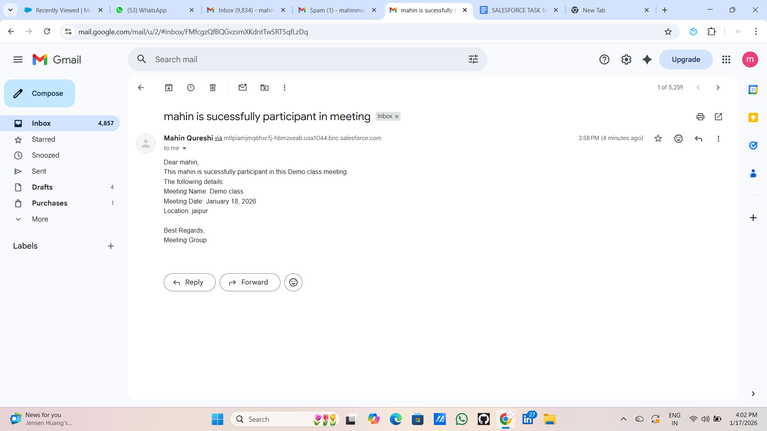
Automated Email Notification
Description: Upon successful registration, the system automatically triggers an Email Alert to the participant, confirming their seat with all meeting details.

Slide 9
Thanking you

