Slide 1


Store Sales Prediction
Mahin Prakash

Slide 2
Objective:
Development of a predictive model for predicting the sales of the specific product or item. The model will determine the sales of the item or product.

Slide 3
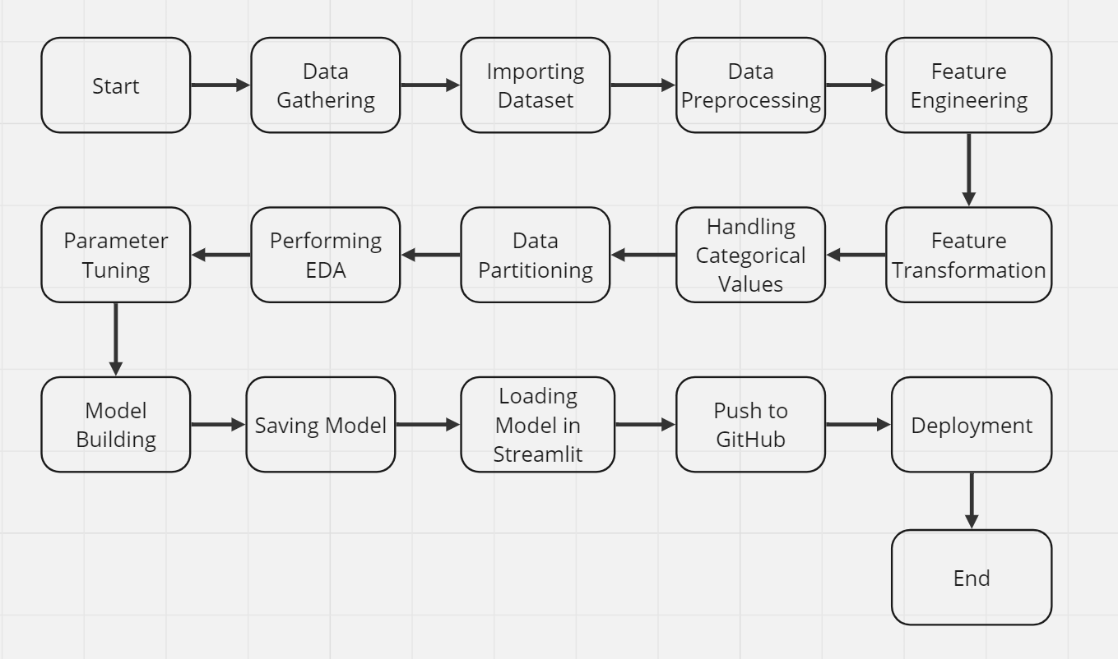
Architecture

Slide 4
Data Gathering: Data source: https://www.kaggle.com/brijbhushannanda1979/bigmart-sales-data Train and Test data which are stored in .csv format. Importing CSV: Once we gather data from the data source, we will import the csv files with the help of pandas. Data Preprocessing: In data preprocessing all the processes required before sending the data for model building are performed. Like, here the ‘Item Visibility’ attributes are having some values equal to 0, which is not appropriate because if an item is present in the market, then how its visibility can be 0. So, it has been replaced with the average value of the item visibility of the respective ‘Item Identifier’ category. New attributes were added named ‘’Outlet years”, where the given establishment year is subtracted from the current year. Mapping of “Item_Type” is done based on ‘Drinks’,’Food’,’Non-Consumable’. And mapping of “Fat content” is done based on ‘Low Fat’, ‘Regular’ and ‘Non-edible’.

Slide 5
Feature Engineering: After preprocessing, it was discovered that certain attributes do not significantly impact the sales of the specific outlet. Therefore, those attributes were eliminated. Additionally, one-hot encoding was utilized to transform the categorical features into numerical features. Parameter Tuning: Parameters are tuned using RandomizedSearchCV. The algorithm used in this problem is Random Forest Regressor. The parameters of the algorithm are tunned and passed into the model. Model Building: After completing various preprocessing tasks mentioned earlier and conducting scaling and hyperparameter tuning, the dataset will be fed into the Random Forest regressor. It was observed that the Random Forest regressor exhibited the best performance with an RMSE value of 1120.40. Therefore, the 'Random Forest regressor' proved to be effective in solving this problem. Model Saving: Model is saved using pickle library in ‘rf.pkl’ format.

Slide 6
Loading the model in Streamlit : After saving the model, Web application creation is done. Whatever the data user will enter and then that data will be given as input to the model to predict the prediction of sales. Push to Github: The whole project directory will be pushed into the GitHub repository. Deployment: We will be deploying the model to AWS using EC2 Instance.

Slide 7
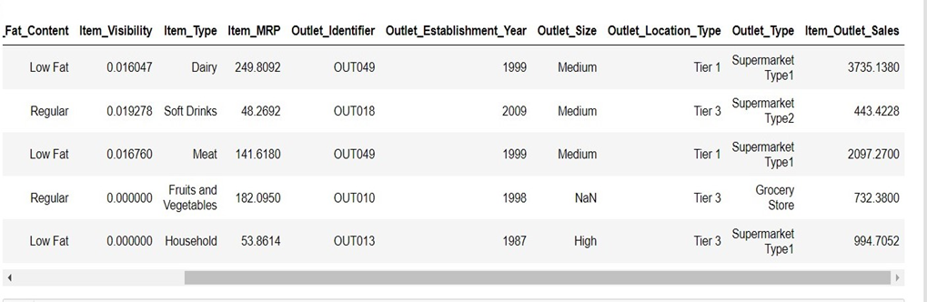
Dataset Description:
Big Mart’s data scientists collected sales data of their 10 stores situated at different locations with each store having 1559 different products as per data collection. Using all the observations it is inferred what role certain properties of an item play and how they affect their sales. The dataset looks like as follow:

Slide 8



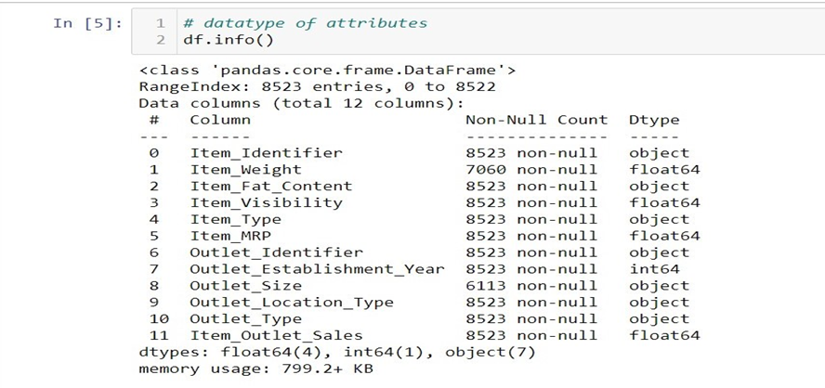

Dataset Description:
The data set consists of various data types from integer to floating to object.

Slide 9
Dataset Description:
In the raw data, there can be various types of underlying patterns which also gives an in-depth knowledge about the subject of interest and provides insights into the problem. But caution should be observed with respect to data as it may contain null values, or redundant values, or various types of ambiguity, which also demands pre-processing of data. The dataset should therefore be explored as much as possible.
Various factors important by statistical means like mean, standard deviation, median, count of values and maximum value, etc. are shown below for numerical attributes.

Slide 10
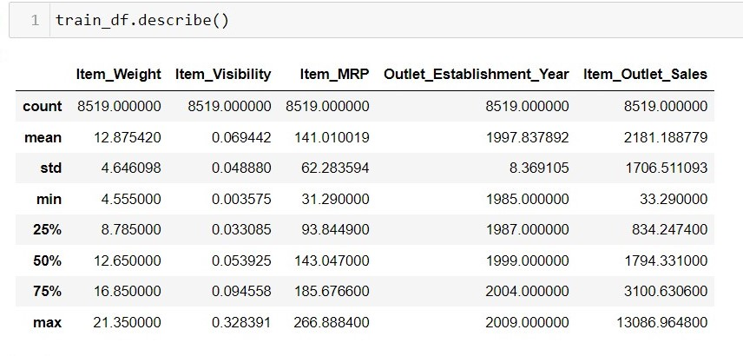
Dataset Description:

Slide 11
Dataset Description:
Preprocessing of this dataset includes doing analysis on the independent variables like checking for null values in each column and then replacing or filling them with supported appropriate data types so that analysis and model fitting is not hindered from their way to accuracy. Shown above are some of the representations obtained by using Pandas tools which tell about variable count for numerical columns and model values for categorical columns. Maximum and minimum values in numerical columns, along with their percentile values for median, play an important factor in deciding which value to be chosen at priority for further exploration tasks and analysis. Data types of different columns are used further in label processing and a one-hot encoding scheme during the model building.

Slide 12
Implementation and Results
In this section, the programming language, libraries, implementation platform along with the data modeling and the observations and results obtained from it are discussed.

Slide 13
Implementation Platform and Language
Python is a general purpose, interpreted-high level language used extensively nowadays for solving domain problems instead of dealing with complexities of a system. It is also termed as the ‘batteries included language’ for programming. It has various libraries used for scientific purposes and inquiries along with number of third-party libraries for making problem solving efficient.
In this work, the Python libraries of Numpy, for scientific computation, and Matplotlib, for 2D plotting have been used. Along with this, Pandas tool of Python has been employed for carrying out data analysis. Random forest regressor is used to solve tasks by ensembling random forest method. As a development platform, Jupyter Notebook, which proves to work great due to its excellence in ‘literate programming’, where human friendly code is punctuated within code blocks, has been used

Slide 14
Prediction Results
The largest location did not produce the highest sales. The location that produced the highest sales was the OUT027 location, which was in turn a Supermarket Type3, having its size recorded as medium in our dataset. It can be said that this outlet’s performance was much better than any other outlet location with any size provided in the considered dataset.
The median of the target variable Item_Outlet_Sales was calculated to be 3364.95 for OUT027 location. The location with second highest median score (OUT035) had a median value of 2109.25.
Its RMSE value is low as compared to other model with highest CV score. Therefore, the Random Forest Regressor model fits better and exhibits accuracy.

Slide 15
Conclusion
This project provides an overview of machine learning fundamentals, along with the relevant data processing and modeling algorithms. These concepts were then applied to predict sales in Big Mart shopping centers across various locations. The results of the implementation revealed the relationship between different attributes and demonstrated that a medium-sized location achieved the highest sales. This suggests that other shopping centers should adopt similar patterns to enhance their sales performance.
Additionally, it can be inferred that switching or relocating more outlets to Tier-3 in the "Supermarket Type3" category would boost product sales at Big Mart. Any comprehensive shopping center, such as Big Mart, can benefit from this predictive model by accurately forecasting sales of its items in different locations.

