Slide 1
Python Programming - V
- By Nimesh Kumar dagur,CDAC Noida, India

Slide 2
Python Functions
In Python, function is a named group of related statements that perform a specific task.
Functions help break our program into smaller and modular chucks.
As our program grows larger and larger, functions make it more organized and manageable.
Furthermore, it avoids repetition and makes code reusable.

Slide 3

Syntax of Function
Components of function definition:
Keyword def marks the start of function header
A function name to uniquely identify it.
Parameters (arguments) through which we pass values to a function. They are optional.
A colon (:) to mark the end of function header.
Optional documentation string (docstring) to describe what the function does
One or more valid python statements that make up the function body.
An optional return statement to return a value from the function.

Slide 4
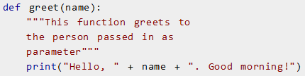

Example of a function

Slide 5
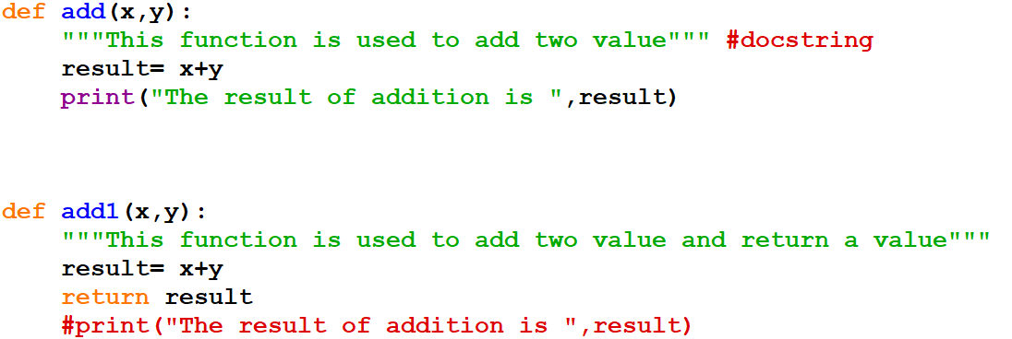
>>> x=add1(12,34)
>>> x
46
>>>

Slide 6
Function Call
Once we have defined a function, we can call it from another function, program or even the Python prompt.
To call a function we simply type the function name with appropriate parameters.

Slide 7
Docstring
The first string after the function header is called the docstring and is short for documentation string.
It is used to explain in brief, what a function does.
Although optional, documentation is a good programming practice.
In the previous example, we have a docstring immediately below the function header.
We generally use triple quotes so that docstring can extend up to multiple lines.
This string is available to us as __doc__ attribute of the function.

Slide 8

Docstring

Slide 9

The return statement
The return statement is used to exit a function and go back to the place from where it was called.
This statement can contain expression which gets evaluated and the value is returned.
If there is no expression in the statement or the return statement itself is not present inside a function, then the function will return the None object.

Slide 10
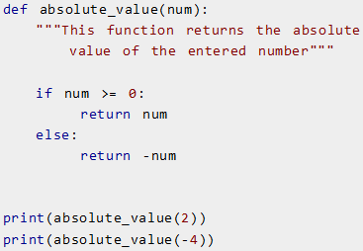

Example of return

Slide 11

Example of return None

Slide 12
Scope and Lifetime of variables
Scope of a variable is the portion of a program where the variable is recognized.
Parameters and variables defined inside a function is not visible from outside. Hence, they have a local scope.
Lifetime of a variable is the period throughout which the variable exits in the memory.
The lifetime of variables inside a function is as long as the function executes.
They are destroyed once we return from the function.
Hence, a function does not remember the value of a variable from its previous calls.

Slide 13
Local Variable
Declared within the function and will be
Accessible within the function only.
Variable
Global Variable
Declared outside the functions and will be
Accessible everywhere.

Slide 14
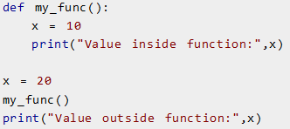

Example
Scope of a variable inside a function

Slide 15
Types of Functions
Basically, we can divide functions into the following two types:
Built-in functions - Functions that are built into Python.
User-defined functions - Functions defined by the users themselves.
Function
Standard Library (Predefined functionality)
User Defined Function

Slide 16
Python Programming User-defined Functions
Functions that we define ourselves to do certain specific task are referred as user-defined functions.
Functions that readily come with Python are called built-in functions.
If we use functions written by others in the form of library, it can be termed as library functions.
All the other functions that we write on our own fall under user-defined functions.
So, our user-defined function could be a library function to someone else.

Slide 17
Advantages of user-defined functions
User-defined functions help to decompose a large program into small segments which makes program easy to understand, maintain and debug.
If repeated code occurs in a program. Function can be used to include those codes and execute when needed by calling that function.
Programmers working on large project can divide the workload by making different functions.

Slide 18
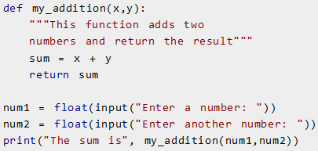

Example of a user-defined function

Slide 19
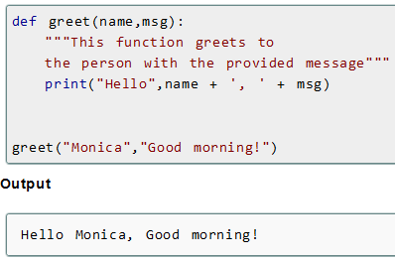
Python Function Arguments

Slide 20
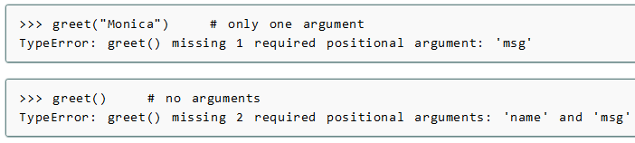
Python Function Arguments
if we call greet function with different number of arguments, the interpreter will complain.
Below is a call to this function with one and no arguments along with their respective error messages.

Slide 21
Variable Function Arguments
In previous example, function had fixed number of arguments.
In Python there are other ways to define a function which can take variable number of arguments.
Three different forms of this type are:
Default Arguments
Keyword Arguments
Arbitrary Arguments or Variable-length arguments

Slide 22
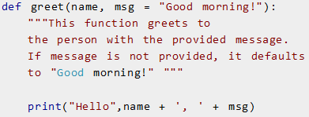
Default Arguments
Function arguments can have default values in Python.
We can provide a default value to an argument by using the assignment operator (=).
Notes:
In this function, the parameter name does not have a default value and is required (mandatory) during a call. On the other hand, the parameter msg has a default value of "Good morning!". So, it is optional during a call. If a value is provided, it will overwrite the default value.

Slide 23
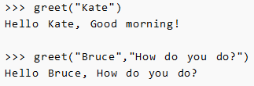
Default Arguments

Slide 24
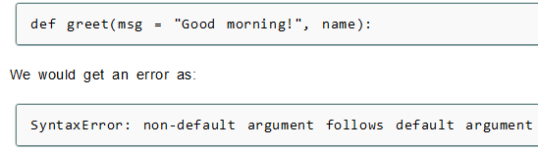
Default Arguments
Any number of arguments in a function can have a default value.
But once we have a default argument, all the arguments to its right must also have default values.
This means to say, non-default arguments cannot follow default arguments.

Slide 25
Keyword Arguments
When we call a function with some values, these values get assigned to the arguments according to their position.
For example, in the above function greet(), when we called it as greet("Bruce","How do you do?"), the value "Bruce" gets assigned to the argument name and similarly "How do you do?" to msg.
Python allows functions to be called using keyword arguments.
When we call functions in this way, the order (position) of the arguments can be changed.

Slide 26

Keyword Arguments
Following calls to the above function are all valid and produce the same result

Slide 27
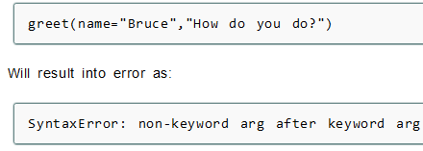
Keyword Arguments
we can mix positional arguments with keyword arguments during a function call.
But we must keep in mind that keyword arguments must follow positional arguments.
Having a positional argument after keyword arguments will result into errors.
Example:

Slide 28
Arbitrary Arguments or Variable-length arguments
Sometimes, we do not know in advance the number of arguments that will be passed into a function.
Python allows us to handle this kind of situation through function calls with arbitrary number of arguments.
In the function definition we use an asterisk (*) before the parameter name to denote this kind of argument.

Slide 29
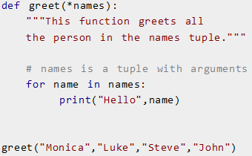

Example.

Slide 30
Python Recursion
Recursion is the process of defining something in terms of itself.
A physical world example would be to place two parallel mirrors facing each other.
Any object in between them would be reflected recursively.

Slide 31
Python Recursive Function
In Python, a function can call other functions.
It is even possible for the function to call itself.
These type of construct are termed as recursive functions.

Slide 32
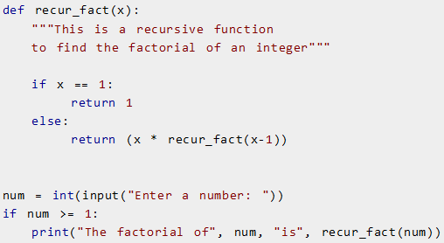

Example of recursive function:
To find the factorial of an integer:

Slide 33
Advantages of recursion
Recursive functions make the code look clean and elegant.
A complex task can be broken down into simpler sub-problems using recursion.
Sequence generation is easier with recursion than using some nested iteration.

Slide 34
Disadvantages of recursion
Sometimes the logic behind recursion is hard to follow through.
Recursive calls are expensive (inefficient) as they take up a lot of memory and time.
Recursive functions are hard to debug.

Slide 35
Python Anonymous/Lambda Function
In Python, anonymous function is a function that is defined without a name.
While normal functions are defined using the def keyword, in Python anonymous functions are defined using the lambda keyword.
Hence, anonymous functions are also called lambda functions.

Slide 36

Syntax of Lambda Function
Lambda functions can have any number of arguments but only one expression.
The expression is evaluated and returned.
Lambda functions can be used wherever function objects are required.

Slide 37

Example of Lambda Function
Here is an example of lambda function that doubles the input value.

Slide 38
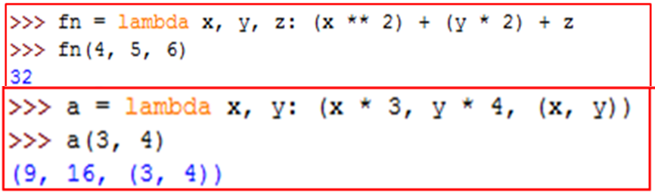
Example of Lambda Function
A lambda can take multiple arguments and can return (like a function) multiple values.

Slide 39
Use of Lambda Function
We use lambda functions when we require a nameless function for a short period of time.
In Python, we generally use it as an argument to a higher-order function (a function that takes in other functions as arguments).
Lambda functions are used along with built-in functions like filter(), map() etc.

Slide 40

Example use with map()
The map() function in Python takes in a function and a list.
The function is called with all the items in the list and a new list is returned which contains items returned by that function for each item.
use of map() function to double all the items in a list.

Slide 41

Example use with filter()
The filter() function in Python takes in a function and a list as arguments.
The function is called with all the items in the list and a new list is returned which contains items for which the function evaluats to True.
use of filter() function to filter out only even numbers from a list:

