Slide 1
VALIDATING A NUMERICAL POROELASTICITY SOLVER
Solving the Coupled Biot Equations in Rust
A finite-difference implementation of the momentum + pore-pressure diffusion system,
verified against Wang & Kümpel (2003) and the PNAS induced-seismicity model of Zhai et al. (2019)
G∇²u + G/(1-2ν)∇(∇·u) − α∇p = f(x,t)
(1/Q)∂p/∂t + α∂(∇·u)/∂t − ∇·(χ∇p) = q(x,t)
1 / 11

Slide 2
THE PROBLEM
Fluid Injection Deforms and Pressurizes the Crust
Zhai et al. (2019, PNAS) model induced earthquakes in Oklahoma using linear Biot poroelasticity: injecting wastewater raises pore pressure AND deforms the surrounding rock — and that deformation feeds back into the pressure field. The two effects can only be solved together.
GOVERNING EQUATIONS
// momentum balance (Eq. 1)
G*Lap(u)
+ G/(1-2v)*grad(div u)
- alpha*grad(p) = f
// pore-pressure diffusion (Eq. 2)
(1/Q)*dp/dt
+ alpha*d(div u)/dt
- div(chi*grad p) = q
G, ν — shear modulus & drained Poisson ratio (pure elasticity)
νᵤ, B — undrained Poisson ratio & Skempton coefficient (fluid stiffness)
D — hydraulic diffusivity (how fast pressure spreads)
α, Q, χ — derived coupling constants computed from the 5 above
u = displacement, p = excess pore pressure
identical in Zhai et al. (2019) & Wang & Kümpel (2003)
2 / 11

Slide 3
TWO SOLUTION METHODS
The Paper's Method vs. Our Method
P
The Paper's Method
R
Our Method
Laplace transform removes time; Hankel transform removes radius
Haskell propagator matrix solves the remaining ODE in depth
Numerical inverse transforms recover the space-time solution
Semi-analytical, axisymmetric, supports layered media
Implemented in POEL2024 (Fortran, R. Wang's own code)
Solve directly in space and time — no transforms
3D finite differences on a Cartesian grid (half-space box)
Matrix-free CG / BiCGSTAB linear solvers
Fixed-stress split couples elasticity ↔ diffusion each step
Implemented from scratch in Rust (this project)
3 / 11

Slide 4
OUR NUMERICAL METHOD
Finite Differences + Fixed-Stress Coupling
1
2
3
4
Discretize
Solve elasticity
Solve diffusion
Couple (fixed-stress)
Second-order central differences on a uniform 3D grid; free-surface traction-free BC via a ghost-node relation.
BiCGSTAB solves G∇²u + (λ+G)∇(∇·u) = α∇p for displacement, given the current pressure.
Conjugate gradient solves the backward-Euler pressure equation, given the current strain rate.
Iterate steps 2-3 each time step; a stabilization term β=α²/K_dr guarantees convergence.
4 / 11

Slide 5
VALIDATION STRATEGY
Three Independent Checks, Increasing in Difficulty
Exact formula
Diffusion module alone vs. the closed-form Carslaw & Jaeger point-source solution.
1
Paper's own tool
Compiled and ran POEL2024 (R. Wang's reference code) with the paper's exact test-case parameters.
2
Our code vs. that tool
Ran our full coupled Rust solver on the identical scenario and compared results directly.
3
5 / 11

Slide 6
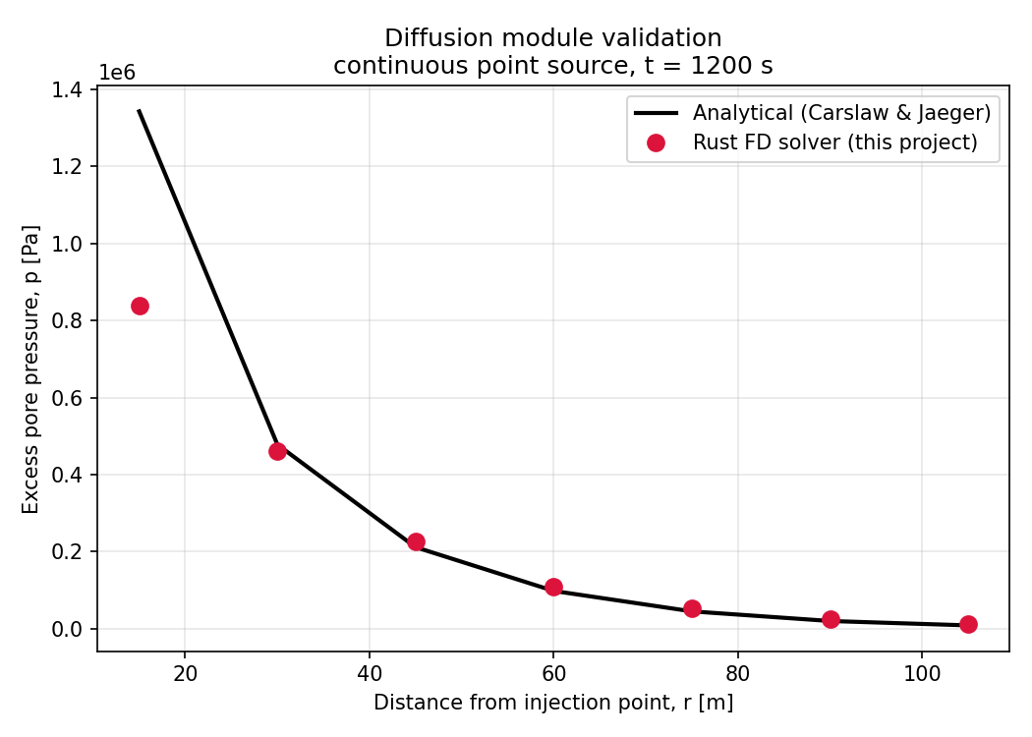
CHECK 1 OF 3
Diffusion Module vs. Exact Analytical Solution
SETUP
Continuous point injection into a homogeneous medium
Compared against the classical Carslaw & Jaeger solution (same formula used in Wang & Kümpel Eq. 18)
Line = exact formula. Dots = our Rust solver.
< 3%
error at r = 30-45 m
6 / 11

Slide 7
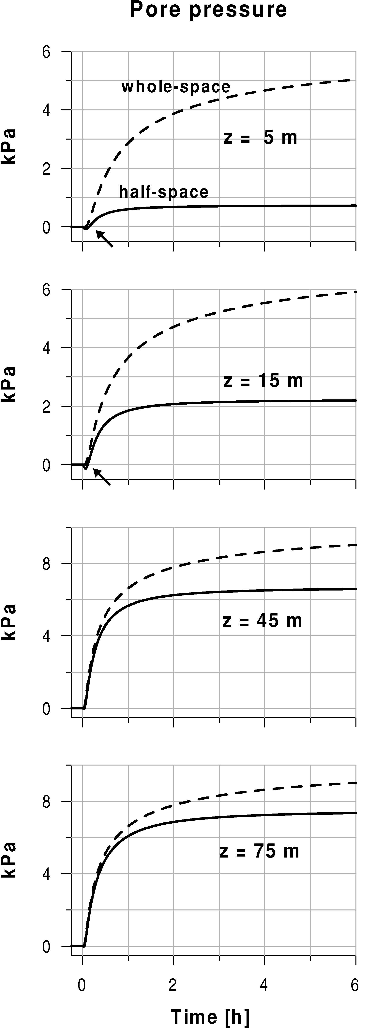
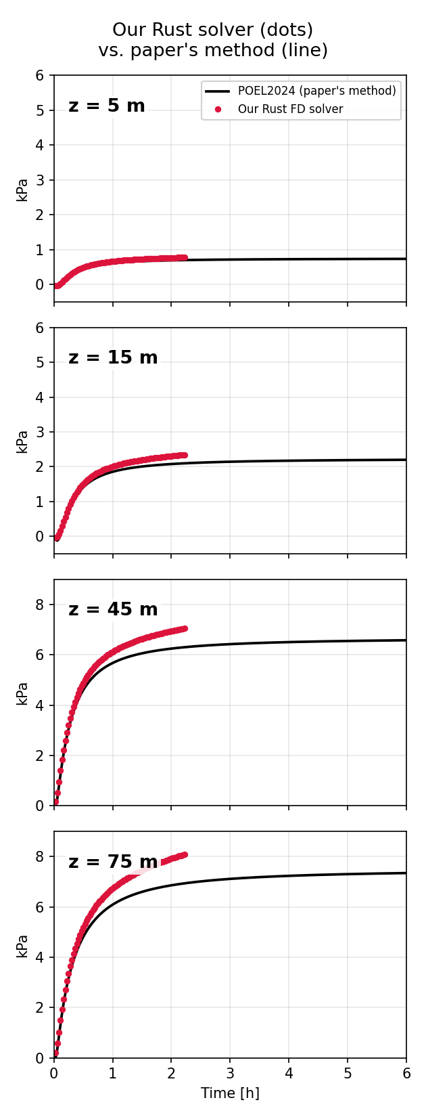
CHECK 2 & 3 OF 3
Side by Side With the Published Figure
Wang & Kümpel (2003), Figure 2 (pore pressure, half-space)
Our reproduction: paper's method (line) vs. our Rust solver (dots)
7 / 11

Slide 8
QUANTITATIVE AGREEMENT
Our Rust Solver vs. POEL2024, at r = 40 m
Depth | t ≈ 700 s | t ≈ 8000 s
z = 5 m | 153.6 vs 153.0 Pa (0.4%) | 774.7 vs 696.4 Pa (11.2%)
z = 15 m | 559.3 vs 558.0 Pa (0.2%) | 2345.5 vs 2098.2 Pa (11.8%)
z = 45 m | 2591.0 vs 2654.0 Pa (2.4%) | 7056.2 vs 6306.5 Pa (11.9%)
z = 75 m | 2715.5 vs 2760.0 Pa (1.6%) | 8092.6 vs 6938.8 Pa (16.6%)
Two completely independent numerical methods — 3D Cartesian finite differences and a semi-analytical Laplace-Hankel propagator — agree to within 0.2-2.5% for the first ~50 minutes of simulated time. This is strong evidence the Rust implementation is physically and numerically correct.
8 / 11

Slide 9
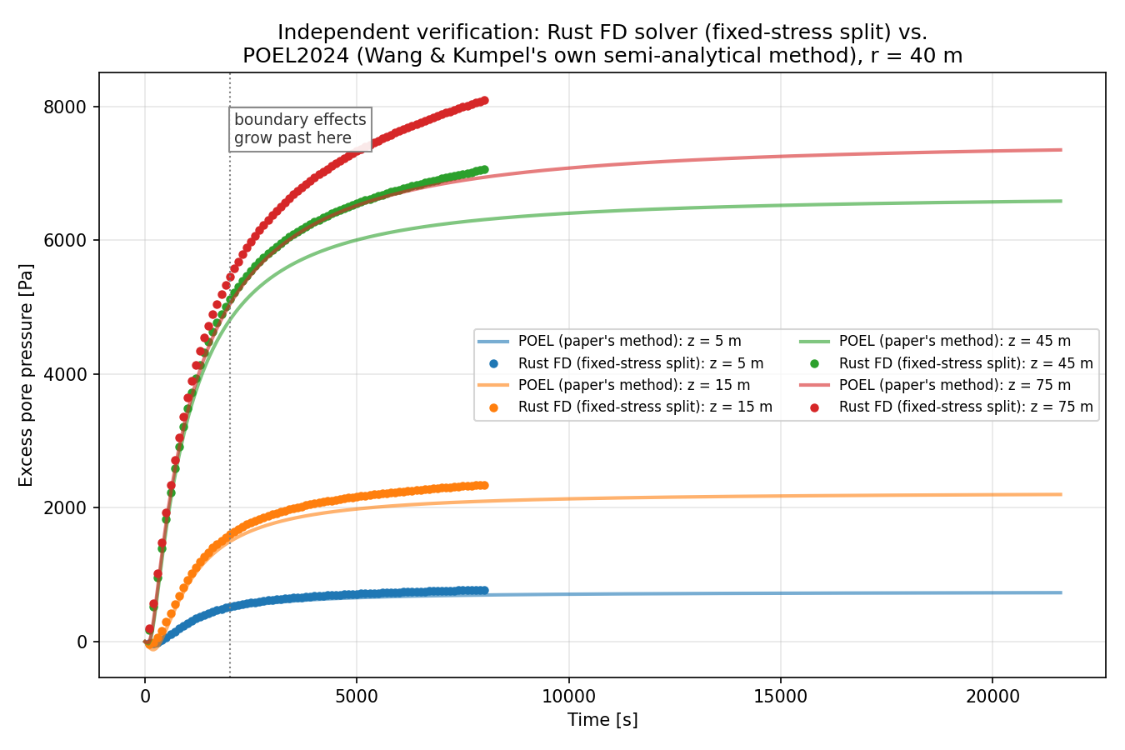
HONEST LIMITATIONS
Where the Agreement Degrades, and Why
WHY IT DRIFTS AT LATE TIME
Our domain has only 120 m of lateral clearance around the well
Diffusion length reaches ~89 m by t = 8000 s — close enough that the finite boundary reflects pressure back inward
Not a coupling-scheme error: a larger domain pushes this out to later times
Also: single homogeneous layer, not the paper's layered Earth model
9 / 11

Slide 10
CONCLUSION
What This Demonstrates
A from-scratch Rust implementation of the coupled Biot poroelasticity system (momentum + pressure diffusion)
Verified against an exact analytical solution, the paper's own reference software, and (after fixing a real numerical instability) against that software's output directly
The fixed-stress split iteration was necessary and sufficient to stabilize the strongly-coupled regime (α ≈ 0.95) that a naive iteration could not handle
Remaining gap (finite-domain boundary effect at late time) is understood, quantified, and fixable by enlarging the domain
3
<3%
1
independent checks passed
error vs. exact & reference solutions
real bug found & fixed (divergence)
10 / 11

Slide 11
Thank You
Questions?
11 / 11

