Slide 1
FINAL project AUTHORIZATION AND AUTHENTICATION
Submitted By :
Tushar Jain [200517688]
Mahipal Singh Rathore[200511282]
Jaskiran Kaur Saini [200513719]

Slide 2
Project summary
The project is ASP.NET Core web application with user data protected by authentication & authorization.
It displays a list of contacts that authenticated (registered) users have created.
There are three security groups:
Registered users
Managers
Administrators

Slide 3
Registered users
View all the approved data.
Can edit/delete their own data.
Managers
Approve/ Reject contact data.
Only approved contacts are visible to users
Administrators
Approve/reject and edit/delete any data. All users are visible

Slide 4



About Team
Tushar Jain
Completed bachelors of technology in Computer science and currently persuading Big data analytics certification.
Mahipal Singh Rathore
5+ years of experience in developing software solutions using big data technologies.
Jaskiran Kaur Saini
2+ years of experience in building data aggregates and ETL framework for various business processes.

Slide 5
Part I DEMONSTRATION

Slide 6
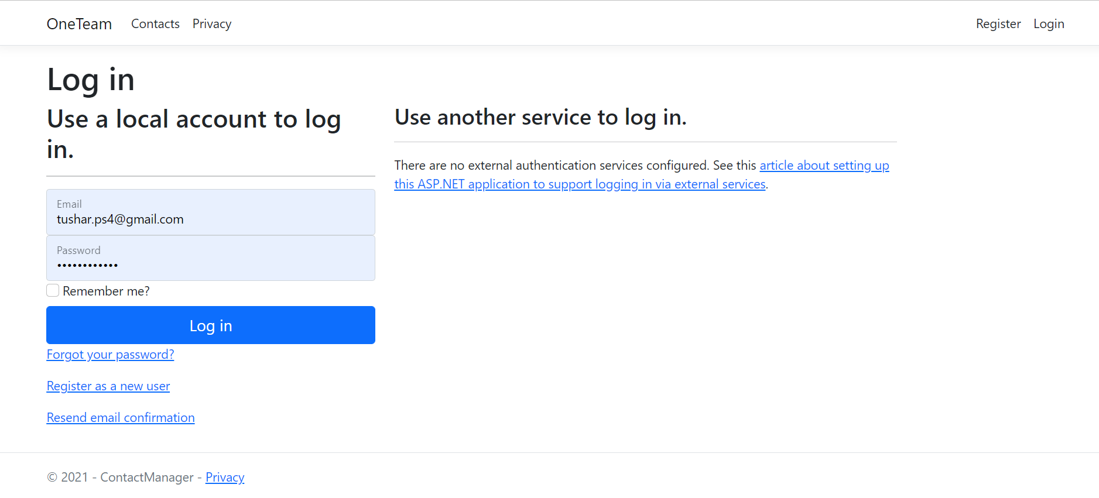
APPLICATION DEMONSTRATION

Slide 7
Part ii QUESTIONS AND RECOMMENDATIONS

Slide 8
How can we transfer personal data securely within their network?
There are several ways we can transfer personal data securely within the network of the company.
Email Encryption
Peer to Peer Communication
Off the Record Messaging
Cloud Services
File Transfer Protocol and Secure File Transfer Protocol

Slide 9
What security protocol is best for transferring personal files?
There are various secured file servers to transfer personal files and can be chosen on the basis of security performance and ease of use.
HTTP: Hypertext Transfer Protocol
SFTP: Secure File Transfer Protocol
FTP: File Transfer Protocol
SSL: Secure Socket Layer Protocol

Slide 10
Can we encode and encrypt images?
YES we can encode and encrypt images the same way we encode/decode anything else as images are made up of bits like all other digital data.
Images are either vectors or bitmaps. Bitmap images are made out of small parts called pixels. Vector images are made using coordinates and geometry. Images can be compressed to reduce file size. Image encryption tool help to protect sensitive images while using online. This tool will make image unrecognizable using the secret key. Some of the examples of techniques used are:
Chaos-Based Encryption Arnold Transform
Rubik Cube Transform
Fractional Fourier Transform
Wavelet Transform
Using Cyclic Shift

Slide 11
Our database cannot be moved from the site and we need to be able to access it externally using a secure API. Can you explain the architecture of a secure API?
Secure Connection
to API
Authentication and Authorization
Encrypted Transmission
Threat Protection, Detection and Alert Mechanism
Retaining history of Users

Slide 12
Can you recommend a secure framework for coding an API?
There are Several API Frameworks available according to the chosen language
For Python : Flask, Django
For JavaScript : Node.JS, Django
For C# : ASP.NET Core

Slide 13
What data interchange format should we use while transferring data between locations?
JSON format is highly recommendable to be used while transferring data because of the following features
Easy to manipulate
Simple design
Lack of a strict schema enables flexibility of the format
Support for Unicode
Ubiquitous
Compatible with modern technologies
Easy to
read and
understand

Slide 14
How should we store our data in our many locations?
Cloud and distributed environment
No More External Hard Drives
Share Files Easily
Keep files Encrypted and Secured
Data Backup
Remotely Update and Sync Files
Remote Access
Storage for a Lifetime

Slide 15
What are the ethical concerns related to the transmission of personal data?
Acknowledgement of data confidentiality
Considering ethical practices including honesty and dignity
Transparency while analysing the data
Masking the delicate and personal information
Privacy and accountability

Slide 16
THANK YOU ! YOUR FEEDBACK IS IMPORTANT.

