Slide 1
Algorithmic Thinking
Alison Pamment
On behalf of the course team
(NCAS/NCEO:CEDA, NCAS:CMS, NCAS Operations)

Slide 2
What is an algorithm?
“An algorithm is a precise, step-by-step set of instructions for performing a task.”
http://raptor.martincarlisle.com/

Slide 3
A little bit of history…
The word “algorithm” comes from the name of the 9th century Muslim scholar Al-Khwarizmi
He wrote down the rules for performing algebraic calculations using arabic numbers (a decimal numbering system, which in turn originated from Hindu scholars in India)
In modern usage, algorithms are usually thought of as the instructions carried out by a computer…
…but the concept isn’t limited to computers

Slide 4
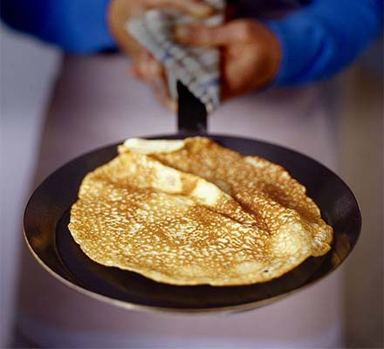
Traditional pancakes
1. Sift 250g plain flour and ¼ tsp salt into a bowl.
2. Break 2 large eggs into centre of the bowl.
3. Pour in 250 ml milk and whisk briskly.
4. Add a further 250 ml milk and whisk until the batter is smooth.
5. Heat an 8 inch pan over a low heat. Add a small knob of butter and swirl the pan to coat the bottom.
6. Use a ladle to spoon the pancake batter into the pan, then tilt the pan to spread the mixture out evenly.
7. As it sets, shake the pan to see if the pancake is loose, then flip it over with a palette knife. Cook the other side for 30 seconds - then shake again to see if it's loose.
8. Slide pancake onto a warm plate, sprinkle over some sugar and a squeeze of lemon juice. Eat immediately!
Notes:
“An algorithm is a precise, step-by-step set of instructions for performing a task.”

Slide 5
Traditional pancakes
1. Sift 250g plain flour and ¼ tsp salt into a bowl.
2. Break 2 large eggs into centre of the bowl.
3. Pour in 250 ml milk and whisk briskly.
4. Add a further 250 ml milk and whisk until the batter is smooth.
5. Heat an 8 inch pan over a low heat. Add a small knob of butter and swirl the pan to coat the bottom.
6. Use a ladle to spoon the pancake batter into the pan, then tilt the pan to spread the mixture out evenly.
7. As it sets, shake the pan to see if the pancake is loose, then flip it over with a palette knife. Cook the other side for 30 seconds - then shake again to see if it's loose.
8. Slide pancake onto a warm plate, sprinkle over some sugar and a squeeze of lemon juice. Eat immediately!
Notes:
“An algorithm is a precise, step-by-step set of instructions for performing a task.”

Slide 6
Traditional pancakes
1. Sift 250g plain flour and ¼ tsp salt into a bowl.
2. Break 2 large eggs into centre of the bowl.
3. Pour in 250 ml milk and whisk briskly.
4. Add a further 250 ml milk and whisk until the batter is smooth.
5. Heat an 8 inch pan over a low heat. Add a small knob of butter and swirl the pan to coat the bottom.
6. Use a ladle to spoon the pancake batter into the pan, then tilt the pan to spread the mixture out evenly.
7. As it sets, shake the pan to see if the pancake is loose, then flip it over with a palette knife. Cook the other side for 30 seconds - then shake again to see if it's loose.
8. Slide pancake onto a warm plate, sprinkle over some sugar and a squeeze of lemon juice. Eat immediately!

Slide 7
Crêpes traditionnelles
1. Tamiser 250g de farine et de sel ¼ de dans un bol.
2. Casser 2 gros œufs dans le centre de la cuvette.
3. Verser 250 ml de lait et fouetter vivement.
4. Ajouter un autre lait 250ml et fouetter jusqu'à ce que la pâte soit lisse.
5. Chauffer une poêle de diamètre 16 cm à feu doux. Ajouter une petite noix de beurre et agiter la poêle pour recouvrir le fond.
6. Utiliser une louche à ramasser la pâte à crêpes dans la poêle, puis incliner la poêle pour étaler le mélange uniformément.
7. Faire cuire jusqu'à ce que la crêpe soit dorée, la retourner et faire cuire l'autre côté.
8. Faites glisser sur une assiette chaude, saupoudrer un peu de sucre et un filet de jus de citron. Manger immédiatement!

Slide 8
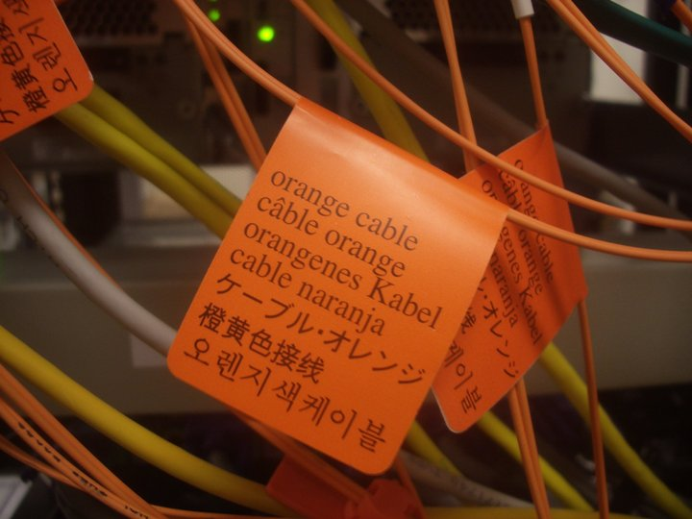
Beware ambiguity!
“Cables must be clearly labelled in all official languages of project participating institutions”

Slide 9
Algorithms for automation
“An algorithm is a precise, step-by-step set of instructions for performing a task.”
The task can then be performed without the need to understand the original problem or knowledge of the final goal
This is very important for automation
Exercise 1

Slide 10
Exercise 1:
Circle the start and end dots
Join the start and end dots with a straight line
Passing through intermediate dots or crossing existing lines is OK
G6 -> G9
I9 -> F11
F12 -> E12
E5 -> D6
etc.
1
2
3
4
5
6
7
8
9
10
11
A
B
C
D
E

Slide 11
What is ‘algorithmic thinking’?
“Algorithmic thinking is the process of analysing a real world problem, breaking it down into a series of logical steps with defined inputs and outputs and then expressing those steps as an algorithm.”
https://www.youtube.com/watch?v=DoTYX4-Z-jA

Slide 12
What is ‘algorithmic thinking’?
Define the “real world” problem
Formulate the problem, including inputs and outputs
Design algorithm to process the inputs and give the required outputs
Implement the algorithm
Run the algorithm and express the output in “real world” terms

Slide 13
Designing an algorithm
The next video gives an example of designing a simple algorithm and introduces the idea of ‘pseudocode’.
Pseudocode is structured like computer code but is not a real programming language
It is human readable and a useful shorthand when designing an algorithm
https://www.youtube.com/watch?v=6hfOvs8pY1k

Slide 14
Control structures
INITIALISATION
Let N = 0
for each pair of people in the room
set N = N + 2
If 1 person remains then
set N = N + 1
Pseudocode can be used to test the logic of an algorithm by trying a few input values and checking whether the output is what you expect
LOOP
BRANCH (CONDITION)

Slide 15
Exercise 2
Imagine you are entertaining a small group of visitors at your workplace. Your task is to serve them each a hot drink from a dispensing machine. Use pseudocode to construct a suitable algorithm for performing this task.

Slide 16
Points to bear in mind…
Often there is no single ‘right’ answer
Some algorithms are more ‘efficient’ than others (i.e. involve fewer steps and take less time to execute)
A well structured algorithm can often be adapted to solve a class of similar problems
Programming languages contain many ‘built in’ algorithms for common operations – use them!

Slide 17
Starting to code
Many online interactive tutorials, for example:
scratch https://scratch.mit.edu/
Python https://docs.python.org/3/tutorial/index.html
Code academy http://www.codecademy.com/en/tracks/python

