Slide 1
Parallel processing of large datasets

Slide 2
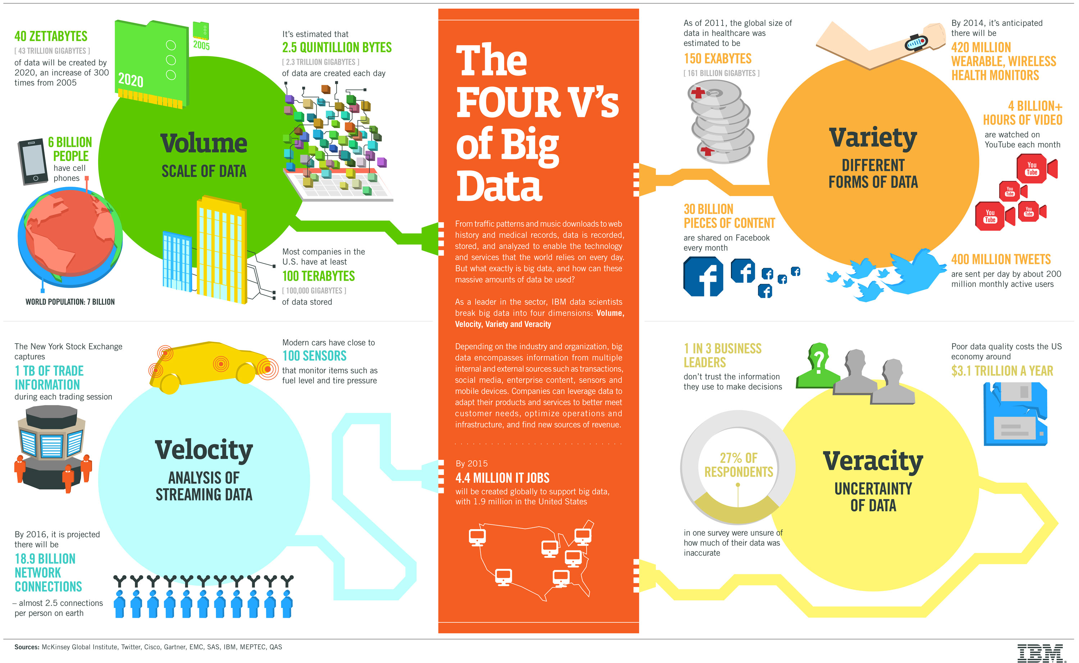
What are Big Data?
1 ZETTABYTE = 1,000,000,000 TERABYTES
Notes:
Big Data is a hot topic. This pretty diagram, courtesy of IBM, tells us about the four “Vs” that are typically used to identify “Big Data”:
- Firstly, there is Volume, talk briefly about some of the text/graphics [click], explain what a Zettabyte is, [click]
- Then, there is Variety, talk briefly about some of the text/graphics [click],
- Then, Velocity, which is about throughput, mention the text/graphics... [click],
- and finally, Veracity, how much do you trust the data you are using/producing?

Slide 3
Processing big data: the issues
Parallel processing in the Environmental Sciences has historically focussed on running highly-parallelised models.
Data analysis was typically run sequentially because:
It was a smaller problem
It didn’t have parallel resources available
The software/scientists were not equipped to work in parallel
The generation of enormous datasets (e.g. UPSCALE – around 300Tb) means that:
Processing big data requires a parallel approach
Fortunately, platforms, tools, and programmers are becoming better equipped
Notes:
Climate models, NWP (Numerical Weather Prediction) models, atmospheric chemistry models, ocean models, sea-ice models, and vegetation and land surface models are all examples of scientific computer code that are designed to run on parallel processing machines. They have been handled in this way since at least the 1980s. The computations required to run a complex global or regional model at high horizontal or vertical resolution could not be achieved on reasonable time-scales unless parallelisation is used. Typically the model is split into geographical regions, each processing unit on a supercomputer performs the calculations for a number of grid-points, the results are shared with neighbouring processors and then the model run continues with the next time step.
By contrast, the analysis of data (whether observed or modelled) has, until much more recently, tended to be run sequentially (i.e. one calculation at a time on a single processor). There are a number of reasons for this (listed on slide).
As supercomputer power has increased, so has the complexity of numerical models. More processing power means that a model can be run at higher resolution, say 50 km in the horizontal instead of 200 km and 100 levels in the vertical instead of 10. More physical and chemical processes can also be included because scientific understanding has improved and because the calculations can now be done on reasonable timescales. Models (especially climate models) are also run repeatedly in large ensembles to allow proper analysis of the statistical variation arising from slight differences in the model physics or starting conditions. Ensembles, higher resolution and additional numbers of calculated parameters have all served to create an explosion in recent years of the quantity of data that are being generated. These must all be stored somewhere and to be effectively analysed the task now needs a parallel approach akin to that of running the models themselves. Also, scientists are better trained in how to use parallel computing techniques to perform their analyses.

Slide 4
Some Terminology
Concurrency: A property of a system in which multiple tasks that comprise the system remain active and make progress at the same time.
Parallelism: Exploiting concurrency in a programme with the goal of solving a problem in less time.
Race condition: A race condition occurs within concurrent environments. It is when a piece of code prevents code that is running elsewhere from accessing a shared resource, e.g., memory, and thus delays the other process.
Notes:
Talk through the definitions....

Slide 5
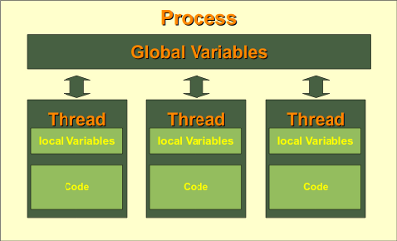
How does my computer do so many things at once?
These days most computers, and even phones, have multiple processors.
However, even on a single processor modern operating systems can give the illusion that multiple tasks are running at the same time by rapidly switching between many active threads.
This is because the modern CPU clock is measuring time at the nanosecond scale where we humans can only keep track of milliseconds.
Picture: http://www.python-course.eu/threads.php
Notes:
A “Thread” or a “Thread of Execution” is defined in computer science as the smallest unit that can be scheduled in an operating system. Threads are normally created by a computer program running on a single processor which then splits (forks) between two or more parallel tasks. The overall task is called a “process”. The threads share the memory and code of the process and the values of its variables.
REVIEW: Paraphrased threads description from http://www.python-course.eu/threads.php
REVIEW: Inserted threads graphic
REVIEW: Highlighted the word “threads” in red.

Slide 6
Parallel processing for data analysis
Data analysis tools do not (typically) do parallelisation automatically.
But parallelisation is normally achievable at a small price.
A lot can be done with:
Decomposition of large jobs into smaller jobs
Batch processing
Understanding tools and schedulers
We will look at these and show examples
Notes:
A lot can be done with:
Batch processing – this is where a process or “job” is designed to run on a computer without the need for any interactive input from a user, e.g. typing something at the keyboard or mouse clicks, while it is running. Any input must be placed in a file which the program then reads to control its actions. The computer can then run several similar processes with different input files at the same time.
The process of performing data analysis may not need to be done as one long continuous process. Splitting the task up into separate logical steps can increase efficiency.
Many tools are available to help with the task of maximising the efficient use of computing resources. “Schedulers” are programs that look at all the processes that are currently running on a computer, including any batch processing jobs that may have been submitted, and automatically decide how best to apportion resources such as the number of processing units and the amount of memory to each of them. As one job finishes and frees up computing resources, the scheduler starts another job running.

Slide 7
(Almost) everything is parallel these days
YOUR DESKTOP MACHINE IS A PARALLEL COMPUTER!
It runs a multi-core processor...
...which means you can speed up processing by asking different parts of your programme to run on different cores.
“But what about race conditions?”...
...True: you still need to design your approach to avoid things getting out of hand!
Notes:
By “out of hand”, we mean that you need to tell the computer the order in which different parts of your code should be run. If code A is dependent on code B then you need to put code A on halt until code B has run.

Slide 8
Simple parallelism by hand (1)
Running on a multi-core machine you can exploit local processes, e.g.:
Long list (100,000) of text files: each file contains the text from a whole book.
Some processing code
A text file: listing all lines in all books that match the word “dog”
#!/bin/bash
input_file=$1
while read FILENAME; do
grep dog $FILENAME >> ${input_file}_result.txt
done < $input_file
grep_for_dog.sh
Notes:
Let’s take a simple example of splitting up a large task into smaller ones that can be executed in parallel…
Say you have a very large number of files (100,000) each of which contains the complete text of the book. You want to find all the lines from all the books that contain the word “dog”.
You could do this in a linear way. One piece of code (represented here by the arrow) opens each file in turn, reads its entire contents one line at a time, checks for a match with the word “dog” and if it finds one writes out the line to a huge output file. In theory, a short script using the linux command “grep”, which matches characters called “regular expressions” could achieve the desired result. But doing it this way might take days, weeks or months to complete, depending on the speed of your computer!
So is there a better way?

Slide 9
Simple parallelism by hand (2)
A simple re-factoring splits the job into five parts:
Some processing code (x 5)
List (20,000) of text files
Result 1
Group together
A text file: listing all lines in all books that match the word “dog”
List (20,000) of text files
Result 2
List (20,000) of text files
Result 3
List (20,000) of text files
Result 4
List (20,000) of text files
Result 5
$ split –l 20000 –d list_of_files.txt # Writes to “x00”, “x01”, ...
$ for i in x??; do grep_for_dog.sh $i & done
$ cat *_result.txt > output.txt
Notes:
You could manually split the input list into chunks of 20,000 files. (The “linux” split command can easily do this). You want to perform the same task on each one so now you can run five processes in parallel.
Each process writes its output to a separate file and then another bit of code collects the contents of those files together into a single list.
The outcome of this approach is identical to the first, but by dividing the task into logical steps we have allowed the result to be achieved much faster. Each task could run on one core of your desktop computer.

Slide 10
Simple parallelism by hand (3)
$ for i in x??; do grep_for_dog.sh $i & done
[2] 3325
[3] 3326
[4] 3327
[5] 3328
[6] 3329
$ ps -ef | grep grep_for_dog
alison 3325 2669 0 00:40 pts/1 00:00:00 /bin/bash ./grep_for_dog.sh x00
alison 3326 2669 0 00:40 pts/1 00:00:00 /bin/bash ./grep_for_dog.sh x01
alison 3327 2669 0 00:40 pts/1 00:00:00 /bin/bash ./grep_for_dog.sh x02
alison 3328 2669 0 00:40 pts/1 00:00:00 /bin/bash ./grep_for_dog.sh x03
alison 3329 2669 0 00:40 pts/1 00:00:00 /bin/bash ./grep_for_dog.sh x04

Slide 11
Simple parallelism by hand (4)
Some time later…
[2] Done ./grep_for_dog.sh $i
[3] Done ./grep_for_dog.sh $i
[4] Done ./grep_for_dog.sh $i
[5]- Done ./grep_for_dog.sh $i
[6]+ Done ./grep_for_dog.sh $i
$ ps –ef | grep grep_for_dog

Slide 12
JASMIN & LOTUS
Notes:
Now moving on a little from the theory of parallelisation we will talk about the JASMIN and LOTUS systems which CEDA administer for NCAS and which provide parallel computing facilities.

Slide 13
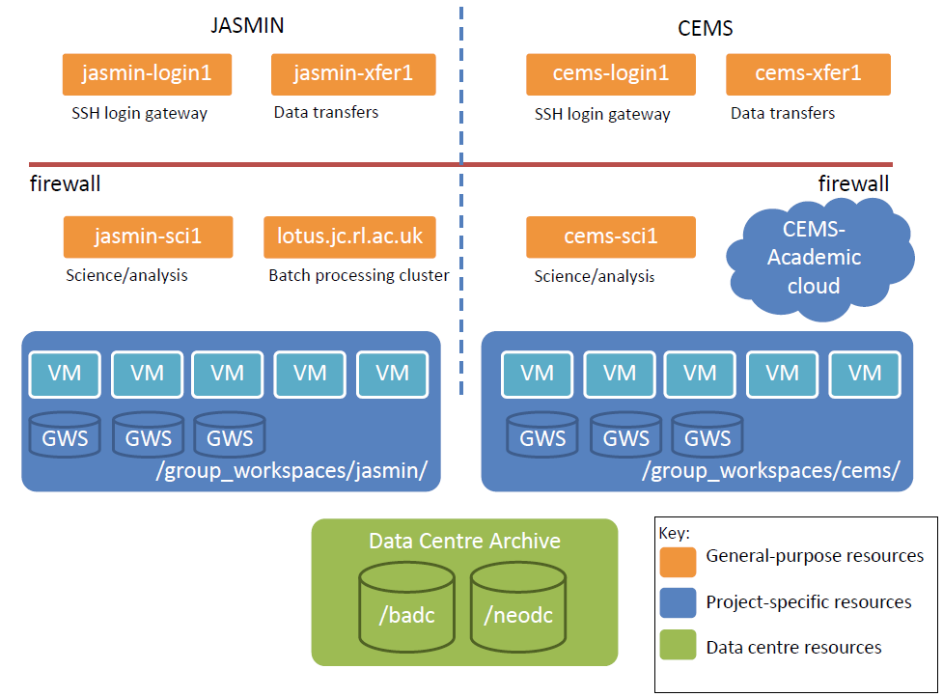
Scientific computing on JASMIN
(jasmin-login1.ceda.ac.uk)
(jasmin-sci[1-5].ceda.ac.uk)
5700 Cores
Notes:
Explain the following points:
* You can log in to JASMIN via the “login1” server
* You can transfer data to/from JASMIN via the “xfer1” server
* Once logged in, you can use 3 different types of computing resource:
- Generic scientific servers (“sci1/2”)
- Generic processing cluster (“lotus”) – very relevant to this presentation.
- Project-specific servers – if you are involved in the relevant project and you have signed up for access.
* Your home directory will appear across all computing resources
* But any large data storage should happen on Group Workspaces – which you need to apply for access to.

Slide 14
Getting access to JASMIN
Apply for an account:
https://help.jasmin.ac.uk/article/189-get-started-with-jasmin
Generate an ssh key pair (required)
Apply for login access
(Optionally) apply for CEDA account, access to project resources, fast data transfer service, etc.
Login using your ssh key
https://help.jasmin.ac.uk/article/187-login
From Windows use MobaXterm – free to download (details on jasmin login help page)
ssh to sci machine / project VM / lotus head node

Slide 15
The LOTUS cluster on JASMIN
The LOTUS cluster is a far bigger resource for running compute intensive jobs than the JASMIN Scientific Analysis Servers.
Having the same software installed on the JASMIN-Sci machines and LOTUS means you can:
develop code on the generic Analysis Servers
run in batch mode via LOTUS

Slide 16
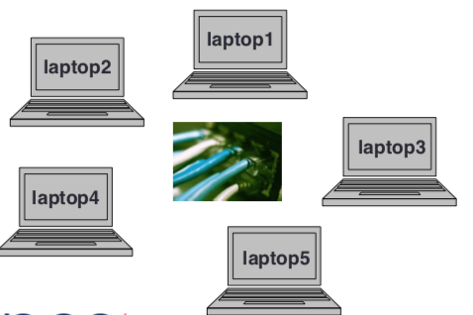

LOTUS: JASMIN’s batch processing cluster (1)
What is a cluster?
A cluster is a collection of computers working together to solve a large problem in a significantly reduced time.
A generic view of a cluster:
Laptops connected by a network
Each laptop has 4 cores/processors
Each laptop is called a compute node
Each has its own operating system
Cluster of 20 cores/processors
Cluster of 5 compute nodes
Network
Notes:
A computer cluster is a group of tightly coupled computers that work together closely so that it can be viewed as a single computer.
Clusters are usually deployed to improve speed and/or reliability over that provided by a single computer

Slide 17
LOTUS: JASMIN’s batch processing cluster (2)
What is batch processing?
Batch processing is the execution of a program or a sequence of commands without user interaction. Program execution does not occur instantly, but via a scheduler that manages the compute resources based on a set of predefined policies.
Differences from interactive processing
User does not login to a compute node directly and type individual commands
Not a GUI-based environment
Resources more tightly monitored and controlled
Greater computing power and more resources e.g. high memory 512GB
Notes:
Benefits of computer cluster:
Processing power
Improved network technology
Scalability: greatest advantage of cluster compared to a fixed processing capacity -easy to expand as requirements change
Availability: if a node fails cluster continue to operate

Slide 18
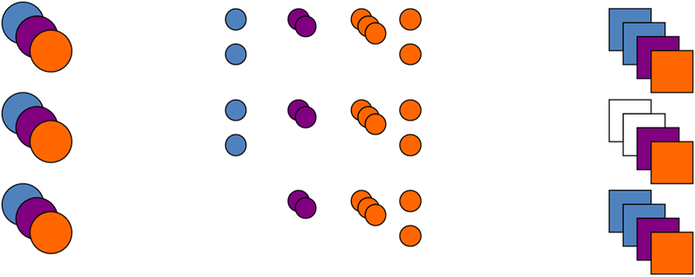
Job Submission
Jobs are submitted using the LSF scheduler
Resources are allocated as they become available
Fair share of resources between users
Notes:
Three users (left column) have jobs in the queue (middle column) which are waiting to run on the cluster (right column). As the blue user's job finishes (middle row), all three users could potentially use the two job slots that become available. However, the orange and purple users already have jobs running, whereas the blue user does not, and as such it is the blue user's jobs that are run (bottom row).

Slide 19
LSF queues on LOTUS
Serial queues -single core
short-serial : default queue, runtime limit 24 hrs, memory control limit
long-serial : runtime limit 168 hrs, memory control limit
Parallel queues -multiple cores, runtime limit 48 hrs
par-single : 16 cores limit on a single compute node
par-multi : cores distributed across many compute nodes
High memory - single core
high-mem
Notes:
Selecting a queue: The default queue is normally suitable to run most jobs. If you want to submit jobs to queues other than the default queue, you should choose the most suitable queue for each job
To see detailed queue information use the bqueues LSF command

Slide 20
LSF Scheduler commands
To interact with the LOTUS LSF scheduler first login to one of:
JASMIN scientific servers (jasmin-sci[1-5].ceda.ac.uk)
LOTUS head node (lotus.jc.rl.ac.uk)
Job submission: bsub <options> command
$ bsub -o %J.out -W 00:10 python2.7 mypythonscript.py
Job <6485340> is submitted to default queue <short-serial>.
Job information: bjobs
$ bjobs
JOBID USER STAT QUEUE FROM_HOST EXEC_HOST JOB_NAME SUBMIT_TIME
6485340 msmiz RUN short-serial jasmin-sci1 host177.jc. Myjob1 Jul 21 11:46
6485346 msmiz RUN short-serial jasmin-sci1 host232.jc. Myjob2 Jul 21 11:46
Cancel a job: bkill <job_id>
$ bkill 6485346
Job <6485346> is being killed
Notes:
To submit jobs to LOTUS you first need to have applied for permission to access the resources?
(REVIEW: Is this done when applying for JASMIN access – I can’t remember!)
The user first logs in to jasmin-login1 and then uses the ssh command to log in to lotus. LOTUS can’t be accessed directly for security reasons).
The bsub command (with various command line options) is used to submit the job. Options will include things like the name of the batch queue, how many processors are needed, how much memory and so on. “Command” is the name of the actual program that is to be executed, for example, it might be a regional climate model or a trajectory model.
The bjobs command lists which jobs are currently known to the system. Each job has a unique number, assigned by the system: this is the jobid. The output from bjobs also shows which user owns the job, its current status (i.e is it waiting to run (pending), currently running, finished, etc.) This is rather like the “jug status” command we looked at earlier for Python jobs running on a desktop machine.
A job can be cancelled before or during a run using the bkill command which takes the job_id as a command line argument.
REVIEW: Are the question marks meant to be there?

Slide 21
LSF commands & job states
Table 1: LSF commands (Use manual page e.g. man bsub)
Table 2: LSF job states
Job submit command | Job status command | Job control command
bsub | bjobs bhist bqueues | bmod bstop bresume bkill
LSF job state | Meaning
PEND | Job is waiting in a queue
RUN | Job is currently running
DONE | Job finished with zero exit value
EXIT | Job finished with non-zero exit value
PSUSP | Job suspended while pending
USUSP | Suspended by user ( by LSF system SSUSP)
Notes:
bsub bqueues bjobs bhist bstop bresume bmod bkill
Use manual page man bsub

Slide 22
Batch system LSF on LOTUS
Batch systems
LSF Load Sharing Facility -IBM
PBS (on Archer)
Slurm
Batch system concepts
Job
Queue
Priority
Notes:
Specification of compute resources is needed to run a job on LOTUS -Priority is a numerical ranking of a job by the scheduler that influences how soon it will start (high priority more likely to start sooner)

Slide 23
Batch job example: extract spatial subsets from CMIP5 experiments (1)
Processing requirement:
For each model:
For each variable (hus, ps, ta, ua & va):
Extract a spatial subset
(80° to 140° Longitude; -30° to 40° Latitude)
Where:
Frequency: 6hr
Ensemble: r1i1p1
Realm: atmosphere
Notes:
Now let’s look at an example that lends itself to parallelisation by the creation of a large number of simultaneous processes…
CMIP5 stands for Climate Model Intercomparison Program, Phase 5. CMIP is a huge international program in which climate models developed independently by many groups around the world run standard sets of experiments, such as 100 year climate prediction simulations using a variety of greenhouse gas and natural forcings. Usually model ensembles are run in which the same experiment is repeated many times, for example, with slightly different initial states but keeping everything else the same. These ensembles are used to analyse the internal statistical variability of the models themselves. The running of standardised in the CMIP project then allows the performance of the different models to be compared and assessed. The simulations are run at various horizontal and vertical resolutions and solving the physics equations at varying time intervals, or time steps. The total quantity of data generated by an exercise like CMIP5 is in excess of 1 petabyte.
Suppose you want to see how a model performed in a particular experiment over one particular region of the earth’s surface. In this example, the area 80 to 140 degrees longitude and -30 to 40 degrees latitude has been chosen. You do not want to have to keep reading and processing data for the whole globe every time you want to find out what is happening in that particular region. So you construct a smaller data set covering only the region and variables of interest.
You want to look at 5 model variables which have been written out once every 6 hours of model simulation for the whole depth of the atmosphere. The experiment you are interested in is a model ensemble entitled r1i1p1.

Slide 24
Batch job example: extract spatial subsets from CMIP5 experiments (2)
Basic (Sequential) Implementation:
Script 1 (bash):
For each variable (hus, ps, ta, ua & va):
Make output directory
Find all relevant input NetCDF files
Loop through list of input files and for each one call Python script
Script 2 (Python):
Read input file; extract spatial subset for variable; write output file.
Main code used: cf-python library
import cf
f = cf.read(infile)
subset = f[2].subspace(latitude=cf.wi(bb.south, bb.north), longitude=cf.wi(bb.west, bb.east))
cf.write(subset, outfile)
Extract from: extract_cmip5_subset.py
Notes:
Again let’s start by thinking about how you would go about extracting the data of interest if you were taking a linear approach…
You could make an output directory for each variable of interest, construct a list of all the model output files that contain that variable and then use a Python script to read the global data, extract only the grid points of interest and place them into a smaller array, then write out the smaller array to an output file. You would have to run the Python script once for each input file. This could be many, many files if you want 6 hourly data from a 100 year climate run and processing them sequentially would be extremely time consuming.

Slide 25
Batch job example: extract spatial subsets from CMIP5 experiments (3)
Parallel Implementation using LOTUS:
Script 1 (bash):
For each variable (hus, ps, ta, ua & va):
Make output directory
Find all relevant input NetCDF files
Loop through list of files and for each one submit a batch job to LOTUS to call the Python script using bsub
bsub -q par-single -o $outdir/`date +%s`.txt ~/extract_cmip5_subset.py $nc_file $this_dir $var
Notes:
So how can we parallelise the task so that it takes less time to work through all the files?
We start off in the same way by making output directories and a list of all the files we need to process. We already have a Python script that will process one file at a time. Now we write a bash shell script that uses bsub to submit a batch job to LOTUS once for every file in our input list. This will create a large number of batch jobs to run in parallel.
Will this work? Yes, because the LOTUS system allows an individual user to submit up to 200 jobs at once. They probably won’t all be executed at the same time, but that doesn’t really matter for this application – all we want is the end result. The LOTUS scheduler balances the load we are placing on the machine across the various computing resources as they become available. (At the same time it will no doubt be scheduling resources to be used by jobs submitted by other users). The jobs will run in parallel, independently of one another.
REVIEW: Is the limit of 200 the number of jobs you are allowed to have in queue at once, or is it the number you can have running at once? In the “Why” section the word “submit” seems to be used to describe creating the job requests and starting them running.

Slide 26
Batch job example: extract spatial subsets from CMIP5 experiments (4)
Why use this approach?
Because you can submit 200 jobs in one go.
Lotus executes jobs when resource becomes available
They will all run and complete in parallel
bsub -q par-single -o $outdir/`date +%s`.txt ~/extract_cmip5_subset.py $nc_file $this_dir $var
Notes:
So how can we parallelise the task so that it takes less time to work through all the files?
We start off in the same way by making output directories and a list of all the files we need to process. We already have a Python script that will process one file at a time. Now we write a bash shell script that uses bsub to submit a batch job to LOTUS once for every file in our input list. This will create a large number of batch jobs to run in parallel.
Will this work? Yes, because the LOTUS system allows an individual user to submit up to 200 jobs at once. They probably won’t all be executed at the same time, but that doesn’t really matter for this application – all we want is the end result. The LOTUS scheduler balances the load we are placing on the machine across the various computing resources as they become available. (At the same time it will no doubt be scheduling resources to be used by jobs submitted by other users). The jobs will run in parallel, independently of one another.
REVIEW: Is the limit of 200 the number of jobs you are allowed to have in queue at once, or is it the number you can have running at once? In the “Why” section the word “submit” seems to be used to describe creating the job requests and starting them running.

Slide 27
Typical workflow for LSF jobs on LOTUS
Test code interactively on Sci analysis servers:
Submission nodes
lotus.jc.rl.ac.uk
jasmin-sci[1-5].ceda.ac.uk
Estimate resources
Job control command
Write a job script
bsub
Job Queued
JobID
Job Runs on LOTUS
Job Finished
Job status command
Output files (& error)
Notes:
Login to one of the scientific analysis servers.
Install/write/configure your processing code.
Test your code interactively: run it locally in a single-process test case.
Create a wrapper script for your code that allows multiple versions to run independently: e.g. running for different dates or processing different spatial regions/variables.
Submit your jobs via the batch script.
Monitor your jobs.
Gather/analyse/review the outputs as required. Inspect error/output files

Slide 28
Efficiency gains through re-factoring (1)
Major gains can be made by changing the order and structure of your code. Issues might be:
Code runs sequentially and takes a long time
Code runs slowly because processing order leads to inefficient I/O
Code will not run because of memory requirements
In some cases you can create loops that can be scripted as separate processes allowing you to submit them in parallel.
Notes:
This slide reminds us of the things we need to take into account when deciding whether and how to re-factor our code. Re-factoring does not necessarily mean parallelising – indeed we may choose to split our code into separate logical steps and run them sequentially. The constraints of our computing resources may still mean that we need to redesign our code, for example, if we have a task that needs a lot of memory. Running out of memory will cause a computer program to crash, even if the logic is sound. In this case we have to break the task down into smaller chunks even if we run all the code sequentially. If the code works, but takes a very long time to complete, it may be a candidate for parallelisation. Running on multiple processors may also increase the amount of memory your code can access.

Slide 29
Efficiency gains through re-factoring (2)
Here is a real-world example:
The Problem: Trying to run the NCO tool ncea to calculate an average from a large dataset. It will not run!
Why? The ncea command reports this:
(which is about 8 Gbytes) ...and then exits.
Possible solutions:
1. Data files hold multiple variables: Operate on one at a time:
2. Reduce the number of files (i.e. years) processed each time:
unable to allocate 7932598800 bytes
ea -v vosaline means/199[45678]/*y01T.nc -o test.nc
ncea means/199[45]/*y01T.nc -o test.nc
Notes:
Here is an example of needing to re-factor code because it uses too much memory.
A software tool is trying to calculate averages of multiple variables all held in a single dataset.
A simple solution would be to concentrate on one variable at a time and only read that in to memory instead of the entire dataset.
Another way would be to calculate averages for shorter periods rather than the whole period at once (rather like our Jug example for monthly means).

Slide 30
The future of parallel data analysis (1)
Analysing Big Data is a challenge! Software needs to adapt and scientists need to be able to adapt their code to keep up!
CMIP5 Status (early 2013)
Number of files | 3,222,967
Number of datasets | 54,274
Archive Volume (TB) | 1,483
Models with data published | 64
Models with documentation published in archive | 38
Experiments | 108
Modelling centres | 32
Data Nodes | 22
Notes:
Some statistics for the CMIP5 exercise that we referred to earlier. The phrase “Big Data” was coined to describe datasets of this sort of proportion. Analysing this quantity of data to realise its full scientific value is an ongoing challenge!

Slide 31
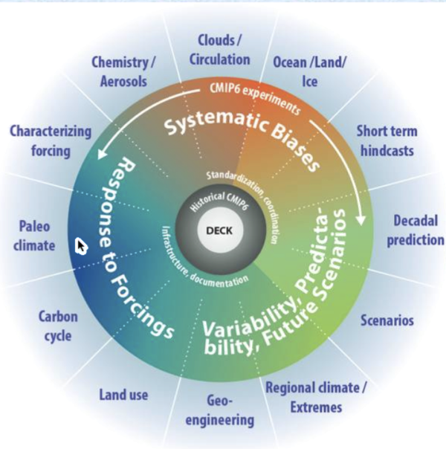
The future of parallel data analysis (2)
CMIP6: 6th Coupled Model Intercomparison Project
Global community activity under the World Meteorological Organisation (WMO) via the World Climate Research Programme (WCRP)
33 institutions
75 models
248 experiments
Approximately 20-30PB
CEDA are currently preparing for ~13PB to be archived
Notes:
~3PB disk, 10PB tape/object store

Slide 32
The future of parallel data analysis (3)
We are likely to see more:
Web processing services that do the parallel analysis remotely;
Analysis Platforms (like JASMIN) that allow scientists to run code next to the data;
Parallel I/O in software libraries.
Learning to write parallel code now is likely to be of great benefit in future
Notes:
Here are some ways in which the “Big Data” challenge will continue to affect the way that scientists need to work.

Slide 33
Further information
LOTUS Overview:
https://help.jasmin.ac.uk/article/110-lotus-overview
https://help.jasmin.ac.uk/article/212-batch-scheduler-overview
LOTUS User Guide
help.ceda.ac.uk/category/107-batch-computing-on-lotus
JASMIN Analysis Platform (software packages):
https://help.jasmin.ac.uk/article/271-jap
Python-based Parallel tools:
https://wiki.python.org/moin/ParallelProcessing
Jug:
jug.readthedocs.io/en/latest/
Parallel processing:
https://computing.llnl.gov/tutorials/parallel_comp/
Notes:
And some further reading …

