Slide 1
Recursive Density-Based Refinement of K-Means for Automatic Cluster Splitting
Submitted To:
Dr. Mohammad Rezwanul Huq
United International University
Submitted By:
Mst. Abida Sultana
ID: 0122430004
Md. Mahir Uddin
ID: 0122430022
Khadija Begum
ID:0122430010

Slide 2
Introduction
K-Means clustering is an unsupervised iterative clustering technique.
It partitions the given data set into k predefined distinct clusters.
Learning algorithms attempt to ‘learn’ patterns in unlabeled data sets.
Attempt to discover similarities within the dataset by grouping objects such that objects in the same cluster are more similar than other clusters.

Slide 3
Limitations
The algorithm needs the number of clusters (K) to be specified beforehand, which can be difficult to determine.
Poor initialization can lead to suboptimal clustering and convergence to local minima.
K-Means assumes clusters are spherical and of equal size, making it ineffective for complex, non-convex shapes.
For wrong initialization of k,
It Merges two distinct clusters into one or
Splits a single cluster into multiple clusters.

Slide 4
Research Goal
In our research, we are addressing the problem of merged cluster in K-means by splitting the wrong clusters by identifying low density regions in the clusters.
Our goal is to-
Improve cluster identification by dynamically adjusting the number of clusters after initial K-means clustering.
Address incorrect clustering where multiple clusters are merged.
Introduce a density-based refinement method to enhance K-Means clustering accuracy.
Enhance cluster boundary detection using density thresholding and spatial analysis.

Slide 5
Literature Review
"Several different techniques have been proposed to improve clustering methods in previous literature:
K-Means++ (Arthur & Vassilvitskii, 2007) improves centroid initialization but still requires a predefined k.
DBSCAN (Ester et al., 1996) is effective for non-spherical clusters but depends heavily on a user-defined density threshold.
Bisecting K-Means refines clusters iteratively but still favors spherical shapes.
Gaussian Mixture Models (GMMs) and Spectral Clustering offer more flexible geometries but are computationally expensive.
Other approaches, such as X-Means and G-Means, attempt to determine k dynamically but fail to detect merged clusters. Despite these advancements, no method fully addresses K-Means' merging issue while maintaining computational efficiency. This gap is what our research aims to fill."

Slide 6
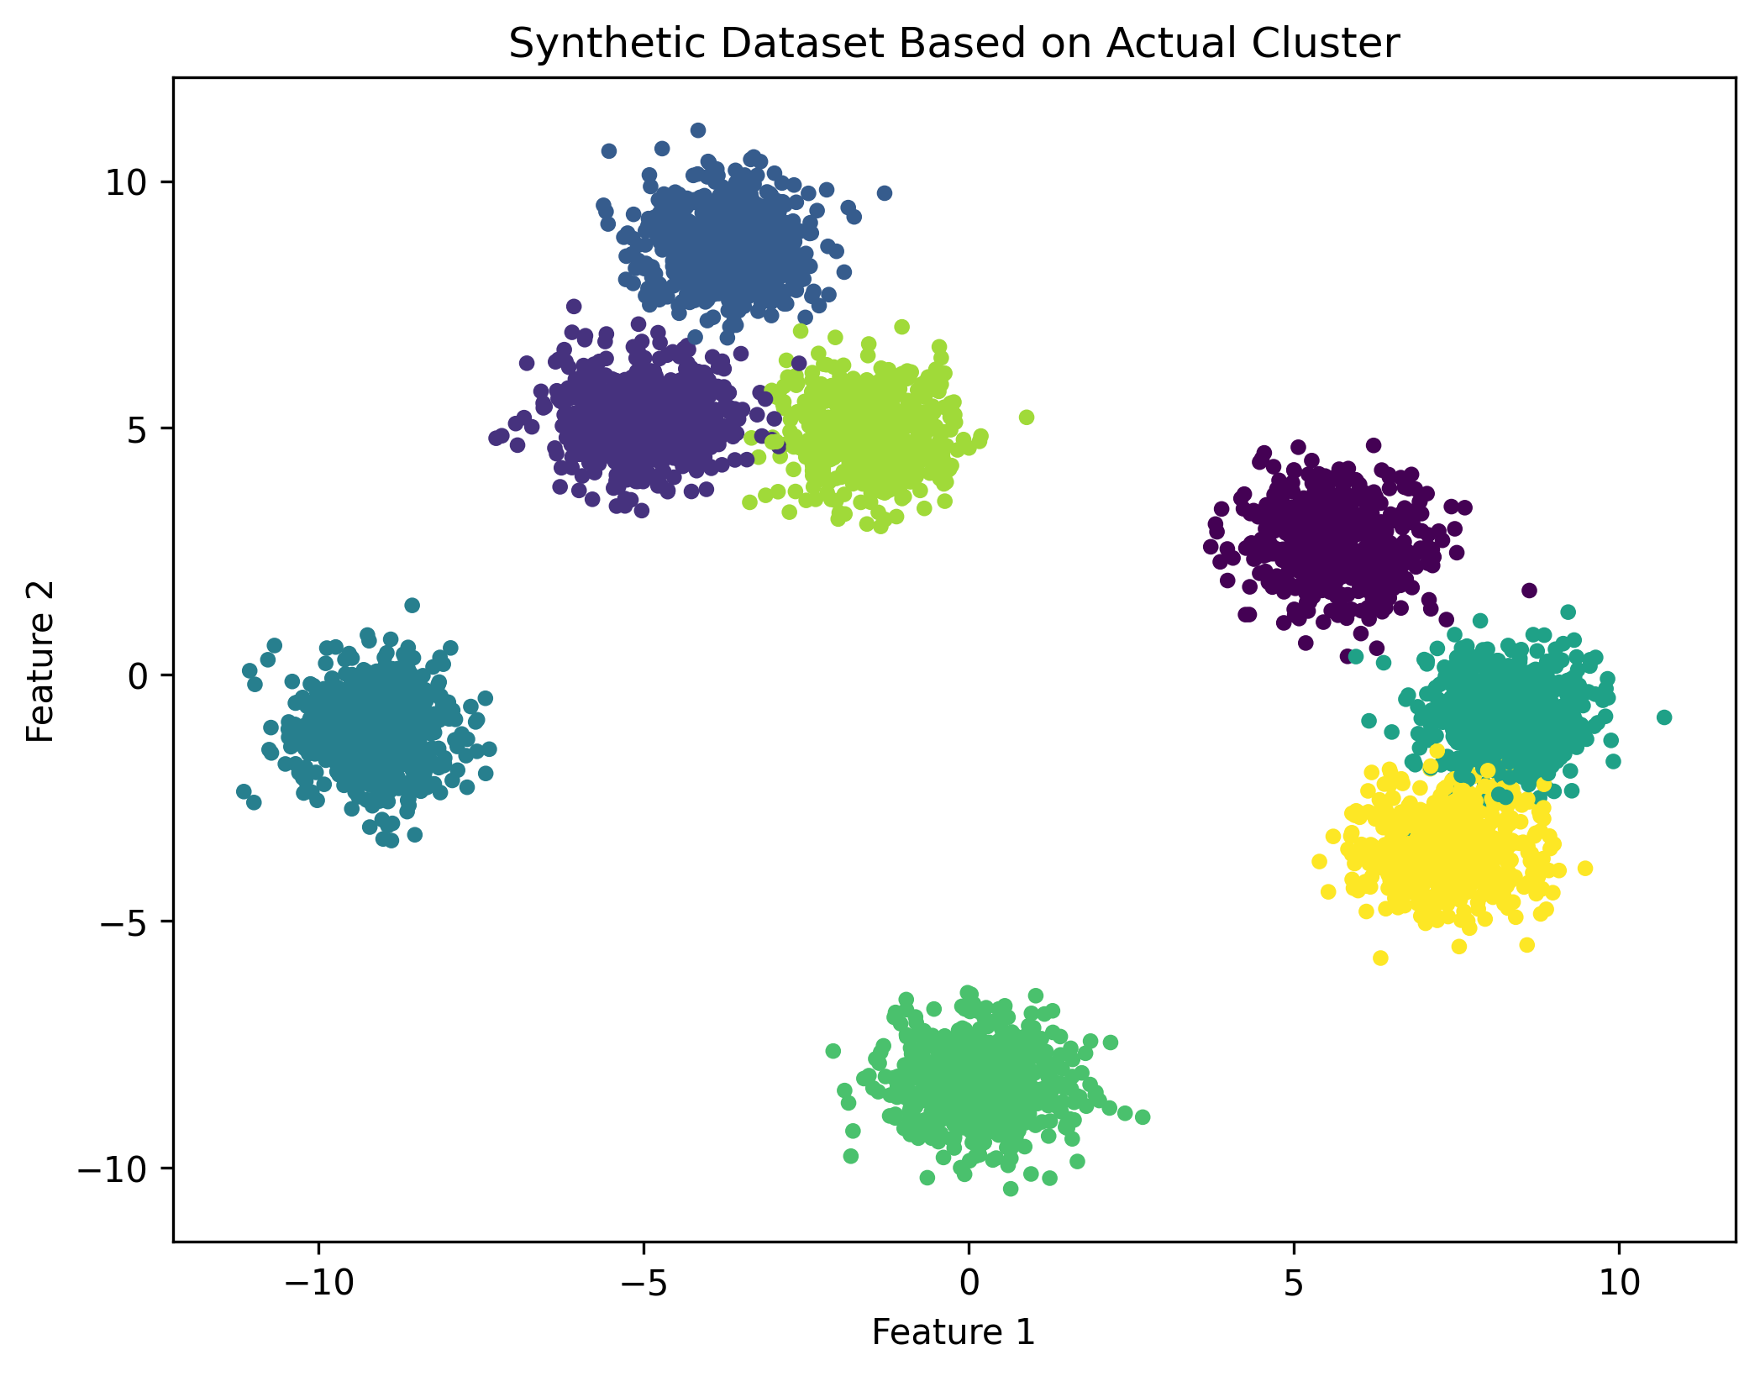
Methodology
A. Dataset Preparation:
Used make_blobs (Scikit-learn) to generate a 2D dataset with 4,500 points spread across 8 clusters.
The standard deviation of clusters was set to 0.70, ensuring moderate overlap between clusters. A fixed random seed (random_state=46) was used to maintain reproducibility.
Each cluster follows a Gaussian distribution, with moderate overlap to test k-means’ limitations.

Slide 7
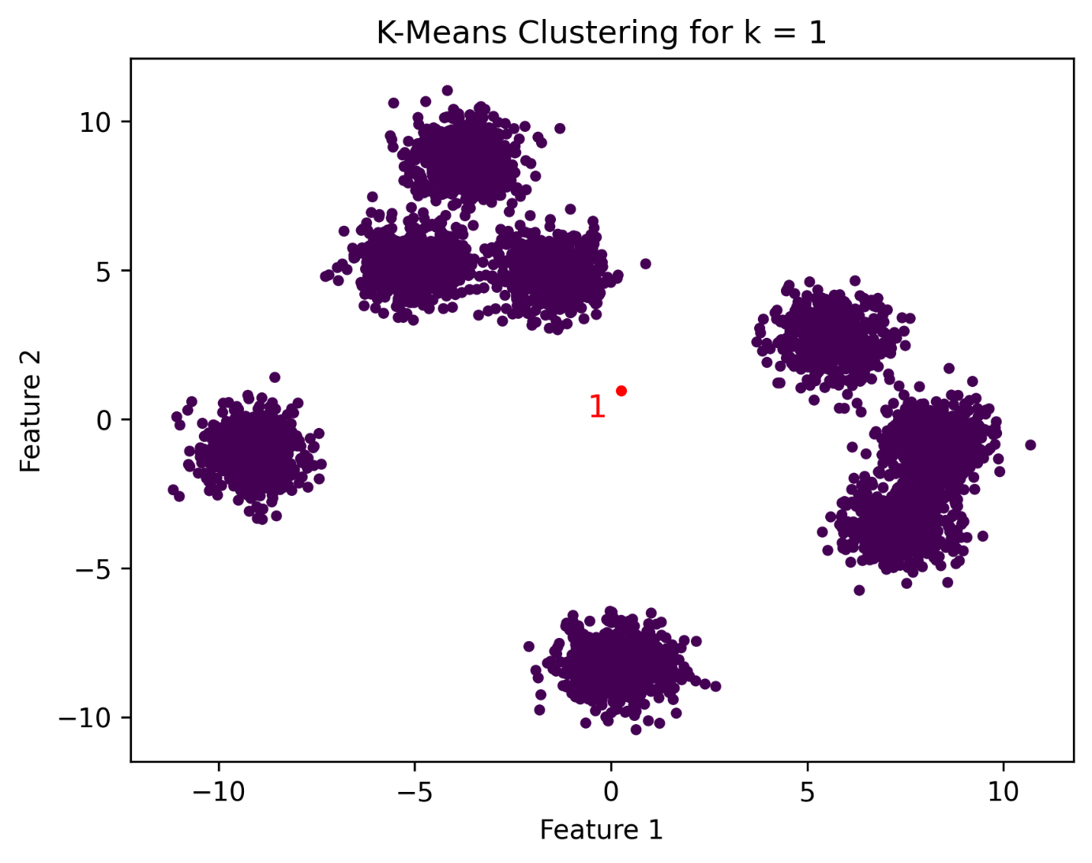
Methodology
B. Initial Clustering:
For this experiment, K-Means is applied first with different k values (1, 3, 5) to show incorrect clusters.
Now If we applied K=1 then, the Cluster will be like this picture.
Traditional K-Means fails to detect optimal clusters when k is misestimated.
Visual representation of initial clustering with incorrect k shows merged clusters.

Slide 8
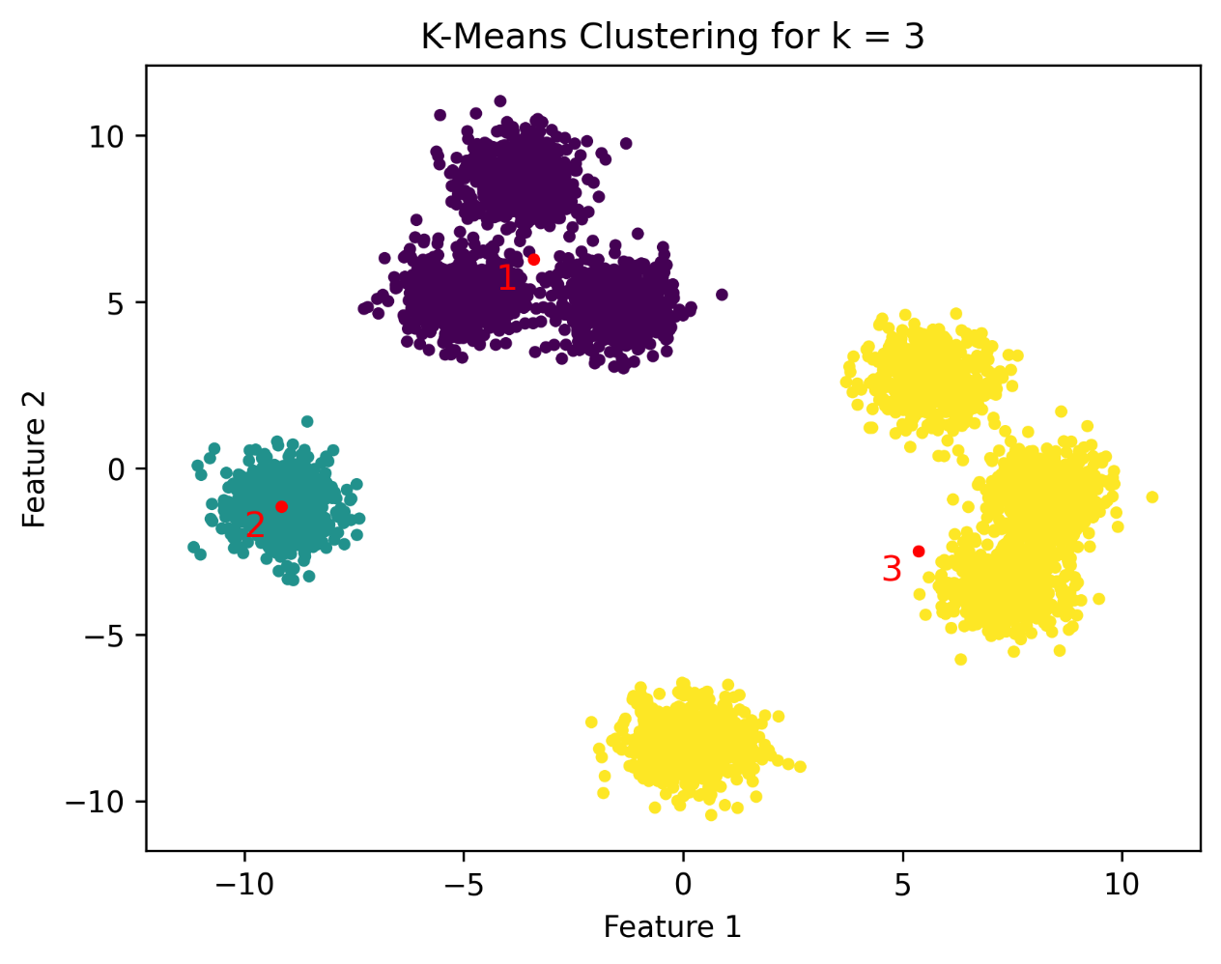
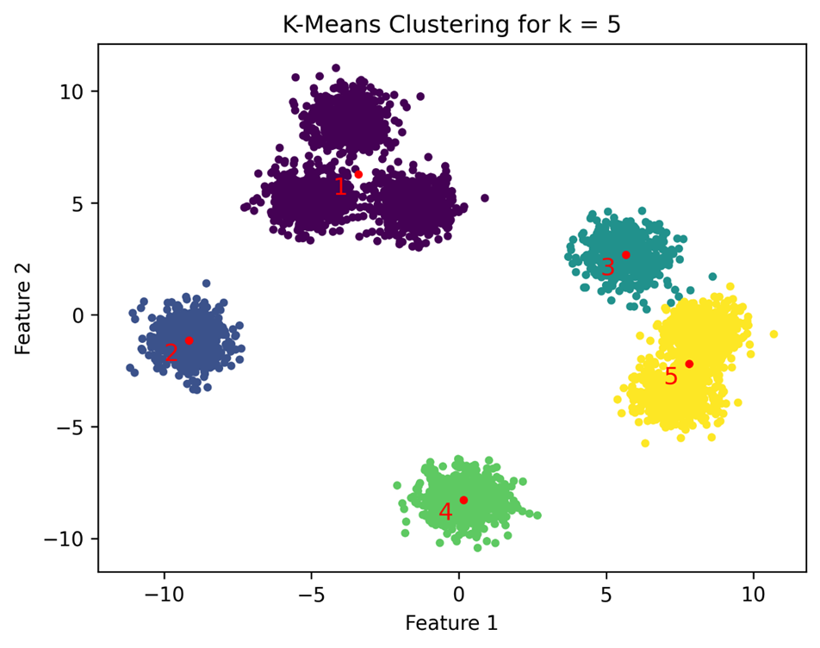
Methodology
Incorrect Clusters for mis-specified k.

Slide 9
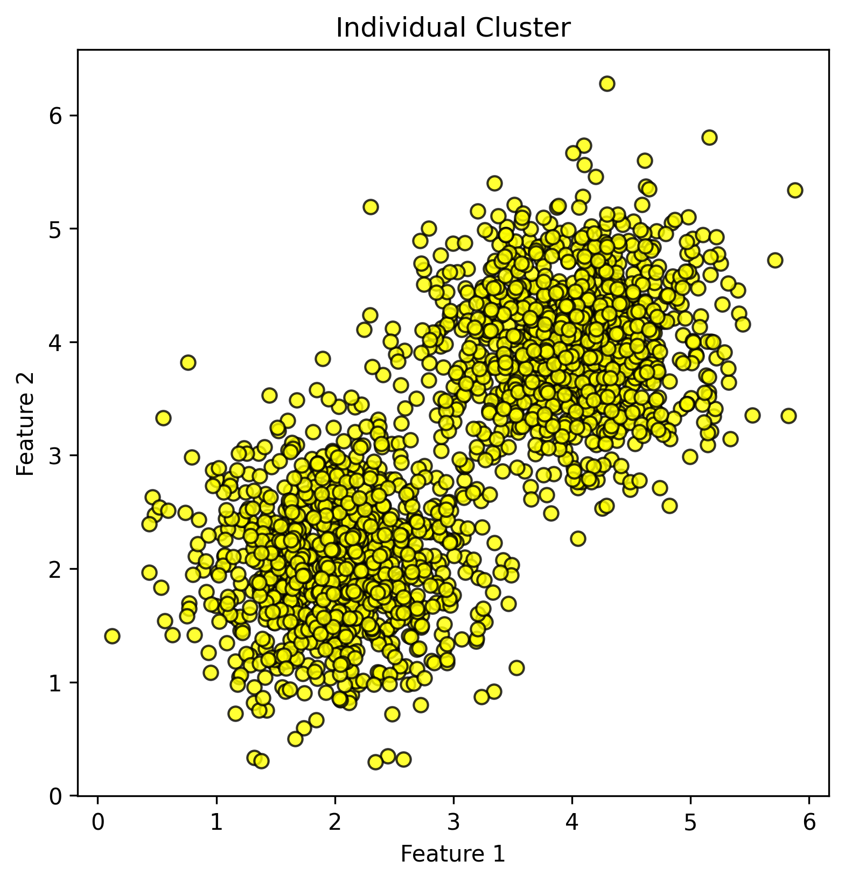
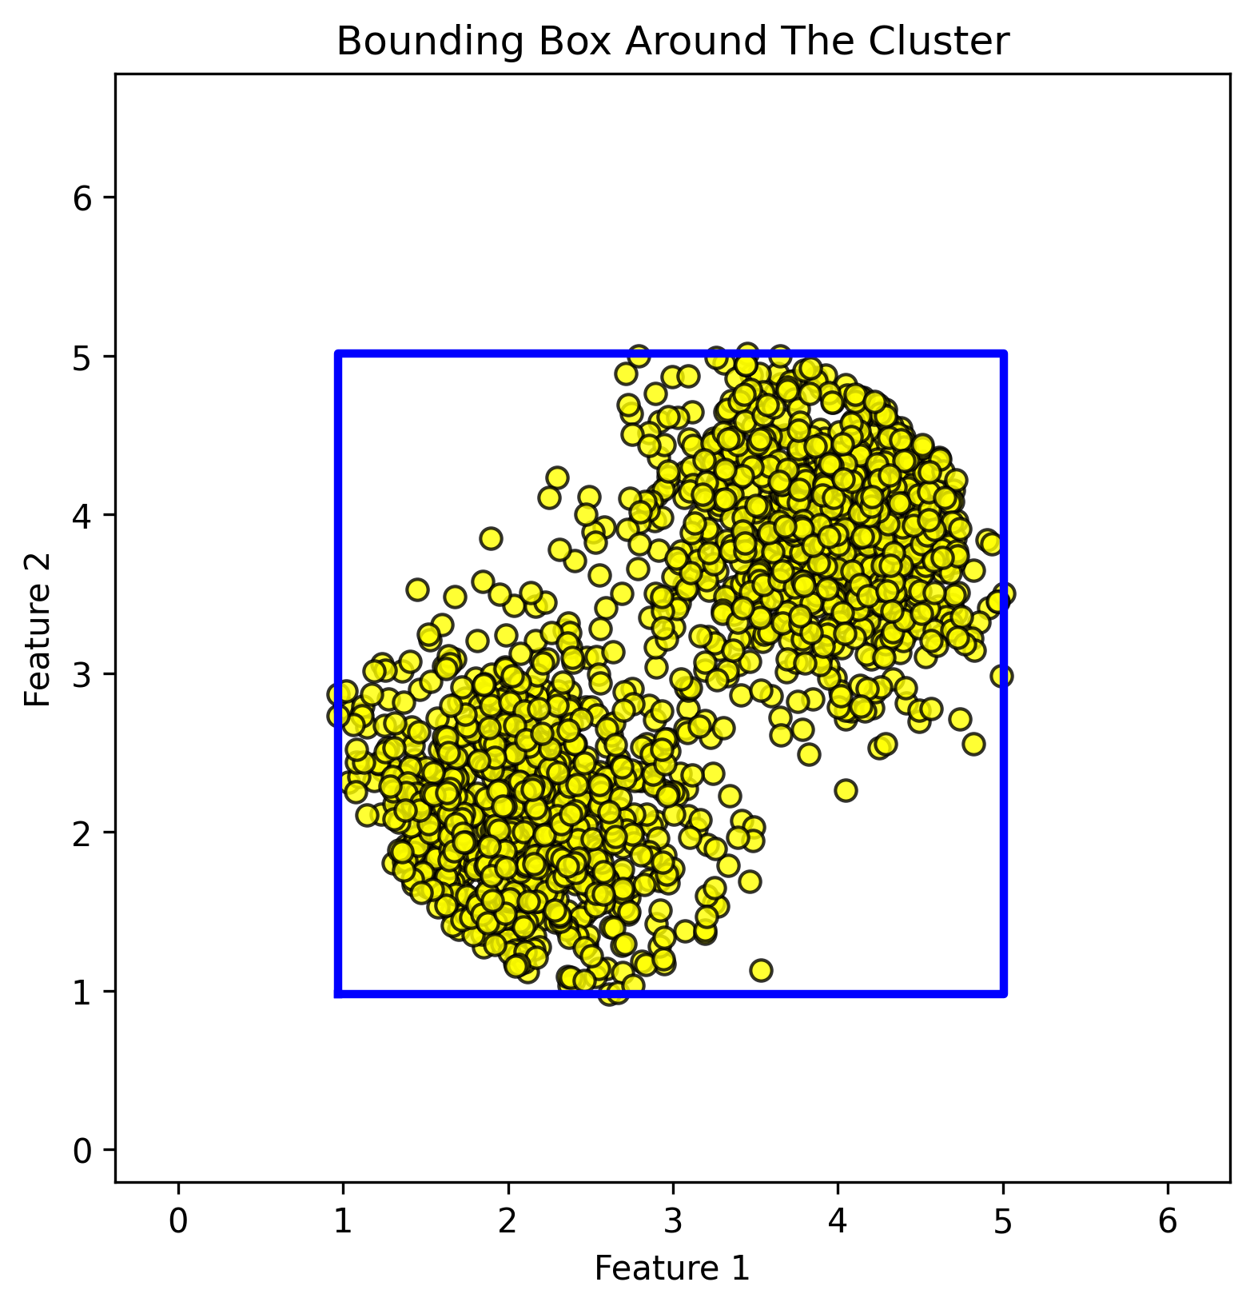
Methodology
C. Outlier Removal and Bounding Box Construction:
Remove outliers & edge points by removing points beyond 1.5σ from the cluster centroid.
Construct bounding box using min/max coordinates of remaining points.
For 2D data points, rectangle coordinates are-(x_min​, y_min​), (x_min, y_max), (x_max, y_min), (x_max ,y_max​)

Slide 10
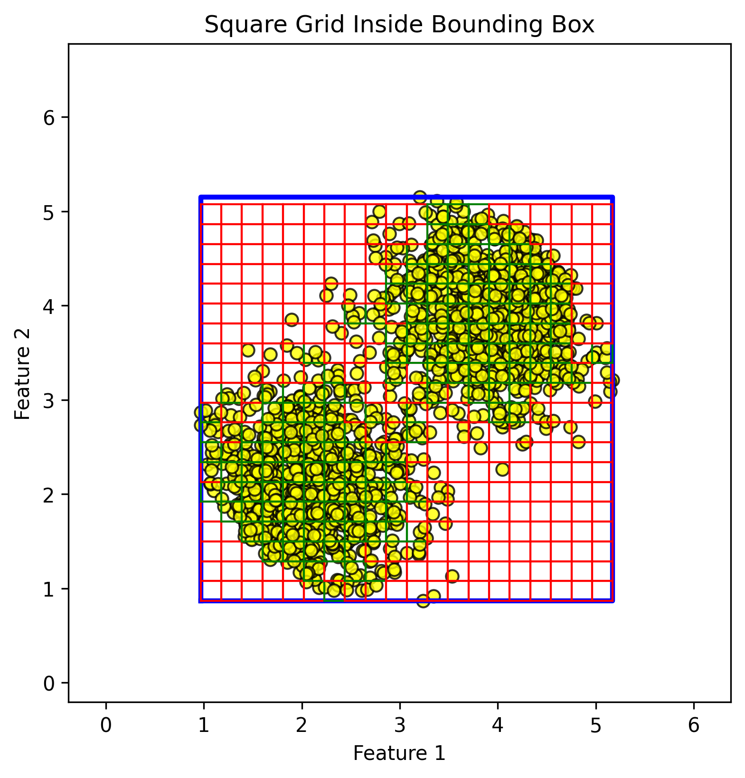

Methodology
D. Density Matrix Generation
Divide the bounding box into a grid of small squares, each with a side length of 5% of the smallest bounding box dimension.
Grid Size=0.05 × min(x_max​−x_min​,y_max​−y_min​)
set a threshold value at 75% of the average cluster density.
Threshold= 0.75 x $x=\frac{Bounding Box Area}{Total Area}$x Square Area
Calculate density for each squares and classify square as 1 if density >= threshold else 0.
Generate a density matrix will the binary classification based on density.

Slide 11
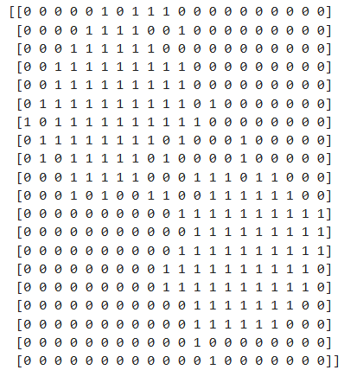
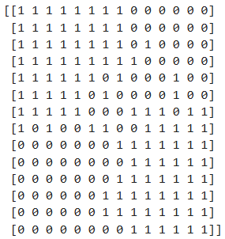
Methodology
E. Low-Density Chain Detection from the Density Matrix
Density Matrix
Trimmed Density Matrix
Edge artifacts are minimized by trimming the outermost 15% of rows and columns.
The core region of the cluster is analyzed for low-density chains (continuous low-density paths).
8-directional Breadth First Search detects connected low-density paths.
A cluster is flagged for splitting if a low-density chain meets either condition:
Top-to-bottom chain spans from the top to bottom edge.
Left-to-right chain spans from the left to right edge.
Presence of such chains suggests multiple subclusters, requiring further subdivision.

Slide 12
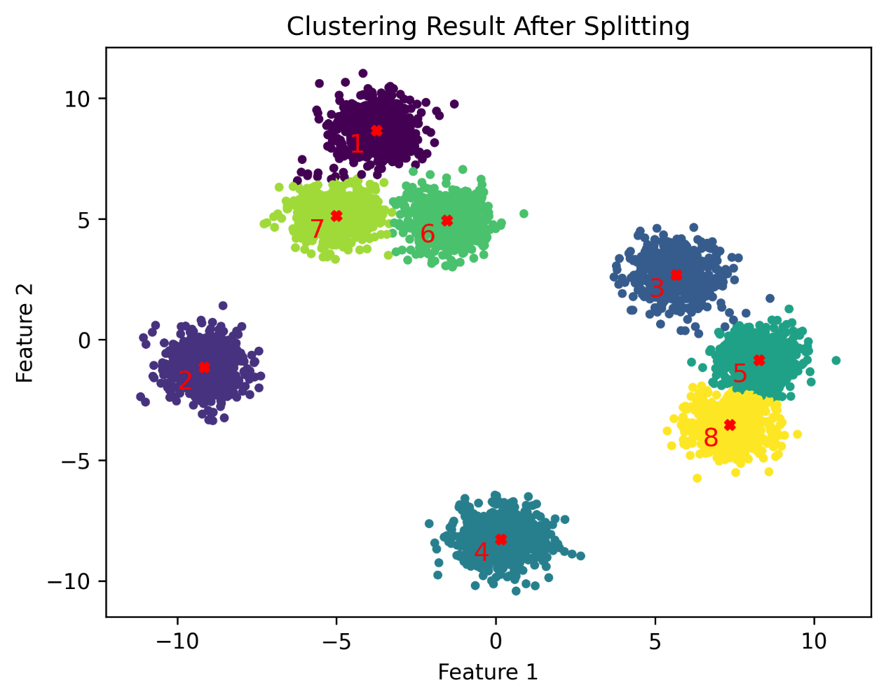
Methodology
F. Recursive Cluster Splitting
Subdivision Using k-means: If a low density chain is found the cluster is split into two subclusters using k-means with k=2. And new label is given to the new cluster.
Recursive Process: Outlier removal, density matrix generation, and chain detection are repeated for each sub-cluster.
Further Subdivision: If low-density chains are found in a subcluster, it is split again.
Iteration: This process continues until no more low-density chains are detected, ensuring correct cluster separation.

Slide 13
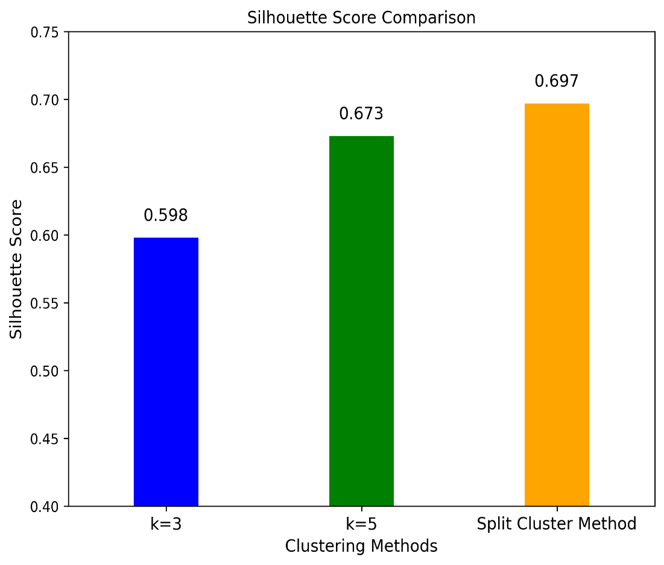
Silhouette Score Comparison
Silhouette scores improved after applying the split-cluster method.
Higher scores indicate better intra-cluster cohesion and inter-cluster separation.
Results confirm the efficacy of the approach in refining clustering outcomes.

Slide 14
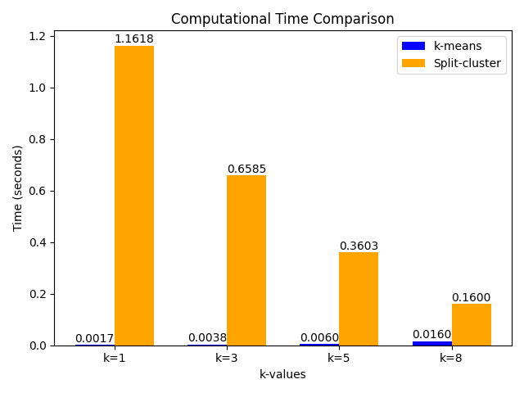
Computational Time Comparison
Computation time increases as value of K rises in initial clustering as its time complexity is O(nkt).
With increasing value of K, split cluster method needs to do less splitting which reduces the required time.
The method took 72 times more time than when k is set as the correct number.
It shows the necessity to optimize the code much more.
Shows unsuitability for large dataset.

Slide 15
Strengths
Effectively addresses the issue of merged clusters, improving clustering accuracy.
Demonstrates consistent recovery of true cluster structures across varying k values.
Gives good output without any additional parameter from the user.

Slide 16
Limitations
High Computational Expense
The split-cluster method is significantly slower than standard k-means, especially for low k values (e.g., k=1).
Processing time can be up to 72 times longer.
Lack of a Merging Mechanism
The method only splits clusters but does not merge over-segmented clusters.
Limited to Two-Dimensional Data
The study experiments were conducted on 2D datasets.
Misclassification of Edge Points
Errors from k-means in assigning edge points persist after the split-cluster process.

Slide 17
Future Work
Optimizing the algorithm for reduced computational cost.
Introducing a merging mechanism to correct over-segmentation.
Extending the approach to higher-dimensional data.
Addressing misclassification issues for better clustering accuracy.

Slide 18
Conclusion
The proposed method refines k-means clustering by detecting low-density boundaries within merged clusters, consistently improving clustering accuracy and silhouette scores. Future work will address over-segmentation, refine edge point handling, and extend the approach to high-dimensional data.

Slide 19
Thank You Any Question?

