Slide 1


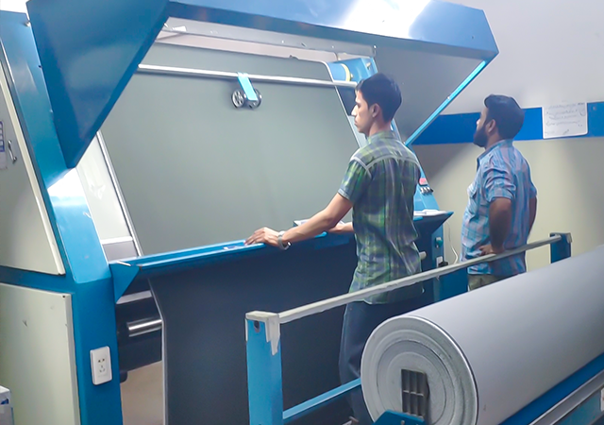








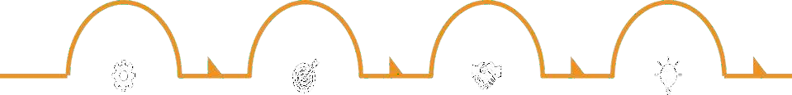


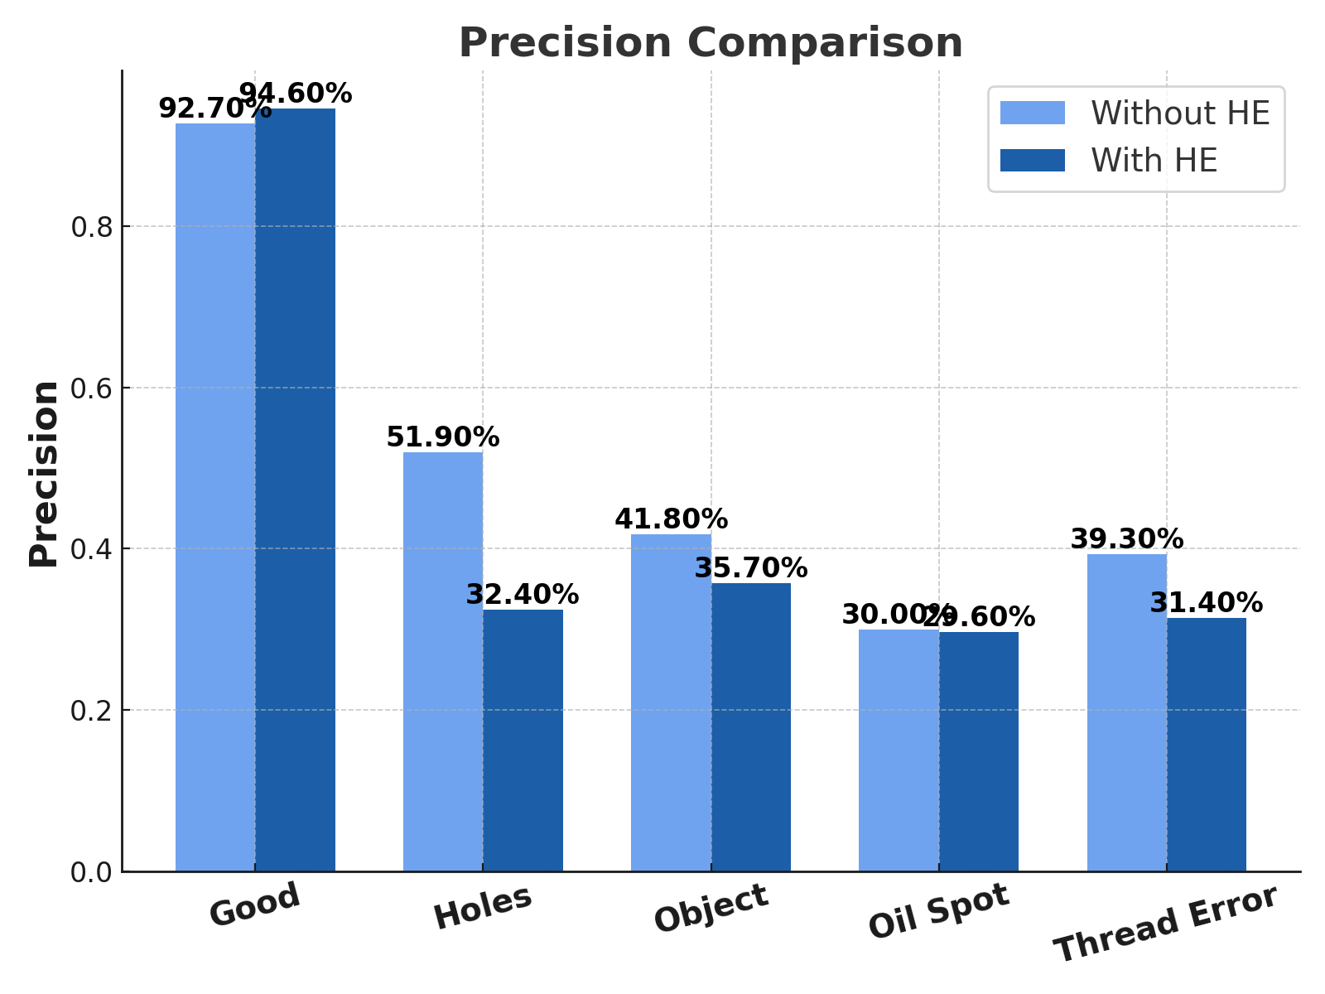
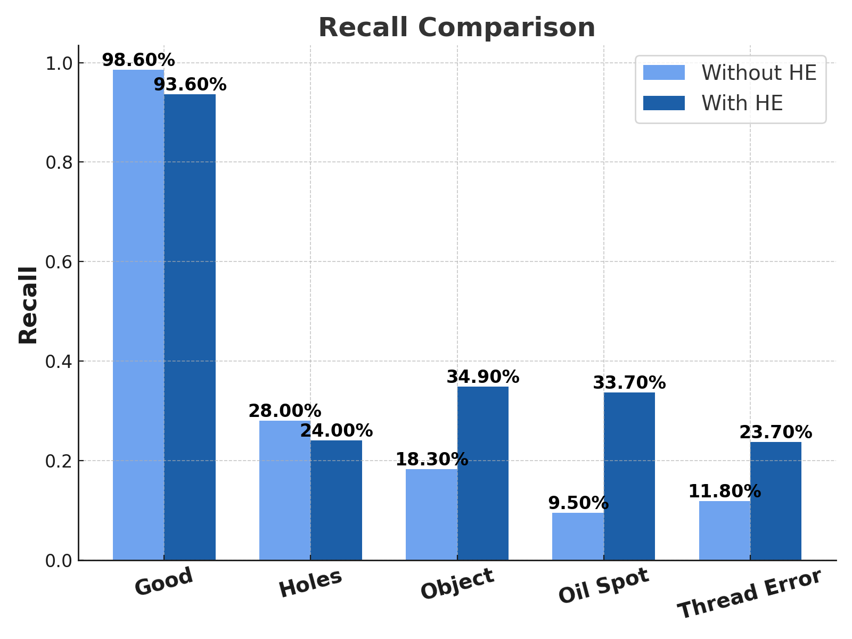
REPLACE THIS BOX WITH YOUR ORGANIZATION’S
HIGH RESOLUTION LOGO
AI-Driven Fabric Defect Detection
Md. Mahir Uddin
Research Methodologies and Technical Writing
Supervisor: Prof. Dr. Khondaker Abdullah Al Mamun
Introduction
Sector Overview
Manual inspection accuracy is only 60-65% with slow inspection rate of only 15 meters/min.
Prone to human fatigue.
Additional step increases cost.
CNN reduces cost to 1/10th
Achieves 90%+ accuracy.
8-12% fabric is rejected.
Global Textile Industry Market Size
$ 1.7T
Bangladesh Export in
FY 24
$ 40B
Global Textile Industry in 2030 to become
$ 3.0T
Bangladesh Export Target in 2030
$ 100B
Existing Works
Rejected Fabric due to Inferior Quality
$ 136B
Bangladesh Market Share in Apparel Export
7.4%
Various approaches have been developed, ranging from statistical and traditional machine learning models to deep learning-based methods.
Among these, Convolutional Neural Networks (CNNs) have demonstrated the highest accuracy, achieving up to 99% defect detection accuracy.
Several companies have already commercialized AI-powered fabric inspection solutions:
1. WiseEye (Hong Kong)
2. Oshima Eagle AI (Taiwan)
3. Brightpoint.AI (India)
These solutions claim to achieve 95%+ accuracy, significantly improving defect detection efficiency in the textile industry.
Challenges & Gaps
Detection Challenge in Yarn-dyed Fabrics
Difficulty in Detecting Print Faults
Challenge in Fabric Surface Variability
Real-time Computation Delay:
Models struggle with unseen yarn-dyed or designed fabrics due to insufficient pattern diversity in training, causing misclassification.
Variations in print quality, color mismatches, and misalignments make detecting defects in printed fabrics highly challenging.
Folds, textures, and 3D designs confuse models by resembling defects, requiring advanced techniques for accurate detection.
Deep learning models' high computational requirements may cause delays, hindering real-time defect detection in high-speed production lines.
2
Methodology
Results
Model's precision and recall performance with and without Histogram Equalization (HE) across different defect categories are shown below:
The overall accuracy of the model was 90.2% without Histogram Equalization (HE), but it dropped to 87.1% after applying HE. While this decline in accuracy is notable, the recall for low-contrast defect classes, such as 'Objects,' 'Oil Spot,' and 'Thread Error,' showed significant improvement due to the contrast enhancement effect of HE. However, the recall for the 'Good' fabric class slightly decreased, as the model became less likely to classify everything as 'Good,' contributing to the reduced overall accuracy as 'Good' fabric constitutes around 90% of the dataset. Despite the drop in overall accuracy, which is influenced by the imbalanced dataset, HE demonstrated a considerable improvement in defect classification, especially for low-contrast defects, indicating a trade-off among overall accuracy decreases and higher defect classification.
01
Collected a dataset of 25,600 fabric images across five defect categories.
Normalized pixel values to a 0–1 range to standardize input for the CNN model.
05
Dataset Preparation
Normalization
Dataset Preparation
02
Converted images to gray scale to reduce computation complexity and focus on texture.
Used ResNet-50, a deep CNN architecture, for feature extraction and classification.
06
Gray Scale Conversion
Model Selection
03
Applied Gaussian filtering to remove noise and enhance defect visibility.
Trained the model with 85% of data, validated with 15%, & optimized hyperparameters for improved accuracy.
07
Noise Removal
Training & Testing
04
A contrast enhancement tool to increase contrast among defected good regions.
Trained the model with 85% of data, validated with 15%, & optimized hyperparameters for improved accuracy.
08
Histogram Equalization
Result Evaluation
Outcome
Improved Accuracy Enhances defect detection by reducing misclassification, especially for low-contrast defects..
01
Reduced Wastage & Rejection Detects defects at an early stage, preventing faulty fabric from progressing through production.
04
Cost Reduction Lowers cosautomating defect ts to 1/10th by detection, eliminating the need for manual inspection by labor.
02
Reduced Step Eliminates one entire inspection step, streamlining the quality control process.
05
Faster and Efficient QC: Automates defect detection, significantly reducing inspection time compared to manual methods.
03
Real Time Detection And Monitoring Enables on-the-spot defect identification, improving quality control and process optimization.
06

