Slide 1
A FULL STACK CASE STUDY
Oh My Flix App
by Adam Wróbel

Slide 2
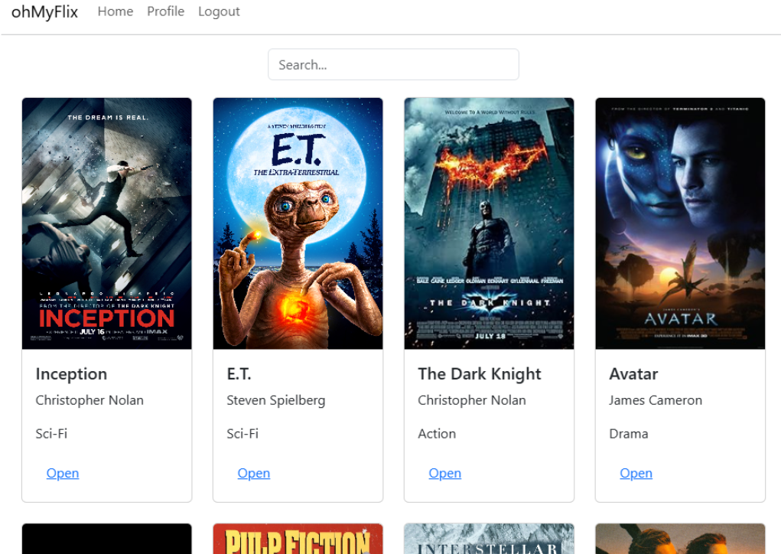
Overview
OhMyFlix is a web application designed with the MERN stack. It provides users with access to information about many movies, including information about the film's directors, genre informations and images. Users can create an account, update their personal information, and save a list of favorite movies.
Source code: GitHub

Slide 3
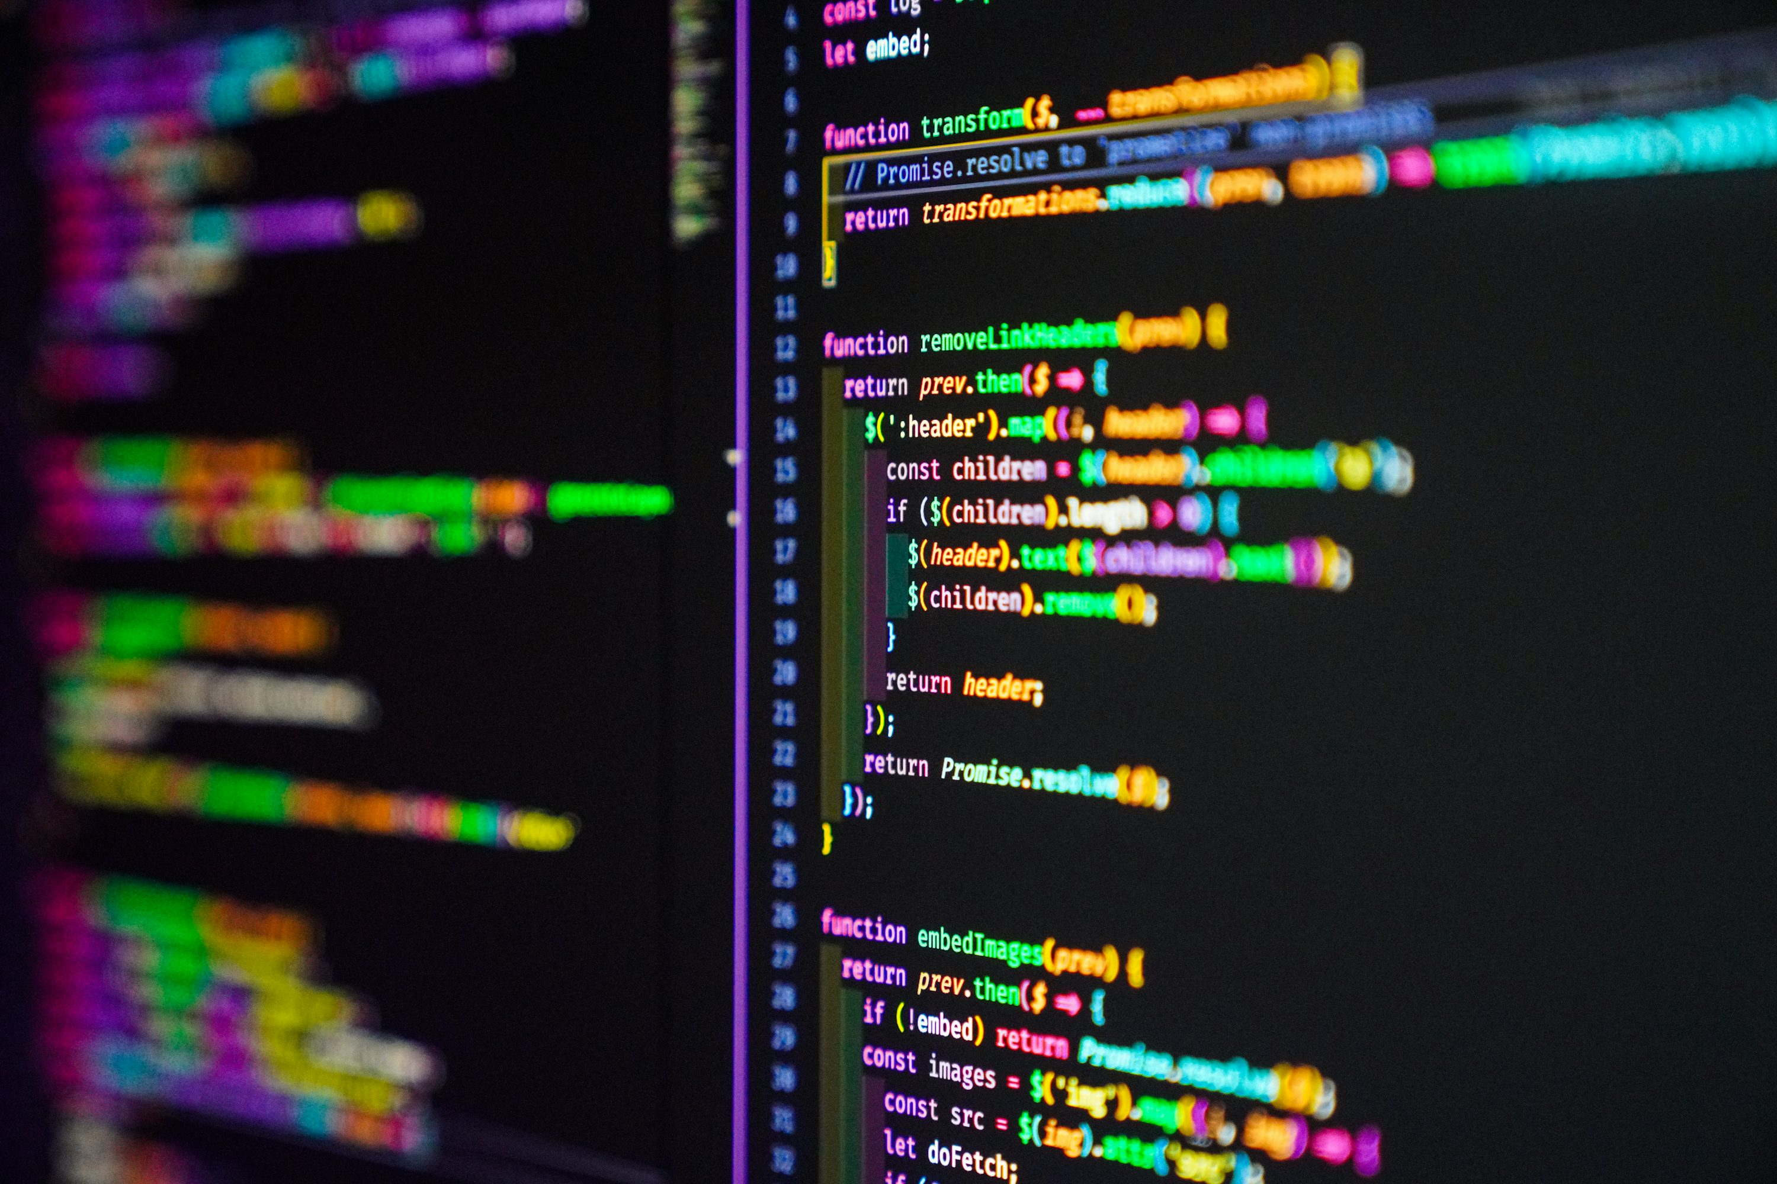
Purpose
This project was created as part of
my web development course at
CareerFoundry to demonstrate
mastery of full stack JavaScript
development

Slide 4
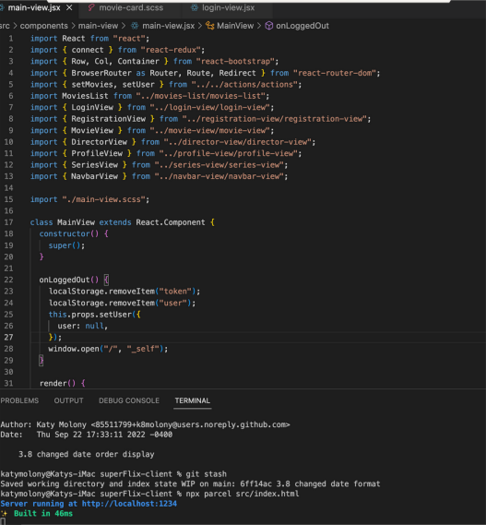
Objective
The aim of the project was to build a
complete server side and client side
web application from scratch to
include in a professional portfolio.

Slide 5

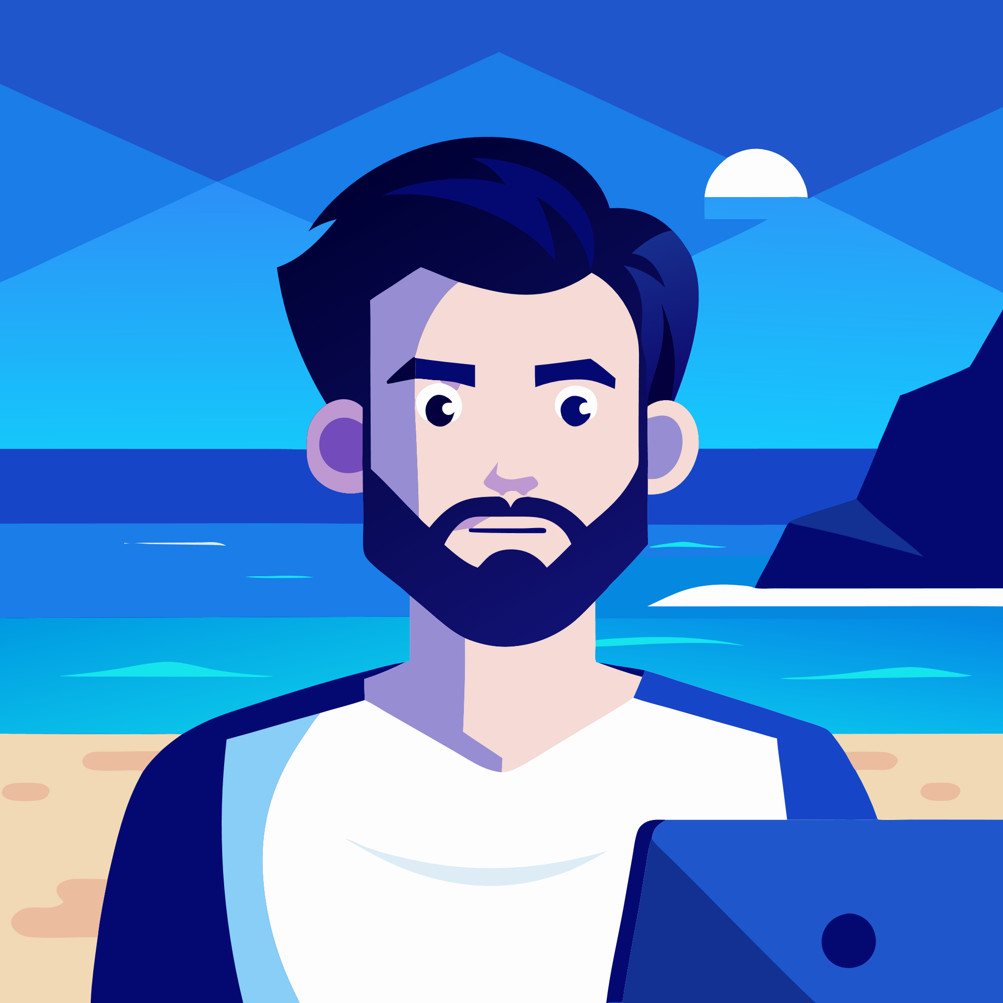


Duration:
Creating the client-side took about twice as long as creating the server-side. I wanted to make sure I had a good grasp on how React and Redux work and achieve the desired result
Credits:
Lead Developer: Adam Wróbel Tutor: Andrew Gad
Mentor: Faizal Patel
Methodologies:
MERN stack
Postman
Heroku
React Bootstrap
Axios
Redux

Slide 6
SERVER-SIDE
1. Basics
I first needed to determine if I wanted a relational or non- relational Database. After testing with PostGreSQL and MongoDB, I chose MongoDB because it is a non-relational database and offers more flexibility.
2. Business Logoic
Next I created models to keep my data consistently formatted and used Mongoose to interact with the database.
I created a RESTful API using Node.js and Express, that interacts with a non-relational database (MongoDB). The API can be accessed via commonly used HTTP methods like GET or POST. To retrieve and store data in the database, CRUD methods are used. The API provides movie information in JSON format.
3. Security
I chose basic HTTP
for initial login paired with a JWT token based authorization to make my site secure. Then, I implemented CORS password hashing and data validation for extra security.
4. Deployment
After testing all endpoints with Postman, I finally used Heroku to deploy my app and MongoDB Atlas to host my database.

Slide 7
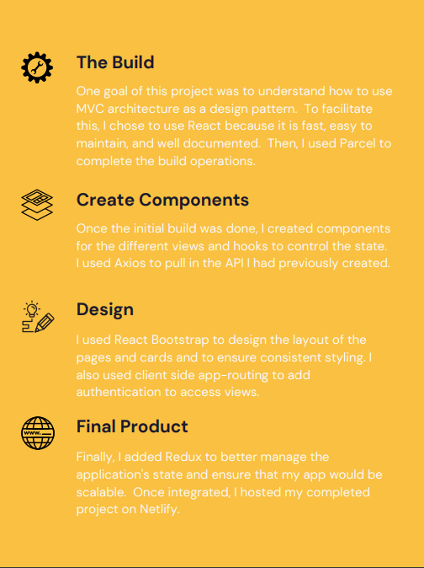
CLIENT-SIDE
After completing the API, I built the interface users would need to interact with the server-side. It is a single-page, responsive application, developed with React. It provides several interface views including a movie view, a login view, a registration view and a profile view (where users can update their user data and list of favorites).

Slide 8
Retrospective
What went well?
I very much enjoyed building the database and setting up the backend. My analytical mind liked to see the order and structure of it, and I was able to fly through that build.
Future development
I would like to continue to build on the
database to include much more movies. I would also like to incorporate some sorting features to order the movies chronologically by setting and release dates.
Challenges.
The biggest challenge was time. Once school got
out and I could devote myself to study, the
pieces all fell into place and things went
much smoother. Plus, by taking my time I
was able to get a fuller understanding of
React and Backend development.
Final thoughts
Overall, I'm quite proud of the product I
produced. Adding Redux was a bit of a
challenge at first, but once I got the hang of
it I really enjoyed working with it and feel like
I have a deep understanding of the full
process of building a website.

Slide 9
Thank You for your time! Adam Wróbel

