Slide 1













PocketGuard
Your Personal Staff

Slide 2
CSE-3120
Course Title: Software Engineering and Information Systems Laboratory
Instructors:
Md Nazirulhasan Shawon
Lecturer
Department of Computer Science and Engineering
Khulna University of Engineering & Technology (KUET)
Argha Chandra Dhar
Lecturer
Department of Computer Science and Engineering
Khulna University of Engineering & Technology (KUET)

Slide 3
Application Overview
User Registration and Login
Transaction add/Update/Delete Panel
Setting a Goal
Setting a Budget
Parental Control
Recommended Sites with Bookmarks Facility
User interaction using Firebase Push Notification
Working on Foreground Notification of our App
Setting implementation with security

Slide 4
Application Overview
10. User Registration and Login
11. Interactive launching activity
12. Our competitor showed and fetched from JSON
13. Transaction Invoice are saved into server and fetched
14. We have performed different types of testing
15. We have added different types of design pattern
16. We have used Javadoc for the documentation
17. Take Decision/Guide from AI

Slide 5
Making It More Professioonal:
Master Branch
A
Totally Different Account
plaban46
Account 1
Branch: Plaban_das
Git UserName: plabandas
Roll: 2007111
Branch: choyan
Git UserName: VE-NOM101
Roll: 2007101
Branch: mahir
Git UserName: Mahir118
Roll: 2007118
Account 3
Account 4
Account 2

Slide 6
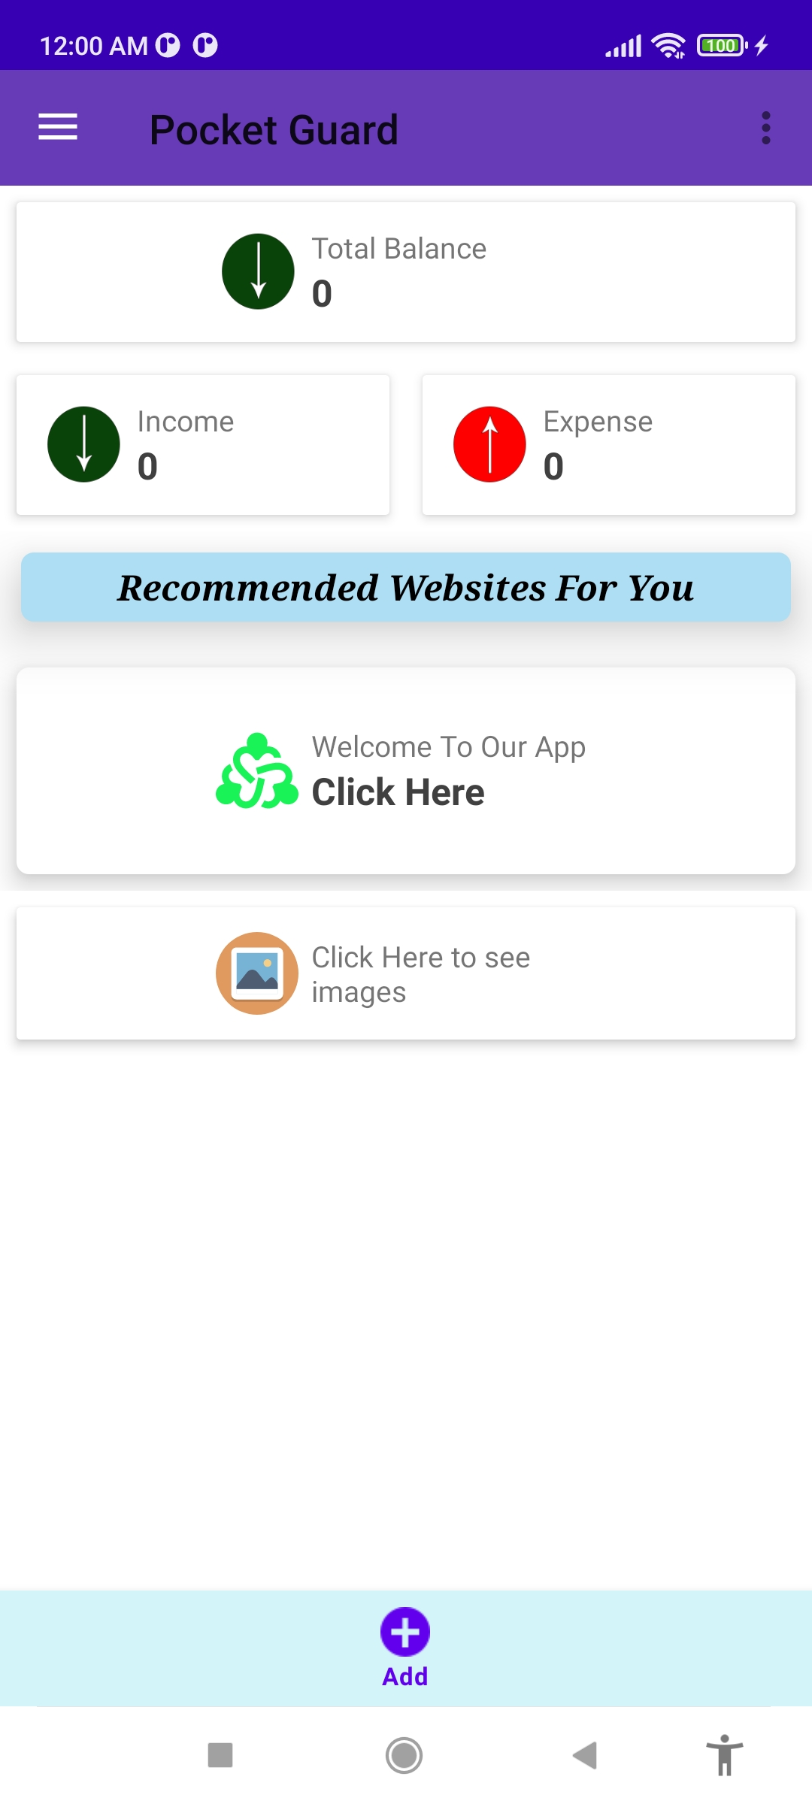
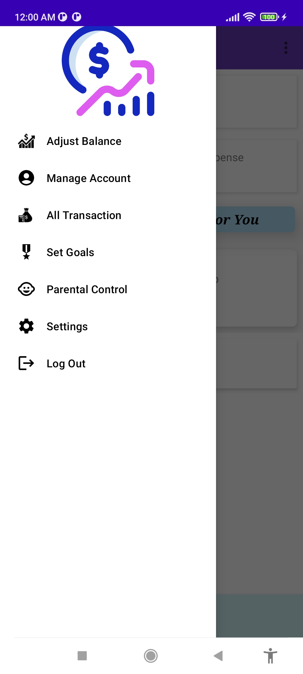
App Preview:
User Dashboard

Slide 7
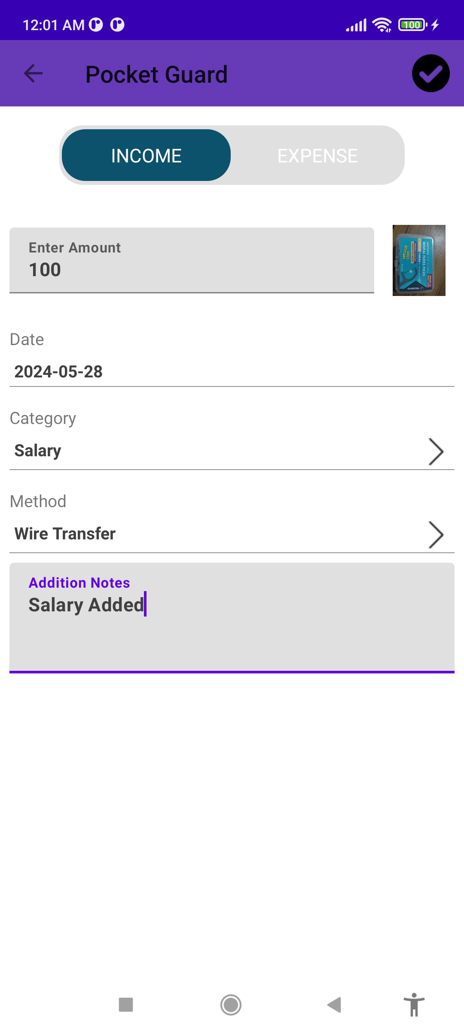
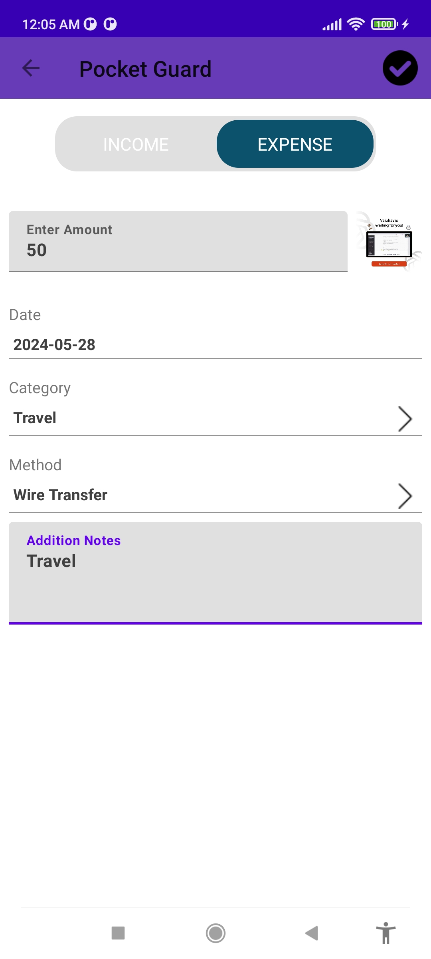
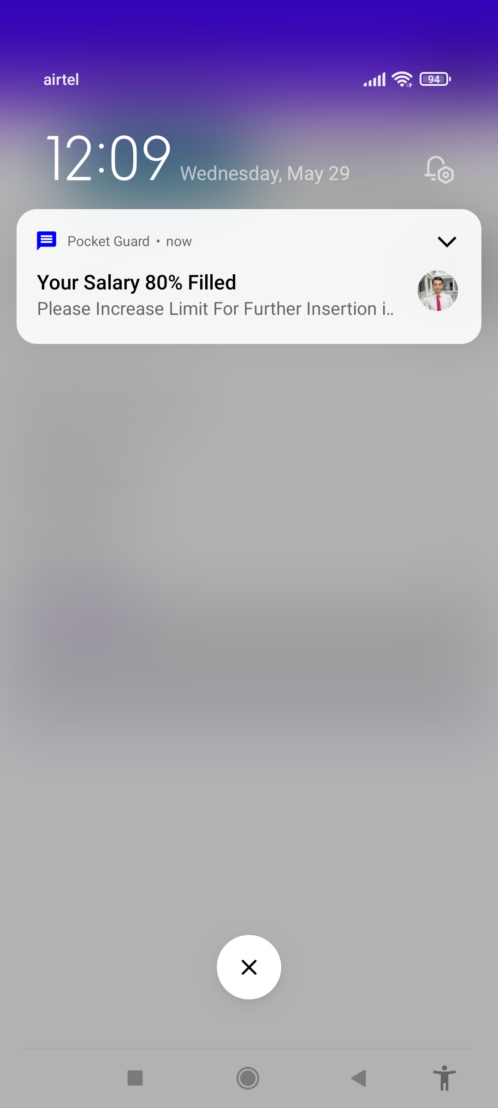
Add Income Expense Activity

Slide 8
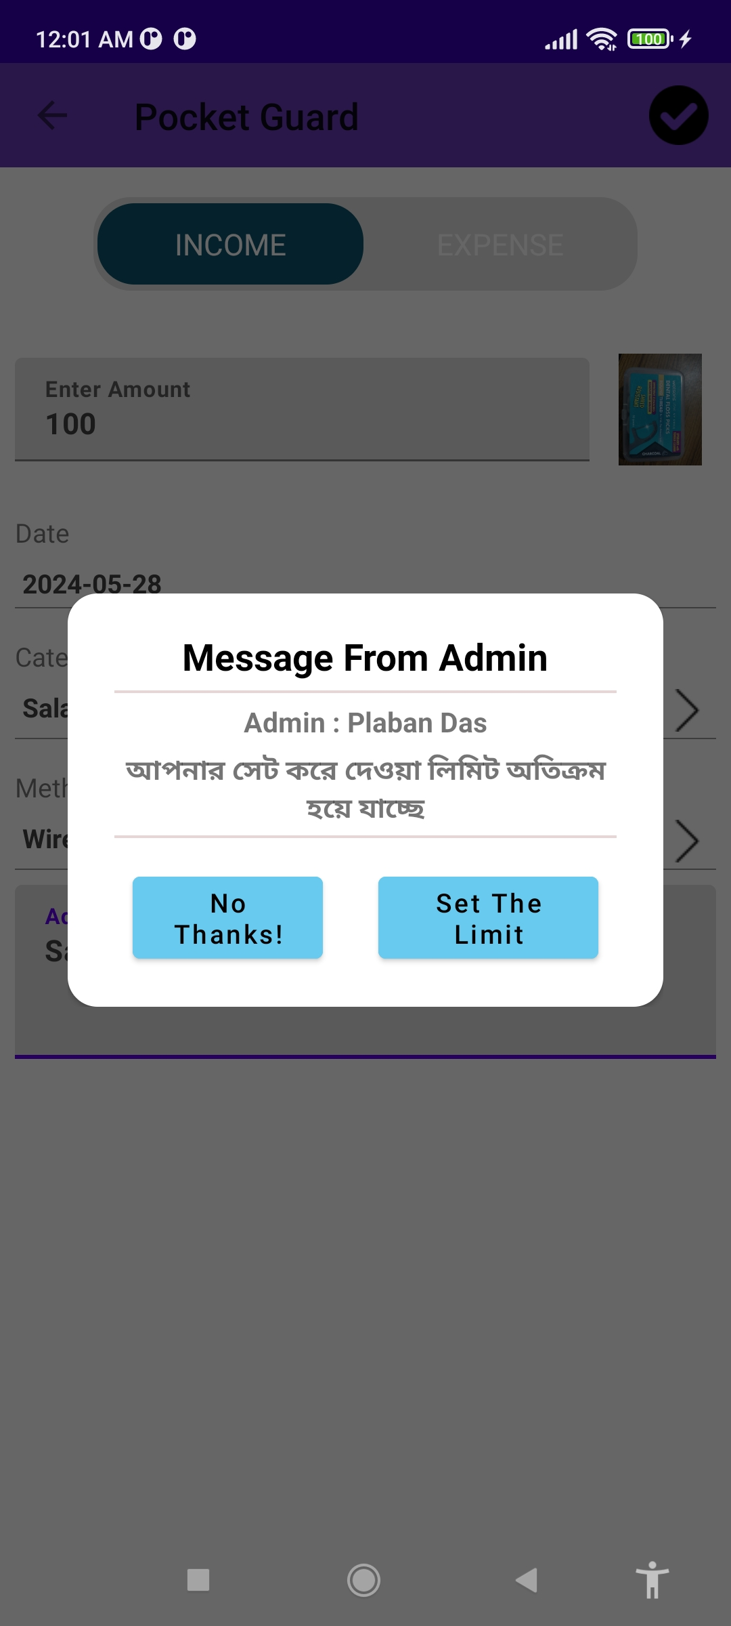
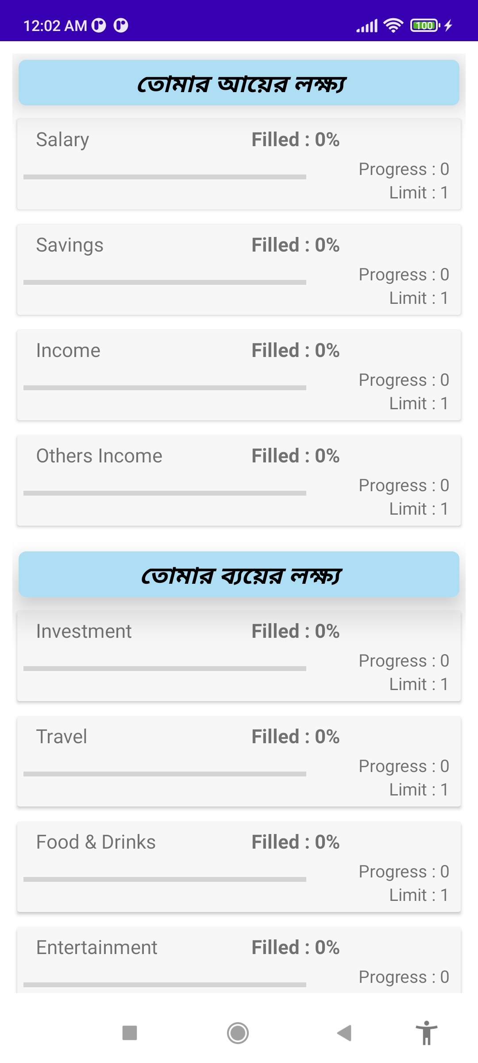
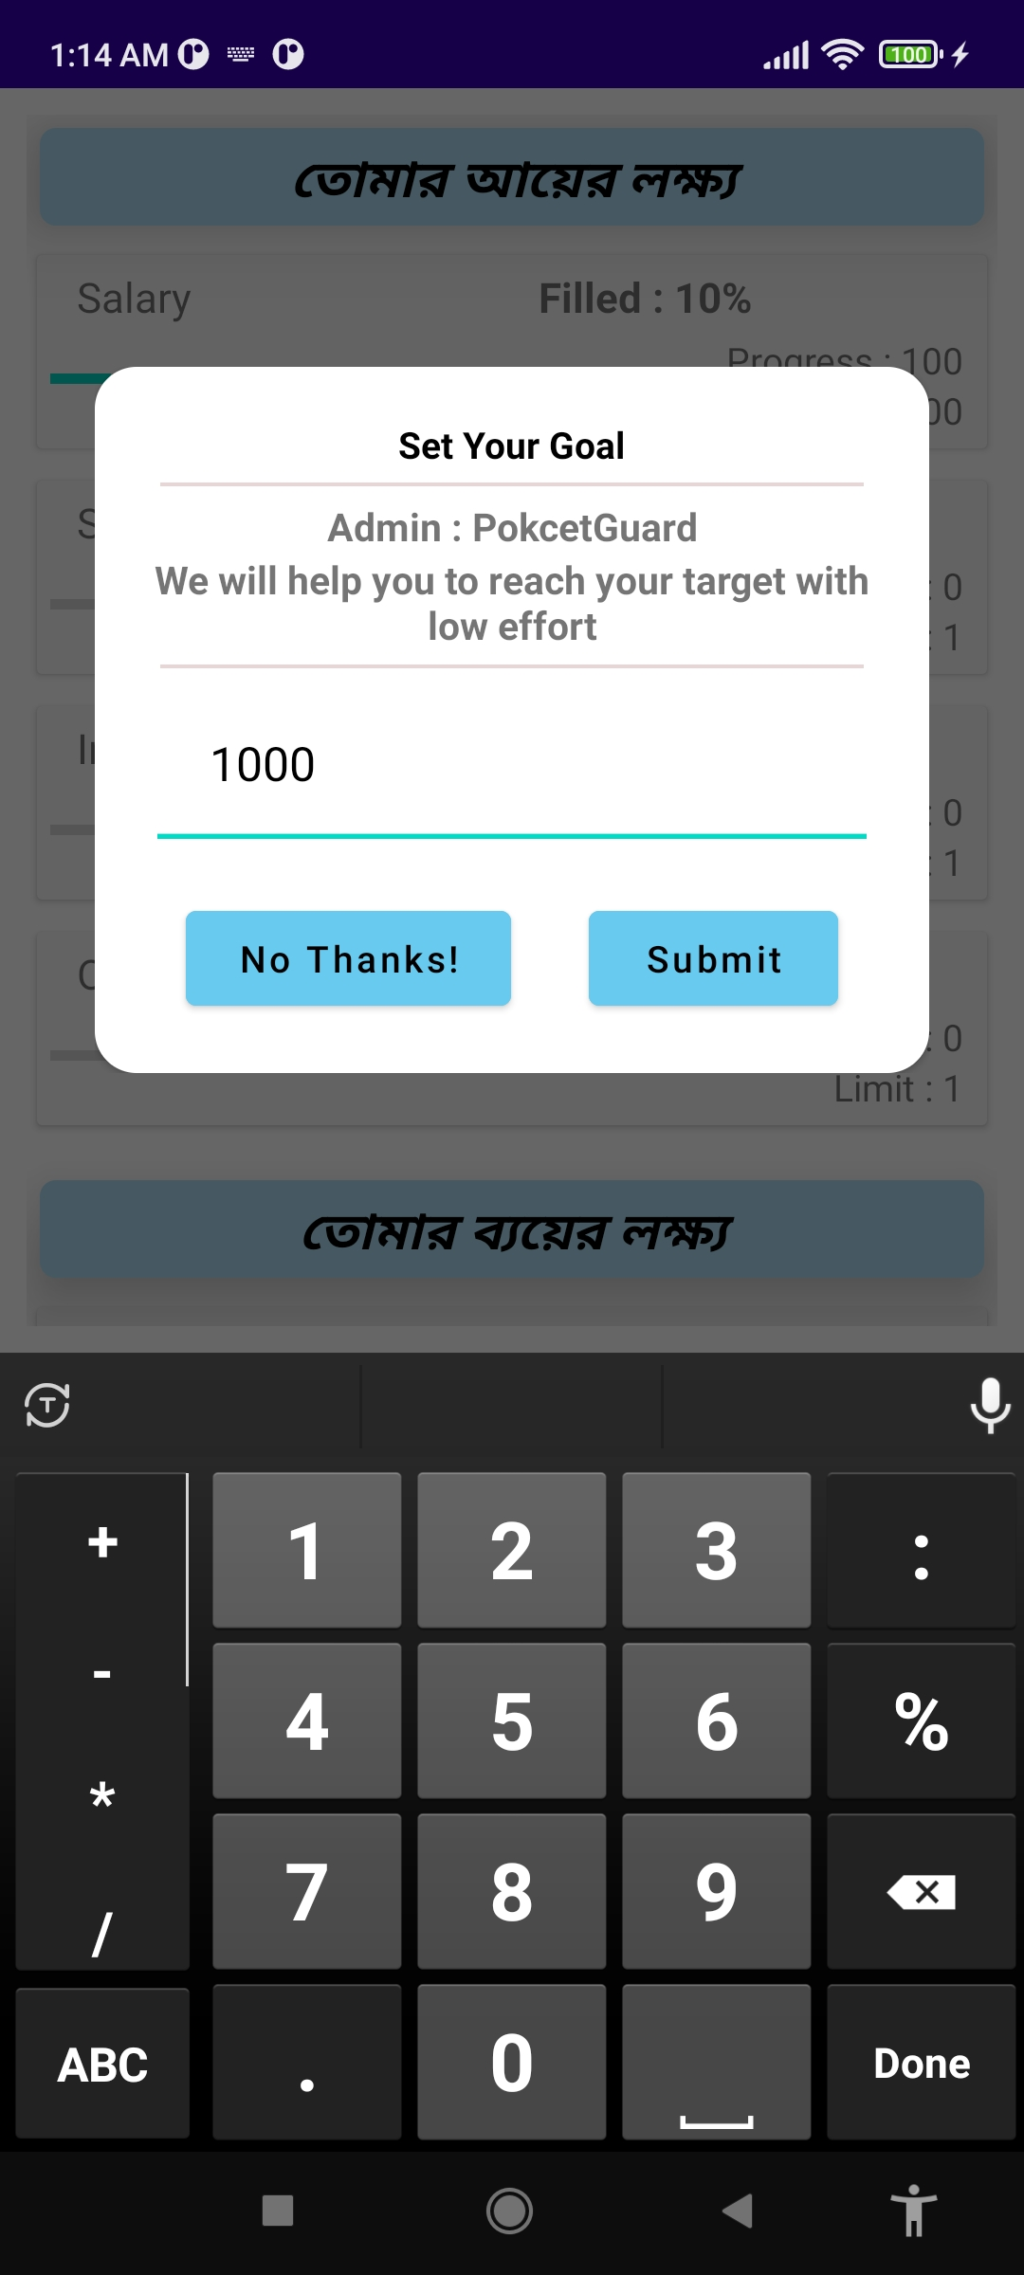
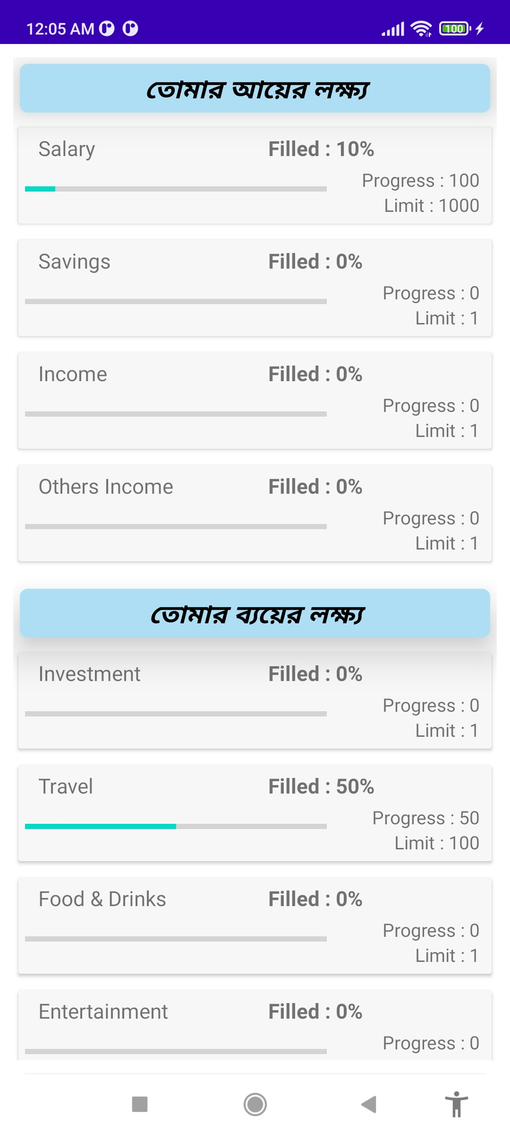
Goal And Budget

Slide 9
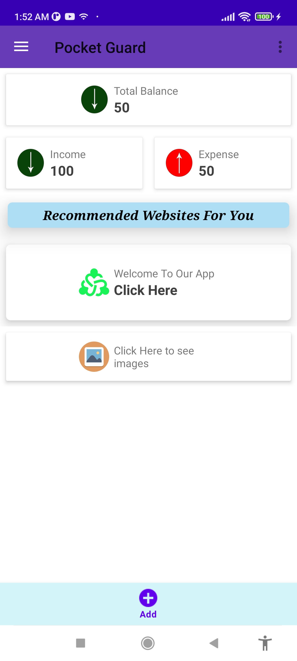
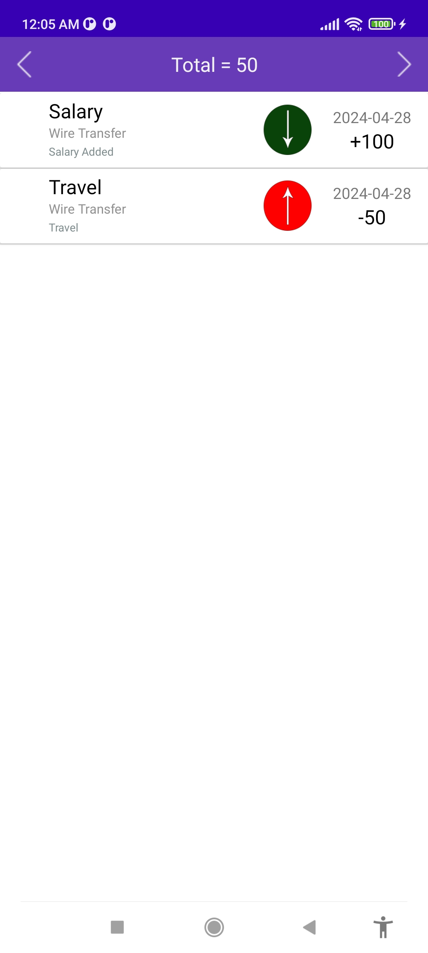
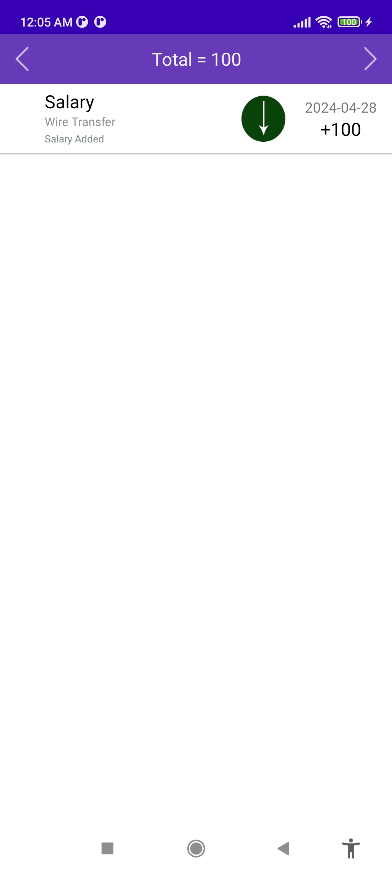
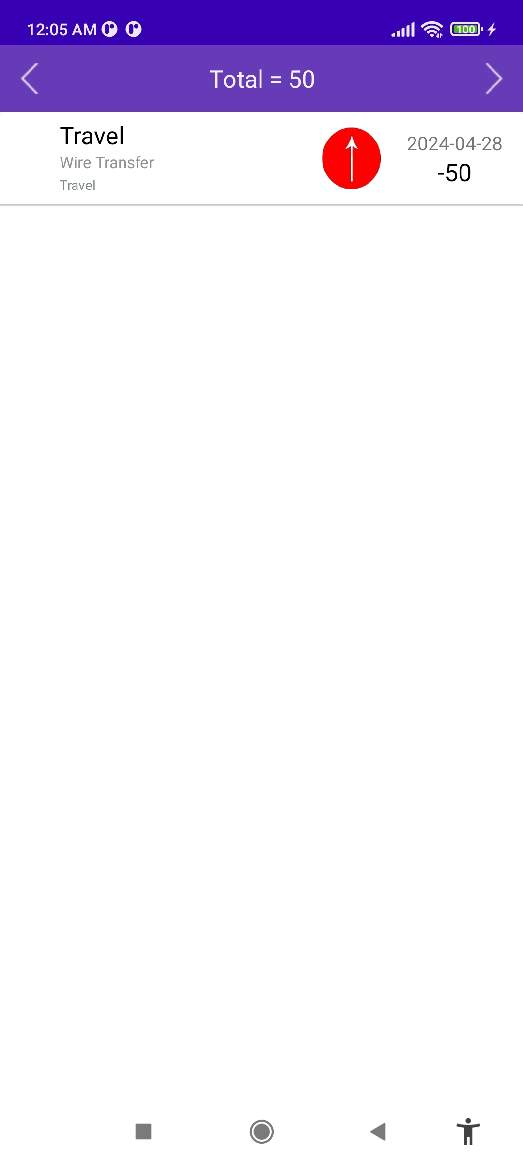
Transaction History

Slide 10
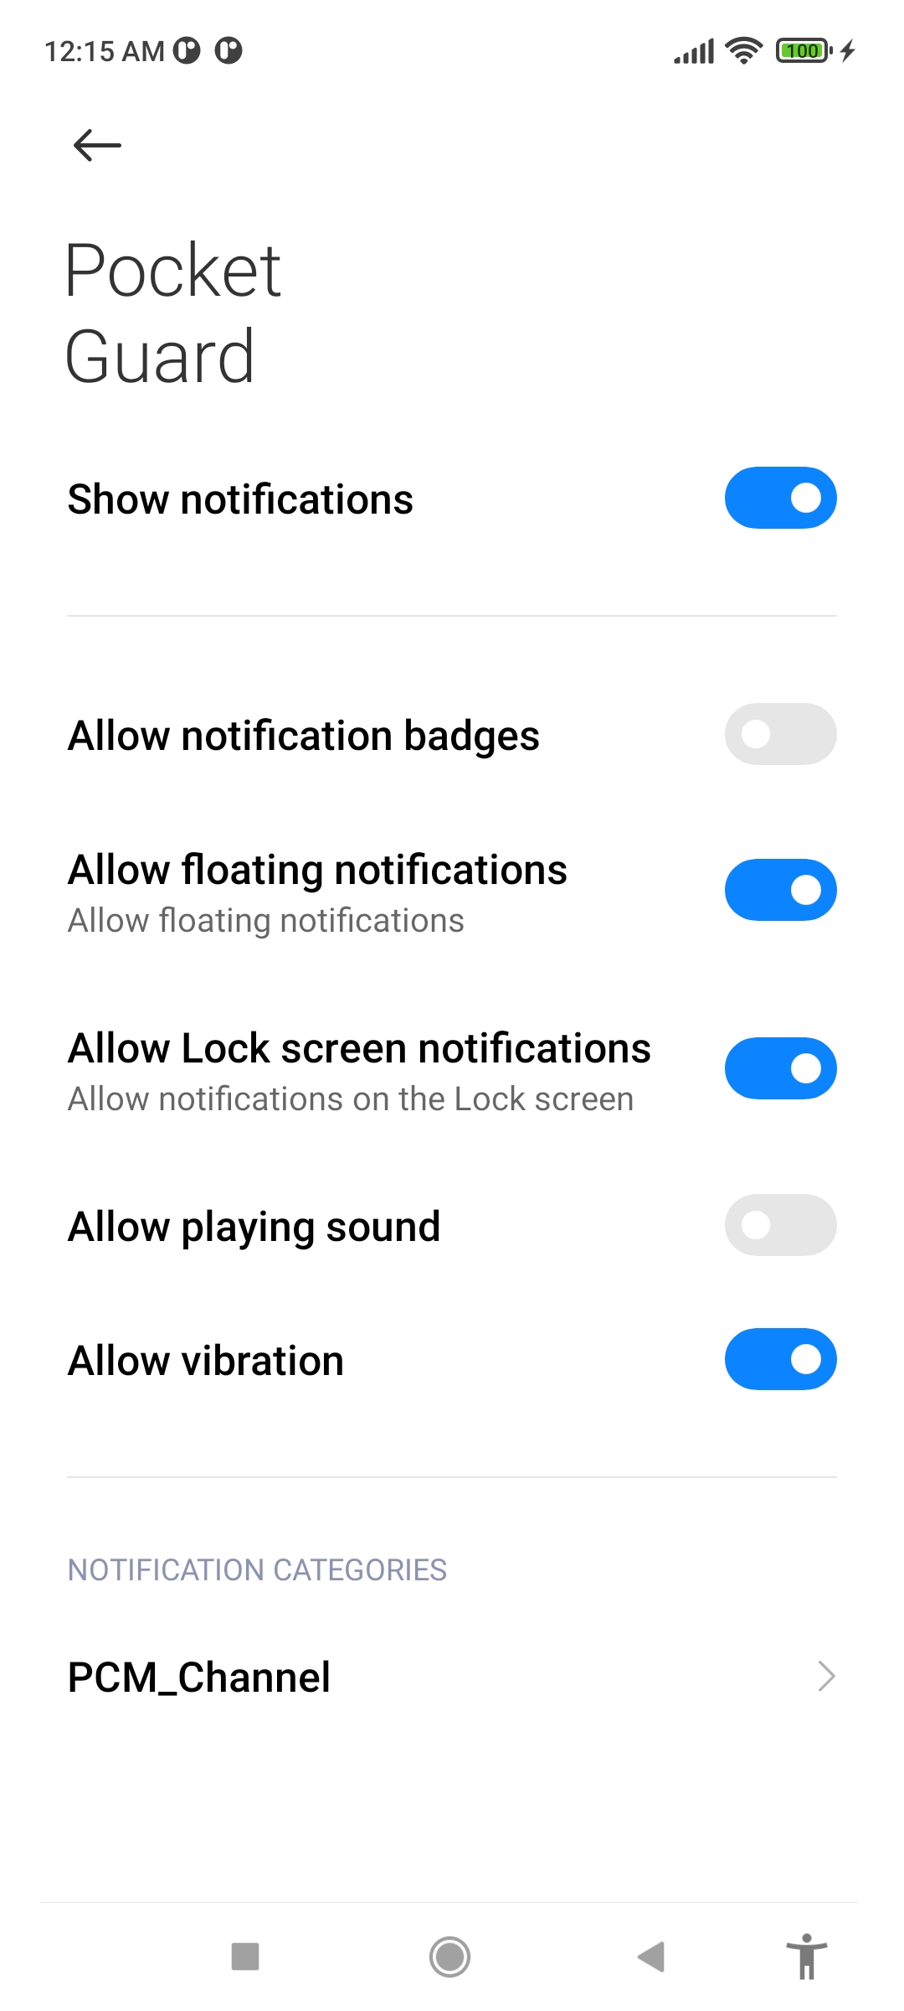
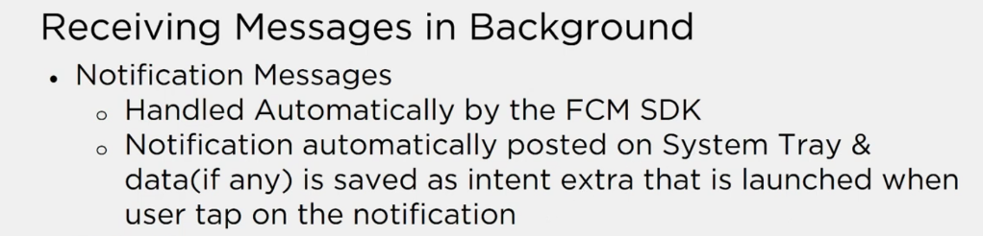
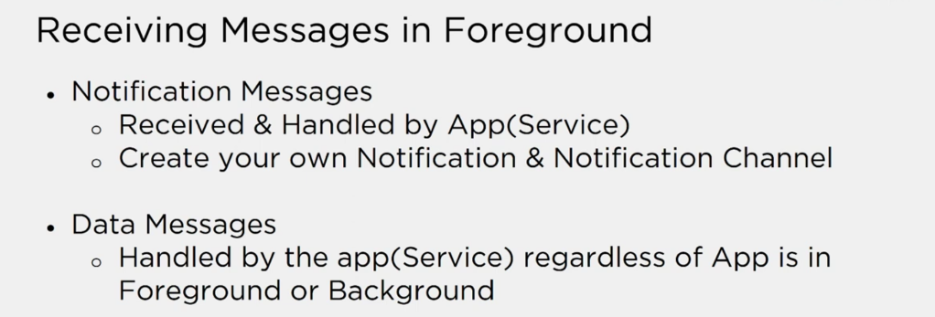
Notification Technology

Slide 11
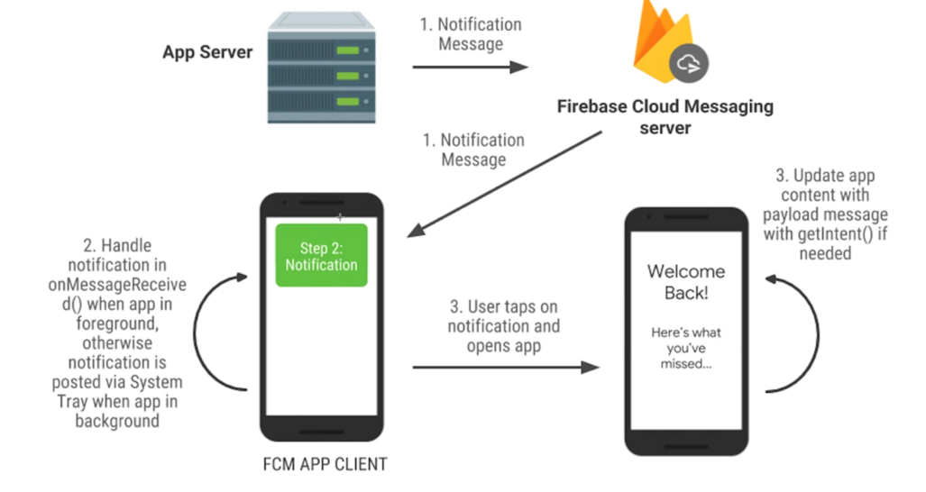
Pictorial View

Slide 12
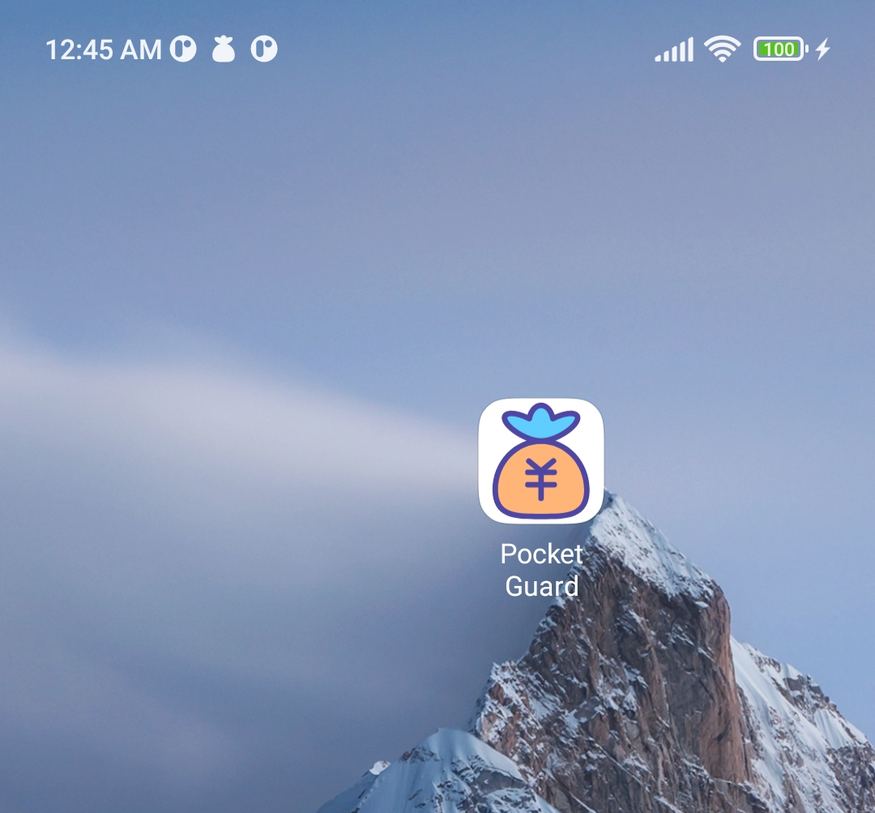

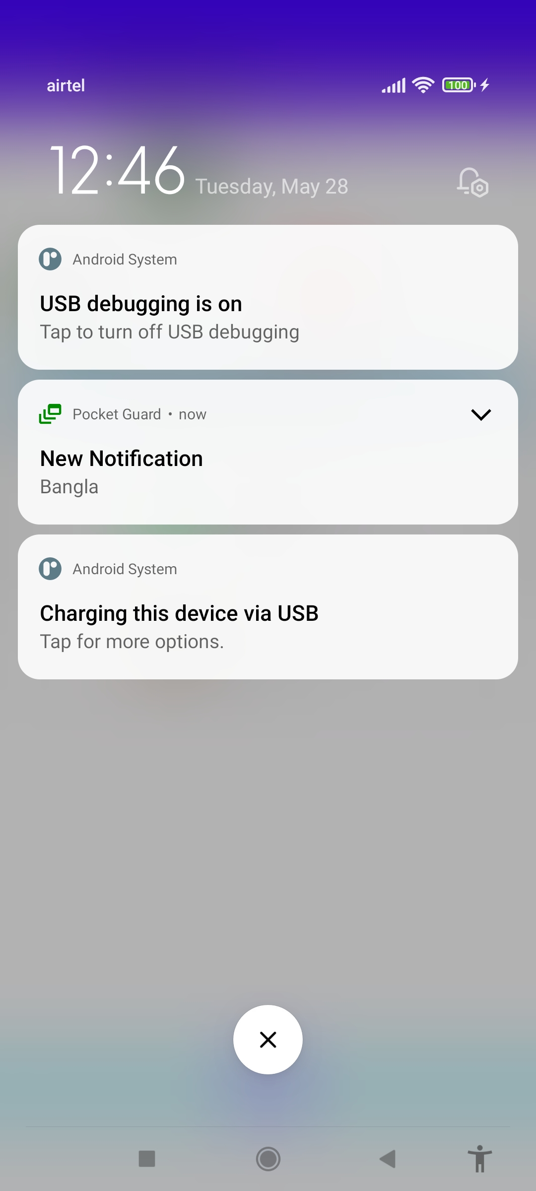
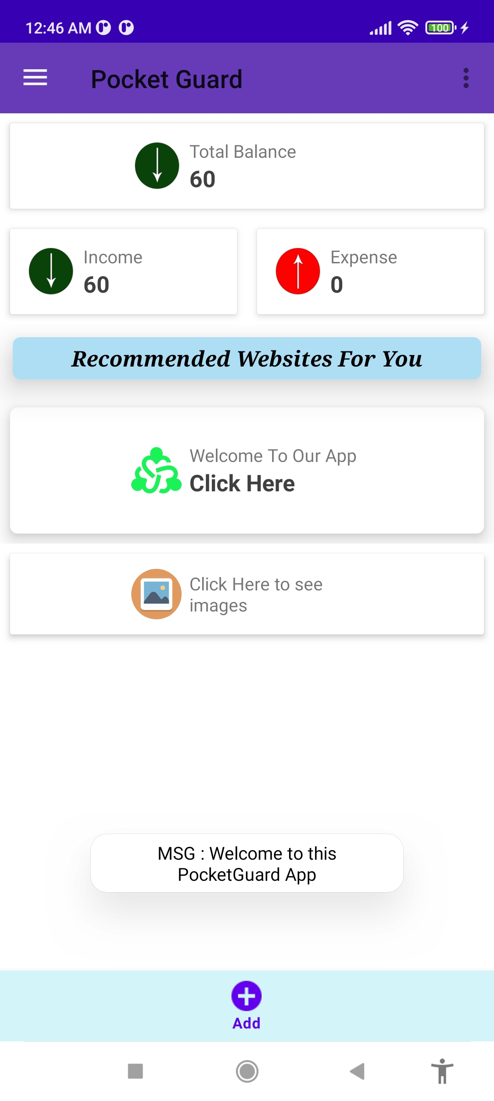
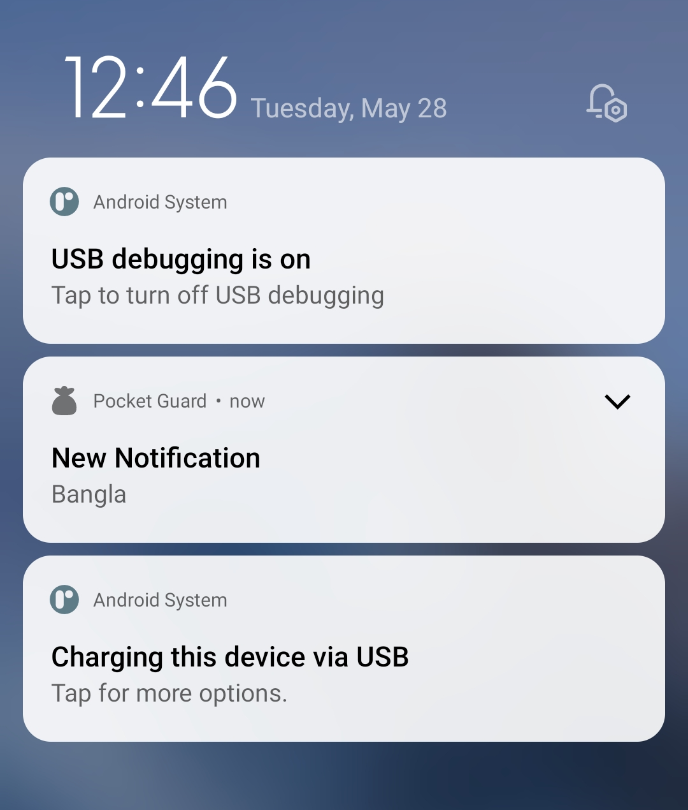
Notification Example

Slide 13
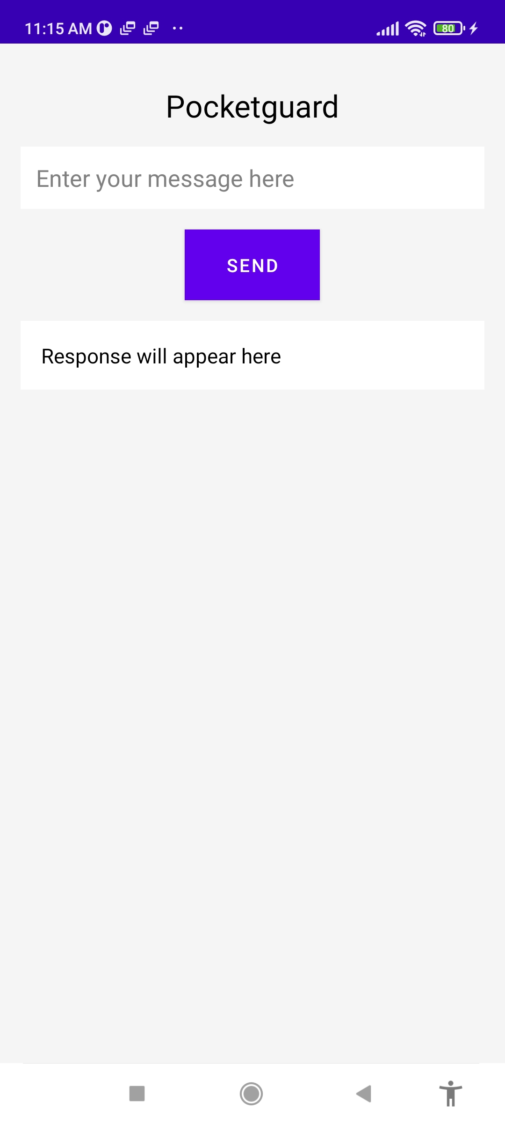
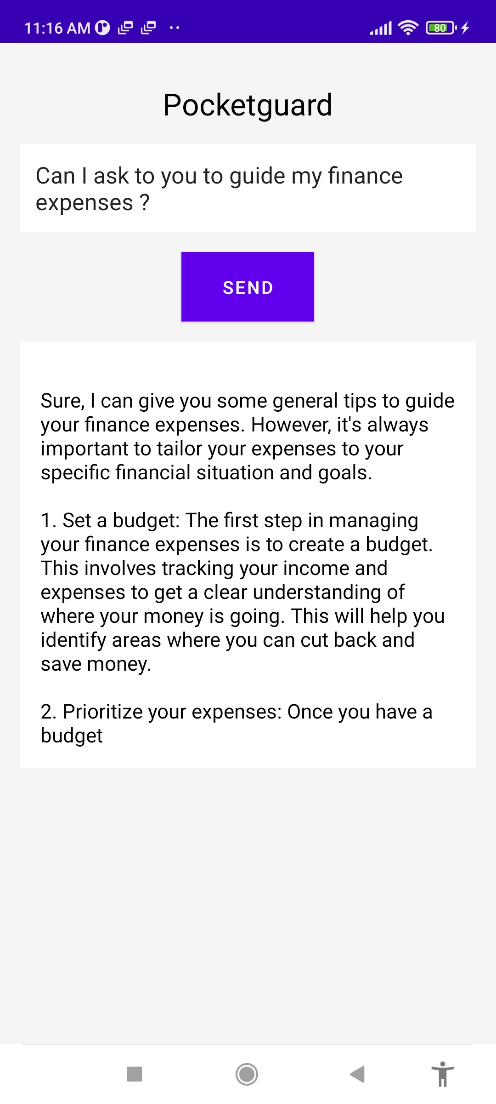
Take Decision With AI

Slide 14
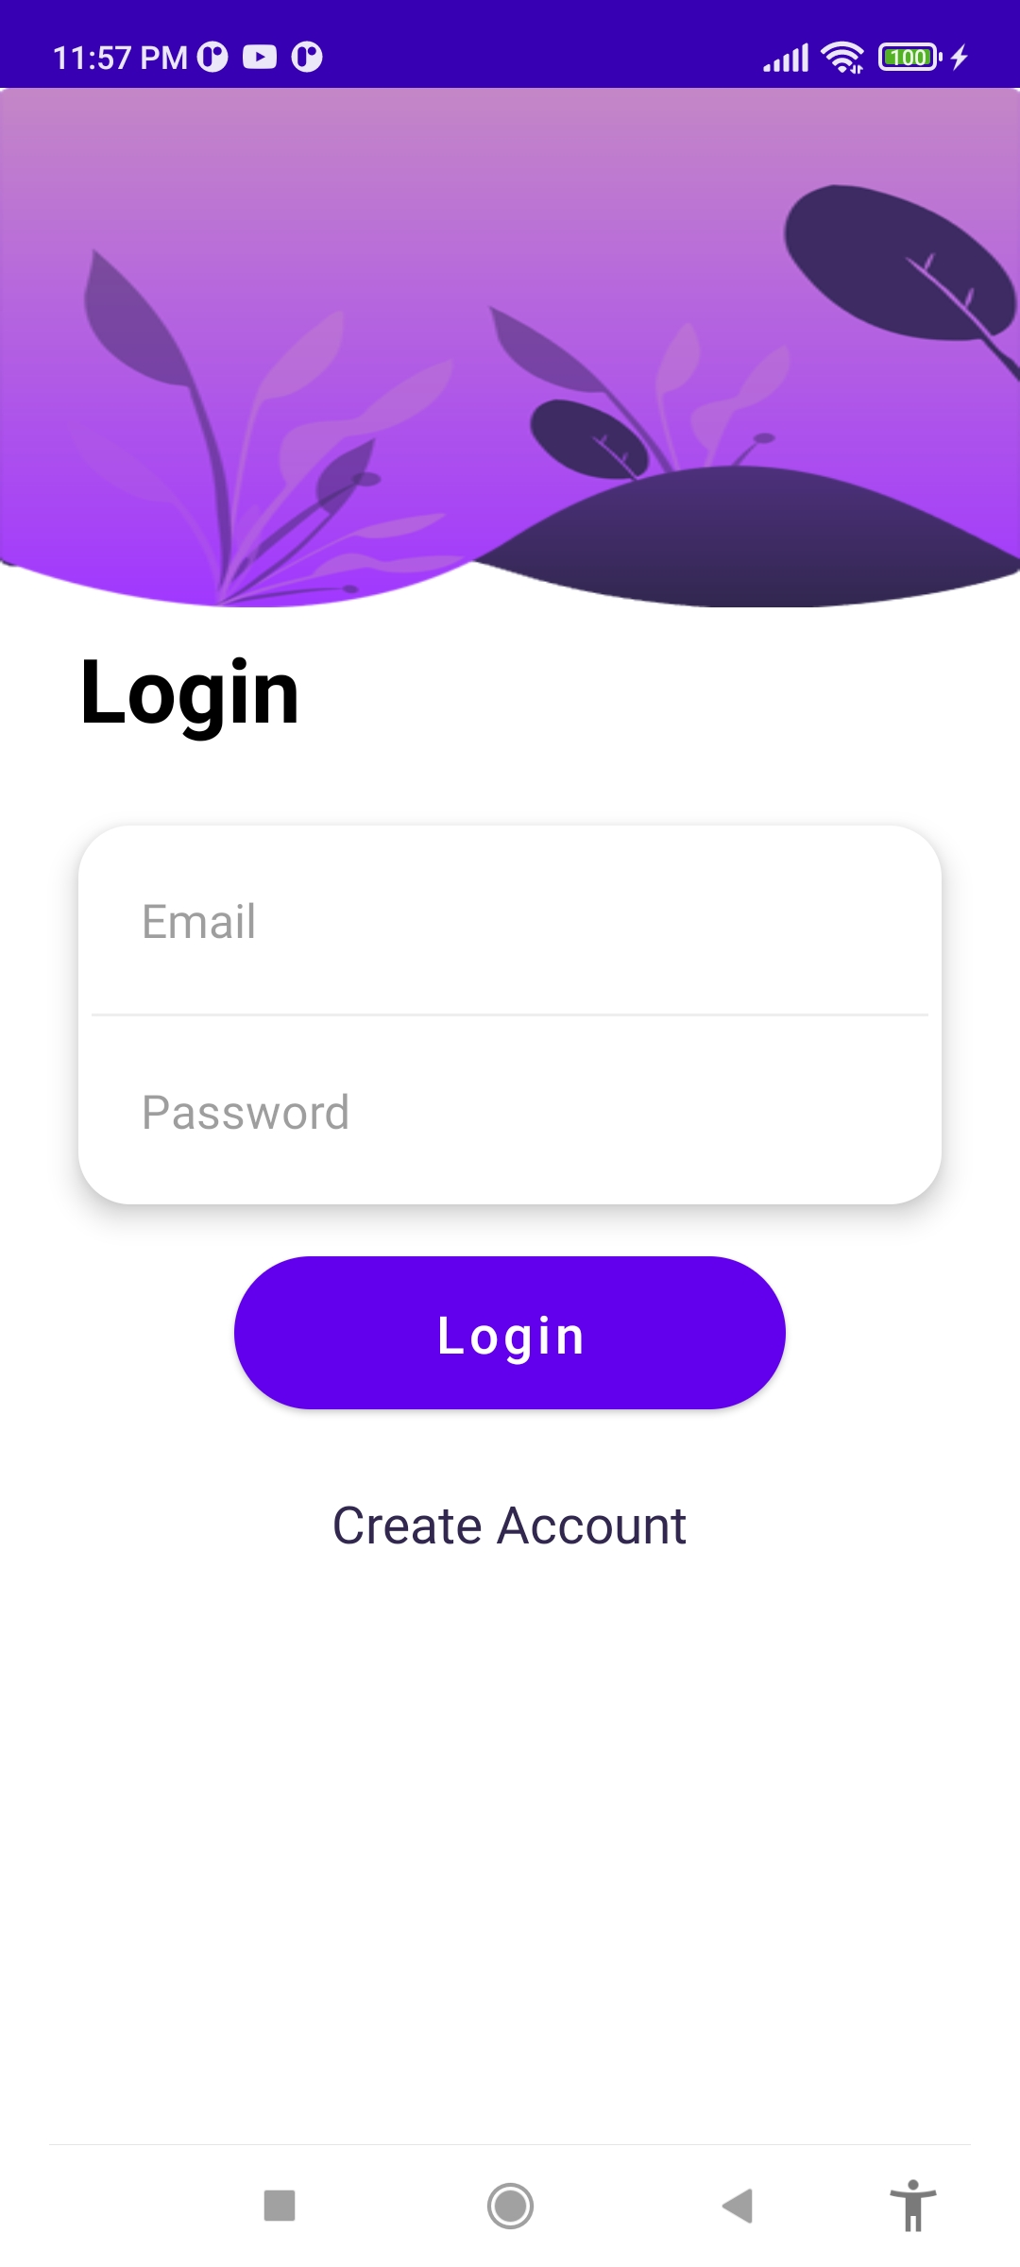
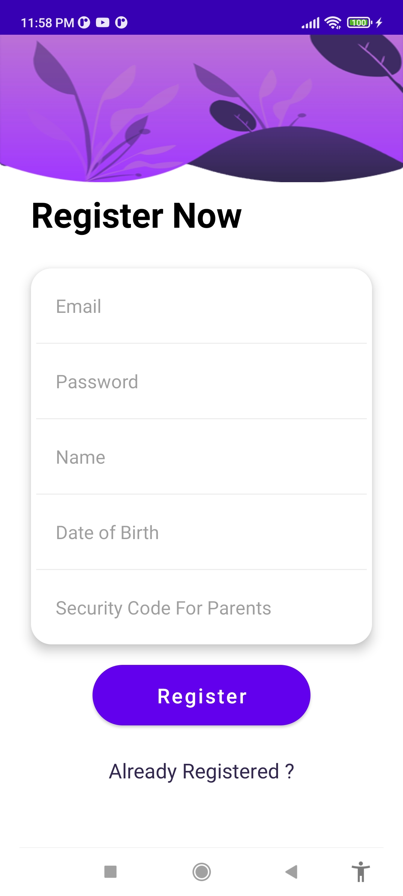
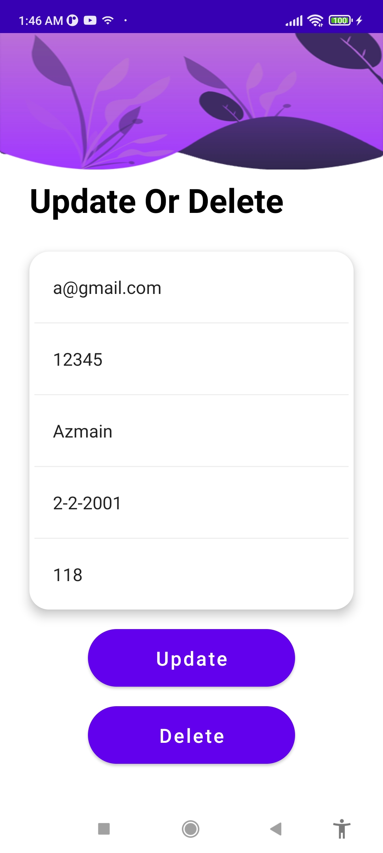
User Registration With Login and Update

Slide 15
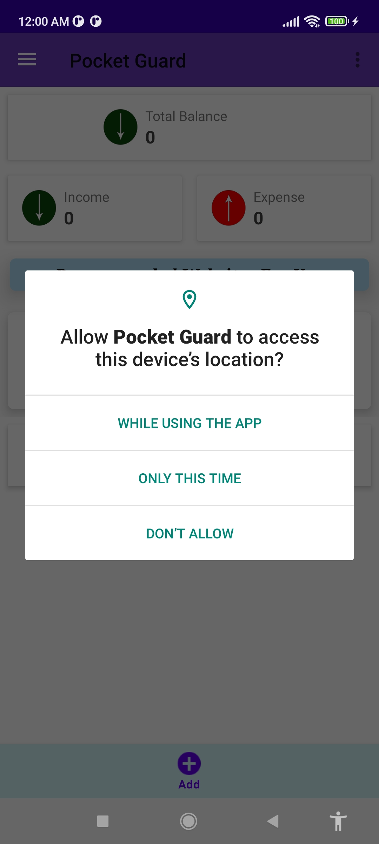
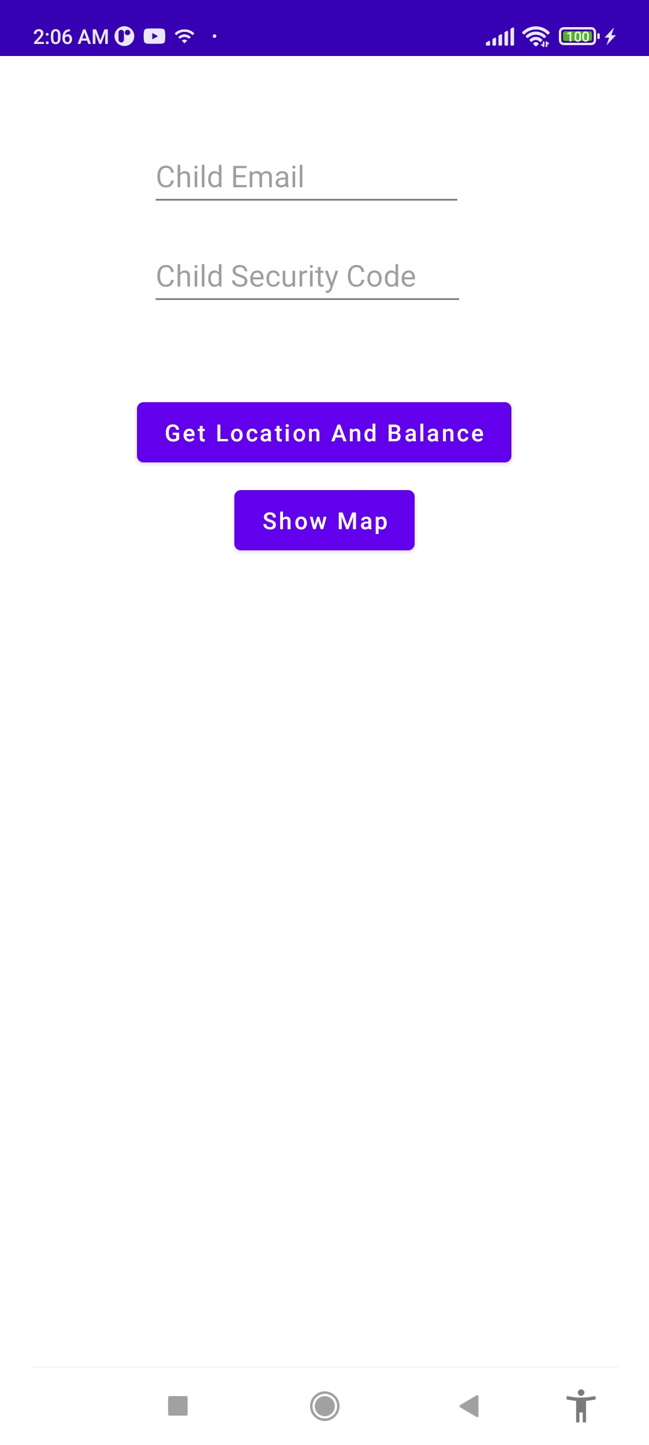
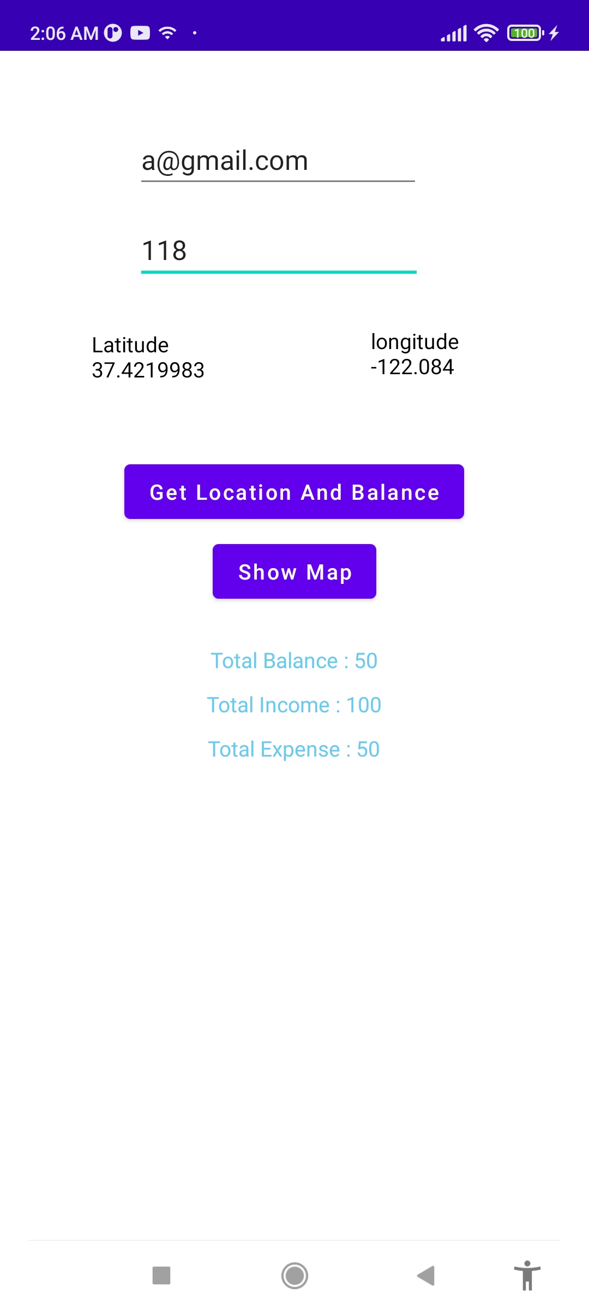
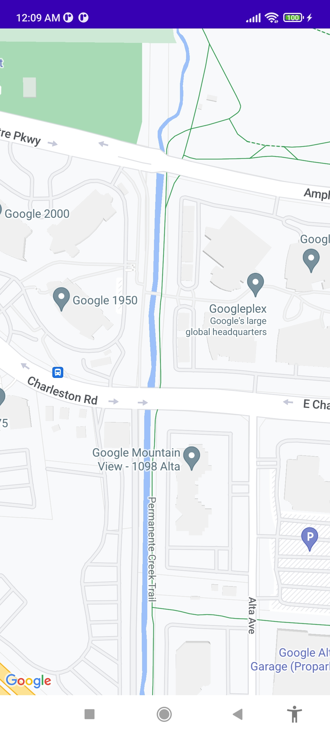
Parental Control

Slide 16
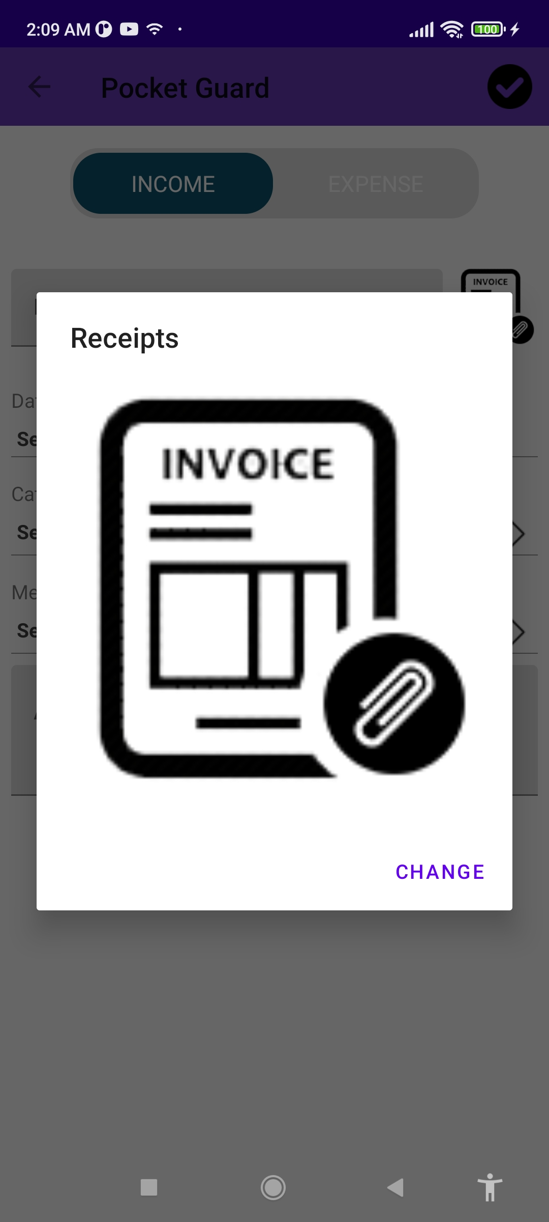
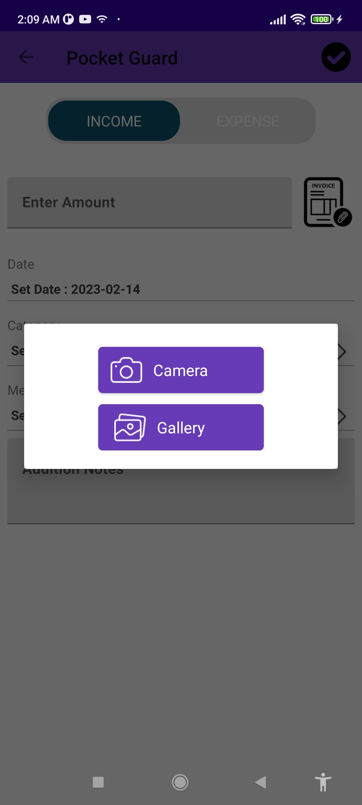
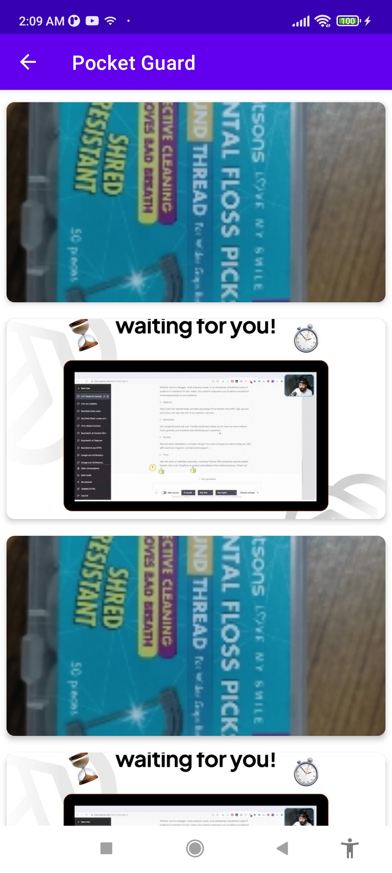
User Invoice Send and Fetch

Slide 17
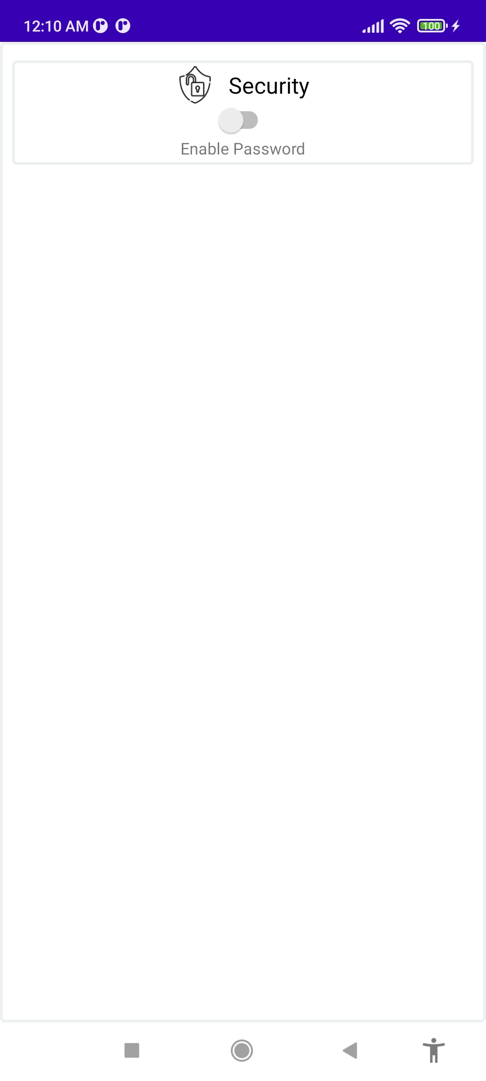
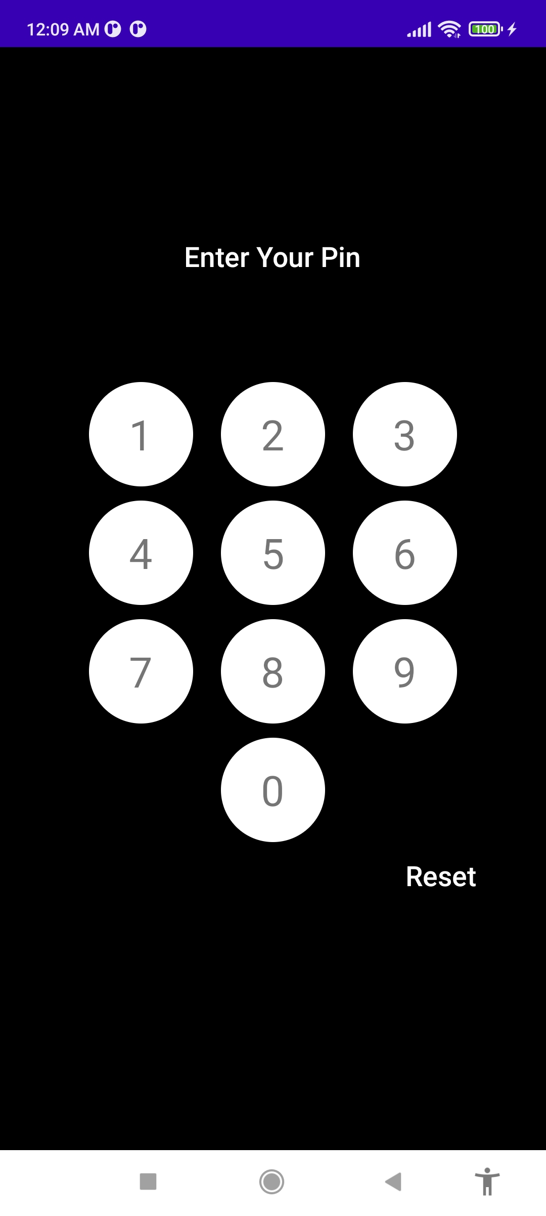
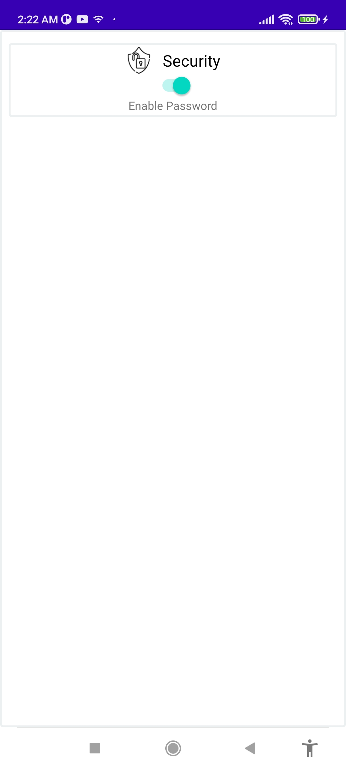
Launching Security Pin

Slide 18
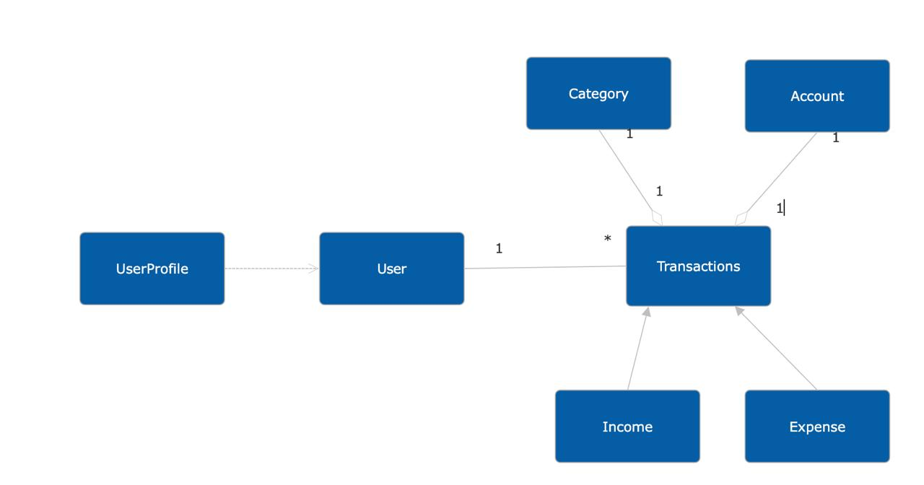
UML DIAGRAM
Competitors
Notifications
Goal
Security
Recommended sites

Slide 19
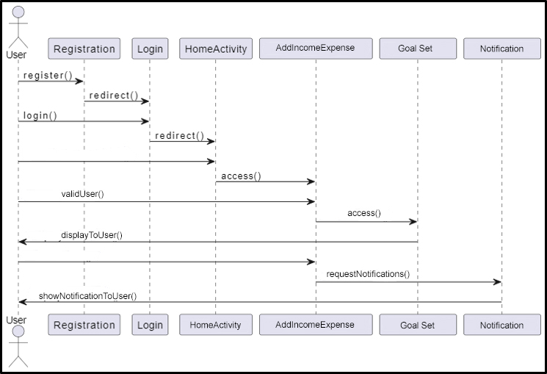
Sequence Diagram

Slide 20
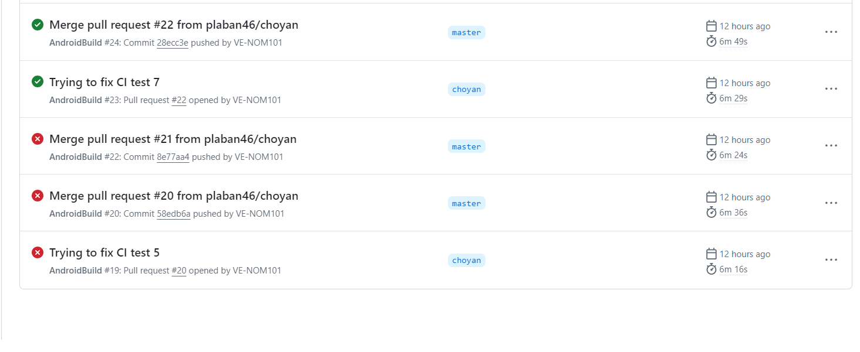
CI Testing

Slide 21
Testing
UI Testing:
1.GoalSetTest
2.HomeActivityTest
3.LoginTest
4.Parrent_ControlTest
5.ToastMatcher

Slide 22
Unit Testing:
1.LoginTest
2.RegiterTest
3.ValidEmailTest

Slide 23
Other Testing:
1. CI Testing
2. Integration Testing

Slide 24
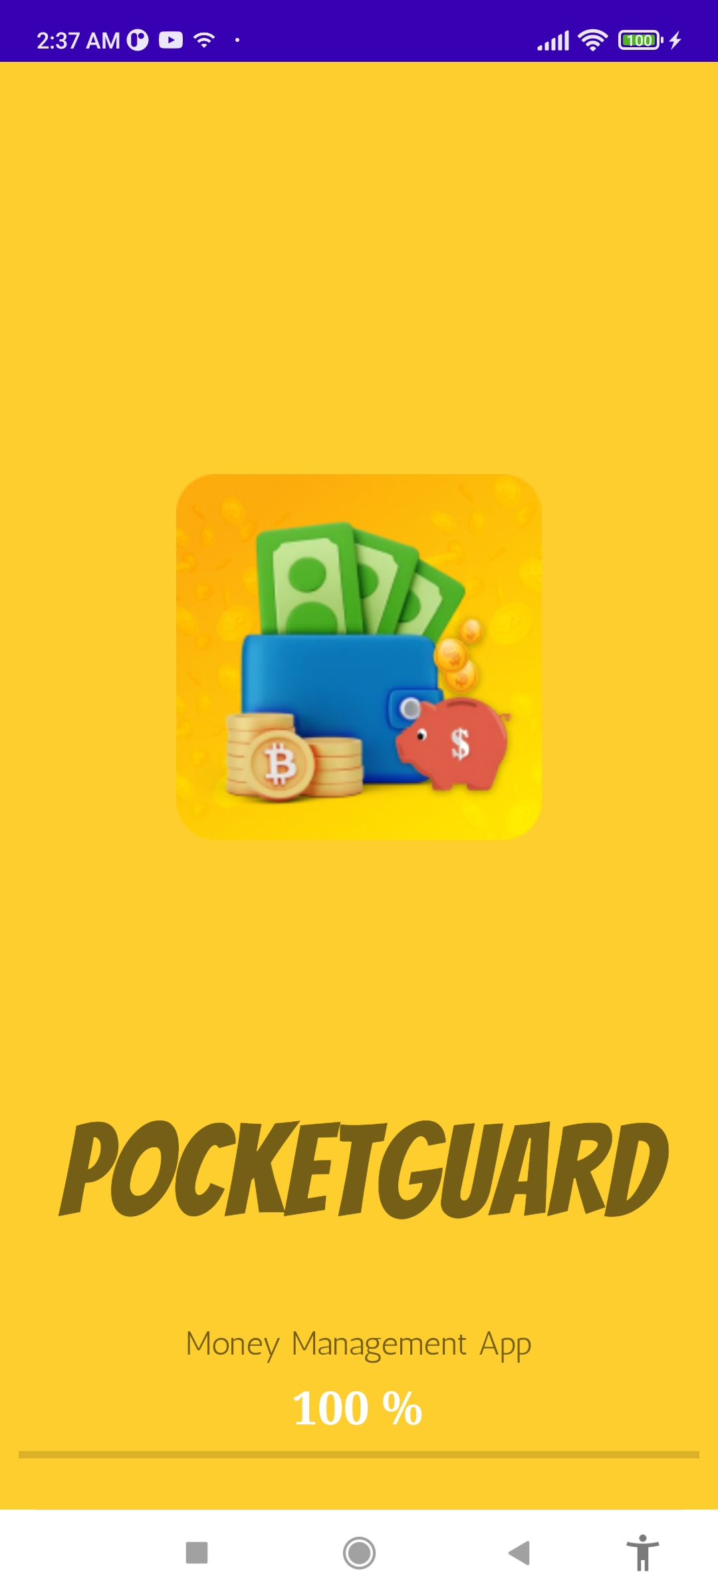
Splash Screen
Splash screen will choose the activity dynamically. Suppose after the Splash screen show the login is done then then splash screen is automatically switched into the home activity

Slide 25
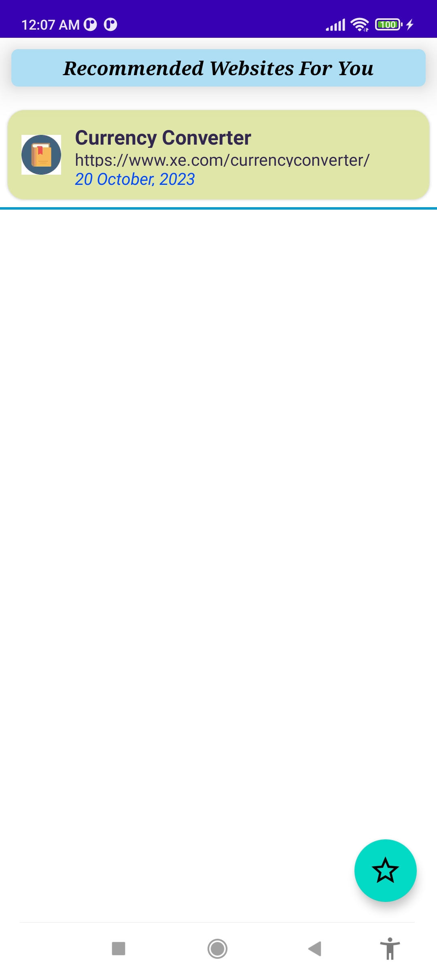
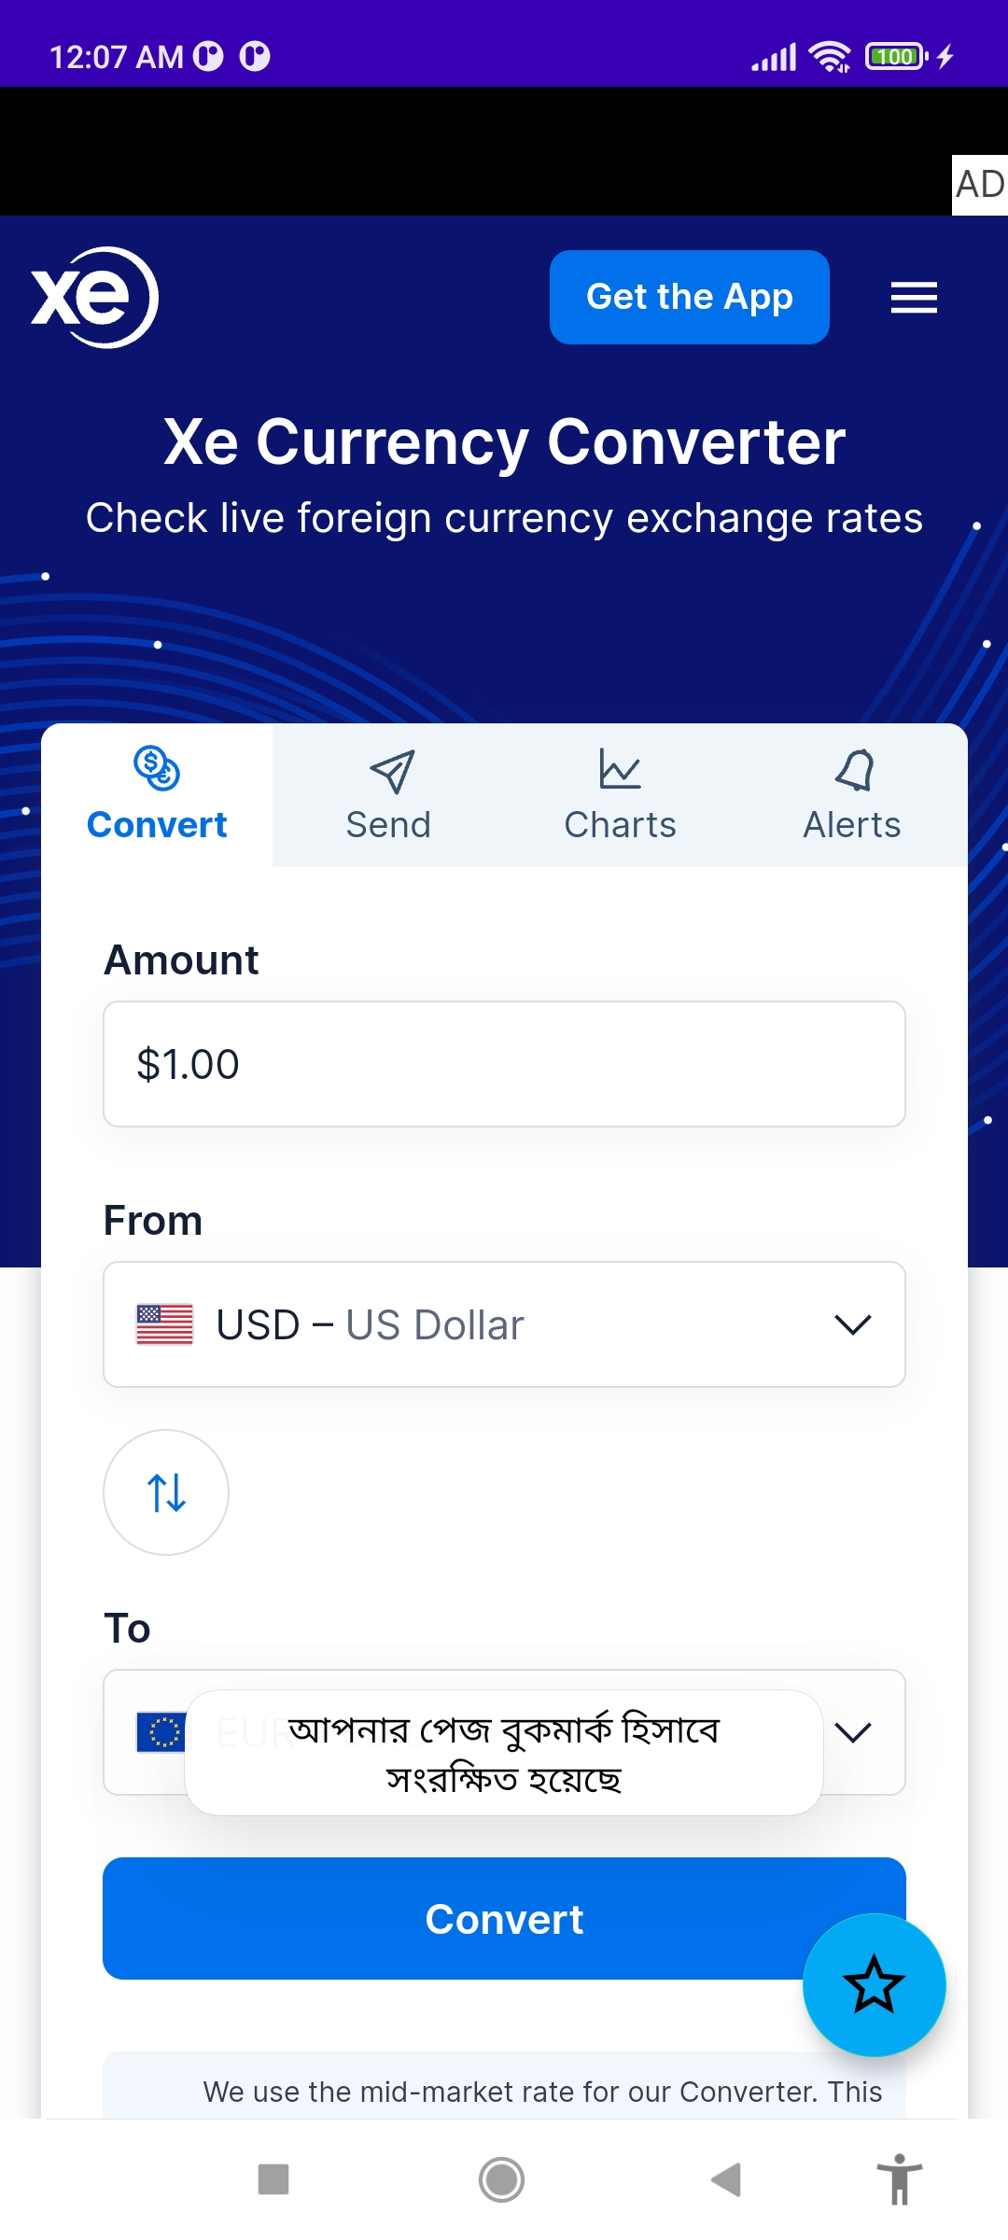
App Preview:
Recommended Site Directly inside App
With
Refreshing Feature

Slide 26
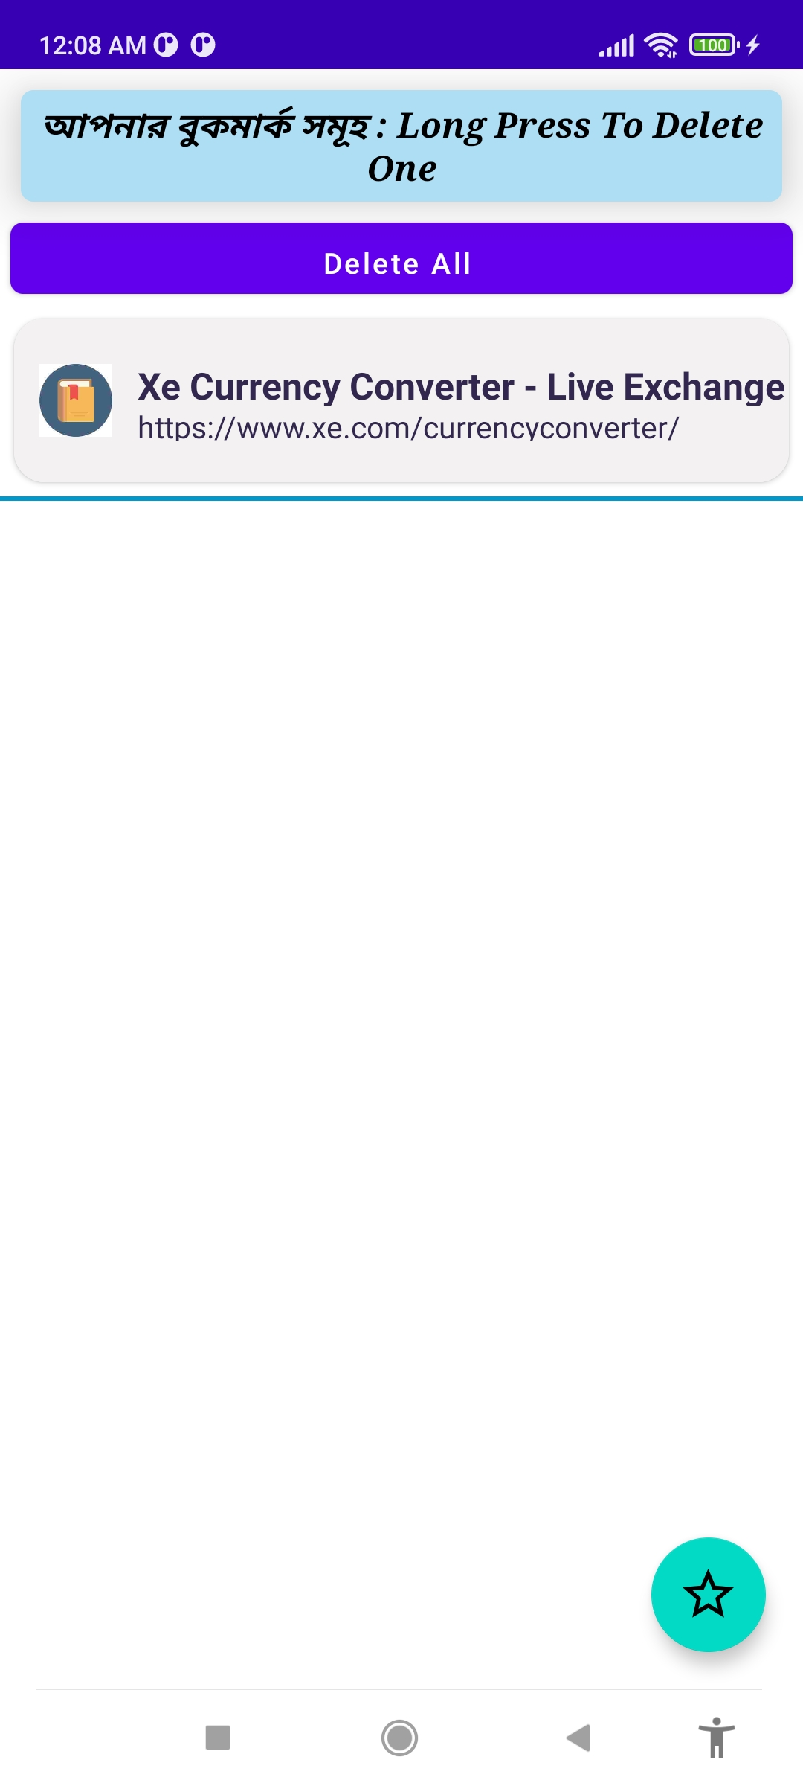
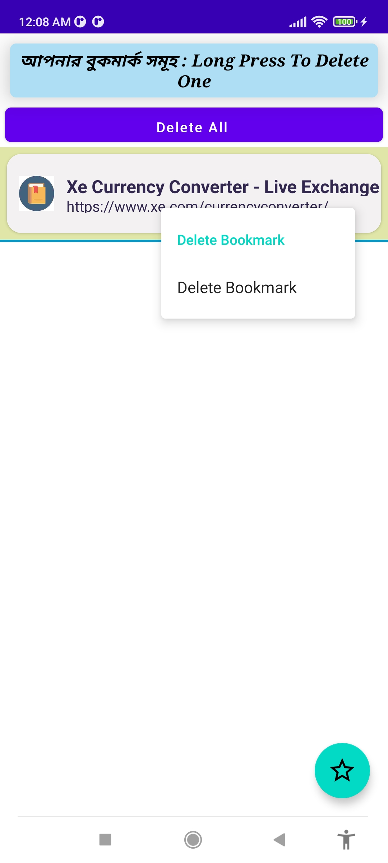
Bookmarks Features

Slide 27
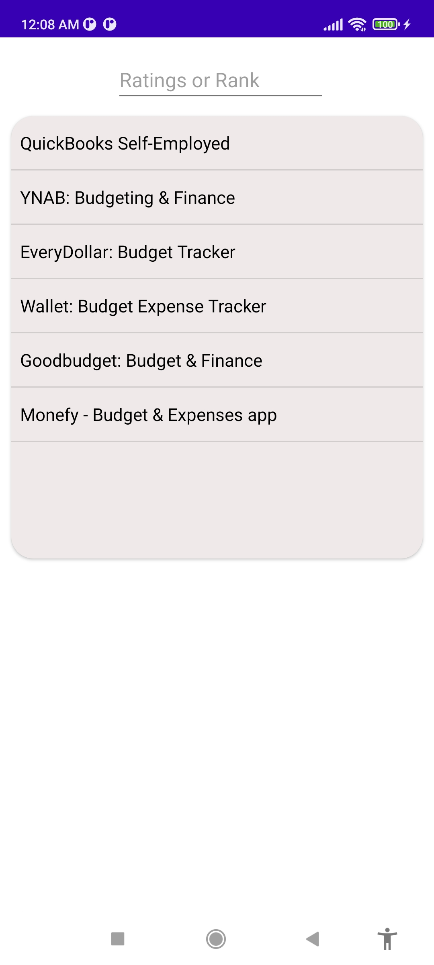
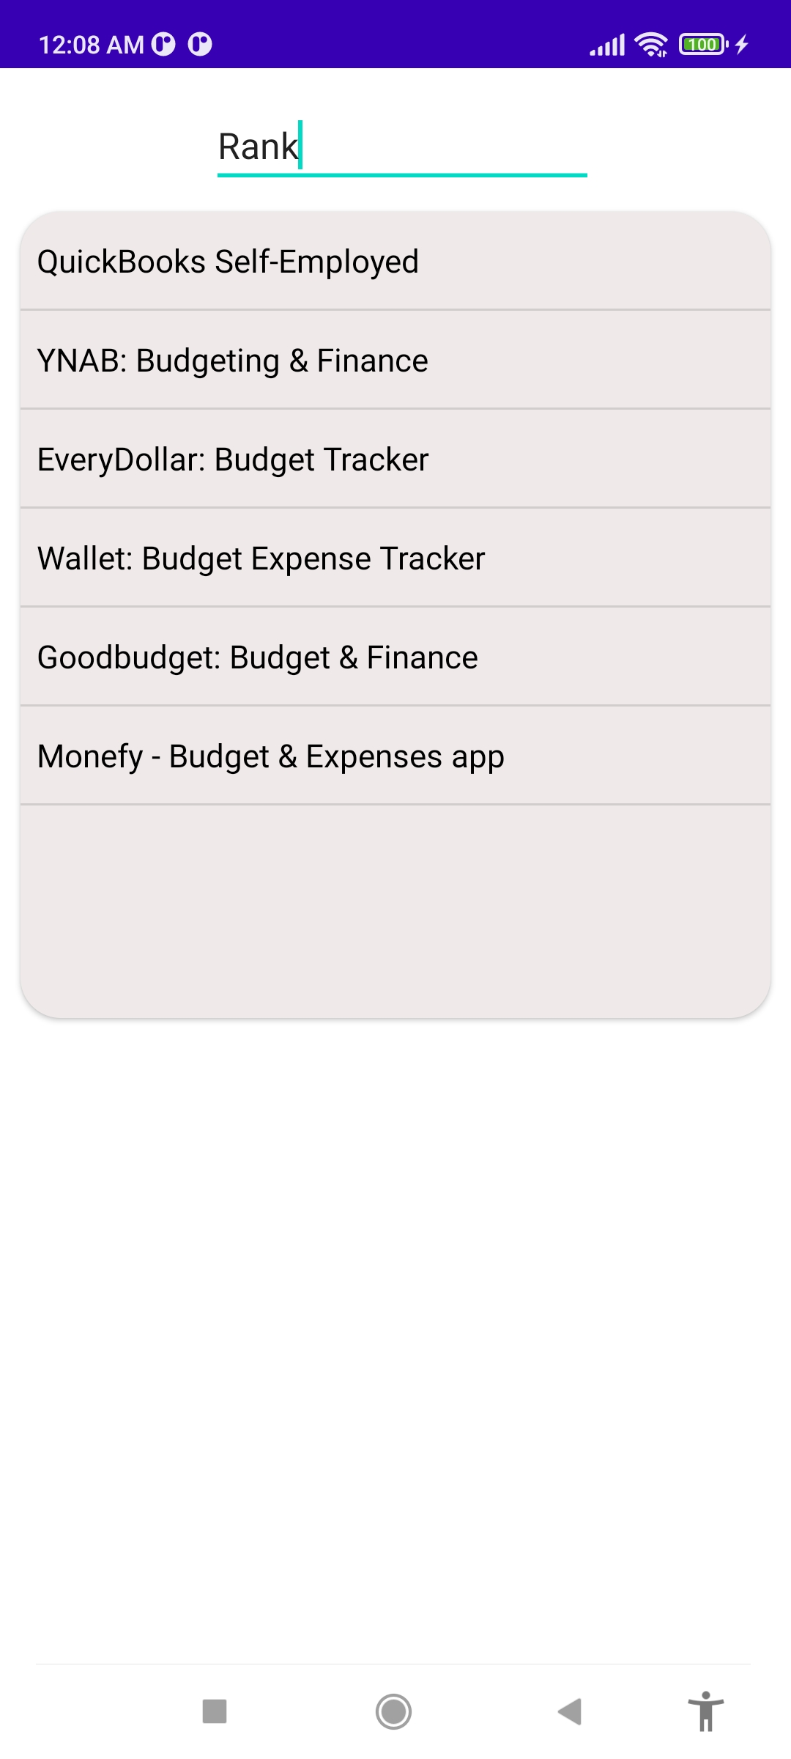
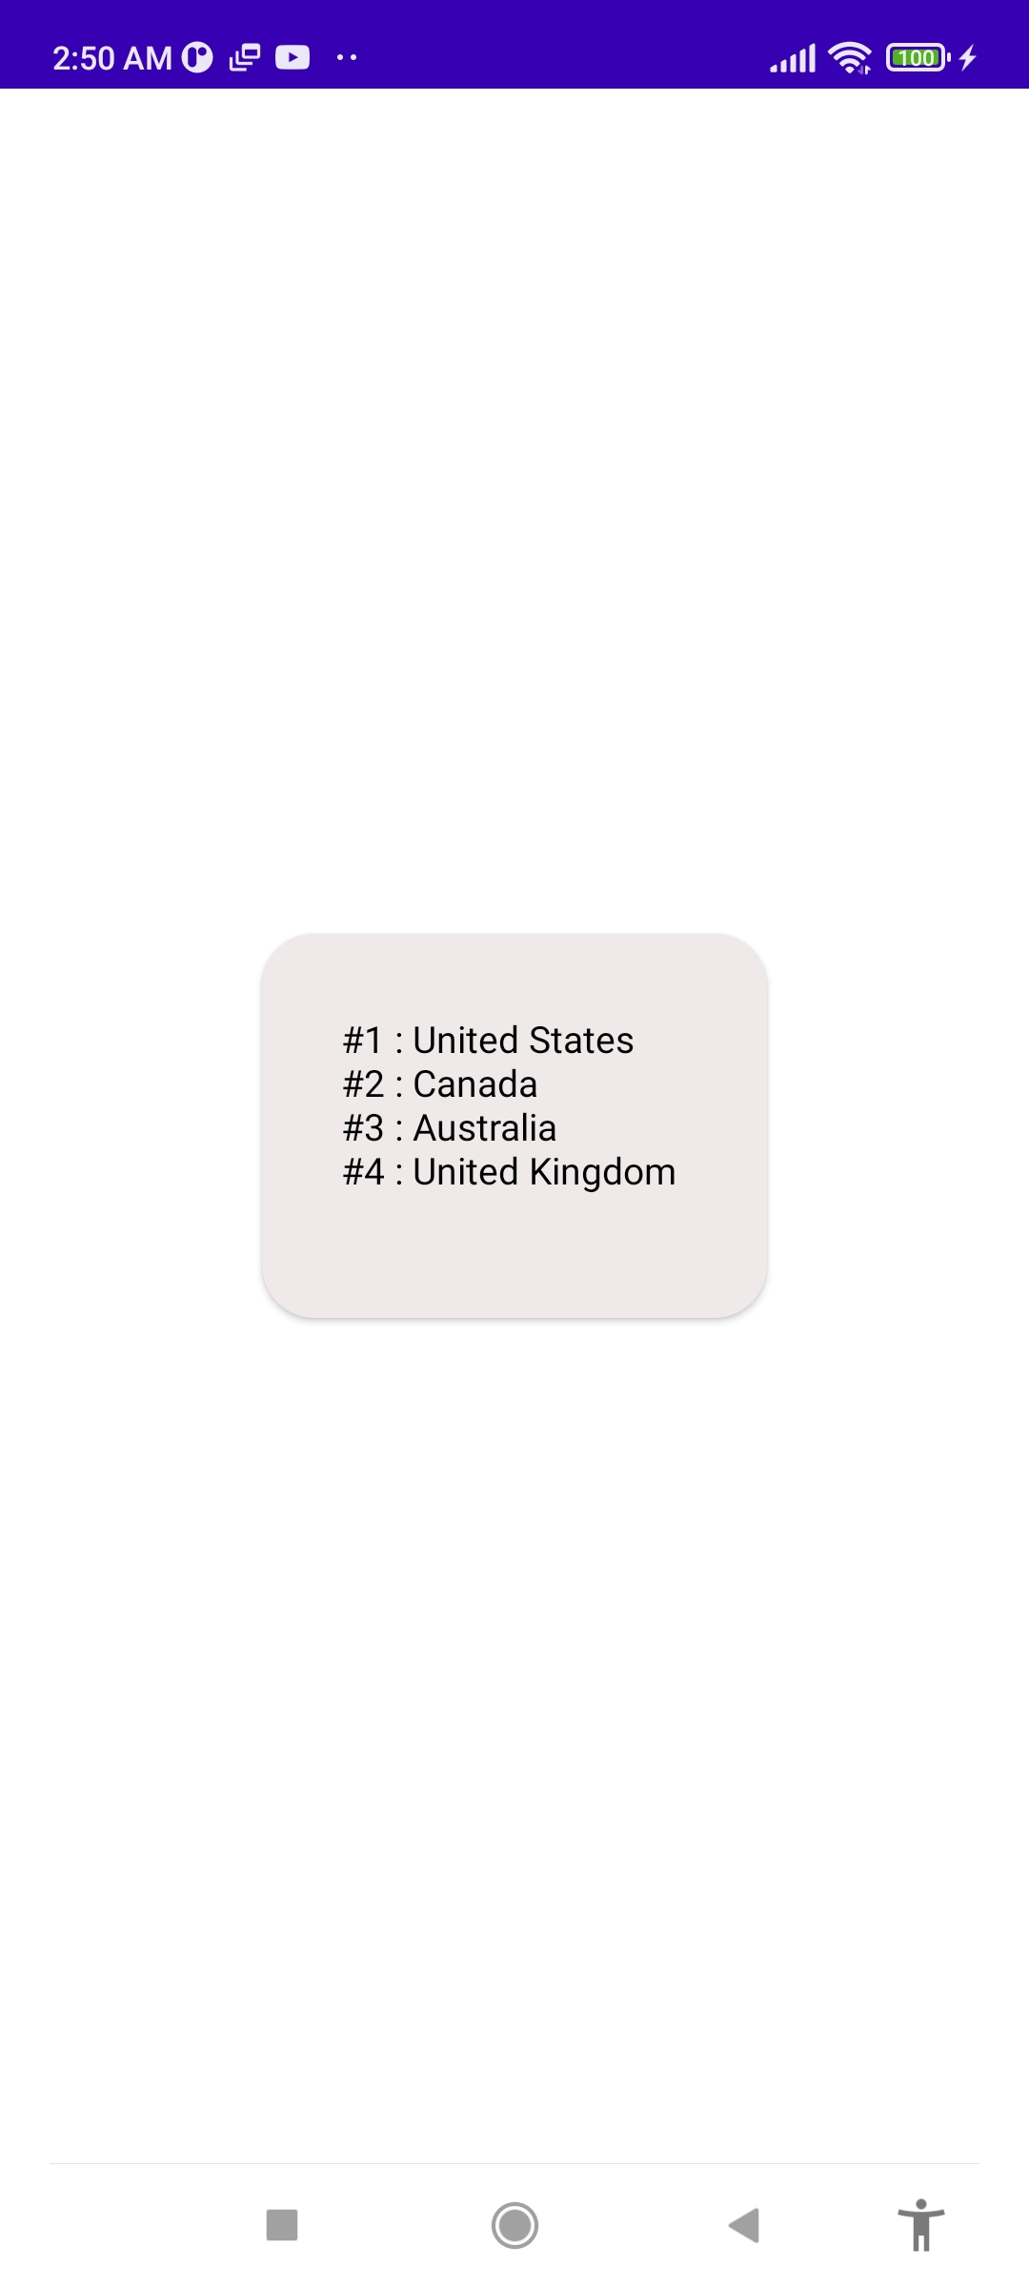
Competitor Ranking

Slide 28
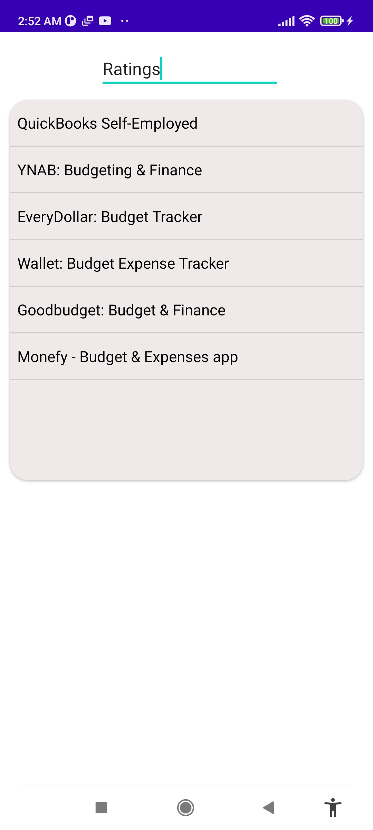
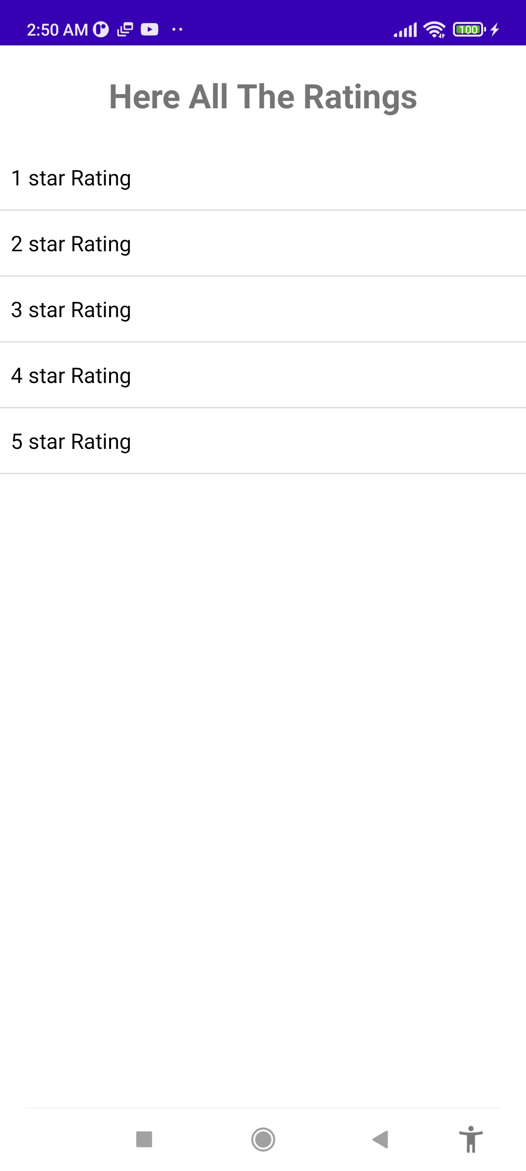

Competitor Ratings

Slide 29
Singleton Design Pattern
Applying Singleton Pattern to Sqlite_StudentDatabaseHelper:
1.Private Constructor:
private Sqlite_StudentDatabaseHelper(@Nullable Context context) {
super(context, DATABASE_NAME, null, DATABASE_VERSION);
}
2.Static Instance:
private static Sqlite_StudentDatabaseHelper instance;
3. Synchronized getInstance Method:
public static synchronized Sqlite_StudentDatabaseHelper getInstance(Context context) {
if (instance == null) {
instance = new Sqlite_StudentDatabaseHelper(context.getApplicationContext());
}
return instance;}

Slide 30
4. Database Management Methods:
@Override
public void onCreate(SQLiteDatabase db) {
db.execSQL(CREATE_TABLE);
}
@Override
public void onUpgrade(SQLiteDatabase db, int oldVersion, int newVersion) {
db.execSQL("DROP TABLE IF EXISTS " + STUDENT_TABLE);
this.onCreate(db);
}
Benefits of Using Singleton for Database Helper:
1. Resource Management
2. Consistency
3. Thread Safety
4. Global Access Point

Slide 31
Adapter Design Pattern
Adapter Design Pattern in GoalAdapter:
1. Context and Data Source:
private Context context;
private ArrayList<constructor> arrayList;
List<constructor> arraylist_search;
2. Constructor:
GoalAdapter(Context context, ArrayList<constructor> arrayList) {
this.context = context;
this.arrayList = arrayList;
this.arraylist_search = new ArrayList<>(arrayList);
}
3. Filterable Interface:
@Override
public Filter getFilter() {
return filter;
}

Slide 32
4. Filter Implementation:
Filter filter = new Filter() {
@Override
protected FilterResults performFiltering(CharSequence charSequence) {
List<constructor> filteredlist = new ArrayList<>();
if (charSequence.toString().isEmpty()) {
filteredlist.addAll(arraylist_search);
} else {
for (constructor list_search : arraylist_search) {
if (list_search.category.toLowerCase().contains(charSequence.toString().toLowerCase())) {
filteredlist.add(list_search);
}
}
}
FilterResults filterResults = new FilterResults();
filterResults.values = filteredlist;
return filterResults;
}
@Override
protected void publishResults(CharSequence charSequence, FilterResults filterResults) {
arrayList.clear();
arrayList.addAll((Collection<? extends constructor>) filterResults.values);
notifyDataSetChanged();
}};

Slide 33
Factory Method Pattern
Factory Method Pattern in GoalRecyclerView:
public class Key_Static_Methods {
public static ArrayList<String> get_goal_information(Context context, String key) {
SharedPreferences sharedPreferences = context.getSharedPreferences(Key_SharedPreference.PREFS_KEY, Context.MODE_PRIVATE);
String category = sharedPreferences.getString(key + "_CATEGORY", "Default Category");
int progress = sharedPreferences.getInt(key + "_PROGRESS", 0);
int limit = sharedPreferences.getInt(key + "_LIMIT", 1);
ArrayList<String> goalInformation = new ArrayList<>();
goalInformation.add(category);
goalInformation.add(String.valueOf(progress));
goalInformation.add(String.valueOf(limit));
return goalInformation;
}}

Slide 34
Observer Design Pattern
Observer Pattern in Your Parental_Control Class:
Code Explanation:
In your code, the Parental_Control activity is set up to observe changes in the Firebase Realtime Database. The ValueEventListener interface methods onDataChange and onCancelled are the mechanisms through which the observer is notified of changes.
DatabaseReference db = FirebaseDatabase.getInstance().getReference("users");
db.addListenerForSingleValueEvent(new ValueEventListener() {
@Override
public void onDataChange(@NonNull DataSnapshot snapshot) {
try {
// Logic to handle data changes
} catch (Exception e) {
e.printStackTrace();
}
}
@Override
public void onCancelled(@NonNull DatabaseError error) {
// Handle database error
}});

Slide 35
Model-View-controller Design Pattern
”All_Web_Pages_NoAds” activity, the MVC pattern can be illustrated as follows:
Model:
Sqlite_StudentModel: Represents the data structure for a bookmark.
Sqlite_StudentDatabaseSource: Manages data operations such as adding and retrieving bookmarks.
View:
XML layout (web_page_drawer_for_webpage.xml): Defines the UI elements.
UI elements like WebView, ProgressBar, and TextView display the current webpage and loading progress.

Slide 36
Controller:
  Manages the lifecycle of the activity.
  Handles user inputs like bookmarking a page.
  Loads URLs into the WebView and updates the ProgressBar.
  Interacts with the Model to save bookmarks and updates the View based on the Model's state.

Slide 37
Code Example for Bookmarking:
When the user clicks the bookmark button:
View:The FloatingActionButton in the layout detects the click event.
Controller:The click event is handled by the bookmark_saved_caller method in All_Web_Pages_NoAds, which creates a new Sqlite_StudentModel and adds it to the database via Sqlite_StudentDatabaseSource.
Model: The Sqlite_StudentDatabaseSource updates the database with the new bookmark.
View: The UI is updated to show a toast message confirming the bookmark action.

Slide 38
THANK YOU
Do you have any questions?
pocketguard@freepik.com
+8801766666666
pocketguard.com
Thanks for watching our Product
Please keep this slide for attribution

