Slide 1
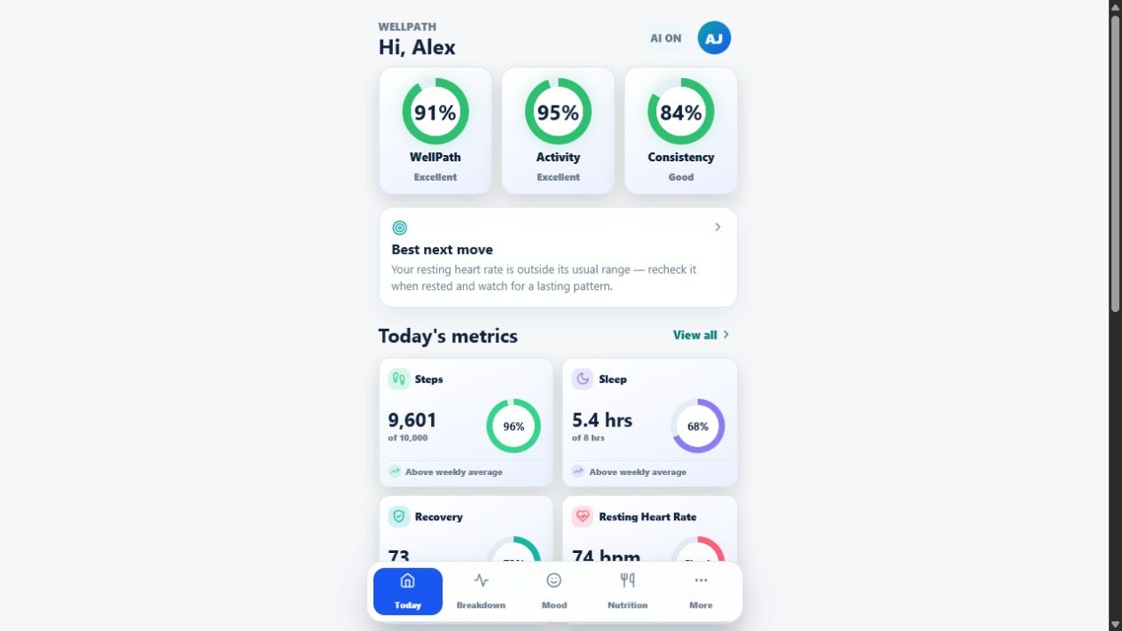
WELLPATH
Exploring what connected health data could become
A concept prototype combining health tracking, model experiments, cycle estimation, and AI explanations.
CONCEPT PRESENTATION
WELLPATH • CONCEPT PROTOTYPE
01
Notes:
Introduce WellPath as an academic exploration, not a finished medical product. The central question is how a future health application might connect different forms of health information while keeping explanations understandable.
[Sources]
- C:\Users\Mahir\Desktop\WellPath\poster_assets\patient-dashboard.png

Slide 2
The harder problem is connecting health data
Collecting measurements is only the first step. Understanding how they relate is what gives them context.
01 COLLECT
02 CONNECT
03 EXPLAIN
Bring together daily habits, symptoms, cycle history, and clinical measurements.
Compare those signals on one timeline and against personal trends.
Show what changed, which factors mattered, and where uncertainty remains.
WellPath explores interpretation, not diagnosis.
WELLPATH • CONCEPT PROTOTYPE
02
Notes:
Frame the problem as interpretation rather than a lack of data. People may see activity, sleep, symptoms, cycle history, and clinical measures in separate places. The prototype asks how a single experience could help users explore connections without claiming to diagnose them.

Slide 3
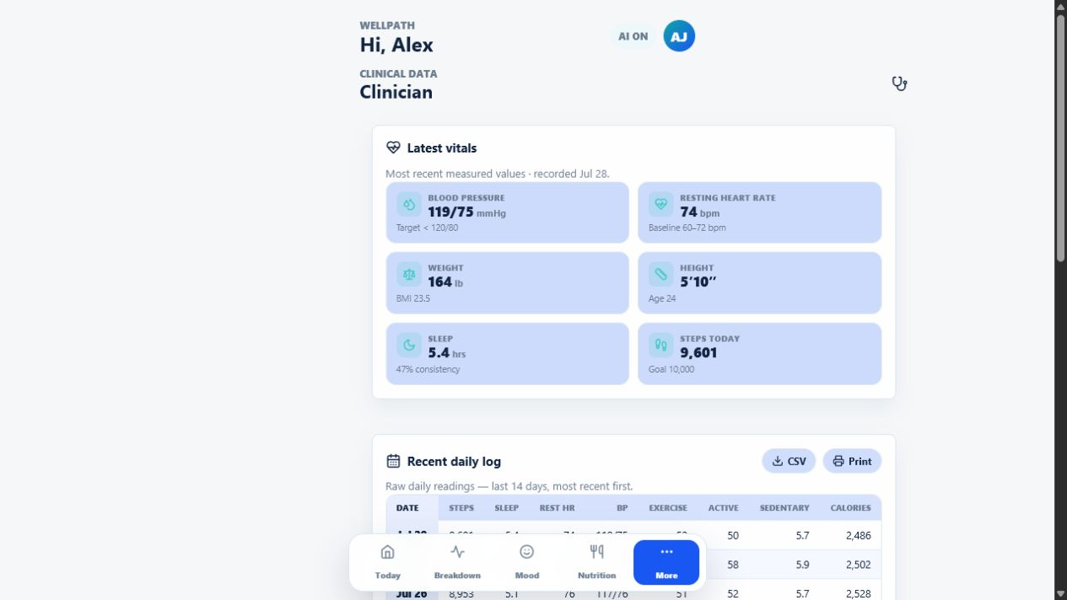
WellPath is a question, not a finished product
What could a more connected and explainable health experience look like?
The concept brings together
Daily tracking and personal trends
Exploratory models and transparent factors
Cycle estimates based on logged history
AI explanations in plain language
The app demonstrates the experience using fictional sample profiles.
WELLPATH • CONCEPT PROTOTYPE
03
Notes:
The purpose is to explore several concepts in one interface: daily tracking, experimental health models, cycle estimation, and AI explanations. Emphasize that the application screens use fictional sample profiles and are not evidence of clinical performance.
[Sources]
- C:\Users\Mahir\Desktop\WellPath\poster_assets\clinical-view.png
- C:\Users\Mahir\Desktop\WellPath\wellpath-condition-models\README.md

Slide 4
The concept moves beyond single purpose tracking
Existing categories become a design starting point, not a market claim.
COMMON APP FOCUS
WELLPATH EXPLORES
Track one category
Connect the context
Fitness
Cycles
Sleep
Symptoms
Records
How factors relate
Why a result changed
Where uncertainty remains
How results can be explained
WELLPATH • CONCEPT PROTOTYPE
04
Notes:
Do not position this as a competitive product comparison. The slide recognizes common categories in health apps and uses them to define the design exploration. WellPath asks what happens when those categories share context and explanations.

Slide 5
Four experiences anchor the prototype
Each one tests a different way of making health information easier to explore.
01
Daily context
Metrics, goals, and recent changes
02
Cycle estimation
History, range, and confidence
03
Model transparency
Scores, factors, and performance
04
AI explanation
Short guidance tied to a result
WELLPATH • CONCEPT PROTOTYPE
05
Notes:
Use this as a brief map of the prototype before moving into the experiments. The dashboard explores daily context, the period tracker explores estimation and confidence, the insight page explores model transparency, and Groq AI explores short explanations.
[Sources]
- C:\Users\Mahir\Desktop\WellPath\poster_assets\patient-dashboard.png

Slide 6
Public research data stays separate from the app
CDC and NHANES datasets support model testing. Fictional profiles demonstrate the interface.
01
02
03
04
05
CDC and NHANES
Model experiments
Held out testing
Sample profiles
WellPath UI
Public research data
Train and compare
Evaluate performance
Fictional profiles
Demonstrate the concept
This separation reduces privacy and security risk.
It also follows dataset access rules and responsible data governance.
WELLPATH • CONCEPT PROTOTYPE
06
Notes:
Explain the two stages clearly. Deidentified NHANES data and other CDC public health sources supported model development and testing. The standalone model project used participant level splits and held out evaluation. Once the team saw that the models could produce meaningful experimental results, fictional sample profiles were used to demonstrate how compatible fields and outputs might appear inside WellPath. The research project does not connect to the application or its database.
[Sources]
- https://www.cdc.gov/nchs/nhanes/
- https://wwwn.cdc.gov/nchs/nhanes/continuousnhanes/
- C:\Users\Mahir\Desktop\WellPath\wellpath-condition-models\README.md
- C:\Users\Mahir\Desktop\WellPath\wellpath-condition-models\data\README.md

Slide 7
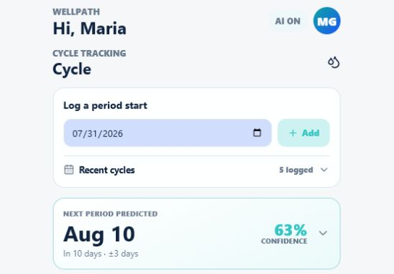
Cycle estimates adapt instead of assuming 28 days
A basic tracker may use the same cycle length for everyone. WellPath learns from recent history.
RECENT HISTORY
Uses the person's latest logged cycles
PERSONAL PATTERN
Gives more importance to recent cycles
CLEAR RESULT
Shows an expected date and a range
The estimate changes as the person's cycle history changes.
WELLPATH • CONCEPT PROTOTYPE
07
Notes:
A simple period tracker may estimate the next start by adding a fixed 28 days. WellPath instead uses the person's recent logged cycle lengths and gives more importance to the newest history. The result includes an expected date and a range so the audience can see that the estimate is not exact. The detailed weighting and uncertainty calculations remain part of the implementation, but the presentation focuses on the user benefit: a more personal and transparent estimate.
[Sources]
- C:\Users\Mahir\Desktop\WellPath\wellpath-health-integrated\wellpath-integrated\src\components\patient\CyclePage.jsx

Slide 8
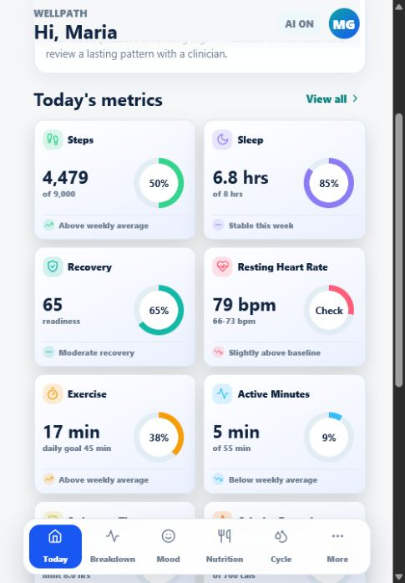
Sample values drive a realistic health experience
The prototype shows how scores, goals, and guidance could respond together.
INPUTS
Sample data
CALCULATION
Goals, ranges, and recent trends
EXPERIENCE
Scores with short guidance
The interface is the experiment here, not the sample user’s health result.
WELLPATH • CONCEPT PROTOTYPE
08
Notes:
The app uses fictional measurements to make the prototype feel complete. The interface compares those values with configured goals, ranges, and recent trends, then displays score cards and guidance. These sample results demonstrate interaction and communication design, not real health conclusions.
[Sources]
- C:\Users\Mahir\Desktop\WellPath\poster_assets\kpi-insights.png
- C:\Users\Mahir\Desktop\WellPath\wellpath-condition-models\README.md

Slide 9
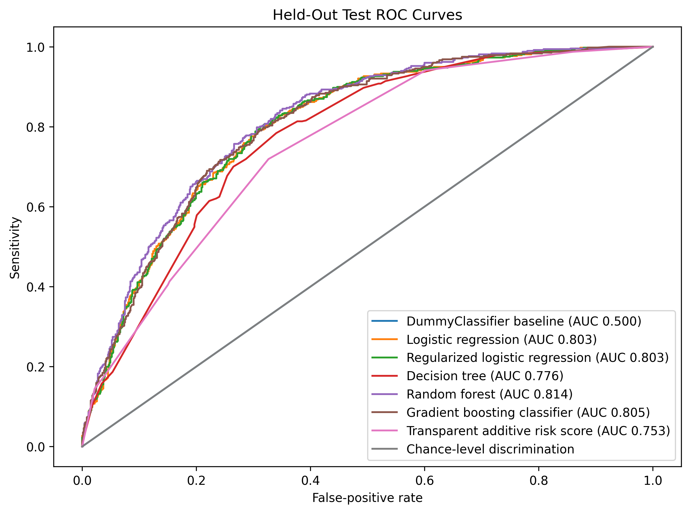
Held out testing checks whether the models learned a signal
The experiment compares several approaches before any app demonstration.
WHAT WAS TESTED
Participant level splits
Model comparisons
Held out performance
Classification performance does not establish diagnosis, safety, or clinical usefulness.
WELLPATH • CONCEPT PROTOTYPE
09
Notes:
The standalone research project compares multiple model types with participant level data splits. The methodology includes training, validation, and held out testing for the multi condition panel, with preprocessing contained inside the model pipeline. ROC curves summarize how well models separate predefined categories in the research dataset. Good separation in one dataset does not prove diagnosis, clinical safety, transportability, fairness, or benefit.
[Sources]
- C:\Users\Mahir\Desktop\WellPath\wellpath-condition-models\outputs\charts\roc_curves.png
- C:\Users\Mahir\Desktop\WellPath\wellpath-condition-models\README.md
- https://www.cdc.gov/nchs/nhanes/

Slide 10
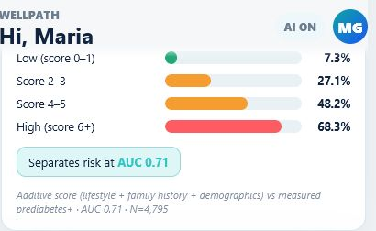
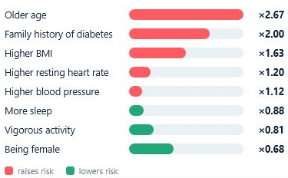
Model outputs become readable, not clinical
The interface separates overall model separation from associated factors.
MODEL SEPARATION
ASSOCIATED FACTORS
Association ≠ causation Classification ≠ diagnosis
WELLPATH • CONCEPT PROTOTYPE
10
Notes:
The prototype experiments with two kinds of transparency. One view communicates model separation, while the other shows variables associated with the output. The factors should be described as model factors, contributing variables, or associations. They should not automatically be called independent risk factors or causes.
[Sources]
- C:\Users\Mahir\Desktop\WellPath\poster_assets\model-card-separation.png
- C:\Users\Mahir\Desktop\WellPath\poster_assets\model-risk-drivers.png
- C:\Users\Mahir\Desktop\WellPath\wellpath-condition-models\README.md

Slide 11
WellPath makes risk scores easier to understand
A simple app may show only a score. WellPath also shows what influenced it.
01 RESULT
02 CONTEXT
03 REASONS
A simple tracker may show only the final score.
WellPath considers several health and habit factors together.
It highlights the factors that had the strongest influence.
The goal is a clearer comparison, not a diagnosis.
WELLPATH • CONCEPT PROTOTYPE
11
Notes:
A basic score can be difficult to interpret when the user cannot see why it changed. WellPath combines several available health and habit factors, then shows which ones had the strongest influence on the relative result. This makes the score easier to explore and compare while keeping the boundary clear: it is an experimental research comparison, not a diagnosis.
[Sources]
- C:\Users\Mahir\Desktop\WellPath\wellpath-health-integrated\wellpath-integrated\src\components\risksignal\riskModel.js
- C:\Users\Mahir\Desktop\WellPath\wellpath-health-integrated\wellpath-integrated\src\components\risksignal\RiskSignal.jsx
- C:\Users\Mahir\Desktop\WellPath\wellpath-health-integrated\wellpath-integrated\src\components\risksignal\multiModel.json

Slide 12
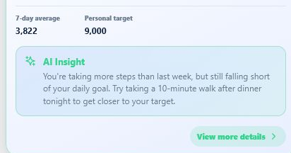
AI explains the result; it does not create it
Groq turns calculated outputs and sample context into a short interpretation.
1
Calculated result
2
Relevant context
3
Plain language insight
The explanation layer can still be incomplete or wrong, so it remains part of the experiment.
WELLPATH • CONCEPT PROTOTYPE
12
Notes:
Groq AI receives calculated scores and relevant sample context, then generates a short explanation. The statistical result is produced before the AI step. The AI layer is being explored as a communication tool, and its explanations may simplify, omit, or misinterpret technical information.
[Sources]
- C:\Users\Mahir\Desktop\WellPath\poster_assets\kpi-ai-insight.png

Slide 13
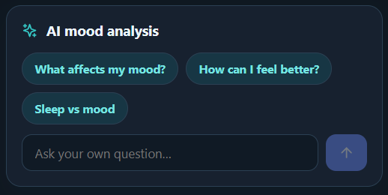
AI insights adapt to each person's habits
Users can select a suggested topic or ask their own question.
1
Choose a question
2
Habits provide context
3
Insights adapt over time
The AI adapts the explanation to logged habits; it does not replace the underlying calculations.
WELLPATH • CONCEPT PROTOTYPE
13
Notes:
The prototype lets users select a suggested insight topic or ask a custom question. Logged sleep, activity, mood, and recent patterns provide context, so the explanation can change as the user's habits change. This remains an exploratory explanation feature and does not replace the underlying calculations or provide a diagnosis.
[Sources]
- C:\Users\Mahir\AppData\Local\Temp\codex-clipboard-8ed7e78c-91ee-4446-95ec-e8fc638e18d5.png
- User supplied concept description in the presentation revision request.

Slide 14
The prototype has clear boundaries
Those boundaries are part of the learning, not fine print.
01
02
03
SAMPLE PROFILES
EXPLORATORY MODELS
NO CLINICAL VALIDATION
The application uses fictional data to demonstrate interactions.
Research results describe classification and association, not causation.
The project cannot support diagnosis or medical decisions.
A real health product would require clinical review, privacy and security work, usability testing, fairness evaluation, and regulatory analysis.
WELLPATH • CONCEPT PROTOTYPE
14
Notes:
State the boundaries directly. Sample profiles are fictional. The models are exploratory research models and are not clinically validated. Associations do not establish causes, and classification does not establish a diagnosis. A real product would require external and prospective validation, clinical utility studies, privacy and security safeguards, subgroup fairness evaluation, deployment monitoring, and relevant regulatory review.
[Sources]
- C:\Users\Mahir\Desktop\WellPath\wellpath-condition-models\README.md
- C:\Users\Mahir\Desktop\WellPath\wellpath-data-research\README.md

Slide 15
Meet Alex
A fictional profile used to demonstrate daily guidance.
01
02
03
BACKGROUND
HEALTH SNAPSHOT
EXERCISE HABITS
Alex is a young professional who enjoys recreational training but struggles to protect his sleep during busy weeks.
Age 24 · 5 ft 10 in
164 lb · 4.8 h sleep
45 minutes per day
3 workouts per week
Demo focus: how sleep and recovery can change guidance even when activity remains strong.
WELLPATH • CONCEPT PROTOTYPE
15
Notes:
Alex is a fictional sample profile. The seeded profile lists age 24, height 70 inches, and weight 164 pounds. His current health baseline averages 4.8 hours of sleep, which supports the demo focus on sleep and recovery.
[Sources]
- C:\Users\Mahir\Desktop\WellPath\wellpath-health-integrated\wellpath-integrated\backend\src\seed\data\users.js
- C:\Users\Mahir\Desktop\WellPath\wellpath-health-integrated\wellpath-integrated\backend\src\seed\data\healthData.js

Slide 16
Meet Maria
A fictional profile used to demonstrate trends and cycle estimates.
01
02
03
BACKGROUND
HEALTH SNAPSHOT
EXERCISE HABITS
Maria works at a desk most days and is gradually building more consistent movement and nutrition habits.
Age 27 · 5 ft 4 in
184 lb · 3,800 steps
12 minutes per day
1 workout per week
Demo focus: how improving habits, cycle history, and model factors appear together.
WELLPATH • CONCEPT PROTOTYPE
16
Notes:
Maria is a fictional sample profile. The seeded profile lists age 27, height 64 inches, and weight 184 pounds. Her current health baseline averages about 3,800 steps per day, which supports the demo focus on gradual movement and habit improvement.
[Sources]
- C:\Users\Mahir\Desktop\WellPath\wellpath-health-integrated\wellpath-integrated\backend\src\seed\data\users.js
- C:\Users\Mahir\Desktop\WellPath\wellpath-health-integrated\wellpath-integrated\backend\src\seed\data\healthData.js

Slide 17
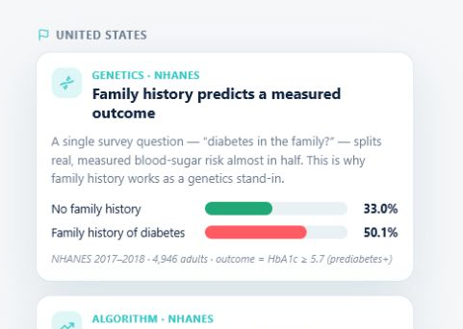
Live demonstration
Two fictional profiles show how the experience responds to different patterns.
01
Start with Alex
02
Review daily guidance
03
Switch to Maria
04
Explore cycle estimate
05
Inspect model and AI insight
WELLPATH • CONCEPT PROTOTYPE
17
Notes:
Use this slide to begin the live demonstration. Start with Alex to show the dashboard and daily guidance. Then switch to Maria to show cycle estimation, model statistics, associated factors, and the short AI insight. Remind the audience that both profiles are fictional and the experience is conceptual.
[Sources]
- C:\Users\Mahir\Desktop\WellPath\poster_assets\insights-overview.png
- C:\Users\Mahir\Desktop\WellPath\wellpath-health-integrated\wellpath-integrated\backend\src\seed\data\users.js

Slide 18
WELLPATH
A health app could help people explore, not just track.
The prototype demonstrates three connected ideas
01
Public data can test an experimental model
02
Sample profiles can safely demonstrate an interface
03
AI can explore clearer explanations of calculated results
WELLPATH • CONCEPT PROTOTYPE
18
Notes:
Close by returning to the central question. WellPath is valuable as a concept because it keeps three ideas connected but distinct: public health data for model experimentation, fictional profiles for interface demonstration, and AI for explanation. Invite questions about the design choices, model experiment, or limitations.
[Sources]
- C:\Users\Mahir\Desktop\WellPath\wellpath-condition-models\README.md

