Slide 1
Chapter 3

Slide 2

Solving Problems by Searching
Reflex agent is simple
  base their actions on
  a direct mapping from states to actions
  but cannot work well in environments
    which this mapping would be too large to store
    and would take too long to learn
Hence, goal-based agent is used

Slide 3
Problem-solving agent
Problem-solving agent
  A kind of goal-based agent
  It solves problem by
    finding sequences of actions that lead to desirable states (goals)
  To solve a problem,
    the first step is the goal formulation, based on the current situation

Slide 4
Goal formulation
The goal is formulated
  as a set of world states, in which the goal is satisfied
Reaching from initial state → goal state
  Actions are required
Actions are the operators
  causing transitions between world states
  Actions should be abstract enough at a certain degree, instead of very detailed
  E.g., turn left VS turn left 30 degree, etc.

Slide 5
Problem formulation
The process of deciding
  what actions and states to consider
E.g., driving Amman → Zarqa
  in-between states and actions defined
  States: Some places in Amman & Zarqa
  Actions: Turn left, Turn right, go straight, accelerate & brake, etc.

Slide 6
Search
Because there are many ways to achieve the same goal
  Those ways are together expressed as a tree
  Multiple options of unknown value at a point,
    the agent can examine different possible sequences of actions, and choose the best
  This process of looking for the best sequence is called search
  The best sequence is then a list of actions, called solution

Slide 7
Search algorithm
Defined as
  taking a problem
  and returns a solution
Once a solution is found
  the agent follows the solution
  and carries out the list of actions – execution phase
Design of an agent
  “Formulate, search, execute”

Slide 8
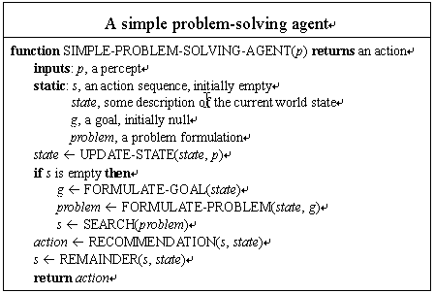

Slide 9
Well-defined problems and solutions
A problem is defined by 5 components:
Initial state
Actions
Transition model or
(Successor functions)
Goal Test.
Path Cost.

Slide 10
Well-defined problems and solutions
A problem is defined by 4 components:
  The initial state
    that the agent starts in
  The set of possible actions
  Transition model: description of what each action does.
  (successor functions): refer to any state reachable from given state by a single action
  Initial state, actions and Transition model define the state space
    the set of all states reachable from the initial state by any sequence of actions.
  A path in the state space:
    any sequence of states connected by a sequence of actions.

Slide 11
Well-defined problems and solutions
The goal test
  Applied to the current state to test
    if the agent is in its goal
  -Sometimes there is an explicit set of possible goal states. (example: in Amman).
  -Sometimes the goal is described by the properties
    instead of stating explicitly the set of states
  Example: Chess
    the agent wins if it can capture the KING of the opponent on next move ( checkmate).
    no matter what the opponent does

Slide 12
Well-defined problems and solutions
A path cost function,
  assigns a numeric cost to each path
  = performance measure
  denoted by g
  to distinguish the best path from others
Usually the path cost is
  the sum of the step costs of the individual actions (in the action list)

Slide 13
Well-defined problems and solutions
Together a problem is defined by
  Initial state
  Actions
  Successor function
  Goal test
  Path cost function
The solution of a problem is then
  a path from the initial state to a state satisfying the goal test
Optimal solution
  the solution with lowest path cost among all solutions

Slide 14
Formulating problems
Besides the four components for problem formulation
  anything else?
Abstraction
  the process to take out the irrelevant information
  leave the most essential parts to the description of the states
  ( Remove detail from representation)
  Conclusion: Only the most important parts that are contributing to searching are used

Slide 15
Evaluation Criteria
formulation of a problem as search task
basic search strategies
important properties of search strategies
selection of search strategies for specific tasks
(The ordering of the nodes in FRINGE defines the search strategy)

Slide 16
Problem-Solving Agents
agents whose task is to solve a particular problem (steps)
  goal formulation
    what is the goal state
    what are important characteristics of the goal state
    how does the agent know that it has reached the goal
    are there several possible goal states
      are they equal or are some more preferable
  problem formulation
    what are the possible states of the world relevant for solving the problem
    what information is accessible to the agent
    how can the agent progress from state to state

Slide 17
Example
Ramtha
15 km
Irbed
20 km
25 km
ajlun
33km
35 km
Mafraq
45 km
15 km
20 km
Jarash
45 km
75 km
Zarqa
Salat
40 km
15 km
15 km
Azraq
25 km
amman
55 km
250 km
Madaba
150 km
150 km
200 km
Karak
180 km
Aqaba

Slide 18
From our Example
1. Formulate Goal
- Be In Amman
2. Formulate Problem
- States : Cities
- actions : Drive Between Cities
3. Find Solution
- Sequence of Cities : ajlun – Jarash - Amman

Slide 19
Our Example
Problem : To Go from Ajlun to Amman
Initial State : Ajlween
3. Operator : Go from One City To another .
4. State Space : {Jarash , Salat , irbed,……..}
5. Goal Test : are the agent in Amman.
6. Path Cost Function : Get The Cost From The Map.
7. Solution :{ {Aj → Ja → Ir → Ma → Za → Am} , {Aj →Ir → Ma → Za → Am} …. {Aj → Ja → Am} }
8. State Set Space : {Ajlun → Jarash → Amman}

Slide 20
Example: Romania
On holiday in Romania; currently in Arad.
Flight leaves tomorrow from Bucharest
Formulate goal:
  be in Bucharest
Formulate problem:
  states: various cities
  actions: drive between cities
Find solution:
  sequence of cities, e.g., Arad, Sibiu, Fagaras, Bucharest

Slide 21

Example: Romania

Slide 22
Single-state problem formulation
A problem is defined by four items:
actions or successor function S(x) = set of action–state pairs
  e.g., S(Arad) = {<Arad → Zerind, Zerind>, … }
goal test, can be
  explicit, e.g., x = "at Bucharest"
  implicit, e.g., Checkmate(x)
path cost (additive)
  e.g., sum of distances, number of actions executed, etc.
  c(x,a,y) is the step cost, assumed to be ≥ 0
A solution is a sequence of actions leading from the initial state to a goal state
initial state e.g., "at Arad"

Slide 23
Example problems
Toy problems
  those intended to illustrate or exercise various problem-solving methods
  E.g., puzzle, chess, etc.
Real-world problems
  tend to be more difficult and whose solutions people actually care about
  E.g., Design, planning, etc.

Slide 24
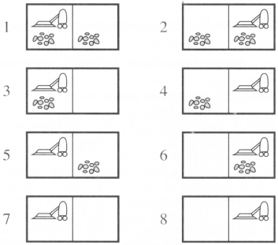

Toy problems
Example: vacuum world
Number of states: 8
Initial state: Any
Number of actions: 4
  left, right, suck, noOp
Goal: clean up all dirt
  Goal states: {7, 8}
Path Cost:
  Each step costs 1

Slide 25
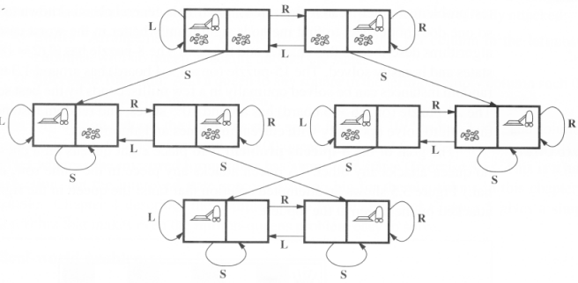

Slide 26
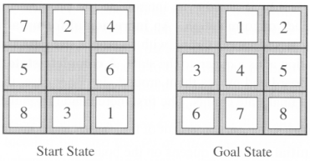
The 8-puzzle

Slide 27
The 8-puzzle
States:
  a state description specifies the location of each of the eight tiles and blank in one of the nine squares
Initial State:
  Any state in state space
Successor function:
  the blank moves Left, Right, Up, or Down
Goal test:
  current state matches the goal configuration
Path cost:
  each step costs 1, so the path cost is just the length of the path

Slide 28
The 8-queens
There are two ways to formulate the problem
All of them have the common followings:
  Goal test: 8 queens on board, not attacking to each other
  Path cost: zero

Slide 29
The 8-queens
(1) Incremental formulation
  involves operators that augment the state description starting from an empty state
  Each action adds a queen to the state
  States:
    any arrangement of 0 to 8 queens on board
  Successor function:
    add a queen to any empty square

Slide 30
The 8-queens
(2) Complete-state formulation
  starts with all 8 queens on the board
  move the queens individually around
  States:
    any arrangement of 8 queens, one per column in the leftmost columns
  Operators: move an attacked queen to a row, not attacked by any other

Slide 31
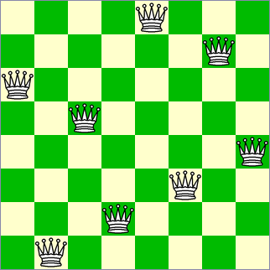
The 8-queens
Conclusion:
  the right formulation makes a big difference to the size of the search space

Slide 32
Example: River Crossing
Items: Man, Wolf, Corn, Chicken.
Man wants to cross river with all items.
  Wolf will eat Chicken
  Chicken will eat corn.
  Boat will take max of two.

Slide 33
3.3 Searching for solutions

Slide 34
3.3 Searching for solutions
Finding out a solution is done by
  searching through the state space
All problems are transformed
  as a search tree
  generated by the initial state and successor function

Slide 35
Search tree
Initial state
  The root of the search tree is a search node
Expanding
  applying successor function to the current state
  thereby generating a new set of states
leaf nodes
  the states having no successors
  Fringe : Set of search nodes that have not been expanded yet.
Refer to next figure

Slide 36

Tree search example

Slide 37

Tree search example

Slide 38
Search tree
The essence of searching
  in case the first choice is not correct
  choosing one option and keep others for later inspection
Hence we have the search strategy
  which determines the choice of which state to expand
  good choice → fewer work → faster
Important:
  state space ≠ search tree

Slide 39
Search tree
State space
  has unique states {A, B}
  while a search tree may have cyclic paths: A-B-A-B-A-B- …
A good search strategy should avoid such paths

Slide 40
Search tree
A node is having five components:
  STATE: which state it is in the state space
  PARENT-NODE: from which node it is generated
  ACTION: which action applied to its parent-node to generate it
  PATH-COST: the cost, g(n), from initial state to the node n itself
  DEPTH: number of steps along the path from the initial state

Slide 41
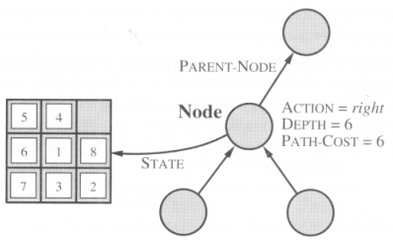

Slide 42
Measuring problem-solving performance
The evaluation of a search strategy
  Completeness:
    is the strategy guaranteed to find a solution when there is one?
  Optimality:
    does the strategy find the highest-quality solution when there are several different solutions?
  Time complexity:
    how long does it take to find a solution?
  Space complexity:
    how much memory is needed to perform the search?

Slide 43
Measuring problem-solving performance
In AI, complexity is expressed in
  b, branching factor, maximum number of successors of any node
  d, the depth of the shallowest goal node.
  (depth of the least-cost solution)
  m, the maximum length of any path in the state space
Time and Space is measured in
  number of nodes generated during the search
  maximum number of nodes stored in memory

Slide 44
Measuring problem-solving performance
For effectiveness of a search algorithm
  we can just consider the total cost
  The total cost = path cost (g) of the solution found + search cost
    search cost = time necessary to find the solution
Tradeoff:
  (long time, optimal solution with least g)
  vs. (shorter time, solution with slightly larger path cost g)

Slide 45
3.4 Uninformed search strategies

Slide 46
3.4 Uninformed search strategies
Uninformed search
  no information about the number of steps
  or the path cost from the current state to the goal
  search the state space blindly
Informed search, or heuristic search
  a cleverer strategy that searches toward the goal,
  based on the information from the current state so far

Slide 47
Uninformed search strategies
Breadth-first search
  Uniform cost search
Depth-first search
  Depth-limited search
  Iterative deepening search
Bidirectional search

Slide 48
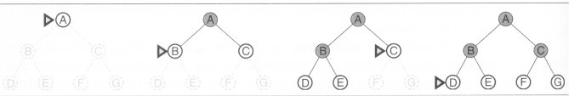
Breadth-first search
The root node is expanded first (FIFO)
All the nodes generated by the root node are then expanded
And then their successors and so on

Slide 49
Breadth-first search
S
A
D
B
D
A
E
C
E
E
B
B
F
11
D
F
B
F
C
E
A
C
G
14
17
15
15
13
G
C
G
F
19
19
17
G
25

Slide 50
Breadth-First Strategy
New nodes are inserted at the end of FRINGE
1
2
3
FRINGE = (1)
4
5
6
7

Slide 51
Breadth-First Strategy
New nodes are inserted at the end of FRINGE
1
2
3
FRINGE = (2, 3)
4
5
6
7

Slide 52
Breadth-First Strategy
New nodes are inserted at the end of FRINGE
1
2
3
FRINGE = (3, 4, 5)
4
5
6
7

Slide 53
Breadth-First Strategy
New nodes are inserted at the end of FRINGE
1
2
3
FRINGE = (4, 5, 6, 7)
4
5
6
7

Slide 54
Breadth-first search (Analysis)
Breadth-first search
  Complete – find the solution eventually
  Optimal, if step cost is 1
  The disadvantage
  if the branching factor of a node is large,
  for even small instances (e.g., chess)
    the space complexity and the time complexity are enormous

Slide 55
Properties of breadth-first search
Complete? Yes (if b is finite)
Time? 1+b+b²+b³+… +b^{d} = b(b^{d}-1) = O(b^{d+1})
Space? O(b^{d+1}) (keeps every node in memory)
Optimal? Yes (if cost = 1 per step)
Space is the bigger problem (more than time)

Slide 56
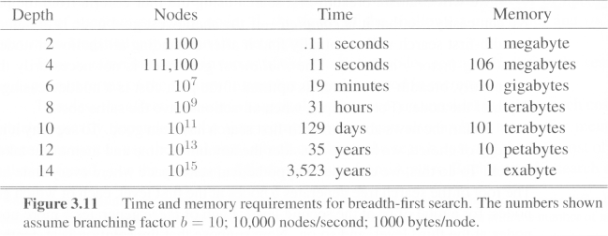
Breadth-first search (Analysis)
assuming 10000 nodes can be processed per second, each with 1000 bytes of storage

Slide 57
Uniform cost search
Breadth-first finds the shallowest goal state
  but not necessarily be the least-cost solution
  work only if all step costs are equal
Uniform cost search
  modifies breadth-first strategy
    by always expanding the lowest-cost node
  The lowest-cost node is measured by the path cost g(n)

Slide 58
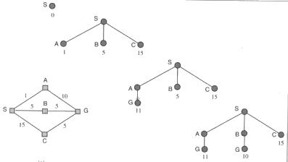
Uniform cost search
the first found solution is guaranteed to be the cheapest
  least in depth
  But restrict to non-decreasing path cost
  Unsuitable for operators with negative cost

Slide 59
Uniform-cost search
Expand least-cost unexpanded node
Implementation:
  fringe = queue ordered by path cost
Equivalent to breadth-first if step costs all equal
Complete? Yes, if step cost ≥ ε
Time? # of nodes with g ≤ cost of optimal solution, O(b^{ceiling(C*/ ε)}) where C* is the cost of the optimal solution
Space? # of nodes with g ≤ cost of optimal solution, O(b^{ceiling(C*/ ε)})
Optimal? Yes – nodes expanded in increasing order of g(n)
let
ε is possitive constant (every action cost)
C* be the cost of optimal solution.

Slide 60
Depth-first search
Always expands one of the nodes at the deepest level of the tree
Only when the search hits a dead end
  goes back and expands nodes at shallower levels
  Dead end → leaf nodes but not the goal
Backtracking search
  only one successor is generated on expansion
  rather than all successors
  fewer memory

Slide 61

Depth-first search
Expand deepest unexpanded node
Implementation:
  fringe = LIFO queue, i.e., put successors at front

Slide 62


Depth-first search
Expand deepest unexpanded node
Implementation:
  fringe = LIFO queue, i.e., put successors at front

Slide 63

Depth-first search
Expand deepest unexpanded node
Implementation:
  fringe = LIFO queue, i.e., put successors at front

Slide 64

Depth-first search
Expand deepest unexpanded node
Implementation:
  fringe = LIFO queue, i.e., put successors at front

Slide 65

Depth-first search
Expand deepest unexpanded node
Implementation:
  fringe = LIFO queue, i.e., put successors at front

Slide 66

Depth-first search
Expand deepest unexpanded node
Implementation:
  fringe = LIFO queue, i.e., put successors at front

Slide 67

Depth-first search
Expand deepest unexpanded node
Implementation:
  fringe = LIFO queue, i.e., put successors at front

Slide 68

Depth-first search
Expand deepest unexpanded node
Implementation:
  fringe = LIFO queue, i.e., put successors at front

Slide 69

Depth-first search
Expand deepest unexpanded node
Implementation:
  fringe = LIFO queue, i.e., put successors at front

Slide 70

Depth-first search
Expand deepest unexpanded node
Implementation:
  fringe = LIFO queue, i.e., put successors at front

Slide 71

Depth-first search
Expand deepest unexpanded node
Implementation:
  fringe = LIFO queue, i.e., put successors at front

Slide 72

Depth-first search
Expand deepest unexpanded node
Implementation:
  fringe = LIFO queue, i.e., put successors at front

Slide 73
Depth-first search
S
A
D
B
D
A
E
C
E
E
B
B
F
11
D
F
B
F
C
E
A
C
G
14
17
15
15
13
G
C
G
F
19
19
17
G
25

Slide 74
Depth-first search (Analysis)
Not complete
  because a path may be infinite or looping
  then the path will never fail and go back try another option
Not optimal
  it doesn't guarantee the best solution
It overcomes
  the time and space complexities

Slide 75
Properties of depth-first search
Complete? No: fails in infinite-depth spaces, spaces with loops
  Modify to avoid repeated states along path
    → complete in finite spaces
Time? O(b^{m}): terrible if m is much larger than d
  but if solutions are dense, may be much faster than breadth-first
Space? O(bm), i.e., linear space!
Optimal? No

Slide 77
Depth-Limited Strategy
Depth-first with depth cutoff k (maximal depth below which nodes are not expanded)
Three possible outcomes:
  Solution
  Failure (no solution)
  Cutoff (no solution within cutoff)

Slide 78
Depth-limited search
It is depth-first search
  with a predefined maximum depth
  However, it is usually not easy to define the suitable maximum depth
  too small → no solution can be found
  too large → the same problems are suffered from
Anyway the search is
  complete
  but still not optimal

Slide 79
Depth-limited search
S
depth = 3
A
D
3
6
B
D
A
E
C
E
E
B
B
F
11
D
F
B
F
C
E
A
C
G
14
17
15
15
13
G
C
G
F
19
19
17
G
25

Slide 80
Iterative deepening search
No choosing of the best depth limit
It tries all possible depth limits:
  first 0, then 1, 2, and so on
  combines the benefits of depth-first and breadth-first search

Slide 81
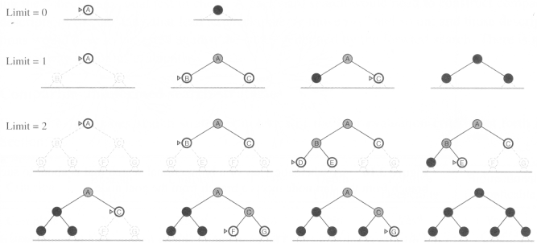
Iterative deepening search

Slide 82
Iterative deepening search (Analysis)
optimal
complete
Time and space complexities
  reasonable
suitable for the problem
  having a large search space
  and the depth of the solution is not known

Slide 83
Properties of iterative deepening search
Complete? Yes
Time? (d+1)b⁰ + d b¹ + (d-1)b² + … + b^{d} = O(b^{d})
Space? O(bd)
Optimal? Yes, if step cost = 1

Slide 84
Iterative lengthening search
IDS is using depth as limit
ILS is using path cost as limit
  an iterative version for uniform cost search
  has the advantages of uniform cost search
    while avoiding its memory requirements
  but ILS incurs substantial overhead
    compared to uniform cost search

Slide 85
Bidirectional search
Run two simultaneous searches
  one forward from the initial state another backward from the goal
  stop when the two searches meet
However, computing backward is difficult
  A huge amount of goal states
  at the goal state, which actions are used to compute it?
  can the actions be reversible to computer its predecessors?

Slide 86
Bidirectional Strategy
2 fringe queues: FRINGE1 and FRINGE2
Time and space complexity = O(b^{d/2}) << O(b^{d})

Slide 87
Bidirectional search
S
Forward
A
D
Backwards
B
D
A
E
C
E
E
B
B
F
11
D
F
B
F
C
E
A
C
G
14
17
15
15
13
G
C
G
F
19
19
17
G
25

Slide 88


Slide 89
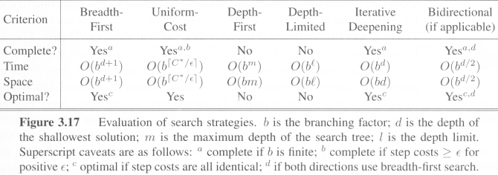
Comparing search strategies

Slide 90
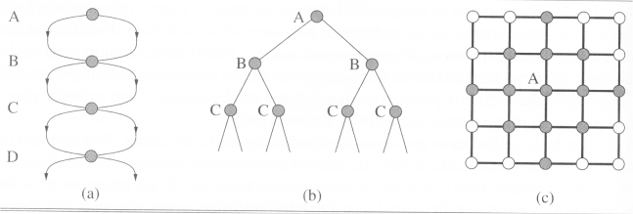
Avoiding repeated states
for all search strategies
  There is possibility of expanding states
    that have already been encountered and expanded before, on some other path
  may cause the path to be infinite → loop forever
  Algorithms that forget their history
    are doomed to repeat it

Slide 91
Avoiding repeated states
Three ways to deal with this possibility
  Do not return to the state it just came from
    Refuse generation of any successor same as its parent state
  Do not create paths with cycles
    Refuse generation of any successor same as its ancestor states
  Do not generate any generated state
    Not only its ancestor states, but also all other expanded states have to be checked against

Slide 92
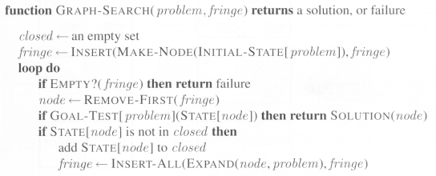
Avoiding repeated states
We then define a data structure
  closed list:
  a set storing every expanded node so far
  If the current node matches a node on the closed list, discard it.

