Slide 1
Formal Description of a Problem
In AI, we will formally define a problem as
  a space of all possible configurations where each configuration is called a state
    thus, we use the term state space
  an initial state
  one or more goal states
  a set of rules/operators which move the problem from one state to the next
In some cases, we may enumerate all possible states (see monkey & banana problem on the next slide)
  but usually, such an enumeration will be overwhelmingly large so we only generate a portion of the state space, the portion we are currently examining

Slide 2
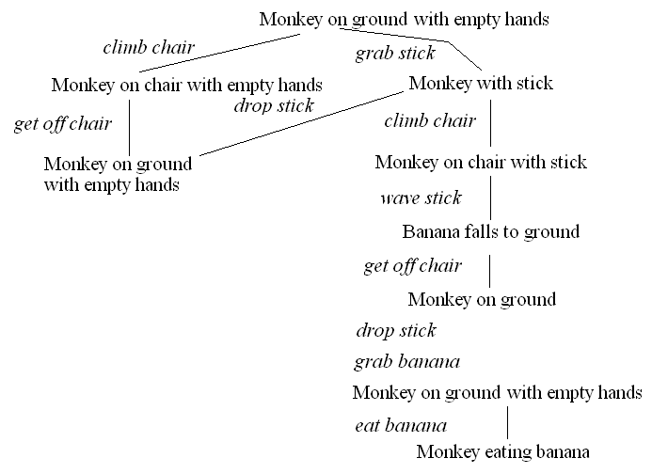
The Monkey & Bananas Problem
A monkey is in a cage and bananas are suspended from the ceiling, the monkey wants to eat a banana but cannot reach them
  in the room are a chair and a stick
  if the monkey stands on the chair and waves the stick, he can knock a banana down to eat it
  what are the actions the monkey should take?
Initial state:
monkey on ground
with empty hand
bananas suspended
Goal state:
monkey eating
Actions:
climb chair/get off
grab X
wave X
eat X

Slide 3
Missionaries and Cannibals
3 missionaries and 3 cannibals are on one side of the river with a boat that can take exactly 2 people across the river
  how can we move the 3 missionaries and 3 cannibals across the river
  with the constraint that the cannibals never outnumber the missionaries on either side of the river (lest the cannibals start eating the missionaries!)??
We can represent a state as a 6-item tuple:
  (a, b, c, d, e, f)
    a/b = number of missionaries/cannibals on left shore
    c/d = number of missionaries/cannibals in boat
    e/f = number of missionaries/cannibals on right shore
    where a + b + c + d + e + f = 6
    and a >= b unless a = 0, c >= d unless c = 0, and e >= f unless e = 0
Legal operations (moves) are
  0, 1, 2 missionaries get into boat (c + d must be <= 2)
  0, 1, 2 missionaries get out of boat
  0, 1, 2 cannibals get into boat (c + d must be <= 2)
  0, 1, 2 missionaries get out of boat
  boat sails from left shore to right shore (c + d must be >= 1)
  boat sails from right shore to left shore (c + d must be >= 1)

Slide 4
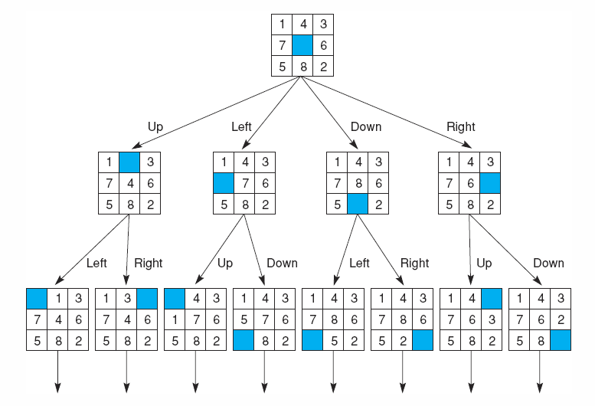
8 Puzzle
The 8 puzzle search space consists of 8! states (40320)

Slide 5
Search
Given a problem expressed as a state space (whether explicitly or implicitly)
  with operators/actions, an initial state and a goal state, how do we find the sequence of operators needed to solve the problem?
  this requires search
Formally, we define a search space as [N, A, S, GD]
  N = set of nodes or states of a graph
  A = set of arcs (edges) between nodes that correspond to the steps in the problem (the legal actions or operators)
  S = a nonempty subset of N that represents start states
  GD = a nonempty subset of N that represents goal states
Our problem becomes one of traversing the graph from a node in S to a node in GD
  we can use any of the numerous graph traversal techniques for this but in general, they divide into two categories:
    brute force – unguided search
    heuristic – guided search

Slide 6
Consequences of Search
As shown a few slides back, the 8-puzzle has over 40000 different states
  what about the 15 puzzle?
A brute force search means try all possible states blindly until you find the solution
  if a problem has a state space that consists of n moves where each move has m possible choices, then there are 2^{m*n} states
  two forms of brute force search are: depth first search, breath first search
A guided search examines a state and uses some heuristic (usually a function) to determine how good that state is (how close you might be to a solution) to help determine what state to move to
  hill climbing
  best-first search
  A/A* algorithm
  Minimax
While a good heuristic can reduce the complexity from 2^{m*n} to something tractable, there is no guarantee so any form of search is O(2^{n}) in the worst case

Slide 7
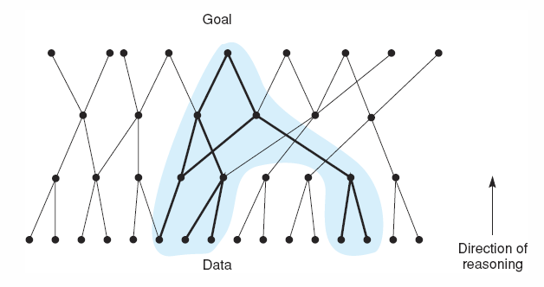
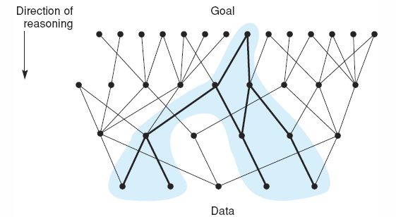
Forward vs Backward Search
The common form of reasoning starts with data and leads to conclusions
  for instance, diagnosis is data-driven – given the patient symptoms, we work toward disease hypotheses
    we often think of this form of reasoning as “forward chaining” through rules
Backward search reasons from goals to actions
  Planning and design are often goal-driven
    “backward chaining”

Slide 8
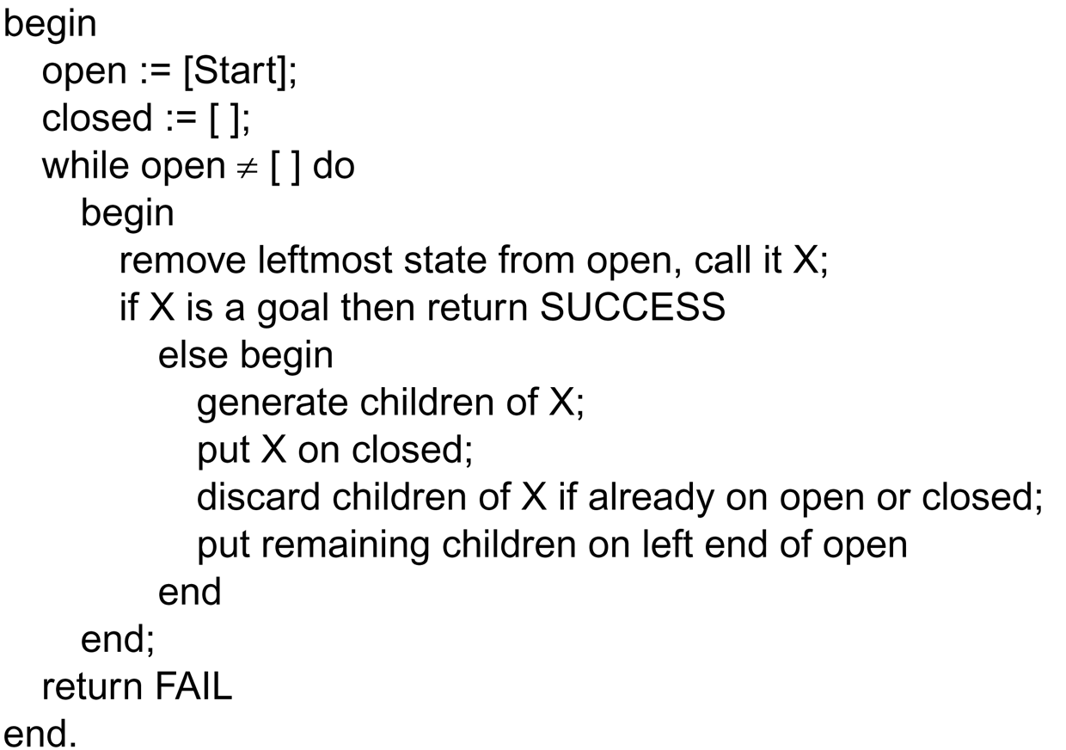
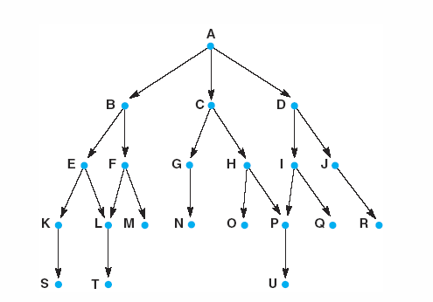
Depth-first Search
Starting at node A, our search gives us:
A, B, E, K, S, L, T, F, M, C, G, N, H, O, P,
U, D, I, Q, J, R

Slide 9
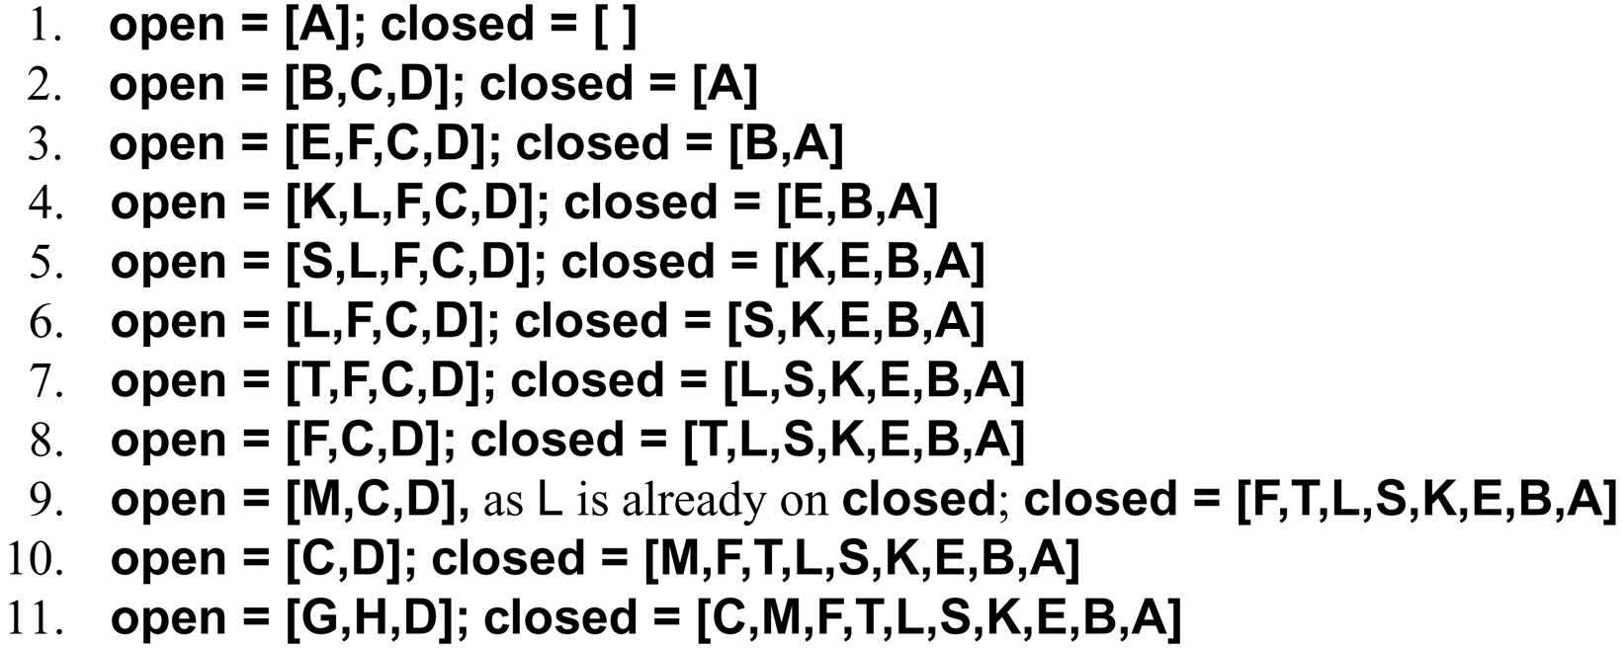
Depth-first Search Example

Slide 10
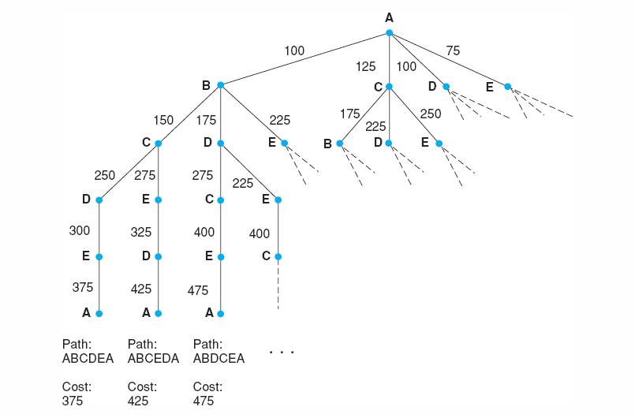
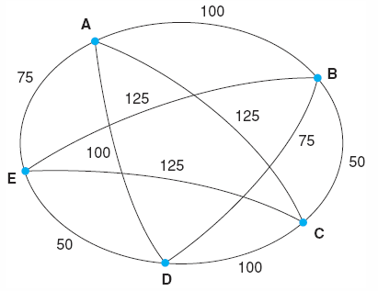
Traveling Salesman Problem

Slide 11
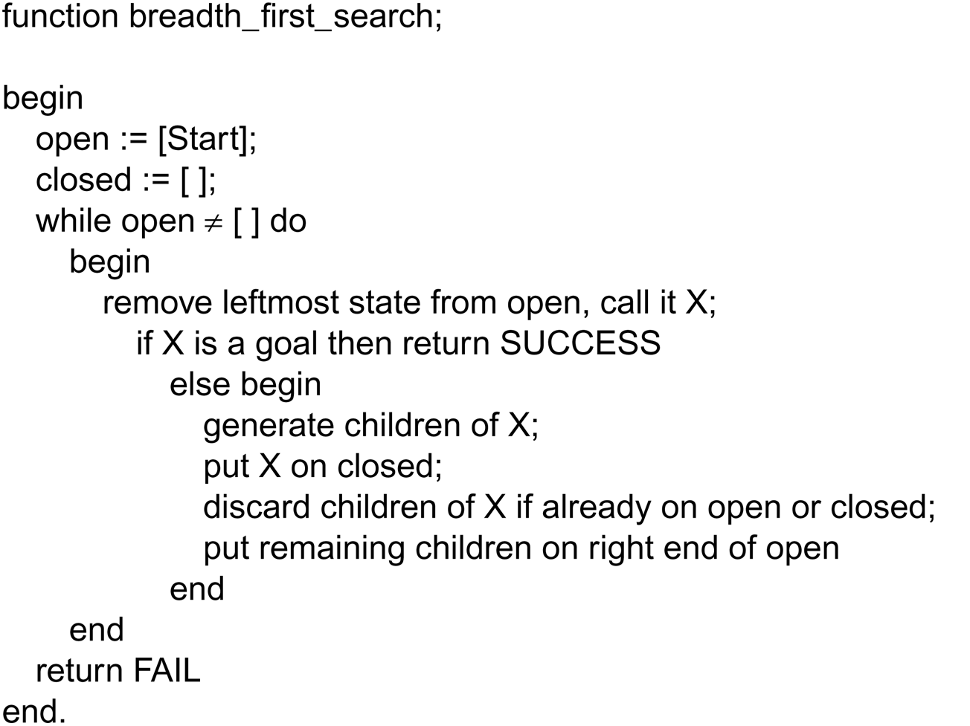
Breadth-First Search
Starting at node A, our search would generate the
nodes in alphabetical order from A to U

Slide 12
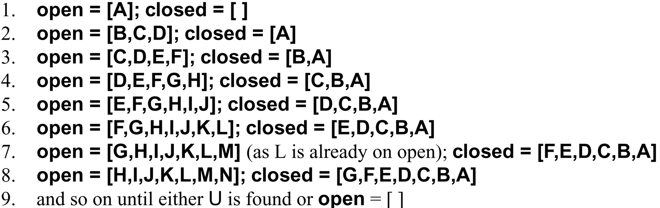
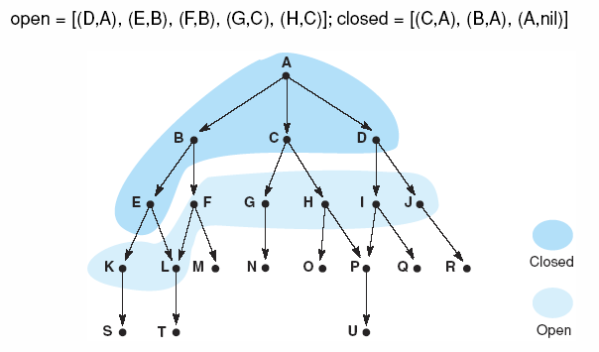
Breadth-First Search Example

Slide 13
Problem Characteristic
To choose an appropriate method for a particular problem first we need to categorize the problem based on the following characteristics.
Is the problem decomposable into small sub-problems which are easy to solve?
Can solution steps be ignored or undone?
Is the universe of the problem is predictable?
Is a good solution to the problem is absolute or relative?
Is the solution to the problem a state or a path?
What is the role of knowledge in solving a problem using artificial intelligence?
Does the task of solving a problem require human interaction?

Slide 14
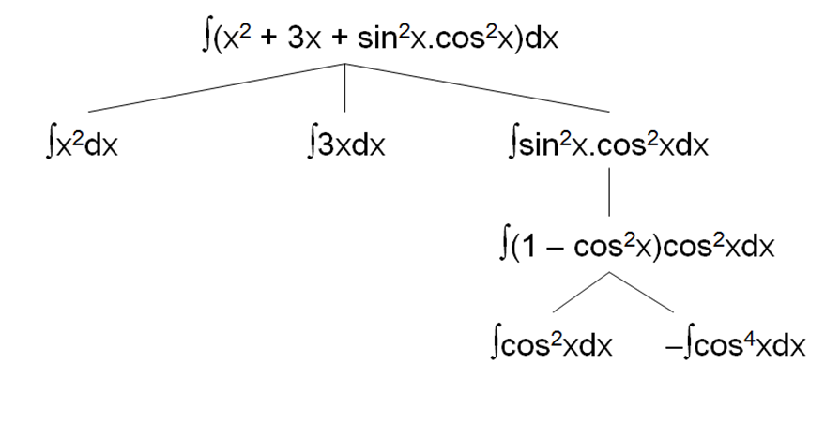
1. Is the problem decomposable into small sub-problems which are easy to solve?
Can the problem be broken down into smaller problems to be solved independently?
Example: In this case, the problem is divided into smaller problems. The smaller problems are solved independently.
Finally, the result is merged to get the final result.

Slide 15
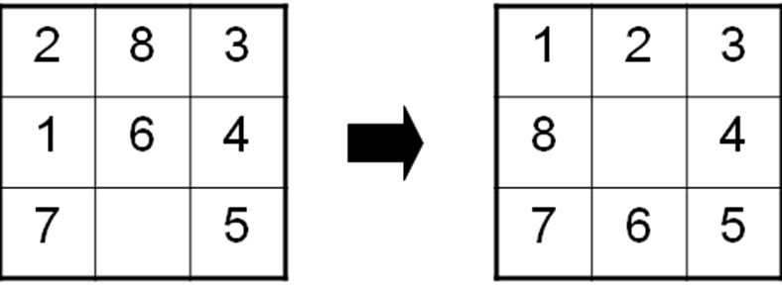
2. Can solution steps be ignored or undone?
In the Theorem Proving problem, a lemma that has been proved can be ignored for the next steps.
Such problems are called Ignorable problems.
In the 8-Puzzle, Moves can be undone and backtracked.
Such problems are called Recoverable problems.
In Playing Chess, moves can be retracted.
Such problems are called Irrecoverable problems.
Ignorable problems can be solved using a simple control structure that never backtracks.
Recoverable problems can be solved using backtracking. Irrecoverable problems can be solved by recoverable style methods via planning.

Slide 16
Is the universe of the problem is predictable?
In Playing Bridge, We cannot know exactly where all the cards are or what the other players will do on their turns.
Uncertain outcome!
For certain-outcome problems, planning can be used to generate a sequence of operators that is guaranteed to lead to a solution.
For uncertain-outcome problems, a sequence of generated operators can only have a good probability of leading to a solution. Plan revision is made as the plan is carried out and the necessary feedback is provided.

Slide 17
Is a good solution to the problem is absolute or relative?
The Travelling Salesman Problem, we have to try all paths to find the shortest one.
Any path problem can be solved using heuristics that suggest good paths to explore.
For best-path problems, a much more exhaustive search will be performed.

Slide 18
Is the solution to the problem a state or a path
The Water Jug Problem, the path that leads to the goal must be reported.
A path-solution problem can be reformulated as a state-solution problem by describing a state as a partial path to a solution. The question is whether that is natural or not.

Slide 19
What is the role of knowledge in solving a problem using artificial intelligence?
Playing Chess
Consider again the problem of playing chess. Suppose you had unlimited computing power available. How much knowledge would be required by a perfect program? The answer to this question is very little—just the rules for determining legal moves and some simple control mechanism that implements an appropriate search procedure.
Additional knowledge about such things as good strategy and tactics could of course help considerably to constrain the search and speed up the execution of the program. Knowledge is important only to constrain the search for a solution.
Reading Newspaper
Now consider the problem of scanning daily newspapers to decide which are supporting the Democrats and which are supporting the Republicans in some upcoming election. Again assuming unlimited computing power, how much knowledge would be required by a computer trying to solve this problem? This time the answer is a great deal.
It would have to know such things as:
The names of the candidates in each party.
The fact that if the major thing you want to see done is have taxes lowered, you are probably supporting the Republicans.
The fact that if the major thing you want to see done is improved education for minority students, you are probably supporting the Democrats.
The fact that if you are opposed to big government, you are probably supporting the Republicans.
And so on …

Slide 20
Does the task of solving a problem require human interaction?
Sometimes it is useful to program computers to solve problems in ways that the majority of people would not be able to understand.
This is fine if the level of the interaction between the computer and its human users is problem-in solution-out.
But increasingly we are building programs that require intermediate interaction with people, both to provide additional input to the program and to provide additional reassurance to the user.
The solitary problem, in which there is no intermediate communication and no demand for an explanation of the reasoning process.
The conversational problem, in which intermediate communication is to provide either additional assistance to the computer or additional information to the user.

