Slide 1


Concept Learning

Slide 2
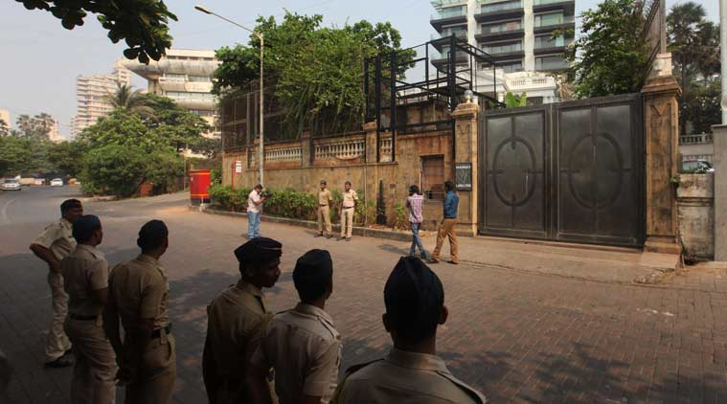
Waiting outside the house to get an autograph.

Slide 3

Which days does he come out to enjoy sports?
Sky condition
Humidity
Temperature
Wind
Water
Forecast
Attributes of a day: takes on values

Slide 4
Learning Task
We want to make a hypothesis about the day on which SRK comes out..
  in the form of a boolean function on the attributes of the day.
Find the right hypothesis/function from historical data

Slide 5
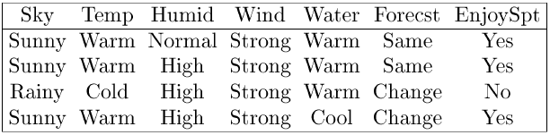
Training Examples for EnjoySport
c( )=1
c( )=1
c( )=0
c( )=1
Negative and positive learning examples
Concept learning:
- Deriving a Boolean function from training examples
  - Many “hypothetical” boolean functions
      Hypotheses; find h such that h = c.
  Other more complex examples:
    Non-boolean functions
Generate hypotheses for concept from TE’s
c is the target concept

Slide 6
Representing Hypotheses
Task of finding appropriate set of hypotheses for concept given training data
Represent hypothesis as Conjunction of constraints of the following form:
  Values possible in any hypothesis
    Specific value : Water = Warm
    Don’t-care value: Water = ?
    No value allowed : Water = ∅
      i.e., no permissible value given values of other attributes
  Use vector of such values as hypothesis:
    ⟨ Sky AirTemp Humid Wind Water Forecast ⟩
      Example: ⟨Sunny ? ? Strong ? Same ⟩
Idea of satisfaction of hypothesis by some example
  say “example satisfies hypothesis”
  defined by a function h(x):
h(x) = 1 if h is true on x
= 0 otherwise
Want hypothesis that best fits examples:
  Can reduce learning to search problem over space of hypotheses

Slide 7
Prototypical Concept Learning Task
TASK T: predicting when person will enjoy sport
  Target function c: EnjoySport : X → {0, 1}
  Cannot, in general, know Target function c
    Adopt hypotheses H about c
  Form of hypotheses H:
    Conjunctions of literals ⟨?, Cold, High, ?, ?, ? ⟩
EXPERIENCE E
  Instances X: possible days described by attributes Sky, AirTemp, Humidity, Wind, Water, Forecast
  Training examples D: Positive/negative examples of target function {⟨x₁, c(x₁)⟩, . . . ⟨x_{m}, c(x_{m})⟩}
PERFORMANCE MEASURE P: Hypotheses h in H such that h(x) = c(x) for all x in D ()
  There may exist several alternative hypotheses that fit examples

Slide 8
Inductive Learning Hypothesis
Any hypothesis found to approximate the target function well over a sufficiently large set of training examples will also approximate the target function well over other unobserved examples

Slide 9
Approaches to learning algorithms
The choice of the hypothesis
space reduces the number of
hypotheses.
Brute force search
  Enumerate all possible hypotheses and evaluate
  Highly inefficient even for small EnjoySport example
    |X| = 3.2.2.2.2= 96 distinct instances
    Large number of syntactically distinct hypotheses (0’s, ?’s)
      EnjoySport: |H| = 5.4.4.4.4.4=5120
      Fewer when consider h’s with 0’s
        Every h with a 0 is empty set of instances (classifies instance as neg)
        Hence # semantically distinct h’s is:
        1+ (4.3.3.3.3.3) = 973
    EnjoySport is VERY small problem compared to many
Hence use other search procedures.
  Approach 1: Search based on ordering of hypotheses
  Approach 2: Search based on finding all possible hypotheses using
  a good representation of hypothesis space
    All hypotheses that fit data

Slide 10
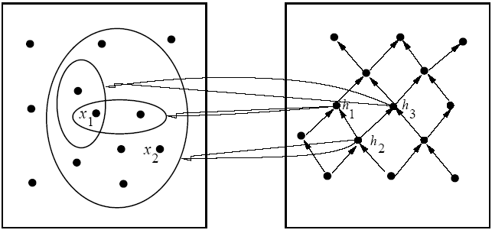
Ordering on Hypotheses
Instances X
Hypotheses H
specific
general
x₁=⟨Sunny Warm High Strong Cool Same⟩
x₂=⟨Sunny Warm High Light Warm Same⟩
h₁=⟨Sunny ? ? Strong ? ?⟩
h₂=⟨Sunny ? ? ? ? ?⟩
h₃=⟨Sunny ? ? ? Cool ?⟩
h is more general than h′( h ≥_{g} h′) if for each instance x,
h′(x) = 1 → h(x) = 1
Which is the most general/most specific hypothesis?

Slide 11
Find-S Algorithm
Assumes
  There is hypothesis h in H describing target function c
  There are no errors in the TEs
Procedure
Initialize h to the most specific hypothesis in H (what is this?)
For each positive training instance x
  For each attribute constraint a_{i} in h
If the constraint a_{i} in h is satisfied by x
do nothing
Else
replace a_{i} in h by the next more general constraint that is satisfied by x
Output hypothesis h
Note
There is no change for a negative example, so they are ignored.
This follows from assumptions that there is h in H describing target function c (ie.,for this h, h=c)
and that there are no errors in data. In particular, it follows that the hypothesis at any stage cannot be changed by neg example.
Assumption: Everything except the positive
examples is negative

Slide 12
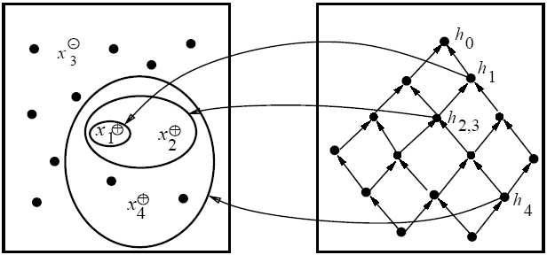
Example of Find-S
Instances X
Hypotheses H
specific
general
h₀=⟨∅ ∅ ∅ ∅ ∅ ∅⟩
h₁=⟨Sunny Warm Normal Strong Warm Same⟩
h₂=⟨Sunny Warm ? Strong Warm Same⟩
h₃=⟨Sunny Warm ? Strong Warm Same⟩
h₄=⟨Sunny Warm ? Strong ? ?⟩
x₁=⟨Sunny Warm Normal Strong Warm Same⟩ +
x₂=⟨Sunny Warm High Strong Warm Same⟩ +
x₃=⟨Rainy Cold High Strong Warm Change⟩ −
x₄=⟨Sunny Warm High Strong Cool Change⟩ +

Slide 13
Problems with Find-S
Problems:
  Throws away information!
    Negative examples
  Can’t tell whether it has learned the concept
    Depending on H, there might be several h’s that fit TEs!
    Picks a maximally specific h (why?)
  Can’t tell when training data is inconsistent
    Since ignores negative TEs
But
  It is simple
  Outcome is independent of order of examples
    Why?
What alternative overcomes these problems?
  Keep all consistent hypotheses!
    Candidate elimination algorithm

Slide 14
Consistent Hypotheses and Version Space
A hypothesis h is consistent with a set of training examples D of target concept c
if h(x) = c(x) for each training example ⟨x, c(x)⟩ in D
  Note that consistency is with respect to specific D.
Notation:
Consistent (h, D) ≡ ∀⟨x, c(x)⟩∈D :: h(x) = c(x)
The version space, VS_{H,D} , with respect to hypothesis space H and training examples D, is the subset of hypotheses from H consistent with D
Notation:
VS_{H,D} = {h | h ∈ H ∧ Consistent (h, D)}

Slide 15
List-Then-Eliminate Algorithm
VersionSpace ← list of all hypotheses in H
For each training example ⟨x, c(x)⟩
remove from VersionSpace any hypothesis h for which h(x) ≠ c(x)
Output the list of hypotheses in VersionSpace
This is essentially a brute force procedure

Slide 16
Example of Find-S, Revisited
Instances X
Hypotheses H
specific
general
h₀=⟨∅ ∅ ∅ ∅ ∅ ∅⟩
h₁=⟨Sunny Warm Normal Strong Warm Same⟩
h₂=⟨Sunny Warm ? Strong Warm Same⟩
h₃=⟨Sunny Warm ? Strong Warm Same⟩
h₄=⟨Sunny Warm ? Strong ? ?⟩
x₁=⟨Sunny Warm Normal Strong Warm Same⟩ +
x₂=⟨Sunny Warm High Strong Warm Same⟩ +
x₃=⟨Rainy Cold High Strong Warm Change⟩ −
x₃=⟨Sunny Warm High Strong Cool Change⟩ +

Slide 17
Version Space for this Example
{ }
S
⟨Sunny Warm ? Strong ? ?⟩
⟨Sunny ? ? Strong ? ?⟩
⟨Sunny Warm ? ? ? ?⟩
⟨? Warm ? Strong ? ?⟩
{ , }
G
⟨Sunny ? ? ? ? ?⟩
⟨? Warm ? ? ? ?⟩

Slide 18
Representing Version Spaces
Want more compact representation of VS
  Store most/least general boundaries of space
  Generate all intermediate h’s in VS
  Idea that any h in VS must be consistent with all TE’s
    Generalize from most specific boundaries
    Specialize from most general boundaries
The general boundary, G, of version space VS_{H,D} is the set of its maximally general members consistent with D
  Summarizes the negative examples; anything more general will cover a negative TE
The specific boundary, S, of version space VS_{H,D} is the set of its maximally specific members consistent with D
  Summarizes the positive examples; anything more specific will fail to cover a positive TE

Slide 19
Theorem
Every member of the version space lies between the S,G boundary
VS_{H,D} = {h | h ∈ H ∧ ∃s∈S ∃g∈G (g ≥ h ≥ s)}
Must prove:
  1) every h satisfying RHS is in VS_{H,D;}
  2) every member of VS_{H,D} satisfies RHS.
For 1), let g, h, s be arbitrary members of G, H, S respectively with g>h>s
  s must be satisfied by all + TEs and so must h because it is more general;
  g cannot be satisfied by any – TEs, and so nor can h
  h is in VS_{H,D} since satisfied by all + TEs and no – TEs
For 2),
  Since h satisfies all + TEs and no – TEs, h ≥ s, and g ≥ h.

Slide 20
Candidate Elimination Algorithm
G ← maximally general hypotheses in H
S ← maximally specific hypotheses in H
For each training example d, do
If d is positive
  Remove from G every hypothesis inconsistent with d
  For each hypothesis s in S that is inconsistent with d
    Remove s from S
    Add to S all minimal generalizations h of s such that
    1. h is consistent with d, and
    2. some member of G is more general than h
  Remove from S every hypothesis that is more general than another hypothesis in S

Slide 21
Candidate Elimination Algorithm (cont)
If d is a negative example
  Remove from S every hypothesis inconsistent with d
  For each hypothesis g in G that is inconsistent with d
    Remove g from G
    Add to G all minimal specializations h of g such that
    1. h is consistent with d, and
    2. some member of S is more specific than h
  Remove from G every hypothesis that is less general than another hypothesis in G
Essentially use
  Pos TEs to generalize S
  Neg TEs to specialize G
Independent of order of TEs
Convergence guaranteed if:
  no errors
  there is h in H describing c.

Slide 22
Example
Recall : If d is positive
  Remove from G every hypothesis inconsistent with d
  For each hypothesis s in S that is inconsistent with d
    Remove s from S
    Add to S all minimal generalizations h of s that are specializations of a hypothesis in G
    Remove from S every hypothesis that is more general than another hypothesis in S
S₀
{⟨∅ ∅ ∅ ∅ ∅ ∅⟩}
G₀
{⟨? ? ? ? ? ?⟩}
⟨Sunny Warm Normal Strong Warm Same⟩ +
S₁
{⟨Sunny Warm Normal Strong Warm Same⟩}
G₁
{⟨? ? ? ? ? ?⟩}

Slide 23
Example (contd)
S₁
{⟨Sunny Warm Normal Strong Warm Same⟩}
G₁
{⟨? ? ? ? ? ?⟩}
⟨Sunny Warm High Strong Warm Same⟩ +
S₂
{⟨Sunny Warm ? Strong Warm Same⟩}
G₂
{⟨? ? ? ? ? ?⟩}

Slide 24
Example (contd)
S₂
{⟨Sunny Warm ? Strong Warm Same⟩}
Recall: If d is a negative example
G₂
{⟨? ? ? ? ? ?⟩}
  Remove from S every hypothesis inconsistent with d
  For each hypothesis g in G that is inconsistent with d
    Remove g from G
    Add to G all minimal specializations h of g that generalize some hypothesis in S
    Remove from G every hypothesis that is less general than another hypothesis in G
⟨Rainy Cold High Strong Warm Change⟩ −
Current G boundary is incorrect
So, need to make it more specific.
S₃
{⟨Sunny Warm ? Strong Warm Same⟩}
{ }
G₃
⟨Sunny ? ? ? ? ?⟩
, ⟨? Warm ? ? ? ?⟩
, ⟨? ? ? ? ? Same⟩

Slide 25
Example (contd)
Why are there no hypotheses left relating to:
  ⟨ Cloudy ? ? ? ? ?⟩
The following specialization using the third value
⟨? ? Normal ? ? ?⟩,
is not more general than the specific boundary
The specializations ⟨? ? ? Weak ? ?⟩,
⟨? ? ? ? Cool ?⟩ are also inconsistent with S
{⟨Sunny Warm ? Strong Warm Same⟩}

Slide 26
Example (contd)
S₃
{⟨Sunny Warm ? Strong Warm Same⟩}
G₃
{⟨Sunny ? ? ? ? ?⟩, ⟨? Warm ? ? ? ?⟩, ⟨? ? ? ? ?Same⟩}
⟨Sunny Warm High Strong Cool Change⟩ +
S₄
{⟨Sunny Warm ? Strong ? ?⟩}
G₄
{⟨Sunny ? ? ? ? ?⟩, ⟨? Warm ? ? ? ?⟩}

Slide 27
Example (contd)
⟨Sunny Warm High Strong Cool Change⟩ +
Why does this example remove a hypothesis from G?:
  ⟨? ? ? ? ? Same⟩
This hypothesis
  Cannot be specialized, since would not cover new TE
  Cannot be generalized, because more general would cover negative TE.
  Hence must drop hypothesis.

Slide 28
Version Space of the Example
S
{⟨Sunny Warm ? Strong ? ?⟩}
⟨Sunny ? ? Strong ? ?⟩
⟨Sunny Warm ? ? ? ?⟩
⟨? Warm ? Strong ? ?⟩
S
G
{⟨Sunny ? ? ? ? ?⟩, ⟨? Warm ? ? ? ?⟩}
version
space
G

Slide 29
Convergence of algorithm
Convergence guaranteed if:
  no errors
  there is h in H describing c.
Ambiguity removed from VS when S = G
  Containing single h
  When have seen enough TEs
If have false negative TE, algorithm will remove every h consistent with TE, and hence will remove correct target concept from VS
  If observe enough TEs will find that S, G boundaries converge to empty VS

Slide 30
Let us try this
Origin | Manufacturer | Color | Decade | Type
Japan | Honda | Blue | 1980 | Economy | +
Japan | Toyota | Green | 1970 | Sports | -
Japan | Toyota | Blue | 1990 | Economy | +
USA | Chrysler | Red | 1980 | Economy | -
Japan | Honda | White | 1980 | Economy | +

Slide 31
And this
Origin | Manufacturer | Color | Decade | Type
Japan | Honda | Blue | 1980 | Economy | +
Japan | Toyota | Green | 1970 | Sports | -
Japan | Toyota | Blue | 1990 | Economy | +
USA | Chrysler | Red | 1980 | Economy | -
Japan | Honda | White | 1980 | Economy | +
Japan | Toyota | Green | 1980 | Economy | +
Japan | Honda | Red | 1990 | Economy | -

Slide 32
Which Next Training Example?
S
{⟨Sunny Warm ? Strong ? ?⟩}
⟨Sunny ? ? Strong ? ?⟩
⟨Sunny Warm ? ? ? ?⟩
⟨? Warm ? Strong ? ?⟩
G
{⟨Sunny ? ? ? ? ?⟩, ⟨? Warm ? ? ? ?⟩}
Order of examples matters for intermediate sizes of S,G; not for the final S, G
Αssume learner can choose the next TE
Should choose d such that
  Reduces maximally the number of hypotheses in VS
  Best TE: satisfies precisely 50% hypotheses;
    Can’t always be done
  Example:
    ⟨Sunny Warm Normal Weak Warm Same⟩ ?
    If pos, generalizes S
    If neg, specializes G

Slide 33
Classifying new cases using VS
S
{⟨Sunny Warm ? Strong ? ?⟩}
⟨Sunny ? ? Strong ? ?⟩
⟨Sunny Warm ? ? ? ?⟩
⟨? Warm ? Strong ? ?⟩
G
{⟨Sunny ? ? ? ? ?⟩, ⟨? Warm ? ? ? ?⟩}
Use voting procedure on following examples:
  ⟨Sunny Warm Normal Strong Cool Change⟩
  ⟨Rainy Cool Normal Weak Warm Same⟩
  ⟨Sunny Warm Normal Weak Warm Same⟩
  ⟨Sunny Cold Normal Strong Warm Same⟩

Slide 34
Effect of incomplete hypothesis space
Preceding algorithms work if target function is in H
  Will generally not work if target function not in H
Consider following examples which represent target function
“sky = sunny or sky = cloudy”:
  ⟨Sunny Warm Normal Strong Cool Change⟩ Y
  ⟨Cloudy Warm Normal Strong Cool Change⟩ Y
  ⟨⟨Rainy Warm Normal Strong Cool Change⟩ N
If apply CE algorithm as before, end up with empty VS
  After first two TEs, S= ⟨? Warm Normal Strong Cool Change⟩
  New hypothesis is overly general
    it covers the third negative TE!
Our H does not include the appropriate c
Need more expressive hypotheses

Slide 35
Incomplete hypothesis space
If c not in H, then consider generalizing representation of H to contain c
  For example, add disjunctions or negations to representation of hypotheses in H
One way to avoid problem is to allow all possible representations of h’s
  Equivalent to allowing all possible subsets of instances as defining the concept of EnjoySport
    Recall that there are 96 instances in EnjoySport; hence there are 2⁹⁶ possible hypotheses in full space H
    Can do this by using full propositional calculus with AND, OR, NOT
    Hence H defined only by conjunctions of attributes is biased (containing only 973 h’s)

Slide 36
Unbiased Learners and Inductive Bias
BUT if have no limits on representation of hypotheses
(i.e., full logical representation: and, or, not), can only learn examples…no generalization possible!
  Say have 5 TEs {x1, x2, x3, x4, x5}, with x4, x5 negative TEs
Apply CE algorithm
  S will be disjunction of positive examples (S={x1 OR x2 OR x3})
  G will be negation of disjunction of negative examples (G={not (x4 or x5)})
  Need to use all instances to learn the concept!
Cannot predict usefully:
  TEs have unanimous vote
  other h’s have 50/50 vote!
    For every h in H that predicts +, there is another that predicts -

Slide 37
Unbiased Learners and Inductive Bias
Approach:
  Place constraints on representation of hypotheses
    Example of limiting connectives to conjunctions
    Allows learning of generalized hypotheses
    Introduces bias that depends on hypothesis representation
Need formal definition of inductive bias of learning algorithm

Slide 38
Inductive Syst and Equiv Deductive Syst
Inductive bias made explicit in equivalent deductive system
  Logically represented system that produces same outputs (classification) from inputs (TEs, instance x, bias B) as CE procedure
Inductive bias (IB) of learning algorithm L is any minimal set of assertions B such that for any target concept c and training examples D, we can logically infer value c(x) of any instance x from B, D, and x
  E.g., for rote learner, B = {}, and there is no IB
Difficult to apply in many cases, but a useful guide

Slide 39
Inductive Bias and specific learning algs
Rote learners:
no IB
Version space candidate elimination algorithm:
c can be represented in H
Find-S: c can be represented in H;
all instances that are not positive are negative

Slide 40
Computational Complexity of VS
The S set for conjunctive feature vectors and tree-structured attributes is linear in the number of features and the number of training examples.
The G set for conjunctive feature vectors and tree-structured attributes can be exponential in the number of training examples.
In more expressive languages, both S and G can grow exponentially.
The order in which examples are processed can significantly affect computational complexity.

Slide 41
Exponential size of G
n Boolean attributes
1 positive example: (T, T, .., T)
n/2 negative examples:
  (F,F,T,..T)
  (T,T,F,F,T..T)
  (T,T,T,T,F,F,T..T)
  ..
  (T,..T,F,F)
Every hypothesis in G needs to choose from n/2 2-element sets.
  Number of hypotheses = 2^{n/2}

Slide 42
Summary
Concept learning as search through H
General-to-specific ordering over H
Version space candidate elimination algorithm
S and G boundaries characterize learner’s uncertainty
Learner can generate useful queries
Inductive leaps possible only if learner is biased!
Inductive learners can be modeled as equiv deductive systems
Biggest problem is inability to handle data with errors
  Overcome with procedures for learning decision trees

