Slide 1
Introduction
HEURISTIC SEARCH TECHNIQUES

Slide 2
HEURISTIC SEARCH TECHNIQUES
The artificial intelligence provides the appropriate search technique to solve the problem,
Because the problem that falls within the artificial intelligence are too complex to be solved by
the direct technique. Hence AI provides the varieties of heuristic search for solving these problems.
1.Generate –and –Test
2.Hill Climbing
3.Best- first search
4. Problem reduction
5.Constraint Satisfaction
6.Mean –End analysis

Slide 3
GENERATE –AND –TEST METHOD
The generate and test method consist of following steps:
1. Generate a possible solution for some problem. Hence it generates a particular point in the problem space and for some other problem it generates a path from start state.
2. Test to see if this is actually a solution by comparing the chosen point or the endpoint of chosen path to set the acceptable goal states.
3. If the solution has been found then quit otherwise go to step (1).
If the generation of possible solution performed systematically then this procedure will find a solution eventually. Unfortunately if the problem space is very large then generate-and-test takes very long time for finding the solution.
The generate -and-test algorithm is a depth first search procedure since the complete solution must be generated before they can be tested.

Slide 4
HILL CLIMBING
The Hill Climbing is a variant of generate-and test procedure. In this method we take the feedback from the possible solution which is used to help the generator to decide which direction to move in the search space. In the pure generate-and-test method the function respond only yes or no but if the test function is augmented with heuristic function that provide an estimate of how close a given state is to a goal state.
Hill Climbing is often used when a good heuristic function is available for evaluating state but when no other useful knowledge is available.
Example: Suppose you are in unfamiliar city without a map and you want to get down town .You simply aim for some location. The heuristic function is just distance between the current location and the location of the goal. The desire states are those in which the distance is minimum

Slide 5
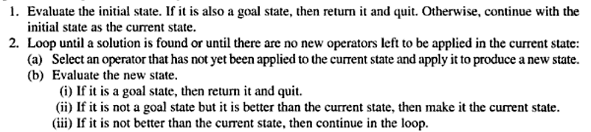
Algorithms
The Key difference is that the use of evaluating function and the task specific knowledge into the control process .

Slide 6
LOCAL MAXIMUM
It is a state that is better than all its neighbor but it is not better than some other states farther away.
Local maximum are frustrating because they often occur almost within sight of a solution.

Slide 7
PLATEAU
Plateau is a flat area of the search space in which a whole set of neighboring states the same value. In this it is not possible to determine the best direction in which to move by making local comparison.

Slide 8
RIDGE
Ridge is a special kind of local maximum. It is an area of the search space that is higher than surrounding areas and that itself has slope. In this it is impossible to traverse a ridge by single moves.

Slide 9
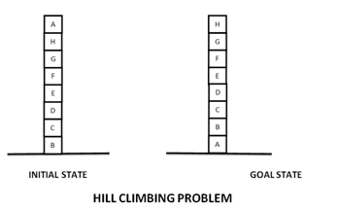
Block world Problem

Slide 10
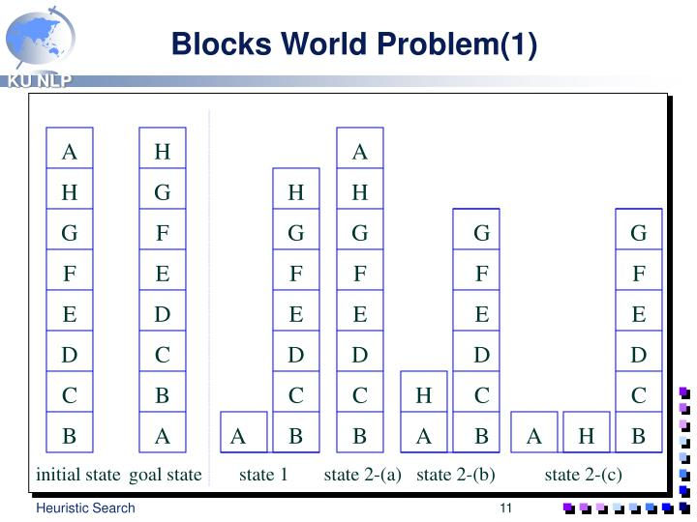


Slide 11
Block world Problem
A local heuristic function
Count +1 for every block that sits on the correct thing. The goal state has the value +8.
Count -1 for every block that sits on an incorrect thing. In the initial state blocks C, D, E, F, G, H count +1 each. Blocks A, B count -1 each , for the total of +4.
Move 1 gives the value +6 (A is now on the correct support). Moves 2a and 2b both give +4 (B and H are wrongly situated). This means we have a local maximum of +6.

Slide 12
Block world Problem
A global heuristic function
Count +N for every block that sits on a correct stack of N things. The goal state has the value +28.
Count -N for every block that sits on an incorrect stack of N things. That is, there is a large penalty for blocks tied up in a wrong structure.
In the initial state C, D, E, F, G, H count -1, -2,
-3, -4, -5, -6. A counts -7 , for the total of -28.

Slide 13
SIMULATED ANNEALING
The simulated annealing as a computational process is patterned after the physical process of annealing in which physical substances such as metals are melted and then gradually cooled until some solid state is reached. Hence the goal of this process is produce of minimal energy in final state. Hence we can say this minimal energy level is equivalent to the heuristic function. Hence
We have to minimize the value of heuristic function of some level in which we found the goal.
Physical substances usually move from higher energy level to lower energy level.
But there is some probability of that transition to higher energy state will occur.

Slide 14
BEST-FIRST SEARCH
Best-first search is a search algorithm, which explores a graph by expanding the most promising node chosen according to a specified rule.
Judea Pearl described best-first search as estimating the promise of node n by a “heuristic evaluation function f(n) which, in general, may depend on the description of n, the description of the goal, the information gathered by the search up to that point, and most important, on any extra knowledge about the problem domain.”
Some authors have used “best-first search” to refer specifically to a search with a heuristic that attempts to predict how close the end of a path is to a solution, so that paths, which are judged closer to a solution, are extended first. This specific type of search is called greedy best-first search.
Efficient selection of the current best candidate for extension is typically implemented using a priority queu

Slide 15
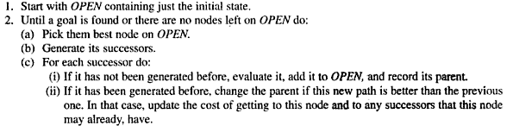
ALGORITHM: BEST FIRST SEARCH

Slide 16
1. OR-GRAPHS:-
This algorithm will operate by searching a directed graph in which each node represents a point in the problem space. Each node will contain to a description of the problem state it represents and how promising node it is. The list of successor will make it possible if a better node or path found to an existing node then to propagate the improvement down to its successor. Hence this type of graph called OR - graph. Since each of its branches represent an alternative problem-solving path.
In each step of the best first search process we select the most promising node with the help appropriate heuristic function to each of them. After that we expand the chosen node rules to generate its successor. If one of them is solution then we quit otherwise again the most promising node if selecting and process continues. This search can return to it whenever all other gets bad i.e. the again most promising path.

Slide 17
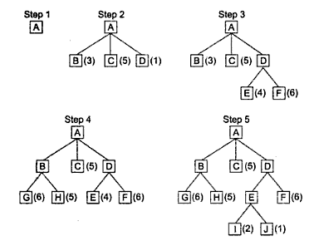
. OR-GRAPHS(cont..)

Slide 18
OR-GRAPHS(cont..)
As shown above fig beginning of best first procedure there is one node we expand it . We generate three nodes. The heuristic function, which is an estimate of the cost of getting to solution from a given node, is applied to each of these new nodes. Since node D is most promising node we expand it producing two-successor node E and F. But at this stage we look another, which is going through B, is more promising. Hence we expand it and generate G and H. But again when these two nodes are evaluated they look less promising than other path. So the attention is returned to the path D and E and E is then expand producing J and I. At next stage J is expanded since it is more promising. This process can continue until a solution is found.
To implement such graph –search procedure we need two lists of nodes.
OPEN: Open is actually a priority queue in which the elements with highest –priority are those with most promising value of the heuristic function. Hence the nodes that has been generated and have heuristic function but it is not examined.
CLOSE: In this list we keep the node that already examined. We keep these nodes in memory because whenever a new node is generated we need to check whether it has been generated before.

Slide 19
2) THE A* ALGORITHM
The best first search algorithm can be simplified of an algorithm called A*Algorithm in which we use heuristic function g, h`, f`. G is the measure of cost getting from initial state to current state (node). The function h’ is an estimate of the additional cost of getting from current node to a goal state. This is the place where knowledge about the problem domain is exploited. The combined function f ‘=g+ h’ represent an estimate of the cost of getting from the initial state to a goal state along the path that generate the current node. If more than one path generate the node then the algorithm will record the best one.
A* algorithm can be used whether we are interested in finding a minimal cost.

Slide 20
THE A* ALGORITHM(cont..)
1. Start with OPEN containing only the initial node. Set the nodes g value to zero then it h’ value to whatever it is and its f’ value to h’ +0=h’. Set closed to empty list.
2. Until a goal node is found repeat the following procedure.
If there are no node in OPEN report failure otherwise pick the node on OPEN with lowest f’ value and call is BESTNODE. Remove it from OPEN and place on CLOSED and see if BESTNODE is a goal state then exit otherwise generate the successor of BESTNODE. For each SUCCESSOR do the following

Slide 21
THE A* ALGORITHM(cont..)
  Set SUCCESSOR to point back to BESTNODE. These backwards links will make it possible to recover the path once a solution is found.
  Compute g’ (SUCCESSOR) = g(BESTNODE) + the cost of getting from BESTNODE to SUCCESSOR.
  See if SUCCESSOR is the same as any node on OPEN then call node OLD because this node already exists. We can throw SUCCESSOR away and add OLD to the list of BESTNODE’ s SUCCESSOR. At this point we must decide whether OLD’ s parent link reset to the point of BESTNODE. We have just found SUCCESSOR is cheaper than the current best path to OLD. Hence we see whether it is cheaper to get to OLD via its current parent or to SUCCESSOR via BESTNODE by comparing their g values. If OLD is cheaper then we do nothing. If SUCCESSOR is cheaper then reset OLD’ s parent link to point to BESTNODE record the new cheaper path in g(OLD) and update f ‘(OLD).

Slide 22
THE A* ALGORITHM(cont..)
  If the SUCCESSOR was not an OPEN see if it is CLOSED, if so called node on CLOSED OLD and add OLD to the list of BESTNODE’ s successor. At that time check to see if the new path or old path is better then set the parent link and g and f’ values appropriately. If we have just found a better path to OLD we propagate the improvement to OLD successor. TO propagate the new cost downward changing the each node g and f’ value and terminating each branch when you reach either a node with no successor or a node to which an equivalent or better path was already been found.
  If the successor was not already on either OPEN or CLOSED then put it on OPEN and add it to the list of BESTNODES successor and compute
F’ (SUCCESSOR)=g(SUCCESSOR)+h’(SUCCESSOR)

Slide 23
Admissibility of A* Algorithm
The cost of reaching the goal state is assessed using an admissible heuristic in an informed search algorithm, however, if we need to discover a solution to the problem, the estimated cost must be lower than or equal to the true cost of reaching the goal state.

Slide 24
Admissibility of A* Algorithm
The evaluation function in A* looks like this:
f(n) = g(n) + h(n)
f(n) = Actual cost + Estimated cost
here,
n = current node.
f(n) = evaluation function.
g(n) = the cost from the initial node to the current node.
h(n) = estimated cost from the current node to the goal state.
Conditions:
h(n) ≤ h*(n) ∴ Underestimation
h(n) ≥ h*(n) ∴ Overestimation

Slide 25
Key Points:
The heuristic function h(n) is admissible if h(n) is never larger than h*(n) or if h(n) is always less or equal to the true value.
If A* employs an admissible heuristic and h(goal)=0, then we can argue that A* is admissible.
If the heuristic function is constantly tuned to be low with respect to the true cost, i.e. h(n) ≤ h*(n), then you are going to get an optimal solution of 100%

Slide 26
PROBLEM REDUCTION :-
When a problem can be divided into a set of sub problems, where each sub problem can be solved separately and a combination of these will be a solution, AND-OR graphs or AND - OR trees are used for representing the solution. The decomposition of the problem or problem reduction generates AND arcs. One AND are may point to any number of successor nodes. All these must be solved so that the arc will rise to many arcs, indicating several possible solutions. Hence the graph is known as AND - OR instead of AND. .

Slide 27
1. AND- OR GRAPH
AND-OR is useful for representing the solution of the problems that can be solved by decomposing them into a set of smaller problems after that all of them solved. This decomposition or reduction generates arc that we call AND arcs. One AND arc may point to any number of successor nodes all of which must be solved in order for the arc to point to a solution just as in OR graph. Hence different arc may come from single node indicating variety of ways in which the original problem might be solved. Hence this type of structure is called AND-OR graph. AND arcs are indicated with a line connecting to all the components

Slide 28

1. AND- OR GRAPH(cont..)
This type of algorithm finds a path from the starting node of the graph to a set of nodes representing the solution. Also it may be necessary to get to more than one solution state since each arm of AND arc must lead to its own solution node. The number at each node represent the value of f’ at that node. Hence for every operation has a uniform cost so each arc with a single successor has a cost of 1 and each AND arc with multiple successor has a cost of 1 for each of its components. For example consider:

Slide 29
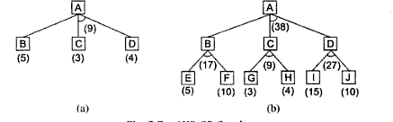
1. AND- OR GRAPH(cont..)
Here we expand B with cost 5. In AND-OR algorithm we describe a node value and call it FUTILITY. If the estimated cost of solution is greater than the value of FUTILITY then we quit the search. FUTILITY is threshold such that any solution with a cost above it is too expensive to be practical.

Slide 30
2. AO*(AO star) algorithms
The main difference between the A*(A star) and AO*(AO star) algorithms is that A* algo is a OR graph algorithm and AO* is a AND-OR graph http://algorithm.In OR graph algorithm it just find only one solution (i.e either OR solution means this OR this OR this).But in the AND-OR graph algo it find more than one solution
AO*is a best-first algorithm for solving a cyclic AND/OR graphs.

Slide 31
AO*(AO star) algorithms(cont..)
Initialise the graph to start node
Traverse the graph following the current path accumulating nodes that have not yet been expanded or solved
Pick any of these nodes and expand it and if it has no successors call this value FUTILITY otherwise calculate only f' for each of the successors.
If f' is 0 then mark the node as SOLVED
Change the value of f' for the newly created node to reflect its successors by back propagation.
Wherever possible use the most promising routes and if a node is marked as SOLVED then mark the parent node as SOLVED.
If starting node is SOLVED or value greater than FUTILITY, stop, else repeat from 2.

Slide 32
AO* algorithm
Let G be a graph with only starting node INIT.
Repeat the followings until INIT is labeled SOLVED or h(INIT) > FUTILITY
  Select an unexpanded node from the most promising path from INIT (call it NODE)
  Generate successors of NODE. If there are none, set h(NODE) = FUTILITY (i.e., NODE is unsolvable); otherwise for each SUCCESSOR that is not an ancestor of NODE do the following:
    Add SUCCESSSOR to G.
    If SUCCESSOR is a terminal node, label it SOLVED and set h(SUCCESSOR) = 0.
    If SUCCESSPR is not a terminal node, compute its h

Slide 33
AO* algorithm (Cont.)
  Propagate the newly discovered information up the graph by doing the following: let S be set of SOLVED nodes or nodes whose h values have been changed and need to have values propagated back to their parents. Initialize S to Node. Until S is empty repeat the followings:
    Remove a node from S and call it CURRENT.
    Compute the cost of each of the arcs emerging from CURRENT. Assign minimum cost of its successors as its h.
    Mark the best path out of CURRENT by marking the arc that had the minimum cost in step ii
    Mark CURRENT as SOLVED if all of the nodes connected to it through new labeled arc have been labeled SOLVED
    If CURRENT has been labeled SOLVED or its cost was just changed, propagate its new cost back up through the graph. So add all of the ancestors of CURRENT to S.

Slide 34
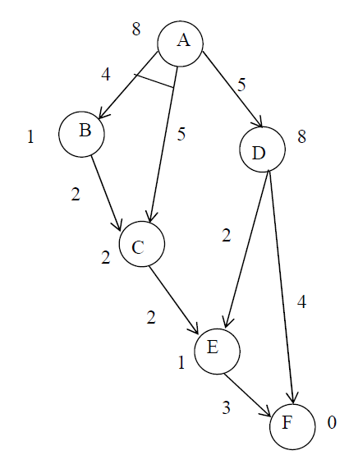
An Example

Slide 35
An Example
(8)
A

Slide 36
An Example
[12]
A
[13]
4
5
5
(1)
B
D
(8)
C
(2)

Slide 37
An Example
[15]
A
[13]
4
5
5
(4)
B
D
(8)
2
C
(2)

Slide 38
An Example
[15]
A
[8]
4
5
5
(4)
B
D
(3)
2
C
2
(2)
4
E
(1)
G
(0)

Slide 39
An Example
[15]
A
[9]
4
5
5
(4)
B
D
(4)
2
C
2
(2)
2
4
E
(3)
3
G
(0)

Slide 40
An Example
[15]
A
Solved
4
5
5
(4)
B
D
Solved
2
C
2
(2)
2
4
E
(3)
3
G
Solved
(0)

Slide 41
Constraint Satisfaction
In artificial intelligence and operations research, constraint satisfaction is the process of finding a solution to a set of constraints that impose conditions that the variables must satisfy.
Constraint satisfaction problems (CSPs) are mathematical problems defined as a set of objects whose state must satisfy a number of constraints or limitations. CSPs represent the entities in a problem as a homogeneous collection of finite constraints over variables, which is solved by constraint satisfaction methods. CSPs are the subject of intense research in both artificial intelligence and operations research, since the regularity in their formulation provides a common basis to analyze and solve problems.

Slide 42
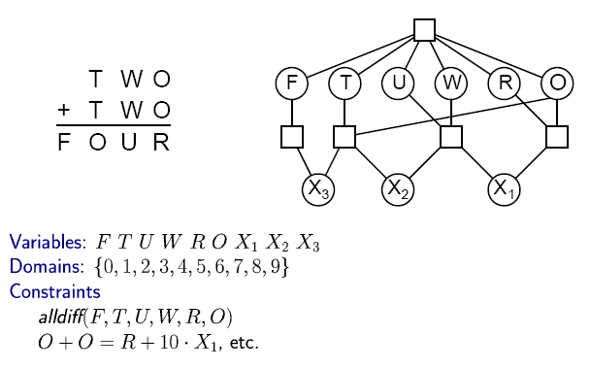

CSP Example: Cryptharithmetic puzzle

Slide 43
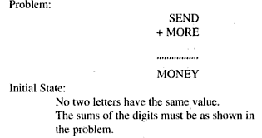
Problem:

Slide 44
Problem Statement
SEND
+ MORE
--------
MONEY
How to assign decimal digits to
letters, so that the following sum
is valid? Assume that we already
know that
The possible digits set for the letters is {0,1,2,…9};
M must be 1;
Two different letters can't be assigned the same digit

Slide 45
using c1,c2 and c3 to represent carries changing problem to solve 4 equations
S E N D D+E = Y+10*C1
M O R E C1+N+R = E+10*C2
+ C3 C2 C1 C2+E+O = N+10*C3
---------------------- C3+S+M = O+10*M
M O N E Y

Slide 46

Exercise

