Slide 1
Cryptography and Network Security
Chapter 14
Fourth Edition
by William Stallings
Lecture slides by Lawrie Brown
Notes:
Lecture slides by Lawrie Brown for “Cryptography and Network Security”, 4/e, by William Stallings, Chapter 14 – “Authentication Applications”.

Slide 2
Chapter 14 – Authentication Applications
We cannot enter into alliance with neighboring princes until we are acquainted with their designs.
—The Art of War, Sun Tzu
Notes:
Opening quote.

Slide 3
Authentication Applications
will consider authentication functions
developed to support application-level authentication & digital signatures
will consider Kerberos – a private-key authentication service
then X.509 - a public-key directory authentication service
Notes:
This chapter examines some of the authentication functions that have been developed to support application-level authentication and digital signatures.
Will first look at one of the earliest and most widely used services: Kerberos. Then examine the X.509 directory authentication service.

Slide 4
Kerberos
trusted key server system from MIT
provides centralised private-key third-party authentication in a distributed network
  allows users access to services distributed through network
  without needing to trust all workstations
  rather all trust a central authentication server
two versions in use: 4 & 5
Notes:
Kerberos is an authentication service developed as part of Project Athena at MIT, and is one of the best known and most widely implemented trusted third party key distribution systems.
Kerberos provides a centralized authentication server whose function is to authenticate users to servers and servers to users. Unlike most other authentication schemes, Kerberos relies exclusively on symmetric encryption, making no use of public-key encryption. Two versions of Kerberos are in common use: v4 & v5.

Slide 5
Kerberos Requirements
its first report identified requirements as:
  secure
  reliable
  transparent
  scalable
implemented using an authentication protocol based on Needham-Schroeder
Notes:
The first published report on Kerberos [STEI88] listed the requirements shown above. To support these requirements, Kerberos is a trusted third-party authentication service that uses a protocol based on that proposed by Needham and Schroeder [NEED78], which was discussed in Chapter 7.

Slide 6
Kerberos v4 Overview
a basic third-party authentication scheme
have an Authentication Server (AS)
  users initially negotiate with AS to identify self
  AS provides a non-corruptible authentication credential (ticket granting ticket TGT)
have a Ticket Granting server (TGS)
  users subsequently request access to other services from TGS on basis of users TGT
Notes:
The core of Kerberos is the Authentication and Ticket Granting Servers – these are trusted by all users and servers and must be securely administered. The protocol includes a sequence of interactions between the client, AS, TGT and desired server.

Slide 7
Kerberos v4 Dialogue
obtain ticket granting ticket from AS
  once per session
obtain service granting ticket from TGT
  for each distinct service required
client/server exchange to obtain service
  on every service request
Notes:
The full Kerberos v4 authentication dialogue is shown in Stallings Table 14.1, divided into the 3 phases shown above. The justification for each item in the messages is given in Stallings Table 14.2.

Slide 8
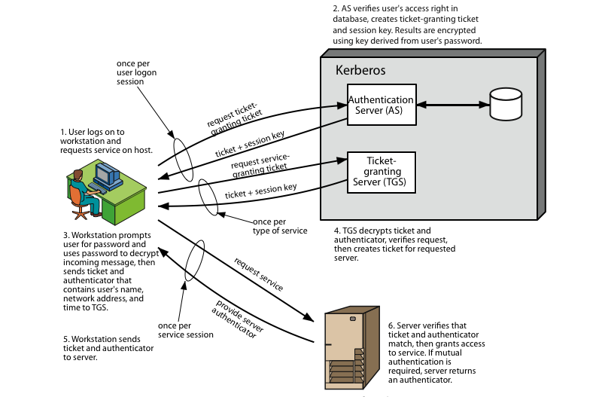
Kerberos 4 Overview
Notes:
Stallings Figure 14.1 diagrammatically summarizes the Kerberos v4 authentication dialogue, with 3 pairs of messages, for each phase listed previously.

Slide 9
Kerberos Realms
a Kerberos environment consists of:
  a Kerberos server
  a number of clients, all registered with server
  application servers, sharing keys with server
this is termed a realm
  typically a single administrative domain
if have multiple realms, their Kerberos servers must share keys and trust
Notes:
A full-service Kerberos environment consisting of a Kerberos server, a number of clients, and a number of application servers is referred to as a Kerberos realm. A Kerberos realm is a set of managed nodes that share the same Kerberos database, and are part of the same administrative domain. If have multiple realms, their Kerberos servers must share keys and trust each other.

Slide 10
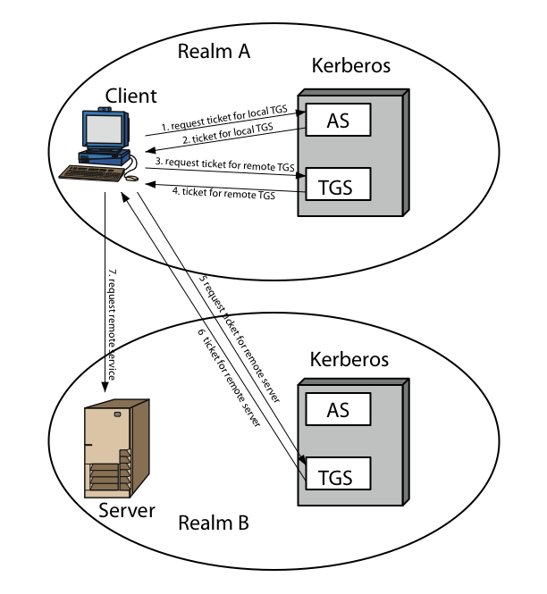
Kerberos Realms
Notes:
Stallings Figure 14.2 shows the authentication messages where service is being requested from another domain. The ticket presented to the remote server indicates the realm in which the user was originally authenticated. The server chooses whether to honor the remote request. One problem presented by the foregoing approach is that it does not scale well to many realms, as each pair of realms need to share a key.

Slide 11
Kerberos Version 5
developed in mid 1990’s
specified as Internet standard RFC 1510
provides improvements over v4
  addresses environmental shortcomings
    encryption alg, network protocol, byte order, ticket lifetime, authentication forwarding, interrealm auth
  and technical deficiencies
    double encryption, non-std mode of use, session keys, password attacks
Notes:
Kerberos Version 5 is specified in RFC 1510 and provides a number of improvements over version 4 in the areas of environmental shortcomings and technical deficiencies, in areas as noted. See Stallings Table 14.3 for details of the Kerberos v5 authentication dialogue.

Slide 12
X.509 Authentication Service
part of CCITT X.500 directory service standards
  distributed servers maintaining user info database
defines framework for authentication services
  directory may store public-key certificates
  with public key of user signed by certification authority
also defines authentication protocols
uses public-key crypto & digital signatures
  algorithms not standardised, but RSA recommended
X.509 certificates are widely used
Notes:
X.509 is part of the X.500 series of recommendations that define a directory service, being a server or distributed set of servers that maintains a database of information about users.
X.509 defines a framework for the provision of authentication services by the X.500 directory to its users. The directory may serve as a repository of public-key certificates. In addition, X.509 defines alternative authentication protocols based on the use of public-key certificates. X.509 is based on the use of public-key cryptography and digital signatures. The standard does not dictate the use of a specific algorithm but recommends RSA.
The X.509 certificate format is widely used, in for example S/MIME, IP Security and SSL/TLS and SET.

Slide 13
X.509 Certificates
issued by a Certification Authority (CA), containing:
  version (1, 2, or 3)
  serial number (unique within CA) identifying certificate
  signature algorithm identifier
  issuer X.500 name (CA)
  period of validity (from - to dates)
  subject X.500 name (name of owner)
  subject public-key info (algorithm, parameters, key)
  issuer unique identifier (v2+)
  subject unique identifier (v2+)
  extension fields (v3)
  signature (of hash of all fields in certificate)
notation CA<<A>> denotes certificate for A signed by CA
Notes:
The X.509 certificate is the heart of the standard. There are 3 versions, with successively more info in the certificate - must be v2 if either unique identifier field exists, must be v3 if any extensions are used. These user certificates are assumed to be created by some trusted certification authority (CA) and placed in the directory by the CA or by the user. The directory server itself is not responsible for the creation of public keys or for the certification function; it merely provides an easily accessible location for users to obtain certificates. The certificate includes the elements shown.
The standard uses the notation for a certificate of: CA<<A>> where the CA signs the certificate for user A with its private key.

Slide 14
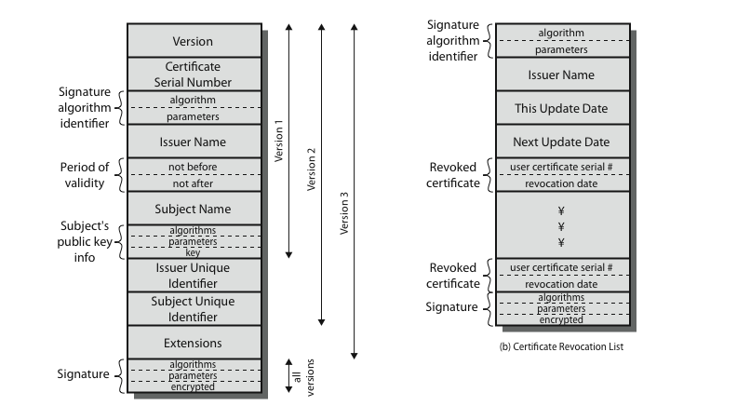
X.509 Certificates
Notes:
Stallings Figure 14.4 shows the format of an X.509 certificate and CRL.

Slide 15
Obtaining a Certificate
any user with access to CA can get any certificate from it
only the CA can modify a certificate
because cannot be forged, certificates can be placed in a public directory
Notes:
User certificates generated by a CA have the characteristics that any user with access to the public key of the CA can verify the user public key that was certified, and no party other than the certification authority can modify the certificate without this being detected. Because certificates are unforgeable, they can be placed in a directory without the need for the directory to make special efforts to protect them.

Slide 16
CA Hierarchy
if both users share a common CA then they are assumed to know its public key
otherwise CA's must form a hierarchy
use certificates linking members of hierarchy to validate other CA's
  each CA has certificates for clients (forward) and parent (backward)
each client trusts parents certificates
enable verification of any certificate from one CA by users of all other CAs in hierarchy
Notes:
If both parties use the same CA, they know its public key and can verify others certificates. If not, then there has to be some means to form a chain of certifications between the CA's used by the two parties, by the use of client and parent certificates. It is assumed that each client trusts its parents certificates.

Slide 17
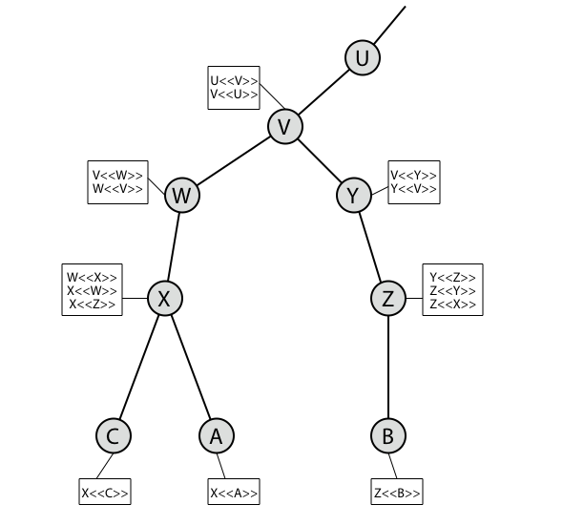
CA Hierarchy Use
Notes:
Stallings Figure 14.5 illustrates the use of an X.509 hierarchy to mutually verify clients certificates.
Track chains of certificates:
A acquires B certificate using chain: X<<W>>W<<V>>V<<Y>>Y<<Z>>Z<<B>>
B acquires A certificate using chain: Z<<Y>>Y<<V>>V<<W>>W<<X>>X<<A>>

Slide 18
Certificate Revocation
certificates have a period of validity
may need to revoke before expiry, eg:
  user's private key is compromised
  user is no longer certified by this CA
  CA's certificate is compromised
CA’s maintain list of revoked certificates
  the Certificate Revocation List (CRL)
users should check certificates with CA’s CRL
Notes:
A certificate includes a period of validity. Typically a new certificate is issued just before the expiration of the old one.
In addition, it may be desirable on occasion to revoke a certificate before it expires, for one of a range of reasons, such as those shown above.
To support this, each CA must maintain a list consisting of all revoked but not expired certificates issued by that CA, known as the certificate revocation list (CRL).
When a user receives a certificate in a message, the user must determine whether the certificate has been revoked, by checking the directory CRL each time a certificate is received, this often does not happen in practice.

Slide 19
Authentication Procedures
X.509 includes three alternative authentication procedures:
One-Way Authentication
Two-Way Authentication
Three-Way Authentication
all use public-key signatures
Notes:
X.509 also includes three alternative authentication procedures that are intended for use across a variety of applications, used when obtaining and using certificates. 1-way for unidirectional messages (like email), 2-way for interactive sessions when timestamps are used, 3-way for interactive sessions with no need for timestamps (and hence synchronised clocks). See Stallings Figure 14.6 for details of each of these alternatives.

Slide 20
One-Way Authentication
1 message ( A->B) used to establish
  the identity of A and that message is from A
  message was intended for B
  integrity & originality of message
message must include timestamp, nonce, B's identity and is signed by A
may include additional info for B
  eg session key
Notes:
One way authentication involves a single transfer of information from one user (A) to another (B), and establishes the details shown above. Note that only the identity of the initiating entity is verified in this process, not that of the responding entity. At a minimum, the message includes a timestamp ,a nonce, and the identity of B and is signed with A’s private key. The message may also include information to be conveyed, such as a session key for B.

Slide 21
Two-Way Authentication
2 messages (A->B, B->A) which also establishes in addition:
  the identity of B and that reply is from B
  that reply is intended for A
  integrity & originality of reply
reply includes original nonce from A, also timestamp and nonce from B
may include additional info for A
Notes:
Two-way authentication thus permits both parties in a communication to verify the identity of the other, thus additionally establishing the above details. The reply message includes the nonce from A, to validate the reply. It also includes a timestamp and nonce generated by B, and possible additional information for A.

Slide 22
Three-Way Authentication
3 messages (A->B, B->A, A->B) which enables above authentication without synchronized clocks
has reply from A back to B containing signed copy of nonce from B
means that timestamps need not be checked or relied upon
Notes:
Three-Way Authentication includes a final message from A to B, which contains a signed copy of the nonce, so that timestamps need not be checked, for use when synchronized clocks are not available.

Slide 23
X.509 Version 3
has been recognised that additional information is needed in a certificate
  email/URL, policy details, usage constraints
rather than explicitly naming new fields defined a general extension method
extensions consist of:
  extension identifier
  criticality indicator
  extension value
Notes:
The X.509 version 2 format does not convey all of the information that recent design and implementation experience has shown to be needed. Rather than continue to add fields to a fixed format, standards developers felt that a more flexible approach was needed. X.509 version 3 includes a number of optional extensions that may be added to the version 2 format. Each extension consists of an extension identifier, a criticality indicator, and an extension value. The criticality indicator indicates whether an extension can be safely ignored or not (in which case if unknown the certificate is invalid).

Slide 24
Certificate Extensions
key and policy information
  convey info about subject & issuer keys, plus indicators of certificate policy
certificate subject and issuer attributes
  support alternative names, in alternative formats for certificate subject and/or issuer
certificate path constraints
  allow constraints on use of certificates by other CA’s
Notes:
The certificate extensions fall into three main categories:
key and policy information - convey additional information about the subject and issuer keys, plus indicators of certificate policy
subject and issuer attributes - support alternative names, in alternative formats, for a certificate subject or certificate issuer and can convey additional information about the certificate subject
certification path constraints - allow constraint specifications to be included in certificates issued for CA’s by other CA’s

Slide 25
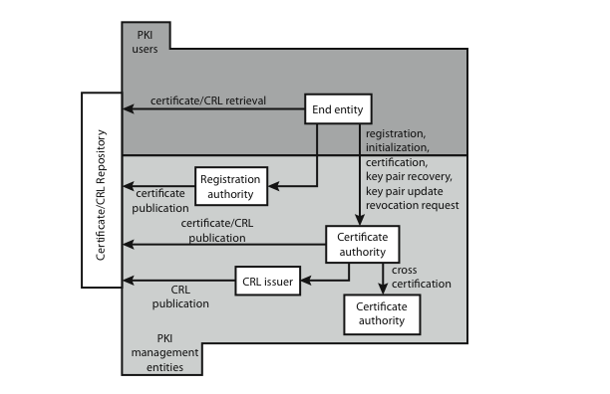
Public Key Infrastructure
Notes:
RFC 2822 (Internet Security Glossary) defines public-key infrastructure (PKI) as the set of hardware, software, people, policies, and procedures needed to create, manage, store, distribute, and revoke digital certificates based on asymmetric cryptography. The IETF Public Key Infrastructure X.509 (PKIX) working group has setup a formal (and generic) model based on X.509 that is suitable for deploying a certificate-based architecture on the Internet.
Stallings Figure 14.7 shows the interrelationship among the key elements of the PKIX model, and lists the various management functions needed.

Slide 26
Summary
have considered:
  Kerberos trusted key server system
  X.509 authentication and certificates
Notes:
Chapter 14 summary.

