Slide 1
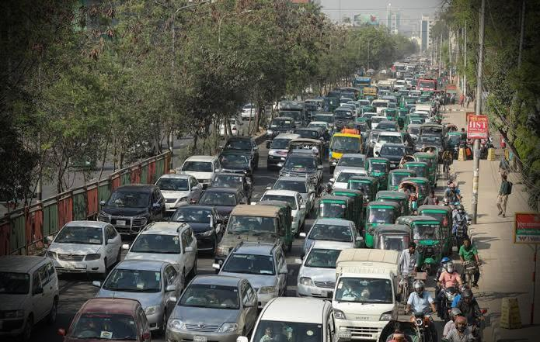
Traffic Jam Problems and Solutions In Dhaka City
Submitted by : mahir sazid malik
Student id : 2010748
Cis101 sec 14 summer 2023

Slide 2
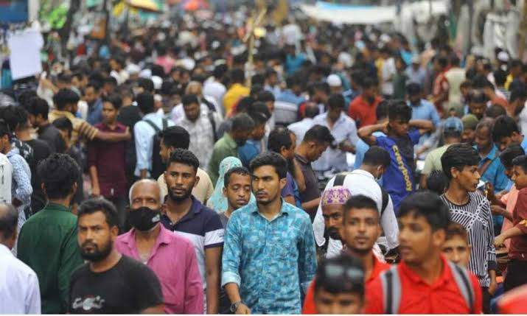
Dhaka’s Background
Urbanization and population increase are the main causes of Dhaka's severe traffic congestion. Daily trips to the site are frequently delayed by traffic, which increases the amount of time spent traveling, increases fuel consumption, and adds to pollution.

Slide 3
Snarled Traffic Reasons
Accelerated urbanization inadequate methods
The tools employed
Insufficient public transportation
Inefficient traffic control

Slide 4
WHAT MAKES IT BETTER THEN?
Boost the use of public transit
Boost and expand the current public transportation system.
Offer reasonable prices, cozy service, and practical routes.
Create projects Construct new overpasses, bridges, and highways.
Implement smart navigation systems and upgrade traffic signal system.
Promoting a car-free lifestyle
Create and maintain routes for pedestrians and bicycles.
Promote car sharing and carpooling
Describe ridesharing services and ridesharing services.
Provide enticements like preferred routes and parking discounts.

Slide 5
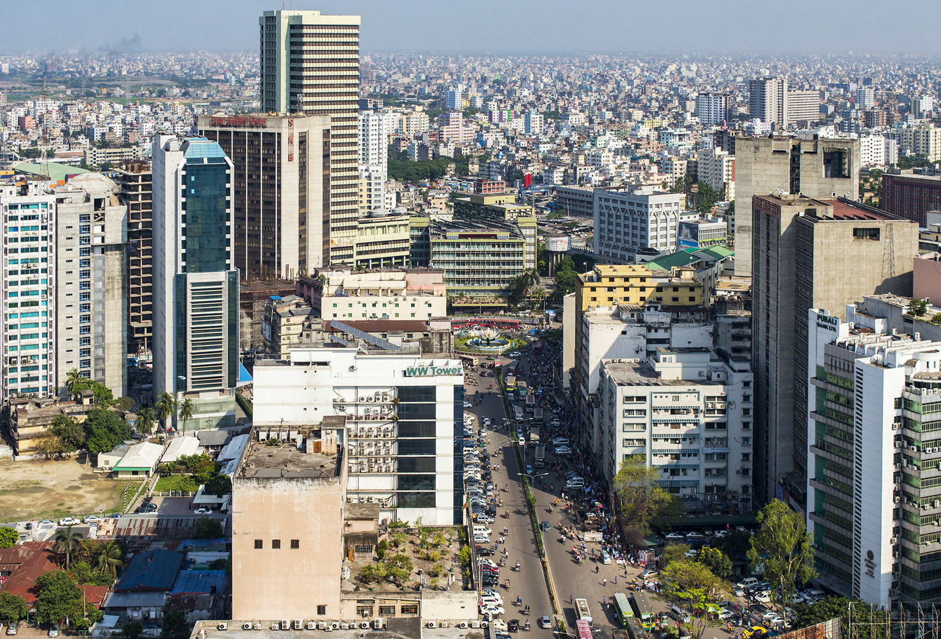
Conclusion
The economy and local population of Dhaka are both negatively impacted by traffic congestion. Solutions suggested include expanding public transportation, creating infrastructure, promoting car-free routes, and promoting carpooling and ridesharing. Government regulations and partnerships are essential for success.

Slide 6
THANK YOU!

