Slide 1

Bılevel optımızatıon
Optımızatıon fınal project
Students
- Mahir Selek 2041295
- Joi Berberi 2023363
Professor:
- Francesco Rinaldi

Slide 2
ıntroductıon
This project aims to explore the theory and implementation of the bilevel optimization problem within the context of online dictionary learning. The objective of dictionary learning is to express data points through a linear combination of basis vectors within a dictionary.
Introducing the CG-BiO algorithm, the approach optimizes an expanded dictionary and coefficients, effectively adapting to changing datasets and comparison with the Frank-Wolfe algorithm.

Slide 3
Maın papers
Paper 1: Revisiting Frank-Wolfe: Projection-Free Sparse Convex Optimization (Jaggi, 2013)
Paper 2: A Conditional Gradient-based Method for Simple Bilevel Optimization with Convex Lower-level Problem (Jiang et al., 2023)
Paper 3: Bilevel Programming for Hyperparameter Optimization and Meta-Learning (Franceschi, 2018)

Slide 4
Dıctıonary learnıng
Dictionary learning is a machine learning technique that aims to find a concise representation of input data from a large dataset. The goal is to discover a set of basis vectors, known as a dictionary, such that each data point can be effectively approximated by a linear combination of a few basis vectors
The objective of dictionary learning is to express data points
through a linear combination of basis vectors within a dictionary

Slide 5
Bılevel optımızatıon problem
Bilevel optimization is a type of optimization problem where one optimization problem is nested within another. It involves an upper-level objective function that is optimized over the feasible set defined by the optimal solutions to a lower-level optimization problem
The goal of bilevel optimization is to find the best solution to the upper-level objective, while satisfying the constraints imposed by the lower-level problem

Slide 6
Dataset generatıon
The paper by Jiang et al. does not explicitly mention the use of a real dataset for online dictionary learning. However, it discusses the process of updating a dictionary when a new dataset is introduced, indicating a focus on the algorithmic aspects of dictionary learning rather than the specific datasets.

Slide 7
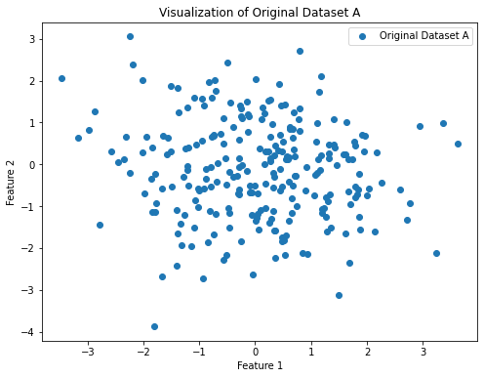
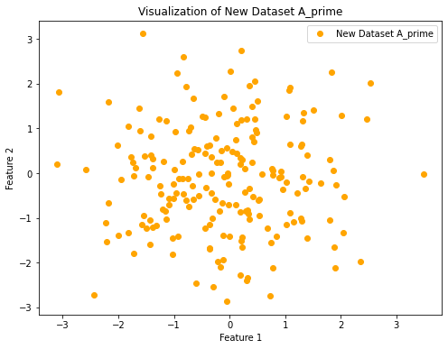
Dataset vısualızatıon
The generated synthetic dataset comprises two dictionaries, Dtrue and Dtrue prime, both with dimensions of 25 × 50. These dictionaries represent the basis vectors used for expressing data points in a linear combination. Dataset A is constructed using Dtrue and a coefficient matrix x with dimensions 50×250, where each column of x corresponds to the coefficients for the linear combination of basis vectors to form the samples in A. Similarly, dataset Aprime is created using Dtrue prime and a coefficient matrix xprime with dimensions 50 × 200, where each column of xprime represents the coefficients for the linear combination to generate the samples in Aprime.
Figure 1. Original Dataset Visualization
Figure 2. New Dataset Visualization

Slide 8
Possıble feature names
Possible feature names based on common scenarios:
1) Pixel Intensity Values (for image data):
• Feature 1: Pixel intensity at a specific location (e.g., grayscale value)
• Feature 2: Pixel intensity at another specific location
2) Health Indicators (for health-related data):
• Feature 1: Blood pressure
• Feature 2: Cholesterol levels
3) Sensor Readings (for sensor data):
• Feature 1: Temperature reading
• Feature 2: Humidity reading
4) Financial Metrics(for financial data):
• Feature 1: Stock price
• Feature 2: Trading Volume

Slide 9
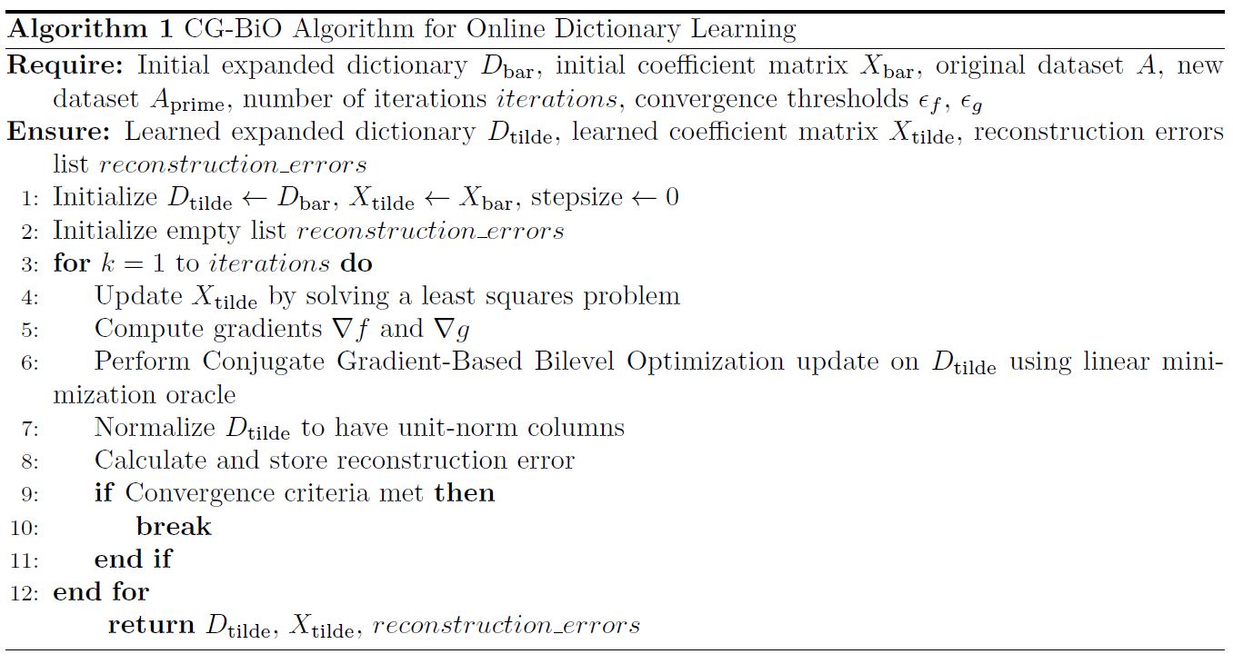
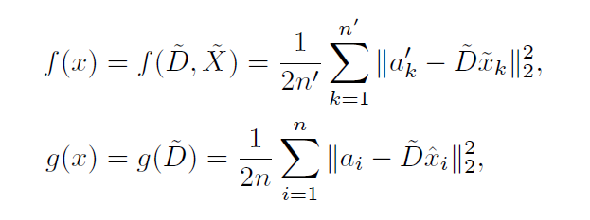
ALGORITHMS
1- CG-BIO ALgorıthm
Figure 3. CG-BIO Algorithm Structure
The algorithm is designed to handle cases where the lower-level function is smooth and convex, while the upper-level function is smooth but not necessarily convex.
The objective functions f(x) and g(x) for the bilevel optimization problem, derived from online dictionary learning, is defined as:

Slide 10
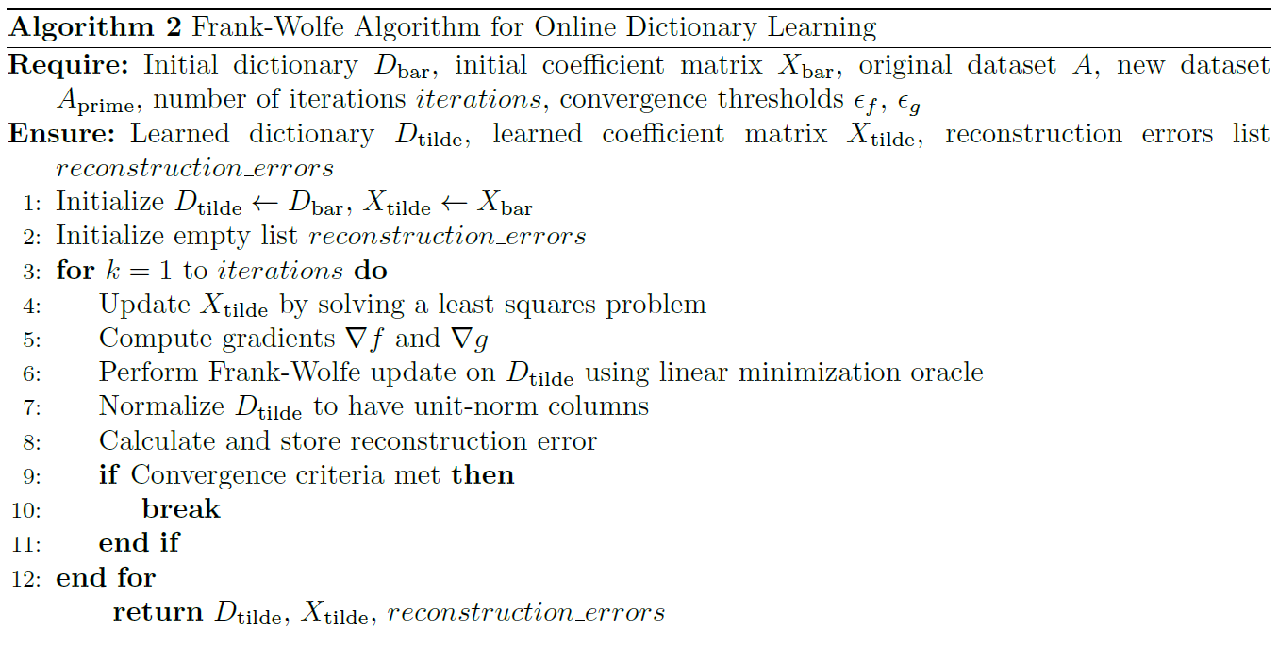
2- Frank wolfe ALgorıthm
ALGORITHMS
Figure 4. Frank-Wolfe Algorithm Structure
The Frank-Wolfe algorithm, originally designed for convex optimization problems, can be adapted for online dictionary learning scenarios
The algorithm’s ability to find sparse solutions aligns well with the common sparsity patterns observed in dictionary learning tasks
Its versatility makes it suitable for various optimization contexts, and in online dictionary learning, it provides a general-purpose approach for updating dictionaries as new samples become available

Slide 11
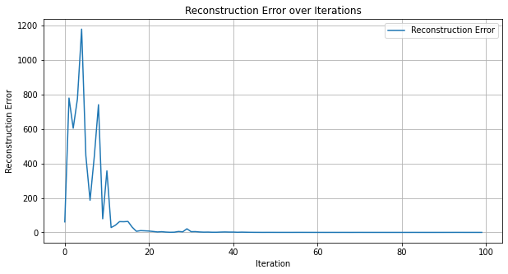
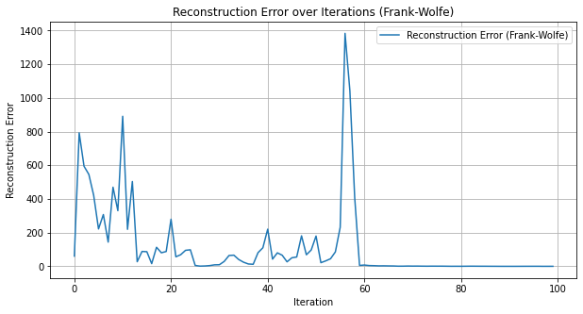
experıments
In the conducted experiments for online dictionary learning, both CG-BiO and Frank-Wolfe algorithms were applied to the task using a synthetic dataset. The datasets, denoted as A and A′, were generated with corresponding true dictionaries D∗ and D∗′ to simulate an evolving dictionary scenario.
The algorithms were evaluated based on their ability to adapt to incremental updates in the dictionary when new data (A′) was introduced.
Figure 5. CG-BIO Reconstrucction Error
Figure 6. Frank-Wolfe Reconstrucction Error
For both algorithms, the plots illustrate the convergence of the reconstruction error over iterations. In general, a decreasing trend in the error signifies improvement in the dictionaries’ ability to accurately represent the datasets

Slide 12
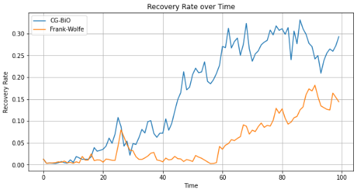
experıments
Figure 7. Recovery Rate Visualization of Algorithms
The recovery rate serves as an evaluation metric for the effectiveness of the bilevel optimization algorithm in the online dictionary learning setting. A successful algorithm should exhibit a recovery rate that increases over time, indicating improved accuracy in reconstructing the original signal
The "original signal" in the context of recovery rate refers to the true or original data that we are attempting to reconstruct

Slide 13
CONCLUSION
In the realm of online dictionary learning, we embarked on a journey to address the challenge of efficiently adapting dictionaries to dynamic datasets. The primary goal was to learn dictionaries that could accurately represent incoming data, leading to effective sparse representations. Two prominent algorithms, the Frank-Wolfe Algorithm and the Conjugate Gradient-Based Bilevel Optimization (CGBiO) Algorithm, were employed to tackle this problem.
Numerical Impact:
CG-BiO: Demonstrated superiority with a lower reconstruction error of 0.11 in your specific task
Frank-Wolfe: Resulted in a higher reconstruction error of 0.48, suggesting potential suboptimal performance for this task
In mathematical terms, CG-BiO’s explicit incorporation of sparse constraints, conditional gradient steps, and bilevel optimization structure makes it better suited for the mathematical intricacies of online dictionary learning compared to the more general-purpose Frank-Wolfe algorithm
Throughout the experiments, both algorithms exhibited their strengths and trade-offs. The Frank- Wolfe Algorithm, while computationally efficient, may require more iterations to converge. In contrast, the CG-BiO Algorithm, with its conjugate gradient optimization, showcased robustness in handling various dataset characteristics, providing a more adaptive solution

Slide 14
Thank you for your attention!

