Slide 1
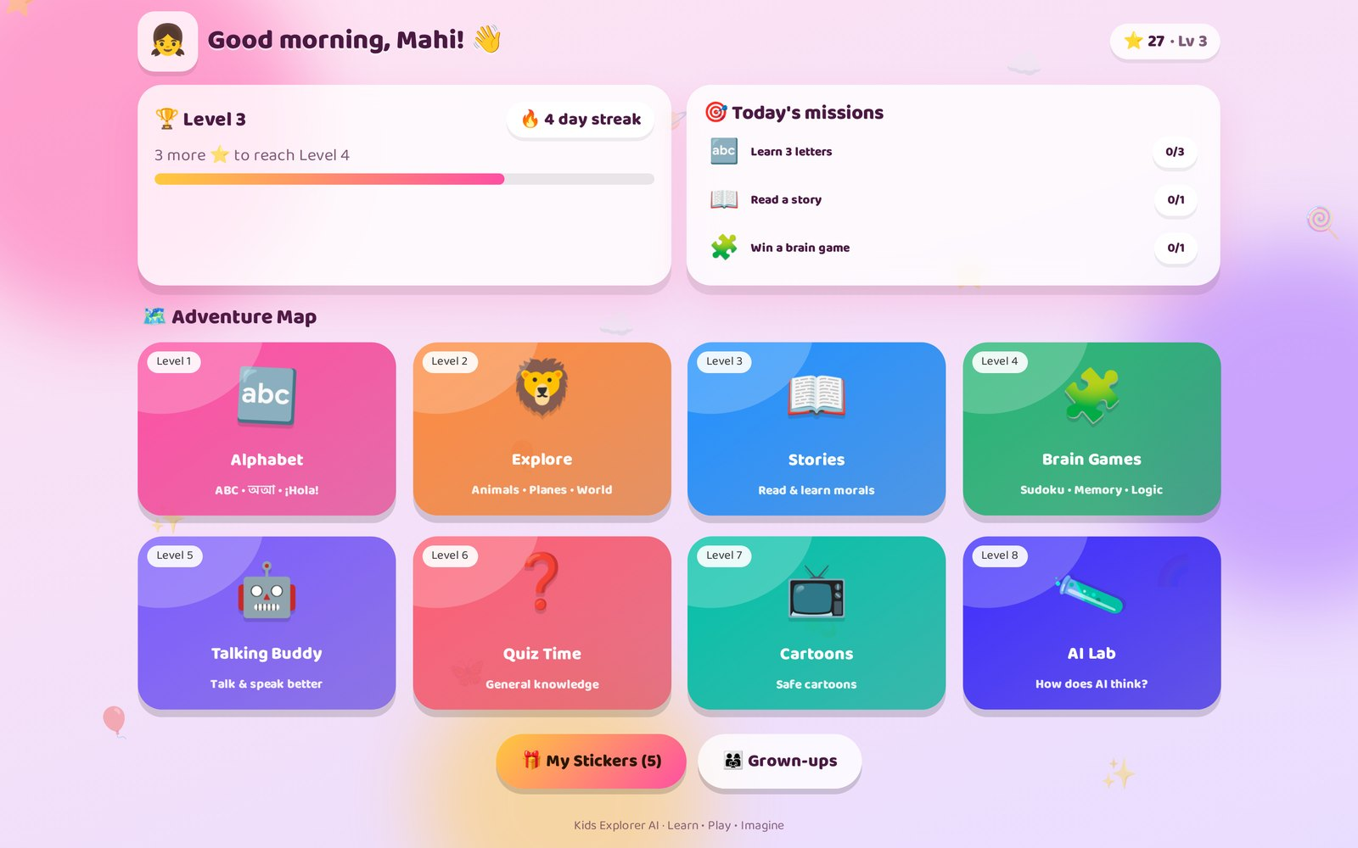
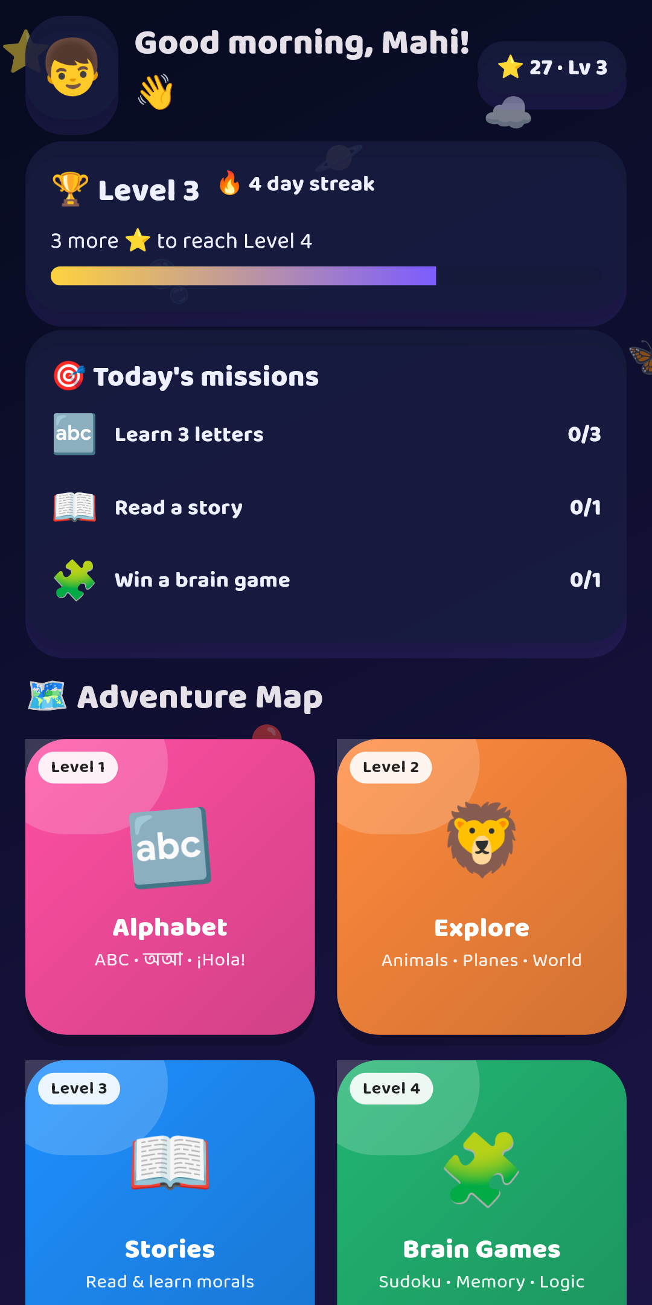
🚀 A free AI learning world for kids aged 2–10+
Kids Explorer
AI
Alphabets • Stories • Brain games • Talking AI buddy • Cartoons — in English, বাংলা and more. No sign-up. Safe. Colorful.
🌐 Website
📱 Android app
🛠️ Admin panel
0 sign-ups
5 languages
15 explore topics
5 brain games
100% free AI buddy
Kids Explorer AI · Learn • Play • Imagine
1
Notes:
Kids Explorer AI is one ecosystem: a website, a Google Play Android app and an admin dashboard that controls both.

Slide 2
WHY
Learning that feels like a game — safe & free
🎮
🌏
🧠
🛡️
Zero barrier
Multilingual
Learn by doing
Safe by design
No account, no email, no payment. Type a name and play.
English, বাংলা, Español, Français, हिन्दी + any language the admin adds.
See → hear → trace → say. Every activity is a 2–5 minute "level".
Data stays on the device. Child-directed ads. Parental gates.
Design informed by leading early-learning apps (Khan Academy Kids, Lingokids, Duolingo ABC): age-adaptive, short lessons, levels & rewards.
Kids Explorer AI · Learn • Play • Imagine
2

Slide 3
ECOSYSTEM
Three apps · one content brain
🌐
Kids Website
📱
Android App
🛠️
Admin Panel
React 18 · Vite · Framer Motion · Web Speech API
Flutter · AdMob (Families) · on-device TTS & speech
React · Tailwind CSS · Recharts · Supabase
🌿 feature/web-app
🌿 feature/mobile-app
🌿 feature/admin-panel
🗄️ Supabase backend (optional, free tier): Postgres JSONB content + Row-Level Security, media storage, anonymous insert-only analytics, optional AI edge function.
📦 Offline-first: every app ships the bundled content, caches the latest admin version and refreshes in the background.
🔁 No backend? Admin demo mode exports one content.json that the website and app can load from any static host.
Kids Explorer AI · Learn • Play • Imagine
3

Slide 4
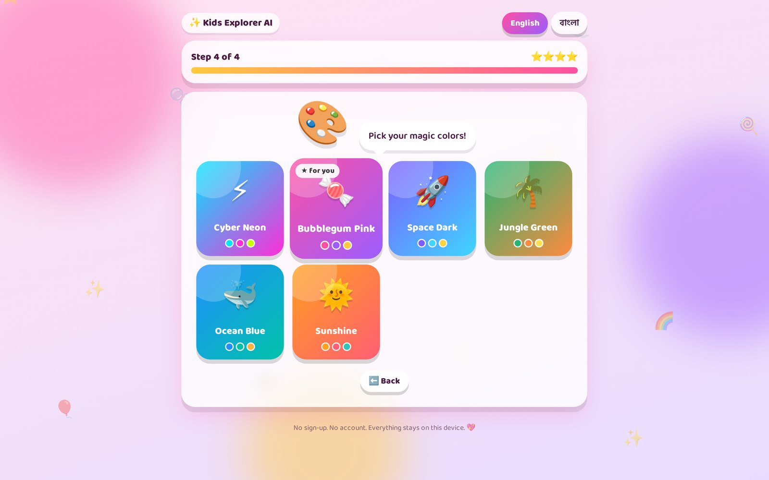
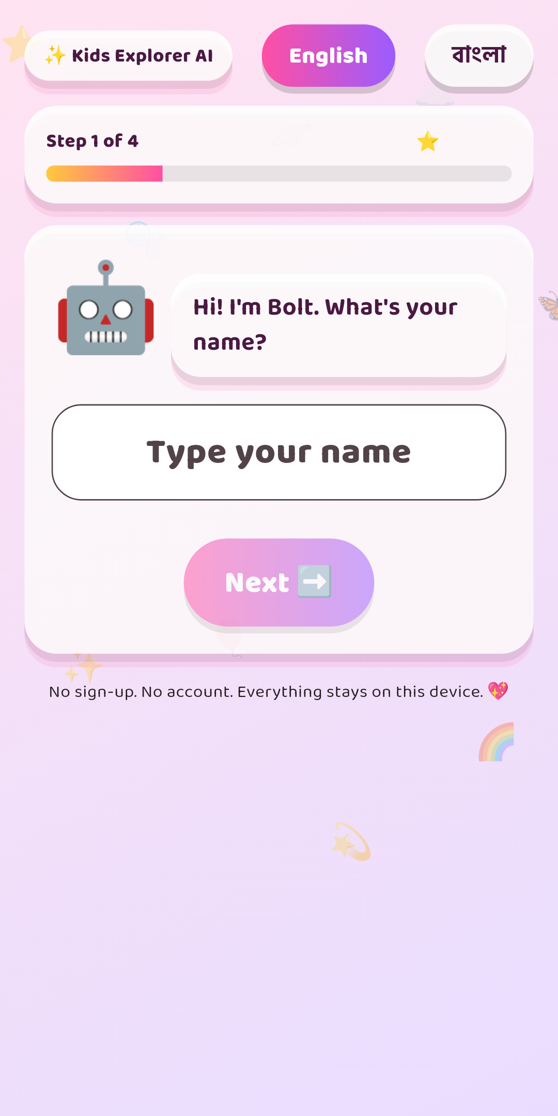
KID JOURNEY
Onboarding is the first game: 4 levels
An animated robot asks (and speaks) each question — name → age → hero → magic colors.
1
✍️ Name
Live "Hello Mahi!"
2
🎈 Age
2–4 · 5–7 · 8–10+
3
🦸 Hero
Boy · Girl · Superhero · Robot · Cosmic
4
🎨 Theme
"★ for you" picked by hero
Saved only on the device (LocalStorage / SharedPreferences).
Kids Explorer AI · Learn • Play • Imagine
4

Slide 5
MOTIVATION
A map that keeps kids coming back
🗺️ Levels on a map — admin chooses which modules appear and in which order.
⭐ Stars → levels (every 10 stars) with an animated progress bar.
🎯 Daily missions rotate every day across modules — spaced practice.
🔥 Streaks, 🎁 stickers (every 5 ⭐) and 🏅 7 badges.
🎉 Confetti, sounds & haptics on every win.
⏱️ Healthy limits: daily screen time + wiggle-break reminders.
Kids Explorer AI · Learn • Play • Imagine
5

Slide 6
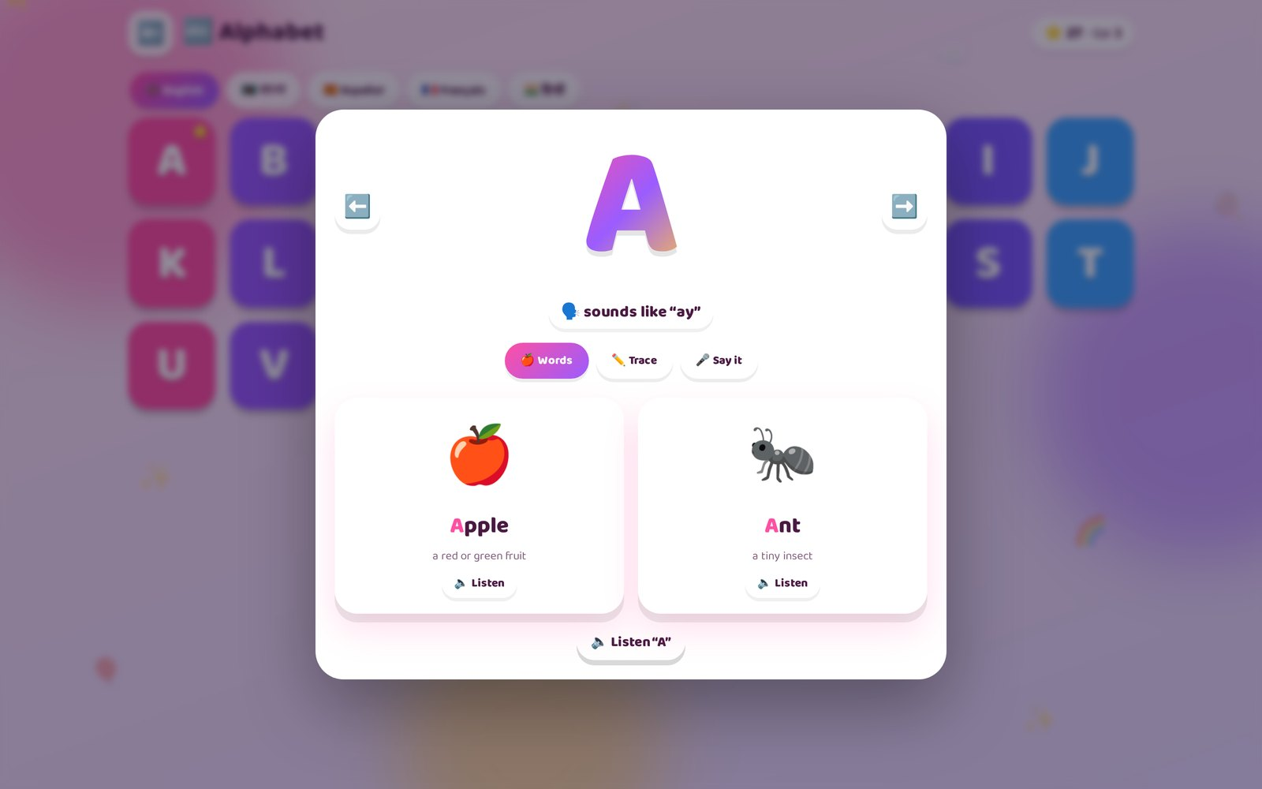
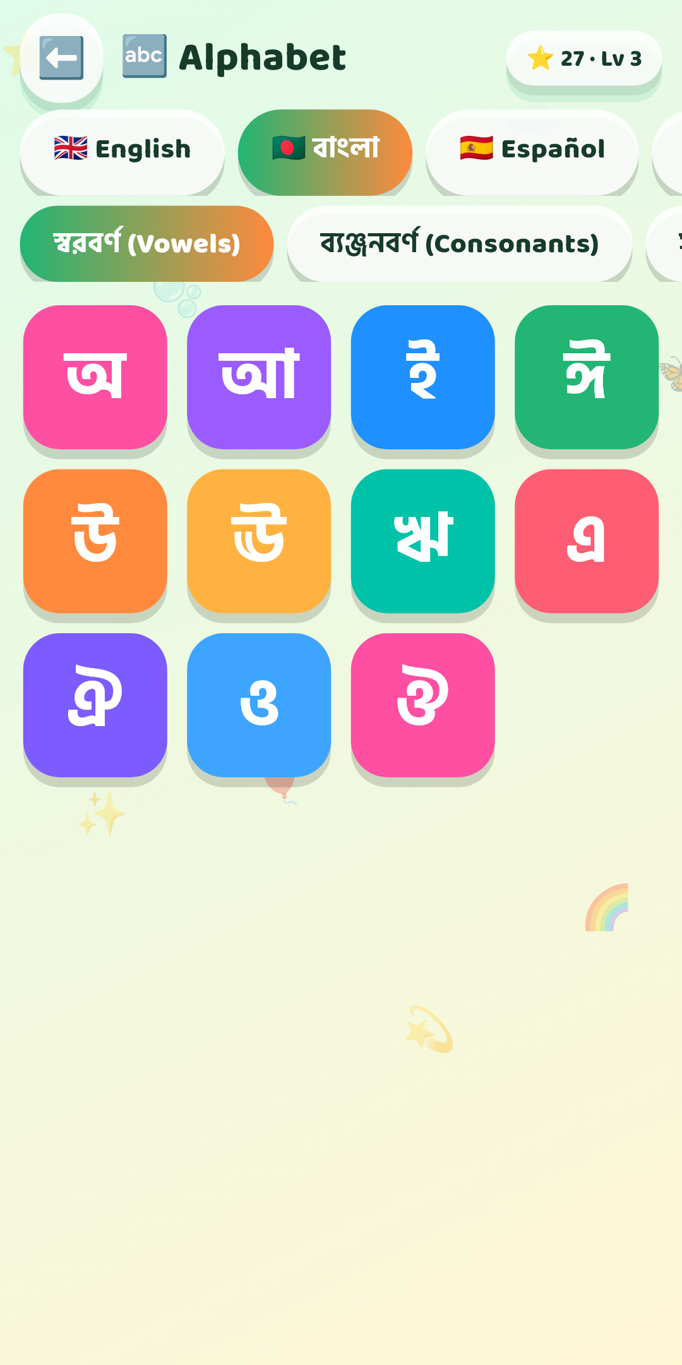
ALPHABET & PHONICS
See it · hear it · trace it · say it
🇬🇧 English 26
🇧🇩 বাংলা 11 + 39 + ০-৯
🇪🇸 Español 27
🇫🇷 Français 26
🇮🇳 हिन्दी 12 + 31
➕ Any language added by admin
✏️ Tracing with sparkle particles
🎤 Pronunciation 0-3 ⭐ + slow syllables
Kids Explorer AI · Learn • Play • Imagine
6

Slide 7
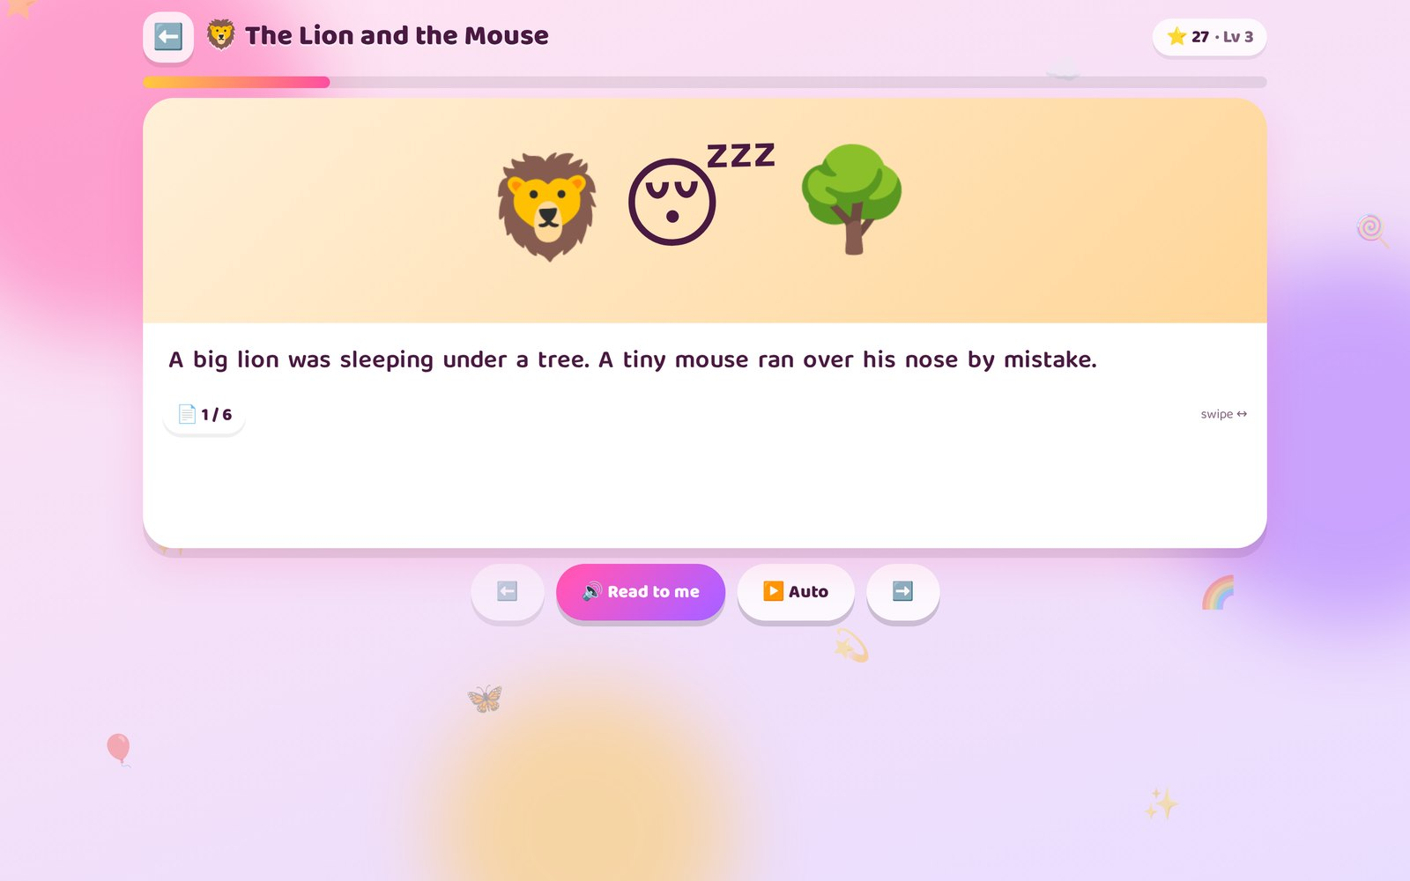
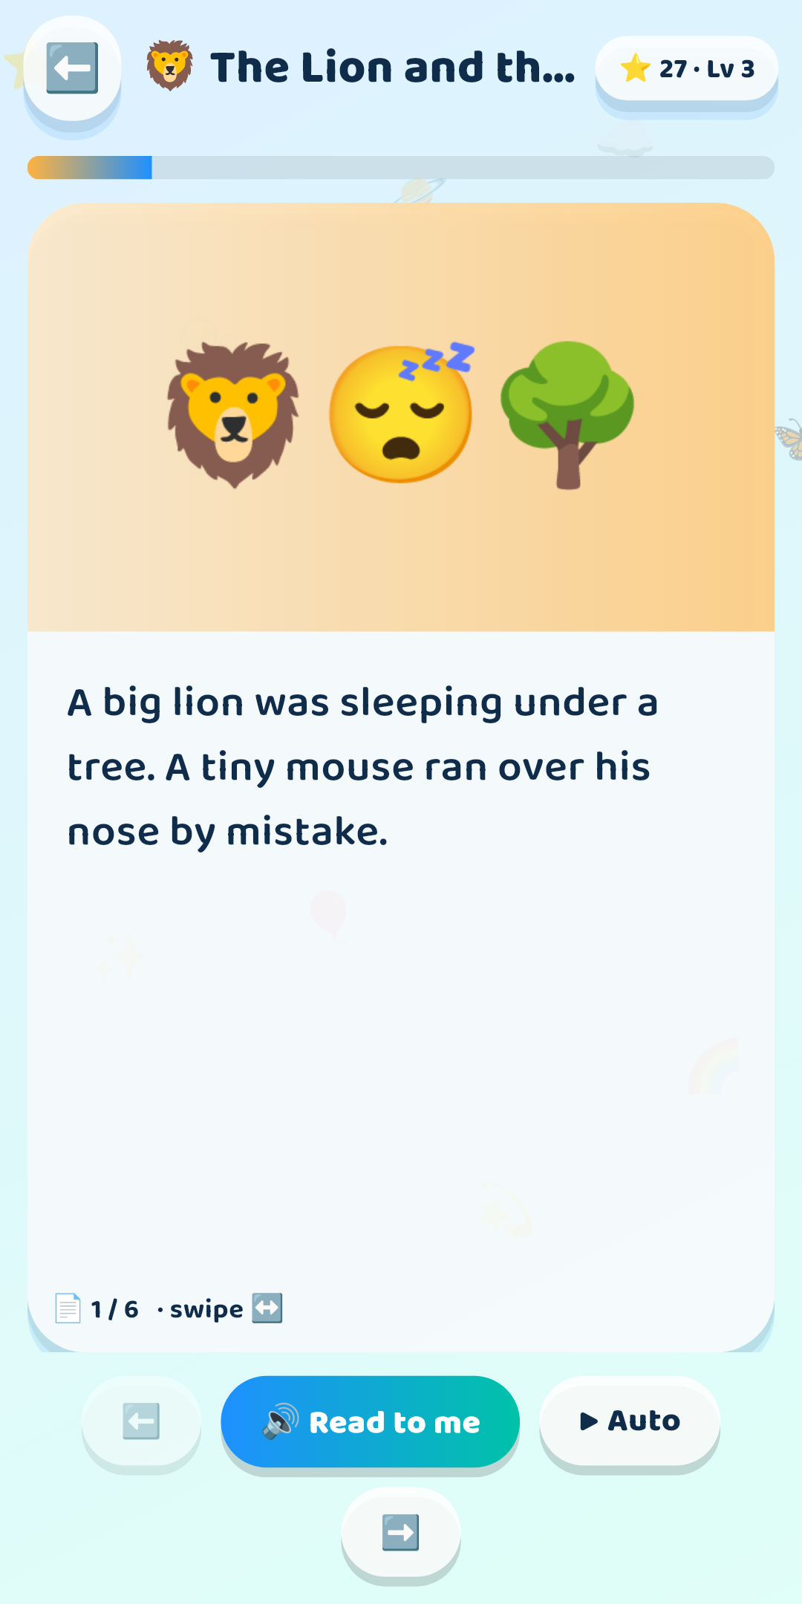
STORYTELLER
Flip-book stories that read themselves
Narration with word-by-word highlighting → moral of the story → quiz → stars.
📖 3D page flip & swipe
🔊 Read to me + auto-play
🖍️ Highlight each spoken word
💡 Moral card after every story
❓ Quiz to check understanding
🛠️ Admin builder: pages, art, audio
Kids Explorer AI · Learn • Play • Imagine
7

Slide 8
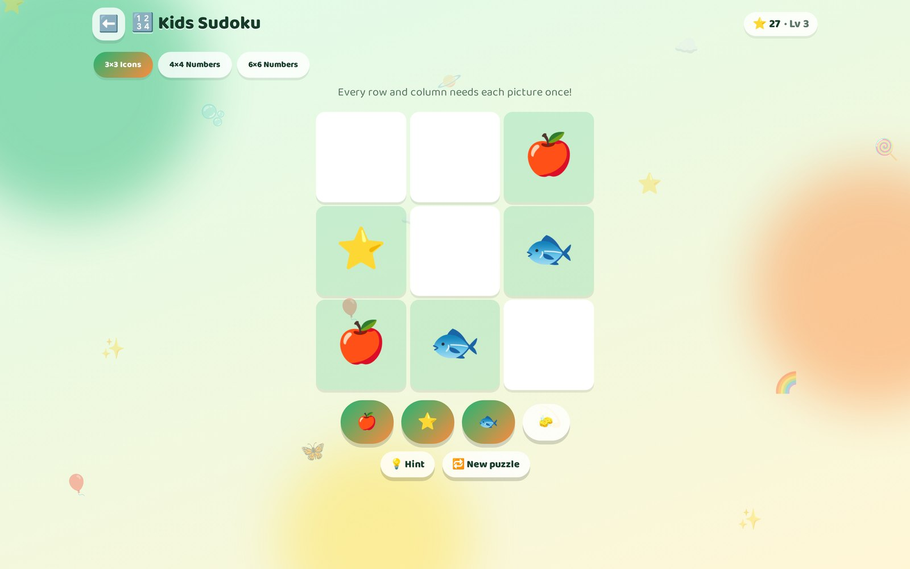
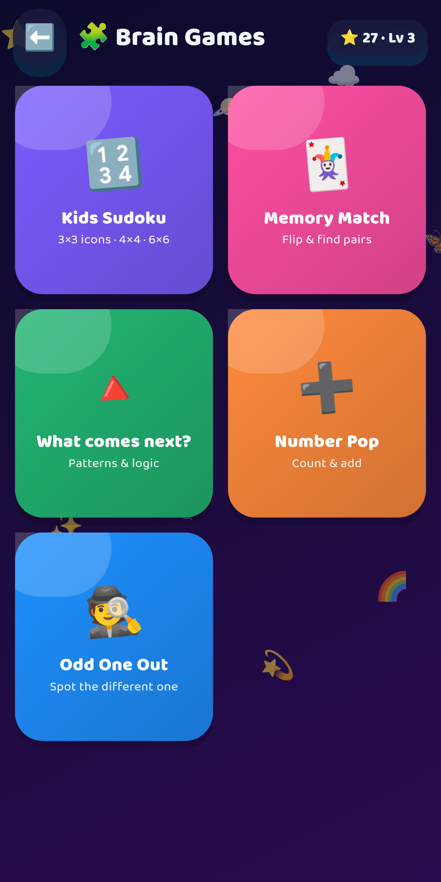
BRAIN GAMES
Five games that grow with the child
🔢 Kids Sudoku 3×3 pictures → 4×4 → 6×6, hints, conflict glow
🃏 Memory Match 3 → 8 pairs by age
🔺 What comes next? AB/ABC patterns & number sequences, drag & drop
➕ Number Pop count → add → × tables
🕵️ Odd One Out cross-topic reasoning
Kids Explorer AI · Learn • Play • Imagine
8

Slide 9
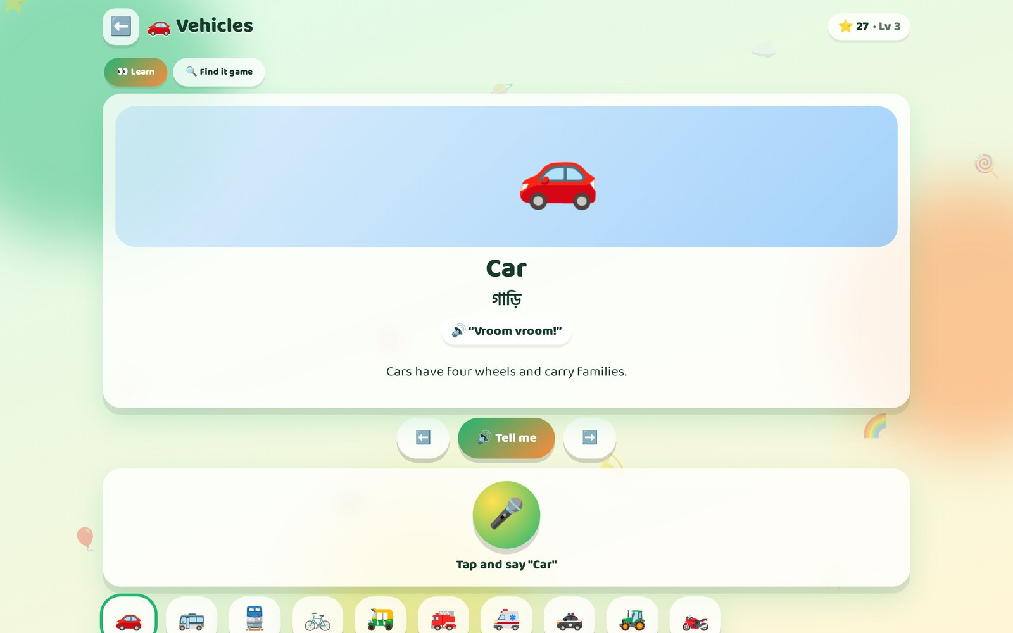
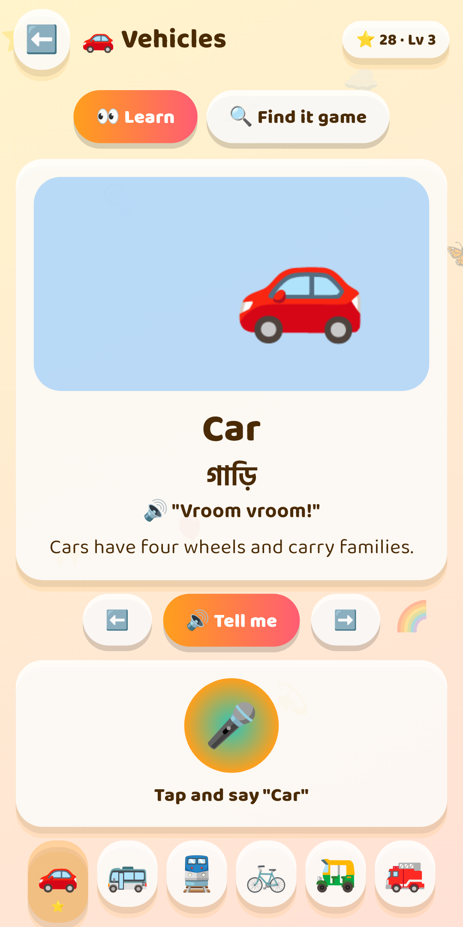
EXPLORE THE WORLD
15 topics · 141 things to discover
🦁 Animals
🦜 Birds
🍎 Fruits
🚗 Vehicles
🚢 Ships
✈️ Planes
🔷 Shapes
🌈 Colors
🔢 Numbers
🌍 Countries
🪐 Space
🧍 Body
🧑‍⚕️ Jobs
😊 Feelings
🪥 Habits
Cars drive, ships sail, planes fly. English + বাংলা names, facts, "Find it!" game.
Kids Explorer AI · Learn • Play • Imagine
9

Slide 10
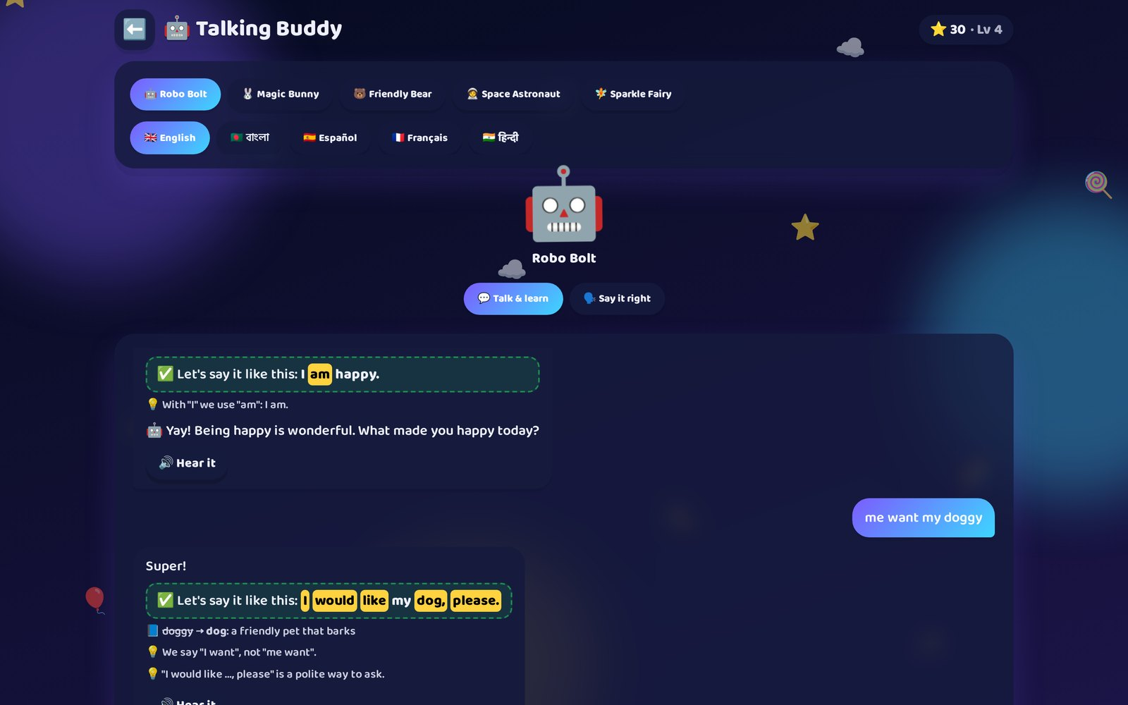
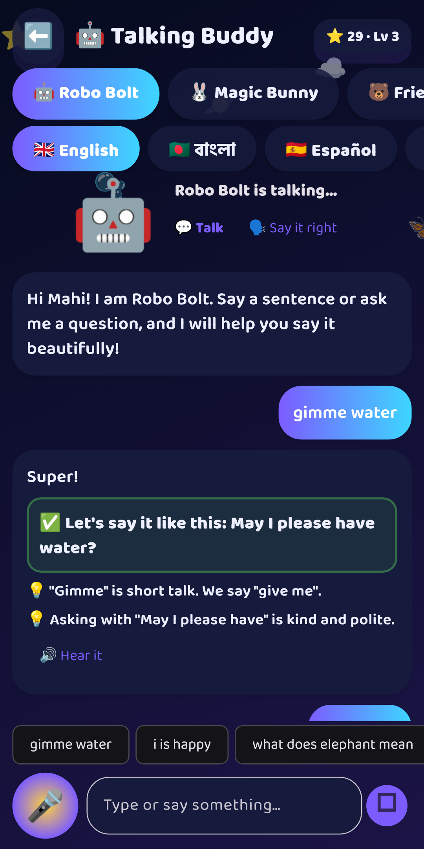
★ STAR FEATURE
100% FREE · ON-DEVICE
Talking Buddy: an AI friend for speaking
🛡️ Safety filter first
✏️ Grammar & dialect: "i is" → "I am"
👶 Baby talk → formal word + meaning
🙏 "gimme water" → "May I please have…?"
❓ Punctuation & capitals
💬 Answers in voice + text
5 voices (Robot, Bunny, Bear, Astronaut, Fairy) × 5 languages. Optional cloud AI via Gemini/OpenAI edge function.
Kids Explorer AI · Learn • Play • Imagine
10

Slide 11
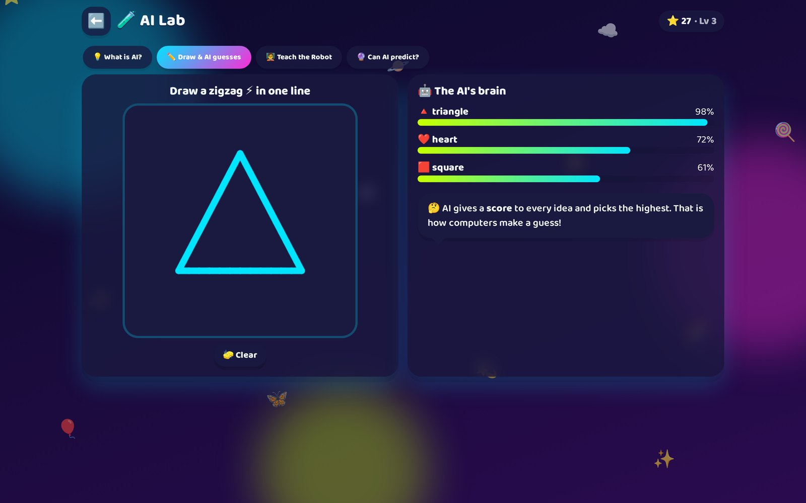
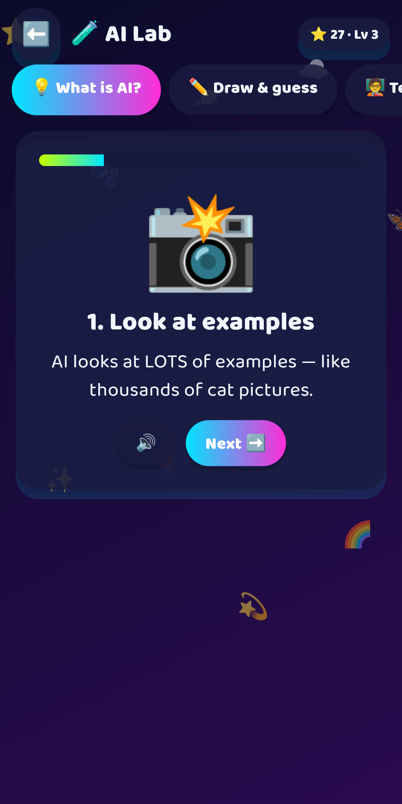
FUTURE SKILLS
AI Lab — kids discover how AI thinks
💡 What is AI? 5 animated steps
✏️ Draw & guess — live confidence bars
🧑‍🏫 Teach the Robot — training data & k-NN
🔮 Can AI predict? — try to trick it!
🤝 Message: AI is a helper made by people; it can be wrong.
Kids Explorer AI · Learn • Play • Imagine
11

Slide 12
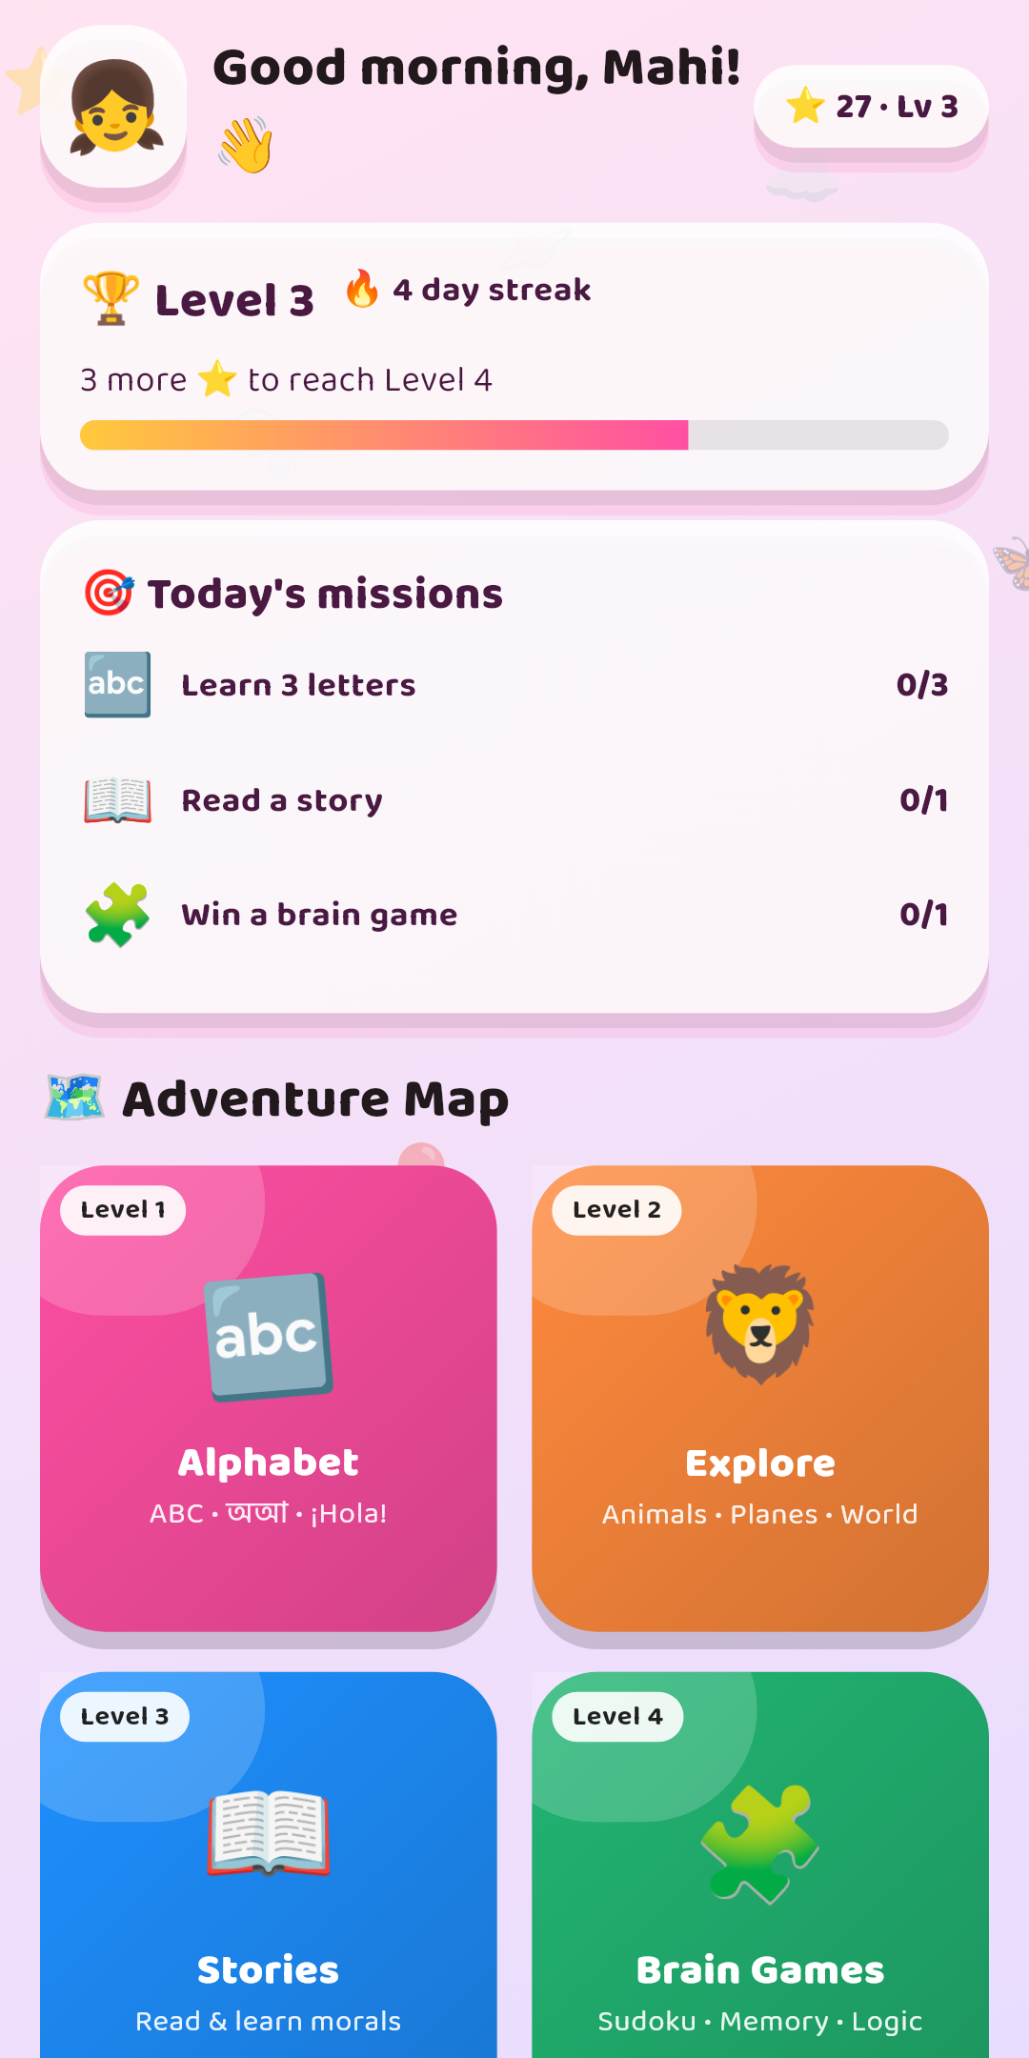
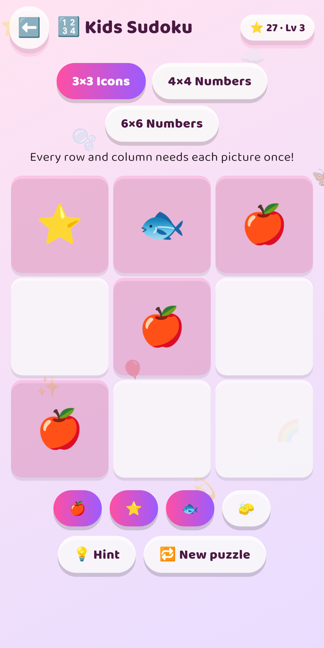
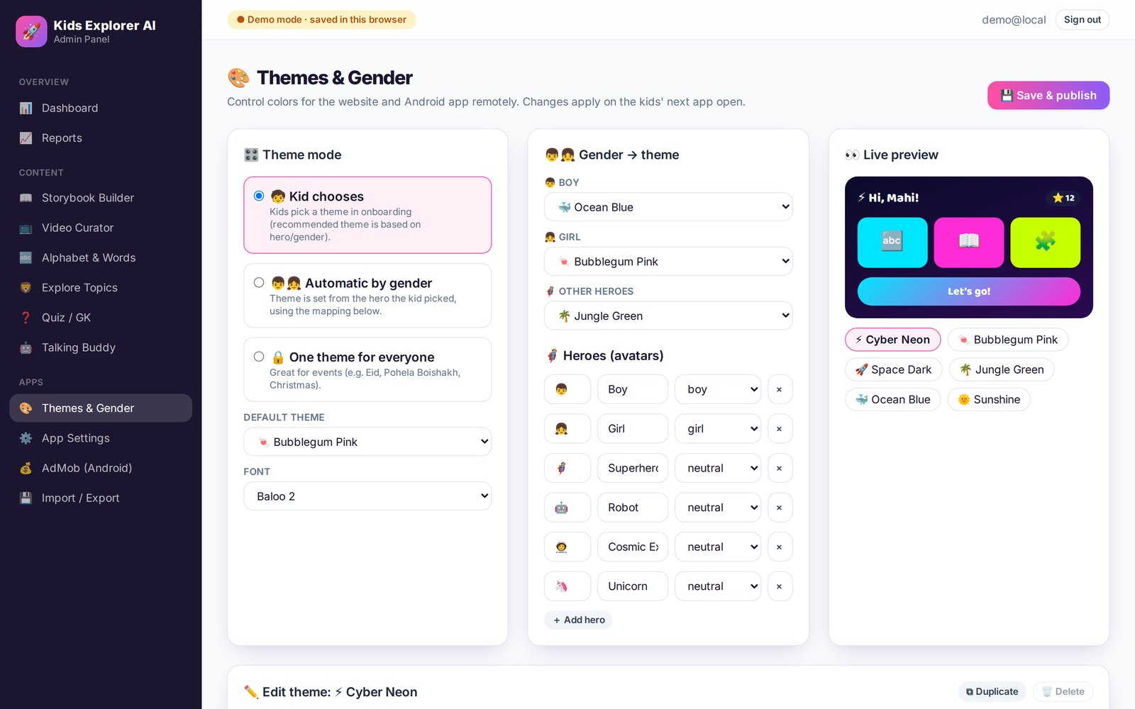
PERSONALISATION
Colors that follow the child — or the admin
Theme modes: Kid chooses · Automatic by gender/hero · One theme for everyone (events).
6 editable themes · gender → theme mapping · heroes · fonts · live preview — applied remotely to web & Android.
Kids Explorer AI · Learn • Play • Imagine
12

Slide 13
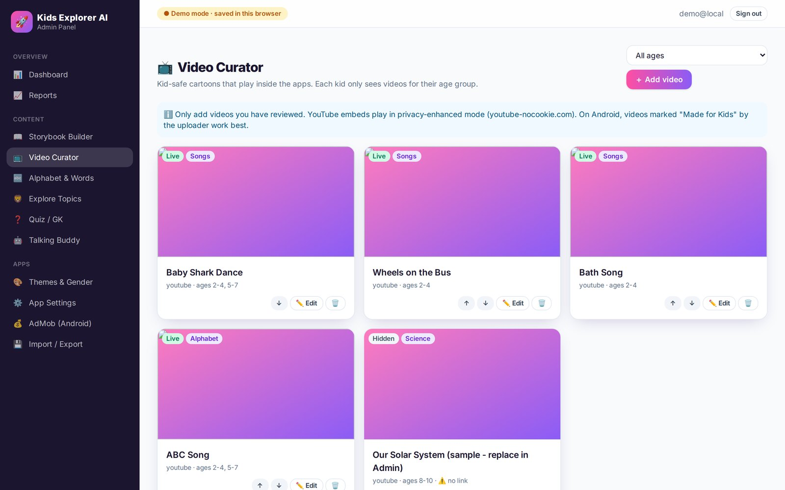
SAFE CARTOONS
Age-curated video hub
🎯 Filtered by age group chosen in onboarding
🔗 Paste any YouTube link — ID & thumbnail detected, preview plays
🕶️ Privacy-enhanced embeds (youtube-nocookie), related videos limited
🚫 No outbound links: tap shield over the title bar
🗂️ Categories: Songs, Alphabet, Stories, Science, Math…
🎬 Also Vimeo & MP4 on the website
Kids Explorer AI · Learn • Play • Imagine
13

Slide 14
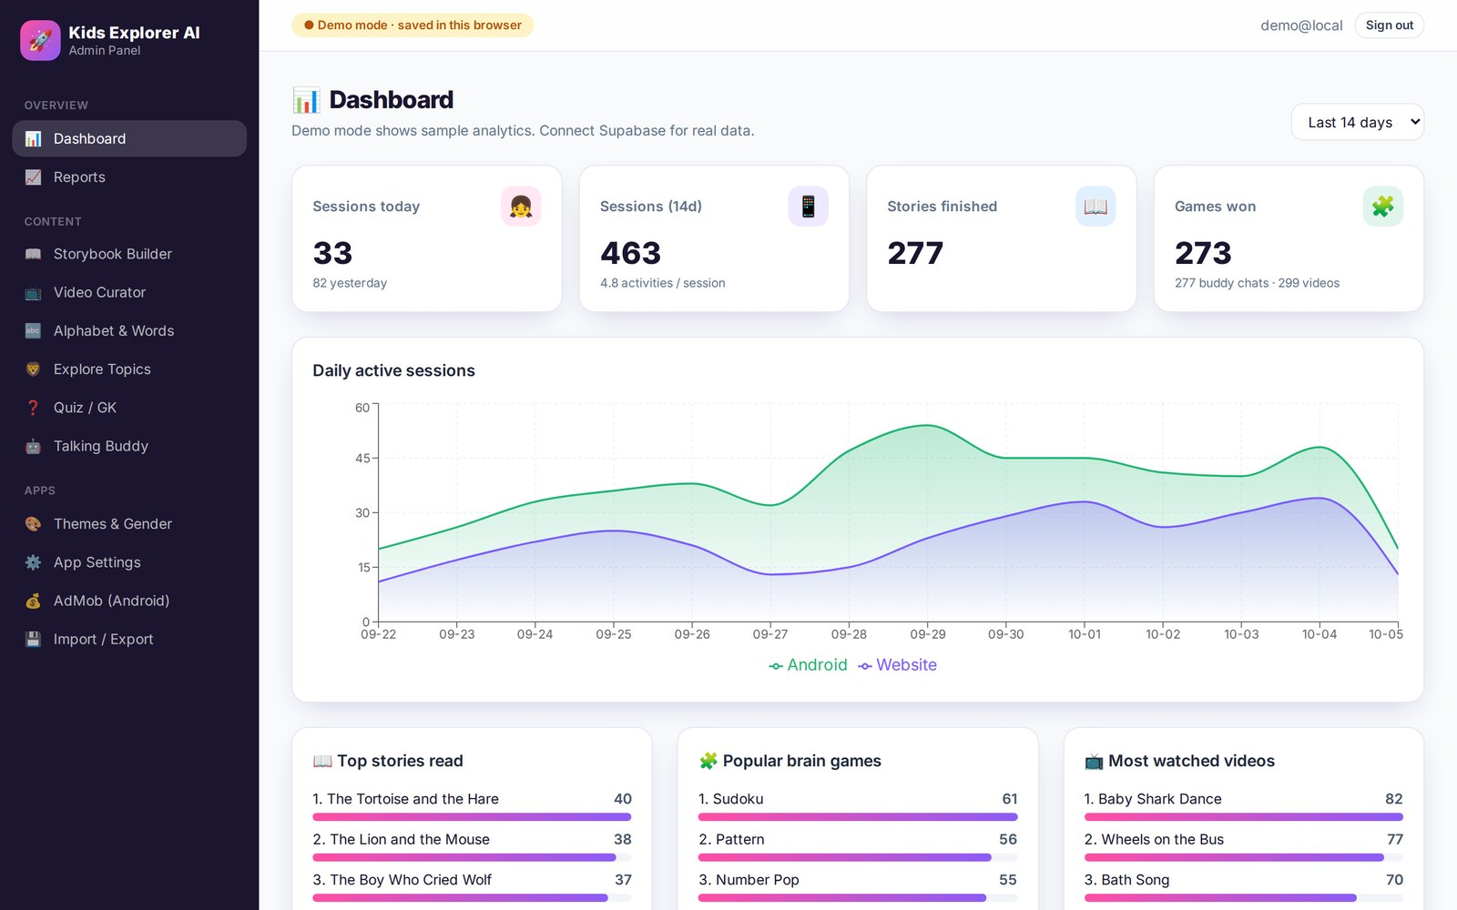
ADMIN PANEL
One dashboard for web + Android
📊 Daily sessions Web vs Android
📖 Top stories, popular games, most-watched videos
🎂 Age, theme, platform and language split
📈 Reports with filters & CSV export
🔒 Anonymous only: no names, no device IDs
👥 Roles: owner · editor · viewer
Kids Explorer AI · Learn • Play • Imagine
14

Slide 15
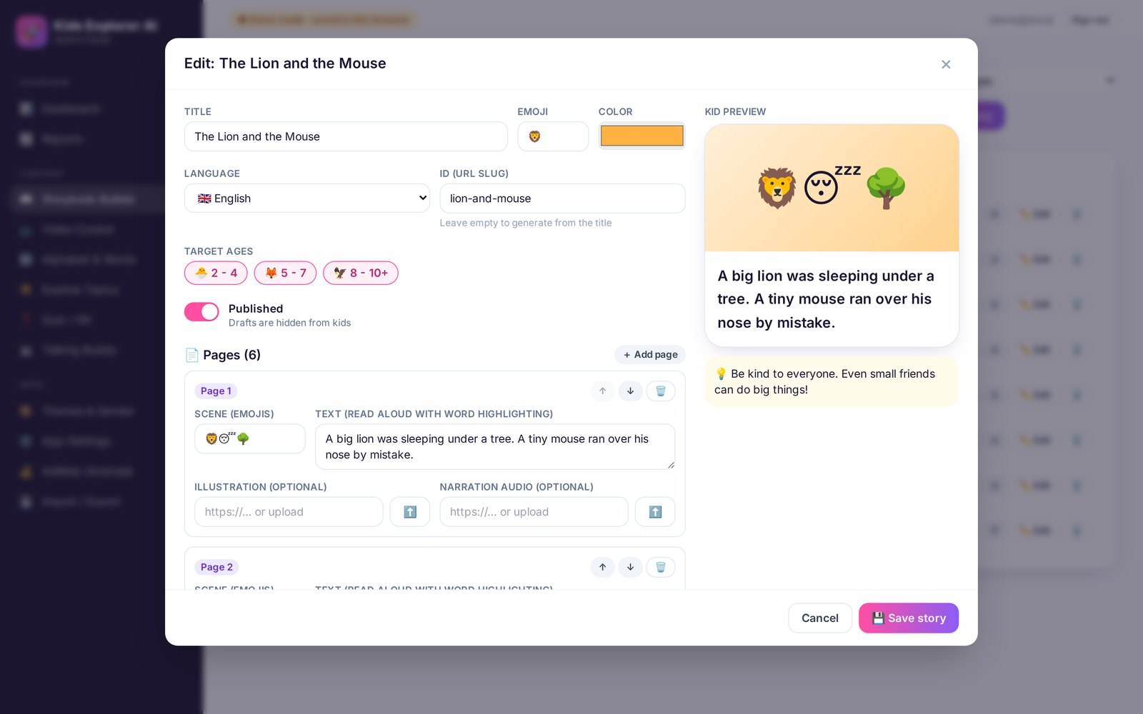
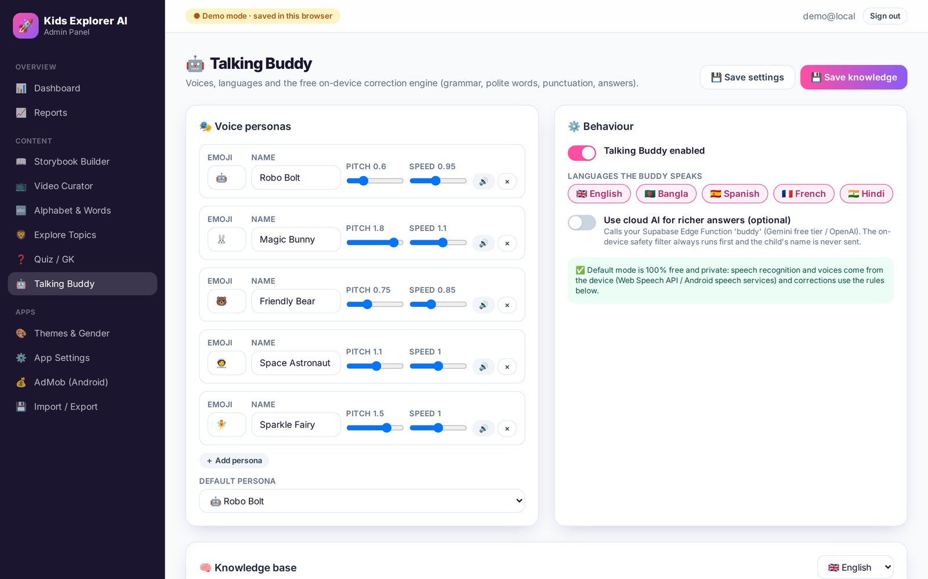
CONTENT ENGINE
Change everything without an app update
📖 Storybook Builder
📺 Video Curator
🔤 Alphabet & Words
🦁 Explore Topics
❓ Quiz
🤖 Buddy rules + test console
⚙️ Features & level order
💾 Import / Export
Kids Explorer AI · Learn • Play • Imagine
15

Slide 16
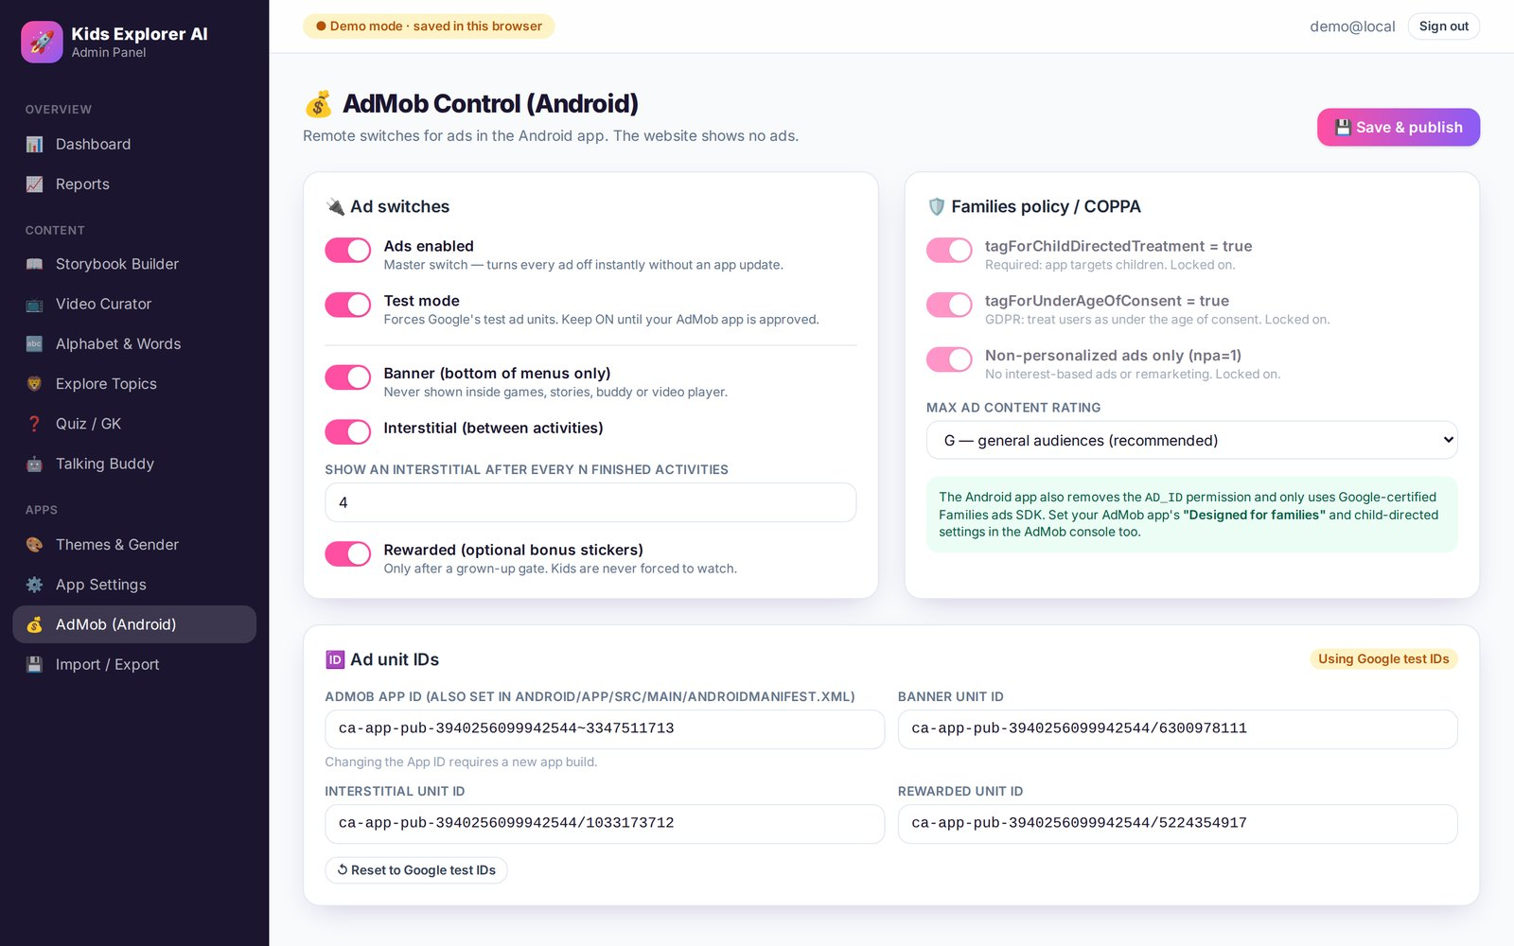
MONETISATION, RESPONSIBLY
AdMob ready for Google Play Families
✅ Child-directed requests, max rating G
✅ Non-personalised ads, no remarketing
✅ AD_ID permission removed
✅ Banners on menus only, capped interstitials
✅ Rewarded ads behind the parental gate
✅ Remote kill-switch from the admin
✅ No accounts, data stays on device
Kids Explorer AI · Learn • Play • Imagine
16

Slide 17
UNDER THE HOOD
Architecture & tech stack
🌐 Website
🛠️ Admin Panel
🗄️ Supabase
React · Vite · Framer Motion
React · Tailwind · Supabase Auth
Postgres JSONB + RLS · Storage · Events
📱 Android
Flutter · AdMob · TTS/STT
📦 shared/content
🧠 Buddy AI (optional)
JSON seed → every app
Gemini / OpenAI-compatible
⚡ Offline-first: seed → cache → refresh.
🔐 RLS: apps read published content & insert anonymous events only; admins write.
Kids Explorer AI · Learn • Play • Imagine
17

Slide 18
QUALITY
Tested, linted and documented
52
14
0
8
Flutter tests
Web unit tests
Lint issues
Guides
engine parity, games, every screen rendered at phone size, onboarding flow
buddy engine, sudoku, AI-lab algorithms, content
flutter analyze · ESLint (web + admin)
README per app, build guide (Win/mac), Play Store, privacy, admin
Store screenshots of the real Android screens are generated automatically: flutter test --tags screenshots --run-skipped --update-goldens
Kids Explorer AI · Learn • Play • Imagine
18

Slide 19
GET STARTED
From clone to Play Store
Works on Windows and macOS — full guide in docs/BUILD_GUIDE.md
🌐 Website
cd web && npm install && npm run dev
🛠️ Admin
cd admin && npm install && npm run dev
📱 Android
cd mobile && flutter pub get && flutter run
📦 Play Store
flutter build appbundle --release -PadmobAppId=…
Next: offline voice packs · handwriting recognition for tracing · classroom mode · iOS
Kids Explorer AI · Learn • Play • Imagine
19

Slide 20
Learn • Play • Imagine
🚀 🦁 📖 🧩 🤖 🌈
Kids Explorer AI — website · Android app · admin panel
Kids Explorer AI · Learn • Play • Imagine
20

