Slide 1
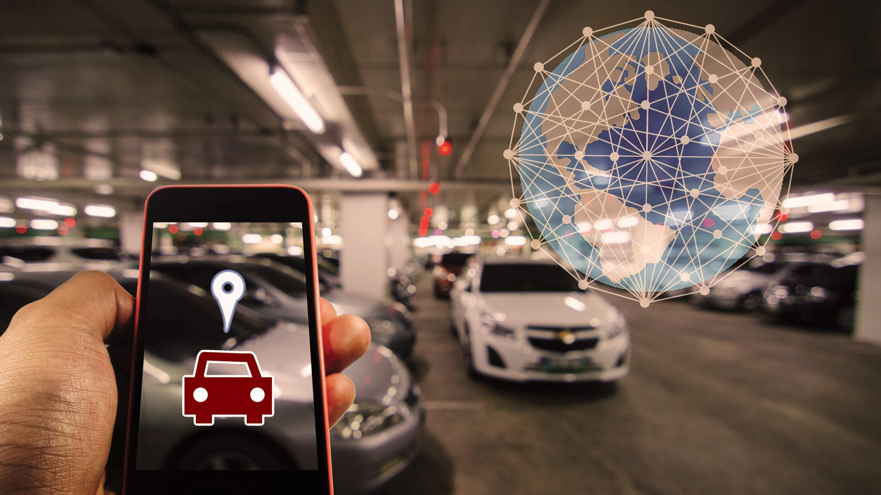
SMART PARKING MANAGEMENT SYSTEM
Project Description:
This is a parking management system that is designed to optimize parking space availability and streamline the reservation process in busy urban areas.
By: MAHIRWE Yvette

Slide 2





Target Users:
Drivers
Companies that control public parking spaces
Maximize Parking Efficiency : Utilize available spaces effectively.
Simplify Reservations :Allow users to book parking spots in advance.
Enhance User Experience : Provide a smooth and convenient parking process.
Reduce Traffic Congestion : Minimize vehicle movement in search of parking.
Problem Definition:
Traffic Congestion & Wasted Time
Inefficient parking space utilization
Unauthorized Parking & Security Issues
Context: (Where and how)
Where? : Public parking spaces
How?:By optimizing parking space availability and boost the reservation process.

Slide 3
BENEFITS
Saves Time :Quick access to available parking. . Reduces Traffic : Less congestion in busy areas.
Boosts Revenue :Better space management increases earnings.
MAIN ENTITIES
Customers: Stores driver details and payment information such as: Customer ID, Name, Email, Phone Number, Vehicle Details (License Plate).
Parking Spaces : Manages slot availability and locations that stores: Parking Space ID Location (Address),Slot Number, Availability Status (Available/Occupied/Reserved),Parking Type (Regular, Handicap, VIP, Electric Vehicle),Price per hour.
Reservations : Tracks bookings and transactions and stores :Reservation ID, Customer ID, Parking Space ID ,Start Time and End Time, Payment Status, Reservation Status (Confirmed/Canceled/Completed)
Parking Lot Operators: Oversees space allocation and pricing: Operator ID, Name (Company or Individual),Contact Information

