Slide 1

Project Title :SEASONAL AGRICULTURE PERFORMANCE ANALYSIS
Subtitle: Data-Driven Analysis of Crop Yield, Resources and Profitability
Student Name: Mahisha V College Name: Vemana Institute Of Technology
AICTE STU ID: STU68a5d246ade8a1755697734

Slide 2

PROBLEM STATEMENT
Agricultural activities are influenced by seasonal variations in environmental conditions, farming practices, resource availability and market conditions. As a result, agricultural performance may differ from one season to another.
However, raw agricultural data does not clearly explain how agricultural performance changes across seasons or what patterns can be observed in different seasonal conditions.
The problem is to analyze the given agricultural dataset and investigate seasonal differences in agricultural performance by identifying meaningful patterns, trends, relationships and variations within the available data.

Slide 3
Project Description
This project analyzes a seasonal agriculture performance dataset containing 4,000 records and 28 variables.
The analysis focuses on:
Crop and season-wise agricultural performance
Environmental conditions such as rainfall, temperature, humidity and soil moisture
Agricultural inputs such as fertilizer and water usage
Irrigation methods and their relationship with yield
Production, revenue and farm profitability
Correlations and relationships among numerical variables
Seasonal differences and crop-level performance
Tools used: Python, Pandas, NumPy, Matplotlib, Seaborn and Google Colab.

Slide 4
WHO ARE THE END USERS?
Farmers
Compare crop and seasonal performance.
Understand resource-use patterns.
Agricultural Planners
Support seasonal planning and resource allocation.
Agricultural Researchers
Study relationships between environmental and agricultural factors.
Government & Agriculture Departments
Understand broader seasonal and crop-level performance patterns.
Agribusiness Decision Makers
Evaluate production, revenue and profitability trends.

Slide 5
Technology Used
Python Used as the primary programming language.
Pandas Used for data loading, cleaning, transformation and analysis.
NumPy Used for numerical operations.
Matplotlib Used to create statistical and analytical visualizations.
Seaborn Used for advanced statistical plots such as box plots, pair plots and heatmaps.
Google Colab Used as the development and execution environment.

Slide 6
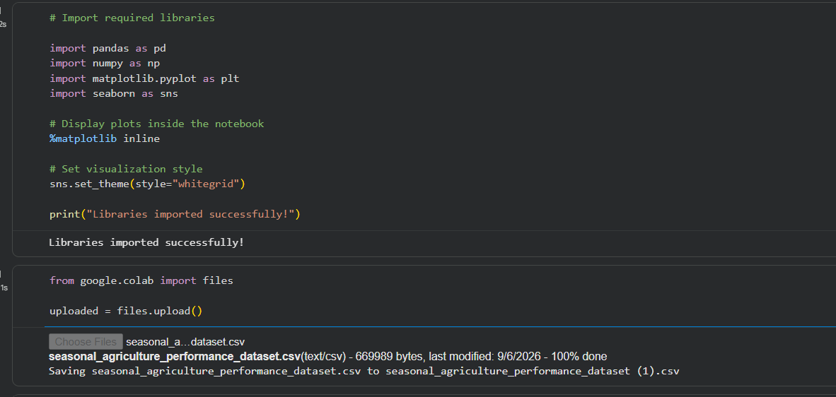
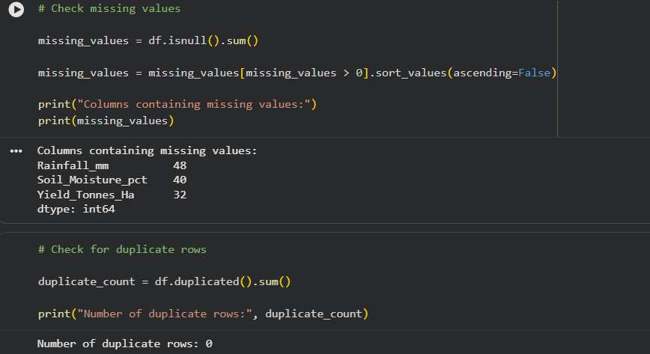
RESULTS - Data Exploration & Cleaning Dataset Overview
Dataset Size
4,000 Rows × 28 Columns
Missing Values
Rainfall: 48
Soil Moisture: 40
Yield: 32
Duplicate Records
0

Slide 7
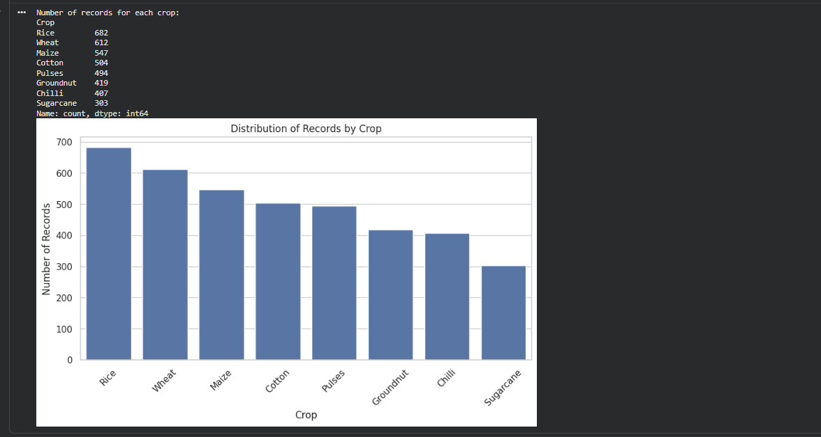
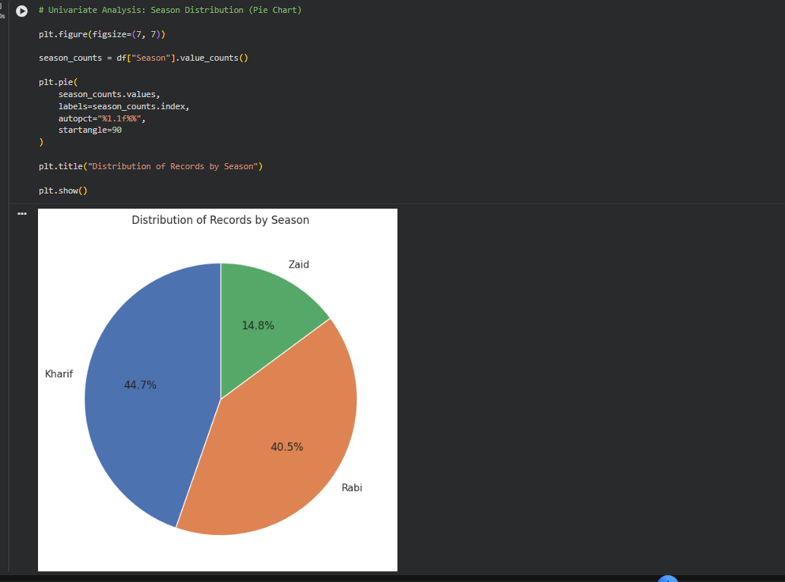
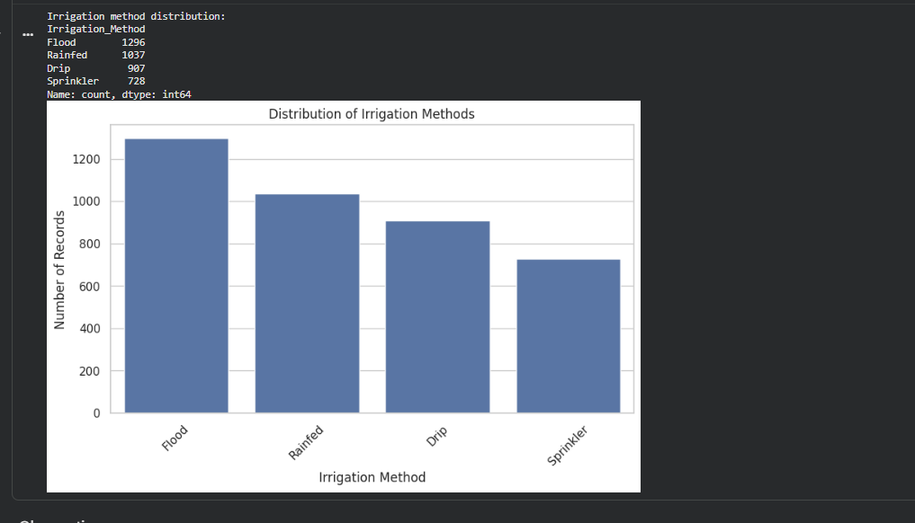
RESULTS – Univariate Analysis
Kharif: 1,779
Rabi: 1,627
Zaid: 594

Slide 8
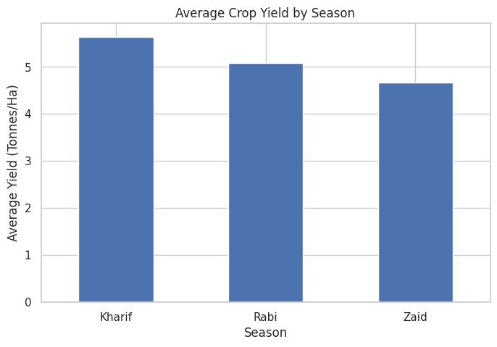
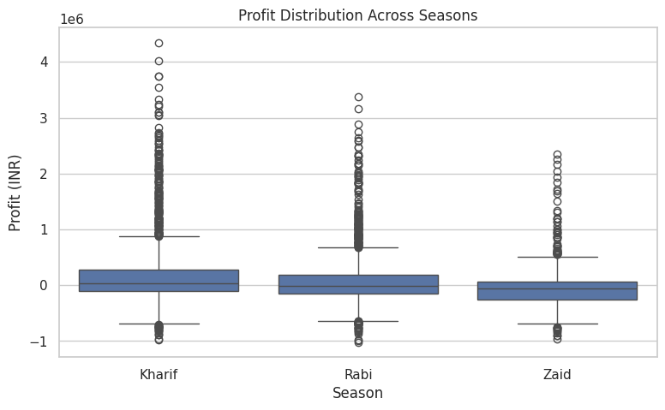
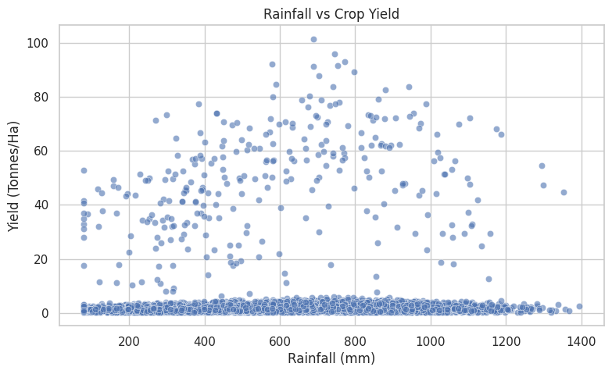
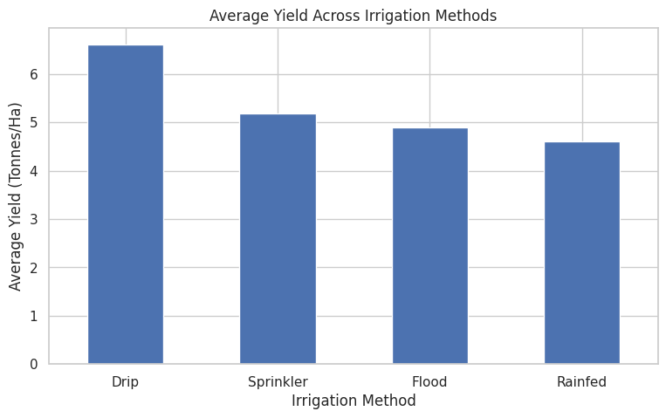
RESULTS - Bivariate Analysis

Slide 9
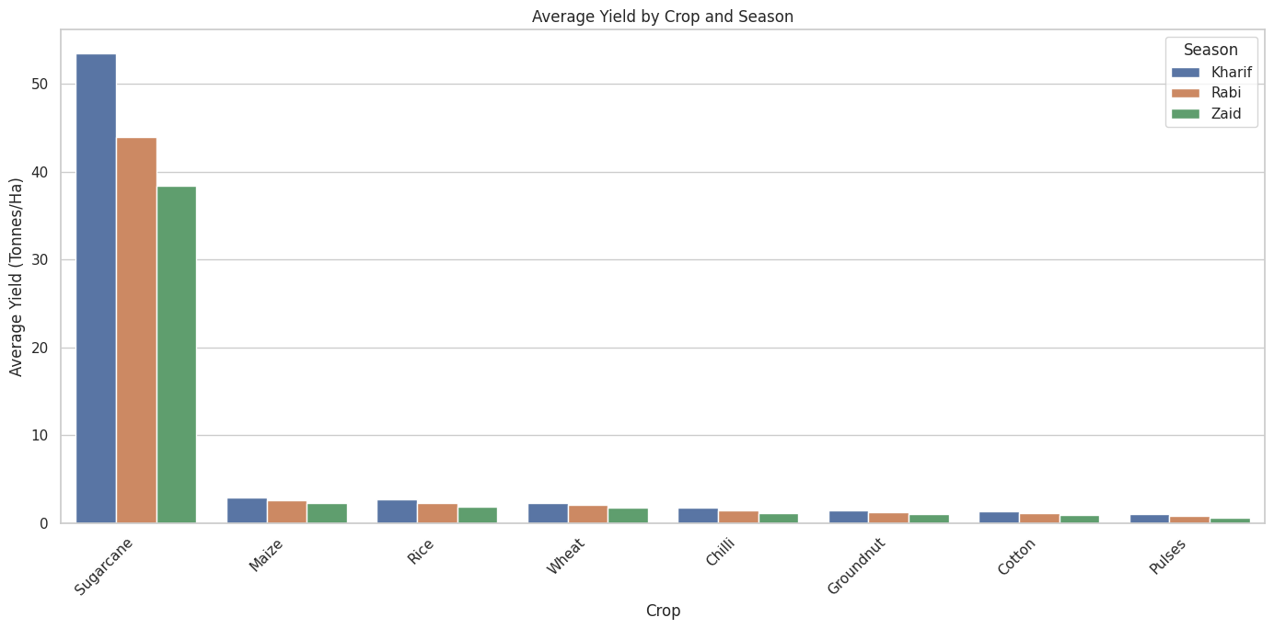
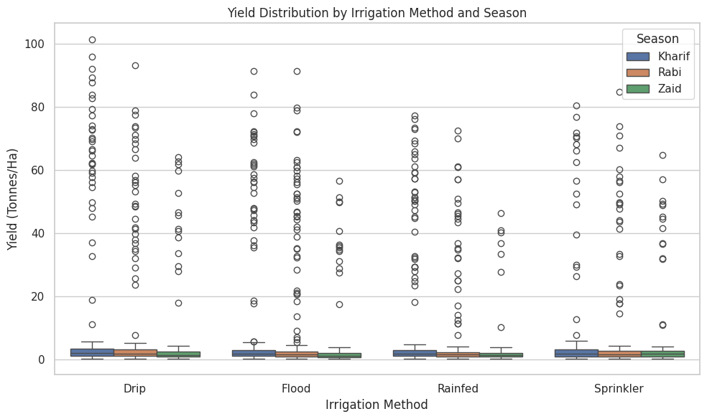
RESULTS - Multivariate Analysis

Slide 10
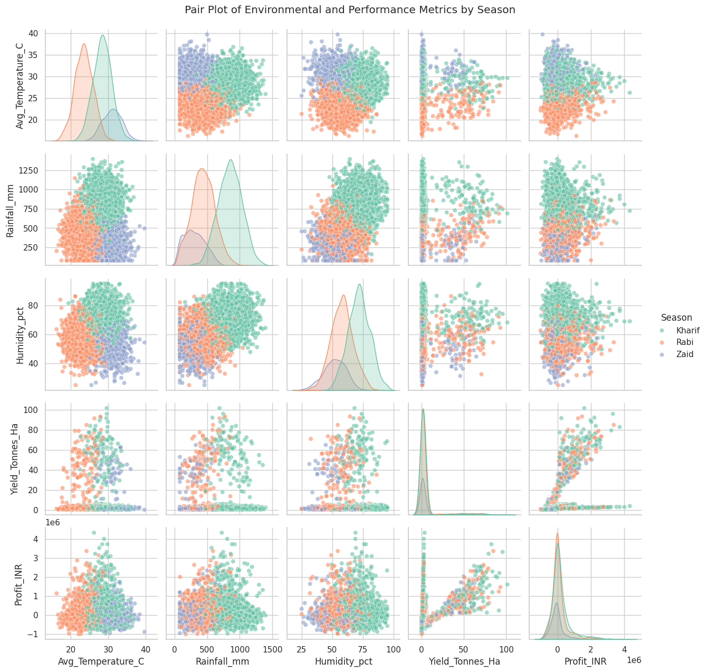
RESULTS - Multivariate Analysis
Multiple variables were analyzed together to identify seasonal and performance patterns.

Slide 11
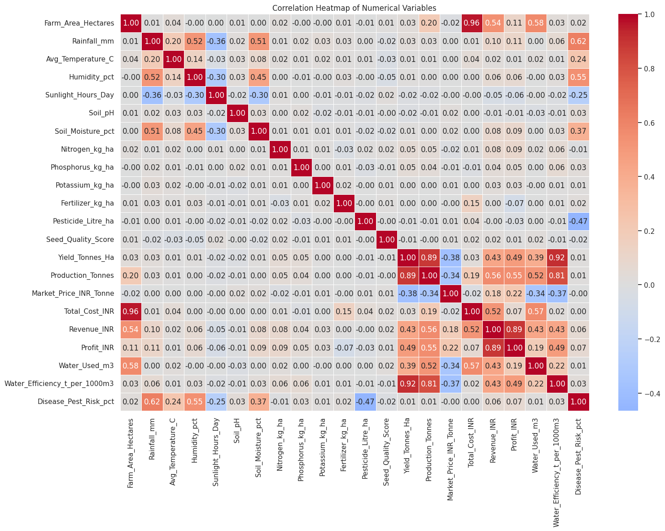
RESULTS - Correlation Analysis
Key Correlations
Farm Area ↔ Production 0.96
Rainfall ↔ Humidity 0.52
Rainfall ↔ Soil Moisture 0.52
Humidity ↔ Soil Moisture 0.45
Rainfall ↔ Yield 0.031
Disease Risk ↔ Yield 0.013

Slide 12
Future scope
1. Larger and More Diverse Datasets
Extend the analysis using agricultural data from more states, districts and farming regions.
Include data from multiple years to study long-term agricultural trends.
2. Machine Learning-Based Prediction
Develop machine learning models to predict:
Crop Yield
Production
Profitability
Water Requirements
Compare different algorithms to identify suitable predictive models.
3. Smart Crop Recommendation
Build a recommendation system using soil, weather, irrigation and historical performance data.
Recommend suitable crops and seasons based on observed agricultural conditions.
4. Resource Optimization
Analyze water, fertilizer and pesticide usage to identify opportunities for more efficient resource utilization.

Slide 13
Future scope
5. Interactive Dashboard
Develop an interactive dashboard using Power BI, Tableau or Streamlit.
Allow users to filter results by crop, season, location and irrigation method.
6. Real-Time Agricultural Data
Integrate real-time weather and environmental data from sensors or external data sources.
Monitor rainfall, soil moisture and temperature for more timely decision-making.
7. Time-Series Analysis
Study seasonal and yearly trends in yield, production, market prices and profitability.
Identify recurring patterns and changes in agricultural performance over time.
8. Risk Analysis
Further investigate disease, pest, weather and market-related risks.
Build early-warning models to support better agricultural planning.
Future Goal
The project can be extended from descriptive analysis into a predictive and decision-support system for data-driven agricultural planning.

Slide 14
GitHub Link
https://github.com/Mahisha04/SEASONAL-AGRICULTURE-PERFORMANCE-ANALYSIS.git

Slide 15
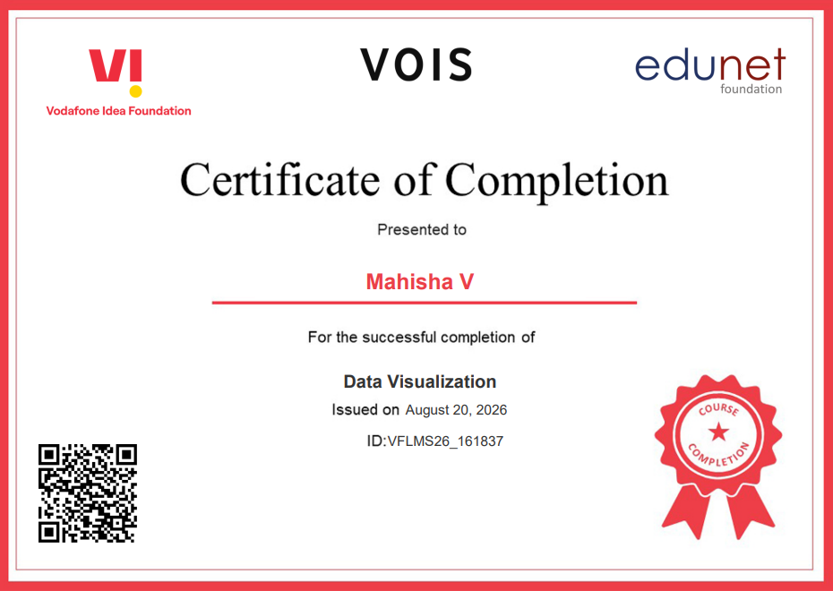
VOIS Course completion certificate - Course name- Data Visualization

Slide 16
Thank you
.
.

