Slide 1
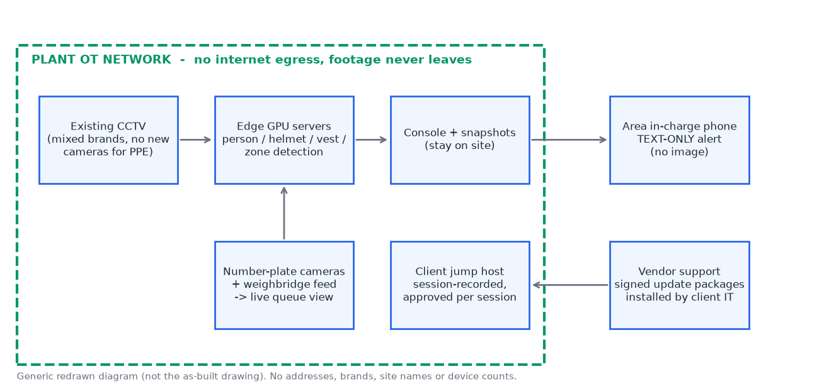
The Case Study Engine
From a messy 8-month project folder to a case study the client can sign
Agents with one job each: the LLM does the judgement (contract rules, KPI definitions, exposure, writing for three readers); code does the counting and checking.
Every line cites a file and line, or a calculation. The verifier refuses wrong numbers, drifted citations, identifiers and unmarked estimates; a fixer agent gets the refused lines back.
Two human stops (our delivery owner, then the client's authorised signatories). Approvals are bound to the pack's hash; 'no' and withdrawal are handled; every project is in one register.
The same code runs another project's library: only a new metric spec (test 10).

Slide 2
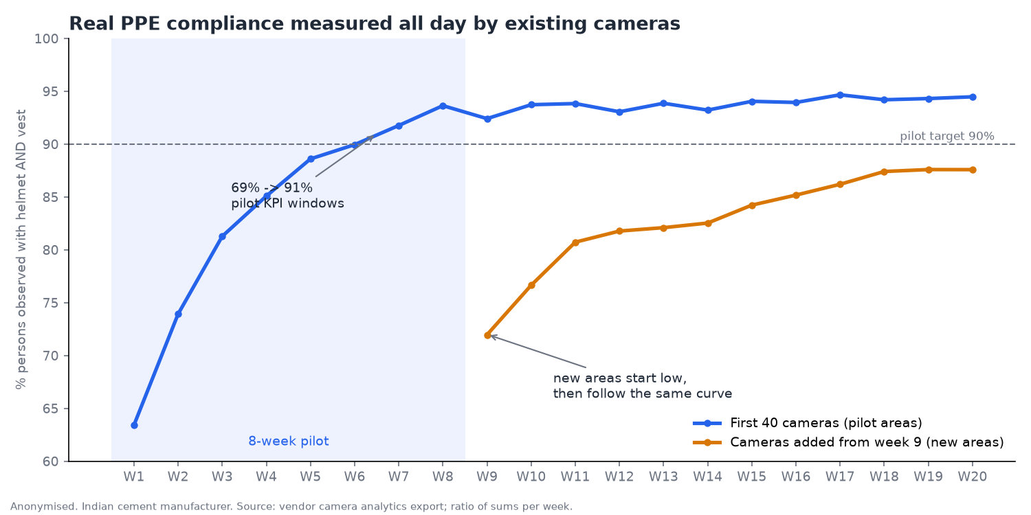
What it found in the library
All signed pilot KPIs recomputed exactly from raw data
Refused: the sales headline '74% to 97%, zero LTIs, Rs 2.3 Cr'. It mixes baselines, uses one zone's best week, and claims savings Finance rejected.
True story: PPE 69% to 91% in the pilot (met), 94% in those areas by September; zone breaches -46% (missed), then -77% after the client's own guards.
Credit shared: the client's safety week, toolbox talks, contractor discipline, guards, and phone escalation. Gate time is -24%, with the client's weighbridge and dispatch slots doing part.
Exposure: plant GPS inside the snapshot file, signage in images, a public post linking client to vendor, and the plant's capacity in the annual report. All media was redrawn from data.

Slide 3
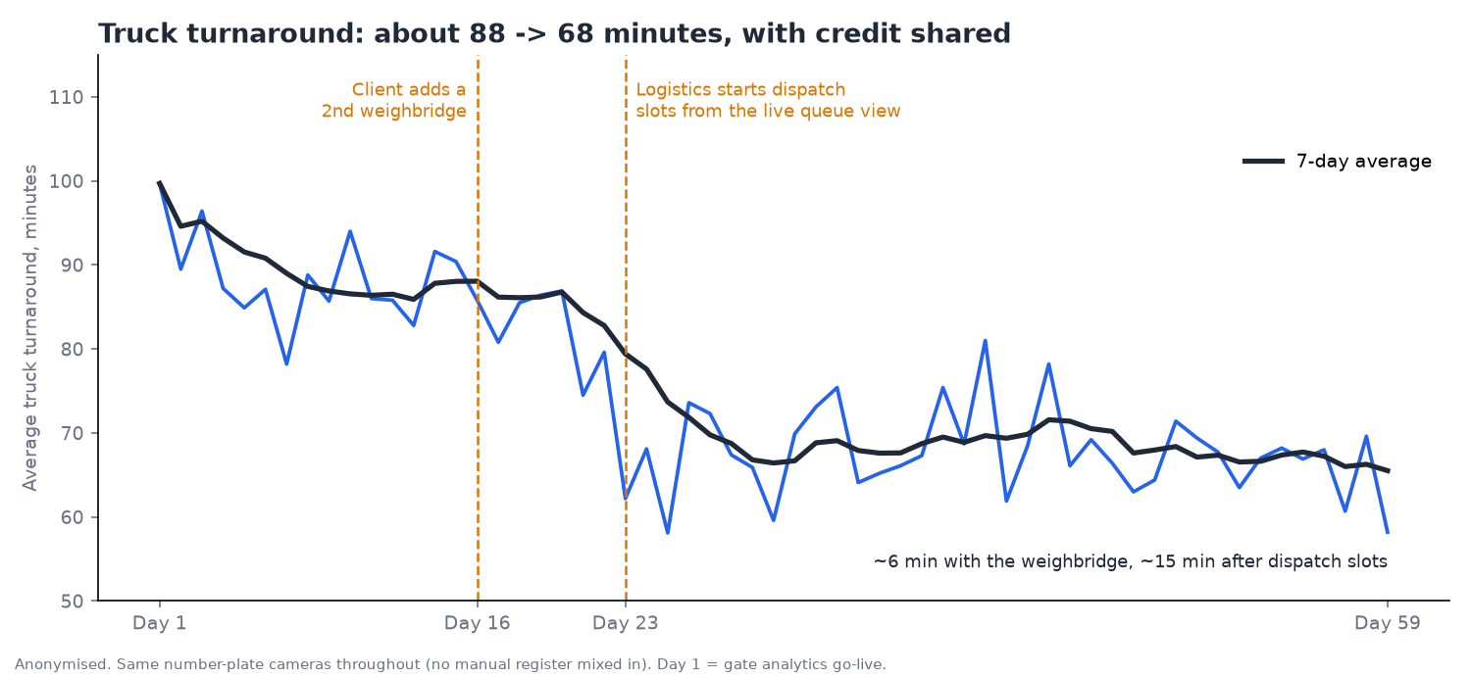
Getting to yes
Safe and rewarding for the people who sign
Gatekeeper: on-prem, no egress, text-only alerts, face module removed with the hash verified by the client's IT, the outage handled openly.
User: a normal day before and after. False alarms checked by their own team; the photo ended arguments; the gang leaders check helmets themselves.
Buyer: one headline; money only where Finance measured it, with estimates marked ASSUMED. Champion: a five-line note to forward.
Approval: to Corporate Comms + Legal by email, reply by 16 Nov (10 business days), per-asset options, and charts offered for their own council deck.

