Slide 1
Exploring COVID Scientometrics Data: Topic Modeling and Query-Driven Recommendations
TEAM DETAILS:
MAHIT NANDAN-211AI001
P JAYANTH -211AI027

Slide 2
Agenda
Introduction
Literature Survey
Outcome of Literature Survey
Problem Statement and Objectives
Existing Methodology
Dataset details
Proposed enhancements/novelty
Work done
Individual Contribution

Slide 3
Introduction
Scientometrics is the study of the quantitative aspects of the process of science as a communication system.
Scientometrics data refers to information derived from the quantitative analysis of scientific publications, citations, and collaboration patterns.
Crucial for evaluating the impact and influence of individual researchers, institutions, or journals and identifying Trends and Patterns.
Unsupervised statistical analysis of unstructured data has gained wide acceptance especially in natural language processing and text mining domains.
Topic modeling in scientometrics identifies the latent topics/concepts/themes for easy clustering and analyze large collections of scientific literature. Most commonly used methods are Latent Dirichlet Allocation (LDA) or Non-Negative Matrix Factorization (NMF) etc.

Slide 4
Introduction
Possible Applications on Scientometrics data:
Clustering Topics
Topic Modeling
Author Network Analysis
Journal Author Network Analysis
key words Identification
Keyword Co-Occurrence Analysis
Term Map
Recommendation systems
Collaboration Network Analysis
Content Analysis
Journal Impact Analysis
Geospatial Analysis
Altmetrics Analysis
Network Visualization

Slide 5
Literature Review
Author/year | Methodology | Advantages | Limitations
Chyi-Kwei Yau, Alan Porter, Nils Newman & Arho Suominen 2014 | Worked on three topic modelling variations LDA, CTM,HLDA,HDA and compared with k-means clustering on web of science bibilographical data. | Identified issues with LDA, Considered alrge data set | Created a set of 4 assumptions. And assumes latent topics arised are from words in document.
Hongshu Chen, Ximeng Wang, 2021 | A topic relation identification approach is then pre sented to quantitatively model the relations among the topics. | Text Clustering and Postclustering Analysis, Latent Dirichlet Allocation and Its Evaluation, Topic Analysis for Big Data Publications | Only restricted to LDA model and have to trace temporal changing in networks
SYED MUHAMMADADNANSHAH,2019 | proposed a topic modeling technique for text mining through hybrid inverse document frequency and machine learning fuzzy k-means clustering algorithm. | proposed technique tackles the redundancy issue and discovers precise topics from the biomedical text documents. Generates local and global term frequencies through the bag-of-words (BOW) model considers global words. | More execution time for proposed method
Ibai Guillén-Pacho, 2023 | Several time-dependent approaches based on topic models were compared to analyse the annual evolution of latent concepts in the CORD-19 corpus: Dynamic Topic Model, Dynamic Embedded Topic Model, and BERTopic. | novel topic labelling strategy is proposed for dynamic topic models to analyse the evolution of latent concepts. It incorporates content changes in both the annual evolution of the corpus and the monthly evolution of the COVID-19 disease. | Clustering and author specific clustering is not covered

Slide 6
Literature Review
Author/year | Methodology | Advantages | Limitations
Damien George and Rob Knegjens. 2020 | Utilizes a network-based approach to visualize the relationships between academic papers, where papers are represented as nodes and citations between them as edges | intuitive visual representation of academic literature, facilitating exploration and identification of thematic clusters. | Clustering will not capture the content of the documents as it does not delve into the text
Liangjie Hong and Brian D. Davison | LDA and author-topic model | Learned models perform well in real-world classification tasks. | The study identifies limitations in modeling hierarchical relationships between entities using the Author-Topic model.

Slide 7
Outcome of Literature Review
Multiple Techniques: Examined LDA, CTM, HLDA, HDA, compared with k-means clustering.
Large Datasets: Addressed challenges of applying techniques to big data.
Temporal Analysis: Investigated methods for capturing topic evolution over time.
Specific Issues: Proposed techniques to tackle redundancy and dynamic topic labeling.
Conclusion:
Topic modeling uncovers hidden themes in text collections.
Different approaches offer unique strengths and limitations, requiring careful selection.
Addressing limitations remains an active research area.

Slide 8
Problem Statement
Analysing the social networks for authors and publications
Clustering and grouping similar scientific articles by using algorithms such as DBSCAN and K-means.
Utilizing Topic modelling for extracting the latent topics from the articles data
Research Article recommendation from the clustered components and extracted latent topics by collaborative filtering.

Slide 9
Research objectives
Exploring different topic modelling approaches from variations of LDA, LSA, Non-Negative Matrix Factorization (NMF)Latent Semantic Analysis (LSA), Probabilistic Latent Semantic Analysis (pLSA), Correlated Topic Model (CTM), Word Embedding Models (e.g., Word2Vec, GloVe, FastText), BERTopic.
Using Machine learning based clustering models such as k means and other models such as DBSCAN, Hierarchial Clustering and visulaizing through TSNE plots.
Observing the most common words in title, abstracts and thus creating word-clouds.

Slide 10
Existing Methodology
Focus: The paper explores early COVID-19 research, especially AI-driven advancements, using the LDA model to categorize articles into 50 topics from their abstracts.
Analysis: It provides a comprehensive overview of COVID-19 studies, including citation behavior, research diversity, and topic interrelations, revealing key insights into the evolving scientific landscape.
P-1: Tracing the pace of COVID-19 research: topic modeling and evolution

Slide 11
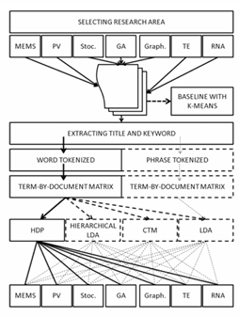
Existing Methodology
P-2: Clustering scientific documents with topic modeling

Slide 12
Existing Methodology
P-3: Topic Modeling Technique for Text Mining Over Biomedical Text Corpora Through Hybrid Inverse Documents Frequency and Fuzzy K-Means Clustering
Convert Text Data Into Lower Case
Tokenization, Punctuation, Stop Words
Bag of Words
Long term Weight
Global term weight
Fuzzy K means clustering

Slide 13
Existing Methodology
P-4: Topic Modeling Technique for Text Mining Over Biomedical Text Corpora Through Hybrid Inverse Documents Frequency and Fuzzy K-Means Clustering.
The system introduces a novel journal recommendation approach that analyzes article content, including title, abstract, keywords, and references, without user-specific data.
By examining recent publications, it provides comprehensive recommendations across multiple publishers.
Utilizing SBERT for sentence-level similarity, the system outperforms traditional methods like Word2vec, Glove, and FastText, effectively guiding researchers towards suitable journal selections.

Slide 14
Proposed Methodology
Text Corpus
Data Formating and cleaning, EDA
Author-Author relation network Analysis
Clustering Papers according to concept
Topic Modelling
Recommendation
system using
SCI-BERT
Average Degree
Degree Distribution
Clustering ,average clustering coefficient
Strong connected components
Giant component and coverage statistics
Kmeans Clustering
DBSCAN clustering
Hierarchial Clustering
LDA
LSA
BERTopic
PLSA
CTM
NMF
Top2Vec

Slide 15
Proposed enhancements/novelty
Performing Network Analysis with nodes as authors and edges as papers they have collaborated
Performing multiple Topic Modeling Techniques
Performing a Recommender System based on user query. Suggest similar documents based on query by topic modelling

Slide 16
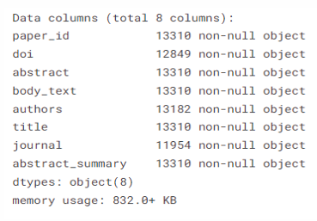
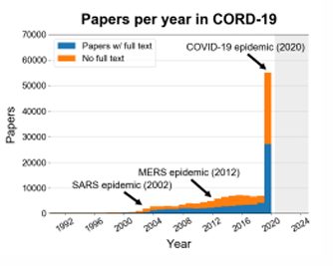
Dataset Description
CORD-19 is a resource of over 1,000,000 scholarly articles, including over 400,000 with full text, about COVID-19, SARS-CoV-2, and related coronaviruses.
The dataset includes a wide range of materials such as academic papers, preprints, articles from scholarly journals, conference papers, and reports. These materials are sourced from various publishers, repositories, and other platforms.

Slide 17

Work done
Data Preprocess and Cleaning
Removing Null values
Choosing English Instances
Removing Stop Words and custom stop words

Slide 18
Work done
Converting the dataset into an undirected graph with nodes as authors and edges as papers.
So if an edge is connecting two authors then the have both have coauthored a paper.
After making the graph we find basic details of the graph like:
Average Degree- 2.0
Degree Distribution
Clustering coefficient and average clustering coefficient- 0
Strong connected components - 9083
Giant component and coverage statistics – 1 gaint component with 0.0001 coverage

Slide 19
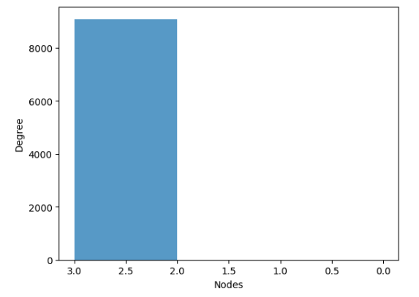
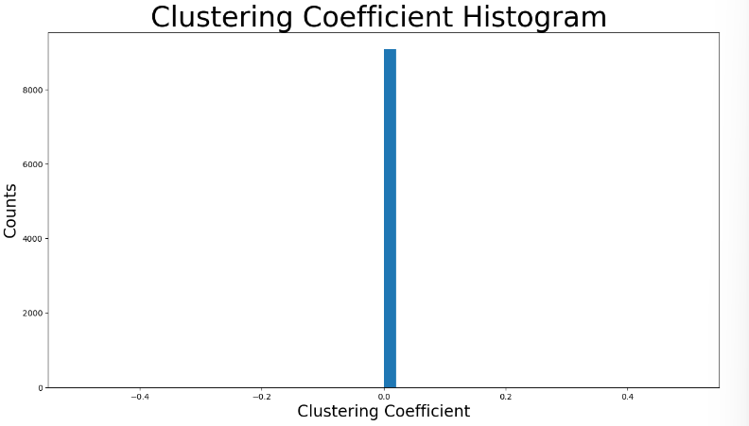
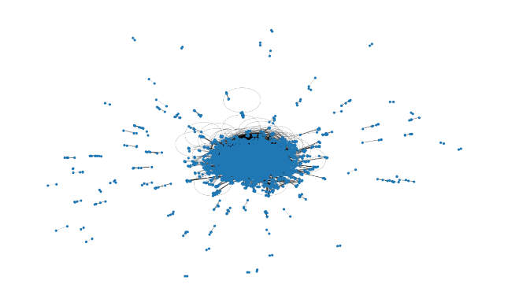
Graph Visualisation for author-author relation:
Clustering coeffecient=0
Average Degree=2
Degree Distribution

Slide 20
Work done
Exploratory Data Analysis on the sampled Dataset
Distribution of title length
Distribution of abstract length
Which are most common words in title?
Which are the most common words in abstracts?
Which are the most common bi-grams in title?
Which are the most common tri-grams in title?

Slide 21
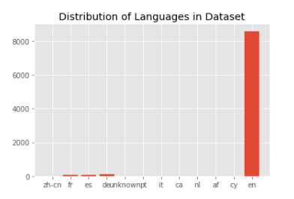
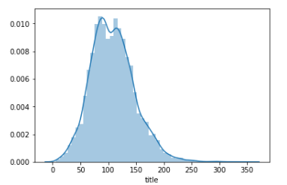
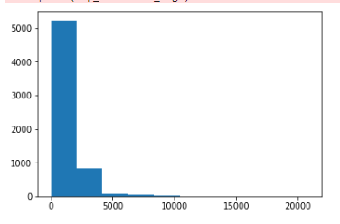
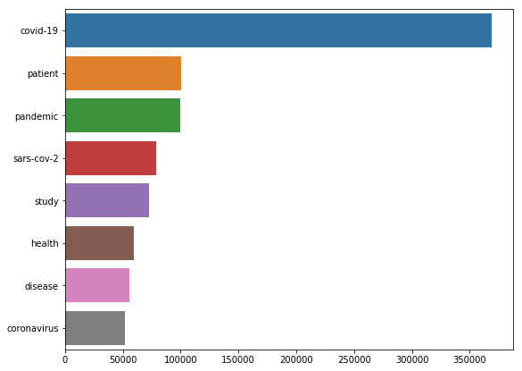
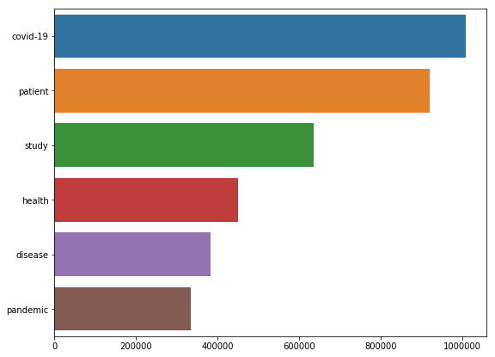
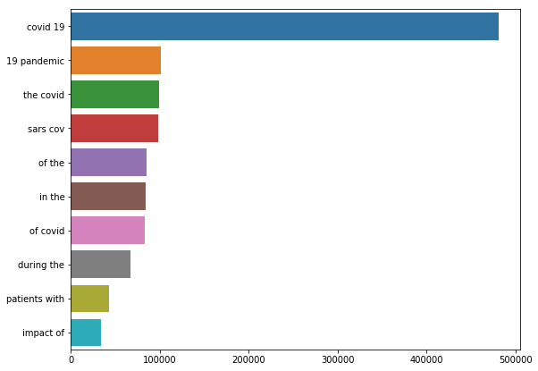
Work done
 | Distribution of title Length | Distribution of Abstract Length
Common words in title Common words in abstract Common bigrams in title

Slide 22
Work done
Data Vectorization, PCA
K-Means Clustering
Convert data to vectors using tf-idf
Perform PCA for dimensionality Reduction
Perform K-Means Clustering for various values of K
Choose suitable K value using Elbow Method
Plot the clusters using T-SNE plot

Slide 23
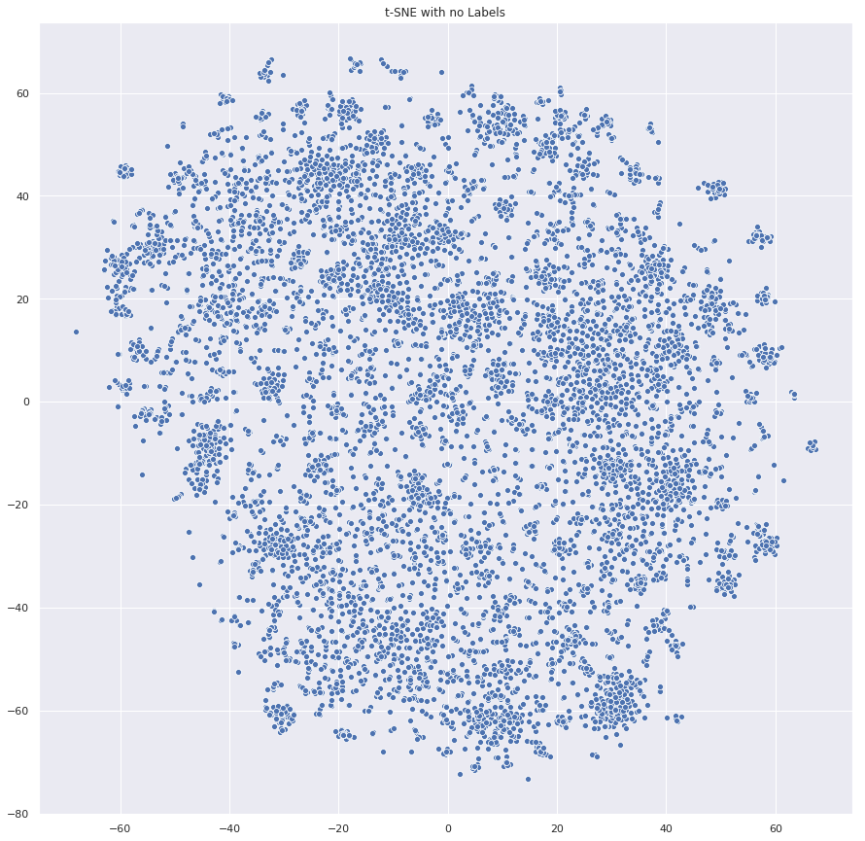
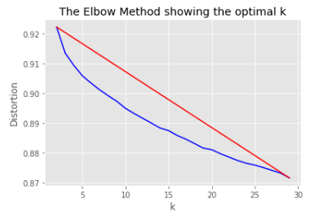
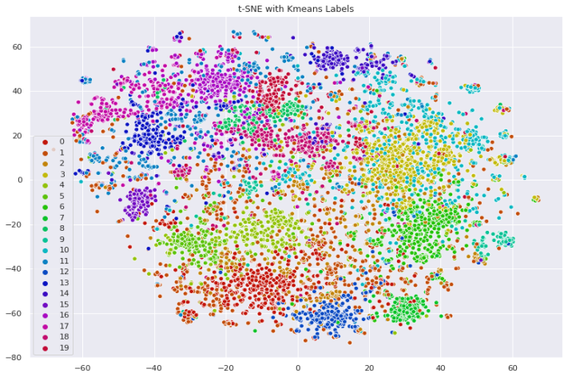
Work done
K-Means Clustering Results and Visualisation

Slide 24
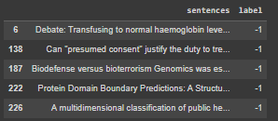
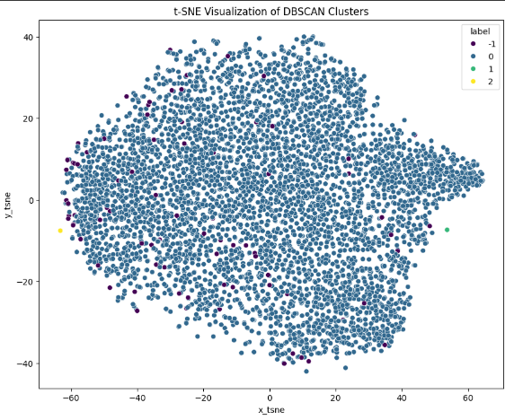
Work done
DBSCAN Clustering
Data Preprocessing
Epsilon Parameter Selection(Epsilon=0.08)
Model Training (DBSCAN module)
Evaluate and Refine
Visualization and Interpretation(T-SNE)

Slide 25
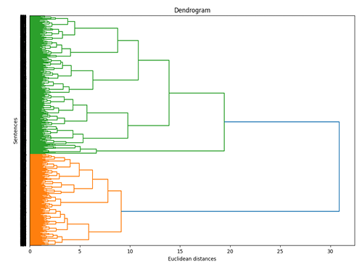
Work done
Hierarchial Clustering
By recursively joining or dividing clusters, hierarchical clustering creates a hierarchy of clusters.
Datasets with nested or hierarchical relationships between clusters are a good fit for hierarchical clustering
Sentences are converted into vectors us ing this model which are passed into Agglomera tiveClustering module with distance threshold=0.5 and ward linkage.

Slide 26
Work done
Topic Modelling
LDA- Latent Dirichlet Allocation
LSA: Latent Semantic Analysis
pLSA: Probabilistic Latent Semantic Analysis
CTM: Correlated Topic Model
NMF: Non-Negative Matrix Factorization
BerTopic
Top2Vec

Slide 27
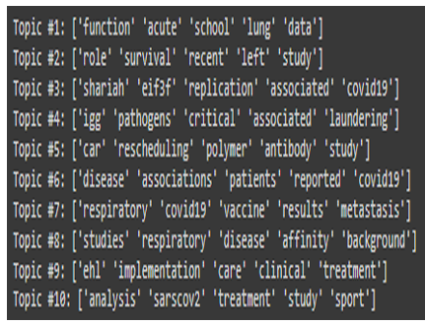
LDA- Latent Dirichlet Allocation
LDA is a generative probabilistic model used for topic modeling in text corpora.
It assumes that documents are generated from a mixture of topics, and each topic is represented by a distribution over words.
LDA infers these latent topic distributions by iteratively assigning words to topics and documents to mixtures of topics.
LatentDirichletAllocation module is called with 10 components required and random state of 42.

Slide 28
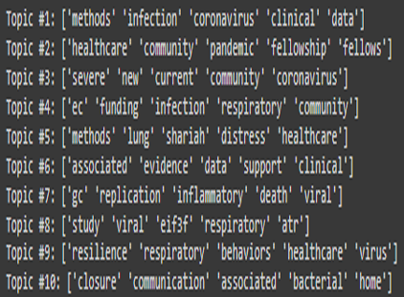
LSA: Latent Semantic Analysis
LSA is a technique in natural language processing used for dimensionality reduction.
It works by analyzing relationships between a set of documents and the terms they contain through singular value decomposition (SVD).
LSA uncovers the underlying structure in the text by representing words and documents as vectors in a semantic space.

Slide 29
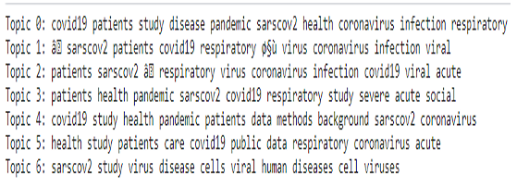
pLSA: Probabilistic Latent Semantic Analysis
pLSA is a probabilistic model used for topic modeling.
It treats documents as a mixture of topics and words as a mixture of topics.
pLSA infers these topic distributions using the expectation-maximization (EM) algorithm.

Slide 30
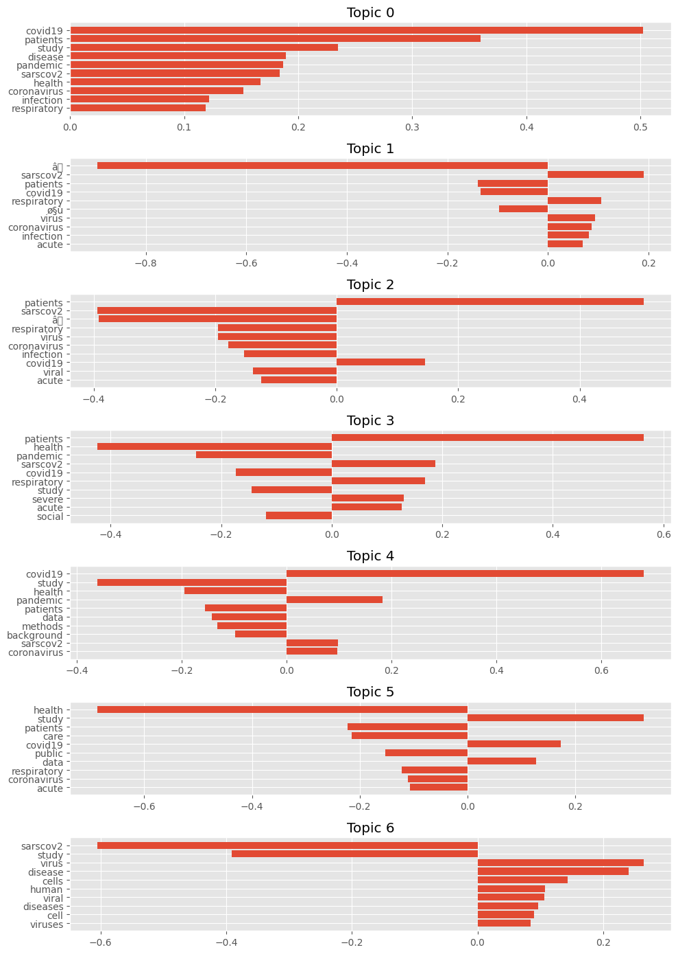
pLSA:

Slide 31
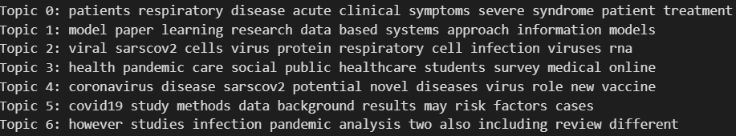
CTM: Correlated Topic Model
CTM is an extension of Latent Dirichlet Allocation (LDA) for modeling correlations between topics.
It assumes that the topics in documents are correlated through a shared Gaussian distribution.
CTM captures these correlations by incorporating a covariance matrix into the topic distribution.

Slide 32
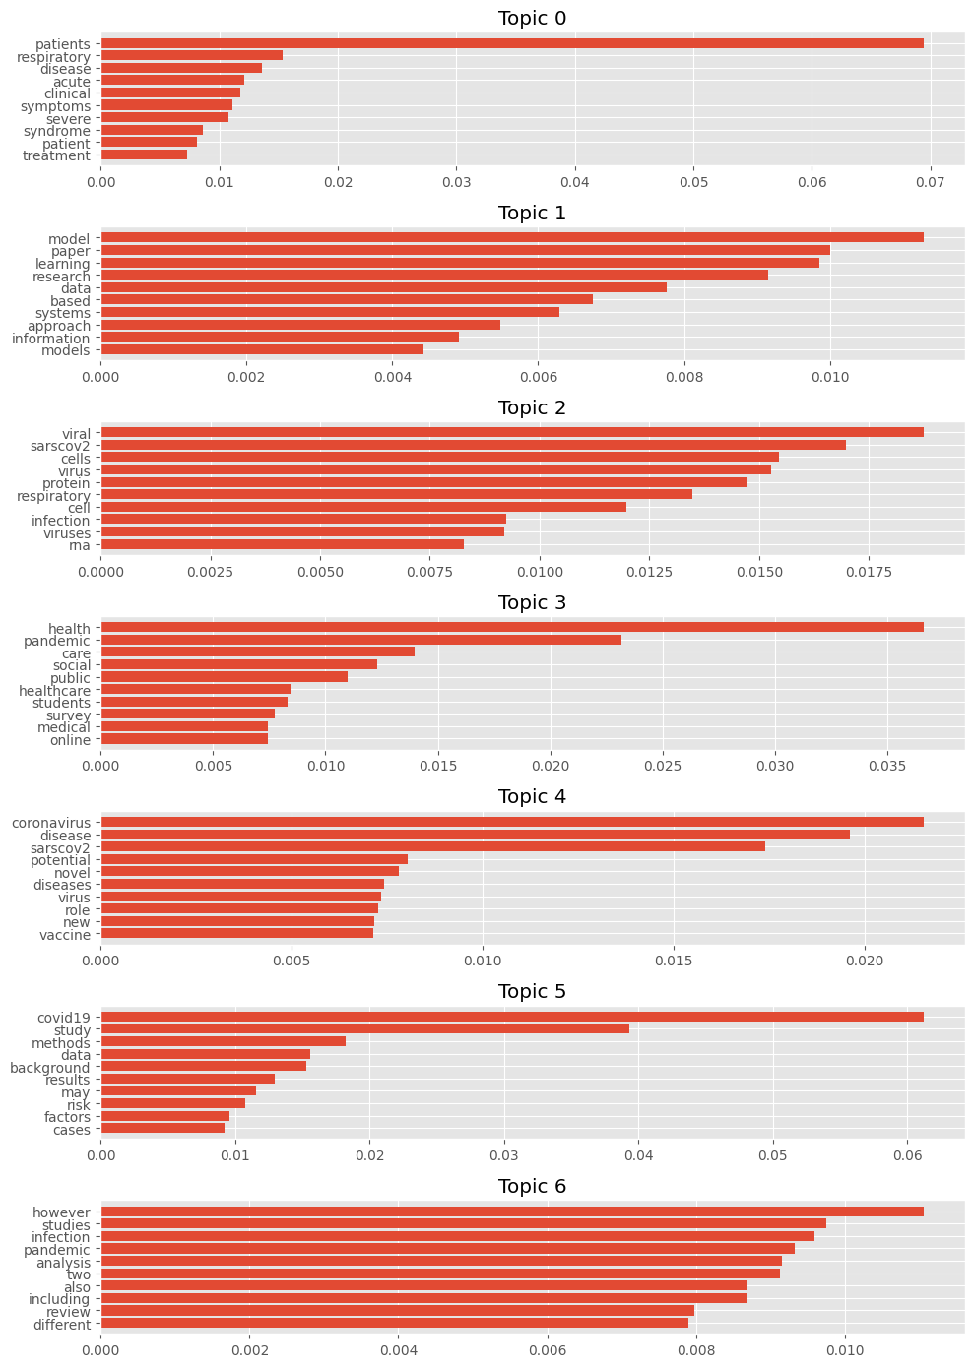
CTM: Correlated Topic Model

Slide 33
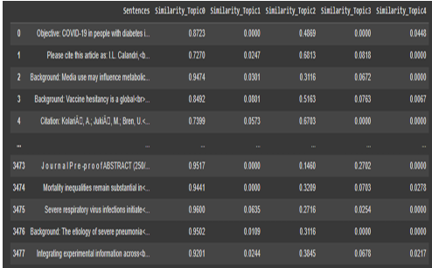
NMF: Non-Negative Matrix Factorization
NMF is a dimensionality reduction technique often used for topic modeling and text mining.
It decomposes a non-negative matrix into two non-negative matrices representing topics and their corresponding word distributions.
NMF aims to find a low-rank approximation of the original matrix while preserving non-negativity.

Slide 34
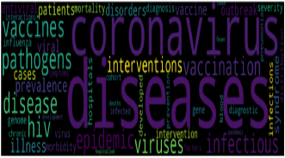
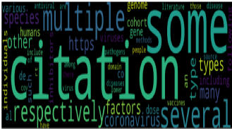
Top2Vec for topic modelling
Top2Vec is a method for document and topic embedding that combines the advantages of document clustering and word embeddings.
It represents documents and words in a high-dimensional space where semantic similarity is preserved.
Top2Vec utilizes a combination of document clustering and word2vec-like algorithms to generate embeddings that capture both document and word-level semantics.

Slide 35
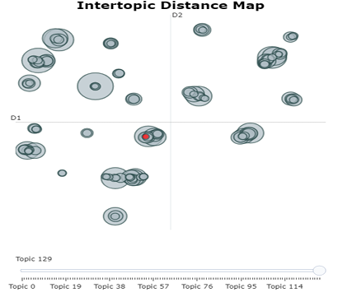
BerTopic for topic modelling
BERTopic leverages BERT embeddings to represent documents as dense vectors in a high-dimensional space, capturing semantic similarities between documents.
It applies clustering algorithms such as Hierarchical Density-Based Spatial Clustering of Applications with Noise (HDBSCAN) to group similar documents together based on their BERT embeddings.
BERTopic automatically extracts representative keywords for each cluster, allowing users to interpret and label topics generated from the document corpus.

Slide 36
Recommendation System
Sentence embeddings are obtained using the SciBERT SciVocab Uncased model, which is specifically tailored for processing scientific documents.
Cosine similarity is computed between the embeddings of the sentences and a query, enabling comparison and ranking of relevance.
The list of sentences is sorted based on cosine similarity, and the top-ranked sentences are presented as results, facilitating effective information retrieval.

Slide 37
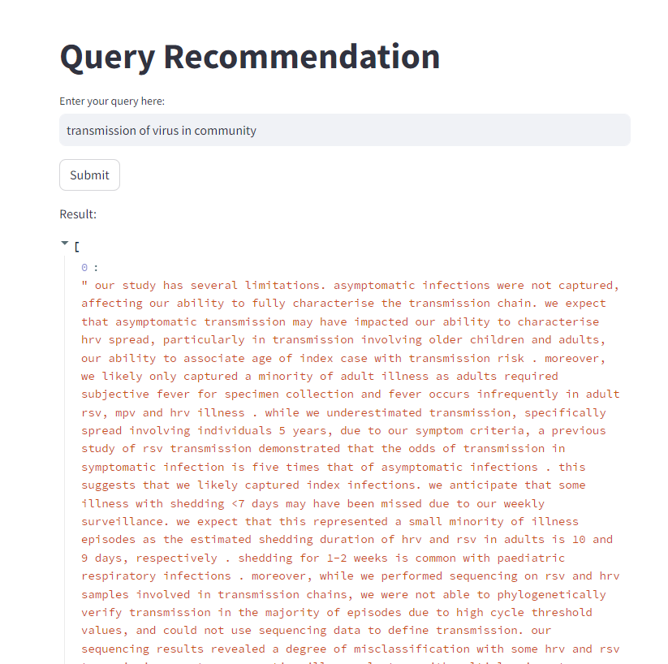
Recommendation System
Implemented a recommendation system using the SciBERT model specifically the scibert_scivocab_uncased variant.
Bert tokenizer is used before for tokenizing and preprocessing before sending into bert model
Sentence embeddings were computed using cosine similarity between the query embeddings and embeddings of sentences in the dataset.
The sorted list based on cosine similarity provided the most relevant sentences as recommendations like 1.0 on top , 0.986, 0.967 and son on

Slide 38
Individual Contribution
Mahit
Exploratory Data Analysis
Clustering using K-Means Clustering
pLSA, CTM, BertTopic
Recommendation system using SciBERT and interactive streamlit deployement.
Jayanth
Author-Author relationship visualisation and extracting network information.
Data preprocessing and Implemented Hierarchial , DBSCAN clustering.
Top2Vec, LDA, LSA, NMF.
Recommendation system using SciBERT and interactive streamlit deployement.

Slide 39
Comparision with base paper
Base paper- Tracing the pace of COVID-19 research: topic modeling and evolution
Experimented with different 7 models and recent Large language models like bertopic, top2vec.
Author-Author relation analysis
Novel Recommendation system using SCI-BERT.

Slide 40
References
https://journals.plos.org/plosone/article?id=10.1371/journal.pone.0244839
https://ieeexplore.ieee.org/abstract/document/8854068/
https://link.springer.com/article/10.1007/s11192-014-1321-8
https://ieeexplore.ieee.org/abstract/document/8682076
https://www.ncbi.nlm.nih.gov/pmc/articles/PMC7251955/
https://uwspace.uwaterloo.ca/handle/10012/16834
https://link.springer.com/article/10.1007/s41870-023-01268-w
https://arxiv.org/abs/2005.06380
https://journals.sagepub.com/doi/full/10.1177/20552076221133696

