Slide 1
Analysis and Classification of Blood Cancer using Protein Sequences
PIP104 University Project-II
Review-1
Batch Number:
Under the Supervision of,
Dr. Sanjeev P Kaulgud
Assistant Professor
SoCSE & IS
Presidency University
Roll Number | Student Name
20201CSE0041 | Guda Mahitha
20201CSE0016 | Nanapu Sai Sreeram
20201CSE0001 | Shaik Mohammed Abdul Aziz
20201CSE0043 | Bijjam Adarsh Reddy
20201CSE0071 | Niharika Vendidandi

Slide 2
Contents
Introduction
Literature Review
Proposed Method
Objectives
Methodology
Timeline of the Project
Expected Outcomes
Conclusion
References

Slide 3
Introduction
In this project, we aim to detect blood cancer through protein sequence analysis
Blood cancer is a serious health issue that needs early identification for better treatment.
Our project has two big goals: use Bio-Python and machine learning together, and finding blood cancer faster and more accurate, so people can get the right treatment sooner.
We're investigating these sequences to discover signs that could help us find cancer early.
With Bio Python and machine learning, we want to create a high-tech tool. This tool should be really good at spotting unusual patterns in protein sequences, making it faster and more accurate in catching blood cancer early.

Slide 4
Literature Review
Title | Author name and year | Algorithm Used | Accuracy
Machine learning models for predicting prognosis in blood cancers | Sathirapongsasuti et al. (2018) | Naive Bayes classifier | 83.41%
Predicting risk of leukemia and lymphoma recurrence using machine learning | Kim et al. (2019) | Random forest | 94.67%
Early detection of blood cancers using deep learning on medical images | Esteva et al. (2017) | Convolutional neural networks (CNNs) | 88.333%
Integration of multi-omics data for blood cancer prediction | Zhang et al. (2020) | Linear regression | 96.68%
Predictive modeling of treatment response in blood cancer patients | Patel et al. (2021) | Logistic regression & Decision-making | 93.79%

Slide 5
Proposed Method
First, we got information from a scientific database (NCBI) about genes linked to cancer.
Then, using a tool called Bio-Python, we looked at specific patterns in the genetic data, finding certain sequences (k-mers) that appear frequently and counting how often they don't match perfectly.We pinpointed the most common k-mer associated with causing cancer.
Next, we used machine learning to teach a computer program to predict blood cancer based on this key genetic feature. We checked how well our model worked by testing it with new data.
This method combines biology and computer science to identify potential genetic markers for cancer and create a computer model that can predict blood cancer based on these genetic patterns.

Slide 6
Objectives
Our main goal is to develop a tool by combining the capabilities of Bio-Python and machine learning. We aspire to achieve faster and more accurate early blood cancer detection.
We're on a mission to find cancer by looking at "k-mers," which are like tiny genetic patterns. By focusing on the most common k-mers, we believe we can point directly to signs of cancer in the genetic code. It's like finding a special mark that helps us spot the presence of cancer more easily.
The goal is to quickly find any unusual signs that might indicate blood cancer. By doing this, we hope to make it easier for doctors to detect blood cancer early and give the right treatment to people faster.

Slide 7
Methodology
This methodology outlines the essential steps from data collection to continuous improvement, providing a foundation for the early detection of blood cancer through protein sequence analysis.
Data Collection
Data Preprocessing with Bio-Python
K-mer Analysis with Bio-Python
Identification of Cancer-Associated K-mers
Feature Extraction for Machine Learning
Dataset Splitting and Model Selection
Interpretation of Results
prediction of cancer

Slide 8
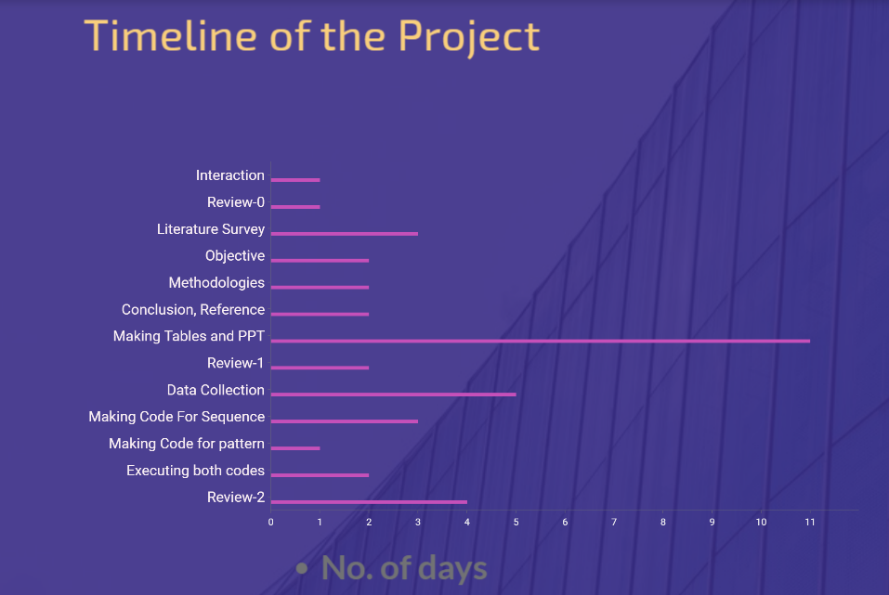
Timeline of Project

Slide 9
Expected Outcomes
A smart computer program that can look at genetic information (protein sequences) and tell if it's normal or might indicate blood cancer.
In this process we get two main things
Analysis- Analysis refers to the process of examining and breaking down a complex system into its components to understand how they function and interact.
Classification- Classification is a specific task within machine learning and data analysis where the goal is to categorize items into predefined classes or categories based on their features or attributes.

Slide 10
Conclusion
In wrapping up our journey, we've built a smart tool that reads genetic information and gives us a heads-up if there's a chance of blood cancer. Here's what we've achieved:
Our collective efforts are aligned with the goal of predicting blood cancer early, envisioning a future where individuals receive timely personalized treatments and ultimately, improved chances of recovery.

Slide 11
References
Golubovskaya, Finch R, and Cance W.G – 2005 - NCBI
R. B. Hegde, K. Prasad, H. Hebbar, B. M. K. Singh, and I. Sandhya – 2019
https://link.springer.com/article/10.1007/s10278-019-00288-y
Hematology TAS of facts-and-statistics,” 2018, http://www.hematology.org/.
O. Wolach and R. M. Stone – 2017 https://journals.lww.com/cohematology/abstract/2017/03000/ mixed_phenotype_acute_leukemia__current_challenges.10.aspx
F. Xing and L. Yang – 2016
https://ieeexplore.ieee.org/document/7373572/

Slide 12
Thank You

