Slide 1

A Symptom-Based Multi-Disease Prediction System Using Machine Learning
by
G. Yashoda Mahitha
Roll No. 224G1A05A2
C. Eswar
Roll No. 234G5A0502
S. Nikitha
Roll No. 224G1A0561
Under the guidance of
Ms. C. Rekha, M. Tech
Assistant Professor
Department of Computer Science and Engineering
Srinivasa Ramanujan Institute of Technology
Autonomous
Rotarypuram Village, B K Samudram Mandal, Ananthapuramu – 515701.
2025-2026

Slide 2

Contents
A Symptom-Based Multi-Disease Prediction System Using Machine Learning
Title Justification
Abstract
Problem statement
Objectives of Project
Literature survey for objectives
Proposed Work -(Methods to be followed for proposed system)
References
GitHub Link
Queries
B4 | Department of Computer Science and Engineering | Srinivasa Ramanujan Institute of Technology | 02

Slide 3
Title Justification
A Symptom-Based Multi-Disease Prediction System Using Machine Learning
The title “A Symptom-Based Multi-Disease Prediction System Using Machine Learning” reflects the system’s core functionality, encompassing:
Predicting multiple diseases using patient symptom data.
Detecting diseases such as Diabetes, Heart Attack, Tuberculosis, Pneumonia, Jaundice, and Bronchial Asthma using Machine Learning algorithms.
Applying models including Logistic Regression, Support Vector Machine (SVM), Decision Tree, Random Forest, XGBoost, AdaBoost, and Artificial Neural Networks (ANN).
Enabling fast and accurate symptom-based disease prediction, reducing manual diagnosis effort and supporting early medical decision-making.
B4 | Department of Computer Science and Engineering | Srinivasa Ramanujan Institute of Technology | 03

Slide 4
Abstract
A Symptom-Based Multi-Disease Prediction System Using Machine Learning
Introduction
Accurate and early prediction of diseases using symptom data plays a vital role in supporting timely medical diagnosis and treatment.
Research Gap
Most existing systems focus on predicting a single disease or lack intelligent learning models capable of handling multiple diseases within a unified framework.
Methodology Used
The proposed system applies machine learning and deep learning techniques including Logistic Regression, Support Vector Machine, Decision Tree, Random Forest, XGBoost, AdaBoost, and an Artificial Neural Network (ANN) to classify multiple diseases based on patient symptoms.
Result
Performance evaluation shows that both machine learning models and the ANN achieve high classification accuracy, demonstrating effective learning of symptom–disease relationships.
Conclusion
The multi-disease prediction system successfully integrates traditional machine learning models with deep learning, offering a reliable and scalable approach for automated disease diagnosis.
B4 | Department of Computer Science and Engineering | Srinivasa Ramanujan Institute of Technology | 04

Slide 5
Problem Statement
A Symptom-Based Multi-Disease Prediction System Using Machine Learning
Many existing disease prediction systems focus on predicting only a single disease, which limits their usefulness in real-world healthcare scenarios where multiple diseases may share similar symptoms.
Traditional diagnosis methods often rely on manual analysis and clinical experience, which can be time-consuming and may delay early disease detection.
There is a need for a system that can analyze symptom-based data efficiently and predict multiple diseases, supporting quick and accurate preliminary health assessment.
B4 | Department of Computer Science and Engineering | Srinivasa Ramanujan Institute of Technology | 04

Slide 6
A Symptom-Based Multi-Disease Prediction System Using Machine Learning
Objectives
Objective 1
To build a system that predicts multiple diseases using patient symptom data and machine learning classification techniques.
Objective 2
To evaluate and compare different machine learning models in order to improve prediction accuracy and provide reliable disease identification.
B4 | Department of Computer Science and Engineering | Srinivasa Ramanujan Institute of Technology | 06

Slide 7
Literature survey for objectives
A Symptom-Based Multi-Disease Prediction System Using Machine Learning
Author(s) / Source | Year | Objective Linked | Main Contribution | Research Gap
Kumar, S., & Khan, N., IJTSRD – Machine Learning-Based Multiple Disease Prediction System | 2025 | Objective 1 | ML-based system predicting multiple diseases using structured input data. | Limited feature set; no side-effect prediction or risk modeling.
Din, F., KJMR – Multi-Disease Prediction Using Machine Learning Algorithms | 2024 | Objective 1 | Compares multiple ML algorithms for multi-disease classification. | Dataset imbalance not addressed; minimal clinical validation.
IJCRT – Multiple Disease Prediction Using Machine Learning | 2024 | Objective 1 | ML models applied to structured clinical/symptom data. | Preprint; limited evaluation metrics, not tested on real-world data.
Nghiem, N. et al., “ML-Based Prediction of Diabetes Complications,” BMC Med. Inf. & Dec. Making | 2024 | Objective 2 | Predicts diabetes complications using ML + socio-administrative data. | Focused only on diabetes; not generalized to multi-disease settings.
B4 | Department of Computer Science and Engineering | Srinivasa Ramanujan Institute of Technology | 07

Slide 8
Proposed System
A Symptom-Based Multi-Disease Prediction System Using Machine Learning
The proposed system develops a symptom-based multi-disease prediction model that can identify multiple diseases within a single platform, improving the efficiency of disease diagnosis.
The system implements and compares multiple machine learning algorithms such as Logistic Regression, Support Vector Machine (SVM), Decision Tree, Random Forest, XGBoost, AdaBoost, and Artificial Neural Networks to achieve better prediction performance.
The system evaluates model performance using metrics such as accuracy, precision, recall, and F1-score to identify the most reliable model for disease prediction.
The system allows users to enter symptoms as input and generates disease predictions automatically, providing a quick and efficient approach for preliminary health analysis.
B4 | Department of Computer Science and Engineering | Srinivasa Ramanujan Institute of Technology | 09

Slide 9
References
A Symptom-Based Multi-Disease Prediction System Using Machine Learning
[1] S. Kumar & N. Khan, “Machine Learning-Based Multiple Disease Prediction System,” International Journal of Trend in Scientific Research and Development (IJTSRD), vol. 9, no. 3, pp. 468–472, 2025.
[2] B. Ramesh, “Feasible Prediction of Multiple Diseases using Machine Learning,” E3S Web of Conferences (ICMPC 2023), 2023.
[3] F. Din, “Multi-Disease Prediction Using Machine Learning Algorithms,” KJMR (Khyber Journal of Medical Research), 2024.
[4] “Multiple Disease Prediction Application using Machine Learning,” TIJER – The International Journal of Engineering Research, vol. 11, issue 11, Nov. 2024.
[5] “Multiple Disease Prediction Using Machine Learning,” IJCRT (conference/journal preprint), 2024.
[6] “Machine Learning Based Multiple Disease Prediction System,” IJARIIE (International Journal of Advance Research, Ideas and Innovations in Technology), 2023.
[7] N. Nghiem, N. Wilson, J. Krebs et al., “Predicting the Risk of Diabetes Complications Using Machine Learning,” BMC Medical Informatics and Decision Making, vol. 24, article 274, 2024.
B4 | Department of Computer Science and Engineering | Srinivasa Ramanujan Institute of Technology | 09

Slide 10
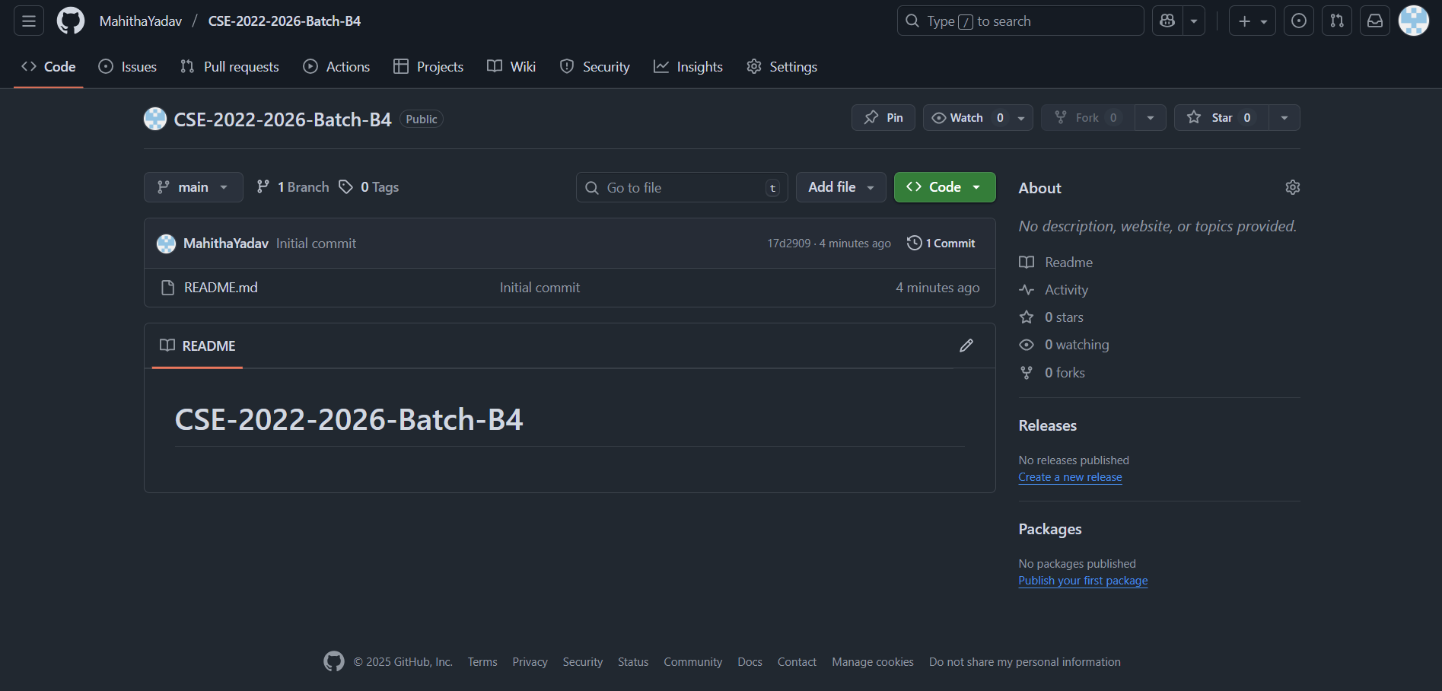
Git Hub Dashboard
A Symptom-Based Multi-Disease Prediction System Using Machine Learning
Link: https://github.com/MahithaYadav/CSE-2022-2026-Batch-B4
B4 | Department of Computer Science and Engineering | Srinivasa Ramanujan Institute of Technology | 10

Slide 11
A Symptom-Based Multi-Disease Prediction System Using Machine Learning
Any Queries?
B4 | Department of Computer Science and Engineering | Srinivasa Ramanujan Institute of Technology | 11

