Slide 1

A Symptom-Based Multi-Disease Prediction System Using Machine Learning
by
C. Eswar
Roll No. 234G5A0502
G. Yashoda Mahitha
Roll No. 224G1A05A2
S. Nikitha
Roll No. 224G1A0561
Under the guidance of
Ms. C. Rekha, M. Tech.
Assistant professor
Department of Computer Science and Engineering
Srinivasa Ramanujan Institute of Technology
Autonomous
Rotarypuram Village, B K Samudram Mandal, Ananthapuramu – 515701.
Accredited by NBA & NAAC with “A” Grade,Affiliated to JNTUA,Ananthapuramu
2025-2026

Slide 2
Title Explanation
A Symptom-Based Multi-Disease Prediction System Using Machine Learning
The title “A Symptom-Based Multi-Disease Prediction System Using Machine Learning” reflects the system’s core functionality, encompassing:
Predicting multiple diseases using patient symptom data.
Detecting diseases such as Diabetes, Heart Attack, Tuberculosis, Pneumonia, Jaundice, and Bronchial Asthma using Machine Learning algorithms.
Applying models including Logistic Regression, Support Vector Machine (SVM), Decision Tree, Random Forest, XGBoost, AdaBoost, and Artificial Neural Networks (ANN).
Enabling fast and accurate symptom-based disease prediction, reducing manual diagnosis effort and supporting early medical decision-making.

Slide 3

Contents
A Symptom-Based Multi-Disease Prediction System Using Machine Learning
Abstract
Introduction
Literature Survey
Existing System
Proposed System
Planning
Design
Implementation
Research Paper
References
GitHub Link

Slide 4
Abstract
A Symptom-Based Multi-Disease Prediction System Using Machine Learning
Introduction
Accurate and early prediction of diseases using symptom data plays a vital role in supporting timely medical diagnosis and treatment.
Research Gap
Most existing systems focus on predicting a single disease or lack intelligent learning models capable of handling multiple diseases within a unified framework.
Methodology Used
The proposed system applies machine learning and deep learning techniques including Logistic Regression, Support Vector Machine, Decision Tree, Random Forest, XGBoost, AdaBoost, and an Artificial Neural Network (ANN) to classify multiple diseases based on patient symptoms.
Result
Performance evaluation shows that both machine learning models and the ANN achieve high classification accuracy, demonstrating effective learning of symptom–disease relationships.
Conclusion
The multi-disease prediction system successfully integrates traditional machine learning models with deep learning, offering a reliable and scalable approach for automated disease diagnosis.

Slide 5
Introduction
A Symptom-Based Multi-Disease Prediction System Using Machine Learning
Disease diagnosis based on symptoms is often challenging due to overlapping symptoms across different diseases.
Manual diagnosis requires experienced medical professionals and can be time-consuming, especially in resource-limited environments.
Delayed or incorrect diagnosis may lead to improper treatment and increased health risks.
There is a need for an automated system that can analyze patient symptoms and accurately predict multiple diseases.
This project addresses this problem by using machine learning and Artificial Neural Network models to predict diseases efficiently and support early medical decision-making.

Slide 6
Literature Survey
A Symptom-Based Multi-Disease Prediction System Using Machine Learning
Author(s) / Source | Year | Main Contribution
S. Kumar & N. Khan – Machine Learning-Based Multiple Disease Prediction System | 2025 | ML-based system predicting multiple diseases using structured input data. GAP: Limited feature set
F. Din – Multi-Disease Prediction Using Machine Learning Algorithms | 2024 | Compares multiple ML algorithms for multi-disease classification. GAP: Dataset imbalance not addressed; minimal clinical validation.
IJCRT – Multiple Disease Prediction Using Machine Learning | 2024 | ML models applied to structured clinical/symptom data. GAP: Preprint; limited evaluation metrics, not tested on real-world data.
Nghiem, N. et al., – ML-Based Prediction of Diabetes Complications | 2024 | Predicts diabetes complications using ML + socio-administrative data. GAP: Focused only on diabetes; not generalized to multi-disease settings.

Slide 7
Existing System
A Symptom-Based Multi-Disease Prediction System Using Machine Learning
Many existing disease prediction systems focus on predicting only a single disease, which limits their applicability in real-world healthcare scenarios where patients may exhibit symptoms related to multiple conditions.
Several studies rely on only one machine learning algorithm, which may not provide the best prediction accuracy or reliability for complex medical datasets.
Most existing systems lack proper comparative analysis of multiple models, making it difficult to determine which algorithm performs best for disease prediction.
Many research works depend mainly on clinical or laboratory data, which may not always be easily available, reducing the accessibility of such systems for early disease detection based on symptoms.

Slide 8
Proposed System
A Symptom-Based Multi-Disease Prediction System Using Machine Learning
The proposed system develops a symptom-based multi-disease prediction model that can identify multiple diseases within a single platform, improving the efficiency of disease diagnosis.
The system implements and compares multiple machine learning algorithms such as Logistic Regression, Support Vector Machine (SVM), Decision Tree, Random Forest, XGBoost, AdaBoost, and Artificial Neural Networks to achieve better prediction performance.
The system evaluates model performance using metrics such as accuracy, precision, recall, and F1-score to identify the most reliable model for disease prediction.
The system allows users to enter symptoms as input and generates disease predictions automatically, providing a quick and efficient approach for preliminary health analysis.

Slide 9
Planning
Programming Language: Python
Development Environment: Any Python Code Editor
Operating System: Windows / Linux
Libraries & Frameworks:
NumPy
Pandas
Matplotlib
Seaborn
Scikit-learn
XGBoost, AdaBoost
TensorFlow / Keras (for ANN)
Version Control (Optional): Git
Data Handling Tool: CSV dataset

Slide 10
Datasets/Modules
A Symptom-Based Multi-Disease Prediction System Using Machine Learning
The dataset used in this project is a symptom-based medical dataset consisting of patient health records.
Two datasets are used:
Training Dataset for model training
Testing Dataset for model evaluation
Each record represents a patient case described using multiple symptoms.
From the available diseases, six diseases were selected for prediction: Diabetes, Bronchial Asthma, Pneumonia, Jaundice, Tuberculosis, and Heart Attack.
Symptoms are encoded in binary format, where:
1 indicates the presence of a symptom
0 indicates the absence of a symptom
The dataset contains symptom-related features and a target column named “Prognosis”; it represents the corresponding disease label.
The dataset has no missing values after preprocessing.
Label encoding is applied to convert disease names into numerical form for model training.
The dataset is suitable for supervised multi-class disease prediction.

Slide 11
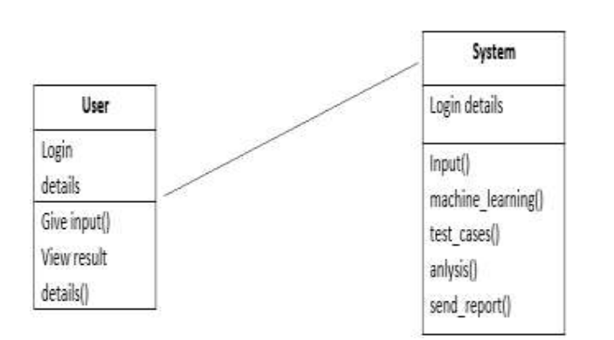
Design
A Symptom-Based Multi-Disease Prediction System Using Machine Learning
UML Class Diagram

Slide 12
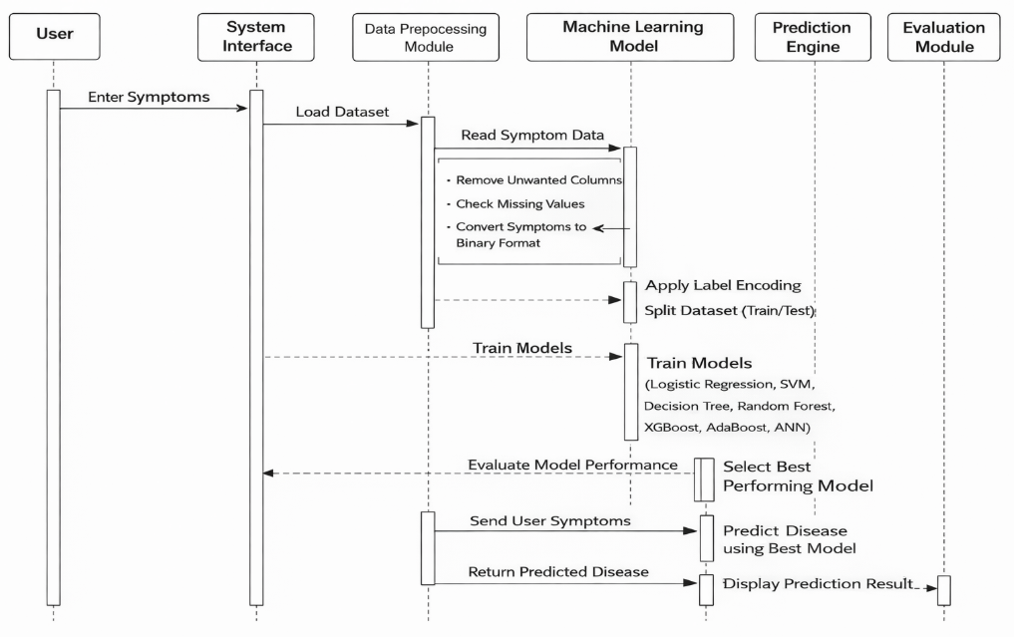
Design
A Symptom-Based Multi-Disease Prediction System Using Machine Learning
UML Sequence Diagram

Slide 13
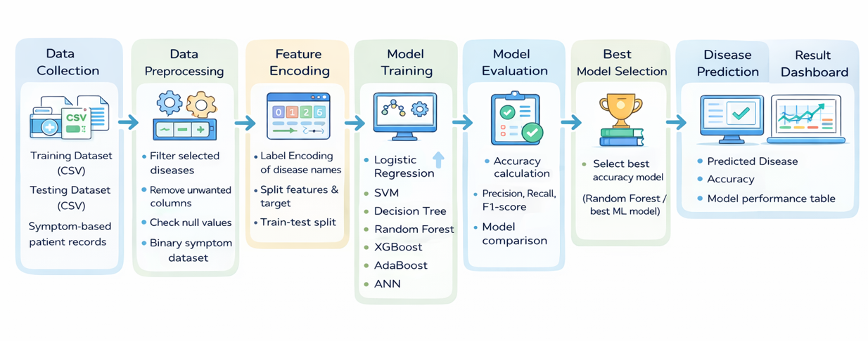
Process flow
A Symptom-Based Multi-Disease Prediction System Using Machine Learning

Slide 14
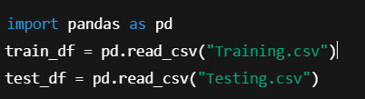
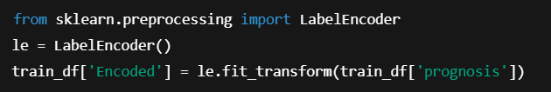
Implementation
A Symptom-Based Multi-Disease Prediction System Using Machine Learning
Data Loading
The dataset is loaded using the Pandas library for easy data manipulation.
Separate files are used for training and testing the models.
This step allows structured access to symptom features and disease labels.
Label Encoding
The disease labels in the prognosis column are categorical in nature.
Label encoding converts disease names into numerical values.
This conversion is required for machine learning and ANN models to process the data.

Slide 15
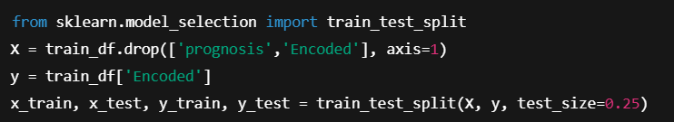
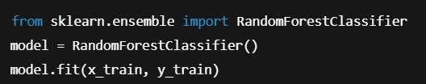
Implementation
A Symptom-Based Multi-Disease Prediction System Using Machine Learning
Train-Test Split
Symptom columns are separated as input features, and encoded disease labels are used as targets.
The dataset is split into training and testing sets.
This helps in evaluating the model’s performance on unseen data.
Machine Learning Model Training
The Random Forest algorithm is used to train the model on symptom data.
It builds multiple decision trees to improve prediction accuracy.
This model helps in learning complex symptom–disease relationships.

Slide 16
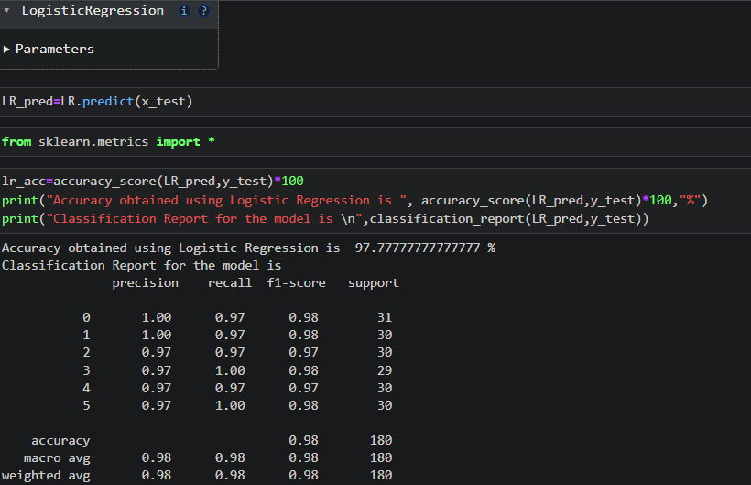
Outputs
A Symptom-Based Multi-Disease Prediction System Using Machine Learning

Slide 17
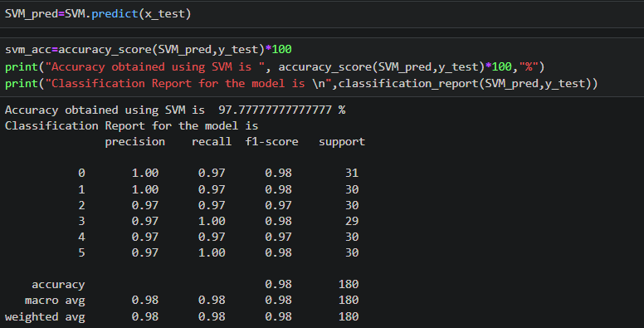
Outputs
A Symptom-Based Multi-Disease Prediction System Using Machine Learning

Slide 18
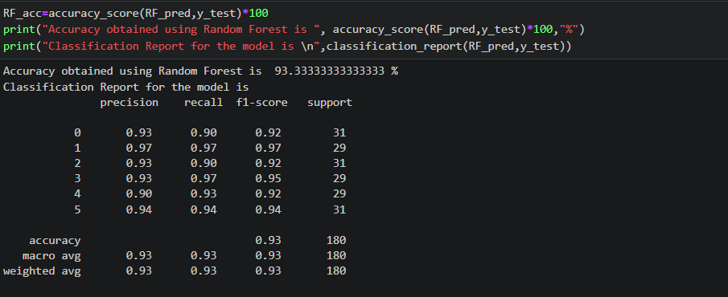
Outputs
A Symptom-Based Multi-Disease Prediction System Using Machine Learning

Slide 19
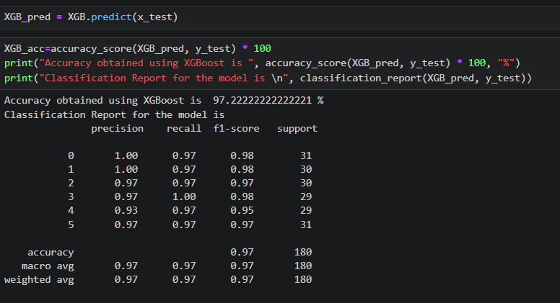
Outputs
A Symptom-Based Multi-Disease Prediction System Using Machine Learning

Slide 20
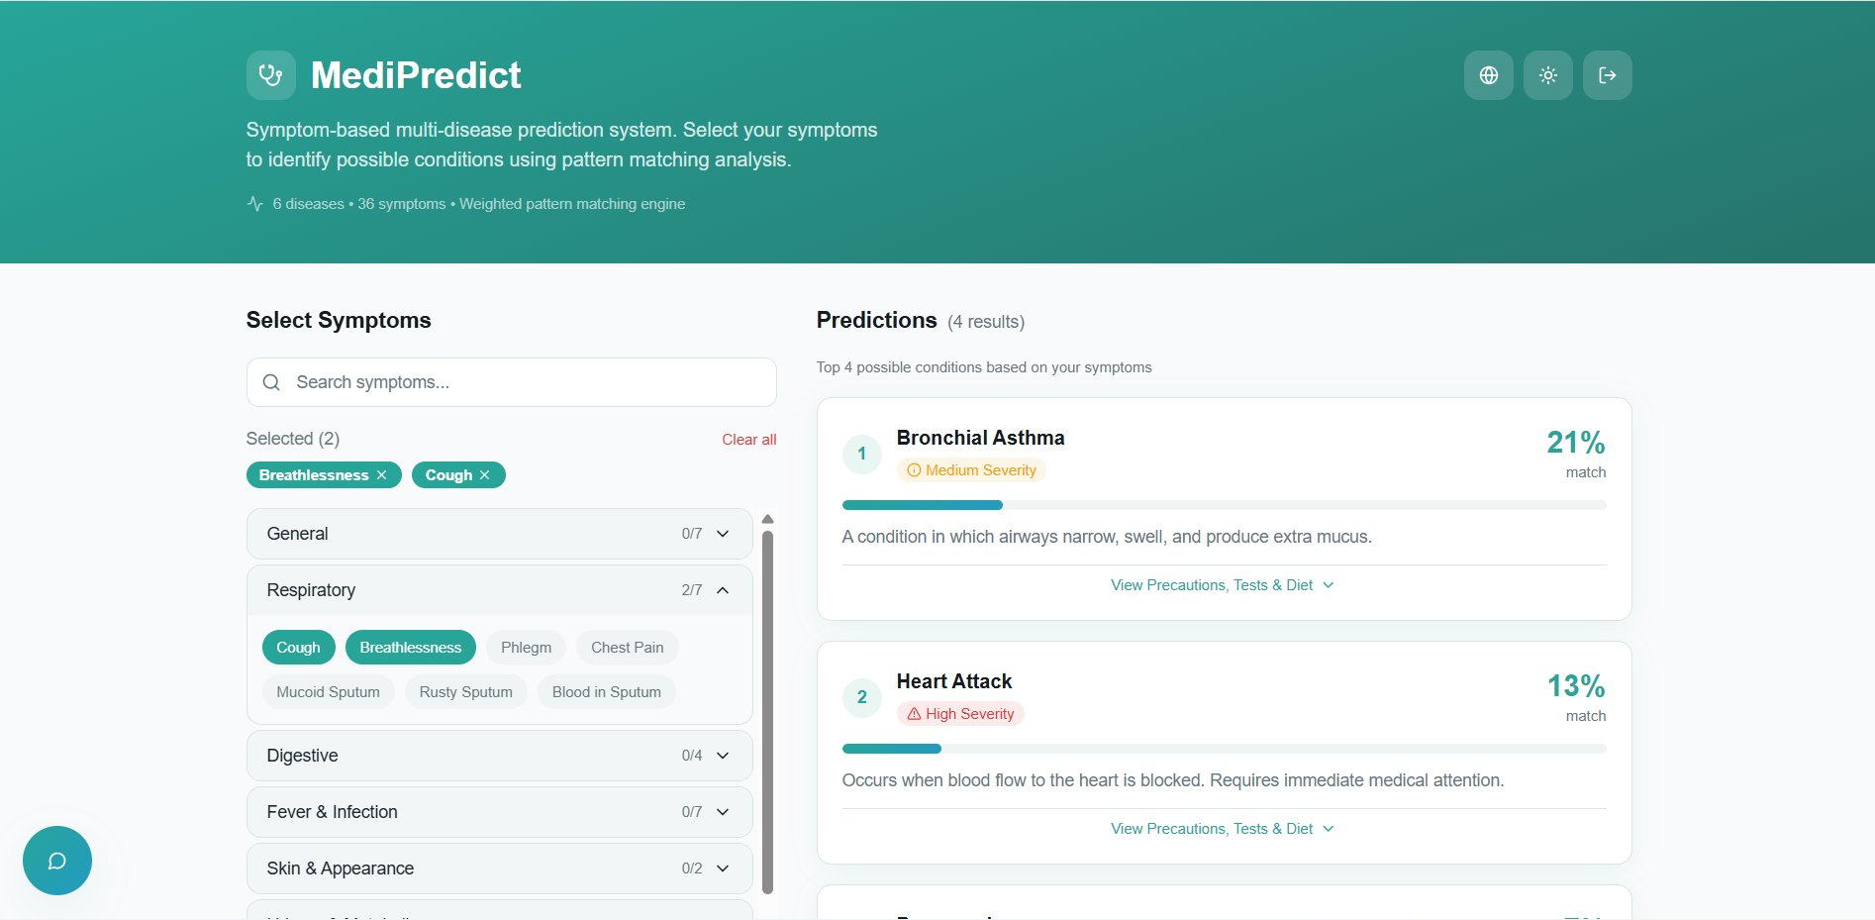
Outputs
A Symptom-Based Multi-Disease Prediction System Using Machine Learning

Slide 21
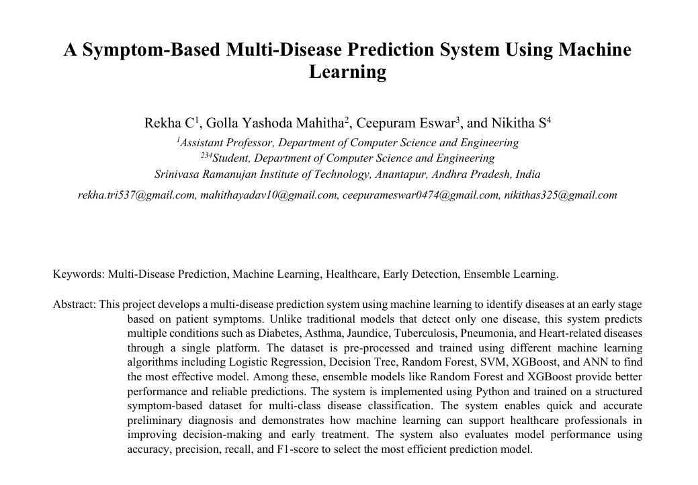
Research Paper
A Symptom-Based Multi-Disease Prediction System Using Machine Learning
Research Paper: https://drive.google.com/file/d/1R6HS-PUNLMRJ25nf1JzcZUhKdcm9Obzk/view?usp=sharing

Slide 22
Conclusion
A Symptom-Based Multi-Disease Prediction System Using Machine Learning
The project developed an ML-based system for predicting multiple diseases using symptom data.
Various machine learning algorithms were implemented to achieve accurate and efficient disease prediction.
The system enables fast and automated diagnosis, reducing dependency on manual analysis.
It provides a cost-effective solution for early detection and supports better medical decision-making.
The project demonstrates the effectiveness of ML in improving healthcare prediction systems.

Slide 23
References
A Symptom-Based Multi-Disease Prediction System Using Machine Learning
[1] H. Liang, B. Y. Tsui, H. Ni, et al., “Evaluation and Accurate Diagnoses of Paediatric Diseases Using Artificial Intelligence,” Journal of Medical Systems, vol. 43, no. 5, pp. 1–12, 2019.
[2] M. J. Shaikh, S. Manjrekar, D. Khan, M. Khan, and D. Jamadar, “Multiple Disease Prediction Webapp,” Journal of Emerging Technologies and Innovative Research (JETIR), vol. 8, no. 6, pp. 1–6, 2021.
[3] R. C. Deo, “Machine Learning in Medicine,” Circulation, vol. 132, no. 20, pp. 1920–1930, 2015.
[4] “Multiple Disease Prediction System Using Machine Learning,” SSRN Electronic Journal, pp. 1–8, 2020.
[5] U. R. Acharya, H. Fujita, S. L. Oh, et al., “Application of Deep Convolutional Neural Network for Automated Detection of Myocardial Infarction Using ECG Signals,” Information Sciences, vol. 415–416, pp. 190–198, 2017.
[6] “Multiple Disease Prediction System Using Machine Learning and Streamlit,” IEEE Xplore, pp. 1–6, 2022.

Slide 24
GitHub Link
A Symptom-Based Multi-Disease Prediction System Using Machine Learning
Link: https://github.com/MahithaYadav/CSE-2022-2026-Batch-B4

Slide 25
A Symptom-Based Multi-Disease Prediction System Using Machine Learning
Thank You!!!

Slide 26
A Symptom-Based Multi-Disease Prediction System Using Machine Learning
Any Query?

