Slide 1

AI/ML Powered Multi-Disease and Side Effects Prediction
by
G. Yashoda Mahitha
Roll No. 224G1A05A2
C. Eswar
Roll No. 234G5A0502
S. Nikitha
Roll No. 224G1A0561
Under the guidance of
Ms. C. Rekha, M. Tech
Assistant Professor
Department of Computer Science and Engineering (AI&ML)
Srinivasa Ramanujan Institute of Technology
Autonomous
Rotarypuram Village, B K Samudram Mandal, Ananthapuramu – 515701.
2024-2025

Slide 2

Contents
AI/ML Powered Multi-Disease and Side Effects Prediction
Title Justification
Abstract
Problem statement
Objectives of Project
Literature survey for objectives
Proposed Work -(Methods to be followed for proposed system)
References
GitHub Link
Queries
B4 | Department of Computer Science and Engineering | Srinivasa Ramanujan Institute of Technology | 02

Slide 3
Title Justification
AI/ML Powered Multi-Disease and Side Effects Prediction
The title “AI/ML Powered Multi-Disease and Side Effects Prediction” reflects the system’s core functionality, encompassing:
Multi-Disease Prediction: Leverages AI/ML algorithms to perform simultaneous classification of multiple disease states.
Data Integration: Fuses heterogeneous clinical and lifestyle datasets to enhance predictive performance and model robustness.
Side Effects Analysis: Quantifies potential secondary health outcomes or complications derived from predicted disease patterns.
B4 | Department of Computer Science and Engineering | Srinivasa Ramanujan Institute of Technology | 03

Slide 4
Abstract
AI/ML Powered Multi-Disease and Side Effects Prediction
The accumulation of excess sugar in the bloodstream is a critical health concern, contributing to life-threatening diseases such as diabetes, heart disease, bronchial asthma, renal failure, and fungal infections. Many of these conditions remain undetected, posing severe risks. Existing diagnostic methods are often time-consuming, costly, and focused on single diseases, overlooking the interconnected nature of multiple health complications. This project addresses these limitations by developing an AI/ML-based multi-disease and side effects prediction system that analyzes several kinds of symptom-related features to classify patients into multiple disease categories. The system provides timely, accurate, and cost-effective diagnoses, supports early intervention, and assists healthcare professionals in informed decision-making, ultimately improving patient outcomes and reducing risks associated with undiagnosed conditions.
Keywords: Multi-Disease Prediction, Side Effects Assessment, Machine Learning, Preventive Care, Symptom Analysis.
B4 | Department of Computer Science and Engineering | Srinivasa Ramanujan Institute of Technology | 04

Slide 5
Problem Statement
AI/ML Powered Multi-Disease and Side Effects Prediction
Excess sugar leads to severe diseases that often remain undiagnosed until late stages, increasing health risks.
Current diagnostic methods are slow, costly, and limited to single-disease detection, reducing early intervention effectiveness.
This project develops an AI/ML system using several kinds of symptom-related features to predict multiple diseases, enabling faster, accurate, and cost-effective diagnosis.
B4 | Department of Computer Science and Engineering | Srinivasa Ramanujan Institute of Technology | 04

Slide 6
AI/ML Powered Multi-Disease and Side Effects Prediction
Objectives of Project
Objective 1
To predict multiple diseases in patients using machine learning algorithms based on several symptom-related features
Objective 2
To assess potential side effects and associated health risks for patients to support early intervention and preventive care
B4 | Department of Computer Science and Engineering | Srinivasa Ramanujan Institute of Technology | 06

Slide 7
Literature survey for objectives
AI/ML Powered Multi-Disease and Side Effects Prediction
Author(s) / Source | Year | Objective Linked | Main Contribution | Research Gap
Kumar, S., & Khan, N., IJTSRD – Machine Learning-Based Multiple Disease Prediction System | 2025 | Objective 1 | ML-based system predicting multiple diseases using structured input data. | Limited feature set; no side-effect prediction or risk modeling.
Din, F., KJMR – Multi-Disease Prediction Using Machine Learning Algorithms | 2024 | Objective 1 | Compares multiple ML algorithms for multi-disease classification. | Dataset imbalance not addressed; minimal clinical validation.
IJCRT – Multiple Disease Prediction Using Machine Learning | 2024 | Objective 1 | ML models applied to structured clinical/symptom data. | Preprint; limited evaluation metrics, not tested on real-world data.
Nghiem, N. et al., “ML-Based Prediction of Diabetes Complications,” BMC Med. Inf. & Dec. Making | 2024 | Objective 2 | Predicts diabetes complications using ML + socio-administrative data. | Focused only on diabetes; not generalized to multi-disease settings.
B4 | Department of Computer Science and Engineering | Srinivasa Ramanujan Institute of Technology | 07

Slide 8
AI/ML Powered Multi-Disease and Side Effects Prediction
Proposed System
Early Detection
Enables timely identification of health conditions.
Facilitates proactive intervention.
Comprehensive Diagnosis
Enhanced Decision Support
Predicts multiple distinct disease categories.
Assists healthcare professionals with accurate insights.
Analyzes several symptom-related features.
Improves patient outcomes through precision.
B4 | Department of Computer Science and Engineering | Srinivasa Ramanujan Institute of Technology | 08

Slide 9
References
AI/ML Powered Multi-Disease and Side Effects Prediction
[1] S. Kumar & N. Khan, “Machine Learning-Based Multiple Disease Prediction System,” International Journal of Trend in Scientific Research and Development (IJTSRD), vol. 9, no. 3, pp. 468–472, 2025.
[2] B. Ramesh, “Feasible Prediction of Multiple Diseases using Machine Learning,” E3S Web of Conferences (ICMPC 2023), 2023.
[3] F. Din, “Multi-Disease Prediction Using Machine Learning Algorithms,” KJMR (Khyber Journal of Medical Research), 2024.
[4] “Multiple Disease Prediction Application using Machine Learning,” TIJER – The International Journal of Engineering Research, vol. 11, issue 11, Nov. 2024.
[5] “Multiple Disease Prediction Using Machine Learning,” IJCRT (conference/journal preprint), 2024.
[6] “Machine Learning Based Multiple Disease Prediction System,” IJARIIE (International Journal of Advance Research, Ideas and Innovations in Technology), 2023.
[7] N. Nghiem, N. Wilson, J. Krebs et al., “Predicting the Risk of Diabetes Complications Using Machine Learning,” BMC Medical Informatics and Decision Making, vol. 24, article 274, 2024.
B4 | Department of Computer Science and Engineering | Srinivasa Ramanujan Institute of Technology | 09

Slide 10
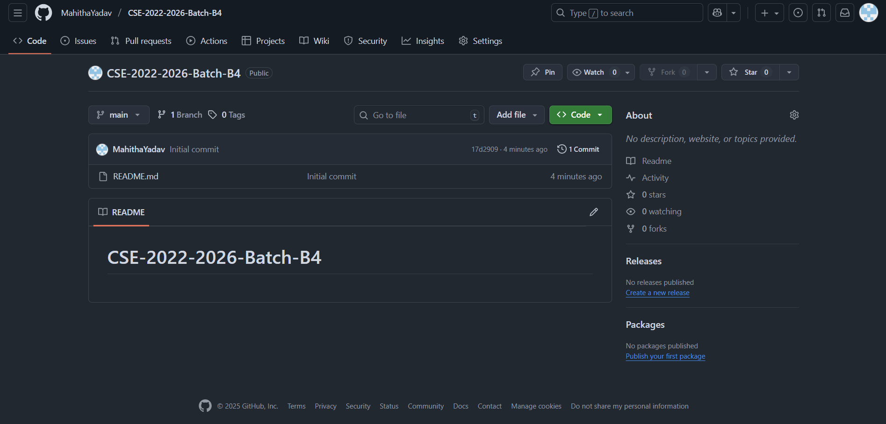
Git Hub Dashboard
AI/ML Powered Multi-Disease and Side Effects Prediction
Link: https://github.com/MahithaYadav/CSE-2022-2026-Batch-B4
B4 | Department of Computer Science and Engineering | Srinivasa Ramanujan Institute of Technology | 10

Slide 11
AI/ML Powered Multi-Disease and Side Effects Prediction
Any Queries?
B4 | Department of Computer Science and Engineering | Srinivasa Ramanujan Institute of Technology | 11

