Slide 1
Farmers' Market Price & Sales Tracker
Programming in Java (26SC1101E PSPJ)
Mahith Chowdary 2620040099
Chandra Harsha 2620040082

Slide 2
Abstract
Simple Java project to help farmers and market sellers manage products, prices and daily sales digitally
Manual tracking of price, quantity and income is slow and prone to calculation mistakes
User enters product name, price per unit and quantity sold; Total Sales = Price × Quantity
A loop handles multiple products and totals their sales automatically
Uses variables, data types, user input, operators, loops, methods and output statements; a separate method calculates the sales amount
Displays each product's sales and the final total, giving small-scale sellers an easy view of daily income

Slide 3
Understanding the Problem Statement
Farmers sell many products (vegetables, fruits, grains) at different prices and quantities
Recording price, quantity sold and income by hand is time-consuming and error-prone
Repeated manual calculations make it hard to know the day's total earnings
Need: a simple, user-friendly program that takes product details as input
It should calculate each product's sales (Price × Quantity) and the total for all products
Goal: show how programming solves a practical real-life problem

Slide 4
CO 1 Topics
Basic Java structure: class and main method
Variables and data types
Input and output statements
Scanner class and Strings
Arithmetic operators
Assignment operators

Slide 5
CO 2 Topics
for loop and increment operator
Conditional statements (if)
continue statement
User input processing
Repetition of statements
Repeated product entry

Slide 6
CO 3 Topics
Problem-solving techniques
Data processing and sales calculations
Modular implementation using classes and constructors
Program testing and output verification
Calculation of total sales

Slide 7
CO 4 Topics
Classes and objects
Constructors and instance variables
Object creation using the new keyword
Encapsulation of product details in a class
Storing product information using objects

Slide 8
CO 5 Topics
ArrayList collection to store multiple product objects
Exception handling using try and catch
InputMismatchException for invalid input
finally block
Resource management using Scanner.close()

Slide 9
CO 6 Topics
Lambda expressions
Java Stream API: stream()
Filtering products using filter()
Sorting products using sorted()
Total sales using mapToDouble() and sum()
Displaying results using forEach()
Data pipeline: input → storage → processing → output

Slide 10
Conclusion
Farmers' Market Price & Sales Tracker automates product sales and income calculation
Reduces manual effort and calculation errors
Applies all six course outcomes: Java basics, loops, modular design, OOP, collections with exception handling, and streams
Helps small-scale sellers keep simple sales records and understand daily income
Shows how a simple program can solve a real-life problem

Slide 11
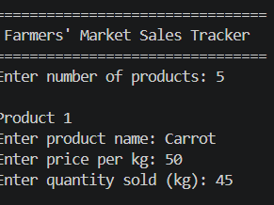
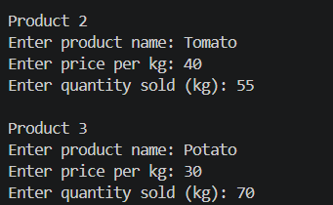
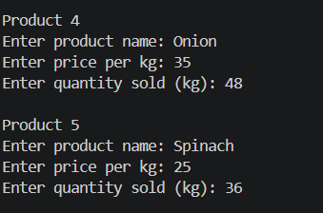
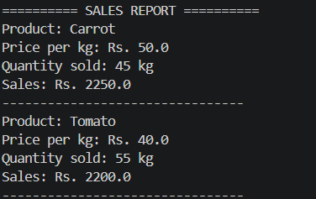
Screenshots (1/2)

Slide 12
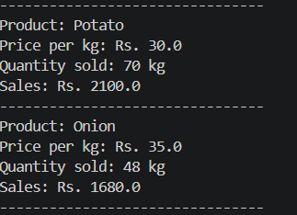
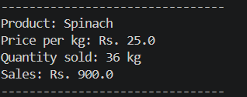
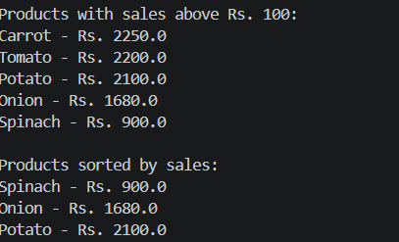
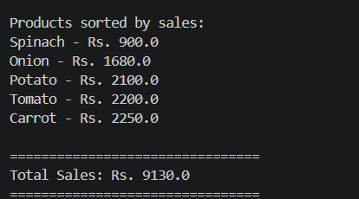
Screenshots (2/2)

Slide 13
Geo Tag Photo and GitHub Link
Geo-tagged photo: add here
GitHub link: add here

