Slide 1
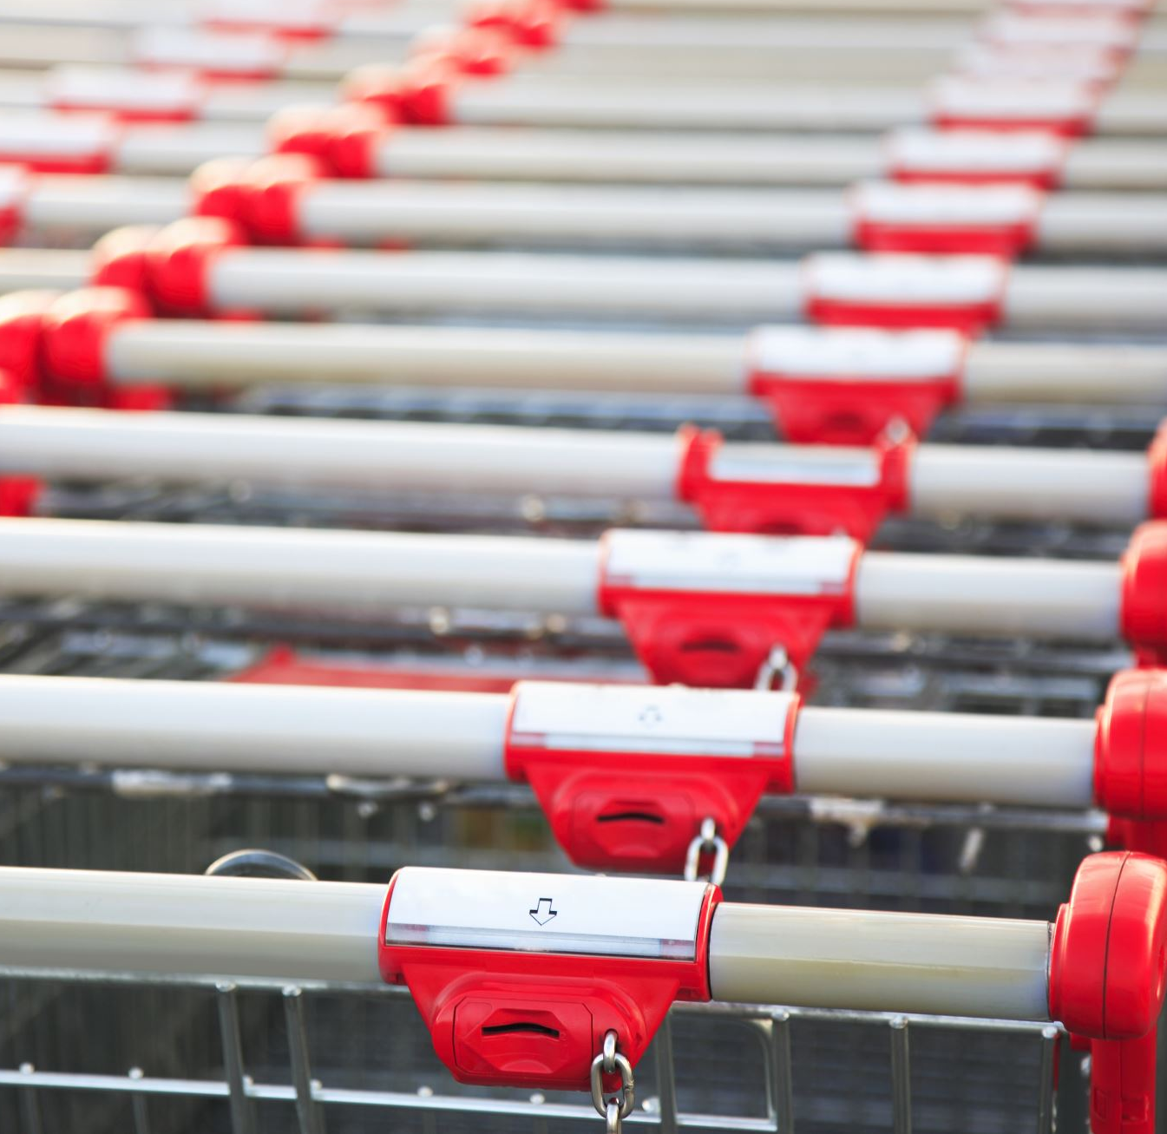
Demand Forecasting for Bravo Supermarket
Riyad Əbdürəhimov
RDS-102

Slide 2
Project Goals
1.Understanding supermarket data
2.Analyzing time series data for each category
3.Creating forecasting model for each category
4.Choosing best parameters for models
5.Evaluating models
6.Comparing results

Slide 3
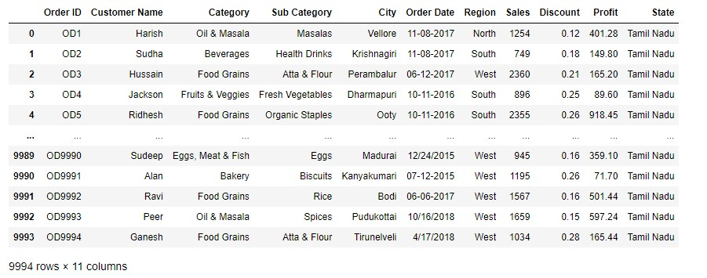

Supermarket Data Understanding
1.There are 9994 rows.
2.There are 11 columns
3.This is historical data from 2015 to 2019 year

Slide 4
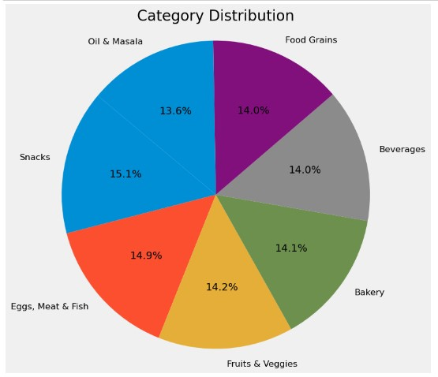
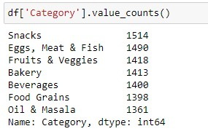
Visualization of each Category

Slide 5
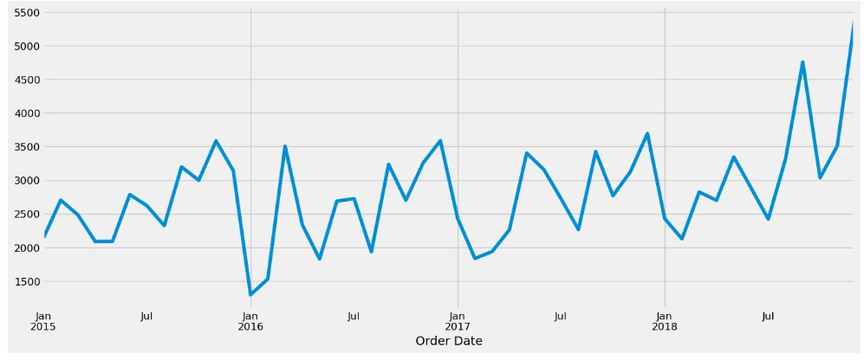
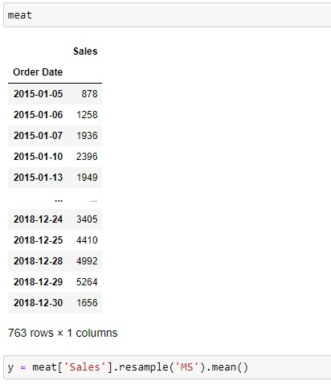
Analyzing Meat Category

Slide 6
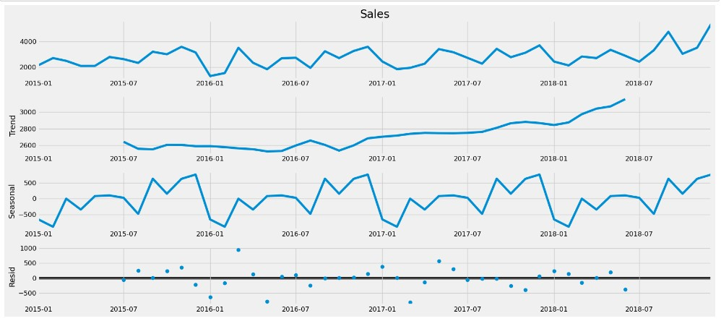
Decomposition Analysis of Meat category

Slide 7
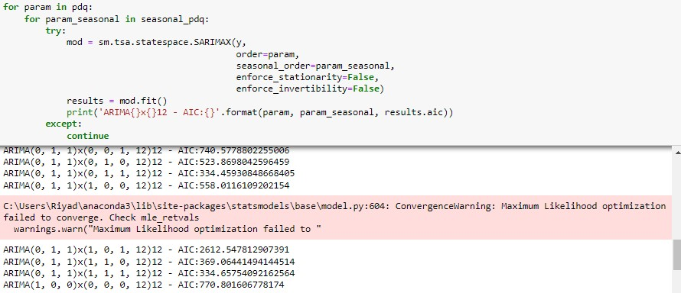
Hyperparameter tuning for time series forecasting

Slide 8
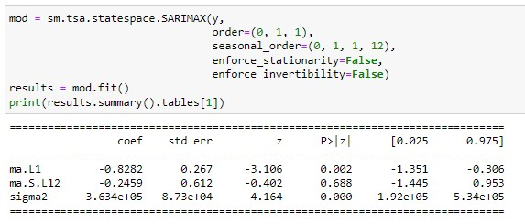
Fitting SARIMAX model

Slide 9
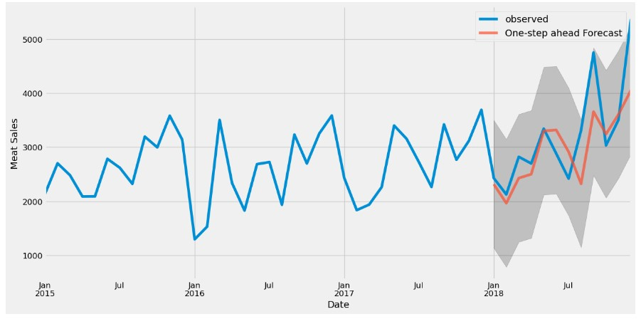
Time series forecasting with SARIMAX

Slide 10
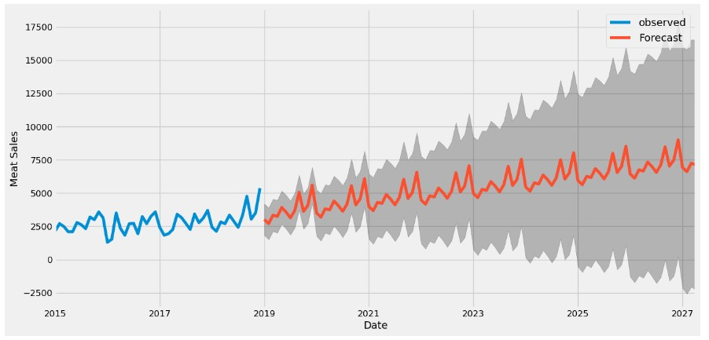
Future forecasting with SARIMAX model

Slide 11
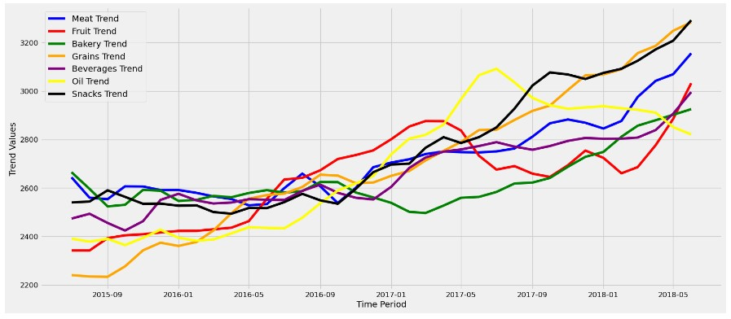
Comparing trends of each category

Slide 12
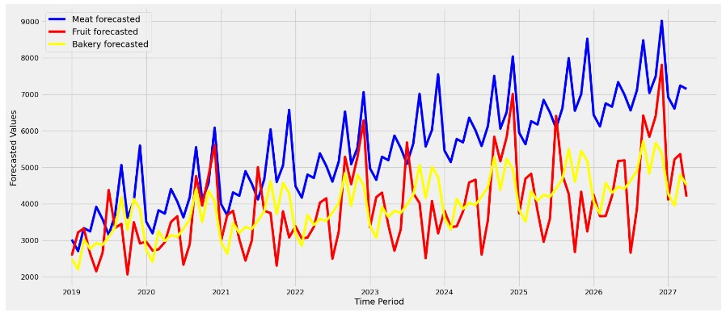
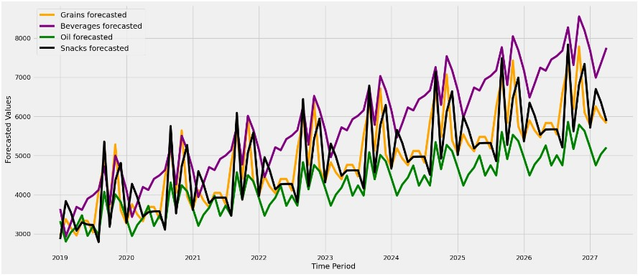

Slide 13
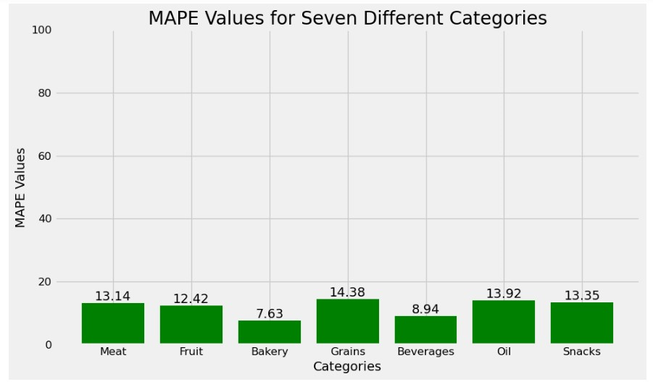
Visualizing MAPE for each model

Slide 14


