Slide 1
Buckman Hackathon
Mahizha 21PW13

Slide 2
Investment Decision Recommendation System Project
We were provided with a data set containing information about individuals and their investment behavior.
The task is to build a recommendation system that can predict the best investment decision for new data based on various factors available in the dataset.
Here I will guide through my the insights I observed and how i re-learned my approach. ( approach varies by person’s perspective)

Slide 3
1)Data Exploration:
Initial step is to go through the given data set.
Data Cleaning and Understanding:
Check for null values
And to make it understandable , i have converted it to integral values
Python Visualization to understand the segregation
Performed the investment behavioural insights including the percentage of household income invested, sources of awareness about investments, knowledge levels, influencers, risk levels, and reasons for investment.

Slide 4
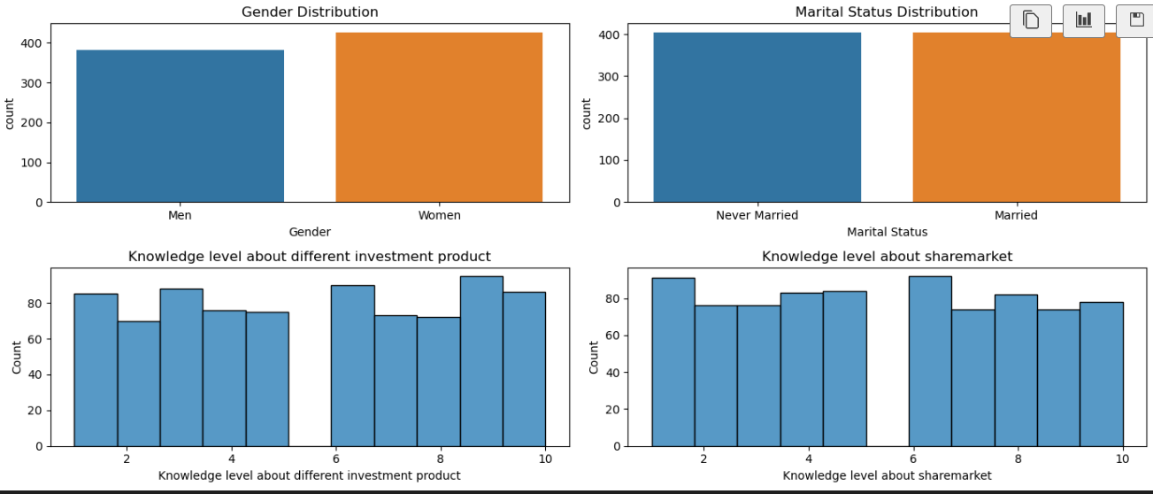

Slide 5
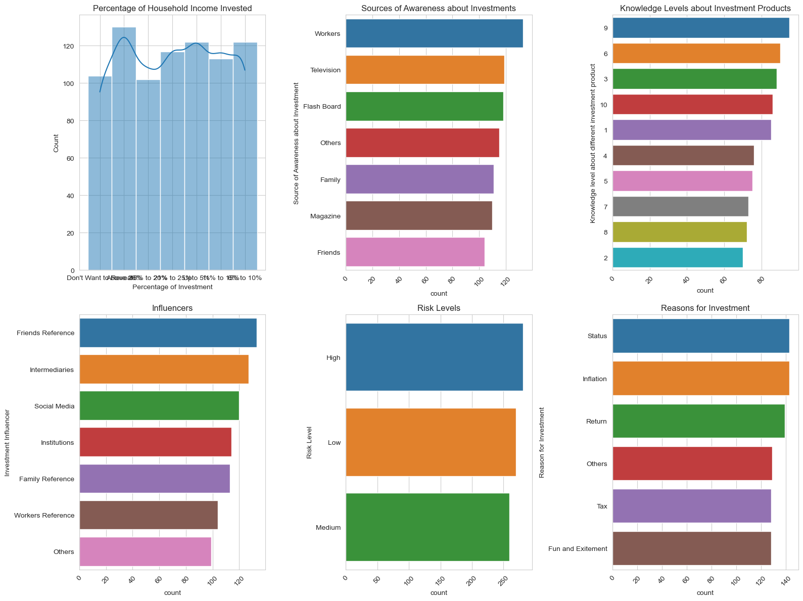

Slide 6
2)Best Investment Decision Identification:
Converted categorical data to numerical data , to train the model.
Done using LabelEncoder and OneHotEncoder
The correlation is performed for each behavioural features , to find the best feature which influences the recommendation system.
Chi-Square Test is used for feature selection
Initially while reading the data set , i thought the main objective was to make the client get maximum profit , and used “Returns Earned” feature as the target variable.

Slide 7
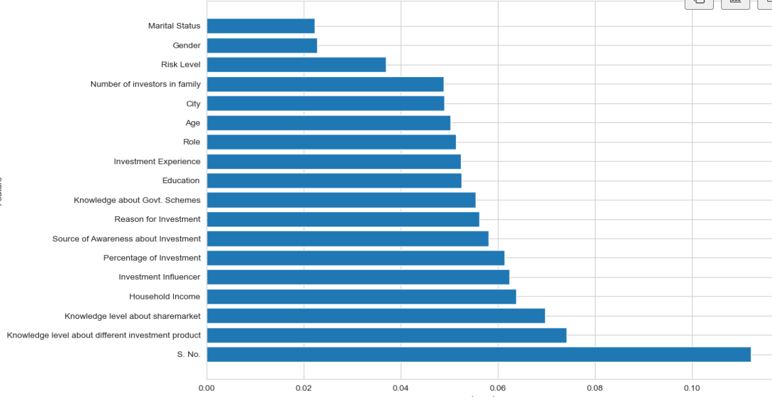
From both Chi-Square test and Random Forest model learning, the Top features are learnt. ie) these features have much more value in contributing to the "Return Earned"
Top-Features being :
* 'Knowledge level about sharemarket'
* 'Knowledge level about different investment product'
* 'Investment Influencer'
* 'Percentage of Investment'
and
Least-contributing features being :
* Gender
* Martial Status

Slide 8
re-learning
But on re analysing the data set and the problem statement, the main outcome is the recommendation system , so I have kept the Amount to invest as needed and , given the clients behaviour as my recommended value.
“Percentage to Investment” as the target value, and proceeded my findings based on that.

Slide 9
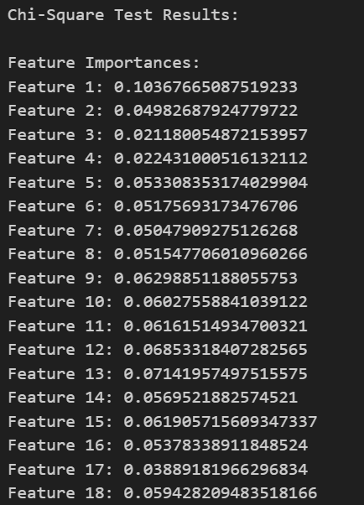
2. Determine which demographic, employment, and behavioral characteristics correlate with
successful investment outcomes
To approach this:
Chi-Square Test: Conducted a chi-square test for each categorical variable in X to determine if there is a significant association between the variable and the Returns.

Slide 10
3)Recommendation System Development:
Here i have checked the presence of outliers, using first quartile and third quartile ,And the results was found to be that no presence of outliers, which is great , to train the model.
I have found the accuracy, f-1 score for the 3 models - decisionTree, RandomForest,Neural Network.
The one with best score is chosen.
Note: I did observe that relatively all the models score range were small.

Slide 11
Selected features based on insights - “Percentage of Investment”
Selected features:
Index(['S. No.', 'Role', 'Knowledge level about different investment product',
'Investment Influencer', 'Return Earned'],
dtype='object')
Feature Selection Information:
{'selected_features': ['S. No.', 'Role', 'Knowledge level about different investment product', 'Investment Influencer', 'Return Earned'], 'scores': [389.8491633948299, 4.047448551211681, 0.44031412066083203, 4.4469568117173, 4.0967606945080846, 7.431002344646254, 10.98712004532755, 3.8557528106983856, 1.3793511863568446, 3.495605388744059, 13.374459533885819, 4.295986891602299, 0.614220097693017, 13.407256857158444, 9.039224928213692, 4.761813268440632, 11.319975434378211, 6.786373955195057]}

Slide 12
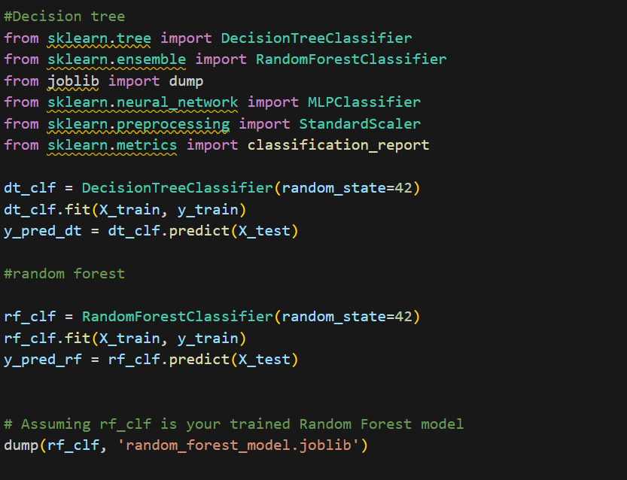
4)Recommendation System Development:

Slide 13
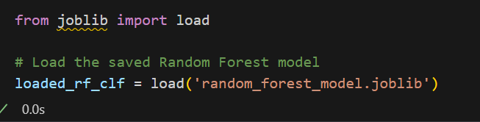
Used Random Forest Model and created the Model called -
Random_forest_model.joblib
I have dumped the learned model, so can be used for later and outside the environment.

Slide 14
5)Implementation:
1.Implement the recommendation system using a programming language of your choice - Used Python Environment.
2. Ensure the system is user-friendly and can accept input data for prediction.
For a user-friendly input i have used Flask which renders the HTML page and gets the user form input ie) clients behaviour, and recommends him/her the percentage of investment he should put , so that he gets good return back.

Slide 15
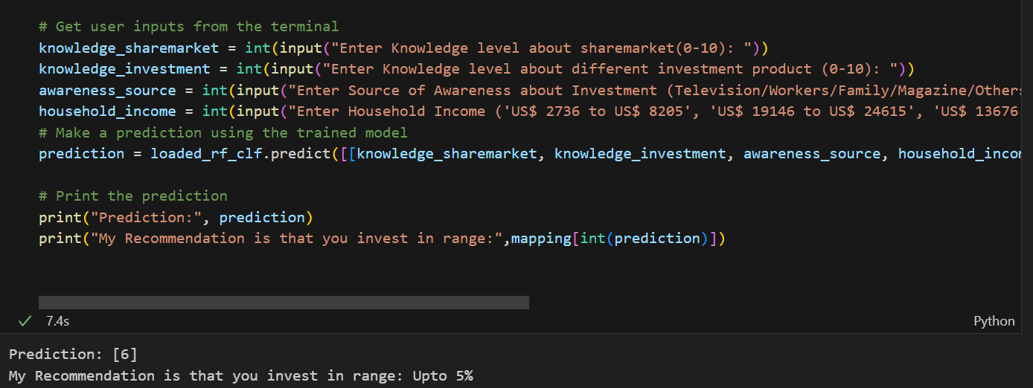

Slide 16
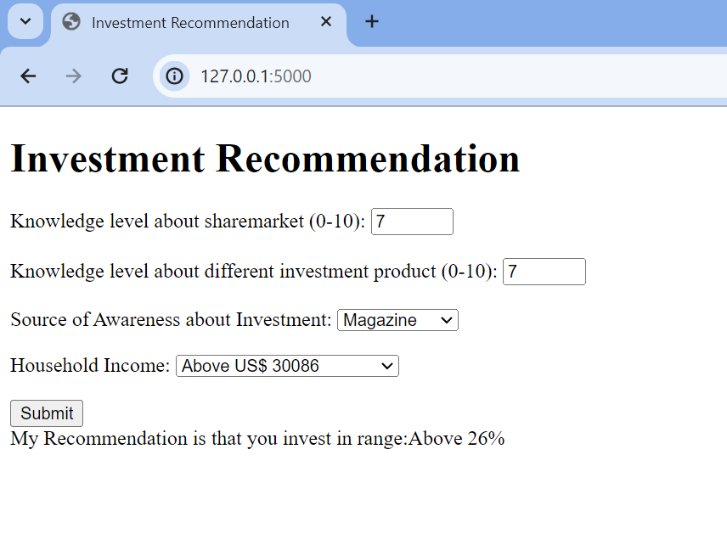

Slide 17
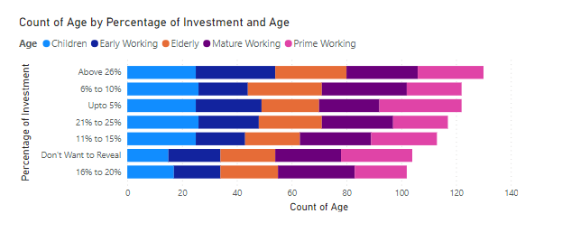
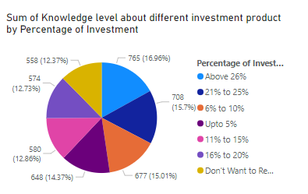
6)Analysis Using POWERBI
Additionally i have used POWERBI for visualization and insights gathering.
Following will be the visual elements i have performed.

Slide 18
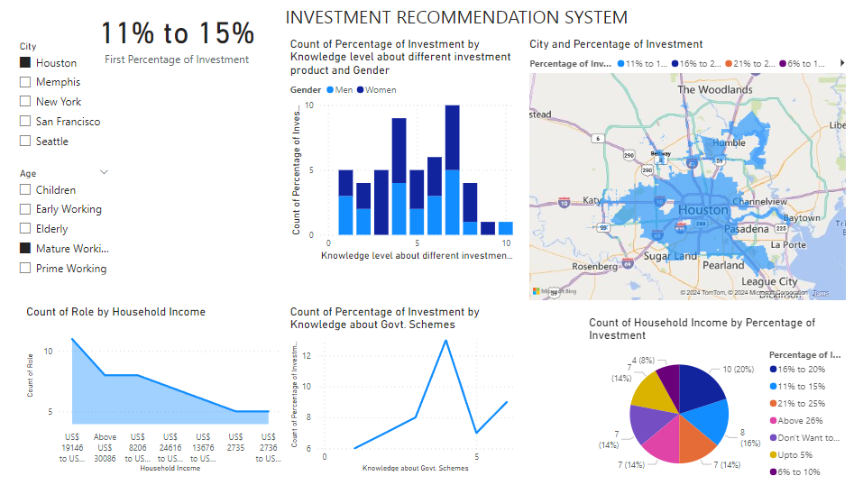

Slide 19
