Slide 1
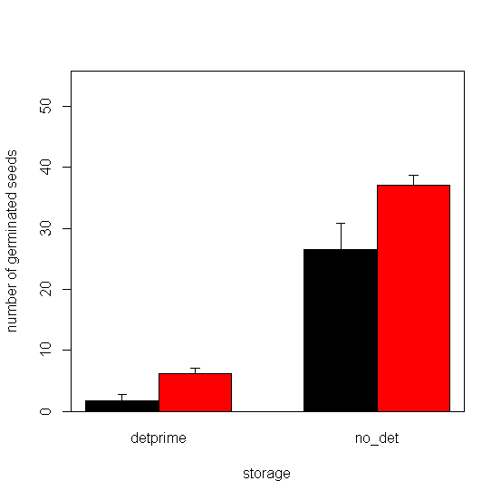
Figure 1. Interaction of storage and treatment on number of germinated canola seeds; black columns represent Control and the red ones represent combination of 50,100,150 micromolars of ABA plus hydropriming. Storage levels are putting seeds in adverse storage condition (detprime) and putting seeds in normal situation (no_det). X-axis is the average of germinated seeds number (out of 50 seeds) and error bars are standard deviation.

Slide 2
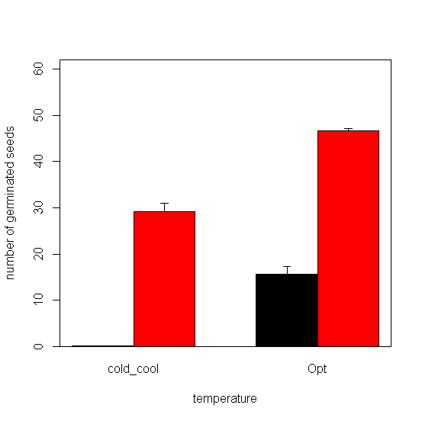
Figure 2. Interaction of temperature and storage situation on number of germinated canola seeds; black columns represent adverse storage condition and the red ones represent normal situation. Temperatures levels are putting seeds are combination of 3 and 7 °C (cold_cool) and 20 °C (Opt). X-axis is the average of germinated seeds number (out of 50 seeds) and error bars are standard deviation.

Slide 3
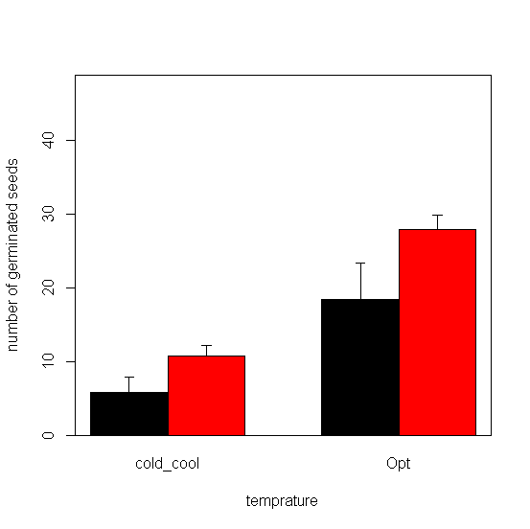
Figure 3. Interaction of temperature and treatment on number of germinated canola seeds; black columns represent Control and the red ones represent combination of 50,100,150 micromolars of ABA plus hydropriming. Temperatures levels are putting seeds are combination of 3 and 7 °C (cold_cool) and 20 °C (Opt). X-axis is the average of germinated seeds number (out of 50 seeds) and error bars are standard deviation.

