Slide 1

Data Preprocessing and Cleaning Summary
Essential steps for improving data quality and usability
Notes:
AI-generated content may be incorrect. ---

Slide 2
Introduction
Notes:
Overview of Data Preprocessing and Cleaning

Slide 3
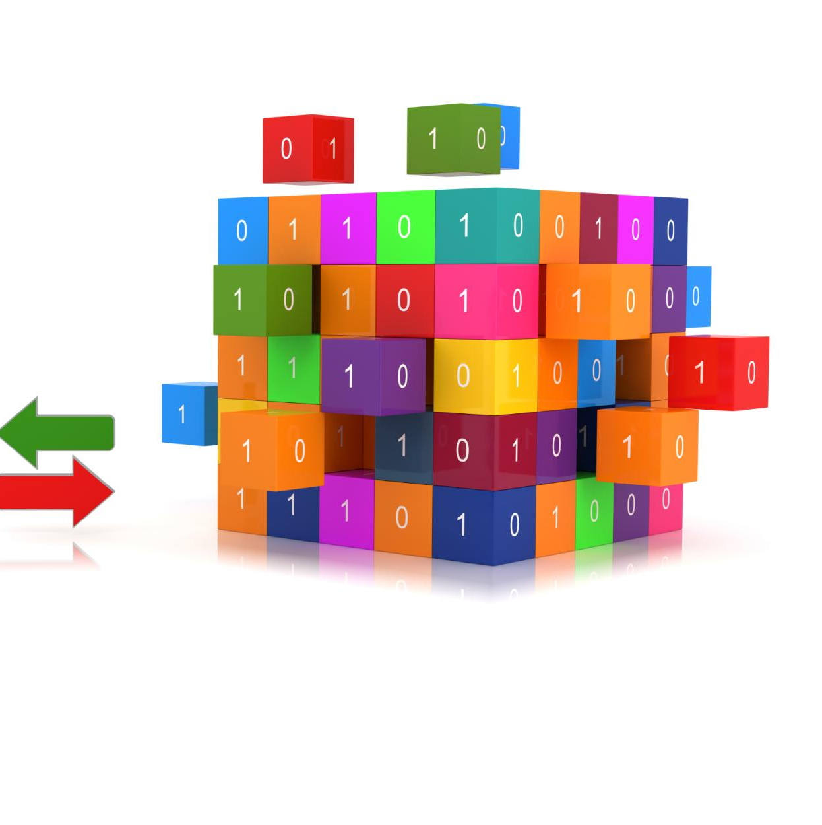
Overview of Data Preprocessing and Cleaning
Dataset Inspection
Initial dataset inspection helps understand data structure and quality before preprocessing.
Handling Missing Values and Duplicates
Removing duplicates and addressing missing values ensure data accuracy and consistency.
Encoding and Scaling Features
Encoding categorical variables and scaling numerical features prepare data for machine learning.
Correlation Analysis
Analyzing correlations between features helps identify relationships and improve models.
Notes:
Data preprocessing and cleaning are essential steps in preparing a dataset for analysis and modeling. These processes ensure that the data is accurate, consistent, and suitable for machine learning algorithms. In this presentation, we explore the preprocessing and cleaning steps applied to the Netflix Customer Churn dataset. The dataset was loaded using pandas, and initial inspections were performed to understand its structure and quality. Key steps included handling missing values, removing duplicates, encoding categorical variables, scaling numerical features, and analyzing correlations. These actions help improve model performance and reliability by ensuring that the input data is well-structured and free from inconsistencies.

Slide 4
Data Loading and Initial Inspection
Notes:
Reading and Exploring the Dataset

Slide 5

Reading and Exploring the Dataset
Loading and Previewing Data
Dataset loaded from CSV using pandas and initial rows previewed with head() to understand data structure.
Dataset Overview
Shape, data types, and non-null counts examined to assess dataset dimensions and completeness.
Missing and Duplicate Data
Missing values and duplicate entries identified to detect data quality issues for preprocessing.
Descriptive Statistics
Descriptive statistics generated to summarize distribution and key metrics in all dataset columns.
Notes:
The dataset was loaded using the pandas library from a CSV file named 'netflix_customer_churn.csv'. Initial exploration involved displaying the first few rows with df.head(), checking the dataset's shape using df.shape, and examining data types and non-null counts with df.info(). Missing values were identified using df.isnull().sum(), and duplicate entries were detected with df.duplicated().sum(). Descriptive statistics were generated using df.describe(include='all') to understand the distribution and summary of each column. These steps provided a comprehensive overview of the dataset's structure and helped identify potential issues that needed to be addressed during preprocessing.

Slide 6
Correlation Analysis
Notes:
Analyzing Relationships Between Numeric Features

Slide 7
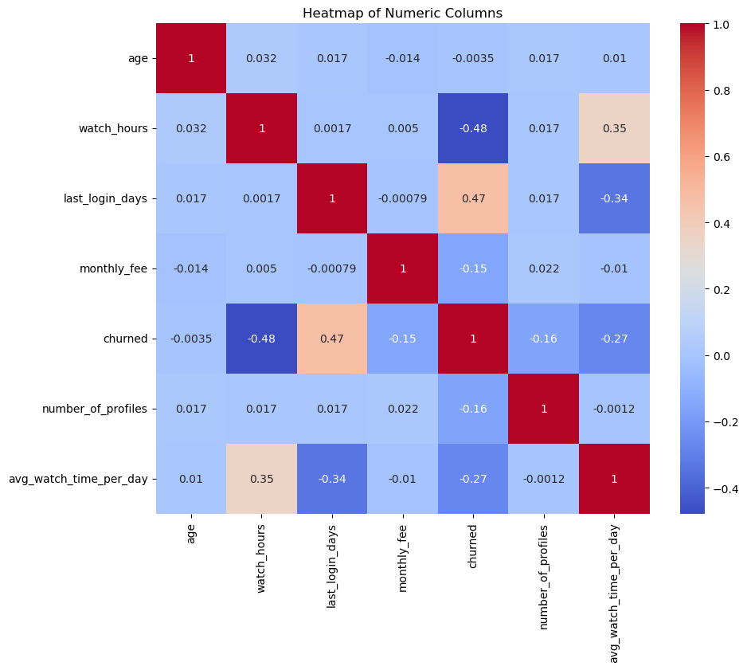
Analyzing Relationships Between Numeric Features
Correlation Matrix Computation
Numeric columns were selected and correlation matrix was computed to measure feature relationships.
Heatmap Visualization
A heatmap with annotations and 'coolwarm' color map was created to clearly display correlations.
Feature Interaction Insights
Analysis helps identify multicollinearity and guides feature selection for better model performance.
Reducing Redundancy
Highly correlated features may be redundant and can be removed or combined to improve models.
Notes:
Correlation analysis was conducted to understand the relationships between numeric features in the dataset. Numeric columns were selected using df.select_dtypes(include=['number']), and their correlation matrix was computed. A heatmap was generated using seaborn's heatmap function to visualize these correlations, with annotations and a 'coolwarm' color map for clarity. This analysis helps identify multicollinearity and understand how features interact, which is crucial for feature selection and model interpretation. Highly correlated features may be redundant and can be removed or combined to improve model efficiency and reduce overfitting.

Slide 8
Data Cleaning
Notes:
Removing Irrelevant and Redundant Data

Slide 9

Removing Irrelevant and Redundant Data
Dropping Irrelevant Columns
Irrelevant columns like 'customer_id' are removed to avoid noise in predictive modeling.
Target Variable Analysis
Analyzing the target variable's distribution ensures balanced classes for effective modeling.
Improving Data Quality
Data cleaning eliminates noise and enhances input quality for machine learning algorithms.
Notes:
Data cleaning involved removing irrelevant columns and verifying the target variable's distribution. The 'customer_id' column was dropped using df.drop(columns=['customer_id']) as it does not contribute to predictive modeling. The target variable 'churned' was analyzed using value_counts(normalize=True) to understand its class distribution. This step ensures that the dataset contains only relevant features and that the target variable is balanced or appropriately handled in subsequent modeling steps. Cleaning the data helps eliminate noise and improves the quality of inputs for machine learning algorithms.

Slide 10
Feature Encoding
Notes:
Transforming Categorical Variables

Slide 11

Transforming Categorical Variables
One-Hot Encoding Purpose
One-hot encoding converts categorical variables into a numerical format suitable for machine learning models.
Use of pd.get_dummies
The pd.get_dummies function was used on key categorical columns to create binary indicator variables.
Avoiding Dummy Variable Trap
The drop_first=True parameter prevents multicollinearity by dropping the first dummy variable.
Benefits for Model Training
Proper encoding allows categorical features to effectively contribute to model training and predictions.
Notes:
Categorical variables were transformed using one-hot encoding to convert them into a format suitable for machine learning models. The pd.get_dummies function was applied to columns such as 'gender', 'subscription_type', 'region', 'device', 'payment_method', and 'favorite_genre'. The parameter drop_first=True was used to avoid the dummy variable trap, which can lead to multicollinearity. This encoding process creates binary columns for each category, allowing models to interpret categorical data numerically. Proper encoding ensures that categorical features contribute effectively to model training and prediction.

Slide 12
Feature Scaling
Notes:
Normalizing Numeric Features

Slide 13

Normalizing Numeric Features
Feature Scaling Purpose
Standardizing numeric columns ensures features have mean zero and unit variance for uniform scale.
Selected Numeric Columns
Columns like age, watch hours, last login days, and monthly fees were normalized using StandardScaler.
Benefits for Algorithms
Scaling improves model performance and convergence for distance-based and gradient descent algorithms.
Notes:
Feature scaling was performed on selected numeric columns to standardize their values. The columns 'age', 'watch_hours', 'last_login_days', 'monthly_fee', 'number_of_profiles', and 'avg_watch_time_per_day' were scaled using sklearn's StandardScaler. This transformation ensures that all numeric features have a mean of 0 and a standard deviation of 1, which is important for algorithms sensitive to feature magnitude. Scaling improves model convergence and performance, especially for distance-based algorithms like k-nearest neighbors and gradient descent-based models.

Slide 14
Final Dataset Preparation
Notes:
Preparing Data for Modeling

Slide 15

Preparing Data for Modeling
Feature and Target Separation
Separate features and target variable by creating matrix X and vector y for supervised learning.
Dataset Preparedness
Clean and well-structured data ensures suitability for building accurate and reliable predictive models.
Importance of Preprocessing
Proper preprocessing is crucial for model training and evaluation in supervised learning tasks.
Notes:
The final step in preprocessing involved separating the features and target variable. The feature matrix X was created by dropping the 'churned' column from the dataset, while the target vector y was assigned the 'churned' column. This separation is essential for supervised learning tasks, where models learn to predict the target variable based on input features. With all preprocessing steps completed, the dataset is now clean, well-structured, and ready for model training and evaluation. Proper preparation ensures that the data is suitable for building accurate and reliable predictive models.

