Slide 1

Car-Rental System
Elice Elifinya Kimaro
Edom Teare Seleba
Mahlet Seyoum
Yadessa Emiru Aga

Slide 2

Have you ever had a problem where or how to rent a car?

Slide 3
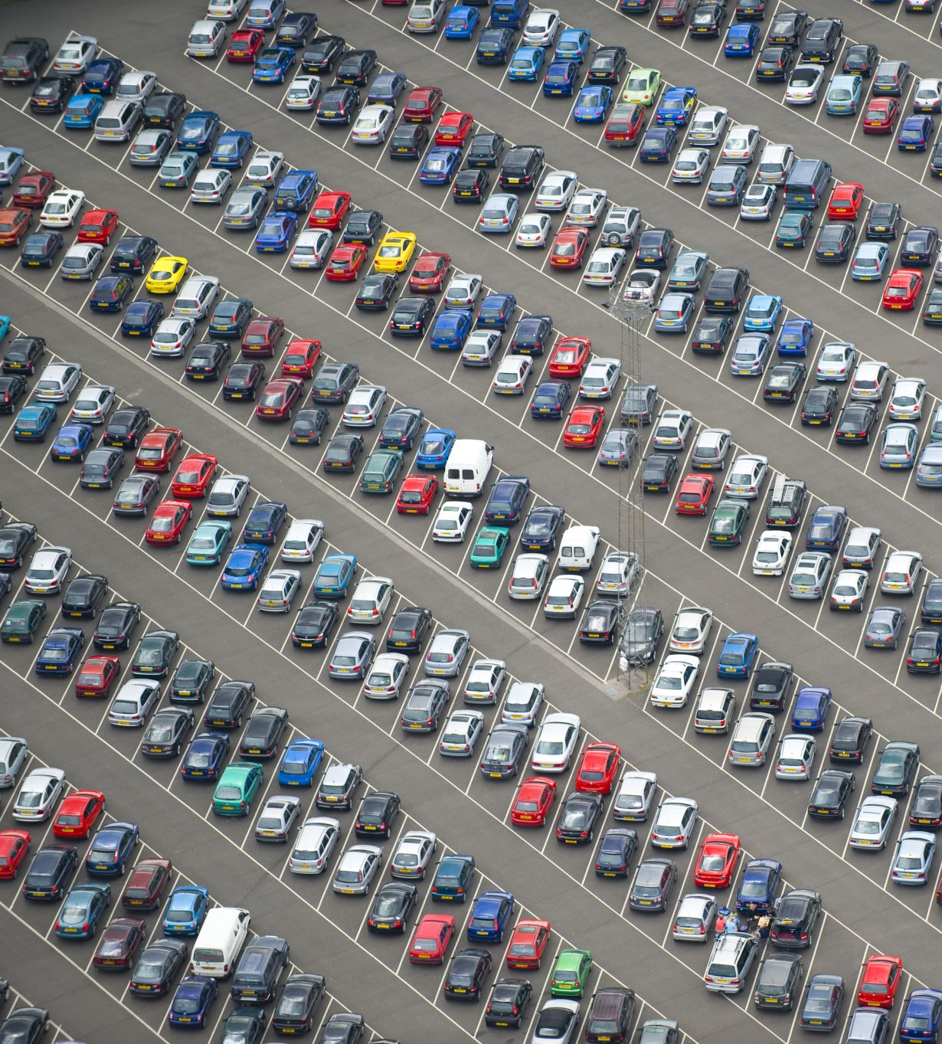
Problem Scenarios
Its not easily accessible
Takes time
Hard to find the exact type of car you want
Not knowing the vehicles enough information

Slide 4

Software Methodology
Agile
Because it was a complex project
Change in requirements
As a team we cycle through a process of planning, executing, and evaluating.

Slide 5
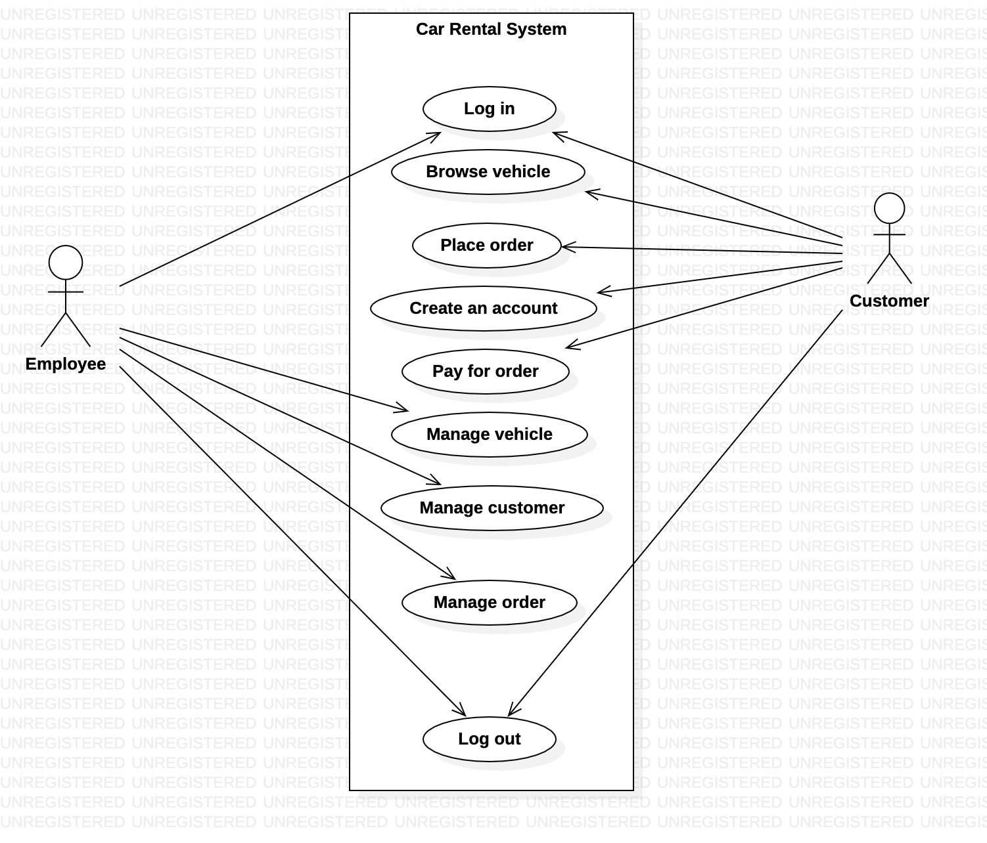
Use-case diagram

Slide 6
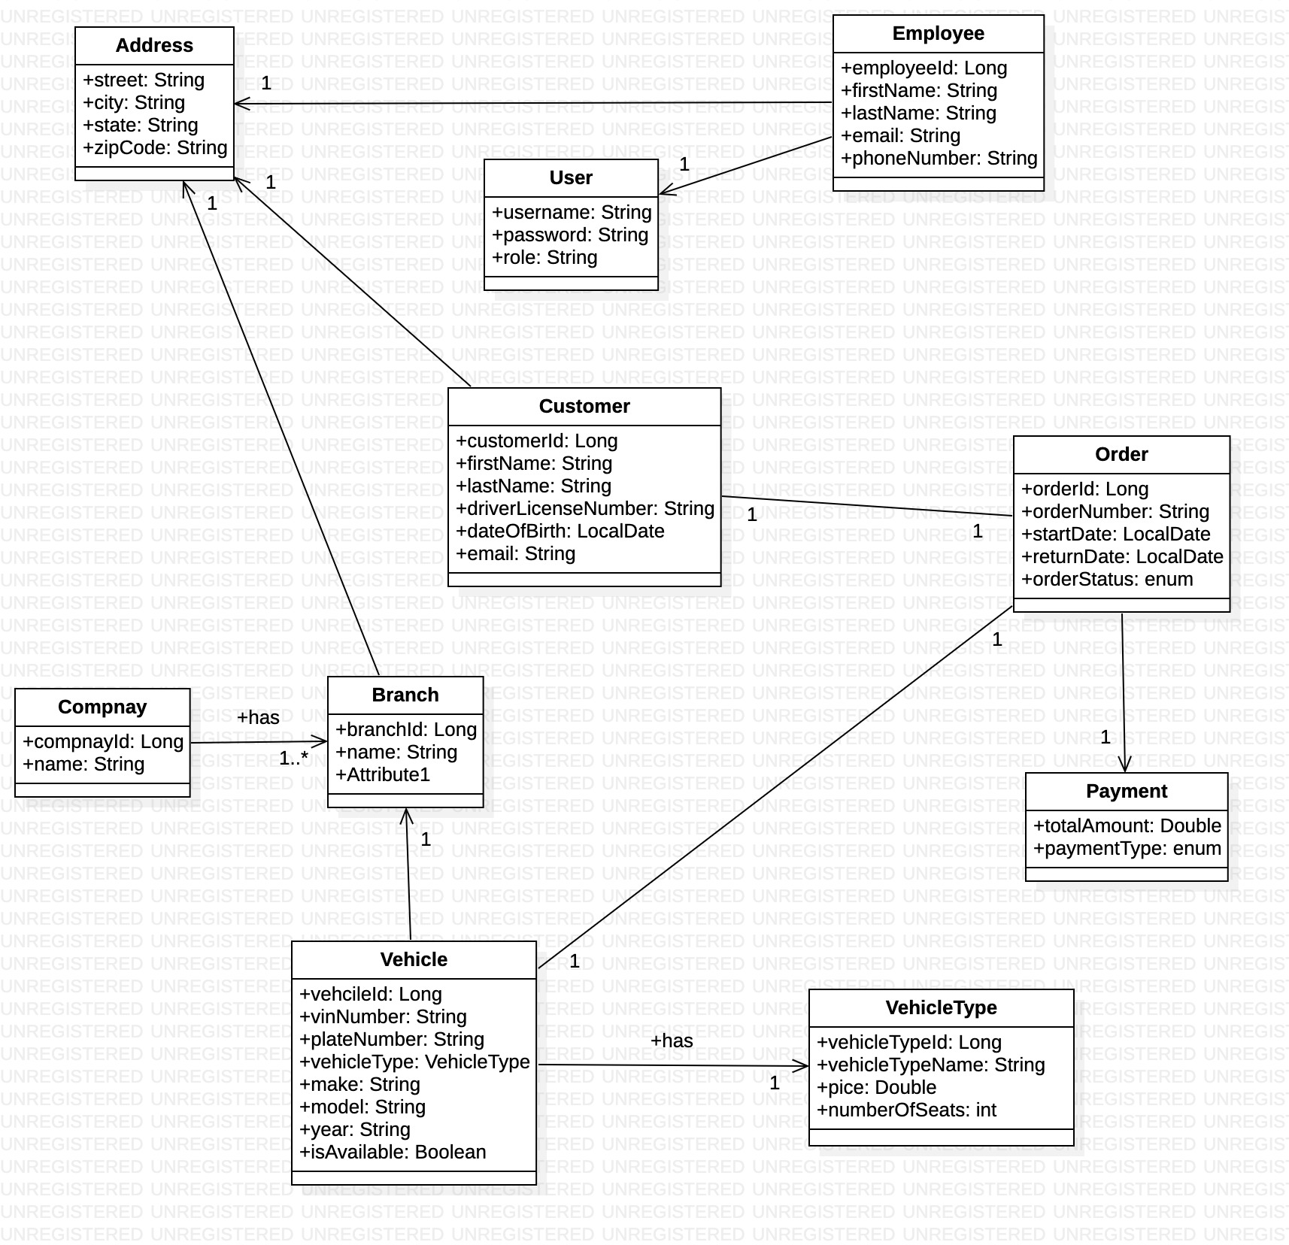
Class diagram

Slide 7
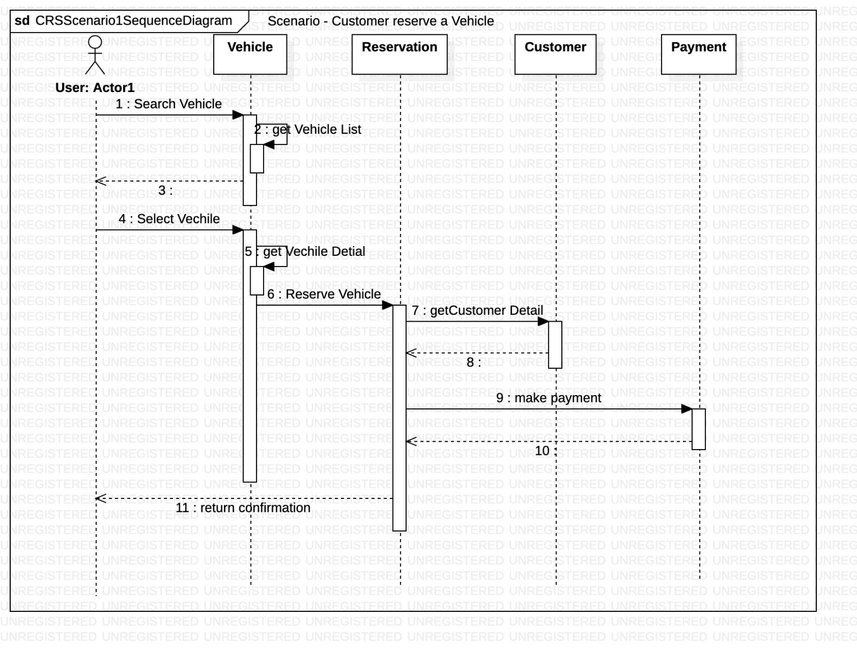
Sequence Diagram

Slide 8
Object-Oriented Analysis
Use-case
Class Diagram
User Story Map
Sequence Diagram
Activity Diagram

Slide 9
Programming Principles, OO-Analysis and Design Pattern used.
Program to interface
Abstraction
High cohesion low coupling
Model View Controller (MVC)

