Slide 1
Snack Chips Category Analysis
Customer Segmentation & Store Trial Evaluation
Strategic Recommendations for Category Growth

Slide 2
Executive Summary
KEY FINDINGS:
• Mainstream Young Singles/Couples pay premium prices ($4.06/pack)
• 175g pack size is the clear consumer favorite (60,000+ transactions)
• Kettle ($386K) and Doritos ($186K) dominate 40% of market
• Store trial: 67% success rate (2 of 3 stores positive)
• Average impact across trial stores: +$37.90
RECOMMENDATION: Target Mainstream segment, optimize 175g format, selectively scale trial

Slide 3
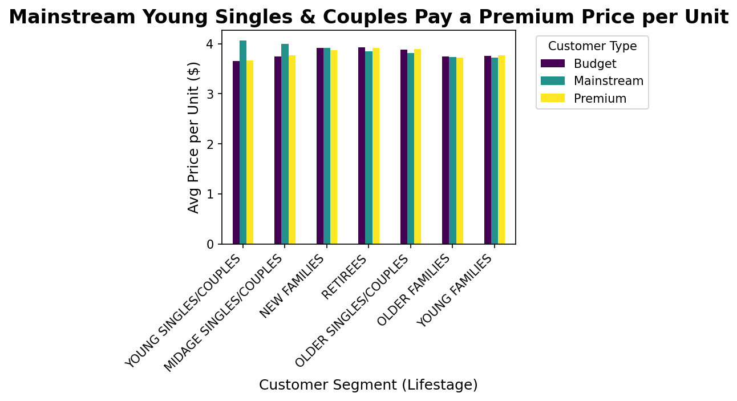
Customer Spending: Who Pays Premium Prices?
INSIGHT:
Mainstream Young Singles & Couples pay the highest price per unit ($4.06)
RECOMMENDATION:
Avoid deep discounts for this segment
Focus on brand-led promotions and 'New Flavor' launches

Slide 4
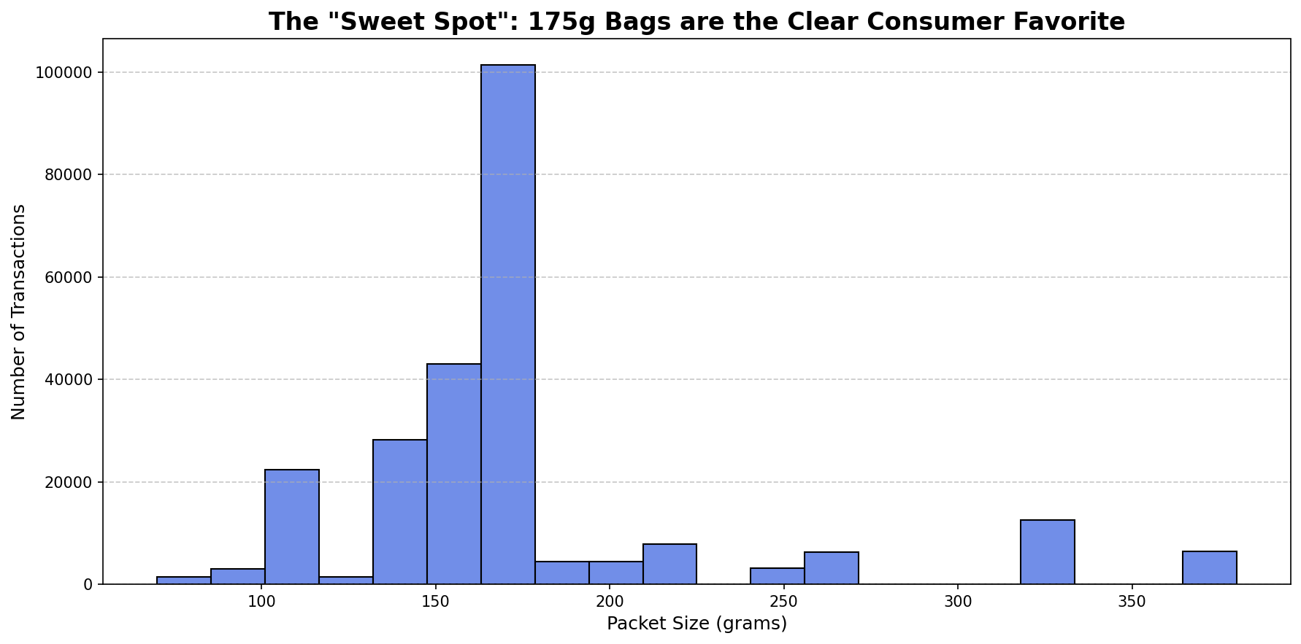
Pack Size Analysis: The 175g 'Sweet Spot'
INSIGHT:
175g bags have the highest transaction volume (60,000+)
RECOMMENDATION: Maximize shelf space for 175g format
Reduce small-format packs (<100g) in high-traffic locations

Slide 5
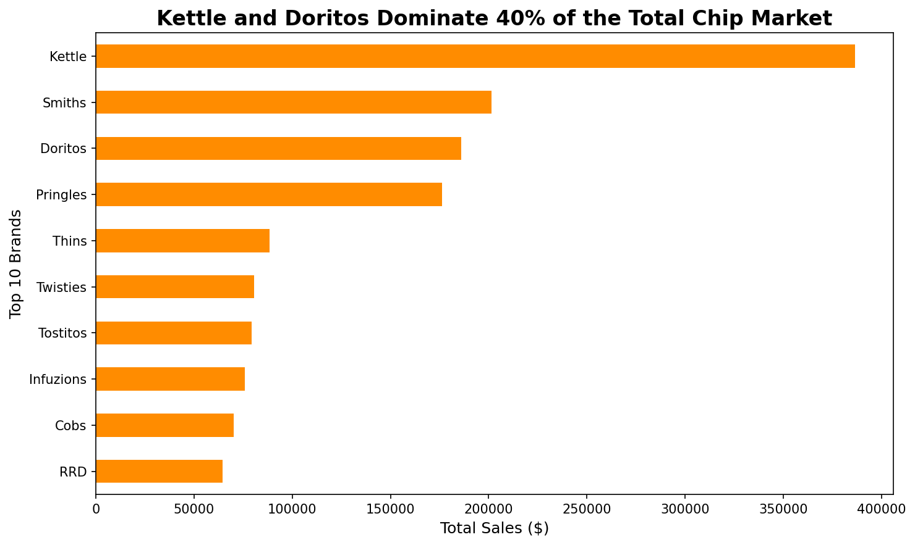
Top Brands by Total Sales
INSIGHT:
Kettle + Smiths = 40% of total chip market ($572K out of $1.4M)
RECOMMENDATION: Protect premium brands for niche segments
Maintain curated selection of Tyrrells and Red Rock Deli

Slide 6

QVI Trial Store
Performance Analysis, 2018–2019
Purpose: Introduce the report and set the stage.

Slide 7
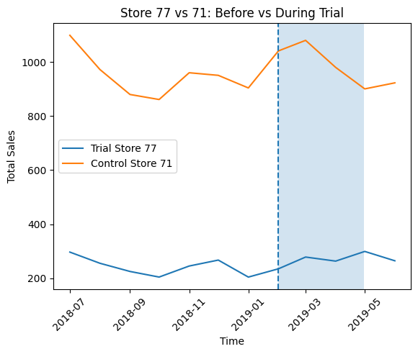
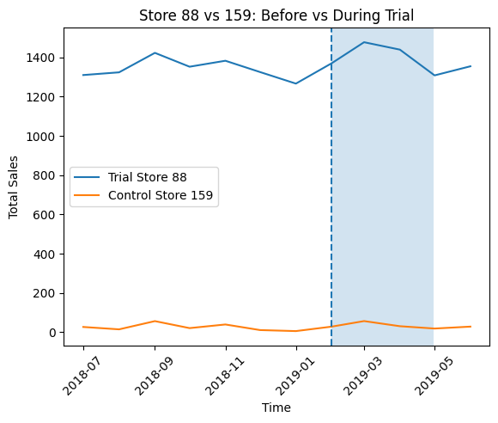
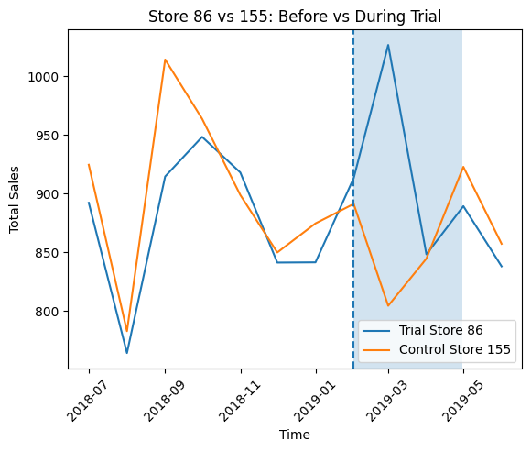
Pre-Trial (Jul 2018–Jan 2019) vs Trial (Feb–Apr 2019).
Insight: Performance measured by comparing sales growth between trial and control stores.
3 trial stores (77, 86, 88) matched with control stores (71, 155, 159)

Slide 8
Trial Store Analysis: Store 77 vs Control Store 71
RESULT: NO POSITIVE EFFECT - Negative impact of -$70.74
• Trial store sales increased by $16.29
• Control store sales increased by $87.02
• Trial store underperformed relative to control

Slide 9
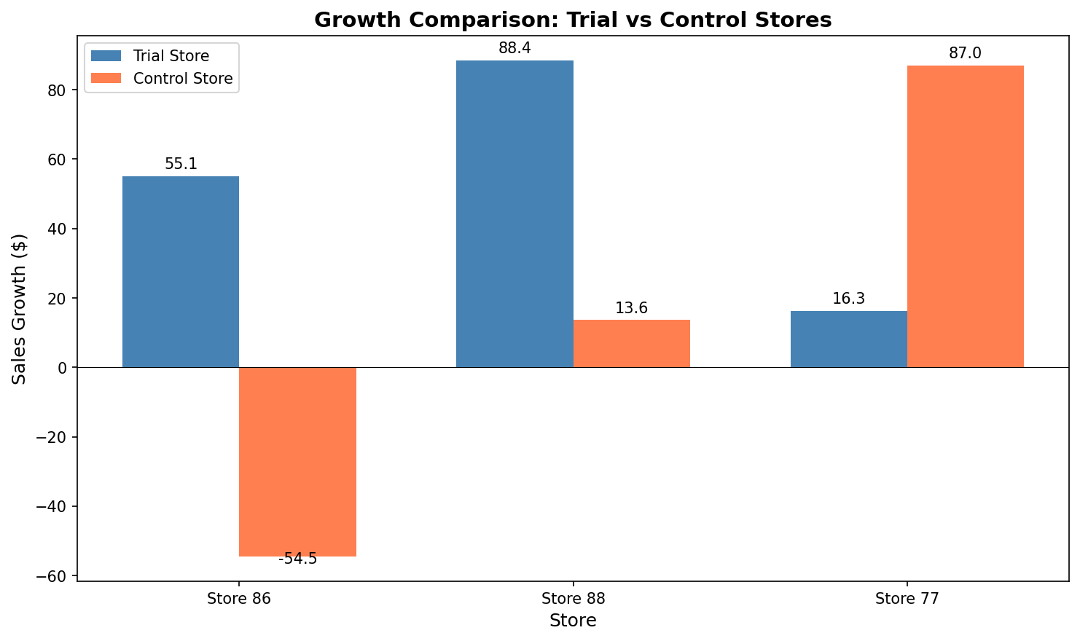
Trial Performance Summary
SUMMARY METRICS:
• Success Rate: 67% (2 out of 3 stores)
• Average Impact: +$37.90
Store 86: +$109.65 impact
Store 88: +$74.78 impact
Store 77: -$70.74 impact

Slide 10
Segment-Specific Brand Strategies
OLDER FAMILIES (Budget/Mainstream):
45,015 transactions (highest volume)
Strategy: Multi-buy promotions (e.g., 2 for $7)
YOUNG SINGLES/COUPLES (Mainstream):
Pay premium price ($4.06/pack)
Strategy: 'New Flavor' launches, avoid discounting
PREMIUM CUSTOMERS (All segments):
Smaller group, loyal to boutique brands
Strategy: Maintain curated selection of Tyrrells, Red Rock Deli

Slide 11
Trial Evaluation: Recommendations
Based on Mixed Outcomes:
HIGH PRIORITY: Roll out trial strategy to stores similar to Stores 86 & 88
MEDIUM PRIORITY: Investigate why Store 77 underperformed
MEDIUM PRIORITY: Improve control store matching (include customer demographics)
LOW PRIORITY: Extend trial period for more robust validation
CONCLUSION: Strategy should be selectively scaled, not fully rolled out

Slide 12
Strategic Recommendations Summary
Target the 'Mainstream' Growth Engine No deep discounts. Focus on brand-led innovation and new flavors
Optimize 175g 'Sweet Spot' Portfolio
Maximum shelf space for Kettle, Doritos in 175g format
Segment-Specific Execution
Families: Multi-buy promotions,
Premium: Curated boutique brands
Selective Trial Scaling
Roll out to stores like 86 & 88, investigate 77 further

Slide 13
Data Integrity & Methodology
Data Cleaning Actions:
• Removed non-snack products (Salsa/Dips) - 2,400+ rows
• Excluded wholesale transactions (Loyalty Card 226000)
• Removed quantity outliers (max reduced from 200 to 5 packs)
• Normalized brand names (RRD:Red Rock Deli, SNWTS:Smiths)
• Removed 667 sales outliers using IQR method
Final Dataset: 264,836 transactions with clean, reliable data

Slide 14
Thank You
Questions & Discussion
Data-driven recommendations for Snack Chips Category Growth

