Slide 1
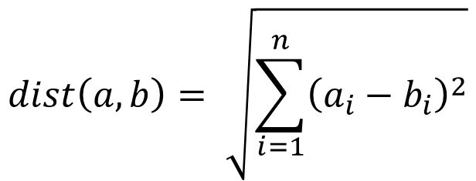
$$dist\left(a, b\right)= \sqrt{\sum_{i=1}^{n}{{\left(a_{i}−b_{i}\right)}^{2}}}$$
Uses:
word2vec video course, lecture 1 segment 4.

