Slide 1
Skip gram neural network architecture
Output Layer Softmax Classifier
Hidden Layer Linear Neurons
Σ
Probability that the word “abandon” appears nearby
Input Vector
0
Σ
0
Σ
Probability that the word “ability” appears nearby
0
0
0
Σ
0
Σ
Probability that the word “able” appears nearby
A ‘1’ in the position corresponding to the word “ants”
0
1
0
0
0
Σ
10,000
positions
Σ
Probability that the word “zone” appears nearby
300 neurons
10,000 neurons

Slide 2
Skip gram neural network architecture – Single Softmax Representation
Hidden Layer Linear Neurons
Input Vector
Σ
Output
Softmax Neuron
0
0
0
0.0021
0
0.0471
0
Σ
Σ
0.0063
Probability, for each word in the vocabulary, of appearing near the input word.
0
0.0005
A ‘1’ in the position corresponding to the word “ants”
0
1
1 neuron
0
0.0316
0
10,000
positions
Σ
0
10,000
positions
300 neurons

Slide 3
Skip gram neural network architecture – OLD / INCORRECT
Hidden Layer Neurons
Input Vector
Output Neurons
Σ
0.0021
0
0.0471
0
0.0063
Word probabilities for position -2
Σ
0.0005
0
0
0
Σ
0.0316
0
10,000
positions
A ‘1’ in the position corresponding to the word “ants”
0
1
0
Σ
0.0048
0
0.0139
0.0001
Word probabilities for position +2
Σ
0.0076
0
4 neurons
10,000
positions
0.0482
300 neurons
10,000
positions

Slide 4
Interpretation of Hidden Layer Weights
Hidden Layer
Weight Matrix
Word Vector
Lookup Table!
300 neurons
300 features
10,000 words
10,000 words

Slide 5
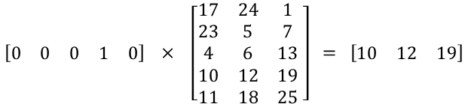
Matrix Multiplication with a one-hot vector
$$\left[\begin{matrix}0 & 0 & 0 & 1 & 0\end{matrix}\right] × \left[\begin{matrix}17 & 24 & 1 \\ 23 & 5 & 7 \\ 4 & 6 & 13 \\ 10 & 12 & 19 \\ 11 & 18 & 25\end{matrix} \right] = \left[\begin{matrix}10 & 12 & 19\end{matrix}\right]$$

Slide 6

Behavior of the output neuron
Output weights for “car”
Probability that “car” shows up nearby
Word vector for “ants”
$$×$$
Weight Matrix for Output Neuron
=
300 features
softmax
300 features
10,000 words
10,000 words

Slide 7
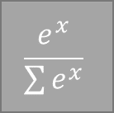
Behavior of the output neuron
Output weights for “car”
softmax
Word vector for “ants”
$$\frac{e^{x}}{\sum{e^{x}}}$$
$$×$$
300 features
=
Probability that “car” shows up near “ants”
300 features

