Slide 1
CET 351 / MACHINE LEARNING
CONTEXT
PROJECT 1 · 26 OCT 2026
One customer message.
Two possible routes.
Customer message
Agent KIO | Website-development customer intent
INTENT ROUTER
A wrong route selects the wrong workflow.
0
Support Agent
1
Sales Agent
Scope: routing + simulated agents, not a full chatbot or RAG implementation.
AGENT KIO · CUSTOMER INTENT ROUTING
01 / 21
Notes:
PRESENTER: Student 1
SPEAKING SCRIPT (simple English):
This is Agent KIO, the customer-facing entry point for a website development agency. A message can be about an existing service issue or a new purchase. Our job is to predict a routing flag: zero for Support, one for Sales. The router calls a simulated specialist agent. The project is about selecting the correct workflow, not building the complete chatbot or RAG system.
ARABIC SPEAKER CUES:
ابدأ بالمشكلة الفعلية: الغلط في Routing مش مجرد رقم؛ ممكن يوصل العميل للقسم الخطأ. وضح 0 و1.

Slide 2
CET 351 / MACHINE LEARNING
SCOPE · SYSTEM
SYSTEM BOUNDARY
Routing decides WHERE—not HOW—to answer
The classifier is the entry gate; the specialist agents are simulated.
IN SCOPE
NOT BUILT
WHY IT MATTERS
Intent classification
0 / 1 routing flag
Print-only agent selection
Full chatbot
Knowledge retrieval
Generated answers
Wrong classification → wrong support/sales workflow.
Routing is not RAG.
Domain decision → routing flag → specialist selection
Source: Project 1 official assignment, page 1.
AGENT KIO · CUSTOMER INTENT ROUTING
02 / 21
Notes:
PRESENTER: Student 1
SPEAKING SCRIPT (simple English):
The project implements the router, not the whole language-model application. The predicted flag determines which specialist workflow receives the request. Both agent functions simply print their names. Retrieval augmented generation is a wider architectural concept, not a feature we claim to have implemented.
ARABIC SPEAKER CUES:
حدود المطلوب: نص → تصنيف → Router → Agent محاكى؛ لا تدّعِ RAG أو chatbot كامل.

Slide 3
CET 351 / MACHINE LEARNING
DOMAIN
BUSINESS LOGIC
Service context—not keywords—defines intent
The label depends on what the customer is asking the agency to do.
SUPPORT
Existing website issue
“The company website you developed for us has been offline...”
0
SALES
New project request
“How much would a one-page landing site cost for a new project?”
1
MIXED
Problem + quotation
“Could you quote a second website? Also, the website you built... has stopped loading.”
0
PRIORITY RULE Existing-service problems override new-sales intent in mixed messages.
Real examples: M13 / M11 / M01 in data/dataset.csv
AGENT KIO · CUSTOMER INTENT ROUTING
03 / 21
Notes:
PRESENTER: Student 1
SPEAKING SCRIPT (simple English):
The key domain rule is not a keyword rule. If a customer reports a website we already built is broken, it is Support. If they request a new site or quote, it is Sales. In a mixed message, an existing problem has priority, so the correct route is Support even if the customer also asks about a second website. Domain knowledge determines our gold labels.
ARABIC SPEAKER CUES:
اشرح Existing Service مقابل New Purchase؛ المثال Mixed = M01 Support رغم ذكر Quote. الأمثلة مقتطفة نصيًا من الداتا.

Slide 4
CET 351 / MACHINE LEARNING
DOMAIN · LABELING
BUSINESS RULES
Two customers can mention “website” but need different teams
Ground truth is decided by service lifecycle and customer intent.
01
New purchase
“I need a quote for a new website.”
Sales (1)
02
Existing-site defect
“Our website you built is offline.”
Support (0)
03
Ongoing cancellation
“Cancel our ongoing redesign.”
Support (0)
04
Negation
“Our site is not broken; we want a new quote.”
Sales (1)
05
Mixed intent
“Quote a second site; also fix the first.”
Support (0)
Labeling rule: existing-service issues override new-purchase intent in mixed messages.
AGENT KIO · CUSTOMER INTENT ROUTING
04 / 21
Notes:
PRESENTER: Student 1
SPEAKING SCRIPT (simple English):
We reviewed cases that look similar but require different actions. A quote for a new site is Sales. Reporting a broken delivered site or cancelling an ongoing redesign is Support. Negation reverses the meaning of a keyword, while mixed intent is resolved using the existing-service-priority business rule.
ARABIC SPEAKER CUES:
خلي التركيز على فهم العلاقة بين الطلب والخدمة القائمة وليس مجرد الكلمات.

Slide 5
CET 351 / MACHINE LEARNING
DATASET
EXPERIMENTAL DESIGN
A balanced dataset creates a fair comparison
Synthetic English website-development messages; near-paraphrases stay together.
60
SELECTED DATASET EXCERPTS
MESSAGES
M01
“Quote a second website? Also, the website... stopped loading.”
Support
Mixed
M11
“How much would a one-page landing site cost...?”
Sales
Paraphrase
30 SUPPORT (0)
30 SALES (1)
M25
“Please cancel our ongoing website redesign project...”
Support
Straightforward
TRAIN
TEST
40
20
“Our current website isn’t broken; we want a quote...”
20 + 20
M53
Sales
Negation
10 + 10
Grouped split: no group_id overlaps between train and test.
Data source: project CSV; excerpts shortened for slide readability.
AGENT KIO · CUSTOMER INTENT ROUTING
05 / 21
Notes:
PRESENTER: Student 1
SPEAKING SCRIPT (simple English):
We created sixty synthetic English customer messages, exactly thirty per class, including straightforward cases, paraphrases, negation, and mixed intent. We agreed labels before testing and grouped near-paraphrases so related messages could not cross training and testing. The classifier used forty balanced training messages. Both approaches were evaluated on the same twenty balanced test messages. These four rows demonstrate the variety of phrasing and business intent.
ARABIC SPEAKER CUES:
اربط Sample / Feature / Target بمصطلحات Lecture 1. وضح 30/30، 40/20، Group ID، وأمثلة 4 رسائل.

Slide 6
CET 351 / MACHINE LEARNING
DATASET · COVERAGE
DATASET DESIGN
Four case types test more than obvious keywords
The case mix is measured from the 60-row dataset, not invented.
Straightforward
23 total
Paraphrase
16 total
Negation
14 total
Mixed
7 total
Support (0)
Sales (1)
Mixed cases: all 7 are Support because existing-service issues take priority.
AGENT KIO · CUSTOMER INTENT ROUTING
06 / 21
Notes:
PRESENTER: Student 1
SPEAKING SCRIPT (simple English):
We did not build only easy messages. The dataset contains twenty-three straightforward, sixteen paraphrase, fourteen negation, and seven mixed-intent messages. We used the agency labeling rule: a mixed message that reports an existing service issue is assigned Support. The chart shows the actual counts from our CSV.
ARABIC SPEAKER CUES:
العدادات الحقيقية من Dataset: 23/16/14/7. الجرافيك Native Editable.

Slide 7
CET 351 / MACHINE LEARNING
DATASET · METHODOLOGY
EXPERIMENTAL VALIDITY
Separate training from the final test—by group
Near-duplicate paraphrases must not leak across the split.
TRAINING
HELD-OUT TEST
40 messages
20 messages
20 Support + 20 Sales
10 Support + 10 Sales
group_id prevents near-paraphrase families from appearing in both sets.
Validation: 0 group overlap; 40/20 split frozen before the model evaluation.
AGENT KIO · CUSTOMER INTENT ROUTING
07 / 21
Notes:
PRESENTER: Student 1
SPEAKING SCRIPT (simple English):
The classifier learns from forty training messages only. Twenty held-out messages are kept for evaluation, with ten per class. Each near-paraphrase group appears in one split, not both. Otherwise the model could memorize almost the same message and give an overoptimistic test score. No test labels are used to fit TF-IDF, SVD, or the SVM.
ARABIC SPEAKER CUES:
Group Leakage هو تسريب جمل شبه متطابقة بين Train وTest. الفاصل الحقيقي يتم على Groups.

Slide 8
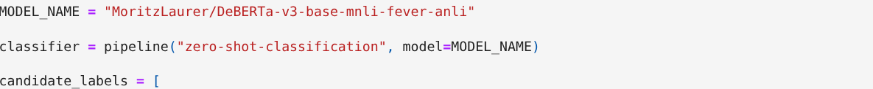
CET 351 / MACHINE LEARNING
DECISION MODEL
MODEL A
DeBERTa makes zero-shot decisions from label descriptions
Pretrained on external language data; no fine-tuning on our 40 messages.
1
Customer text
2
Candidate labels
3
Zero-shot model
4
Routing flag
Input message
Support vs. Sales intent
DeBERTa (NLI)
0 or 1
REAL NOTEBOOK CODE · src/kio/decision_model.ipynb, Cell 2
Candidate intent descriptions: existing service issue / new sales inquiry.
Model card: MIT license | Framework: Hugging Face Transformers
Structured flag validation is required by the project contract.
Model: MoritzLaurer/DeBERTa-v3-base-mnli-fever-anli • Hugging Face model card
AGENT KIO · CUSTOMER INTENT ROUTING
08 / 21
Notes:
PRESENTER: Student 2
SPEAKING SCRIPT (simple English):
Our alternative is the open-source MoritzLaurer DeBERTa model used through the Hugging Face zero-shot classification pipeline. It does not learn from our forty examples. Instead, it compares each message with descriptions of Support and Sales intent, then returns a ranking and scores. We map the selected category to zero or one for KIO. The model card lists an MIT license. We should validate that the returned label is one of our permitted categories, not silently accept an unknown value.
ARABIC SPEAKER CUES:
قول Zero-shot مش fine-tuned؛ ورّي المقاطع الحقيقية في الـNotebook: pipeline وcandidate_labels. مهم: شرط validation موجود في العقد؛ نسخة notebook فيها else غير صارم، متدعيش إنها enforced.

Slide 9
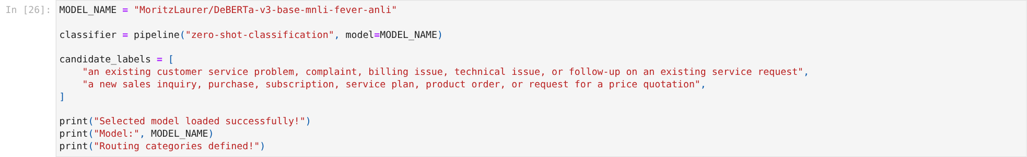
CET 351 / MACHINE LEARNING
DECISION MODEL · IMPLEMENTATION
DECISION SERVICE
Pretrained language inference, then a routing flag
Candidate-label descriptions are compared with each incoming message.
REAL NOTEBOOK SNIPPET · decision_model.ipynb
SETUP
Model · DeBERTa-v3 NLI
Task · Zero-shot classification
Fine-tuning · None
License · MIT
Output contract: only “customer_service” or “sales” should map to flag 0 or 1; unexpected values must be rejected.
AGENT KIO · CUSTOMER INTENT ROUTING
09 / 21
Notes:
PRESENTER: Student 2
SPEAKING SCRIPT (simple English):
We selected the openly released MoritzLaurer DeBERTa model using Hugging Face zero-shot classification. It receives the customer message and two candidate descriptions and scores how strongly they match. The implementation did not fine-tune on our forty labeled messages. Our shared contract requires a validated label and an integer flag. In the current decision notebook, the label-to-flag conversion deserves stricter validation before a live external demo.
ARABIC SPEAKER CUES:
لقطة الكود حقيقية؛ لا تدعي إن notebook فعّلت strict validation كاملة. الرخصة MIT من Model Card.

Slide 10
CET 351 / MACHINE LEARNING
DECISION RESULTS
HELD-OUT EVALUATION
DeBERTa finds all Support—but misses half of Sales
The descriptive-label experiment is exploratory, not an untouched second test.
DECISION MODEL · CONFUSION MATRIX
75%
Predicted Support
Predicted Sales
10
0
Actual Support
15 / 20 correct
5
5
Baseline labels 70%
Actual Sales
Descriptive labels 75%
5 of 10 real Sales inquiries were routed to Support.
EXAMPLE M06: “What features would you include ... new business website?” Actual: Sales / Predicted: Support
Source: results/decision_results.csv and docs/decision_model_experiment_log.md
AGENT KIO · CUSTOMER INTENT ROUTING
10 / 21
Notes:
PRESENTER: Student 2
SPEAKING SCRIPT (simple English):
With descriptive candidate labels, DeBERTa correctly classified fifteen of the twenty test messages, or seventy-five percent. It caught all ten Support cases, but it identified only five of ten real Sales cases. For example, a new website live-chat request was incorrectly sent to Support. We also tested original short labels and got seventy percent. Because the descriptive labels were changed after reviewing the earlier test results, we report the seventy-five-percent result as exploratory rather than an independent final benchmark.
ARABIC SPEAKER CUES:
الـConfusion Matrix الصفوف Actual والأعمدة Predicted. وضّح Support Recall=100% وSales Recall=50%. قول تغيير Candidate Labels بعد baseline يجعل 75% exploratory.

Slide 11
CET 351 / MACHINE LEARNING
DECISION MODEL · EVALUATION INTEGRITY
TWO PROMPT CONFIGURATIONS
Label wording changed the observed prediction pattern
Important: the second test was exploratory, not a new independent hold-out.
BASELINE
DESCRIPTIVE LABELS
70%
75%
14 / 20 correct
15 / 20 correct
Candidate labels: “Support”, “Sales”
Longer, service-specific intent descriptions
CAUTION The descriptive labels were evaluated after reviewing baseline test results; 75% is exploratory.
Source: docs/decision_model_experiment_log.md; do not present 75% as an untouched test estimate.
AGENT KIO · CUSTOMER INTENT ROUTING
11 / 21
Notes:
PRESENTER: Student 2
SPEAKING SCRIPT (simple English):
We first used the short labels Support and Sales; fourteen of twenty messages were correct. We then tried more descriptive labels, which produced fifteen correct. However, we chose that second wording after looking at the first test results on the same messages. We therefore explicitly label seventy-five percent an exploratory result. It should not be described as an unbiased independent generalization estimate.
ARABIC SPEAKER CUES:
الفرق خطوة واحدة صحيحة، لكن التعديل تم بعد الاطلاع على test؛ لازم نذكر exploratory.

Slide 12
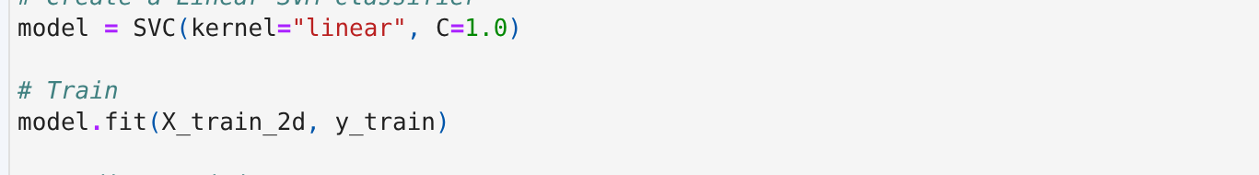
CET 351 / MACHINE LEARNING
FEATURE ENGINEERING
MODEL B
Text becomes numbers before the SVM learns a boundary
The same training-fitted transformations are reused at test time.
01
02
03
04
40 train messages
TF-IDF
TruncatedSVD
Linear SVM
Raw customer text
675 unigrams / bigrams
2 numeric components
kernel = linear · C = 1
ACTUAL TRAINING CELL · traditional_ml.ipynb
WHY TWO FEATURES?
The plotted line is the fitted SVM decision boundary—not a projection of a different classifier.
SVD explains 5.18% of TF-IDF variance; this is not the model accuracy.
Source: traditional_ml.ipynb, Cells 4–8 • scikit-learn TF-IDF / TruncatedSVD / SVC
AGENT KIO · CUSTOMER INTENT ROUTING
12 / 21
Notes:
PRESENTER: Student 3
SPEAKING SCRIPT (simple English):
Unlike the decision model, our Linear SVM is trained on forty labeled KIO messages. TF-IDF first converts words and neighboring word pairs into six hundred seventy-five numeric features. We use Truncated SVD to reduce that matrix to two features and fit the SVM with a linear kernel and C equal to one. This lets us plot the exact boundary of the fitted classifier, not a misleading projection. The two components explain about five percent of feature variance; that number is not accuracy.
ARABIC SPEAKER CUES:
اربط X=Numeric Features وy=labels بالمحاضرة. TF-IDF fit_transform على train فقط، test transform. Explained Variance 5.18% ≠ accuracy.

Slide 13
CET 351 / MACHINE LEARNING
TRADITIONAL ML · FEATURES
FEATURE EXTRACTION
TF-IDF turns short messages into measurable features
The classifier cannot learn directly from raw strings.
“Please cancel our ongoing website redesign project.”
TOKENIZE
please · cancel · our · ongoing · website · ...
UNIGRAMS
cancel | ongoing | website | redesign
BIGRAMS
ongoing website | website redesign
TF-IDF VECTOR
one numerical weight per learned vocabulary feature
40 × 675 TRAIN MATRIX
AGENT KIO · CUSTOMER INTENT ROUTING
13 / 21
Notes:
PRESENTER: Student 3
SPEAKING SCRIPT (simple English):
TF-IDF converts text to numeric features. Our vectorizer uses unigrams and bigrams, so it can represent both single words and neighboring pairs. It learns a vocabulary of six hundred seventy-five features from the forty training messages. During testing, we call transform, not fit_transform, so the test set cannot redefine the feature vocabulary.
ARABIC SPEAKER CUES:
فرق Feature Extraction عن Classification. الرقم 675 من fit training only. TF = term frequency, IDF weights terms less common across docs more.

Slide 14
CET 351 / MACHINE LEARNING
TRADITIONAL ML · DIMENSION
DIMENSIONALITY REDUCTION
Why compress 675 text features into just 2?
A 2D model gives a transparent, genuine decision-boundary plot.
675
2
TF-IDF features
SVD components
Explained variance = 5.18% ≠ Accuracy
Trade-off: easier visualization, but SVD preserves variance—not necessarily class separation.
AGENT KIO · CUSTOMER INTENT ROUTING
14 / 21
Notes:
PRESENTER: Student 3
SPEAKING SCRIPT (simple English):
Truncated SVD is an unsupervised dimensionality-reduction method, not a classifier. We fit it on the training TF-IDF matrix and kept two components. This makes the SVM decision boundary directly plottable. The two components account for about five point one eight percent of the TF-IDF variance. This is not classification accuracy and cannot tell us by itself how accurate the model will be. Low retained variance is an important trade-off.
ARABIC SPEAKER CUES:
TruncatedSVD لخفض الأبعاد، لا تنقل توقع التصنيف؛ explained variance مش accuracy ولا proof أن 94.8% من إشارات التصنيف ضاعت.

Slide 15
CET 351 / MACHINE LEARNING
TRADITIONAL ML · MODEL LOGIC
LEARNING ALGORITHM
Linear SVM selects a boundary with a margin
Support vectors are training points influencing the separating line.
OUR FITTED SETTINGS
SVC(kernel="linear", C=1.0)
C: penalty for classification errors versus margin width.
Support vectors: 17 Support + 17 Sales = 34.
ILLUSTRATIVE MARGIN GEOMETRY · NOT THE PROJECT BOUNDARY
The diagram on this slide is explanatory; the authentic fitted decision boundary appears next.
AGENT KIO · CUSTOMER INTENT ROUTING
15 / 21
Notes:
PRESENTER: Student 3
SPEAKING SCRIPT (simple English):
Linear SVM finds a separating line. It balances keeping a margin between classes with penalizing training errors; the C parameter controls this trade-off. We used the default C equal to one and a linear kernel. Our fitted SVM has thirty-four support vectors: seventeen from each class. This sketch is conceptual only; the following slide shows the actual model boundary saved from the notebook.
ARABIC SPEAKER CUES:
فرق schematic من true boundary. C صغير regularization stronger؛ C كبير عقوبة أخطاء أعلى. Do not conflate support vectors with all misclassified.

Slide 16
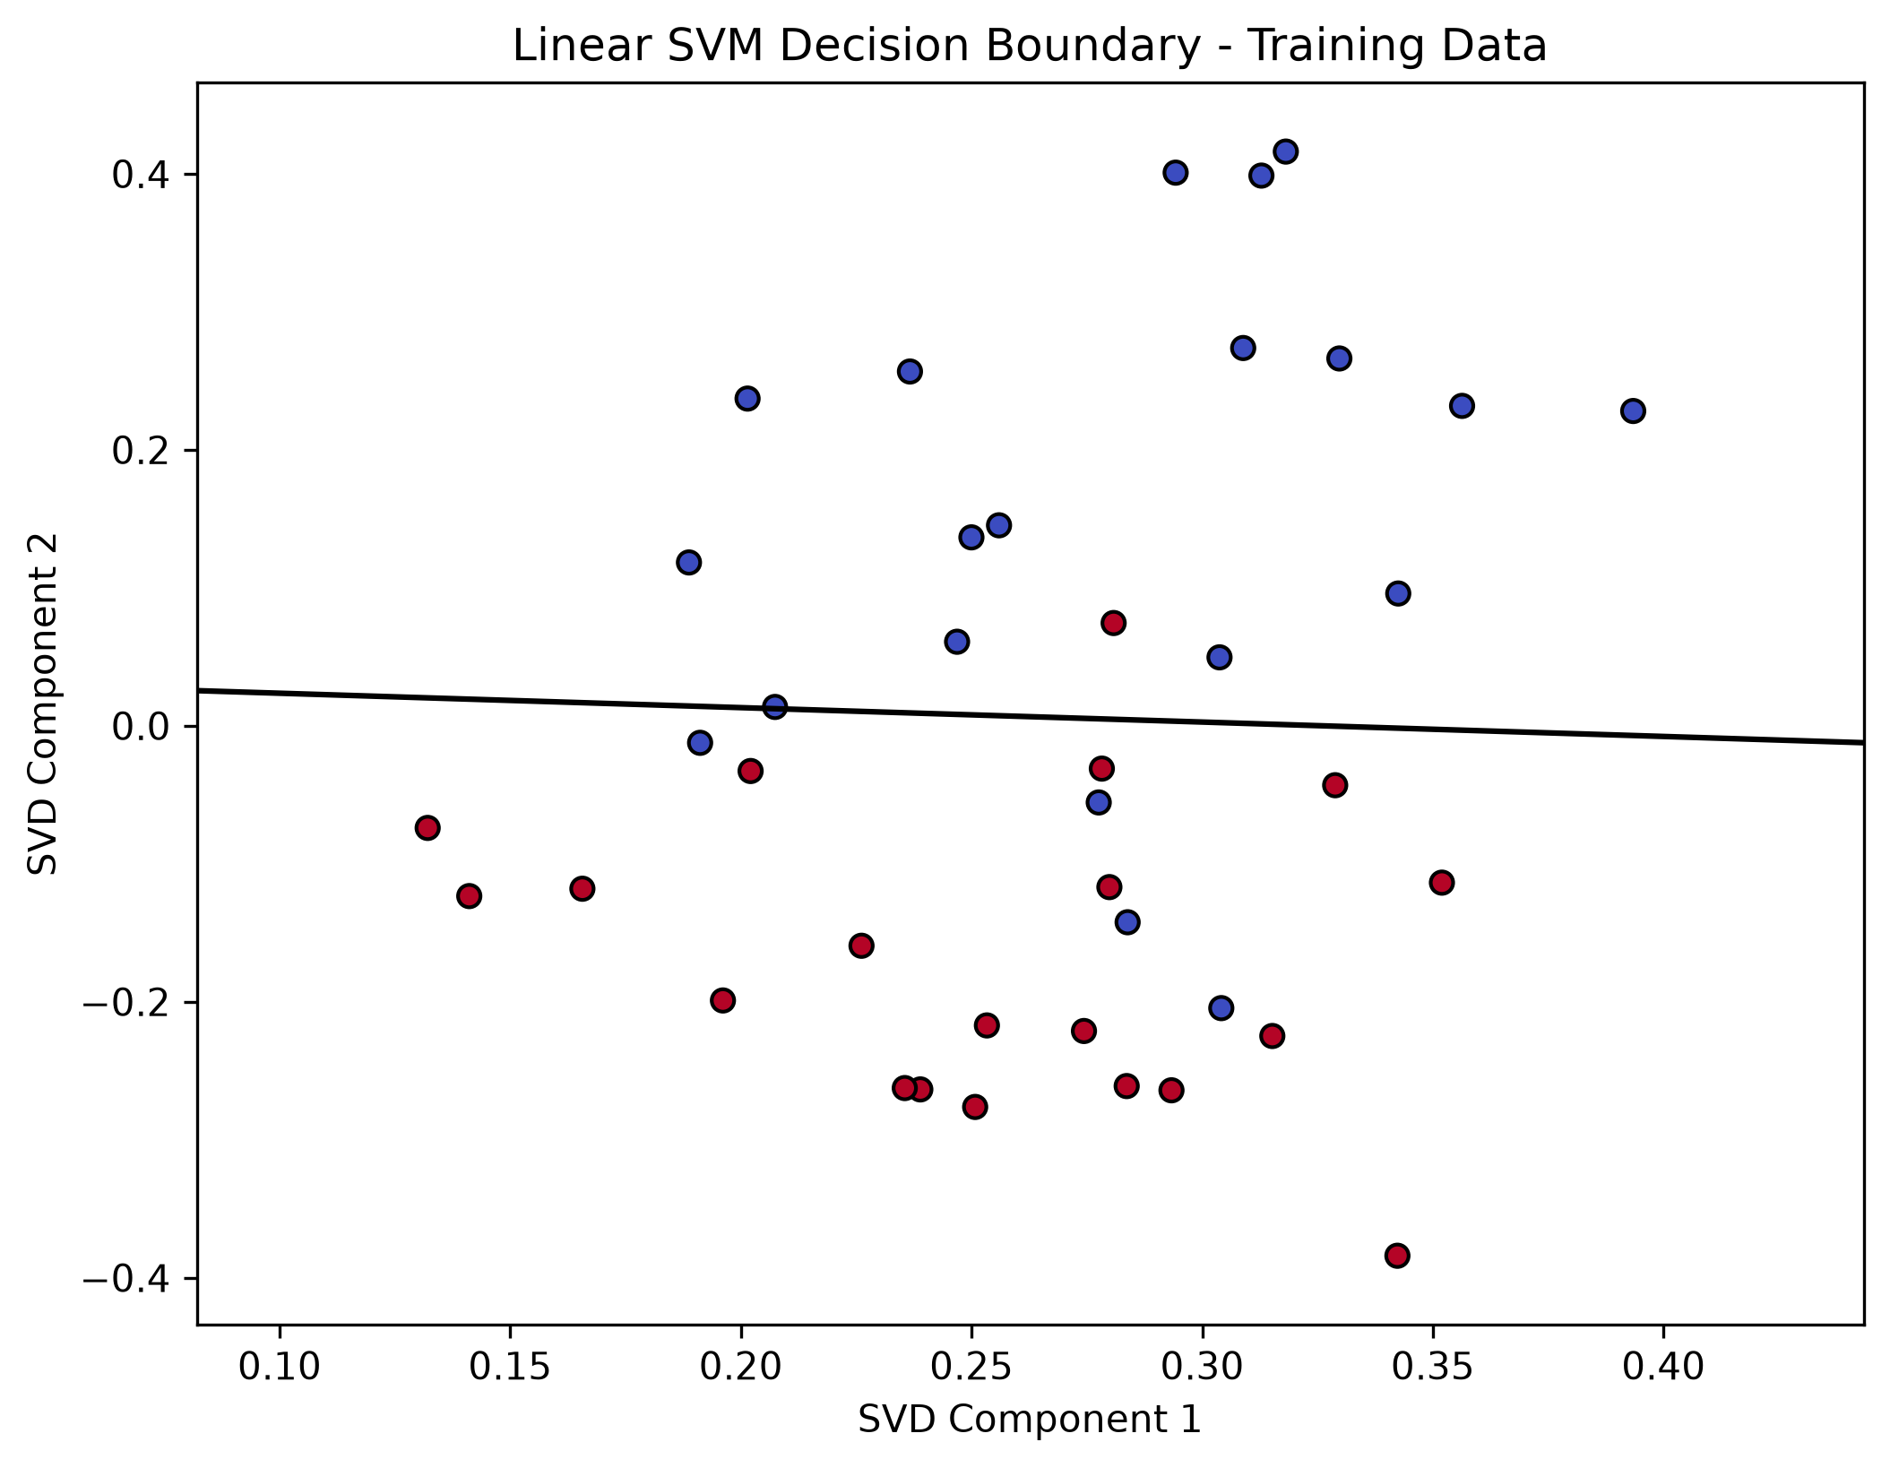
CET 351 / MACHINE LEARNING
MODEL GEOMETRY
MODEL GEOMETRY
The boundary is real because training is 2D
The black line is where model.decision_function(X) = 0.
TRUE BOUNDARY
Same SVD features for fit and plot.
TRAINING
87.5% · 35/40 correct
WHAT YOU SEE
Support (0) / Sales (1) points
Black line: decision score = 0
Authentic figure: results/boundary.png | Training data only
AGENT KIO · CUSTOMER INTENT ROUTING
16 / 21
Notes:
PRESENTER: Student 3
SPEAKING SCRIPT (simple English):
Here is the actual saved decision-boundary plot from our training notebook. Each point is a training message after SVD, with its true class shown by color. The black line marks a zero decision score, so the model predicts different labels on its two sides. Because we trained the SVM on exactly these two numeric components, this is its real boundary. On the training messages the accuracy was eighty-seven point five percent. Some points remain on the wrong side, so the classes are not perfectly separable.
ARABIC SPEAKER CUES:
Decision score =0 يعمل خط الفصل، مش نسبة احتمال. الصورة أصلية من نتائجنا. الـTraining Accuracy مش Test Accuracy.

Slide 17
CET 351 / MACHINE LEARNING
TRADITIONAL ML · TEST EVALUATION
MEASURED PERFORMANCE
One mistaken route in each class
Linear SVM predictions on the 20 held-out messages—not training estimates.
SVM · TEST CONFUSION MATRIX
TEST ACCURACY
Predicted Support
Predicted Sales
90%
9
1
Actual Support
18 correct / 20
1
9
Actual Sales
Precision 0.90 / 0.90
Recall 0.90 / 0.90
F1 score 0.90 / 0.90
Source: traditional_ml.ipynb / results/ml_results.csv. Test labels: Support=0, Sales=1.
AGENT KIO · CUSTOMER INTENT ROUTING
17 / 21
Notes:
PRESENTER: Student 3
SPEAKING SCRIPT (simple English):
Our Linear SVM classified eighteen of twenty test messages correctly, so test accuracy was ninety percent. The confusion matrix shows nine correct Support, nine correct Sales, and one error in each direction. Because the test has ten messages per class, precision, recall, and F1 are point nine for both. This is a balanced result on this particular small held-out set, not a claim about real production traffic.
ARABIC SPEAKER CUES:
مصفوفة الالتباس: rows Actual columns Predicted. precision/recall/F1 both .90; no new experiments.

Slide 18
CET 351 / MACHINE LEARNING
MATCHED TEST
HEAD-TO-HEAD
The SVM makes three more correct routes on the same test set
Exactly the same 20 message IDs and labels for both models.
TEST ACCURACY
RECALL BY CLASS
Linear SVM
18 / 20
Support
90%
100%
90%
Sales
90%
50%
DeBERTa
15 / 20
75%
SVM
DeBERTa
ERRORS · M24 both wrong | M25 SVM only | M06, M09, M10, M14 DeBERTa only
Sources: results/ml_results.csv, decision_results.csv, comparison.csv
AGENT KIO · CUSTOMER INTENT ROUTING
18 / 21
Notes:
PRESENTER: Student 3
SPEAKING SCRIPT (simple English):
On the same twenty held-out messages, our SVM correctly routed eighteen, compared with fifteen for DeBERTa: ninety versus seventy-five percent. SVM recall was ninety percent in both classes. DeBERTa found all Support but only fifty percent of Sales. The error lists explain the difference. Both models missed sales inquiry M24. SVM also mislabeled cancellation M25 as Sales. The decision model missed four additional true Sales messages. These are exact recorded predictions, not estimated values.
ARABIC SPEAKER CUES:
مهم: فرق +15 percentage points، مش زيادة 15% نسبية. 90% =18/20، 75%=15/20. عدد الاختبار صغير.

Slide 19
CET 351 / MACHINE LEARNING
COMPARISON · FAILURE ANALYSIS
MODEL ERRORS
Six distinct messages expose different failure modes
An error means the route conflicts with the agency’s labeling rules.
DECISION ONLY
M06 · M09 · M10 · M14
4 new-site Sales inquiries sent to Support.
BOTH MODELS
M24
Package features question → should be Sales (1).
SVM ONLY
M25
Cancel ongoing project → should be Support (0).
The unique-error count is 6 because one message (M24) was wrong for both models.
AGENT KIO · CUSTOMER INTENT ROUTING
19 / 21
Notes:
PRESENTER: Student 3
SPEAKING SCRIPT (simple English):
The decision model wrongly sent four additional new-site Sales requests to Support. Both models misunderstood M24, a question about package features, which is Sales because it precedes a potential purchase. Only SVM got M25 wrong: cancelling an ongoing redesign is Support because it concerns an existing project. The union of errors is six distinct messages, because one is shared.
ARABIC SPEAKER CUES:
Error analysis: support vs sales depends service lifecycle. M24 and M25 are strongest examples.

Slide 20
CET 351 / MACHINE LEARNING
DISCUSSION · BUSINESS IMPACT
DECISION TRADE-OFFS
Why accuracy alone is not enough for a routing system
The cost of each wrong route depends on the customer’s actual need.
FALSE SALES ROUTE
FALSE SUPPORT ROUTE
Existing customer issue → Sales.
Risk: delays in solving a real service problem.
New sales inquiry → Support.
Risk: missed or delayed commercial opportunity.
Observed: DeBERTa missed 5/10 Sales; SVM missed 1/10 Sales and 1/10 Support.
These are qualitative risks from the business setting, not measured monetary costs.
AGENT KIO · CUSTOMER INTENT ROUTING
20 / 21
Notes:
PRESENTER: Student 3
SPEAKING SCRIPT (simple English):
For a routing system, an error can have different operational consequences. Sending an existing website problem to Sales delays support. Sending a potential new customer to Support risks losing the opportunity. On our test set, DeBERTa missed half of the true Sales requests; SVM missed one true Sales and one true Support. We did not measure financial losses, so these are plausible business risks, not quantified outcomes.
ARABIC SPEAKER CUES:
لا تدّعِ خسائر مالية مقاسة. Trade-off يفسر أهمية precision recall business context.

Slide 21
CET 351 / MACHINE LEARNING
CONCLUSION
EVIDENCE-BASED RECOMMENDATION
Choose Linear SVM for this pilot.
Validate more before deployment.
WHY SVM
WHAT WE CANNOT CLAIM
90% test accuracy; balanced Support / Sales recall; 3 more correct routes on this sample.
Only 20 synthetic test messages; DeBERTa’s 75% setting was revised after seeing test results.
EVIDENCE & REFERENCES
Project brief: Project 1 — Routing for Agent KIO (26 Oct 2026)
CET 351 lecture materials: Orientation; Linear & Polynomial Classifiers
Hugging Face: MoritzLaurer/DeBERTa-v3-base-mnli-fever-anli (MIT)
scikit-learn documentation: TfidfVectorizer · TruncatedSVD · SVC
AGENT KIO · CUSTOMER INTENT ROUTING
21 / 21
Notes:
PRESENTER: Student 3
SPEAKING SCRIPT (simple English):
Our recommendation for this small KIO experiment is Linear SVM. It had higher overall test accuracy and better balance between recognizing Sales and Support. However, the evidence comes from only twenty synthetic held-out messages, so it is not enough to claim superiority in production. The seventy-five-percent DeBERTa configuration is also exploratory because label descriptions were revised after an earlier test. Next, a larger independent set should be evaluated, especially existing-project cancellations and new package inquiries. The source material includes our professor's brief, the course lectures, our saved project results, scikit-learn, and the model card.
ARABIC SPEAKER CUES:
الإجابة العلمية: recommend SVM لهذا Pilot فقط، وليس بشكل مطلق. أذكر محدودية 20 رسالة وتعديل candidate labels بعد test.

