Slide 1



Sales Dashboard WWI
View in Power BI
Last data refresh:
11/16/2024 8:03:45 PM UTC
Downloaded at:
11/16/2024 9:05:35 PM UTC

Slide 2
Introduction
Business intelligence (BI) is crucial for organizations aiming to gain insights, enhance decision-making, and achieve strategic objectives. This project leverages BI methodologies and tools to analyze sales, profits, and other key metrics within an organization. The project's primary objective is to transform raw data into meaningful visualizations that support strategic decision-making. The report outlines the objectives, methodology, data preparation, and dashboard development for the business.

Slide 3
Data Source
The data for this project is sourced from the WideWorldImporters dataSet, containing detailed information about the company’s sales, customers, products, and transactions. The key tables in the dataSet are:
▶ Dimension.City: Geographic locations of customers.
▶ Dimension.Customer: Customer details.
▶ Dimension.Date: Time-based transaction data.
▶ Dimension.Employee: Employee details.
▶ Dimension.StockItem: Product details.
▶ Fact.Sale: Sales transactions.

Slide 4
Project Objectives
interactive dashboards that provide insights into sales and profitability.
The key objectives are:
▶ Data Transformation: Structuring raw transactional data into accessible visualizations.
▶ Dashboard Development: Creating three dashboards—Sales, Profit, and Detail.
▶ Performance Monitoring: Enabling real-time tracking of business performance.
▶ Dimensional Modeling: Implementing a Star Schema for effective queries.

Slide 5
Business Questions
The dashboards are designed to answer critical business questions:
▶ What are the total sales and profits over time?
▶ How do sales and profitability vary across regions?
▶ Which product categories generate the highest sales?
▶ How do sales fluctuate by quarter and year?
▶ Which employees excel in sales and profitability?
▶ What is the impact of purchase groups on sales and profits?

Slide 6
Data Preparation
The data preparation process involved:
▶ Cleaning the raw data to handle missing values, duplicates, and inconsistencies.
▶ Creating new calculated columns such as Cost and Profitability.
▶ Validating the data to ensure accuracy and consistency.

Slide 7
Dimensional Model
The dimensional model follows a star schema, organizing data into fact and dimension tables. The Fact.Sale table serves as the central fact table, containing transactional data analyzed across various dimensions:
▶ Fact.Sale: Sales transactions.
▶ Dimension.City: Customer locations.
▶ Dimension.Customer: Customer details.
▶ Dimension.Date: Time-based analysis of sales.
▶ Dimension.Employee: Sales performance.
▶ Dimension.StockItem: Product details.

Slide 8
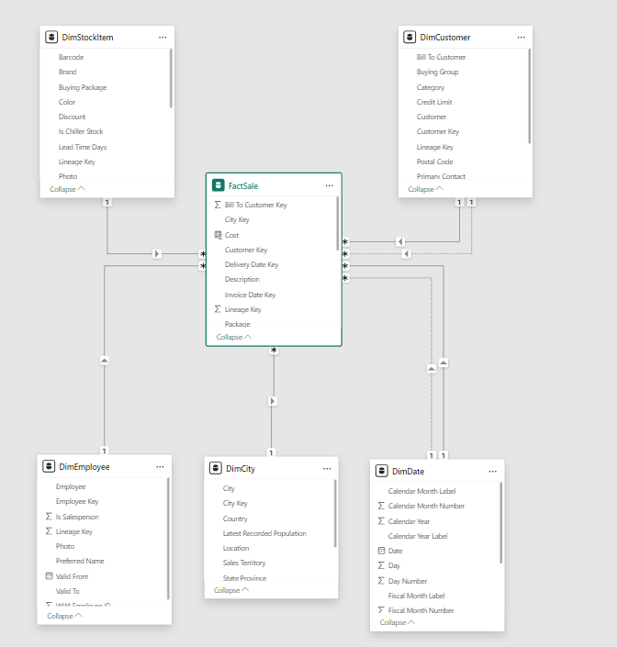
Dimensional Model

Slide 9
Dimensional Model
The methodology used to implement the dashboards in Power BI:
▶ Three dashboards were created: Sales, Profit, and Detail.
▶ Each dashboard contains interactive visualizations and filters.
▶ Sales Dashboard: Column charts, line charts, tables, and slicers.
▶ Profit Dashboard: Line charts, column charts, and tables.
▶ Detail Dashboard: Bar charts, pie charts, and tables.

Slide 10
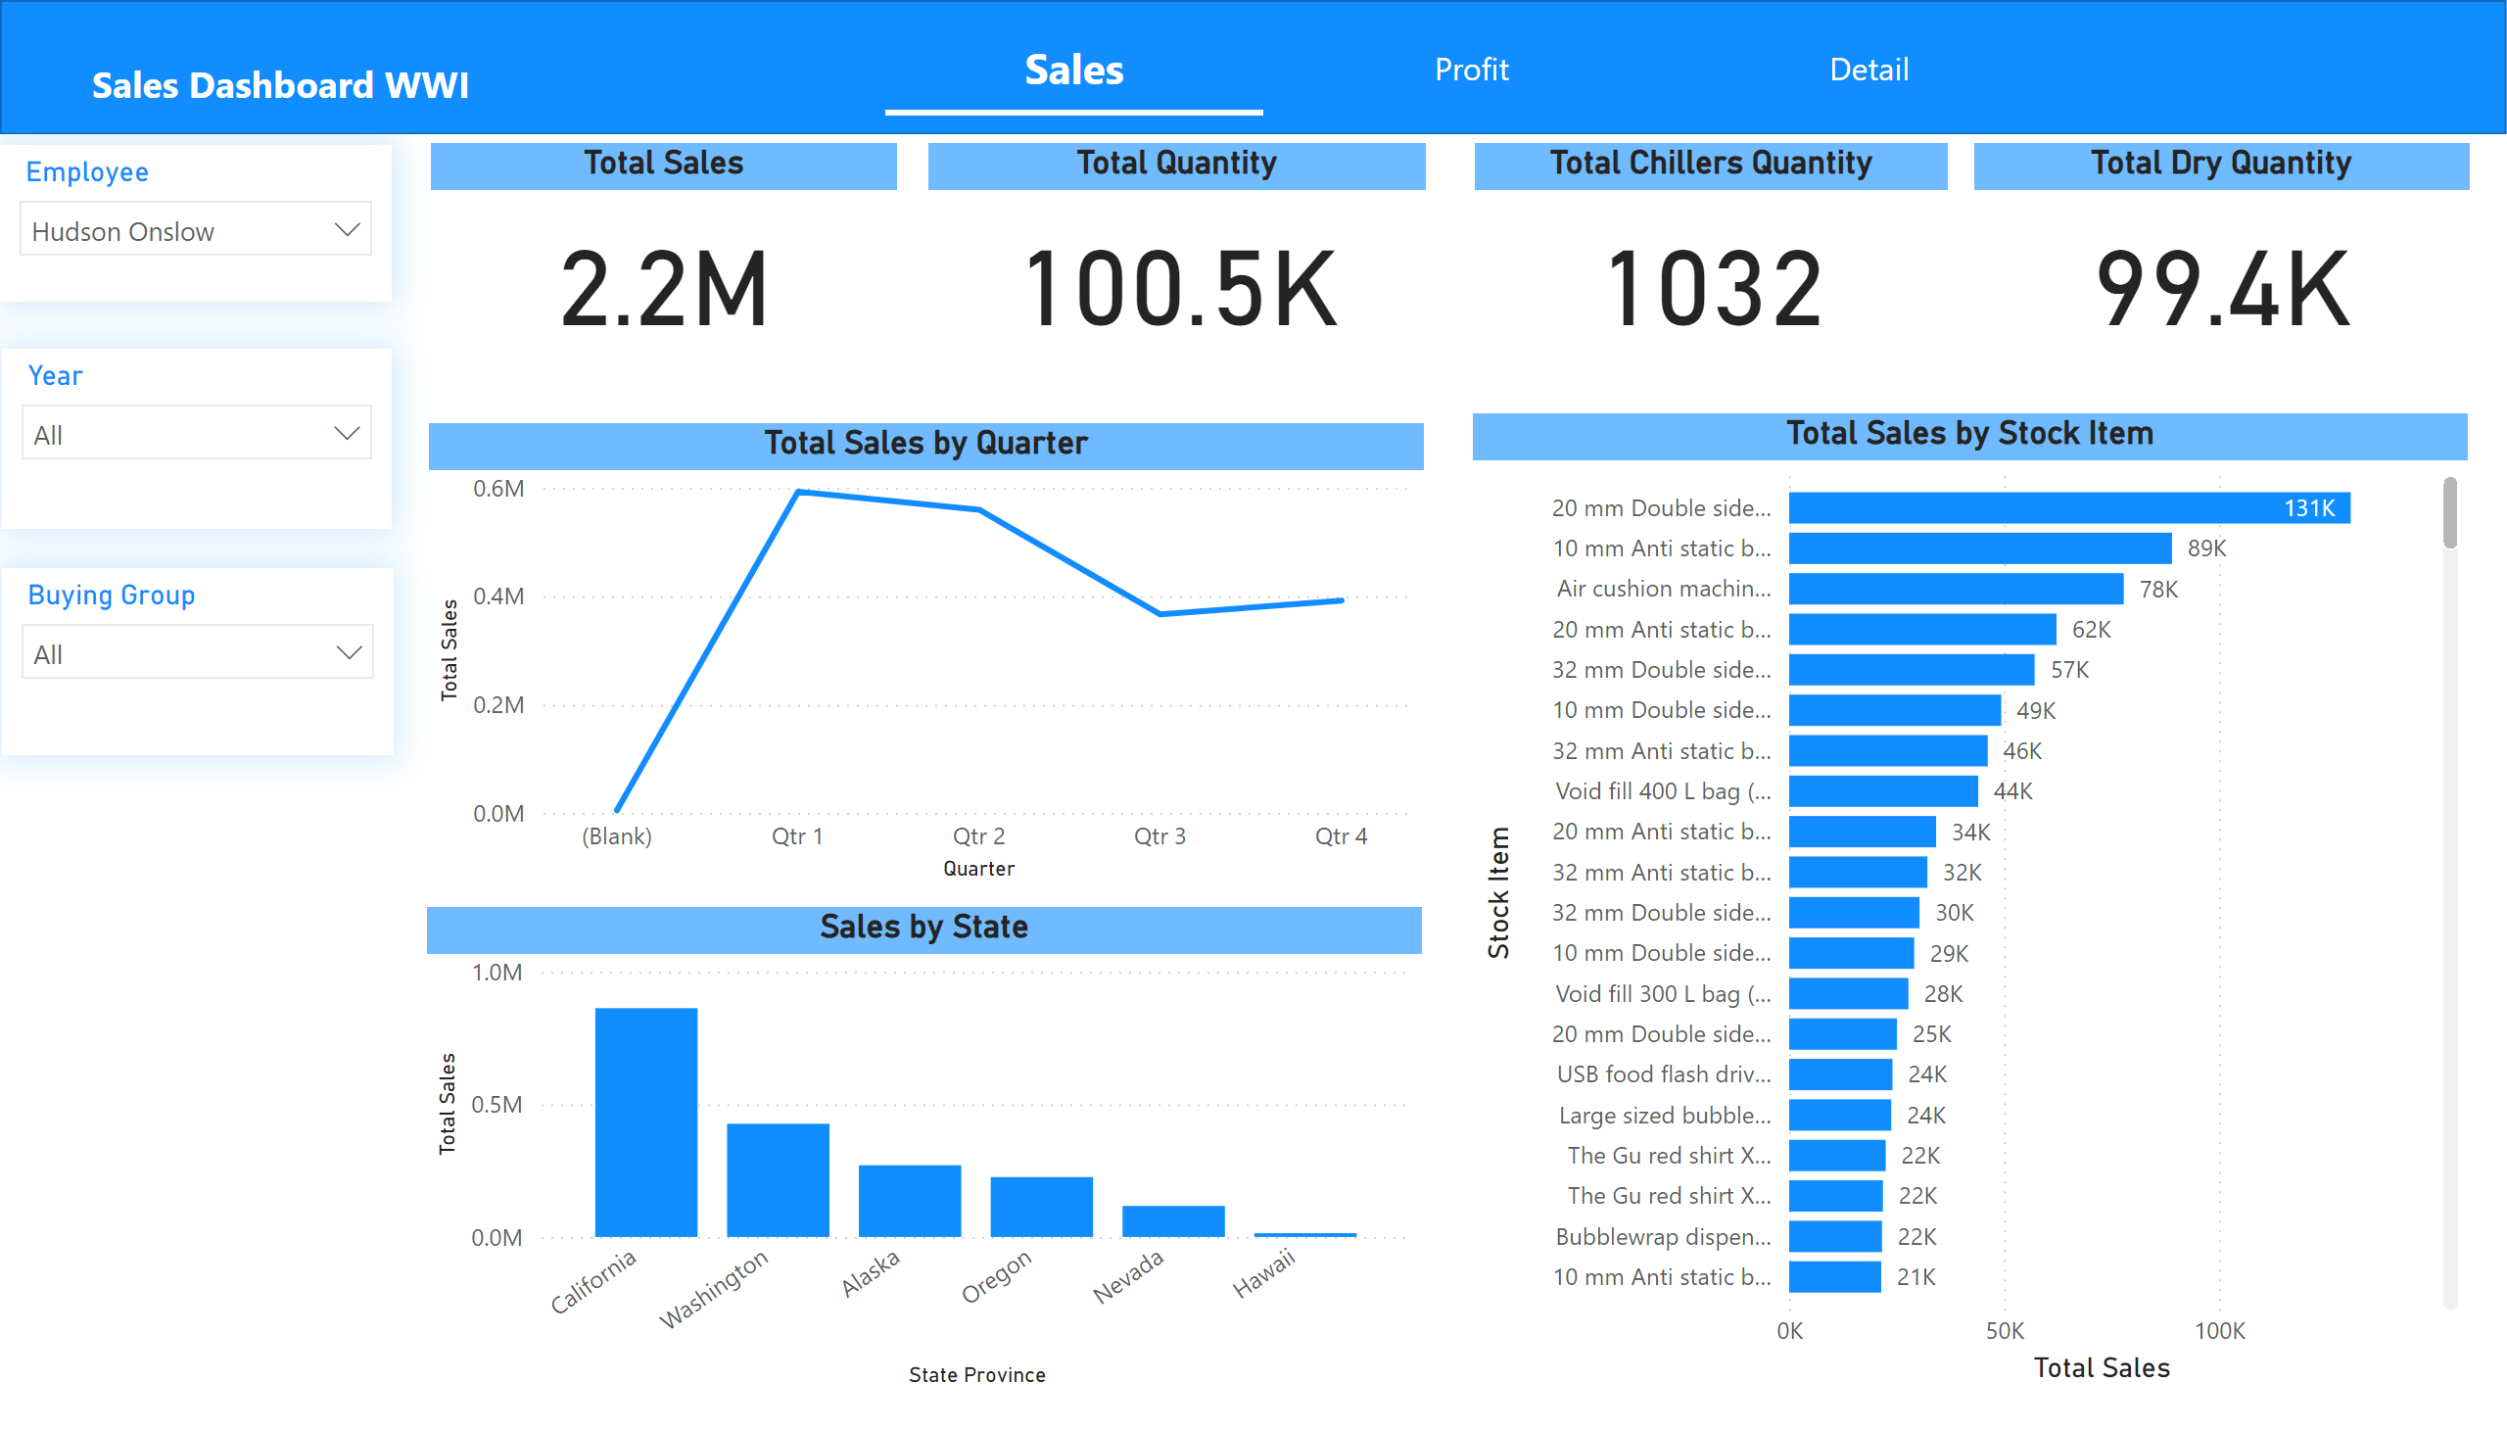
Sales
Notes:
lineChart
No alt text provided
barChart
No alt text provided
Sales by State
No alt text provided
slicer
No alt text provided
slicer
No alt text provided
slicer
No alt text provided
shape
No alt text provided
Total Sales
No alt text provided
Total Quantity
No alt text provided
Total Chillers Quantity
No alt text provided
Total Dry Quantity
No alt text provided
pageNavigator
No alt text provided
textbox
No alt text provided

Slide 11
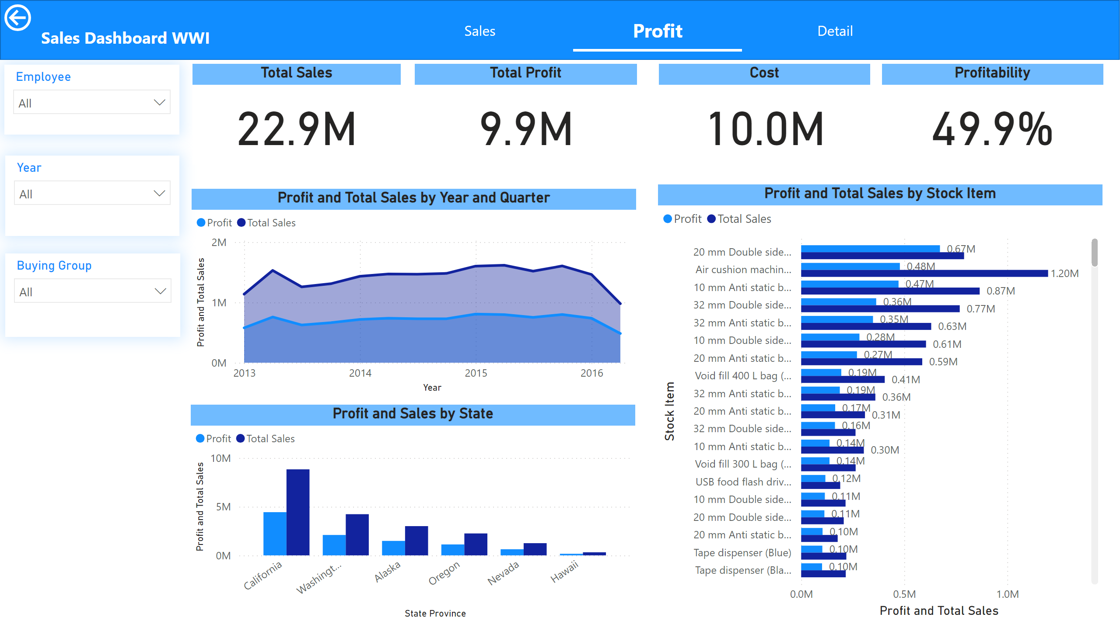
Profit
Notes:
areaChart
No alt text provided
clusteredBarChart
No alt text provided
Profit and Sales by State
No alt text provided
slicer
No alt text provided
slicer
No alt text provided
slicer
No alt text provided
shape
No alt text provided
Total Sales
No alt text provided
Total Profit
No alt text provided
Cost
No alt text provided
Profitability
No alt text provided
textbox
No alt text provided
pageNavigator
No alt text provided
actionButton
No alt text provided

Slide 12
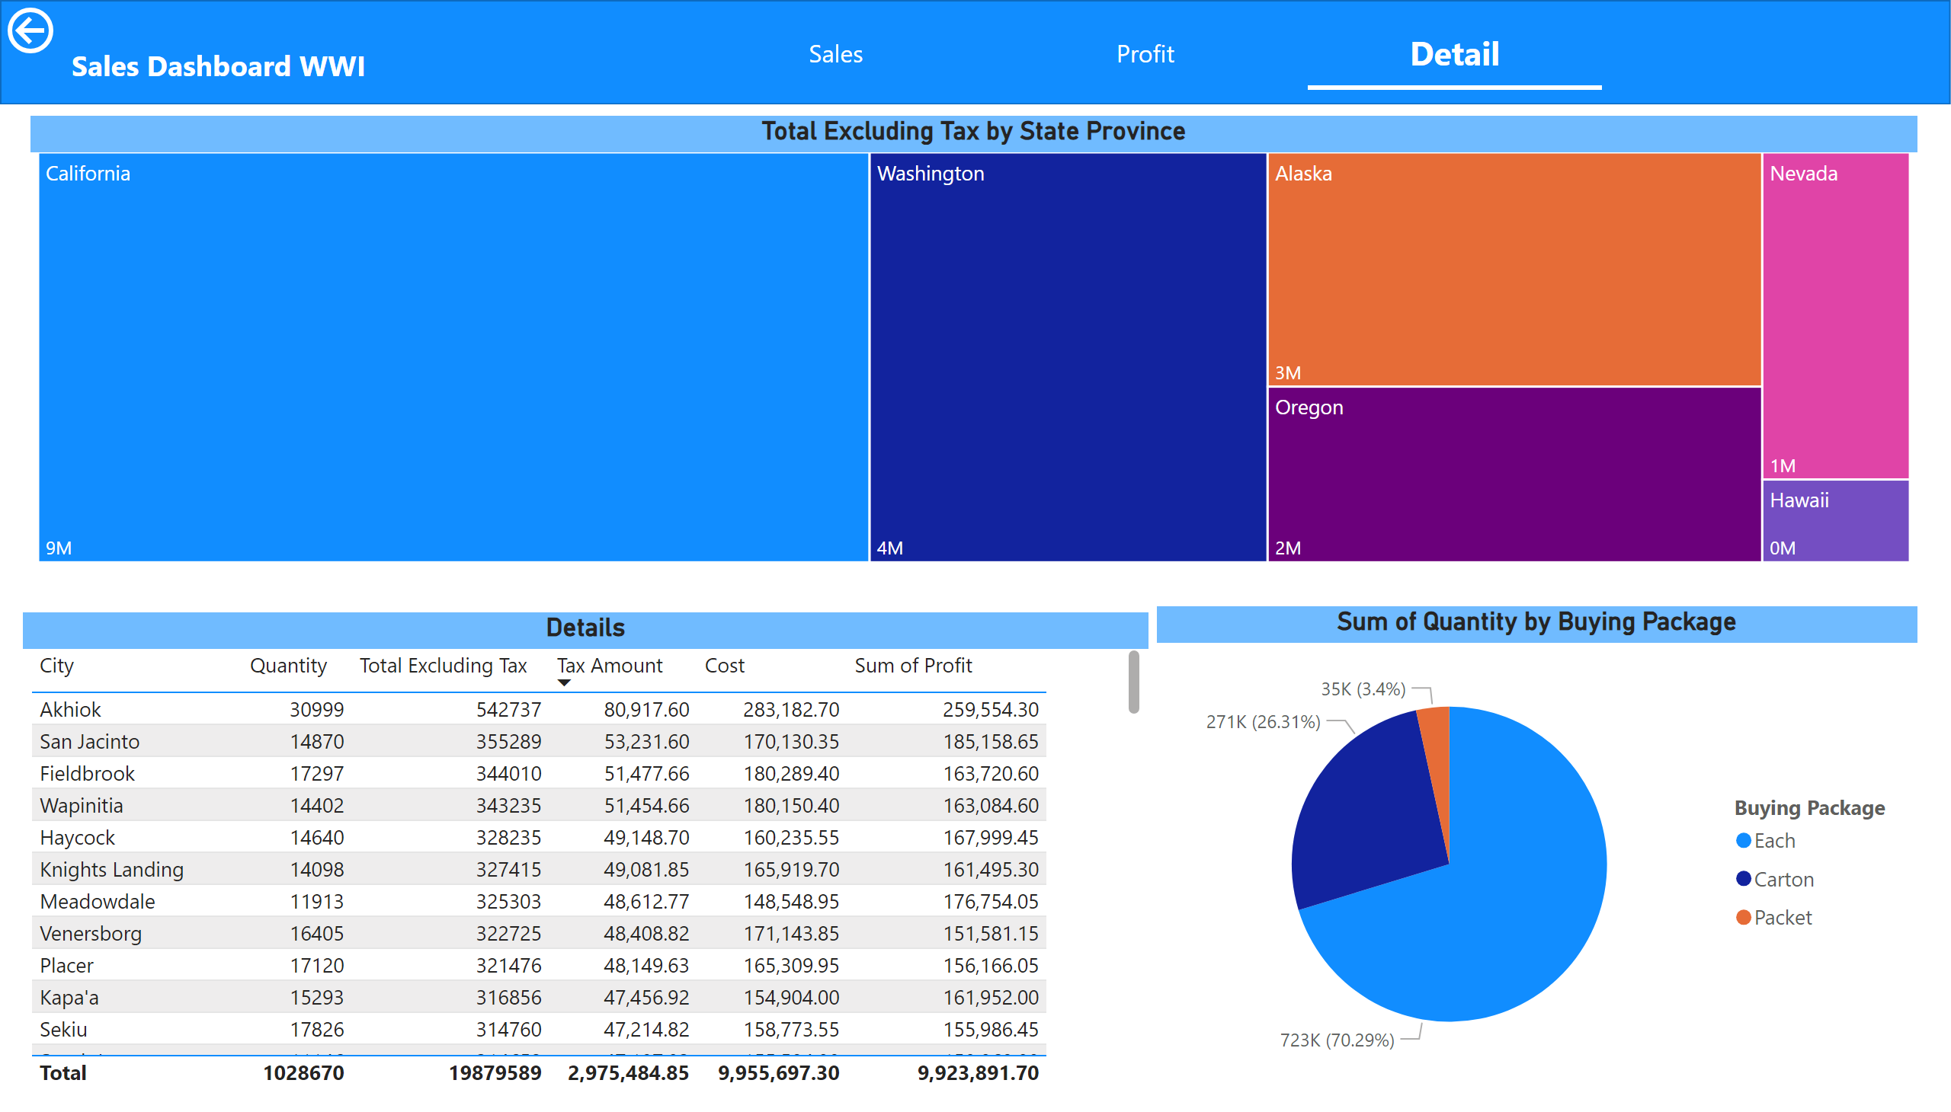
Detail
Notes:
shape
No alt text provided
actionButton
No alt text provided
textbox
No alt text provided
pageNavigator
No alt text provided
Total Excluding Tax by State Province
No alt text provided
pieChart
No alt text provided
Details
No alt text provided

Slide 13
Conclusion
This project demonstrates the power of BI to convert raw data into
actionable insights:
▶ The dashboards provide valuable insights into sales and profitability.
▶ The Star Schema enables efficient querying and analysis.
▶ The project fosters data-driven decision-making and enhances business performance.
Future work could involve integrating more data sources and
refining the model to tackle further business questions.

