Slide 1
Data science: Case study

Slide 2
Problem statement
Big data : The volume of this dataset is around 43GB. This is make it big data problem.
Chest X-Ray dataset has 112120 gray scale images with 1024 by 1024 image size.
Multiple class with multiple labels:
The dataset contains x-ray images that shows one or more Thorax Disease and the total number of diseases is 14.
This make the problem as multiple class and multiple labels problem.

Slide 3
Challenges
Big data : with 42 GB of images
Data types : images and text thus NLP is required to extract labels
Multiple class and multiple labels
Requirements powerful hardware : Hadoop
Project management tools
Confluence
JIRA
BITBUCKET

Slide 4
How Data are store
Data Description:
Stored in CSV file which contains information about each patients and what diseases he/she has. This shown here
xray_data_statistics+.html
Most important Columns :
Image index : unique name of each image
Finding Labels: List of all possible disease in each X-ray image
Where is the labels :
NLP is used to extract the labels from the finding labels.
Convert_images_final_jan29.html
Images are stored in sperate folder with unique names

Slide 5
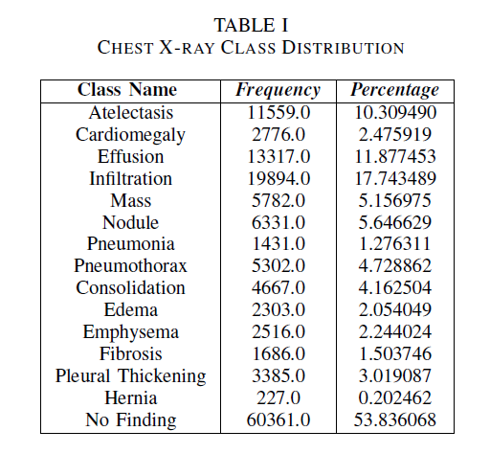
Dataset : Classes distribution
Imbalanced dataset

Slide 6
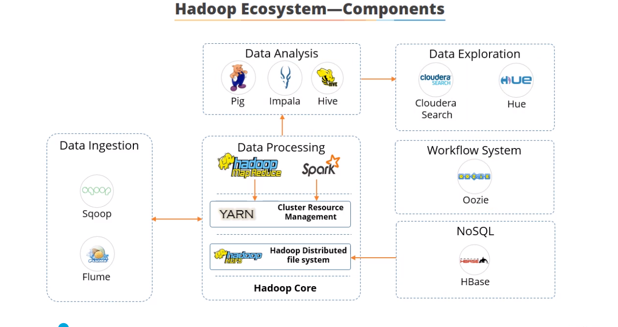
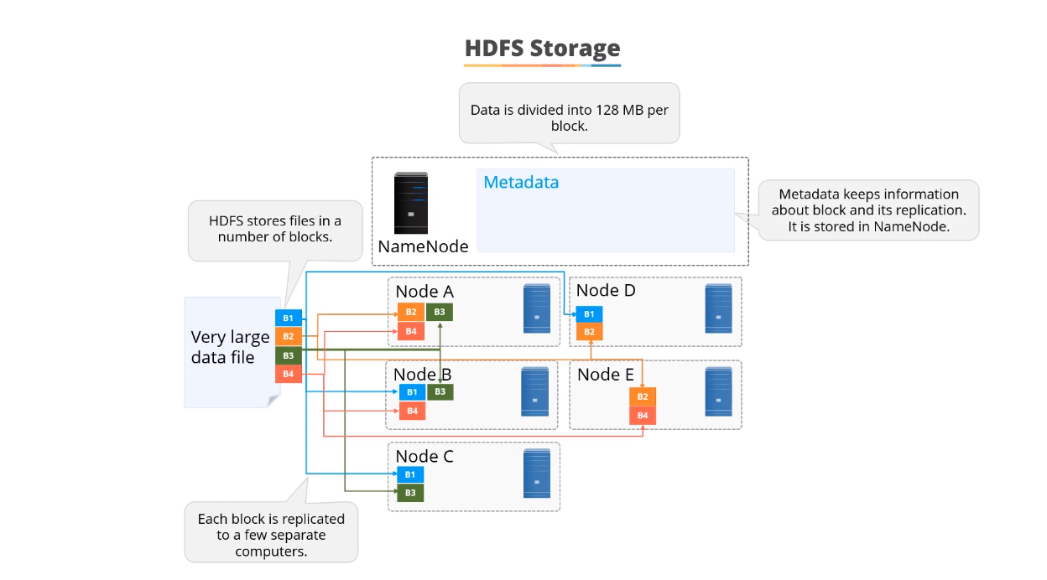
Requirements: Hardware infrastructure

Slide 7
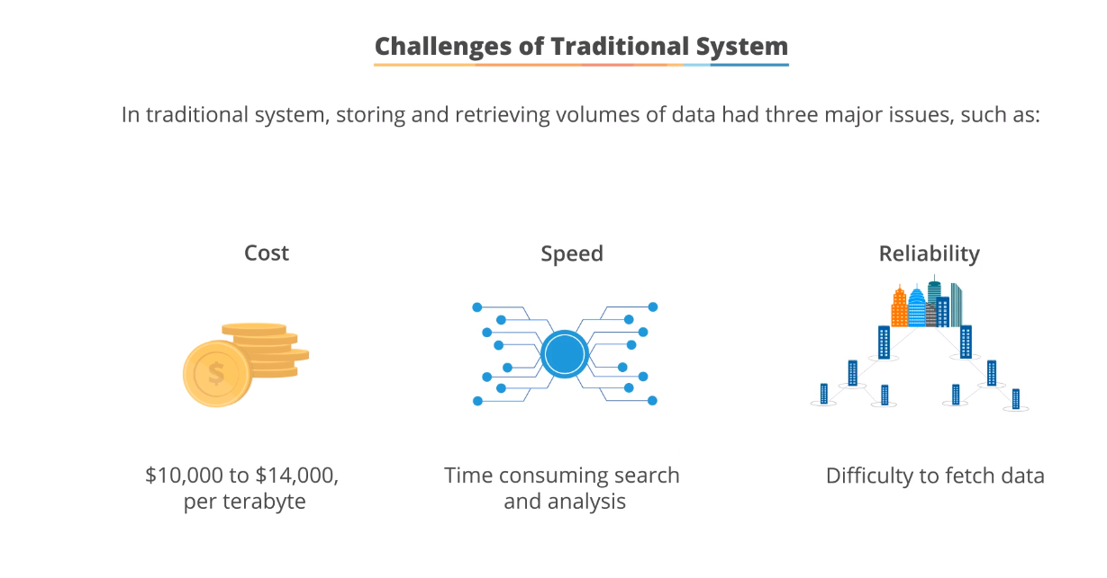
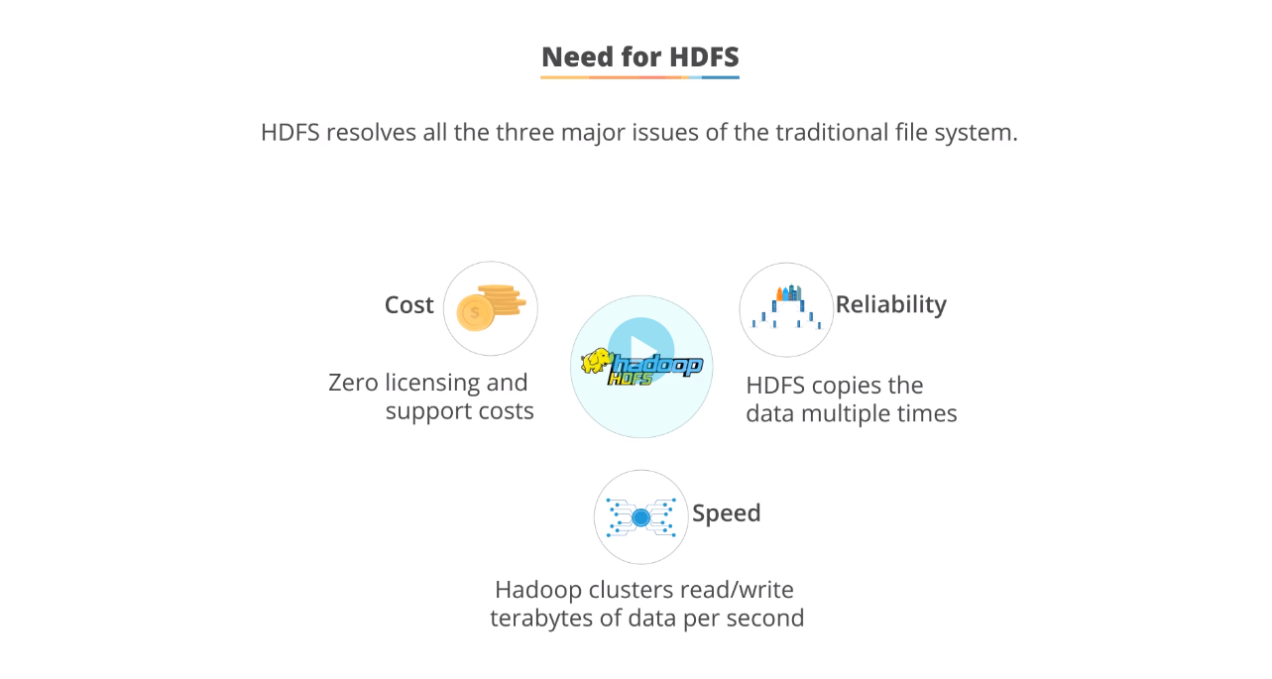
Requirements: Why Hadoop

Slide 8
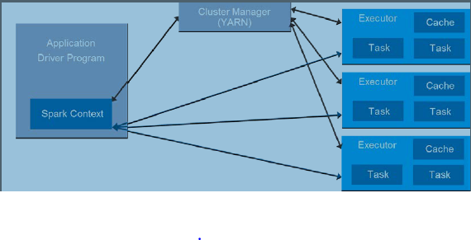
Parallel processing: Task distribution
Number of executors: 16
Number of cores : 46
Batch size : 1024 , 512 , 2048 ..etc

Slide 9
Deep learning using transfer learning
Transfer learning is utilized to predict the diseases in images using
Resent
Densenet
VGG16
Inception
The complete code is here :
HTML_code_Chest_ray.html

Slide 10
Deep learning: workflow
Number of layers : 227 layers
Last layer : sigmoid

Slide 11
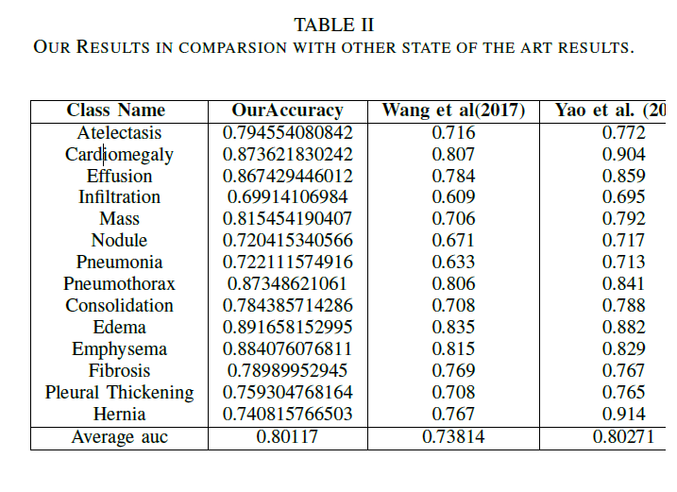
Our Results

