Slide 1
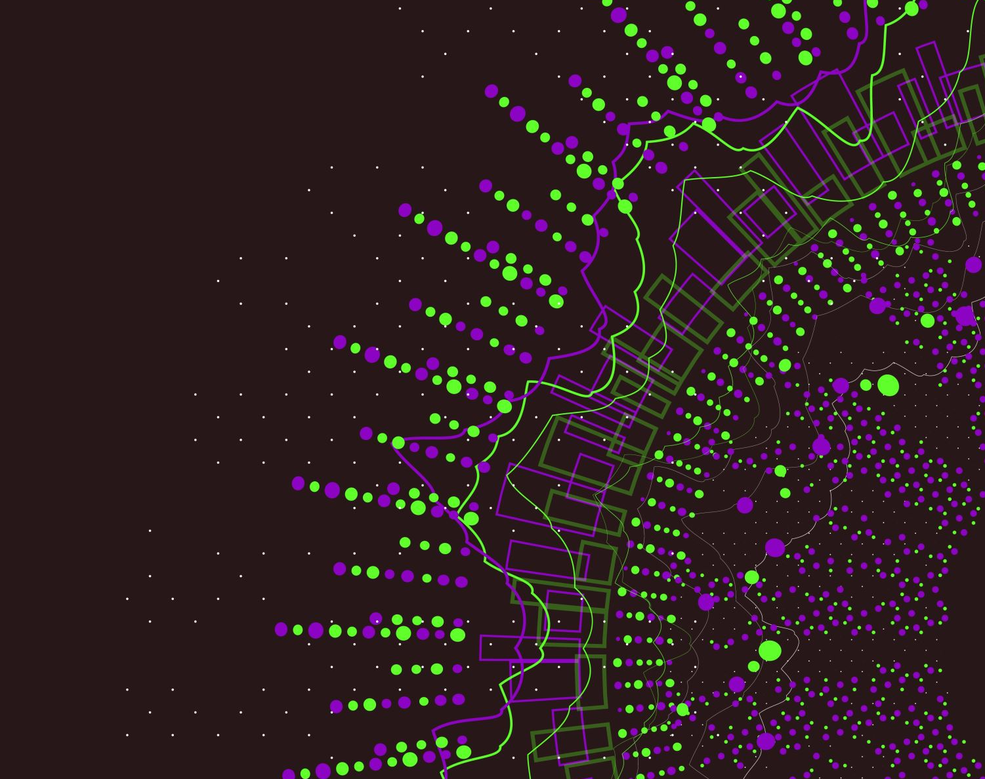
Sales Program
Owner: Mahmoud waheed

Slide 2
- 6 Phases of the Software Development Life Cycle
ANALYSIS
DESIGNE
DEVELOPMENT
TESTING
DEPLOYMENT
MAINTENANCE
Product Agent
Project Manager
Business Analyst
System Architect
UX/UI designer
Front-end Developer
Back-end Developer
Solutions Architect
QA Engineer
Tester
Data Administrative
Users Architect
Testers
Support Managers

Slide 3
1-Phase: ANALYSIS
Problem Definition
There are manual operations in the Botany department
Students need to borrow slides
Doctors need some slides
The department head inquires about the slides !
Peoples && Problems
Students
Doctors
Admin

Slide 4
2-Phase: DSIGNE
2.1 System Architect :
Solution Description (Methods) :
DB
Admin
Login
User
Login
Input
Processing
Admin Process
Result

Slide 5


2-Phase: DSIGNE
2.1 System Architect :
UML Use Case Diagram :
Login
Create new user
Login
Manage User
Delete user
Select
User Info
Update existing user
Request
Export To
Reports
Forms
Search
PDF
Excel

Slide 6
2-Phase: DSIGNE
Tools :
MySQL Workbench -V 8.0 CE
Android Studio -V 2021.2.1
Figma website Online
Online Color picker Online
Logo Designer Online
Rive For animations Online
Trello Online
Technologies:
Dart --Version 2.18.5
Flutter --Version 3.3.9
Firebase Authentication
Firebase Cloud Messaging
GitHup
MVVM
Provider

Slide 7
3-Phase: DEVELOPMENT
3.1 Back-end Developer :
ER Diagram
Relational Model
Connection with firebase
Tables Models on Firebase
MVVM
Sign up Authentication
Login Authentication
Notifications

Slide 8
1-The ER Diagram Conceptual Design
ID
Image
Ceils
ArabicName
EnDate
Notes
Course
Supervisor
StDate
ReDate
EngName
Count
SlideNo
Position
Slide
BoxNo
N
Receipt
M
CupBord
FNum
Name
Password
d
Level
State
UserId
Phone
Specimen
SpecialGroup
Others
Person
Email
Type
SectionType
LatineName
Family

Slide 9
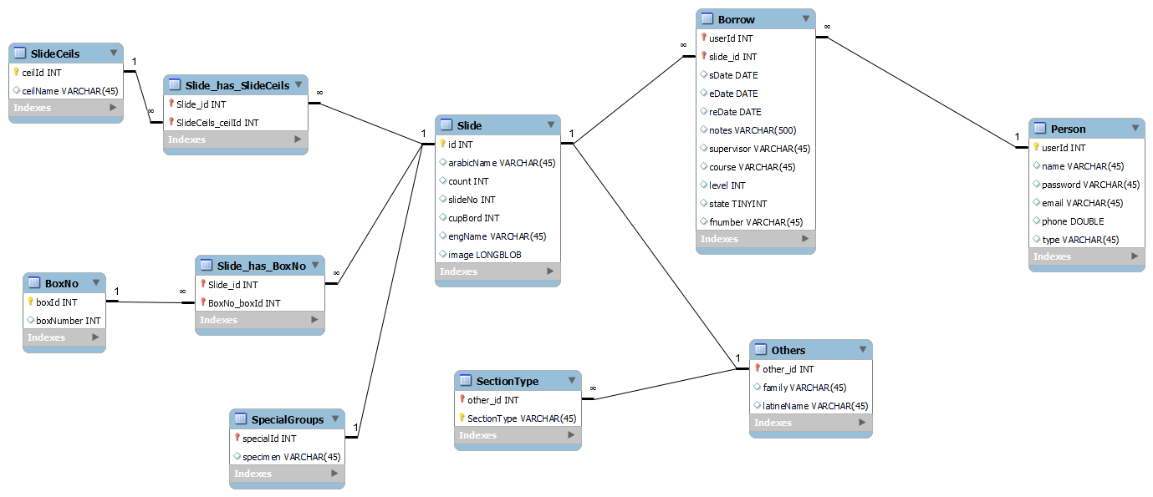
3-Phase: DEVELOPMENT
3.1 Back-end Developer :
Relational Model :

Slide 10
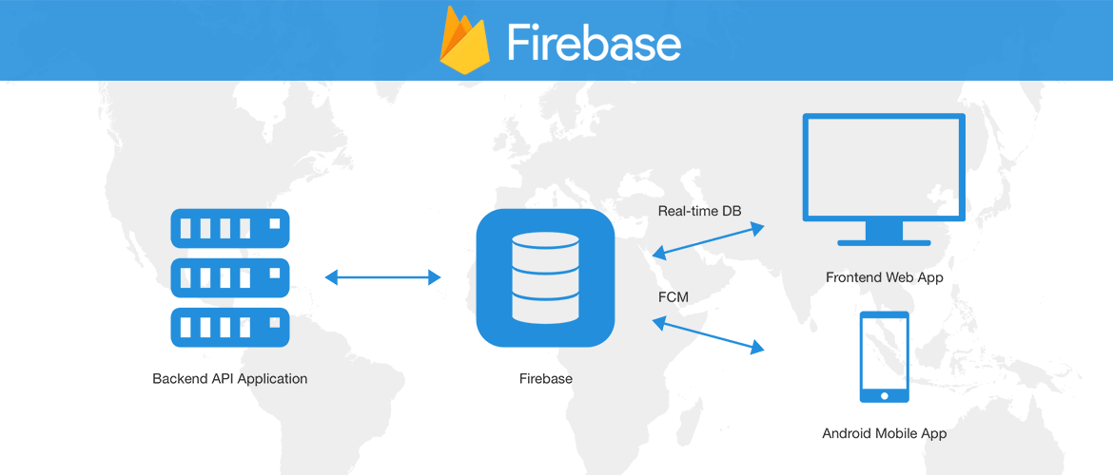
3-Phase: DEVELOPMENT
3.1 Back-end Developer :
Connection With firebase:

Slide 11
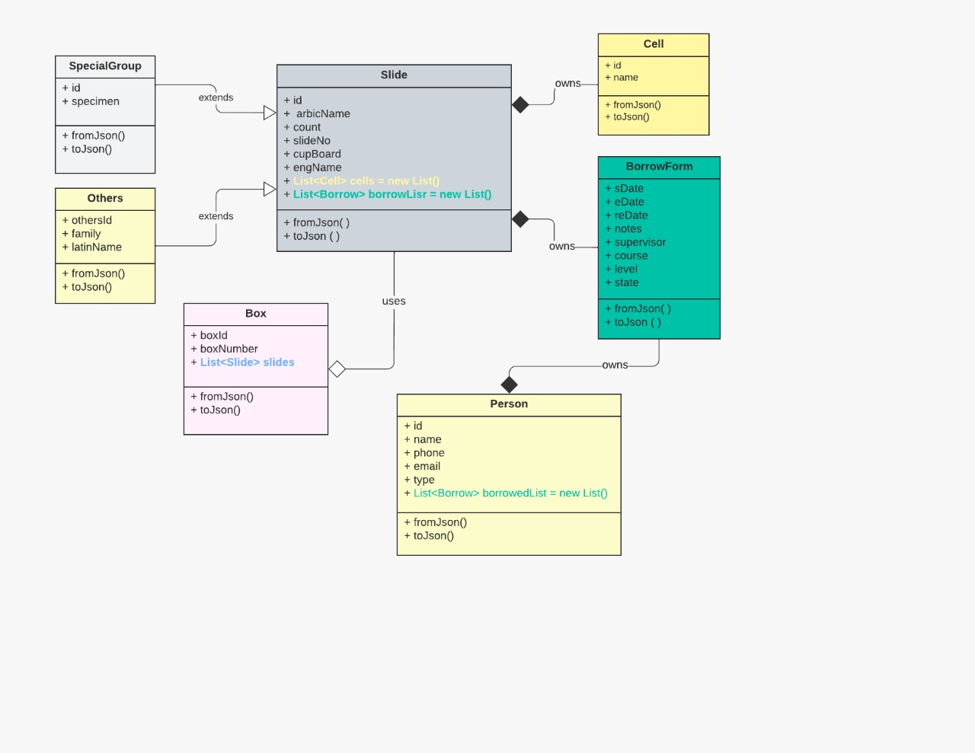
3-Phase: DEVELOPMENT
3.1 Back-end Developer :
UML Model For Tables :

Slide 12
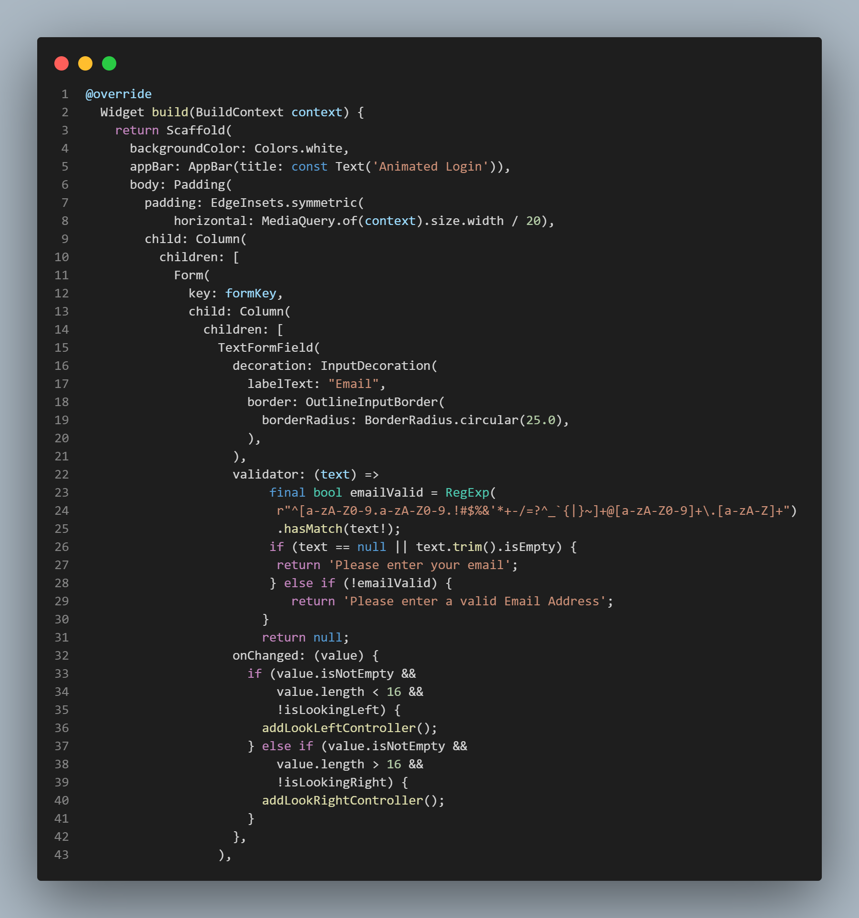
3-Phase: DEVELOPMENT
3.1 Back-end Developer :
MVVM :

Slide 13
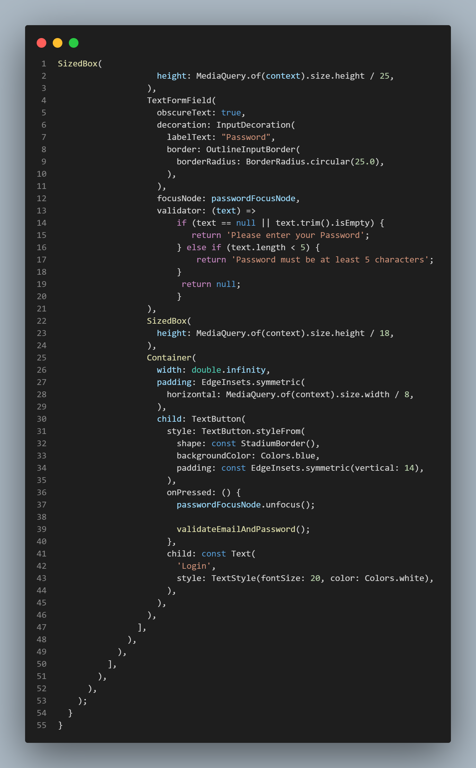
3-Phase: DEVELOPMENT
3.1 Back-end Developer :
MVVM :

Slide 14
3-Phase: DEVELOPMENT
3.1 Back-end Developer :
MVVM :
Values
Get
View
View Model
Model
Events
Save
UI
Business Logic
Data

Slide 15
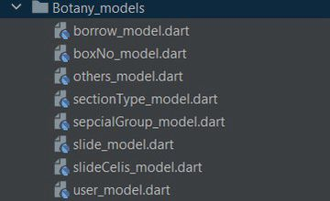
3-Phase: DEVELOPMENT
3.1 Back-end Developer :
Tables Models on Firebase :

Slide 16


3-Phase: DEVELOPMENT
3.1 Back-end Developer :
Login Authentication :
on validation failed bear.addFailController()
Login
click
Void login()
Validation Succeeded
viewModel.signInWithEmailAndPassword(email, password)
On Succeeded
Tray to authenticate user from firebase
DB
on FirebaseAuthException catch error
Print Error Message !

Slide 17
3-Phase: DEVELOPMENT
3.1 Back-end Developer :
Sign up Authentication :
on validation failed bear.addFailController()
Login
click
Void login()
Validation Succeeded
viewModel.createUser(email, password)
On Succeeded
Tray to authenticate user from firebase
DB
on FirebaseAuthException catch error
Print Error Message !

Slide 18


