Slide 1
Traffic Sign Classification using CNN
Team ID: 61

Slide 2
Model Architecture
1) In the convolutional layer, number of filters is specified. It performs the convolution operation on the original image and
generates a feature map.
2) The ReLU performs the maximum function to convert the negative values to zero without changing the positive ones and
generate a rectified feature map. The Pooling layer takes the rectified feature map and performs a down-sampling operation
(like Max Pooling or average pooling) and thus reduces the dimensionality of the image.
3) The flattening layer is used to convert the input feature map to a 1-dimensional array.
4) The dropout layer is used to avoid overfitting by setting some of the input neurons to 0 during the training process. The dense
layer, on the other hand, feeds all the outputs from the preceding layer to all its neurons and perform the matrix- vector
multiplication (the row vector of the output from the preceding layer should be equal to the column vector of the dense layer),
to generate a m-dimensional vector.
Convolution layer
Convolution layer
Pooling layer
Dropout layer
Flattening layer
Dense layer
Dropout layer
Dense layer

Slide 3
Dataset Details
We found Traffic Sign Dataset - Classification dataset on kaggle.com: https://www.kaggle.com/datasets/ahemateja19bec1025/traffic-sign-dataset-classification?select=traffic_Data
The dataset has folder DATA which contains 58 folder labeled from 0 to 57, each represents a type of traffic signs but the last 3 folders are unknown.
The type of images is RGB and doesn’t have different sizes.
The dataset has folder TEST which contains random images.
We made some changes on this dataset : - we removed last 3 classes because they were unknown - we added random images from the internet for each type in the folder DATA - we added images that was in the TEST folder to suitable folder in the DATA folders, that make us able to split the data the way shown in the paper(65% train, 25% validation, 10% test).

Slide 4
Implementation Details
Preprocessing dataset: - Resizing images to size 32*32 - Apply grayscale to images - Apply histogram equalization - Normalization
Split the dataset (65% train, 25% validation, 10% test).
Building CNN model.
Compiling the model.
Training the model.
Get some visualizations and results.

Slide 5
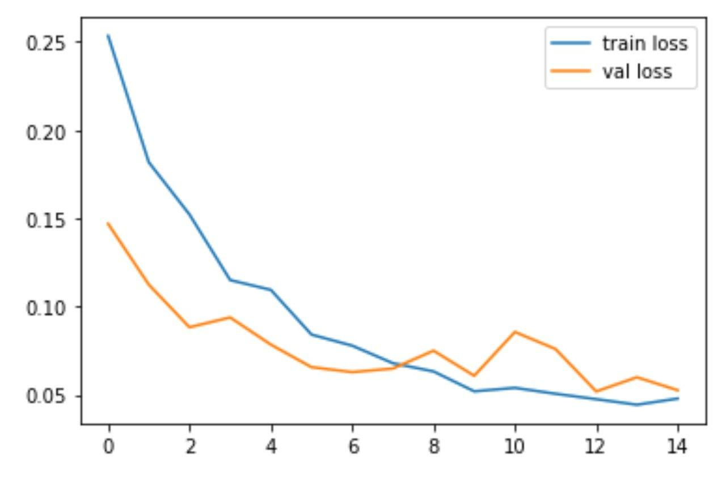
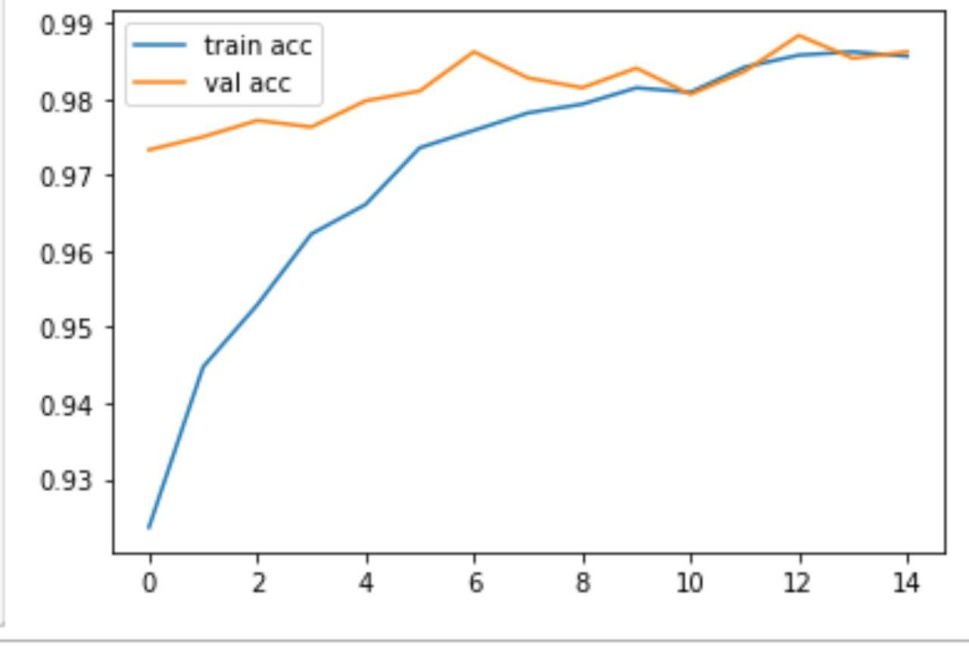
Results and Visualization
Training Loss: 0.04779958352446556
Validation Loss: 0.05254281312227249
Training accuracy: 0.9856507182121277
Validation accuracy: 0.9862306118011475
array([[32, 0, 0, ..., 0, 0, 0], [ 0, 11, 0, ..., 0, 0, 0], [ 0, 0, 36, ..., 0, 0, 0], ..., [ 0, 0, 0, ..., 27, 0, 0], [ 0, 0, 0, ..., 0, 43, 0], [ 0, 0, 0, ..., 0, 0, 6]], dtype=int64)

