Slide 1
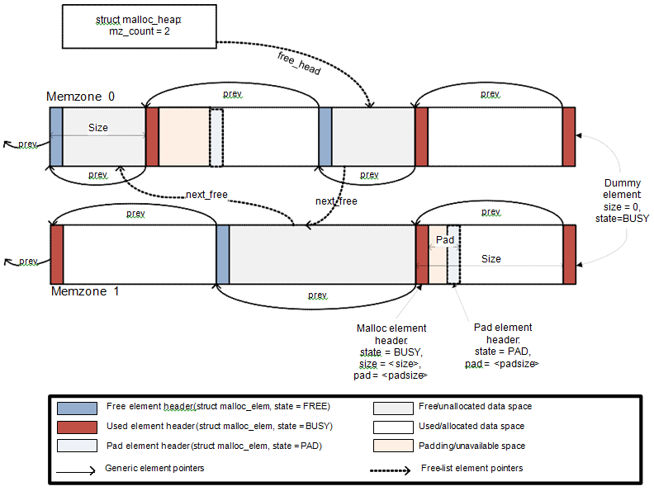
Heap Memory Management
Advanced System Programming under Linux Training @STMicroelectronic.
Instructor: Eng. Reda Maher.

Slide 2

TABLE OF CONTENTS
01
Phase 1 – VM Page De(allocation)
05
Phase 5 – VM Page Management
02
Phase 2 – Page Family Registration
06
Phase 6 – Free Data Block Management
03
Phase 3 – Meta and Data Blocks
07
Phase 7 – Final Push – Implement Xmalloc & Xfree
04
Phase 4 – Block Splitting and Merging
08
Phase 8 – Implementing Xfree

Slide 3
01
Phase 1 – VM Page De(allocation)

Slide 4

Phase 1 - VM Page De(allocation)
Size of the virtual memory page is constant on the system (8192 Byte on most systems)
We usually use malloc/calloc to allocate dynamic memory in our programs
To start with, we need to learn how we can request underlying Linux OS the complete VM Page
Our LMM
(a user space process)
Request a VM Page
Pointer to the VM Page
Linux Kernel
continue your work

Slide 5
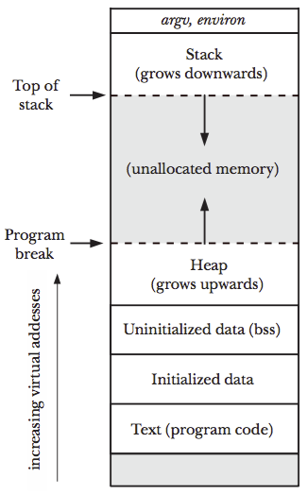
In UNIX like OS, there are two primary systems calls used to allocate/deallocate virtual memory blocks from the OS by a running process are
malloc/free
(glibC library functions)
syscall: sbrk/brk
mmap/munmap (glibC fn)
syscall: mmap_pgoff()
Standard glibC memory management functions malloc, free, realloc, calloc, etc. invokes systems calls
In this project, we shall go to make use of “mmap/munmap” functions for memory allocation for a process from kernel instead of sbrk

Slide 6
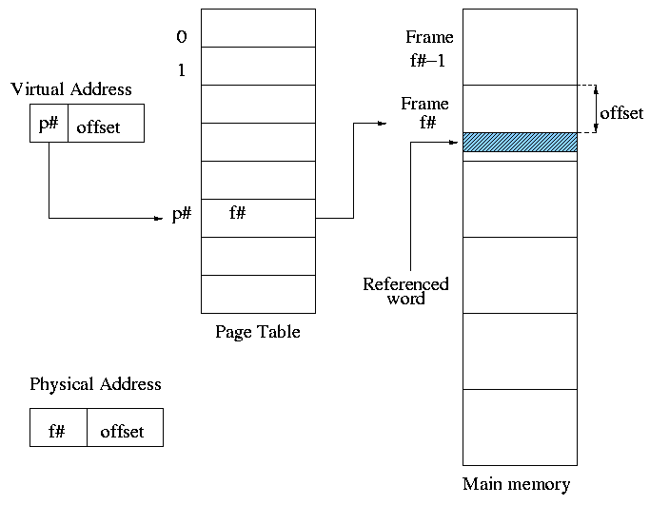
Let discuss how mmap/munmap functions/syscalls can be used by user space process to request and release virtual memory page to and from the kernel, and then we will discuss the implementation

Slide 7

Kernel space
User space
Heap
addr1 = mmap();
syscall
mmap/munmap
LMM
Once our LMM is assigned the VM complete page from kernel, LMM will future split VM page to meet the application hunger for memory.
VM Page 1

Slide 8

Kernel space
User space
Heap
addr1 = mmap();
VM Page 1
VM Page 2
syscall
mmap/munmap
addr2 = mmap();
LMM
Once our LMM is assigned the VM complete page from kernel, LMM will future split VM page to meet the application hunger for memory.
VM page allocated are need not be contiguous in heap memory segment of the process as opposed to “sbrk” behavior.
VM Page 1

Slide 9


Kernel space
User space
Heap
addr1 = mmap();
VM Page 1
VM Page 2
syscall
mmap/munmap
addr2 = mmap();
VM Page 2
LMM
Once our LMM is assigned the VM complete page from kernel, LMM will future split VM page to meet the application hunger for memory.
VM page allocated are need not be contiguous in heap memory segment of the process as opposed to “sbrk” behavior.
VM Page 1
Heap memory segment is just a data structure maintained by kernel for every process, which keeps track of virtual memory page being used by the process (LMM).
Our LMM always request and release memory from kernel in virtual memory PAGE_SIZE granularity.

Slide 10
API for VM Page (De)allocation from kernel
Requesting “units” number of contiguous pages from kernel
Static void *mm_get_new_vm_page_from_kernel(int units);
Brief: Allocate a new virtual memory page from the kernel.
Returning: Pointer to the allocated memory page, or NULL if allocation fails.
VM Page 3
VM Page 2
VM Page 1
Returned address
Requesting “units” number of contiguous pages to kernel
Static void mm_return_vm_page_to_kernel(void *vm_page, int units);
Brief: Return a virtual memory page to the kernel.

Slide 11
Component Interaction
malloc (x Bytes)
glibC library
malloc/free
User space process/Application
Memory allocation/deallocation between process and glibC can happen of any size.
Memory allocation and deallocation between glibC and kernel MMU happen only in unit of page size
Sbrk/mmap
1 VM Page
Kernel MMU
(Virtual address space of a user space process)

Slide 12
Component Interaction
malloc (x Bytes)
glibC library
malloc/free
User space process/Application
Memory allocation/deallocation between process and glibC can happen of any size.
1 VM Page
0x00000000
x Bytes
Memory allocation and deallocation between glibC and kernel MMU happen only in unit of page size
Sbrk/mmap
System calls (sbrk/mmap) are expensive calls
glibC caches the VM page allocation by kernel MMU and allocates small chunks from it to a process
Kernel MMU
(Virtual address space of a user space process)
When glibC detects that process freed all memory in each VM page, glibC return the page to the kernel MMU (sbrk/munmap)
In this project we shall replace glibC MMU with our own Heap memory manager

Slide 13
Component Interaction
Xmalloc (x Bytes)
Our own Memory Manager
User space process/Application
Memory allocation/deallocation between process and glibC can happen of any size.
1 VM Page
0x00000000
x Bytes
Memory allocation and deallocation between glibC and kernel MMU happen only in unit of page size
Sbrk/mmap
System calls (sbrk/mmap) are expensive calls
glibC caches the VM page allocation by kernel MMU and allocates small chunks from it to a process
Kernel MMU
(Virtual address space of a user space process)
When glibC detects that process freed all memory in each VM page, glibC return the page to the kernel MMU (sbrk/munmap)
In this project we shall replace glibC MMU with our own Heap memory manager

Slide 14
TABLE OF CONTENTS
01
Phase 1 – VM Page De(allocation)
05
Phase 5 – VM Page Management
02
Phase 2 – Page Family Registration
06
Phase 6 – Free Data Block Management
03
Phase 3 – Meta and Data Blocks
07
Phase 7 – Final Push – Implement Xmalloc & Xfree
04
Phase 4 – Block Splitting and Merging
08
Phase 8 – Implementing Xfree

Slide 15
02
Phase 2 – Page Family Registration

Slide 16
Phase 2 – Page Family Registration
Page Family Registration mean, the user space application relying on LMM, during initialization, tell LMM the details of the structure’s application is using .
Application may be using 100s of structures.
This is essential since LMM need to know how much bytes to be allocated to application if application issues request for memory allocation for a structure.
LMM need to store application’s structure information: Name of structure and its size.
LMM uses VM Pages as requested from kernel to store registration information.
Our own Memory Manager
person_t, 60B
User space process/Application
occcupation_t, 120B
student_t, 75B

Slide 17
exam_t size = 56
agent_t
size = 120
Our own Memory Manager
person_t, 60B
User space process/Application
student_t
size = 75
occcupation_t, 120B
occcupation_t
size = 120
student_t, 75B
person_t
size = 60
vm_page_family_t
next
next
NULL
vm_page_for_families_t
LMM request VM pages(s) from kernel to store registration information.
The information: structure name and structure size is called a page family (vm_page_family_t).
The VM page stores the page families, starting from bottom to top, in a contiguous manner.
VM page used to store page families are called (vm_page_for_families_t).
If LMM needs more VM pages to store more Application’s pages families, LMM request more VM page.
Multiple VM pages for families are linked through linked list, most recent one – The head.

Slide 18
exam_t size = 56
agent_t
size = 120
Our own Memory Manager
person_t, 60B
User space process/Application
student_t
size = 75
occcupation_t, 120B
occcupation_t
size = 120
student_t, 75B
person_t
size = 60
vm_page_family_t
next
next
NULL
vm_page_for_families_t
LMM request VM pages(s) from kernel to store registration information.
The information: structure name and structure size is called a page family (vm_page_family_t).
The VM page stores the page families, starting from bottom to top, in a contiguous manner.
VM page used to store page families are called (vm_page_for_families_t).
If LMM needs more VM pages to store more Application’s pages families, LMM request more VM page.
Multiple VM pages for families are linked through linked list, most recent one – The head.

Slide 19
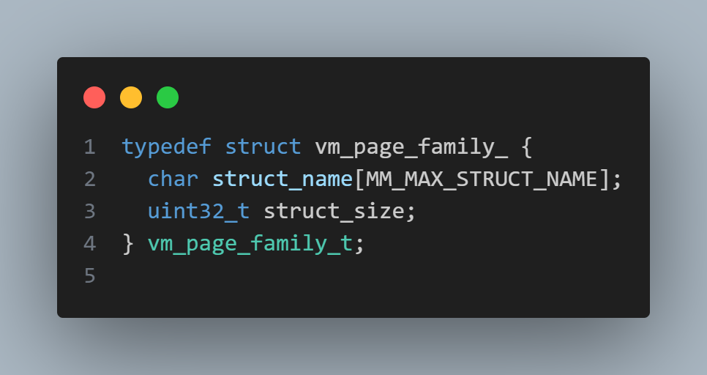
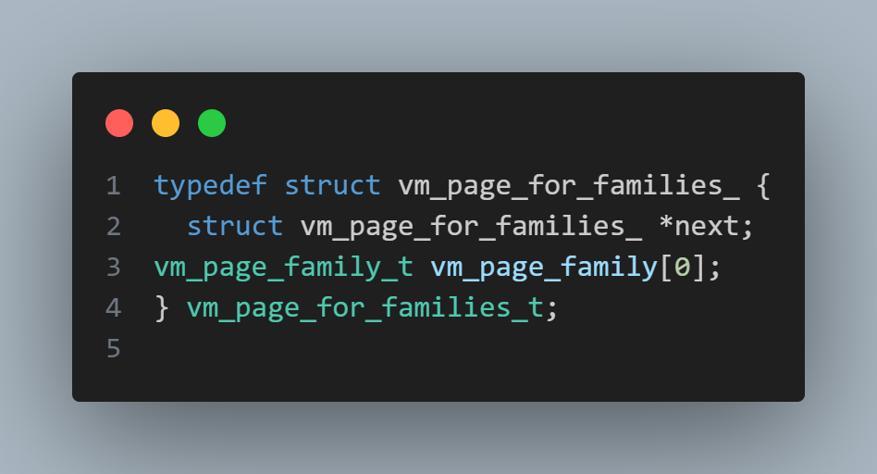
exam_t size = 56
agent_t
size = 120
Our own Memory Manager
person_t, 60B
User space process/Application
student_t
size = 75
occcupation_t, 120B
occcupation_t
size = 120
student_t, 75B
person_t
size = 60
vm_page_family_t
next
next
NULL
vm_page_for_families_t

Slide 20
Our own Memory Manager
person_t, 60B
User space process/Application
occcupation_t, 120B
student_t, 75B
vm_page_family_t
next
NULL
How Application Process going to report its page family information to LMM?
LMM provide an API using which User Application can perform page family registration with LMM
Void mm_instantiate_new_page_family (char *struct_name, uint32_t struct_size);

Slide 21
Our own Memory Manager
person_t, 60B
User space process/Application
occcupation_t, 120B
student_t, 75B
vm_page_family_t
next
NULL
How Application Process going to report its page family information to LMM?
LMM provide an API using which User Application can perform page family registration with LMM
Void mm_instantiate_new_page_family (char *struct_name, uint32_t struct_size);

Slide 22
Our own Memory Manager
person_t, 60B
User space process/Application
student_t
size = 75
occcupation_t, 120B
occcupation_t
size = 120
student_t, 75B
person_t
size = 60
vm_page_family_t
next
NULL
mm_instantiate_new_page_family (“person_t,” sizeof(person_t))
mm_instantiate_new_page_family (“occcupation_t”, sizeof(occcupation_t))
mm_instantiate_new_page_family (“student_t”, sizeof(student _t))

Slide 23
Algorithm
void mm_instantiate_new_page_family (char *struct_name, uint32_t struct_size) {
Create a new vm_page_family_t from arguments.
If LMM has not taken its first vm_page_for_families_t VM page, allocate one from kernel, update first_vm_page_for_families ptr.
Check if new vm_page_family_t can accommodate in first_vm_page_for_families VM page
Yes, then insert new vm_page_family_t entry into first_vm_page_for_families, end.
No, allocate a new VM page from kernel, update linked list and update first_vm_page_for_families to point to most recent allocated VM page.
Insert new vm_page_family_t into current first_vm_page_for_families VM page.
}
/**< New Global Variable */
static vm_page_for_families_t *first_vm_page_for_families = NULL

Slide 24
Writing a Looping Macros
Write a looping macro in mm.h file to iterate over all page families (vm_page_family_t) objects stored in a virtual memory page (vm_page_for_families_t) from bottom to top
Vm_page_family *curr = NULL;
#define ITERATE_PAGE_FAMILIES_BEGIN(vm_page_for_families_ptr, curr)
<provide definition>
#define define ITERATE_PAGE_FAMILIES_END(vm_page_for_families_ptr, curr)
<provide definition>
Macro must iterate over page families starting from bottom of VM page towards top.
Macro must set curr to current vm_page_family_t object present in VM page.
Macro must terminate when empty vm_page_family_t object is encountered (identified by struct_size = 0).
Maro must not overshoot VM page upper boundary.
size = 0
size = 0
student_t
size = 75
occcupation_t
size = 120
person_t
size = 60
next
vm_page_for_families_t

Slide 25

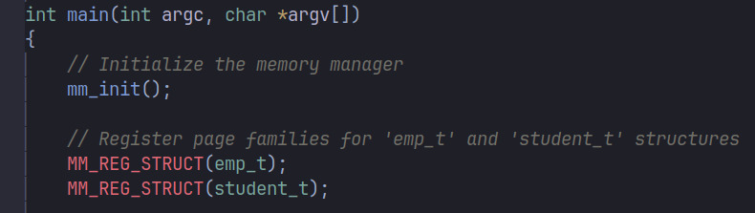
LMM Integration with Application
LMM
Create new file mm_api.h
mm.h
mm.c
Provide public exposed structures and APIs of LMM in this header file uapi_mm.h is an interface between LMM lib and application
#define MM_REG_STRUCT(struct_name) \
mm_instantiate_new_page_family(#struct_name, sizeof(struct_name))
mm_uapi.h
Used as: create file “test_app.c”
#include “mm_uapi.h”
Application
test_app.c

Slide 26
TABLE OF CONTENTS
01
Phase 1 – VM Page De(allocation)
05
Phase 5 – VM Page Management
02
Phase 2 – Page Family Registration
06
Phase 6 – Free Data Block Management
03
Phase 3 – Meta and Data Blocks
07
Phase 7 – Final Push – Implement Xmalloc & Xfree
04
Phase 4 – Block Splitting and Merging
08
Phase 8 – Implementing Xfree

Slide 27
03
Phase 3 – Meta and Data Blocks

Slide 28
Meta and Data Blocks
Data Block
Meta Data
VM Pages
VM Pages to store Page Families
(vm_page_for_families_t)
VM Pages for alloc/de-alloc memory to application Data VM Pages
(vm_page_t)
Data VM Page
Meta block is responsible to store meta information of its data block + Maintain chains of free and allocated blocks.
Data block is a chunk of VM page which is given to application for use.
Application don’t know anything about Meta blocks.
A block, whether allocated or freed, is guarded by its Meta block.

Slide 29
Meta Block Data Structure
Typedef struct block_meta_data_ {
vm_bool_t is_free ;
uint32_t block_size;
struct block_meta_data_ *prev_block;
struct block_meta_data_ *next_block;
} block_meta_data_t;
is_free = FALSE
block_size = 90
prev_block
next_block = NULL
MB3
uint32_t offset;
meta_data_size = sizeof(block_meta_data_t)
is_free = FALSE
block_size = 20
prev_block
next_block
MB2
Meta-block | Offset
MB1 | 0
MB2 | meta_data_size + MB1.block_size
MB3 | 2 * meta_data_size + MB1.block_size + MB2.block_size
is_free = FALSE
block_size = 50
prev_block = NULL
next_block
MB1

Slide 30
Macros to Manipulate Meta blocks
#define offset_of(container_structure, field_name)
Macro to calculate the offset of a field within a structure.
is_free = FALSE
block_size = 90
prev_block
next_block = NULL
#define MM_GET_PAGE_FROM_META_BLOCK(block_meta_data_ptr)
Macro to retrieve the virtual memory page from a block's metadata.
MB3
#define NEXT_META_BLOCK_BY_SIZE(block_meta_data_ptr)
Macro to retrieve the metadata of the next block based on the current block's size.
is_free = FALSE
block_size = 20
prev_block
next_block
MB2
#define NEXT_META_BLOCK(block_meta_data_ptr)
Macro to get the pointer to the next metadata block.
#define PREV_META_BLOCK(block_meta_data_ptr)
Macro to get the pointer to the previous metadata block.
is_free = FALSE
block_size = 50
prev_block = NULL
next_block
MB1

Slide 31
TABLE OF CONTENTS
01
Phase 1 – VM Page De(allocation)
05
Phase 5 – VM Page Management
02
Phase 2 – Page Family Registration
06
Phase 6 – Free Data Block Management
03
Phase 3 – Meta and Data Blocks
07
Phase 7 – Final Push – Implement Xmalloc & Xfree
04
Phase 4 – Block Splitting and Merging
08
Phase 8 – Implementing Xfree

Slide 32
04
Phase 4 – Block Splitting and Merging

Slide 33
When new VM Page is requested from kernel
4048 Byte
is_free = TRUE
block_size = 4048
prev_block = nil
next_block = nil

Slide 34
4048 Byte
3980 Byte
3900 Byte
is_free = TRUE
block_size = 3900
prev_block = MB2
next_block = nil
Xcalloc(5, sizeof(int))
Xcalloc(8, sizeof(int))
32 Byte
is_free = TRUE
block_size = 3980
prev_block = MB1
next_block = nil
is_free = FALSE
block_size = 32
prev_block = MB1
next_block = MB3
20 Byte
20 Byte
is_free = TRUE
block_size = 4048
prev_block = nil
next_block = nil
is_free = FALSE
block_size = 20
prev_block = nil
next_block = MB2
is_free = FALSE
block_size = 20
prev_block = nil
next_block = MB2
When new VM Page is requested from kernel

Slide 35
4048 Byte
3980 Byte
3900 Byte
For every calloc, a free block is splitted into allocated block and remaining area left is a smaller free block.
If VM page don’t have free block to satisfy calloc request, a new data VM page is requested from kernel, and same exercise is repeated.
is_free = TRUE
block_size = 3900
prev_block = MB2
next_block = nil
Xcalloc(5, sizeof(int))
Xcalloc(8, sizeof(int))
32 Byte
is_free = TRUE
block_size = 3980
prev_block = MB1
next_block = nil
is_free = FALSE
block_size = 32
prev_block = MB1
next_block = MB3
20 Byte
20 Byte
is_free = TRUE
block_size = 4048
prev_block = nil
next_block = nil
is_free = FALSE
block_size = 20
prev_block = nil
next_block = MB2
is_free = FALSE
block_size = 20
prev_block = nil
next_block = MB2
When new VM page is requested from kernel

Slide 36
3900 Byte
Whenever a free block is split into allocated and smaller free block, how many prev_block and next_block pointer needs to be adjusted? Let’s discuss all possible cases
is_free = TRUE
block_size = 3900
prev_block = MB2
next_block = nil
32 Byte
is_free = FALSE
block_size = 32
prev_block = MB1
next_block = MB3
20 Byte
is_free = FALSE
block_size = 20
prev_block = nil
next_block = MB2

Slide 37
Assumption
Size of Meta-Data is zero for simplification for example
Rest…
MB7
P = MB6, N = nil
MB6
20B
P = MB5, N = MB7
Xcalloc(5, sizeof(int))
MB5
20B
P = MB4, N = MB6
40B
MB4
P = MB3, N = MB5
60B
MB3
P = MB2, N = MB4
MB2
20B
P = MB1, N = MB3
MB1
20B
P = nil, N = MB2

Slide 38
Assumption
Size of Meta-Data is zero for simplification for example
Rest…
Rest…
MB7
P = MB6, N = nil
MB7
P = MB6, N = nil
MB6
20B
P = MB5, N = MB7
Xcalloc(5, sizeof(int))
MB6
20B
P = MB5, N = MB7
MB5
20B
P = MB4, N = MB6
MB5
20B
P = MB4, N = MB6
40B
40B
MB4
P = MB3, N = MB5
MB4
P = MB3, N = MB5
60B
60B
MB3
P = MB2, N = MB4
MB3
P = MB2, N = MB4
MB2
20B
P = MB1, N = MB3
MB2
20B
P = MB1, N = MB3
MB1
20B
P = nil, N = MB2
MB1
20B
P = nil, N = MB2

Slide 39
Assumption
Size of Meta-Data is zero for simplification for example
Rest…
Rest…
MB7
P = MB6, N = nil
MB7
P = MB6, N = nil
MB6
20B
P = MB5, N = MB7
Xcalloc(5, sizeof(int))
MB6
20B
P = MB5, N = MB7
MB5
20B
P = MB4, N = MB6
MB5
20B
P = MB4, N = MB6
40B
40B
MB4
P = MB3, N = MB5
MB4
P = MB3, N = MB5
60B
40B
MB3
P = MB2, N = MB4
20B
MB2
20B
P = MB1, N = MB3
MB2
20B
P = MB1, N = MB3
MB1
20B
P = nil, N = MB2
MB1
20B
P = nil, N = MB2

Slide 40
Assumption
Size of Meta-Data is zero for simplification for example
Rest…
Rest…
MB7
P = MB6, N = nil
MB7
P = MB6, N = nil
MB6
20B
P = MB5, N = MB7
Xcalloc(5, sizeof(int))
MB6
20B
P = MB5, N = MB7
MB5
20B
P = MB4, N = MB6
MB5
20B
P = MB4, N = MB6
40B
40B
MB4
P = MB3, N = MB5
MB4
P = MB31, N = MB5
60B
40B
MB3
P = MB2, N = MB4
MB31
P = MB32, N = MB4
MB32
20B
P = MB2, N = M31
MB2
20B
P = MB1, N = MB3
MB2
20B
P = MB1, N = MB3
MB1
20B
P = nil, N = MB2
MB1
20B
P = nil, N = MB2

Slide 41
Block Merging
Rest…
Rest…
Rest…
MB7
MB7
MB7
Xfree(MB3)
Block Merging
MB6
20B
MB6
20B
MB6
20B
MB5
20B
MB5
20B
MB5
20B
40B
40B
120B
MB4
MB4
MB4
60B
60B
MB3
MB3
MB3
MB2
20B
MB2
20B
MB2
MB1
20B
MB1
20B
MB1
20B

Slide 42
3900 Byte
3900 Byte
3900 Byte
A3
is_free = FALSE
block_size = 3900
prev_block = MB2
next_block = nil
is_free = FALSE
block_size = 3900
prev_block = MB2
next_block = nil
is_free = FALSE
block_size = 50
prev_block = MB1
next_block = nil
MB3
32 Byte
Xfree(A1)
32 Byte
Merging
Pointer Adjustment
(No MB2)
Two Pointers need to be updated
100 Byte
is_free = TRUE
block_size = 32
prev_block = MB1
next_block = MB3
A2
is_free = TRUE
block_size = 32
prev_block = MB1
next_block = MB3
MB2
20 Byte
20 Byte
A1
is_free = FALSE
block_size = 20
prev_block = nil
next_block = MB2
is_free = TRUE
block_size = 20
prev_block = nil
next_block = MB2
is_free = TRUE
block_size = 100
prev_block = nil
next_block = MB3
MB1

Slide 43
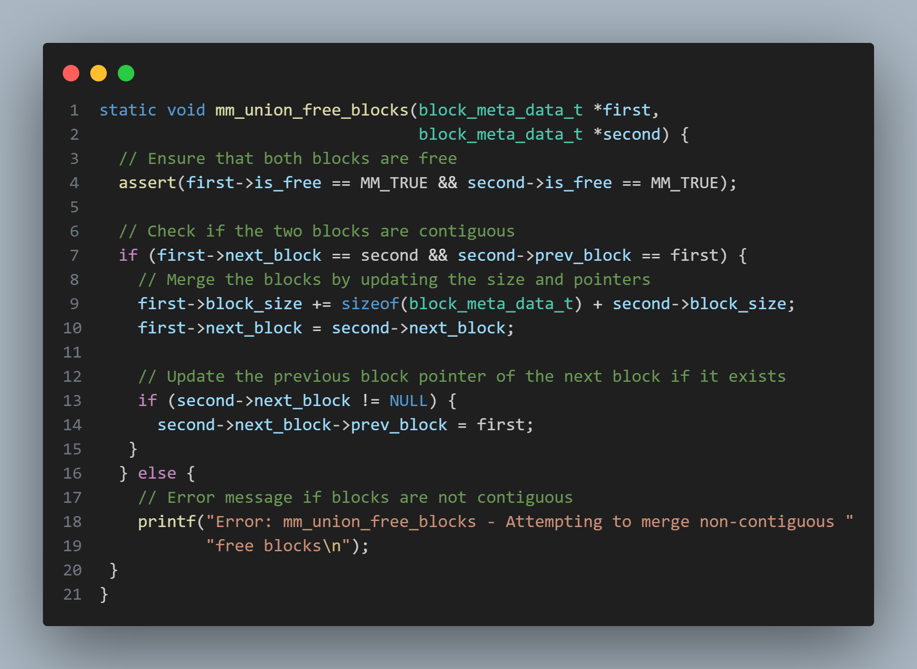
3900 Byte
3900 Byte
mm.c file
is_free = FALSE
block_size = 3900
prev_block = MB2
next_block = nil
is_free = FALSE
block_size = 50
prev_block = MB1
next_block = nil
32 Byte
Merging
Pointer Adjustment
(No MB2)
Two Pointers need to be updated
100 Byte
is_free = TRUE
block_size = 32
prev_block = MB1
next_block = MB3
20 Byte
is_free = TRUE
block_size = 20
prev_block = nil
next_block = MB2
is_free = TRUE
block_size = 100
prev_block = nil
next_block = MB3

Slide 44
TABLE OF CONTENTS
01
Phase 1 – VM Page De(allocation)
05
Phase 5 – VM Page Management
02
Phase 2 – Page Family Registration
06
Phase 6 – Free Data Block Management
03
Phase 3 – Meta and Data Blocks
07
Phase 7 – Final Push – Implement Xmalloc & Xfree
04
Phase 4 – Block Splitting and Merging
08
Phase 8 – Implementing Xfree

Slide 45
05
Phase 5 – VM Page Management

Slide 46
VM Page Management
LMM
Xmalloc (x Bytes)
User space process/Application
When LMM request a VM page(Data VM page), From kernel (mm_get_new_vm_page_from_kernel()), LMM Need to perform operations on this VM page:
Allocation of Data block.
Deallocation of Data block.
If page is completely free, return to kernel.
If page is exhausted of VM pages.
Collect certain statistics.
We need a Data structure which would enable LMM to manipulate/organize Data VM page.
vm_page_t is a data structure used to represent a single Data VM page.
1 VM Page
0x00000000
x Bytes
munmap
1 VM Page
mmap
Kernel MMU
(Virtual address space of a user space process)

Slide 47
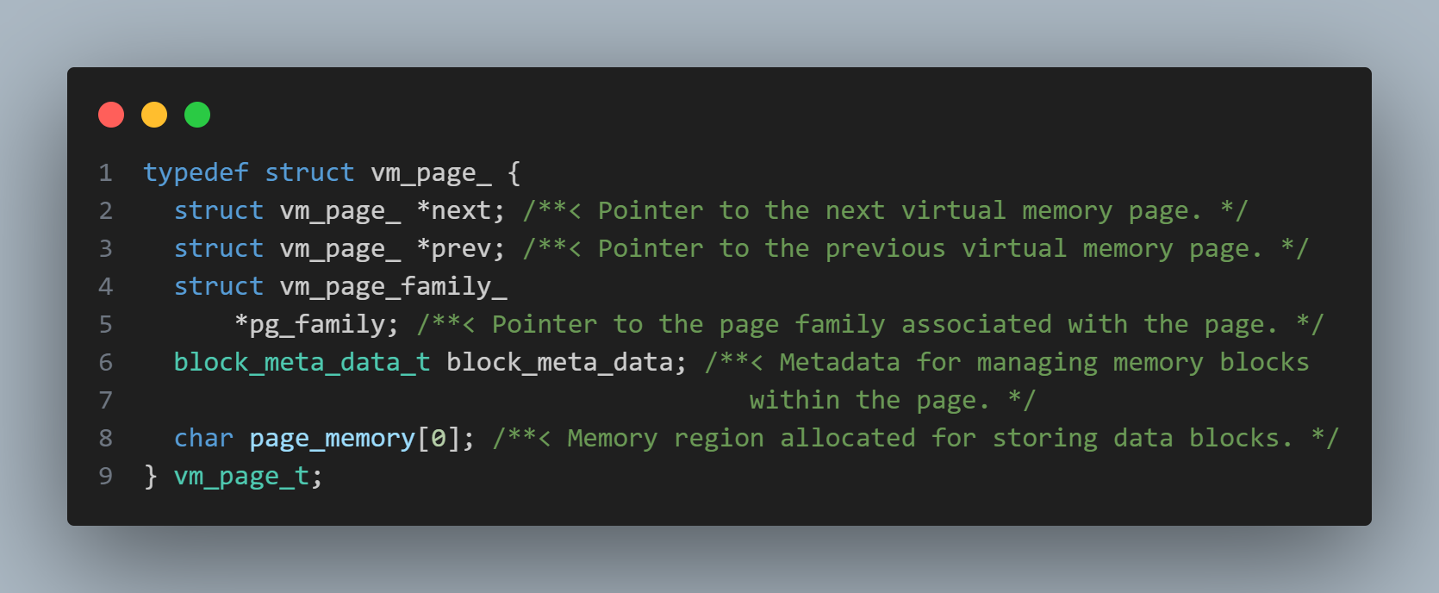
agent_t size = 124
4048 Byte
4048 Byte
4048 Byte
4048 Byte
pg_family
next
prev
pg_family
next
prev
pg_family
next
prev
vm_page_for_families_t
is_free = TRUE
block_size = 4048
prev_block = nil
next_block = nil
When new VM Page is requested from kernel

Slide 48
APIs for VM Data Page Management
4048 Byte
vm_bool_t mm_is_vm_page_empty(vm_page_t *vm_page);
Brief: Checks if a virtual memory page is empty.
Return:
MM_TRUE if the page is empty.
MM_FALSE if the page is not empty or if the input pointer is NULL.
#define MARK_VM_PAGE_EMPTY(vm_page_t_ptr)
Brief: Macro to mark a virtual memory page as empty.
pg_family
next
prev
When new VM Page is requested from kernel

Slide 49
Iterate over virtual memory
pages
4048 Byte
4048 Byte
4048 Byte
agent_t size = 124
pg_family
next
prev
pg_family
next
prev
pg_family
next
prev
vm_page_for_families_t
vm_page_t *curr = NULL;
curr: Pointer variable to hold the current virtual memory page during iteration
#define ITERATE_VM_PAGE_BEGIN(vm_page_family_ptr, curr)
Brief: Macro to iterate over virtual memory pages beginning from the first page of a page family.
#define define ITERATE_VM_PAGE_END(vm_page_family_ptr, curr)
Brief: Macro marking the end of the iteration over virtual memory pages.

Slide 50
Iteration over all memory blocks within a virtual memory page.
#define ITERATE_VM_PAGE_ALL_BLOCKS_BEGIN(vm_page_ptr, curr)
Brief: Macro to begin iteration over all memory blocks
curr: Pointer to hold the current memory block during iteration.
#define ITERATE_VM_PAGE_ALL_BLOCKS_END(vm_page_ptr, curr)
Brief: Macro to end iteration over all memory blocks.
pg_family
next
prev
VM Page

Slide 51
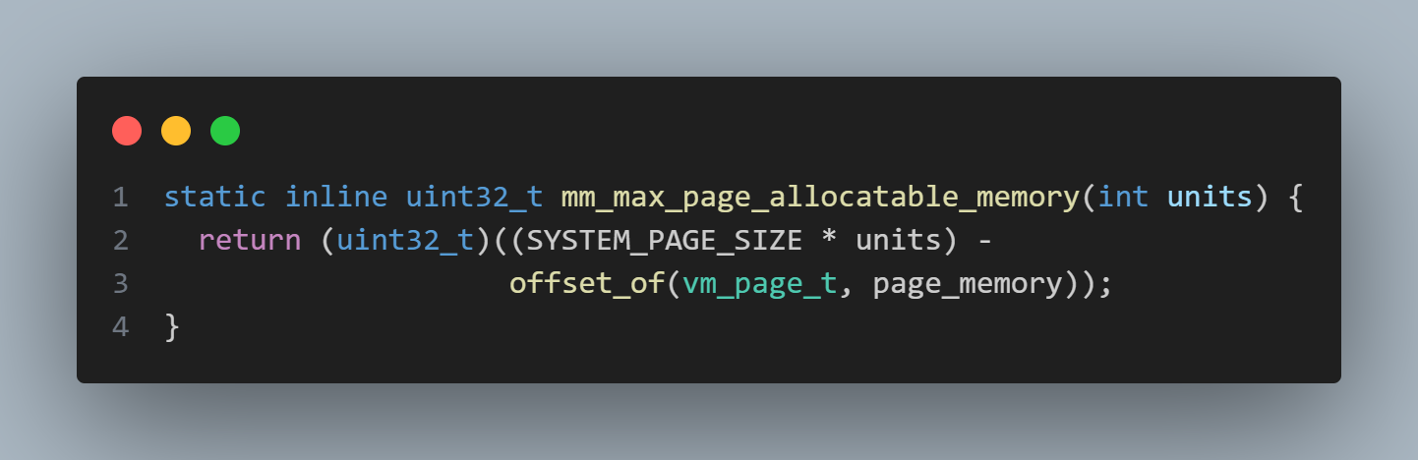
The size of Free Data Block of an Empty VM Page
4048 Byte
4048 Byte
4048 Byte
Brief: Calculates the maximum allocatable memory within a virtual memory page.
units: The number of memory units to be allocated.
Return: The maximum allocatable memory size in bytes.
Note:
Giant VM Page: Two or more contiguous VM Pages.
pg_family
next
prev
pg_family
next
prev
1 VM Page
2 Contiguous
VM Page
(Giant VM Page)

Slide 52
Delete VM Page and Free it
void mm_page_delete_and_free(vm_page_t *vm_page)
Brief: Deletes and frees a virtual memory page.
vm_page: Pointer to the virtual memory page to be deleted and freed.
4048 Byte
4048 Byte
4048 Byte
agent_t size = 124
pg_family
next
prev
pg_family
next
prev
pg_family
next
prev
vm_page_for_families_t

Slide 53
Allocate VM Page
4048 Byte
vm_pagea_t allocate_vm_page(vm_page_family_t *vm_page_family)
4048 Byte
4048 Byte
4048 Byte
agent_t size = 124
is_free = TRUE
block_size = 4048
prev_block = nil
next_block = nil
pg_family
next
prev
pg_family
next
prev
pg_family
next
prev
pg_family
next
prev
vm_page_for_families_t
When new VM page is requested from kernel

Slide 54
TABLE OF CONTENTS
01
Phase 1 – VM Page De(allocation)
05
Phase 5 – VM Page Management
02
Phase 2 – Page Family Registration
06
Phase 6 – Free Data Block Management
03
Phase 3 – Meta and Data Blocks
07
Phase 7 – Final Push – Implement Xmalloc & Xfree
04
Phase 4 – Block Splitting and Merging
08
Phase 8 – Implementing Xfree

Slide 55
06
Phase 6 – Free Data Block Management

Slide 56
For a given Family, which data VM page should be used to meet the xmalloc request?
Ans: Select the page which has the largest free data block available – Worst Fit
FB5
FB1
FB4
FB2
FB3
xmalloc(1, agent_t)
xfree(ptr1)
xfree(ptr2)
xmalloc(1, agent_t)
agent_t size = 124
How to find the biggest free data block across all Data VM pages of a given page family?

Slide 57
How to find the biggest free data block across all Data VM pages of a given page family?
Ans: Each Page Family must maintain a Max-Priority Queue of free data blocks.
FB5
FB1
FB4
FB2
FB3
agent_t size = 124
FB1
FB5
FB2
FB3
FB4

Slide 58
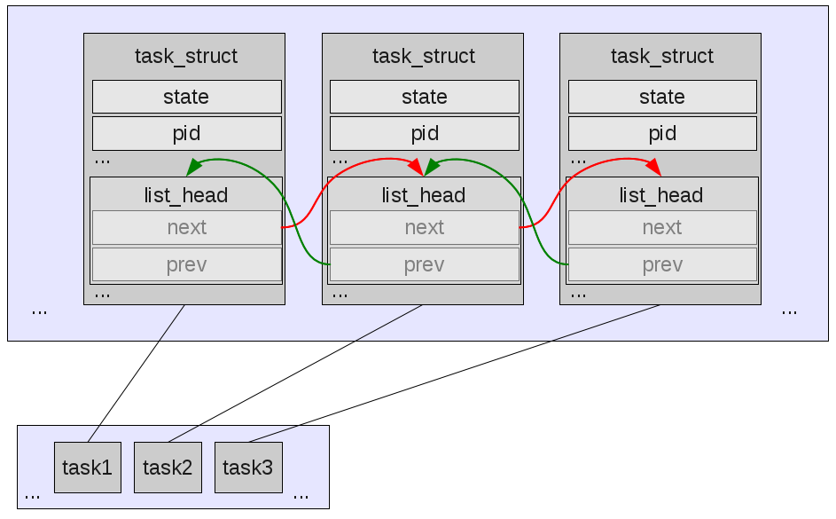
Glue Concept

Slide 59
Glue Concept
Let’s introduce a new way of using Standard Data Structure – The Glue Concept.
We shell redefine out DLL library in a new way algorithm.
We will realize the benefits of using Glue Libraries over Traditional Library.
Linux kernel code use GLUED version of standard data structure such as Tree, Linked List etc.
Even in industry, it’s easier to find glue libraries being used instead of traditional libraries.
Let us call our Glue Doubly linked list as Glthreads – Just a name change, it’s still a doubly linked list.
The Glue concept are applicable to any Data Structures.

Slide 60
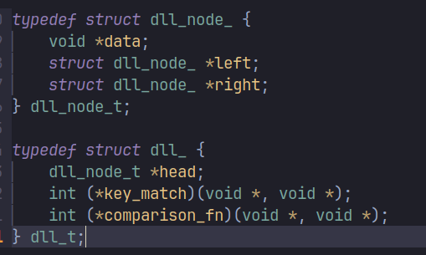
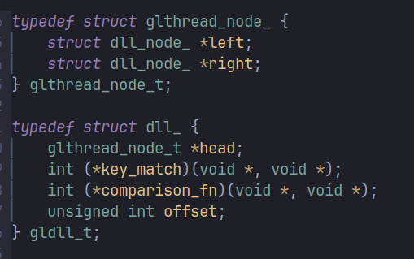
Glthreads – Glued Doubly Linked List
Traditional DLL
Glthreads DLL
Glthread nodes don’t have void *data member.
Then how do glthreads hold the application data?

Slide 61
Glthreads Vs Traditional DLL
Traditional DLL
App data
App data
App data
Left | Data | Right
Left | Data | Right
Left | Data | Right
Glthreads DLL
struct app_data_ {
…
...
…
<node of Glthread> → Glue
};
App data
App data
App data
Left
Right
Left
Right
Left
Right

Slide 62
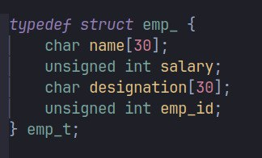

Offset manipulation in C structures
We need to write a C macro which computes the offset of a given field in each C structure.
Ex:
Memory footprint of object
<Name> | <salary> | <designation> | <emp_id>
Fields | Size | offset
name | 30 | 0
salary | 4 | 30
designation | 30 | 34
emp_id | 4 | 64

Slide 63
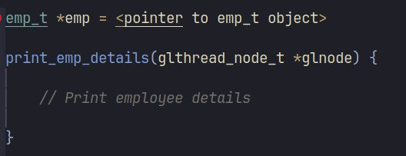
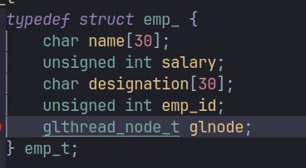
Cont.
Print the Employee details.
Memory Layout of the object of type emp_t
<Name> | <salary> | <designation> | <emp_id> | <glnode>
This is what we need!!
This is what we have!!

Slide 64
Glthreads – Node insertion
Notice that, to add an object to glthread DLL, glthread node itself must be a member of structure .
It mean, while designing the application, Developer knew beforehand that he going to glue (add) the object of emp_t type to glthread DLL.
An API to insert a new glthread node after the current node

Slide 65
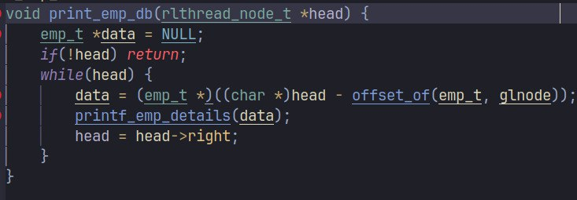
Glthreads – Iteration
App data
App data
App data
Left
Right
Left
Right
Left
Right

Slide 66
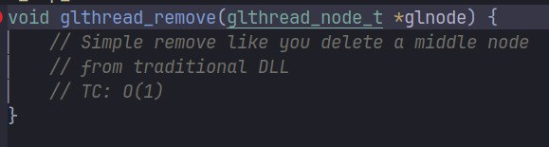
Glthreads – Node Removal
Left | Data | Right
Left | Data | Right
Left | Data | Right

Slide 67
Glthread – Benefits
Why have we twisted things a little if we are accomplishing the same end goals before by traditional DLL?
Let us discuss the benefits of glthread DLL over traditional DLL.
Let us see the problem with traditional DLL. This problem applies to traditional Tree, Queues, etc.
Our application is maintaining three DLL:
L1: DLL to maintaining the records of employees.
L2: DLL to maintaining records of employees above Mgr level.
L3: DLL to maintaining the records of employees whose promotion are due.

Slide 68
Glthread – Benefits
Mahmoud
Multi-reference scenarios – Traditional DLL case
1500000
VP
Left
Right
Now suppose, Mahmoud leaves the company, and you need to remove his record from all lists.
So, iterate over all lists one by one, find the record matching with Mahmoud, and un-reference it from all lists.

Slide 69
Glthread – Benefits
Mahmoud
Multi-reference scenarios – Traditional DLL case
1500000
VP
Left
Right
Now suppose, Mahmoud leaves the company, and you need to remove his record from all lists.
So, iterate over all lists one by one, find the record matching with Mahmoud, and un-reference it from all lists.

