Slide 1
Project using oracle 10g

Slide 2
Information about the project
Project are designed and developed using oracle 10g .
Forms are created using oracle form builder.
Insert and delete data are available in forms.
View data and make change on tables.
4 files are created to insert data into SQL plus commend line:
BuildDB.sql
InhibitDB.sql
DropDB.sql
ClearDB.sql

Slide 3
About project
Hospital System
Hospital sys are a huge sys that take months to incur it to be full system after days and days from studying all aspects and make the sys goes will.
In my humble project I give part of hospital sys that can by developed and maintain in easy way.
I put in my hospital sys 7 tables, 5 sequences and 3 views.
Tables are created to save data and gathering information's, sequences created to create primary keys for deferent tables and sure that data have consistency between each other and views to collection data from tables and view it in form;
Let’s get started…..

Slide 4
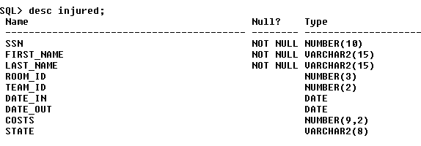
HOSPITAL SYSTEM
Injured or patient Table.
Table contain info about injured.

Slide 5
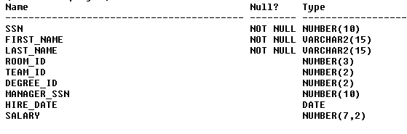
Hospital sys con.
Employee table
From his name for doctors and other employees

Slide 6
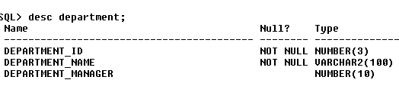
Hospital sys con.
Department table.
Is collection of departments

Slide 7
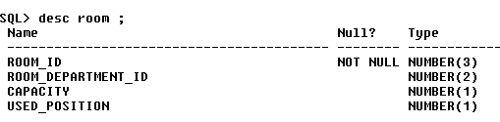
Hospital sys con.
Room table.
That contain rooms for both injured and employees.

Slide 8
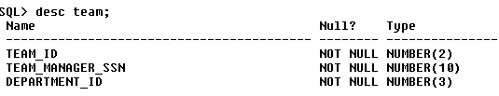
Hospital sys con.
Team table
Contain teams that have responsibility for patient

Slide 9
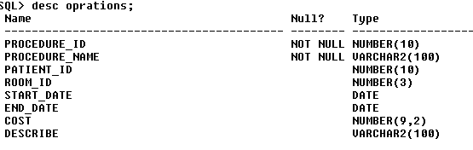
Hospital sys con.
Op_rations or procedure table are the same.
Has info about patient surgery's .

Slide 10

Hospital sys con.
Degree table
Degree is table for employees only;

Slide 11
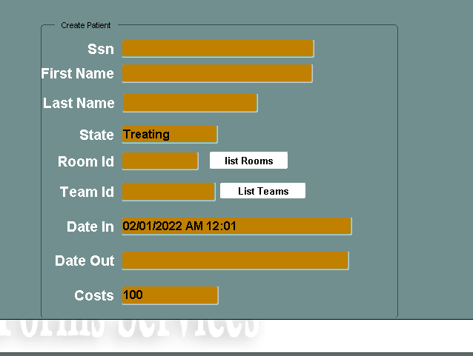
Hospital form
To create patient and review patient info

Slide 12
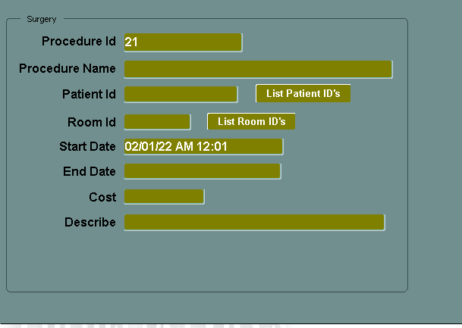
Hospital form
To adding procedure or surgery.

Slide 13
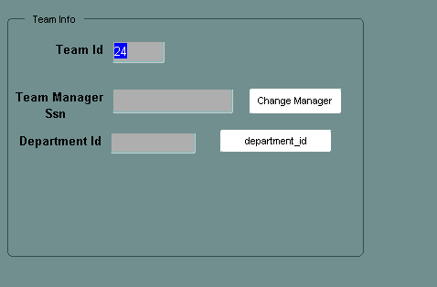
Hospital form
Create team with all foreign key’s

Slide 14
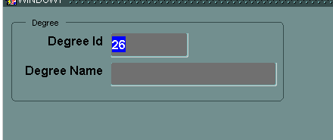
Hospital form
Create degree for employee

Slide 15
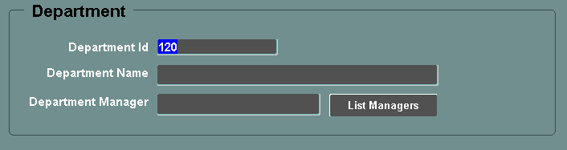
Hospital form
Department adding

Slide 16
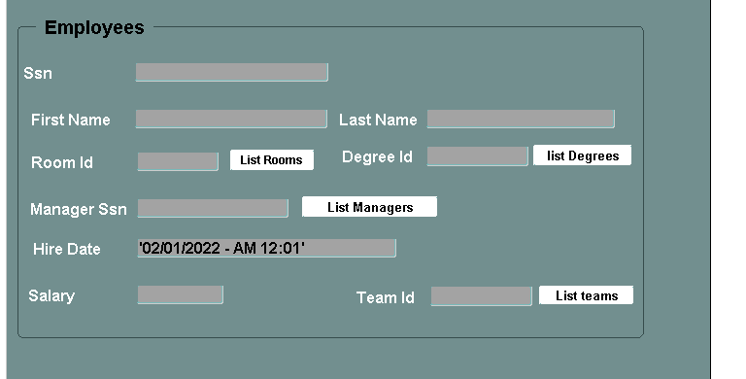
Hospital form
Adding employees

Slide 17
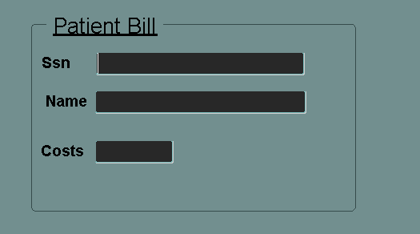
Hospital form
All employees has cost to pay

Slide 18
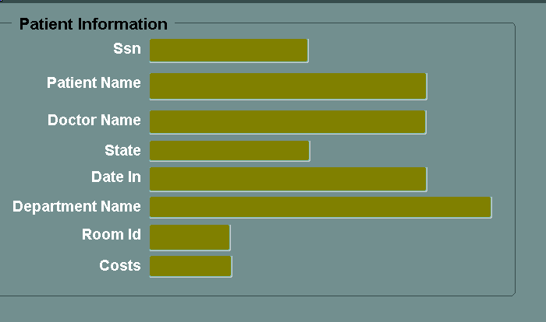
Hospital form
Patient information are collection from employee table , patient and department

Slide 19
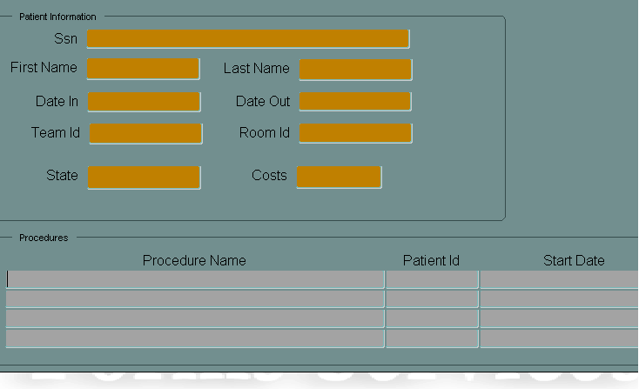
Hospital form
Operations for single patient

Slide 20
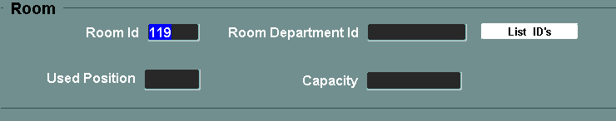
Hospital form
Add room

Slide 21
Creation
List of values are available on all forms to make consistency of foreign key
Create tables is to run BuildDB.sql
To insert tables data , add constraints, sequences and views InhibitDB.sql
Delete all tables with data DropDB.sql
Delete data from tables ClearDB.sql
Run all forms that will direct connect to data by connect with the same user.

Slide 22
Name: Mahmoud Yousef Abu-Zubaidah.
ID:2019902158.

