Slide 1
Predicting Sleep Quality with Machine Learning

Slide 2
Introduction
Objective: Predicting sleep quality based on various features.
Dataset: Sleep health and lifestyle dataset.
Algorithms: Linear Regression, Ridge Regression, Lasso Regression.

Slide 3
DataSet
Dataset Overview:
The Sleep Health and Lifestyle Dataset comprises 400 rows and 13 columns, covering a wide range of variables related to sleep and daily habits. It includes details such as gender, age, occupation, sleep duration, quality of sleep, physical activity level, stress levels, BMI category, blood pressure, heart rate, daily steps, and the presence or absence of sleep disorders.

Slide 4
Data Preprocessing
Steps:
Blood Pressure: Split into upper and lower values.
Encoding: Label encoding for categorical features (Gender, Occupation, BMI Category, Sleep Disorder).
Scaling: Min-max scaling for "Daily Steps" feature.

Slide 5
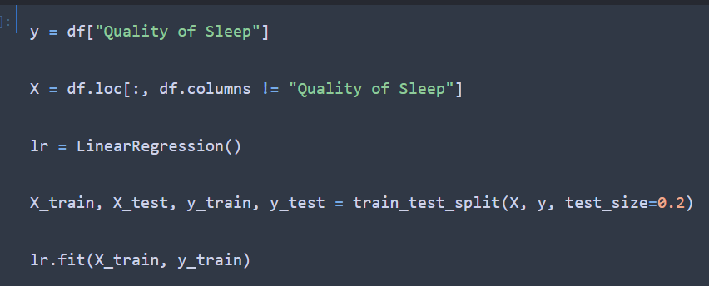
Linear Regression
Code Highlights:

Slide 6
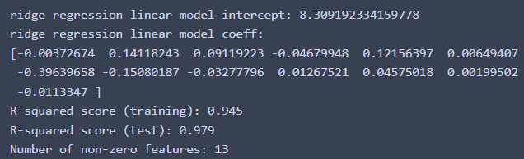
Ridge Regression
Ridge Regression is effective when there is multicollinearity in the data, i.e., when independent variables are highly correlated (have a mutual relationship or connection) .
It shrinks the coefficients, but it doesn't force them to be exactly zero.
Results:

Slide 7
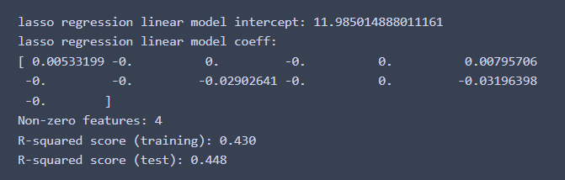
Lasso Regression
Lasso Regression is particularly useful when there are many irrelevant or redundant features in the dataset.
It performs automatic feature selection by setting the coefficients of less important features to zero.
Results:

Slide 8
Model Comparison
Algorithm | R-squared score training | R-squared score test
Linear Regression | 0.9466670783283735 | 0.9796841265948352
Ridge Regression | 0.945 | 0.979
Lasso Regression | 0.430 | 0.448

Slide 9
Classification

Slide 10
classifiers
SVM (linear , rbf , poly)
RandomForestClassifier
KNeighborsClassifier
GradientBoostingClassifier
DecisionTreeClassifier

Slide 11
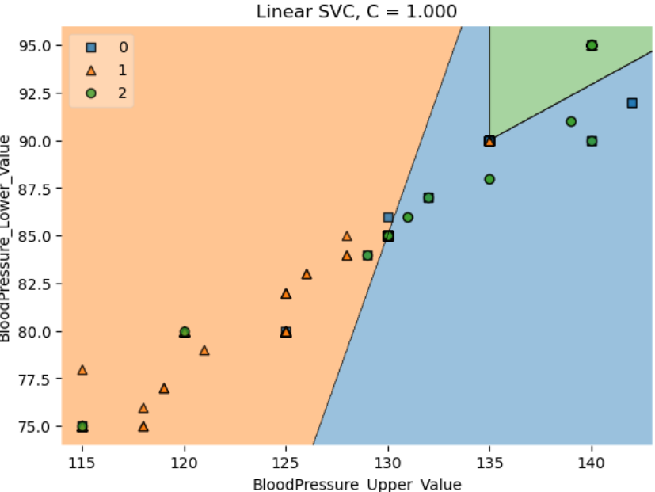
insomnia = 0 , sleep apnea = 2 , no = 1

Slide 12
SVM
Linear : It works by finding the best hyperplane that separates the data points into different classes with the maximum margin. A linear SVM can handle linearly separable data, but it may not be able to capture complex and non-linear patterns.
RBF : can perform non-linear classification using the rbf function.
Poly : can perform non-linear classification using the polynomial function.
C : controls the trade-off between the complexity and the accuracy of the model

Slide 13
RandomForestClassifier
It is based on ensemble learning, which combines multiple decision trees to improve the accuracy and reduce the overfitting of the model. A RandomForestClassifier trains each decision tree on a random subset of the data and features, and then averages the predictions of all the trees to get the final output.
N_estimator : number of trees
max_depth : A higher max_depth value means a more flexible and expressive model, but it also increases the risk of overfitting

Slide 14
KNeighborsClassifier
It works by finding the k nearest neighbors of a new data point in the feature space, and assigning it the most common class label among those neighbors. KNeighborsClassifier can handle both linear and non-linear data, and it can use different distance metrics to measure the similarity between data points. KNeighborsClassifier is a simple and intuitive algorithm, but it also has some drawbacks, such as being sensitive to noise, outliers, and irrelevant features.
N_neighbors : A smaller n_neighbors → overfitting

Slide 15
GradientBoostingClassifier
It works by combining multiple weak learners(models), usually decision trees, into a strong ensemble model. Each weak learner tries to correct the errors of the previous one, by fitting on the negative gradient of the loss function. The final prediction is obtained by averaging the predictions of all the weak learners.
Learning_rate : how much each tree contributes to the final prediction, A larger learning_rate means a faster and simpler model, but it also increases the risk of overfitting

Slide 16
DecisionTreeClassifier
It works by creating a tree-like structure of nodes and branches, where each node represents a test or a decision on a feature, and each branch represents an outcome or a class. The algorithm starts from the root node, which contains all the data, and splits it into two or more child nodes based on the best feature and threshold. This process is repeated recursively until all the nodes are pure (contain only one class) or meet some stopping criteria. A Decision Tree Classifier can handle both numerical and categorical features,

Slide 17
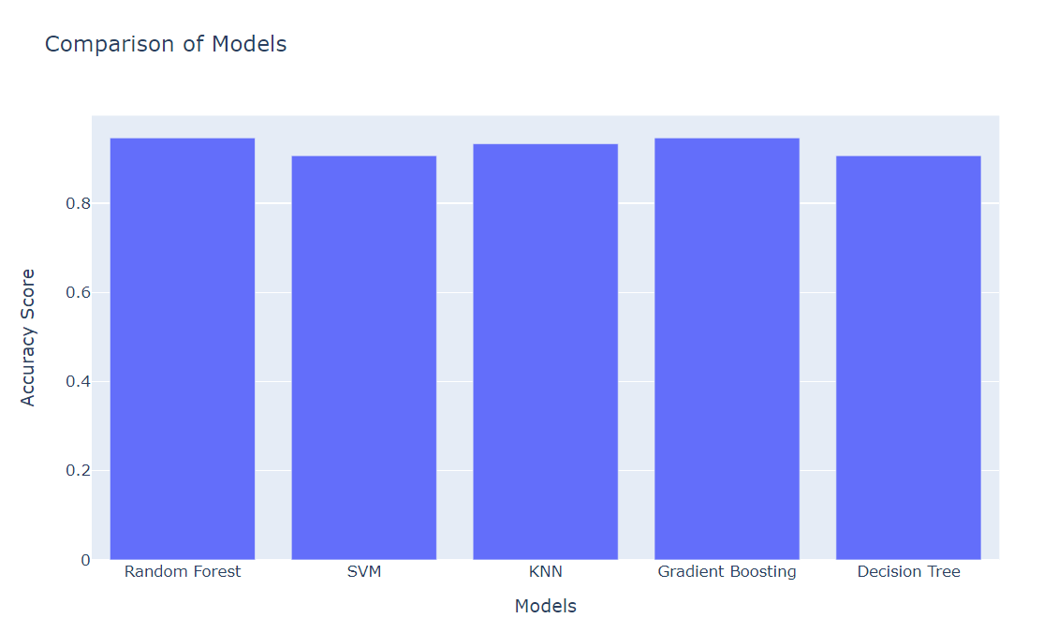

Slide 18
