Slide 1
ShareMeCode
Where teams code together in real-time.
Team: Mahmoud Alaaraj, Nabeel Ismaeel, Wadea Khader.
Supervisor: Dr. Suboh Alkhushayni.

Slide 2
Introduction
Problem:
Remote developers face challenges with: Complex local environment setups (IDEs, dependencies).
Real-time code synchronization.
Version control and access management.
Solution: ShareMeCode - A web-based platform enabling:
Real-time collaborative coding.
Zero-installation development.
Built-in AI-assisted programming.
Secure project management.

Slide 3
ShareMeCode Features
Real-Time Collaboration
Web Socket-based live editing.
Multi-user synchronization.
Language-Agnostic Execution
Docker-powered sandboxing (Java, C++, Python).
Distributed processing via RabbitMQ.
AI Code Generation
Natural language → executable code.
LLM-as-a-Judge quality evaluation.
Project Management
File and directory operations.
Git-like version control (commit, revert, clone).
Security
OAuth 2.0 (Google, GitHub).
Role-Based Access Control (Owner, Editor, Viewer).

Slide 4
ShareMeCode Architecture
Full-Stack Implementation:
Frontend: ReactJS.
Backend: Java Spring Boot (REST APIs).
Database: MySQL.
Infrastructure:
Docker containers for execution.
RabbitMQ for distributed processing.
GitHub Actions CI/CD.
AI Pipeline:

Slide 5
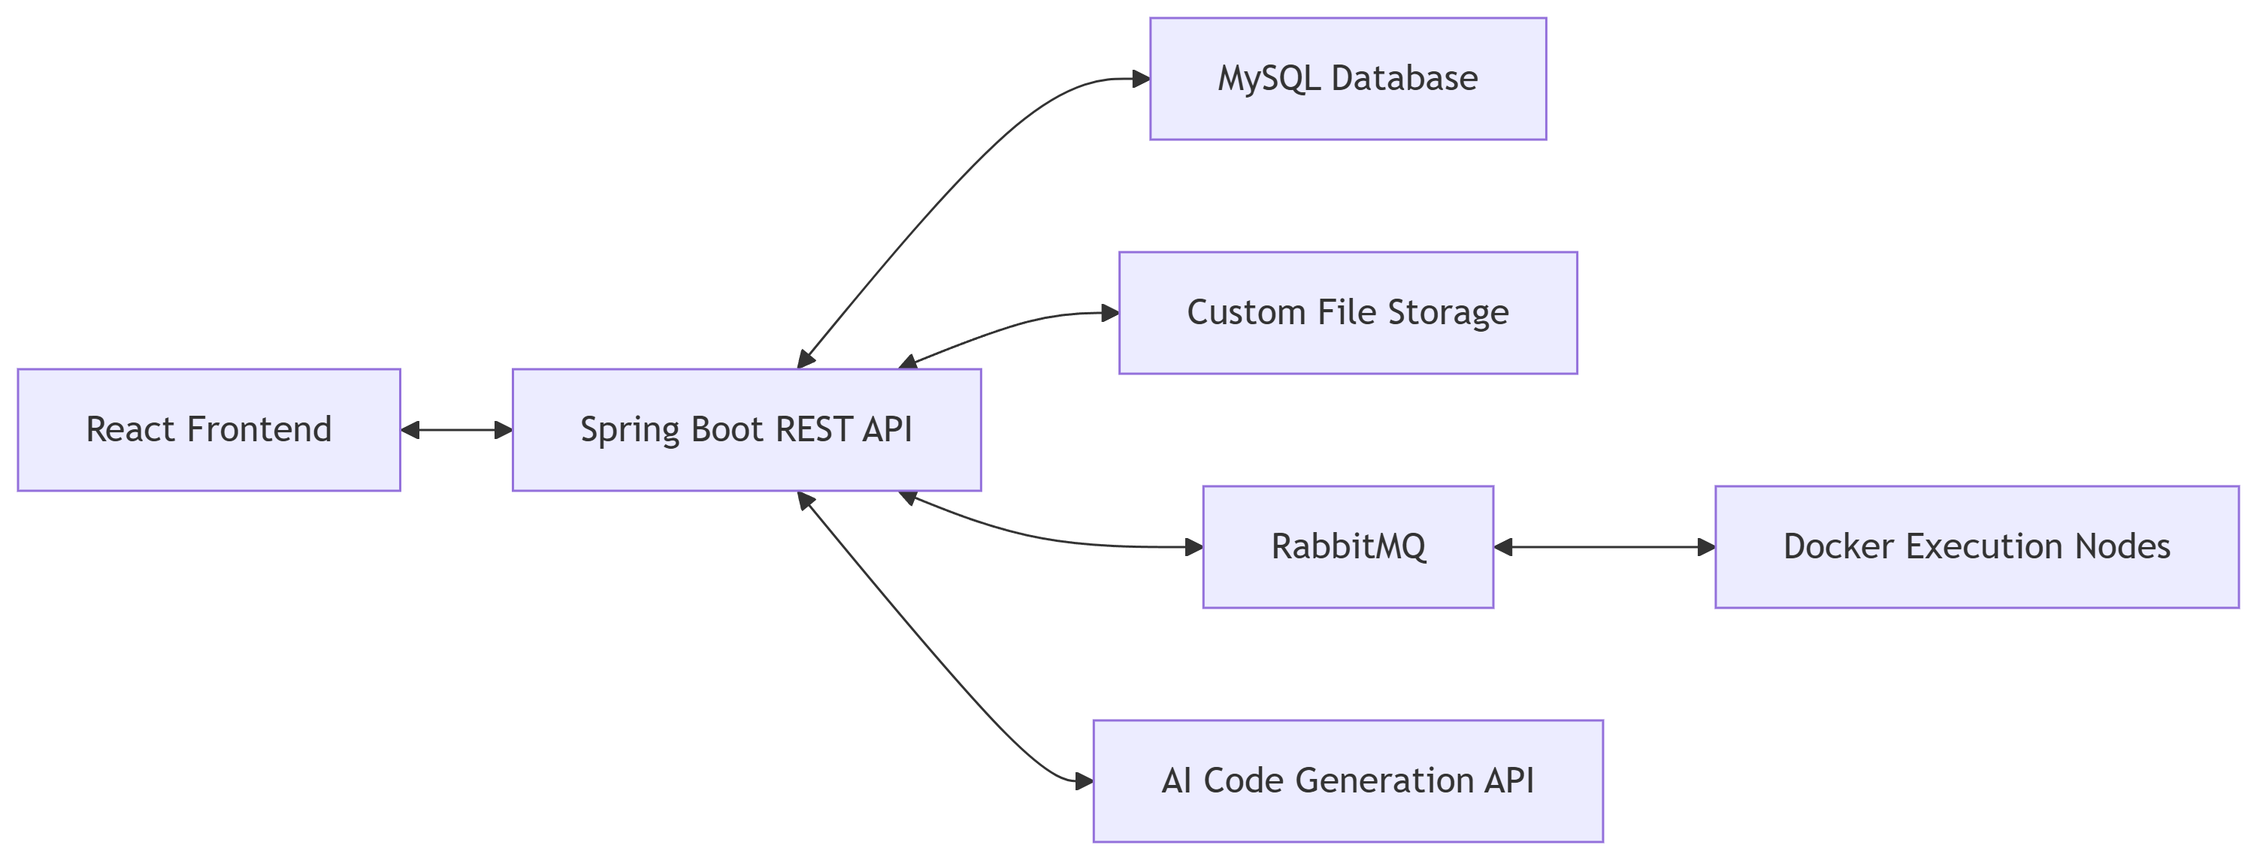
ShareMeCode Architecture

Slide 6
Key Innovations
Distributed Code Execution
Decoupled processing via message queues.
Scalable container orchestration.
Multi-LLM Evaluation
6 evaluation criteria (Correctness, Clarity , Idiomatic Use, Error Handling, Performance, Maintainability).
Weighted scoring across multiple AI models.
RBAC Integration
Fine-grained project permissions.
Dynamic role assignment.

Slide 7
Results & Validation
Functional Success:
Real-time collaboration with <100ms latency.
Code execution isolation (Docker security).
AI code acceptance rate: ----------------------.
Technical Compliance:
Adherence to SOLID principles.
Factory/Strategy design patterns.
Clean code practices.

Slide 8
Limitations & Future Work
Current Limitations:
Internet required (no offline mode).
Limited language support (3 languages).
Basic version control.
Future Roadmap:
Advanced debugging tools.
Voice/video collaboration.
Plugin ecosystem.
Offline synchronization.
Expanded AI model fine-tuning.

Slide 9
Conclusion
ShareMeCode Delivers:
Elimination of development environment friction.
Secure, real-time collaborative coding.
AI-powered productivity enhancement.
Foundation for future extensibility.

Slide 10
"Code together, not alone: ShareMeCode delivers real-time collaboration, AI-enhanced development, and environment-free execution."

Slide 11
Thank You

