Slide 1

Dynamic Price Prediction
Graduation Project

Slide 2

Agenda
Problem Statement
Project Charts and Components
Data Sets
Feature Engineering
Data cleaning
Exploratory Data Analysis (EDA)
Data preprocessing
Models Evaluation
Deployment (Web App)

Slide 3

Problem Statement

Slide 4
Dynamic Pricing
One of the problems facing transport companies is the Dynamic price problem
Where the company is required to determine the best and most appropriate price for a trip, taking into account the increase in its revenue and profits
The company's revenue depends on the trip price and the number of trips
An increase in the trip price does not necessarily mean higher profits for the company

Slide 5
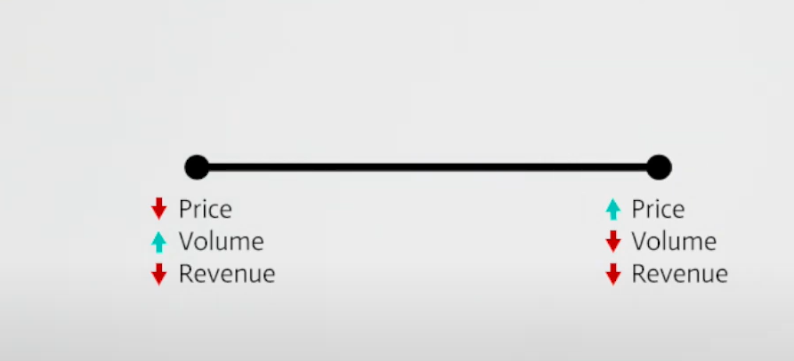
Price Problem
Here, if the company increases the price of the trip, the number of trips will decrease, and thus its profits will decrease
And vice versa, if the price of the trip decreases, the number of trips will increase and the company’s profits will also decrease

Slide 6
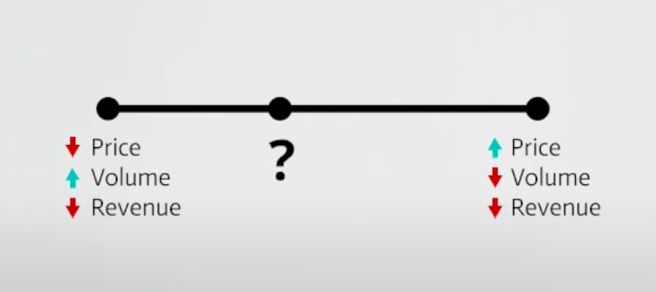
Solution
Search for the best price that achieves profits for the company and is suitable for the customer
Determine the places that will have pressure on trips.
so that the company can send a notification
to the drivers so that they head towards the place that have pressure.
and this will lead to an increase in the number of trips and an increase in the company’s revenues

Slide 7

Why are the prices different for
the same trip?
This is due to many reasons, the most important of which are:
Supply and demand policy :
This is due to the fact that the number of required trips is
more than the number of cars available in the place
2) Weather conditions :
Certainly weather conditions affect the price of the trip
3) Traffic congestion :
There is no doubt that the price of the trip varies according
to road conditions

Slide 8

Objectives
1) Determining the ideal price for both the company and the customer.
2) Determining the most requested places for trips.
3) Knowing and analyzing the customer's opinion about the trip

Slide 9

Study on solutions already on the market
One of the most famous international companies that is famous for transporting customers is Uber
What distinguishes the project from the applications already on the market is the feature of identifying the customer's opinion of the trip through the analysis of text messages.

Slide 10
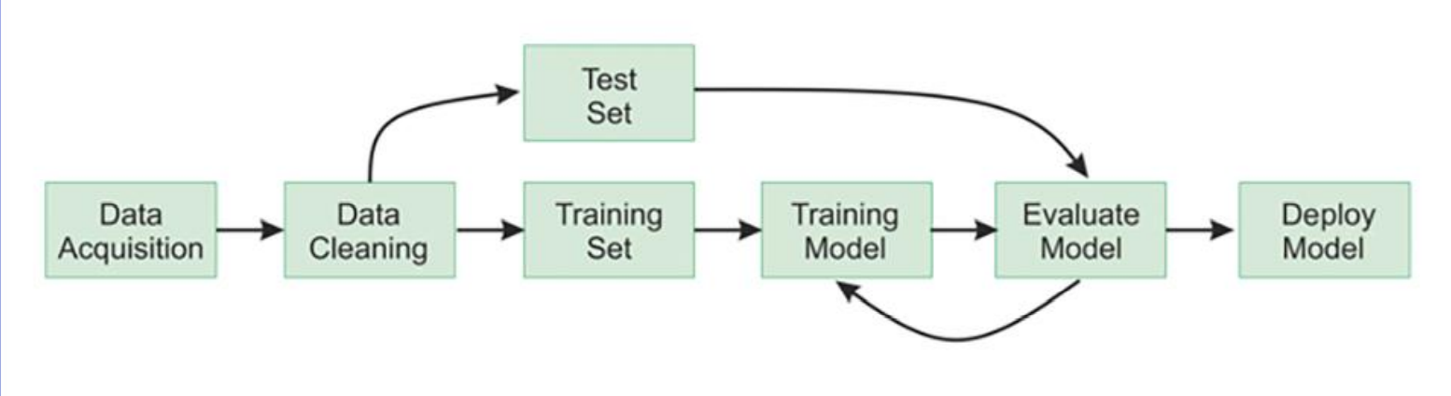
The Pipeline of the Project

Slide 11

Data Sets

Slide 12

Data from the Kaggle website
Link (1): https://www.kaggle.com/datasets/brllrb/uber-and-lyft-dataset-boston-ma
Data consist of 57 Features and 693071 Rows
Link (2):
It contains 10,000 recent Tweets with the user ID
The data had many problems, such as :
1) NULL Values
2) Outliers
3) Categorical Features

Slide 13

The data revolves around one of the largest transportation services companies around the world, which is Uber and Lyft
The data was collected from November 26, 2018 to December 18, 2018.
Data on the population of Boston, USA

Slide 14
Features
Cab Type
Weather
Transport Info
Cab type
product id
name
. . . .
Distance
Source
Destination
....
Pressure
windspeed
Humidity
....

Slide 15

Feature Engineering

Slide 16
How is it done
Extract and Create useful features from raw data into features suitable for analysis and modeling.
⬡ Create features like ( road , county, state )from features like ( latitude , longitude ).
⬡ Create feature like ( day name ) from feature like ( date ) .
⬡ Create time-based features like ( period ) from existed features like (hour).

Slide 17

Data cleaning

Slide 18
Steps
Objectives
Handle Data Types
Handle Missing Data (using Median)
Check and Handle Outliers (using box plot and median)
Check Duplicates (Not Found)
Inconsistent Data (Not Found)
1) Make the data more proportional
2) Improve data mining analysis

Slide 19

Exploratory Data Analysis

Slide 20
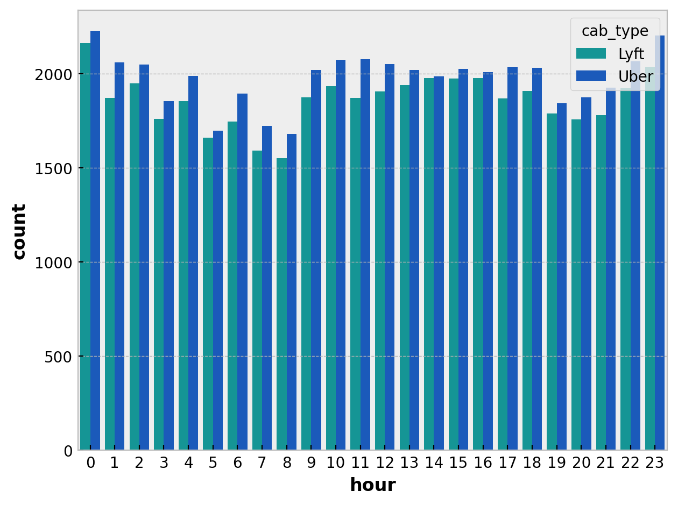
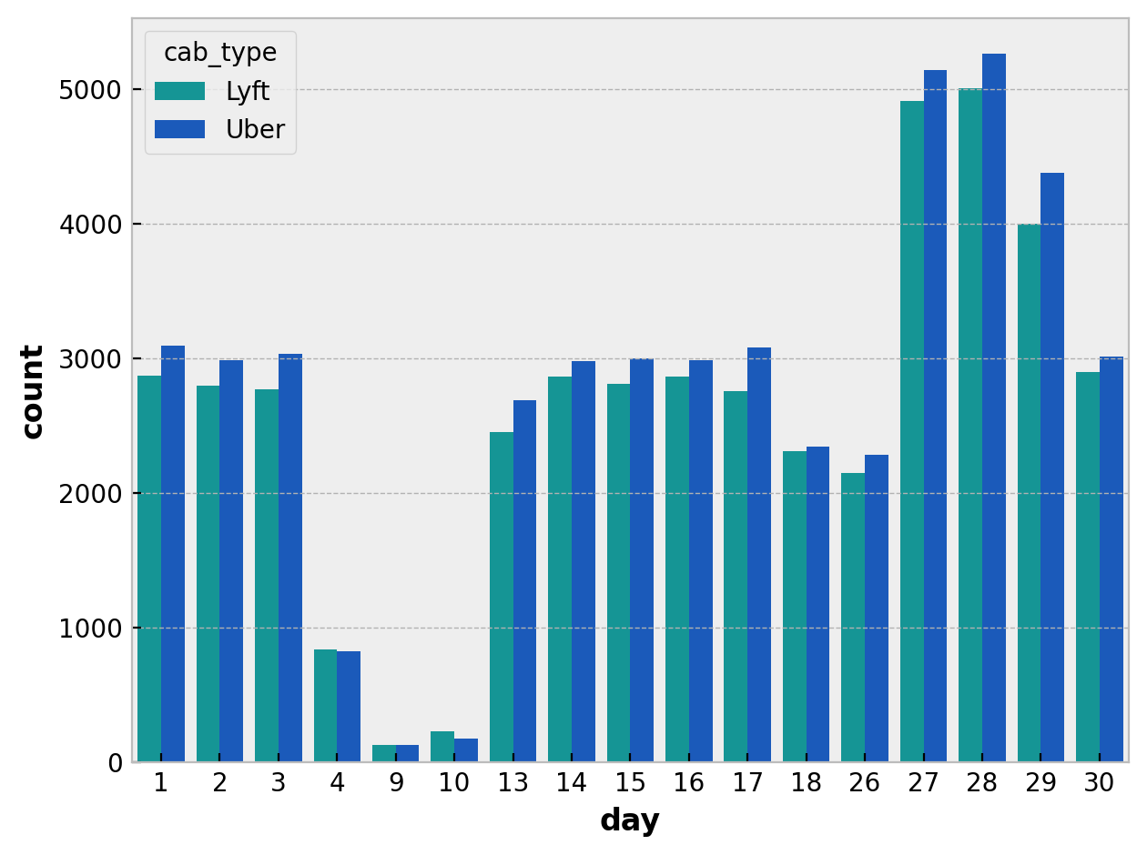
The number of trips for each company during the hours of day
The number of trips for each company during the days of month
There are many differences between the days, and there are many days that have no Trips, and this is due to many circumstances, such as, for example, the curfew and official holidays and Feasts .
Uber achieves more trips than Lyft ,except for the 9th and 10th ,and this may be due to Lyft making some offers and discounts on those two days.

Slide 21
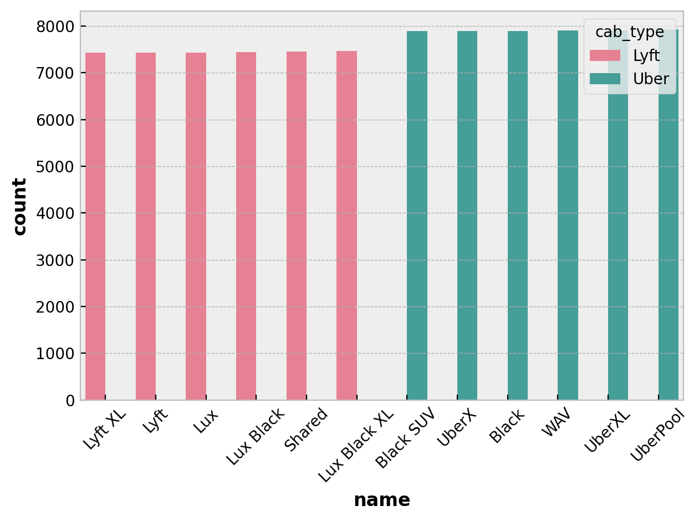
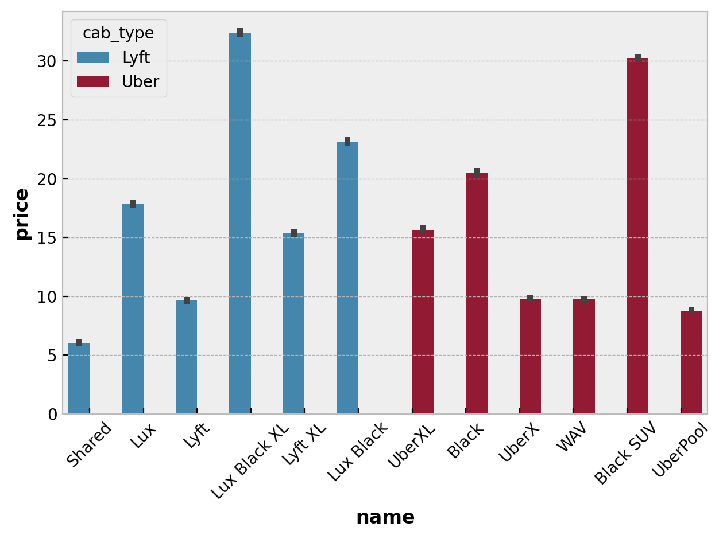
The number of trips made by each type of each company
Average prices of trips carried out by each type of each company

Slide 22
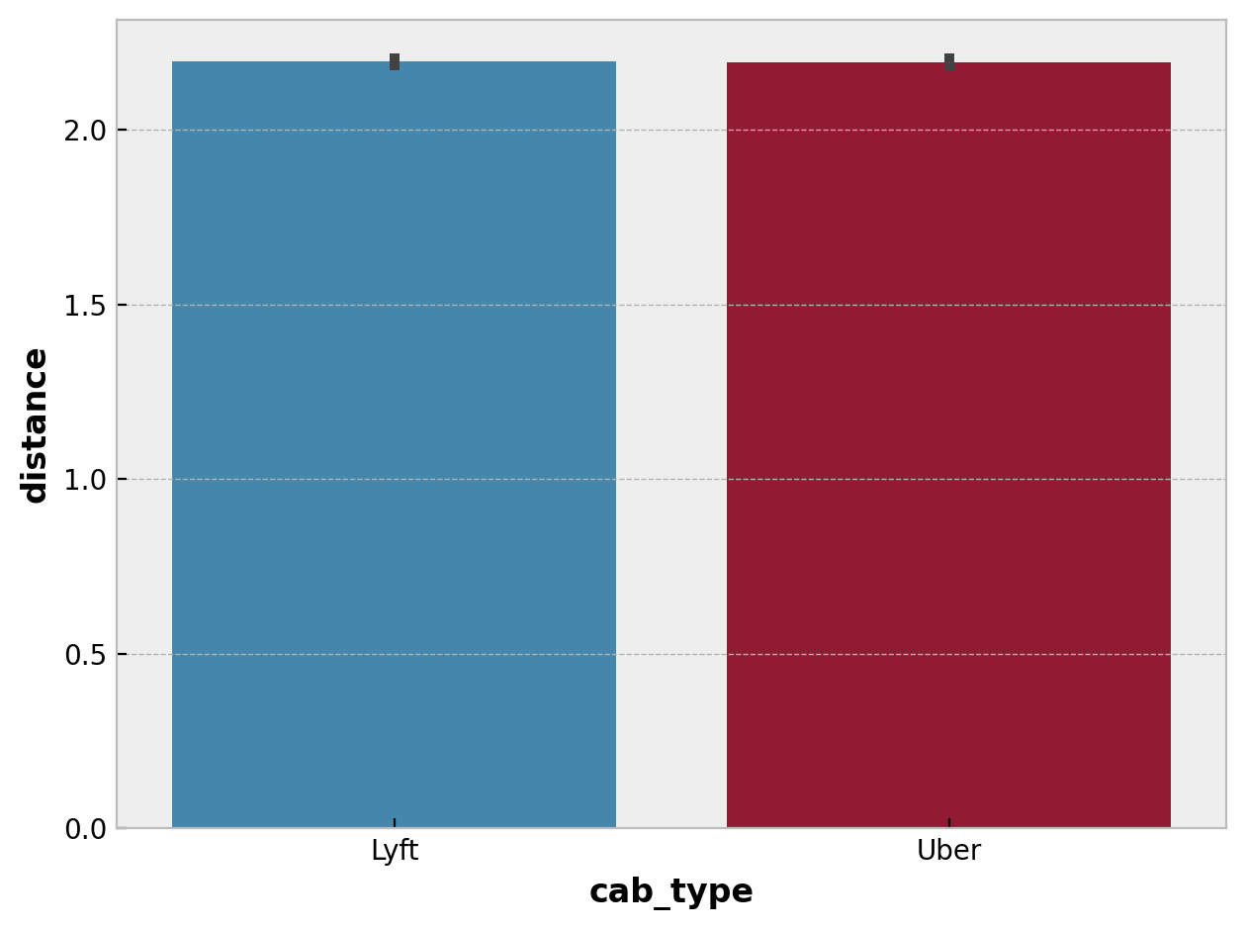
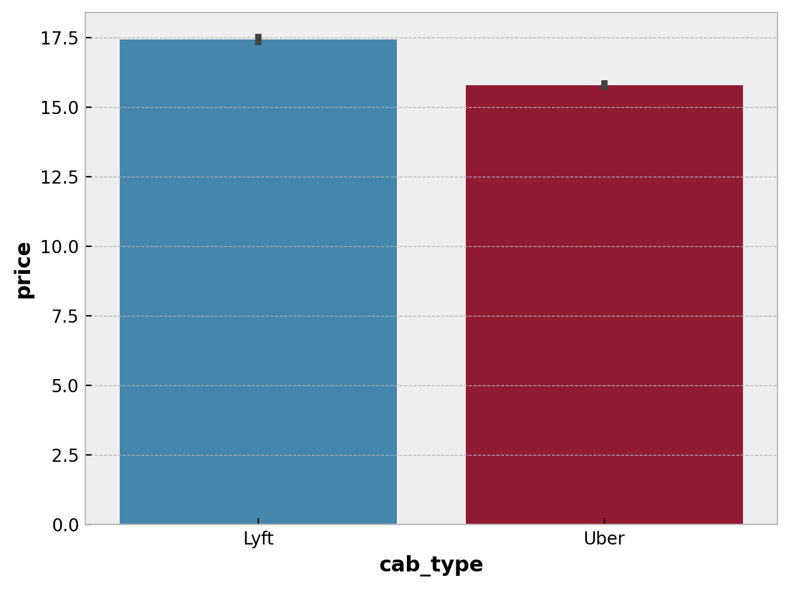
Average distance traveled for each company
The average trip price for each company.
- Here we will notice that despite the equal distance traveled for each company, the average price of the trip for Lyft is more expensive

Slide 23
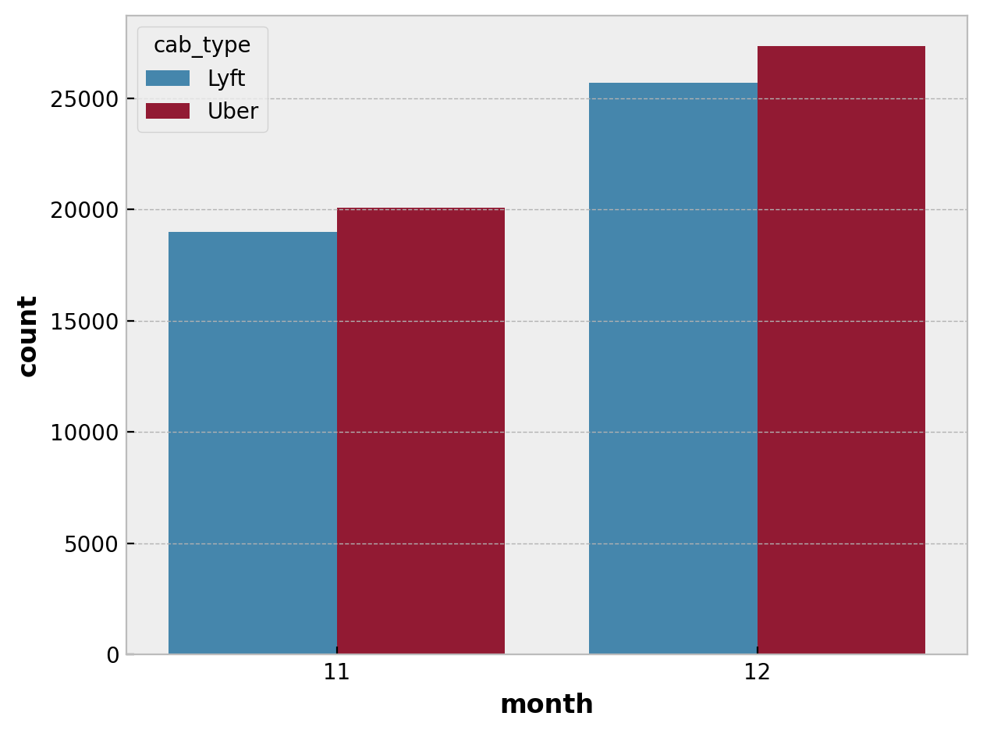
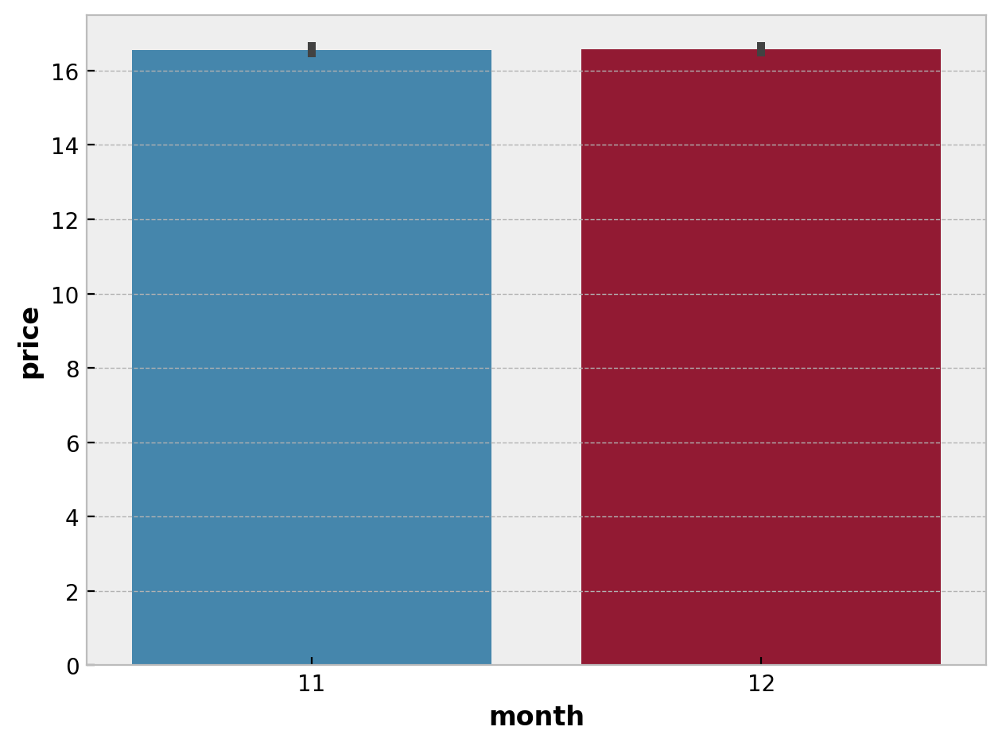
The number of trips for each company over the month
Average trips prices for each month
- The number of trips that took place in the month of 12 is more, although the average price of trip during the two months is equal
- The increase in the number of trips in the month of 12 in particular , may be due to the year-end vacations and the large number of outings

Slide 24
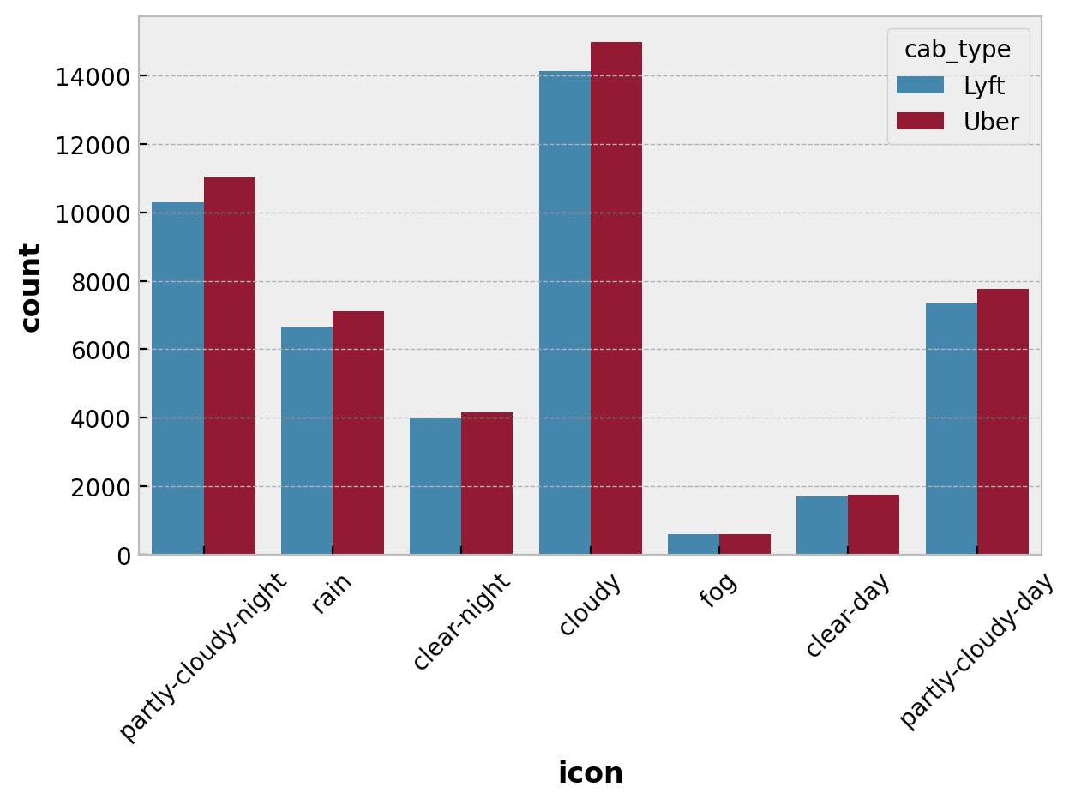
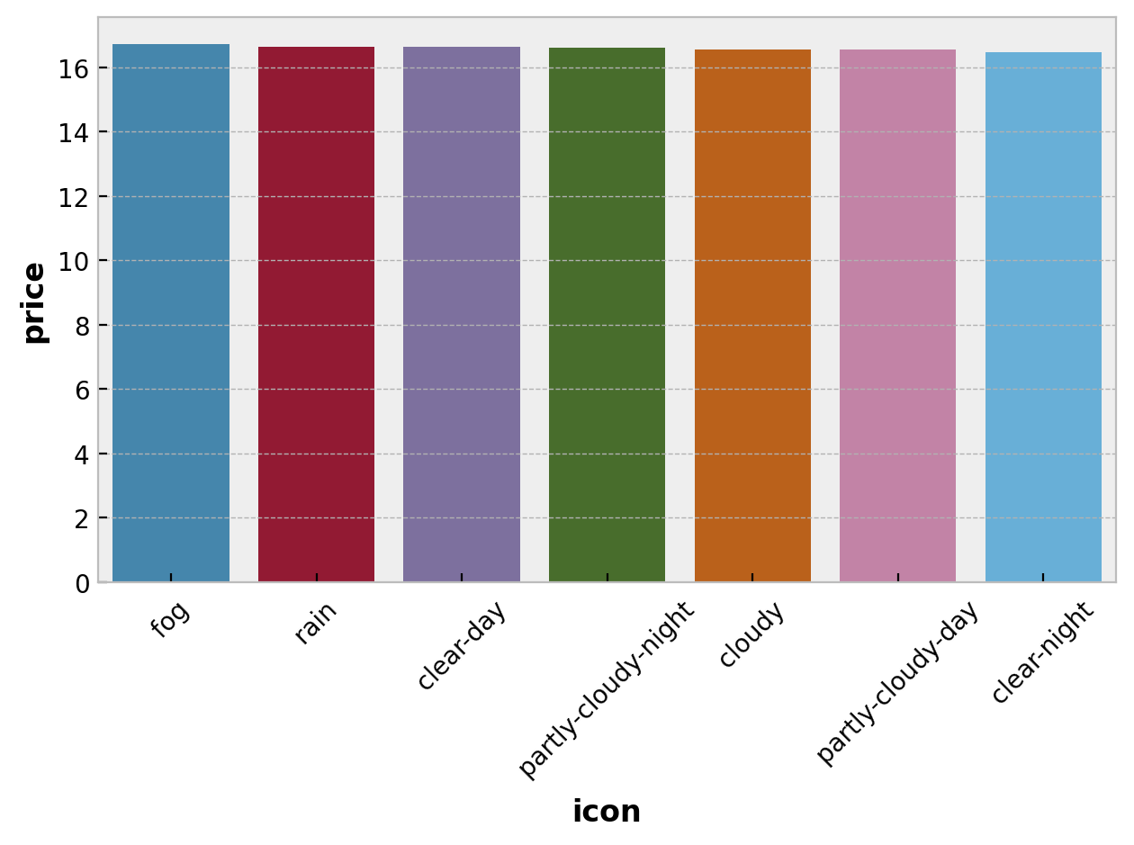
The number of trips for each company over weather conditions
The relationship between weather conditions and trip prices
- Cloudy weather is the most common condition during trips.
- Weather condition don’t affect the price of the trip.

Slide 25
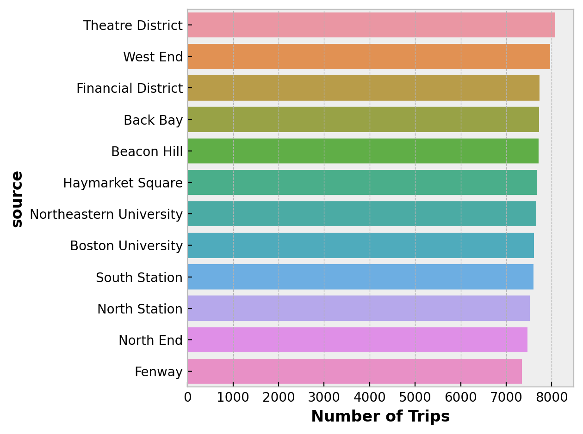
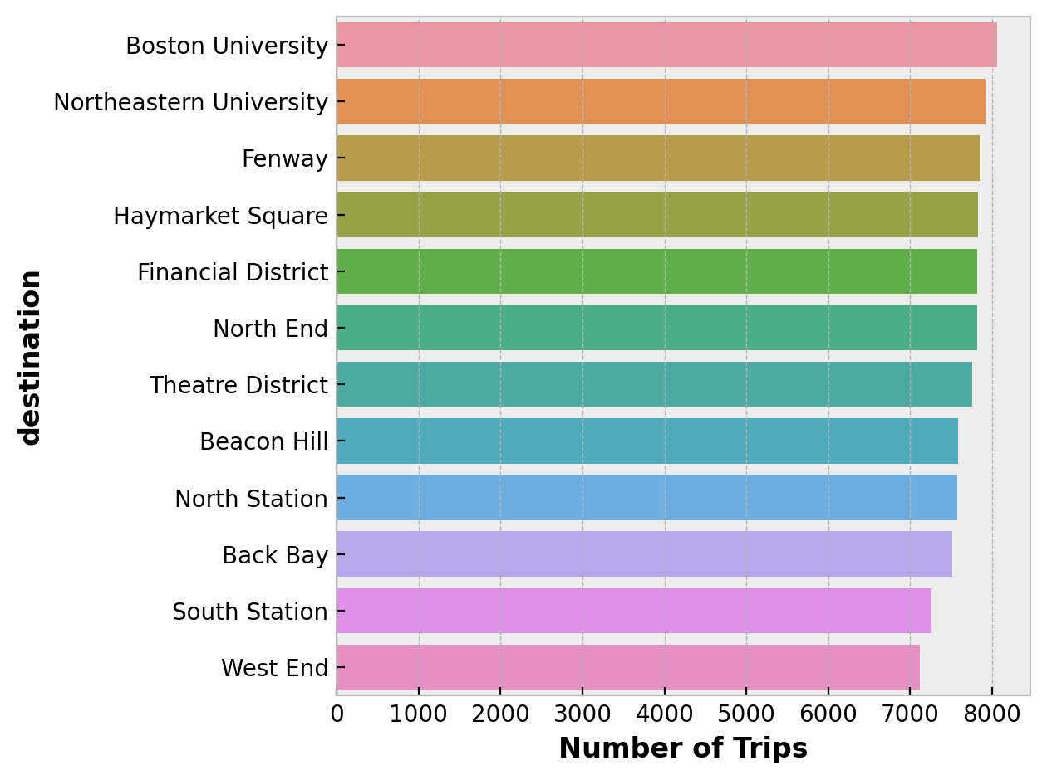
The number of trips originating from each source
The number of trips originating from each destination
- The most requested source for trips is Theatre District , while the most popular destination for trips is Boston University and Northeastern University.

Slide 26
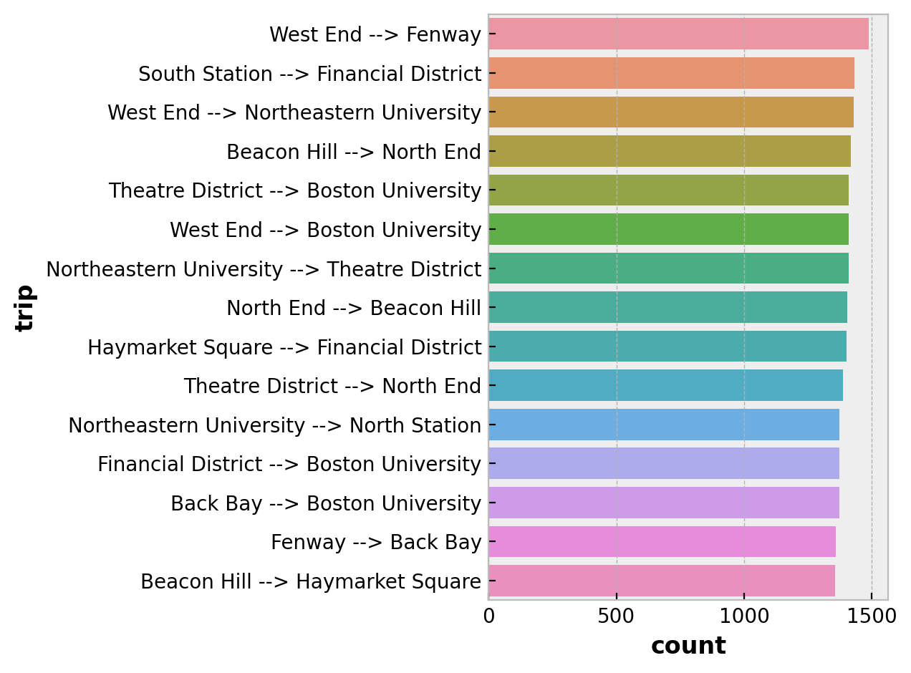
West End -> Fenway
Most popular trips
1489 Trips from West End to Fenway
800 of them are Lyft trips , and 689 trips are Uber trips.
The lowest price for a Lyft trip was $3, while the highest was $52.5.
The lowest price for an Uber trip was $7.5, while the highest was $35.
The average trip distance is 2.9 kilometers.
Average taxes charged for a trip are 1$.

Slide 27
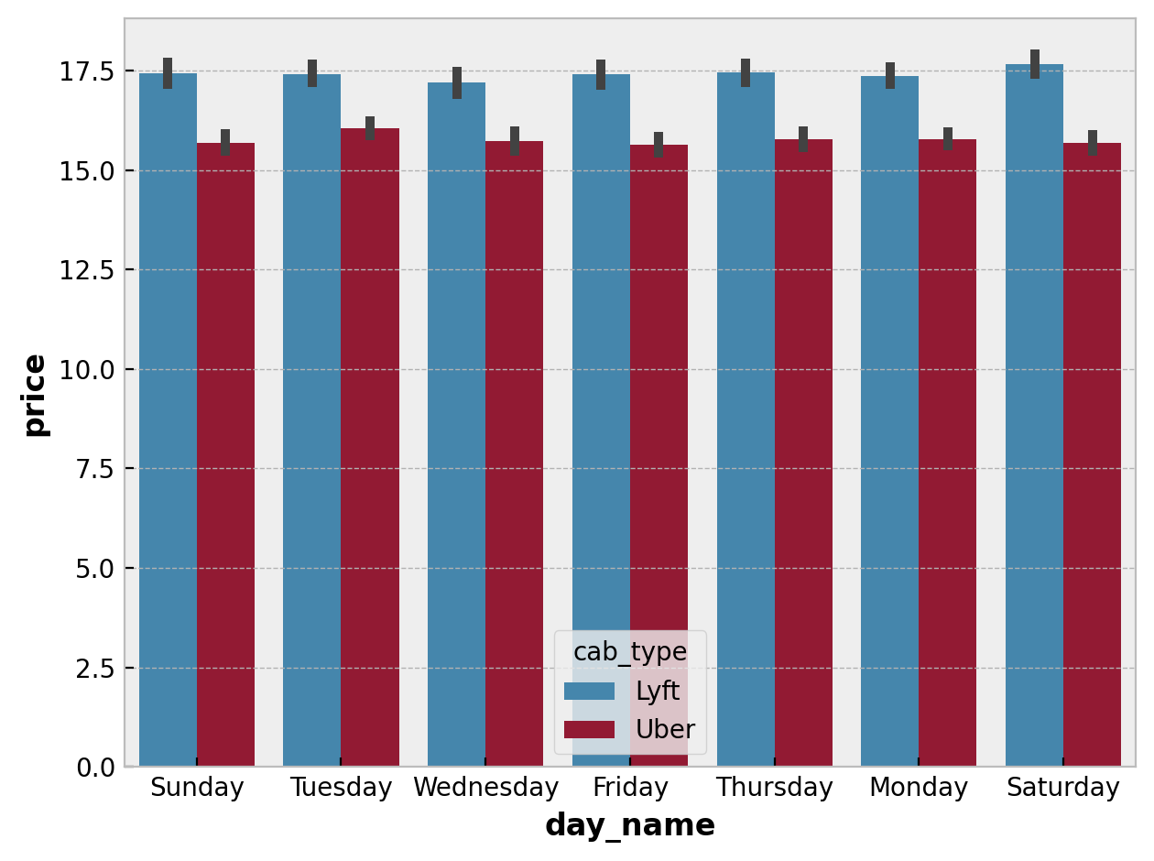
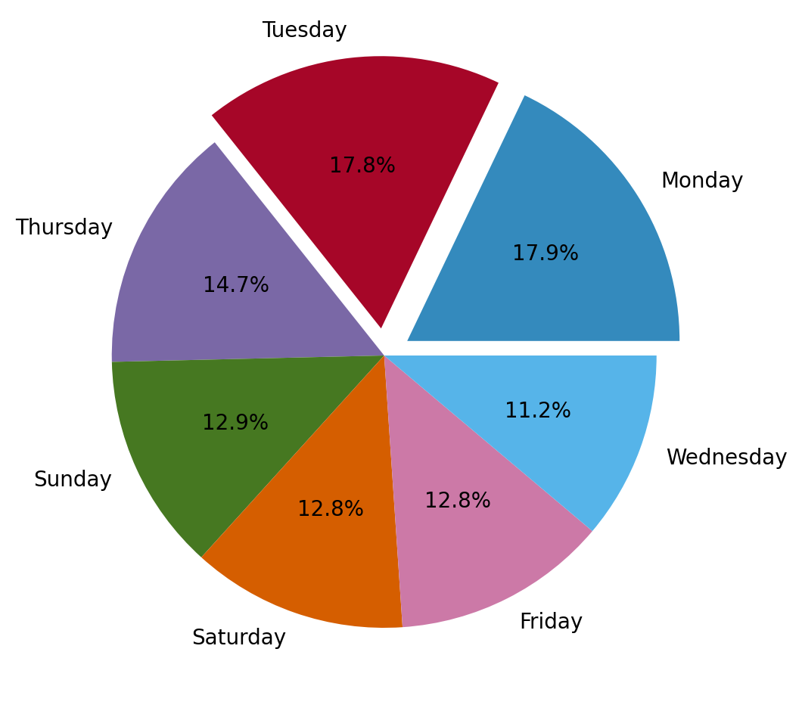
Distribution of number of trips on the days of the week
Trip prices throughout the week for both companies
- Days of the week don’t affect the prices of trips
- The beginning of the week (Monday and Tuesday) are the busiest with trips

Slide 28
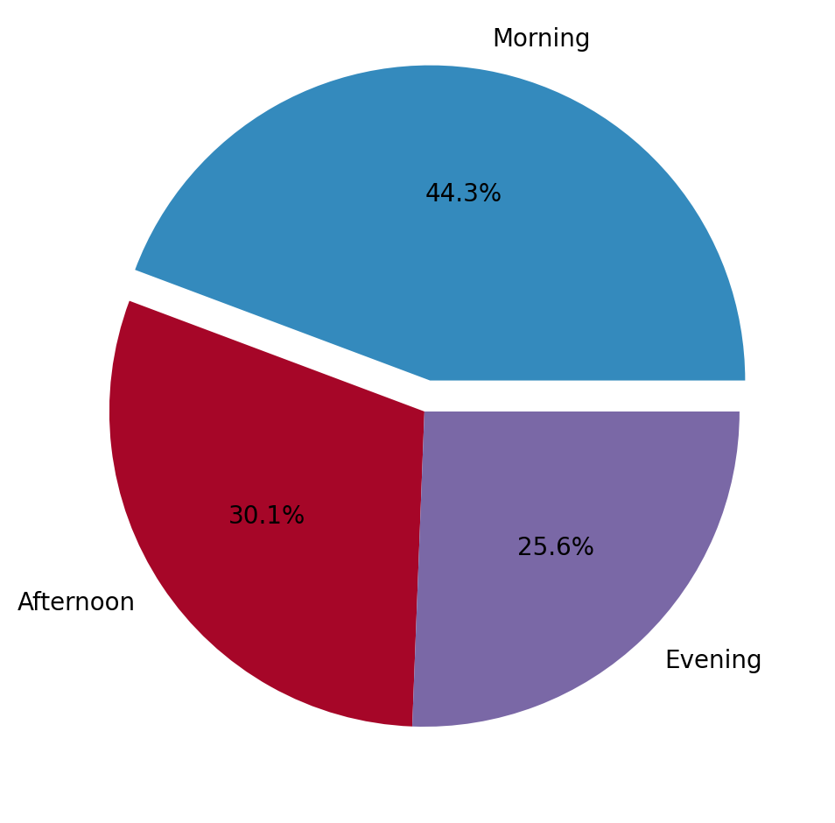
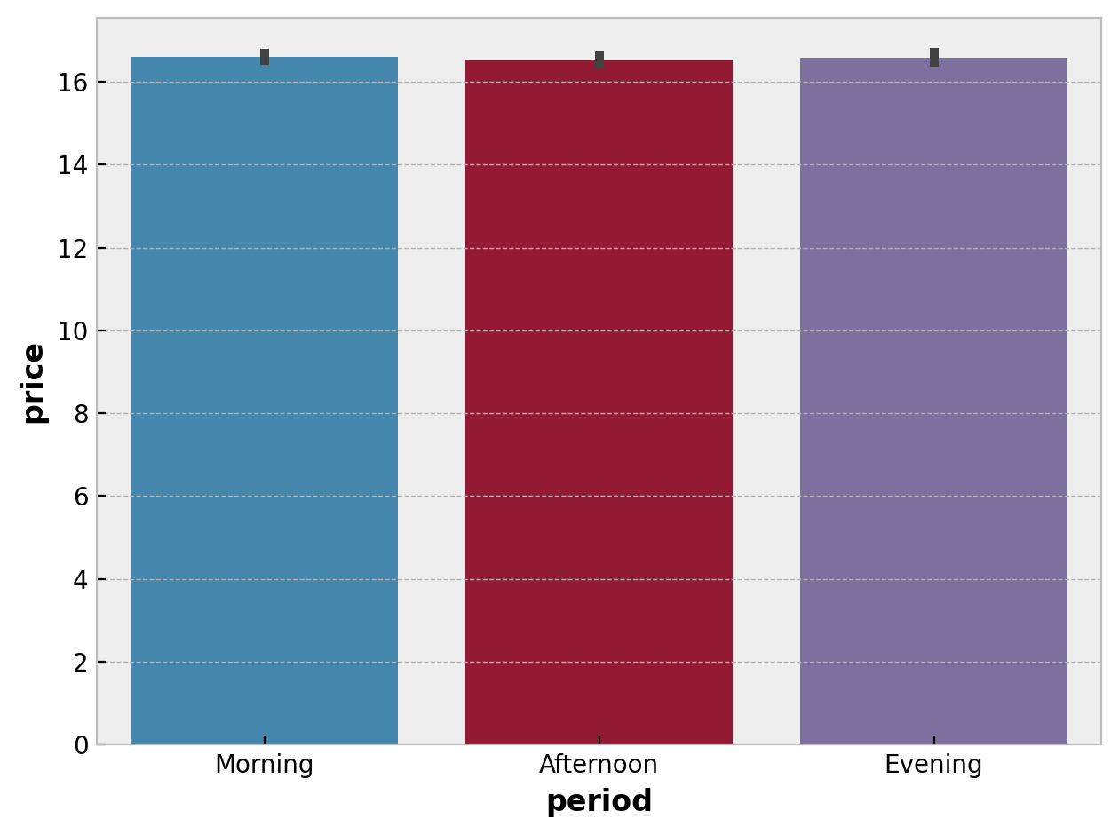
The relationship between the time period and price of the trip
Distribution of number of trips to the periods of the day
Most of the trips depart in the morning
The period of day is irrelevant to the price of the trip

Slide 29
surge_multiplier:2$
Average distance : 3.82 KM
Most expensive trip price.
Cab name:
Lux Black XL
Max price: 92.0 $
Cab type:
Lyft
number of trips: 2
Destination:
Financial District

Slide 30
surge_multiplier:1$
Average distance : 1.27 KM
Cheapest trip price.
Cab name:
Shared
Max price: 2.5 $
Cab type:
Lyft
number of trips: 31

Slide 31

Data preprocessing

Slide 32
Data preprocessing
The process of converting raw data into a form that can be easily processed by machine learning models.
steps
Splitting data into input ( X ) and output ( Y )
Feature Encoding ( One Hot Encoder )
Splitting data into train (80%) and test (20%)
Feature Scaling ( Standardization)
Dimensionality Reduction (PCA : 90% )

Slide 33
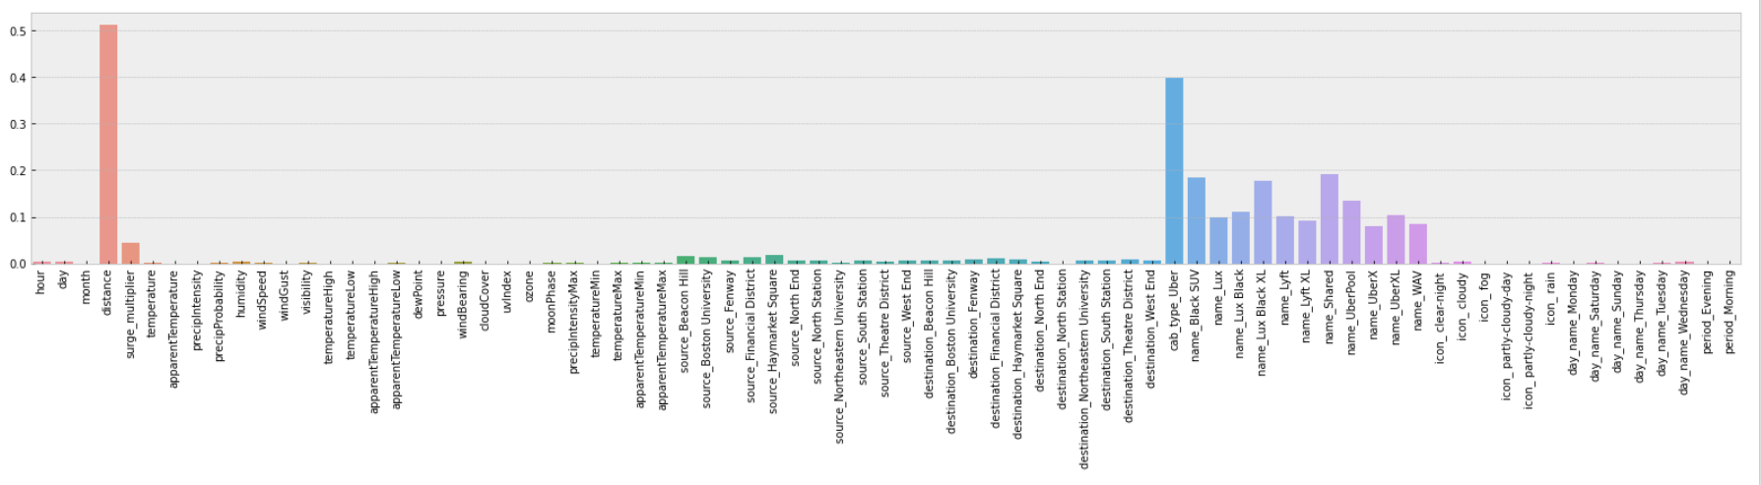
Feature Selection
Feature Selection : using Mutual Information (MI)
Most Important Features: distance , source , name , cab_type , surge_multiplier

Slide 34

Models Evaluation

Slide 35
R2 score
F1 Score
Model | Train | Test
Linear Regression | 0.928 | 0.927
KNN | 0.965 | 0.957
Decision Tree | 0.998 | 0.962
Xgboost | 0.969 | 0.965
LightGBM | 0.967 | 0.967
Accuracy Values for each model after hyper parameter Tuning.
LightGBM is the best model

Slide 36
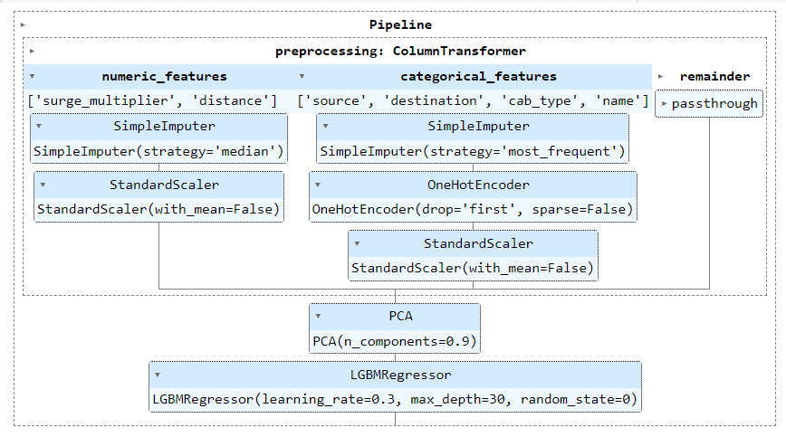
Pipeline

Slide 37

Deployment
(Web Application)
https://uber-web.streamlit.app/
This Photo by Unknown Author is licensed under CC BY-SA-NC

Slide 38

Thank you

