Slide 1

World Happiness “Tim, Tobe, Jake, James, Mahmoud”
- What is world Happiness report?
Is a yearly publication which ranks countries based on their happiness levels
- Life ladder (how scoring works)
- Limiting factors
- Life ladder (how scoring works)
- Can You Accurately Predict Happiness?

Slide 2
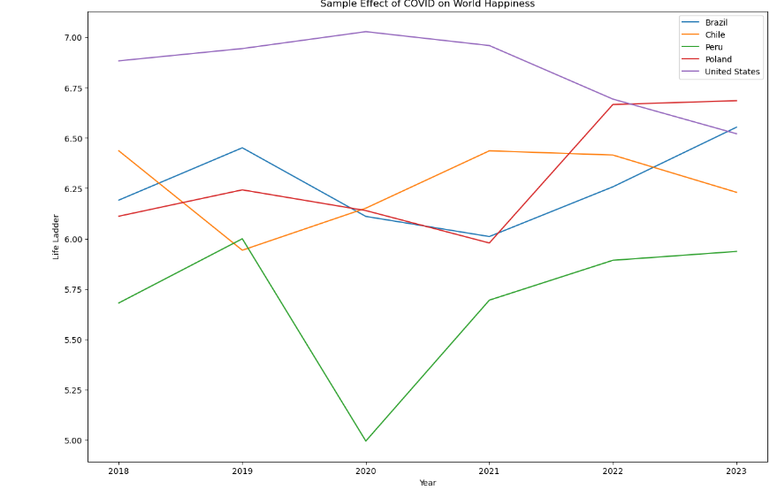
Did COVID Effect World Happiness “Tobe”
“Torture the data, and it will confess to anything.” –Ronald Coase
Highest Deaths Per 100k during COVID by Country:

Slide 3
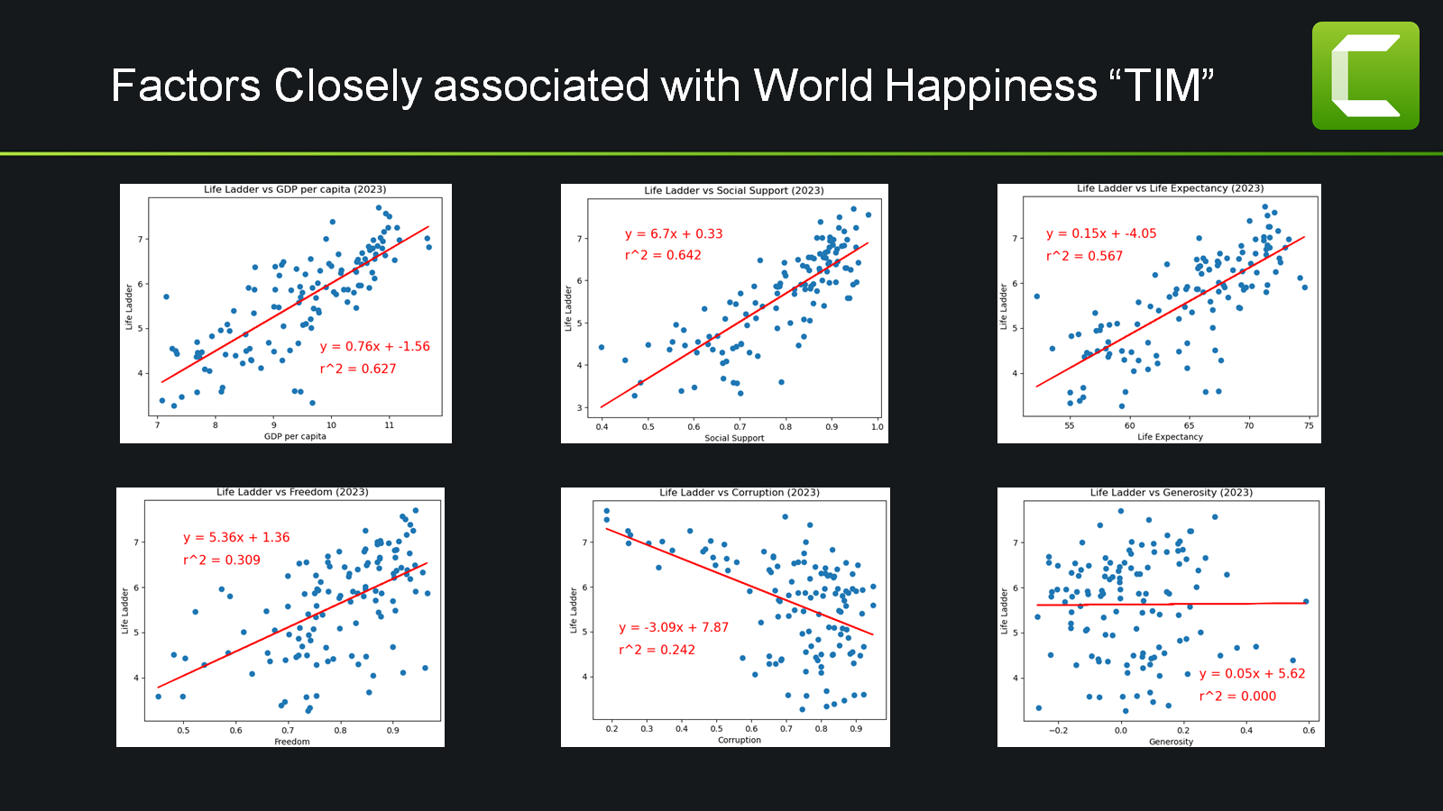

Slide 4
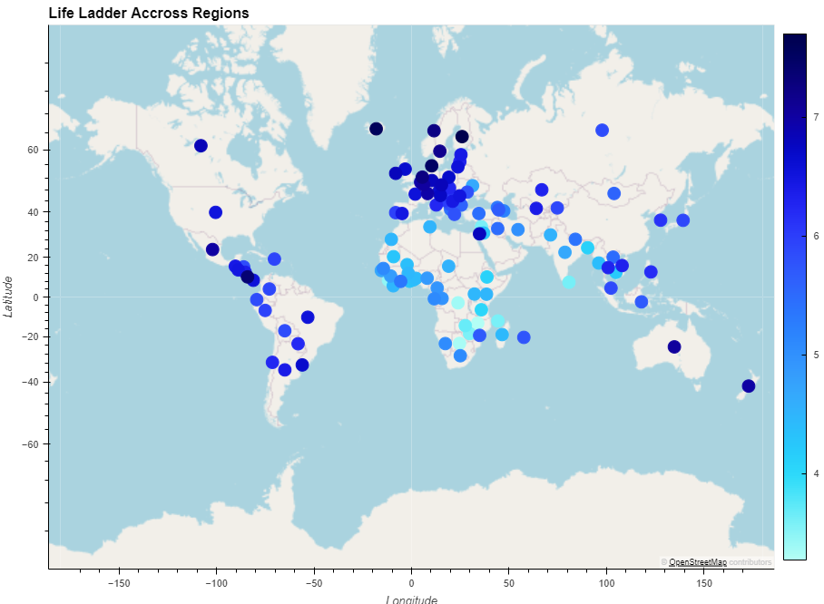
Life Ladder Score Across different Regions “JAKE”
- How does Life Ladder change across
different Regions of the world?
- Geoapify.com
  error handling
- hvplot in pandas
- color = “Life Ladder”

Slide 5
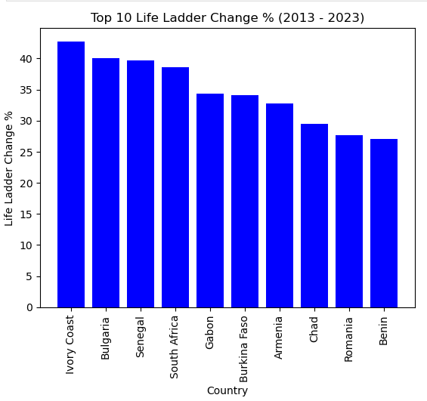
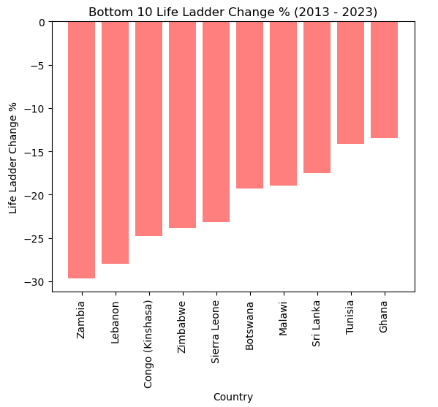
Conclusion “JAMES”
Top and bottom 10 countries
Key take away
- Based on the finding from WHR, interviewing 1000 people from a country provided them with the Accurately predicting happiness involves a whole lot more than just a few questions . The definition of happiness varies in different regions of the world, and you cannot have one standard apply to everyone and accurately predict their happiness.

Slide 6
Conclusion “JAMES”
Can You Accurately Predict Happiness?
- According to our research, accurately predicting happiness involves a whole lot more than just a few questions. The definition of happiness varies in different regions of the world. So, you cannot have one standard apply to everyone and accurately predict happiness.
- No
Sources
https://worldhappiness.report/
https://coronavirus.jhu.edu/data/mortality
Images used in this presentation were obtained from Google and belong to their respective owners

