Slide 1
Struct in C

Slide 2
Table of content
1
Introduction
2
Syntax , Simple Code , Object
3
Struct Arithmetic
4
Struct with typedef
5
Struct with Function
6
Struct with Array
7
Struct with Pointer
8
Struct with Bit field
9
Size of Struct

Slide 3
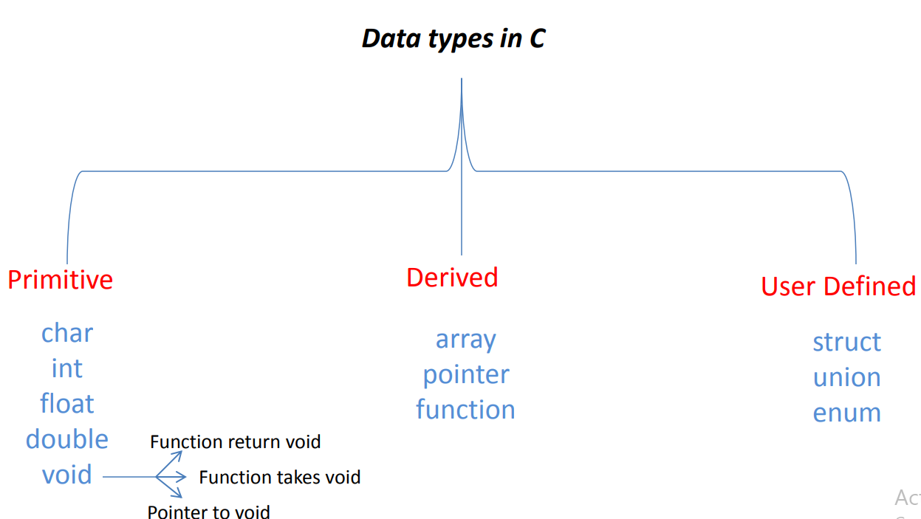
Introduction
What is Struct?
Struct: is a user-defined data type that allows you to make a collection of variables of different data
types under a single name .
Why we use Struct ?
Organizing related data: Structures allow you to group together related variables of different types under a single name. This helps in organizing data in a logical and meaningful way, making the code more readable and maintainable.
Creating complex data structures: Structures enable the creation of more complex data structures by combining multiple variables and structures. For example, you can create linked lists, trees, queues.

Slide 4
Syntax
Syntax :
struct struct_name
{
member_1_Type member_1_Name ;
member_2_Type member_2_Name ;
----
----
};
struct struct_name object_name ;
struct struct_name object_name = { member_1_Value , Member_2_Value, …. };
We use the dot operator ( . ) to access any member in the structure.
object_name.member_name
char
double
Note : No memory consume
int

Slide 5
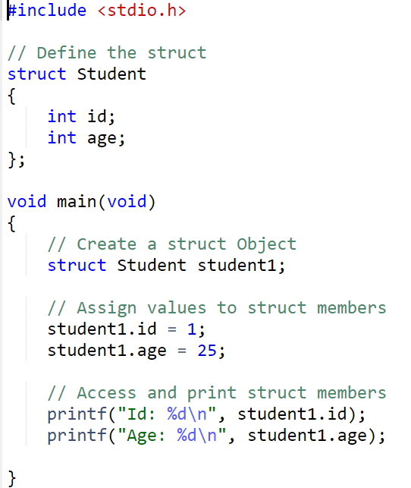
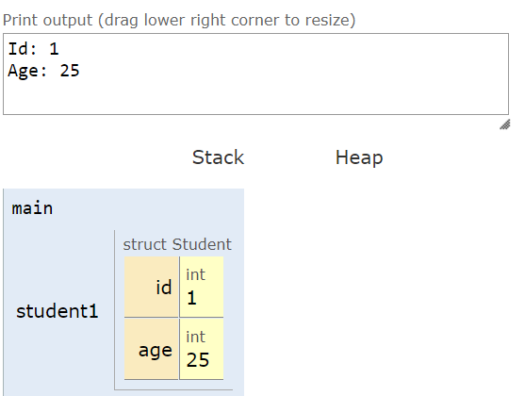
Simple Code

Slide 6
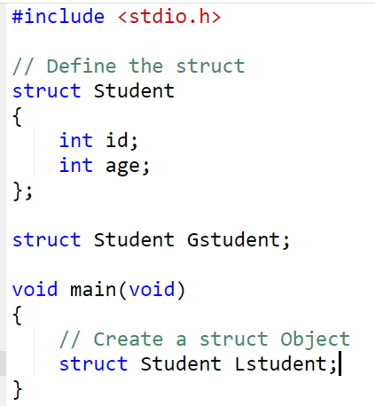
Object
Note : Never make init value in struct
Global Object
Local Object

Slide 7
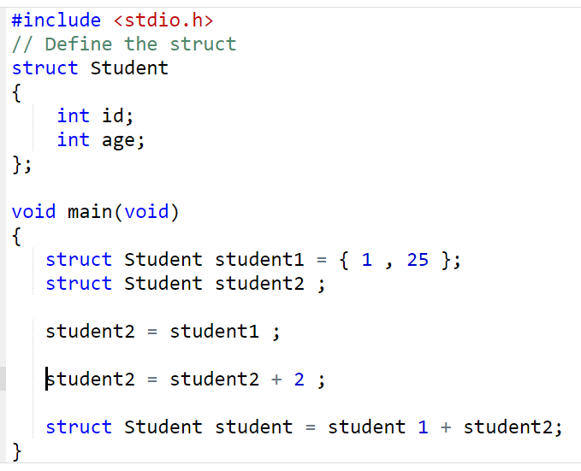
Struct Arithmetic
No Arithmetic operation allowed on the struct
Only the assignment operator can be used with the structure, to copy a content of
structure to another structure.
Allowed
Not Allowed
Not Allowed

Slide 8
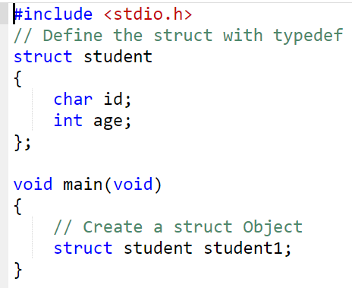
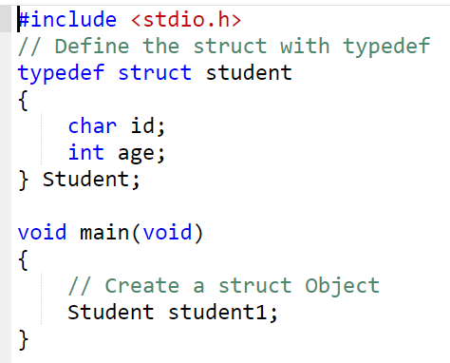
Struct with typedef
typedef can be used with structure. It would add the value of defining an object
from structure by the structure name only without mentioning the word struct.
Syntax : typedef Old_Type New_Type ;
without typedef
with typedef

Slide 9
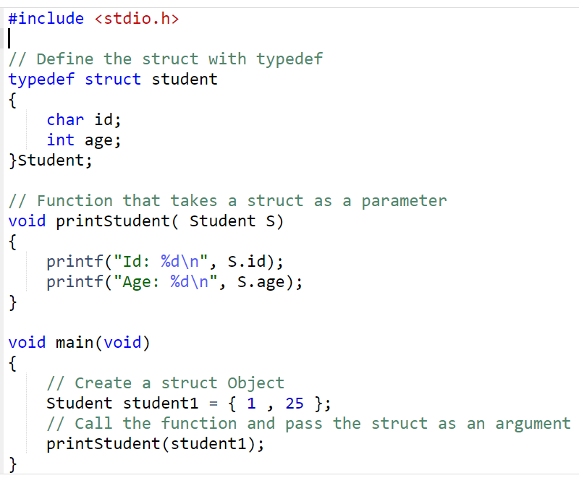
Struct with Function
1) Function that takes a struct as a parameter

Slide 10
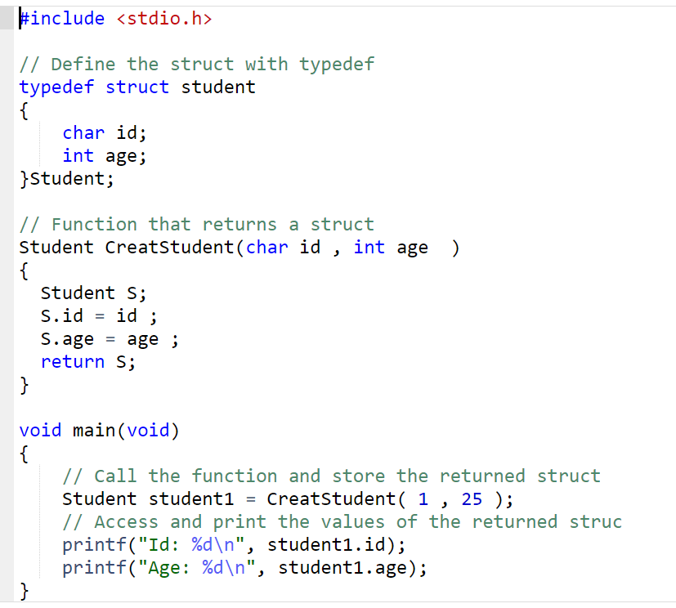
Struct with Function
2) Function that returns a struct
Note : you can return more than one value from function by struct

Slide 11
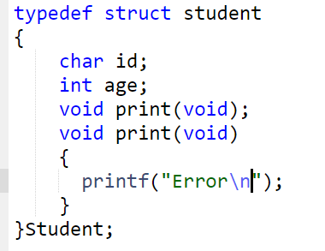
Struct with Function
3) Function that takes a struct as a parameter and returns a struct
Note : not allowed to declare or define Function inside Struct
Synatax Error

Slide 12
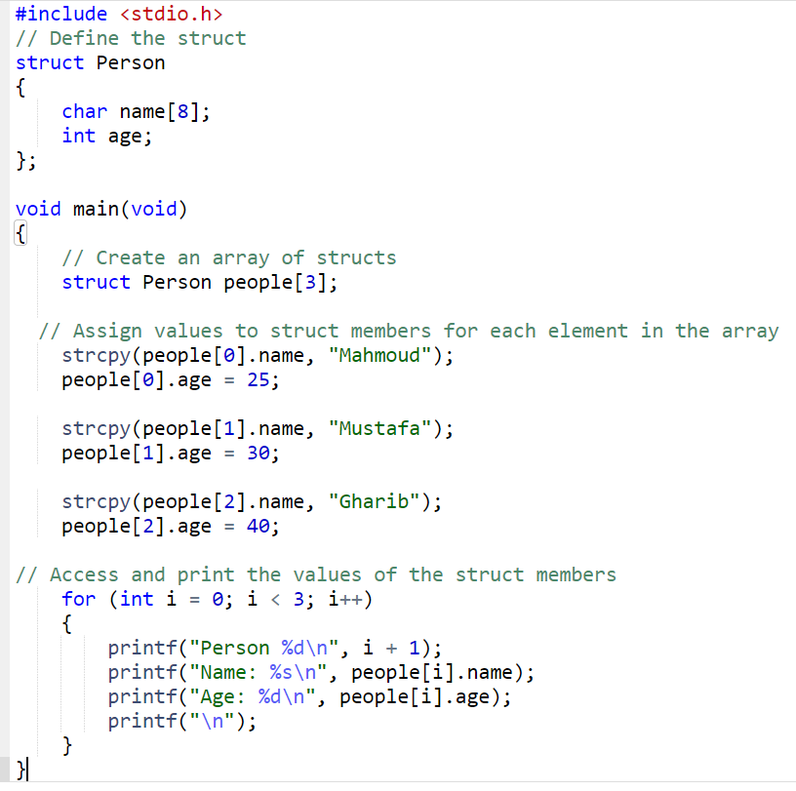
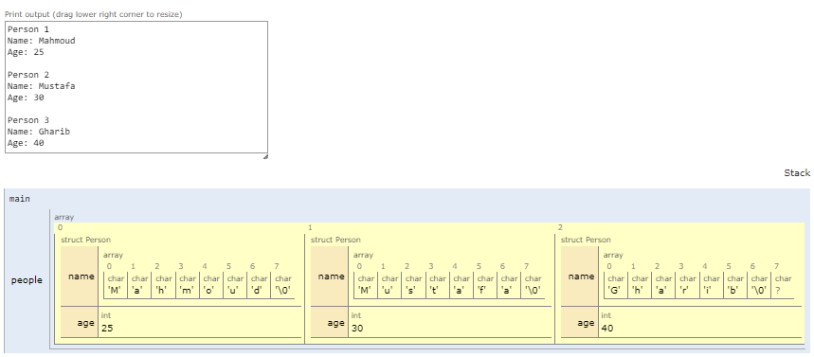
Struct with Array
1) Create member inside struct as an Array
2) Create an array of structs

Slide 13
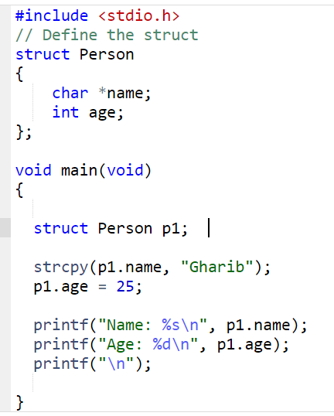
Struct with Pointer
1) Create member inside struct as a Pointer

Slide 14
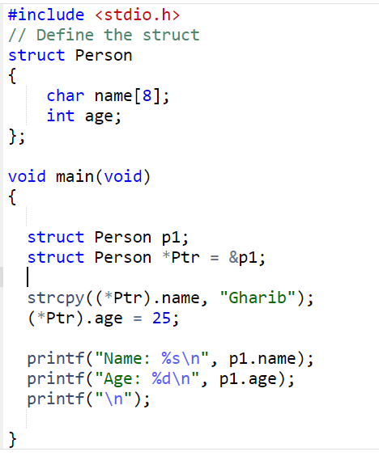
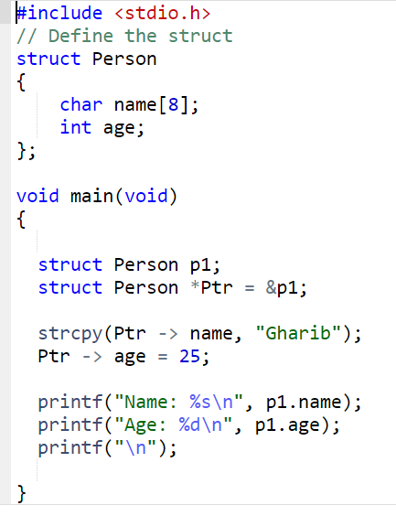
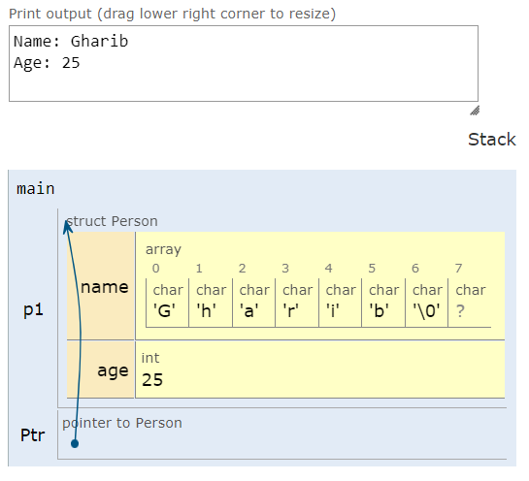
Struct with Pointer
2) Create a Pinter that point to struct
Note : The arrow operator -> is used with pointer to struct as replacement to the dereference operator * and the dot operator .

Slide 15
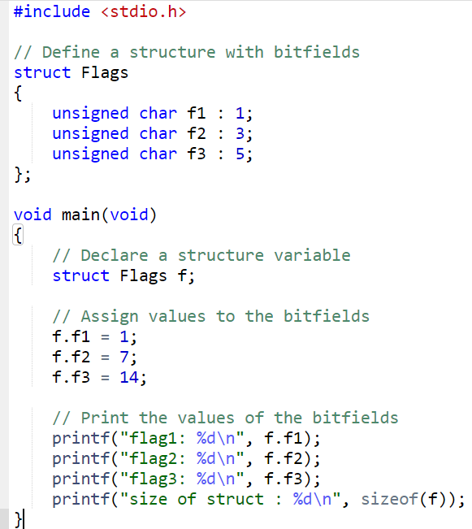
Struct with Bit field
Bit field : is a member of a struct that has size of certain number of bits
used to 1) optimize memory usage
2) to store and modify data at the bit level
Syntax : type name : number_of_bits ;
size of struct : 2 Byte

Slide 16
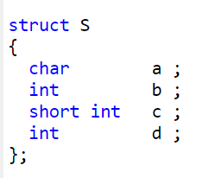
Size of Struct
( Size of Struct > = sum of its member sizes )
Assuming 32 bit memory width
a
padding
b
c
padding
d

Slide 17
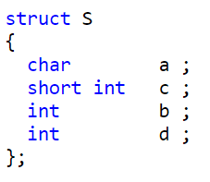
Size of Struct
The general rule states that always arrange the members in ascending order or descending order to get the lowest size.
Assuming 32 bit memory width
a
c
padding
b
d

Slide 18


